Slide 1
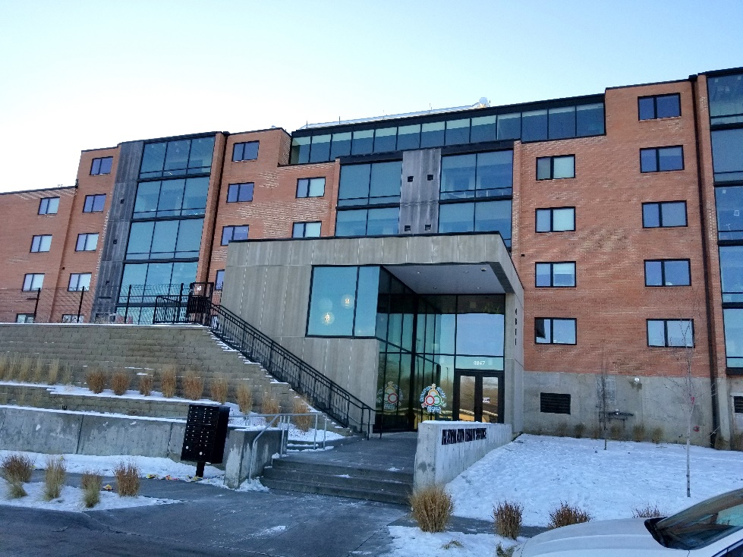
Family Involvement Review
Heather Bird, LICSW
Monica Meier, LICSW
Heartland Family Service
Omaha, Nebraska

Slide 2
About Our Agency
Heartland Family Service is a multi-service agency working to strengthen individuals and families in our community through education, counseling, and support services.
We serve over 52,000 individuals of all ages a year in over 50 programs.
Family Works is a women and children’s residential substance use treatment program supported by federal and state behavioral health funding, child welfare funding and private donations/fundraising.
Started program with PPW grant 11 years ago. Two years ago we moved to a much larger facility serving 60% more families and offering supportive housing. Services to fathers and extended family members decreased.

Slide 3
Identified Need
What? Improve services to extended family and fathers and integrate them more into our program and family treatment model.
Why? Engaging Fathers is important because they are an integral part of the child’s family system, whether or not parents choose to stay together. Our program does really well being at the forefront for treatment practices for women and children, but the fathers have been left behind.

Slide 4
Project Description
How to engages fathers in a way that helps them feel more comfortable with being more present in their partner and child’s treatment while at Nebraska Family Works and/or how to engage them so they feel they can begin their own recovery journey.

Slide 5
Progress Update
We have identified the intervention (focus groups) and the questions to be asked. Brought questions to the team to review. Completed father friendly program assessment tool.
Outcomes: Reflective practice and a culture shift
Staff have been able to put voice to some of the biases they carry about fathers as well as begin a shift in their willingness to engage with them in a different way.

Slide 6
Next Steps
Pick a date and time for focus groups
Identify reward for attending (free meal, extended visit, etc)
Hold focus group (leader of session, note taker)
Compile results and meet with staff to process and determine action plan
Start process again focusing on extended family members! ☺

