Slide 1
This product was funded under a cooperative agreement from the Substance Abuse and Mental Health Services Administration (SAMHSA) Center for Substance Abuse Treatment (CSAT) (Grant Number TI-080200). All material, except that taken directly from copyrighted sources, is in the public domain and may be used and reprinted for training purposes without special permission. However, any content used should be attributed to the Mountain Plains Addiction Technology Transfer Center.
Notes:
Place your title on this first slide and include any subtitle.
DO NOT CHANGE THE FORMAT OF THIS TEMPLATE. If you are creating ATTC-branded slides, you must use this template. If you move around boxes, make sure to check the reading order. If you widen any boxes they must not overlap any other box.
IF YOU ADD ANY GRAPHICS, you will need to add ALT TEXT and check READING ORDER.
(If the notes on ALT TEXT and READING ORDER do not make sense to you, please let the ATTC National Coordinating Office know to help with remediation.)

Slide 2
Supporting Recovery by Understanding Benchmarks
Notes:
Place your title on this first slide and include any subtitle.
DO NOT CHANGE THE FORMAT OF THIS TEMPLATE. If you are creating ATTC-branded slides, you must use this template. If you move around boxes, make sure to check the reading order. If you widen any boxes they must not overlap any other box.
IF YOU ADD ANY GRAPHICS, you will need to add ALT TEXT and check READING ORDER.
(If the notes on ALT TEXT and READING ORDER do not make sense to you, please let the ATTC National Coordinating Office know to help with remediation.)

Slide 3
Recovery Benchmarks
Important to:
differentiate between the needs of peers in early, middle, and late recovery
understand risk factors that can negatively impact recovery

Slide 4
4 Time-Linked Recovery Benchmarks
less than 6 months
6 to less than 18 months
18 to 36 months
more than 3 years
Laudet & White, 2010

Slide 5
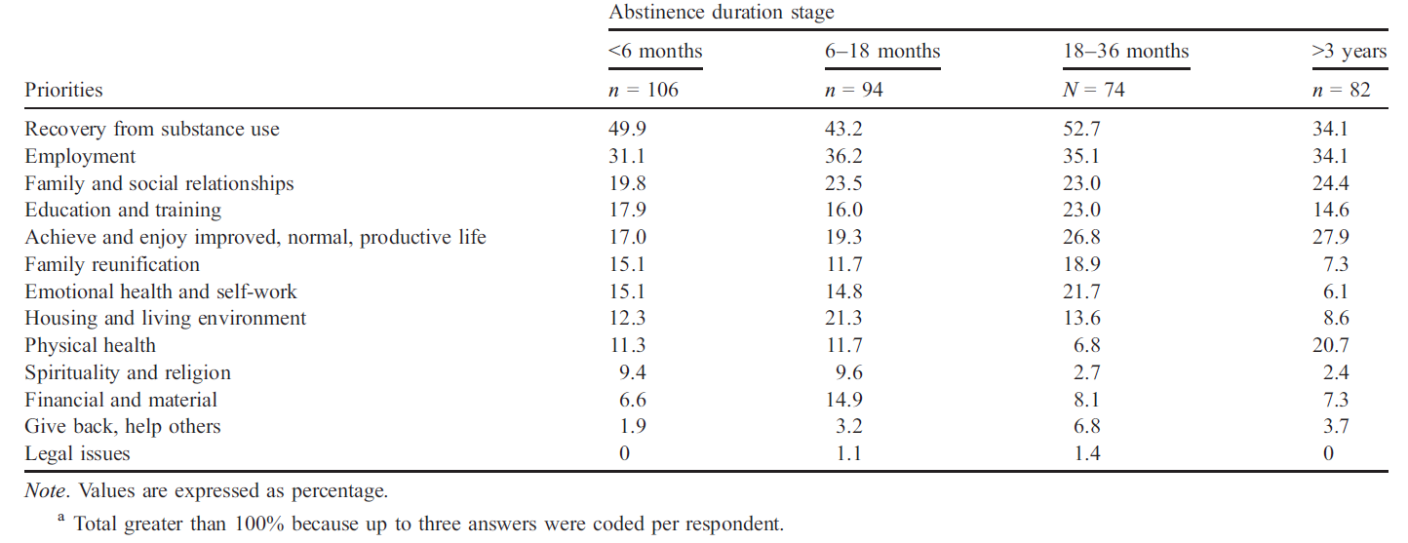
Research on Stages of Recovery and Life Priorities
Laudet & White, 2010

Slide 6
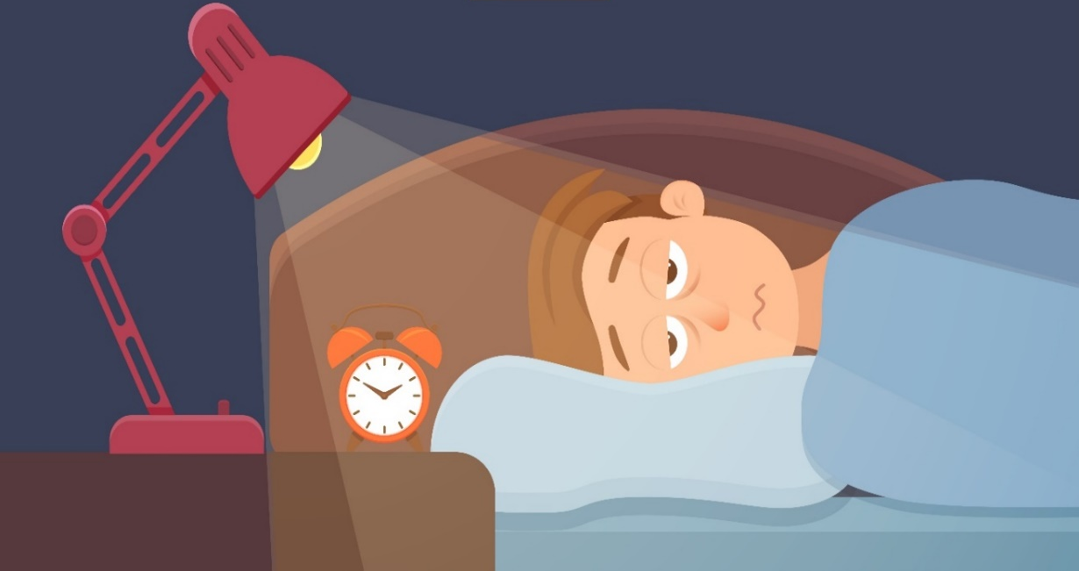
Early Recovery
Patients with a pattern of using alcohol to help with sleep have a poor quality of sleep and their sleep continues to remain disrupted even after cessation of alcohol use.
could indicate that patients with a pattern of using alcohol to help with sleep potentially have preexisting sleep disturbances, which some patients may attempt to treat with alcohol
sleep problems appear to persist following 4 weeks of abstinence and could lead to a relapse
study revealed that a large proportion (69.3%) of patients in early alcohol recovery have sleep disturbances and even after their first month of abstinence, rates of sleep disturbances were 49.1%
Kolla, et al., 2014

Slide 7
Early Recovery - Part 2
- things may get worse before they get better—notably, happiness and self-esteem appear to drop during the first few months followed by a gradual increase beginning 6 to 12 months into recovery.
Kelly et al., 2018; White, 2018

Slide 8
Women in Recovery
Suggests a potentially more persistent challenge facing women in recovery than men, as they appear to struggle more with psychological stress and are less satisfied with physical, psychological, and social aspects of their life in recovery
Some of these may reflect ongoing different biological (e.g., increased cortisol) and psychosocial challenges (e.g., negative affect; or sociocultural challenges (e.g., gender bias/discrimination) compared to men
Kelly et al., 2018; White, 2018

Slide 9
Mixed Race or Native Americans in Recovery
Individuals reporting mixed race or a racial group other than Black, White, or Hispanic (e.g., Native American) showed persistent challenges following AOD problem resolution in these indices of QOL and psychological well-being.
This group includes native/indigenous Americans and other mixed ethnicities who appear to be assiduously disadvantaged and show worsening, rather than improvements, in QOL and psychological distress over time.
Kelly et al., 2018; White, 2018

Slide 10
Individuals with OUDs or Stimulant Use Disorders
Appear to begin their recovery journey at a substantial disadvantage- recovery capital compared to those resolving alcohol or cannabis problems
They make take several years to achieve similar sobriety rates compared to other individuals with different drugs of choice
May be among the most marginalized and stigmatized (i.e., those with heroin, methamphetamine, or crack cocaine as their primary substance)
Appear to be at a distinct disadvantage early in the recovery process in terms of access to recovery resources
More likely to have drug-related criminal records that can prevent access to jobs, loans, education and training opportunities, and housing and may need more resource support
Kelly et al., 2018; White, 2018

Slide 11
Recovery Benchmarks Implications
First year of recovery is a risky period (happiness/self-esteem; difficulties with sleep); things get worse and then get better… More support services in 1st year, may be necessary around relaxation, stress, sleep, other health issues
Individuals in recovery are still concerned about abstinence, family/friend relationships, and employment even after 3 years…
Women, Native Americans, and Individuals of Mixed Races face more challenges in recovery… due to trauma/ discrimination/stigma
Individuals with OUDs or stimulant abuse started out with lower recovery capital and may require more resources… Increase resources over an extended period of time
Bottom Line… ‘Greater problem severity may entail a longer period of disentangling the baggage of addiction before a process of emotional thawing and healing ensues’
Kelly et al., 2018; White, 2018

