Slide 1
Stigma and Service Barriers Tribal Opioid Response (TOR) Regional Meeting Fairbanks Alaska – November 19, 2019
Notes:
Talking points: In this presentation we will focus on the stigma associated with SUD including OUD and some of the ways stigma becomes its own barrier to recovery.

Slide 2
Presented by:
Pamela Baston, MPA, MCAP, CPP

Slide 3
SUDs/OUDs carry a high burden of stigma
People who experience stigma are less likely to seek out treatment services and access those services.
When they do, people who experience stigma are more likely to drop out of care earlier.
Both of these factors compound and lead to worse outcomes overall.
Notes:
Stock photo ID: 513536552

Slide 4
Significant and complex histories
These individuals often have significant and complex histories of physical and sexual abuse, abandonment, loss, and associated trauma (for Native populations historical trauma) adversely affecting their ability to engage in/comply with programming.
Notes:
Talking points: They may have YEARS and even LIFETIMES of trauma. I want to come back to this issue as we KNOW these are the presenting factors and should build our systems of care accordingly and failure to address can = failure all the way around.
Photo source: http://www.williamwhitepapers.com/blog/2015/02/from-trauma-to-transformative-recovery.html

Slide 5
Language and labels can bring significant social stigma and discrimination.
Notes:
Talking points: With a little background in brain science and stigma/discrimination in general, lets switch over to a discussion of the power of language and labels in promoting stigma and discrimination.

Slide 6
Stigmatizing vs. non-stigmatizing language
Dated Language Instead of … | Use Preferred Language | Rationale
Alcoholic/Addict/ Junkie | Person; or Person not yet in recovery; or a person with an alcohol/drug disorder | It is not right to define the person by the disease or by the drug.

Slide 7
Stigmatizing vs. non-stigmatizing language
Dated Language Instead of … | Use Preferred Language | Rationale
Drug abuser | A person with a substance use disorder | Drug abuser implies the person is the problem, rather than as a person with a substance use disorder.

Slide 8
Stigmatizing vs. non-stigmatizing language
Dated Language Instead of … | Use Preferred Language | Rationale
Clean and sober | Free from illicit and non-prescribed medications | “Free from illicit and non-prescribed medications” is a description of a person’s current substance use status, as opposed to a value-laden term.

Slide 9
Stigmatizing vs. non-stigmatizing language
Dated Language Instead of … | Use Preferred Language | Rationale
Clean drug screen | Negative drug screen | Clear description of test results, versus a value-laden term.

Slide 10
Stigmatizing vs. non-stigmatizing language
Dated Language Instead of … | Use Preferred Language | Rationale
Dirty drug screen | Positive drug screen | Clear description of test results, versus a value-laden term.

Slide 11
Stigmatizing vs. non-stigmatizing language
Dated Language Instead of … | Use Preferred Language | Rationale
Drug-addicted babies/opioid babies | Babies experiencing neonatal opioid withdrawal (NOW) or neonatal abstinence syndrome (NAS) | Babies can be born “dependent” on a substance used by their mother but cannot be born “addicted.” Addiction requires meeting a number of criteria such as the inability to control or reduce use; continue use despite adverse consequences, and more.

Slide 12
Stigmatizing vs. non-stigmatizing language
Dated Language Instead of … | Use Preferred Language | Rationale
Drug habit | Substance use disorder | “Drug habit” inaccurately implies that a person is choosing to use substances or can choose to stop.

Slide 13
Stigmatizing vs. non-stigmatizing language
Dated Language Instead of … | Use Preferred Language | Rationale
Drug of “choice” | Drug(s) of use/drug(s) used | Ignores the genetic, environmental, and coercion aspects of addiction as well as the brain science

Slide 14
Stigmatizing vs. non-stigmatizing language
Dated Language Instead of … | Use Preferred Language | Rationale
IVDUs (injection drug users) | A person who injects substances | Injection drug abuser/IVDU implies the person is the problem, rather than as a person who injects substances.

Slide 15
Stigmatizing vs. non-stigmatizing language
Dated Language Instead of … | Use Preferred Language | Rationale
“Replacement” or “substitution” when discussing opioid use disorder treatment medications | Medication-assisted treatment (MAT) | “Replacement” or “substitution” imply that medications merely “substitute” one drug or “one addiction” for another.

Slide 16
Avoid these words!
Notes:
Use person first: Person with an opioid use disorder (not addict, alcoholic); Person who injects drugs (not junkie); return to use or recurrence of substance if person has not completed care (not relapse);

Slide 17
Systems Barriers
Misaligned policies (punitive vs. therapeutic, timelines/punishment vs. accountability); lack of timeliness; misalignment between client needs vs. system response (e.g., unreasonable efforts); and workforce challenges.
Notes:
DISCUSSION: Now let’s turn to the institutional, legal, or other barriers associated with or worsened by the opioid crisis.
Accountability is when we have clear expectations and offer support to meet those expectations.
Punishment is a penalty for an offense.
Stock photo ID:1009803562
Stock photo ID: 847065172

Slide 18
System failure
“We are routinely placing individuals with high problem severity, complexity, and chronicity in treatment modalities whose low intensity and short duration offer little realistic hope for successful post-treatment recovery maintenance. For those with the most severe problems and the least recovery capital, this expectation is not a chance, but a set-up for failure—a systems failure masked as personal failure.” (Bill White, 2013)
Notes:
Taking points: Also insufficient cross system collaborative practice.
Source: Bill White

Slide 19
Systems barriers
OUD/other SUD treatment is offered to/accepted by too few—only about 10% a year of people in need of it and only a lifetime engagement rate of 25%
Begins too late—with years and, in some cases, decades of dependence preceding first treatment admission.

Slide 20
Systems barriers
Ends too quickly, e.g., before the 90 days across levels of care recommended by the National Institute on Drug Abuse (NIDA);
Offers too few evidence-based choices (especially MAT);
Is too disconnected from indigenous recovery community resources (AI/AN ways of “knowing”);
Notes:
Stock photo: 162248304

Slide 21
Systems barriers
Retains too few (less than 50% national treatment completion rate) and some kicked out for confirming their diagnosis (for no other major health problem is one thrown out for becoming symptomatic in the service setting);
Expelling a client from addiction treatment for substance use—often involves thrusting the client back into drug-saturated social environments without provision for alternate care. What have we accomplished?

Slide 22
Systems barriers
There is no other major health problem for which one is admitted for treatment and then thrown out for becoming symptomatic in the service setting.
For other chronic health care problems, symptom manifestation serves as a confirmation of diagnosis or feedback that alternative methods of treatment and alternative approaches to patient education and motivation are needed.
Notes:
Stock photo ID. 978082548

Slide 23
Systems barriers
Fails to alter treatment methods in response to patient non-responsiveness, e.g., blaming SUD recurrence on the patient rather than the treatment methods; and
Offers minimal continuing care--far short of the five-year point of recovery durability.

Slide 24
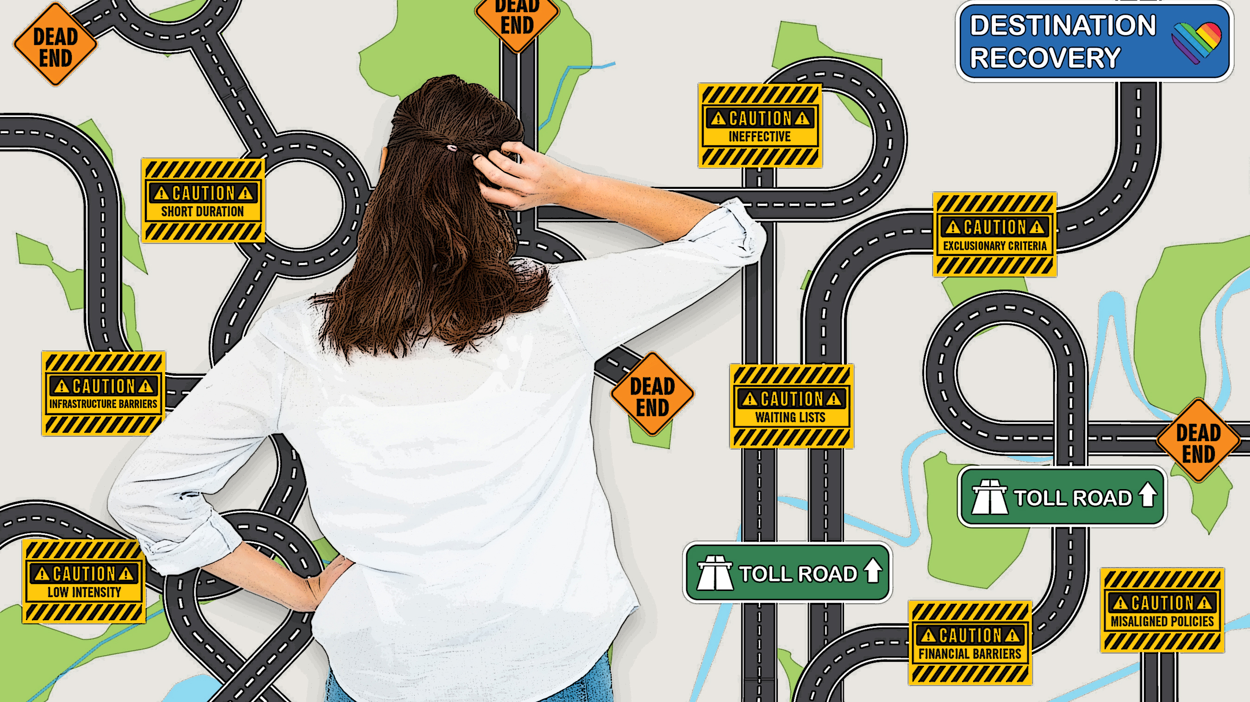
Notes:
Talking points: Discuss the slide. And when we miss effective policy and practice opportunities, we move the individual from treatment to under the bridge, to the corrections systems etc. etc. etc. passing them along through our systems/recycling/churning with harmful results often affecting many generations.

Slide 26
Summary and solutions
Stigma flourishes in the absence of clear, consistent, multi-year educational campaigns that convey and affirm the validity and effectiveness of MAT as effective treatment, especially when it is integrated with culturally relevant Native practices.
What are you doing, or can you do in your tribal community to educate key stakeholders to reduce stigma?

Slide 27
Summary
Having an increased awareness of the relationship between language and stigma is key to changing how we communicate with more respectful and inclusive language!
With careful attention to language, we can reduce the burden of stigma surrounding SUDs, improve access to health care for people with SUDs, and save lives.
Notes:
Stock photo ID: 623827624

Slide 28
Questions?

Slide 29
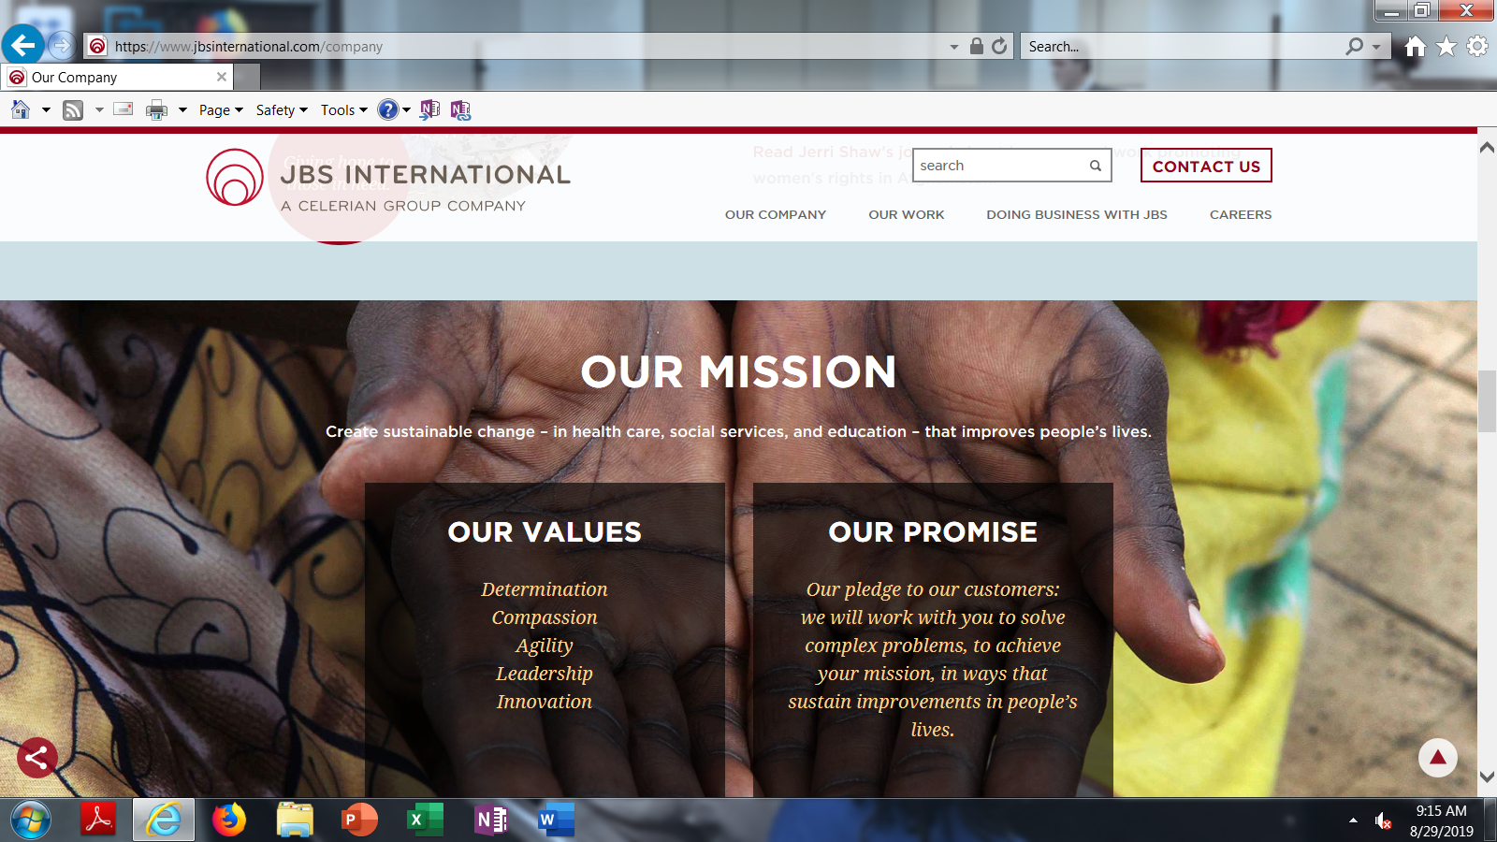
Questions/Information about this presentation:
Pam Baston 828 817 0385

Slide 30
Contact your ai/an attc for relevant TA needs. Your fellow peer grantees can also be a great resource.
THANK YOU!
Notes:
Stock Photo –id: 172910474

Slide 31
Citations
https://ajp.psychiatryonline.org/doi/pdfplus/10.1176/appi.ajp.2018.17101174
https://www.behavioral.net/article/natcon15-what-dopamine-tells-us-about-opioid-addiction
http://www.williamwhitepapers.com/blog/2015/02/from-trauma-to-transformative-recovery.html
Barry, C. L., McGinty, E. E., Pescosolido, B. A., & Goldman, H. H. (2014). Stigma, discrimination, treatment effectiveness, and policy: public views about drug addiction and mental illness.

Slide 32
Citations
Barry, C. L., McGinty, E. E., Pescosolido, B. A., & Goldman, H. H. (2014). Stigma, discrimination, treatment effectiveness, and policy: public views about drug addiction and mental illness.
Words Matter: How Language Choice Can Reduce Stigma; https://www.samhsa.gov/capt/sites/default/files/resources/sud-stigma-tool.pdf
Corrigan, P.W., Kuwabara, SA., O’Shaughnessy, J. (2009). The public stigma of mental illness and drug addiction: findings from a stratified random sample. Journal of Social Work. (9)(2): 139-147. Barry, C.L., McGinty, E.E., Pescosolido, B.A., Goldman, H.H. (2014). Stigma, discrimination, treatment, effectiveness, and policy: public views about drug addiction and mental illness. Psychiatric Services. (65)(10): 1269-1272. Kelly, J.F., Westerhoff, C.M. (2010). Does it matter how we refer to individuals with substance-related conditions? A randomized study of two commonly used terms. International Journal of Drug Policy. 21(3):202-7.

Slide 33
Citations
Stop Saying “They’re Just Junkies;” https://www.huffingtonpost.com/Alicia-cook/stop-saying-theyre-just-junkies_b_8881604.html; 12.28.2015
Toward An Addiction-Ary: Language, Stigma, Treatment, and Policy. John F. Kelly, P Professionals. Anaheim, CA, June 2016.
Language of Recovery; http://attcnetwork.org/home/Language%20of%20Recovery%20071416.pdf; and Language of Recovery. Retrieved from http://attcnetwork.org/home/Language%20of%20Recovery%20071416.pdf

