Slide 1

Cultural Competence & CLAS Webinar Series-Part 3
Midwest Center for Cultural Competence, LLC
&
Great Lakes Addiction Technology Transfer Center/NIATx
August 8, 2018

Slide 2

Learning Objectives
To understand…
how to create a cultural and linguistic competence action plan.
how to successfully move along the cultural competence continuum.
how the CLAS assessment tool can change service delivery.

Slide 3
Cultural and Linguistic Competence: Action Planning (1)

Slide 4
Cultural and Linguistic Competence:
Action Planning Continued… (2)

Slide 5
Cultural and Linguistic Competence:
Action Planning
Continued… (3)

Slide 6

Reflection
How can you use the information from the action plan in your counseling practice?
What would incorporating cultural competence in your practice look like?

Slide 7

What is a Culturally Competent Organization?
Understanding
Responsiveness
Agency wide

Slide 8
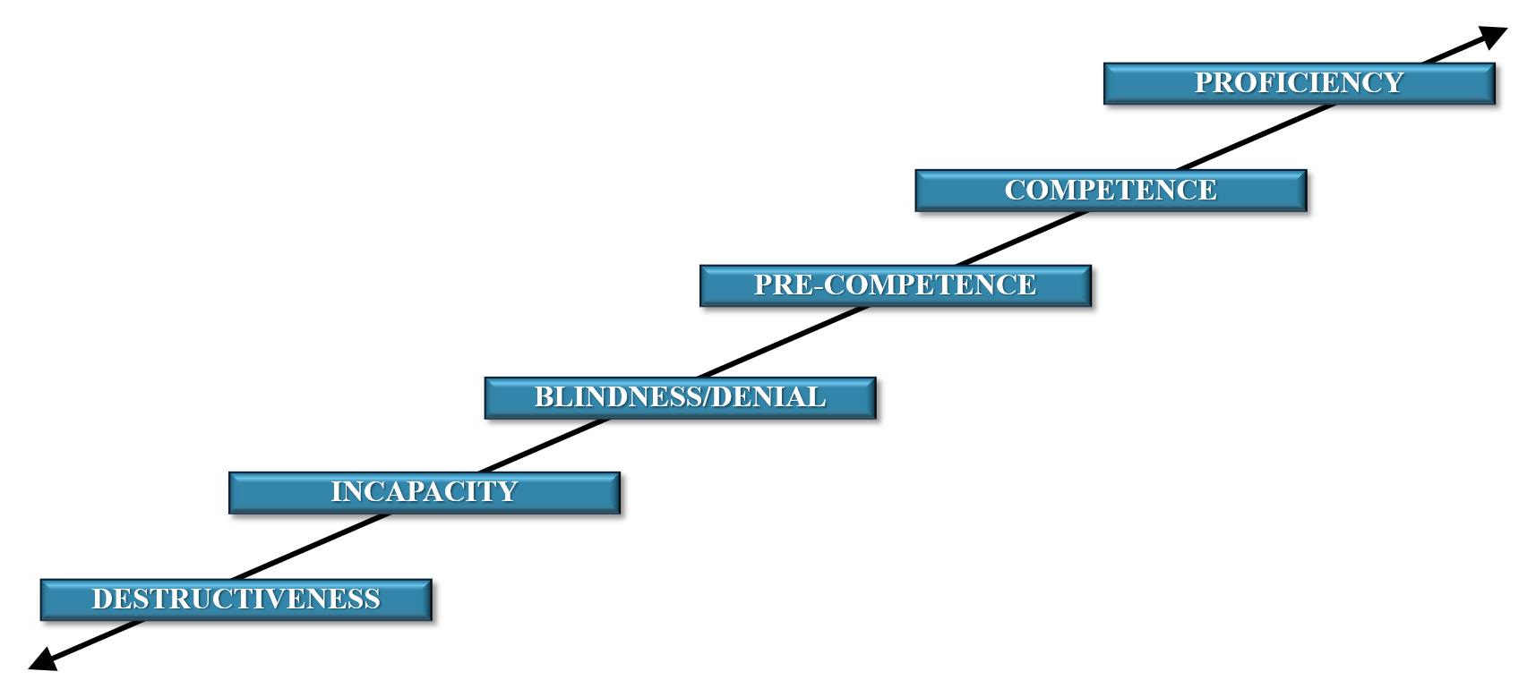
Review: Cultural Competence Continuum

Slide 9
Successful Movement Along the Continuum
Progress does not happen by chance
Change agents and change teams
Change pre-crisis
Integration
Behavioral response
Responding to culture and difference
Identifying where we are on the continuum
Movement along continuum

Slide 10

The Messages We Send Through…
Service Delivery
Staff/Team Development
Organizational Environments
Community Relationships
Notes:
The Messages We Send Through…
Service Delivery
Staff/Team Development
Organizational Environments
Community Relationships

Slide 11

Service Delivery-
Consumer/Client/Patient Focus
Access
Involvement
Orientation
Outreach
Reception
Notes:
-Access to support services
-Meaningful involvement in decisions
-Family-friendly orientation
-Outreach services that increase access
-Principled grievance process
-Culturally competent reception services

Slide 12

Service Delivery - Documentation
Recruitment
PR materials
Enrollment
Direct Service Materials
Notes:
-Recruitment and eligibility
-PR materials
-Enrollment and forms
-Assessments
-Direct service materials
-Evaluation/feedback
-Supervisory/team reviews
-Documentation review

Slide 13
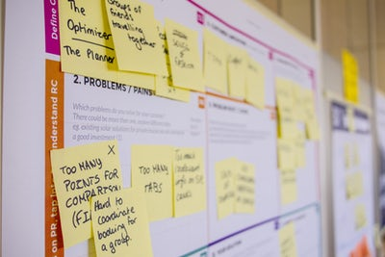
Service Delivery- Quality Assurance
Decentralization
Representation
Leadership development
Use of resources
Cross cultural collaboration
Notes:
Decentralization
Representation
Leadership development
Culturally competent use of resources
Cross cultural collaboration

Slide 14

Staff/Team Development- Recruitment
Selection criteria
Hiring
Language/cultural skill
Quality assurance
Notes:
Fair selection criteria
Fair hiring process
Interview questions about diversity and culturally competent strategies
Language/cultural skill reflective of community
Quality assurance cultural competence

Slide 15

Staff/Team Development-
Compensation & Benefits
Pay structure
Compensation
Performance
Personnel policies
Notes:
-Clear pay structure
-Compensation for competence
-Equal access to benefits
-Principled performance appraisal
-Articulated and reviewed personnel policies

Slide 16
Staff/Team Development-
Development and Retention
Mentoring/support
Empowerment
Personal development
Training opportunities
Performance reviews/accountability
Conflict resolution processes
Reflective supervision/practice
Removing barriers
Supporting success!
Notes:
-Mentoring/support
-Empowerment
-Personal development
-Training opportunities
-Performance reviews/accountability
-Conflict resolution processes
-Reflective supervision/practice
-Removing barriers
-Supporting success!

Slide 17

Organizational Environments-
Physical
Accessibility
Welcoming environment
Signage
Use of equipment/materials
Notes:
-Accessibility
-Visual and auditory environment
-Space allocation
-Welcoming/comfortable environment
-Scale of furniture
-Barriers/entryways
-Signage
-Cleanliness
-Use of equipment/materials

Slide 18

Organizational Environments- Communication
Language ability
Vision and values
Communication
Shared language
Cultural knowledge
Notes:
-Language ability
-Oral and written agency vision and values, policies, and procedures
-Clear channels of communication
-Shared language
-Evidence of cultural knowledge
-Responsive staff/management interactions
-Clear conflict resolution strategies

Slide 19
Organizational Environments- Leadership
Board of Directors
Management
Staff
Structure
Notes:
-Diversity of Board of Directors
-Diversity of management
-Diversity of staff
-Inclusive organizational structure

Slide 20
Community Relationships- Visibility
Public relations and media
Social presence
Professional development
Outreach and education about public policy

Slide 21
Community Relationships- Community Engagement
Leaders
Evangelists
Contributors
Members
Visitors
The Community Engagement Pyramid
Adapted from Balancing Community Building and Audience Engagement, Juan Gonzalez, September 11, 2012, http:www.echoditto.com/blog/balancing-community-building-audience-engagement
Notes:
-Participant/client advocacy
-Principled community alliances
-Role model of cultural competence

Slide 22

Community Relationships-
Fund Development
Relationship building
Grant writing
Collaborative endeavors
Donor development

Slide 23

Characteristics of a
Culturally Competent Agency (1)
Acceptance and respect
Attention paid
Cultural self assessment
Cultural groups
Hiring diversity
Notes:
Acceptance and respect for cultural differences
Careful attention paid to dynamics of difference
Cultural self assessment
Cultural groups are viewed as being different
Attention is paid to hiring culturally diverse and competent workers

Slide 24

Characteristics of a
Culturally Competent Agency (2)
Clear expectations
Continuous expansion
Support to staff
Policies
Notes:
-Agency is clear about what it is capable of providing to a multi-cultural community
-Continuous expansion of knowledge, resources, and adaptations to service programs
-Provides support to staff in their efforts to increase their competence
-Policies support and drive the effort

Slide 25
Put It Into Practice!
Cultural Competence Target Areas
Service Delivery
Staff/Team Development
Organizational Environment
Community Relationships

Slide 26
CLAS Self Assessment Tool Pages 1 & 2 of 3

Slide 27
CLAS Self Assessment Tool Page 3 of 3
Massachusetts Office of Health Equity Webpage

Slide 28
PDSA Cycle
Plan
Study
Act
Do
Plan
Do
Study
Act
Notes:
PDSA is a rapid-cycle process improvement model
You can use PDSA cycle to address needs and goals from CLAS Self Assessment Tool

Slide 29
Action Plan - The Power to Serve
Cultural Competence Priority Area | Aim/Desired Outcome | Task(s) | Responsible Party | Resources In-Hand Needed | How will the team know if the aim is achieved? | Timeline/ Benchmarks
Service Delivery
Staff and Team Development
Organizational Environment/Structure
Community Partnerships

Slide 30
NIATx Process Improvement
CLAS Implementation
Integrated into your process improvement work
Certain CLAS Standards work well in PDSA cycles
Ongoing evaluation
Wisconsin DHS-Minority Health Program
Notes:
CLAS Implementation
Integrated into your process improvement work
Certain CLAS Standards work well in PDSA cycles
Ongoing evaluation

Slide 31
NIATx Example
Accessibility and treatment
CLAS Standard
Walk-through
Project Aim
PDSA (Plan‐Do‐Study‐Act)
Sustain
Notes:
-Linguistic and culturally appropriate accessibility and treatment in your clinic.
-Choose a CLAS Standard to work toward
-Do a walk-through
-Select your Project Aim (ex. increased continuation between levels of care for non‐English speaking patients).
-Rapid‐cycle PDSA (Plan‐Do‐Study‐Act) small changes.
-Sustain improvements.

Slide 32

Nominal Group Technique
Culturally & Linguistically Appropriate Services
Discussion Questions from the Self-Study materials:
1) What do we do well?
2) What could we do better?
3) What would we like to change?
Notes:
1. What do we do well related to Culturally & Linguistically Appropriate Services?
2. What could we do better with related to Culturally & Linguistically Appropriate Services?
3. What would we like to change in how we train for and implement Culturally & Linguistically Appropriate Services (What change would we like to actually try out)? What do we need to do to work on our most recent CLAS goal?

Slide 33
Nominal Group Technique
Culturally & Linguistically Appropriate Services (1)
Step 1-Preparation
Prior to using the Nominal Group Process
Welcome statement
Review
Step 2-Idea Generating
Welcome the group
Encourage participation
Step 3- Recording Ideas
Ask for Input
Record ideas
Adapted from NIATx: http://www.niatx.net/content/contentpage.aspx?NID=147
Notes:
STEP 1: Preparation
Prior to using the Nominal Group Process
Welcome statement
Review-Bring flip charts, masking tape, markers; pens and paper for each participant.
-Prepare a welcome statement that explains the purpose of the meeting, outlines individual roles, and describes how the output will be used.
-Review the NGT process.
- STEP 2: Begin the meeting with silent idea generation
Welcome the group, and present in writing and verbally the questions that the group will consider during the meeting.
-Encourage participants to silently and independently write ideas in brief phrases on paper for a good length of time.
STEP 3: Round-robin recording of ideas
Ask for input
Record ideas-Go around the room and record one idea from each participant on the flip charts. Do one question at a time.
-The ideas should be recorded verbatim with little to no paraphrasing. However, you may ask questions for clarification of the idea. Keep going around the room, each person contributing one idea during each round, until all ideas have been recorded. When a participant is out of ideas, they should just pass to the next person.

Slide 34
Nominal Group Technique
Culturally & Linguistically Appropriate Services (2)
Step 4-Discussion of Ideas
Take each idea one at a time
Discuss and clarify idea
Vote
Step 5-Prioritization
Generate change list
Narrow down idea list
Build on the discussion
Adapted from NIATx: http://www.niatx.net/content/contentpage.aspx?NID=147
Notes:
STEP 4: Serial discussion of ideas – working with the What would we like to change? list
This involves taking each idea, one at a time (serially) and discussing or clarifying the idea prior to the preliminary vote
STEP 5: Prioritization – just with the What would we like to change list
Narrow the list of potential ideas.
Build on the discussion
-During this stage, the group participants will begin to narrow the list of potential ideas.
-Building on the discussion of ideas, each member will make an independent judgment about those ideas that they consider most likely to represent the key area to focus on, if any, in strengthening the program’s provision of Culturally & Linguistically Appropriate Services.

Slide 35
Questions? Comments?
Harold Gates, MSSW, CISW, HS-BCP
Midwest Center for Cultural Competence, LLC
haroldgates@charter.net

Slide 36
Resources
National CLAS Standards
Community Engagement Pyramid, Adapted from Balancing Community Building and Audience Engagement, Juan Gonzalez, September 11, 2012
CLAS Assessment Tool
Cultural and Linguistic Competence Action Plan, Midwest Center for Cultural Competence LLC

