Slide 1
Applying for Grant Funding
General Grant Writing Guidance
Notes:
Welcome to the Native Center for Behavioral Health! I am Elleh Driscoll, and today, Avis Garcia will be presenting Safe at Home: Domestic Violence Awareness Series Part 2!

Slide 2
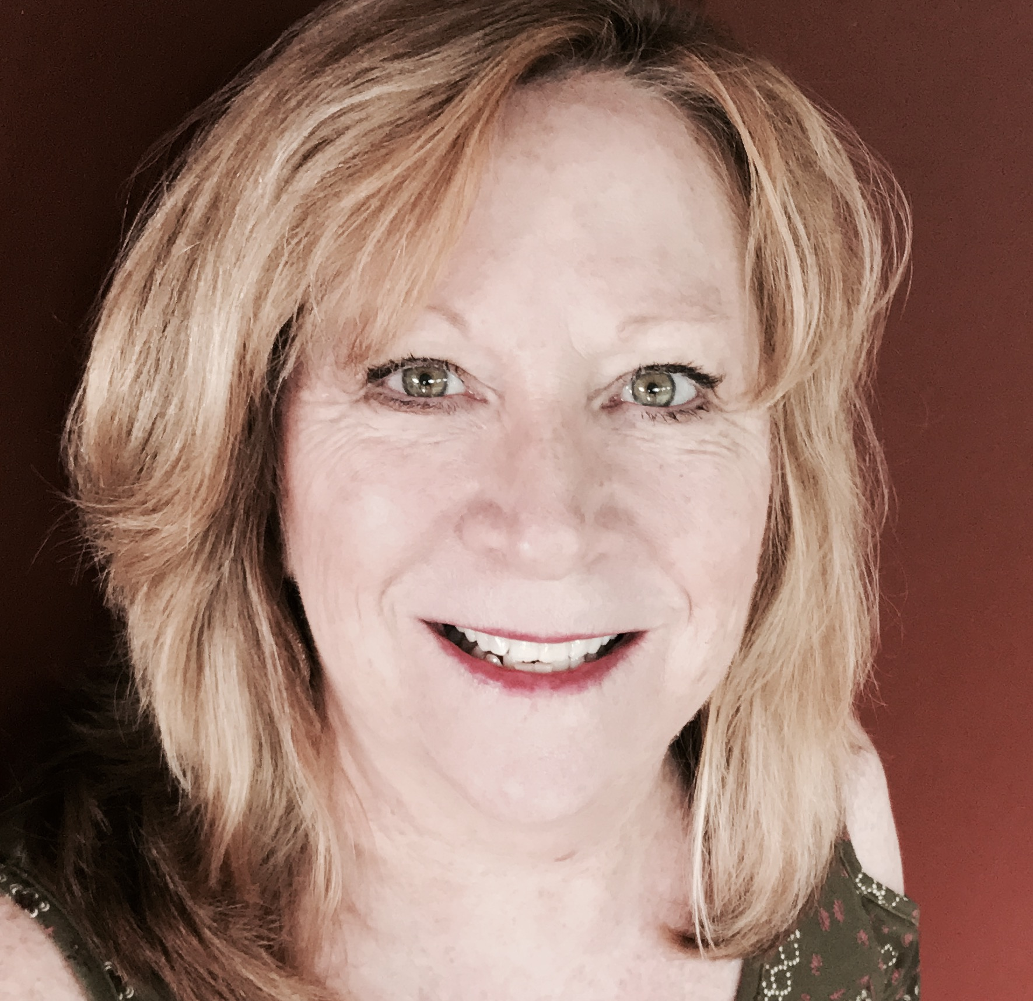
Today’s Office Hours Consultant: Pam Baston
Pam has been in the substance use disorder prevention and treatment field for 41 years. During the past 20 years, she has engaged in grant writing (part-time) and has a 90% successful win rate. She will share practical strategies.
Notes:
SAMHSA GPOs are also on the line for questions.

Slide 3
VERY helpful resources
https://www.samhsa.gov/sites/default/files/grant-application-manual.pdf
You can read more information about this registration process beginning on page 15 of the SAMHSA document pictured left.
Also check out this webinar slide deck:
https://www.samhsa.gov/sites/default/files/foa-applicant-webinar.pdf
Notes:
This resource includes lots f helpful templates and ideas.

Slide 4
Tribal Opioid Response (TOR) Basics
https://www.samhsa.gov/grants/grant-announcements/ti-21-007

Slide 5
Tribal Opioid Response (TOR) Basics
The applicant must be a federally recognized American Indian or Alaska Native tribe or tribal organization. Tribes and tribal organizations may apply individually, as a consortia, or in partnership with an urban Indian organization. Tribes and tribal organizations may only be included in one grant application.
Anticipated Total Available Funding
$37,647,916
Anticipated Number of Awards
Approximately 150
Anticipated Award Amount
See Appendix K
Length of Project
2 years
Cost Sharing/Match Required?
No

Slide 7
Section A:

Slide 8
Documenting needs: Many methods
Direct methods: Data for determining community needs can be collected through:
Surveys
Questionnaires
Focus groups
Public meetings
Direct observations
Key informant interviews
These do not have to be super sophisticated or elaborate to be informative!
Notes:
Talking points: Sometimes a crisis in a tribal community or a funding opportunity or other situation will necessitate an accelerated needs and resource assessment process. So let’s look at a few resources that could be helpful in such circumstances. The items on this slide represent actions you can take (perhaps you would want to enlist the assistance of a tribal member with expertise, a university researcher or combination/team)
Source: https://www.ruralhealthinfo.org/toolkits/rural-toolkit/1/needs-assessment

Slide 9
Documenting needs cont.
Testimonies from clients, families, referral sources, other stakeholders, funders, staff (summaries or quotes from satisfaction/perception of care surveys, focus groups, etc.)
Waiting lists
Other sources
Don’t forget, if you have insufficient data to tell the story about the strengths and needs related to opioid and stimulant use disorders affecting your tribal community you can budget for this in your grant as an important activity.

Slide 10
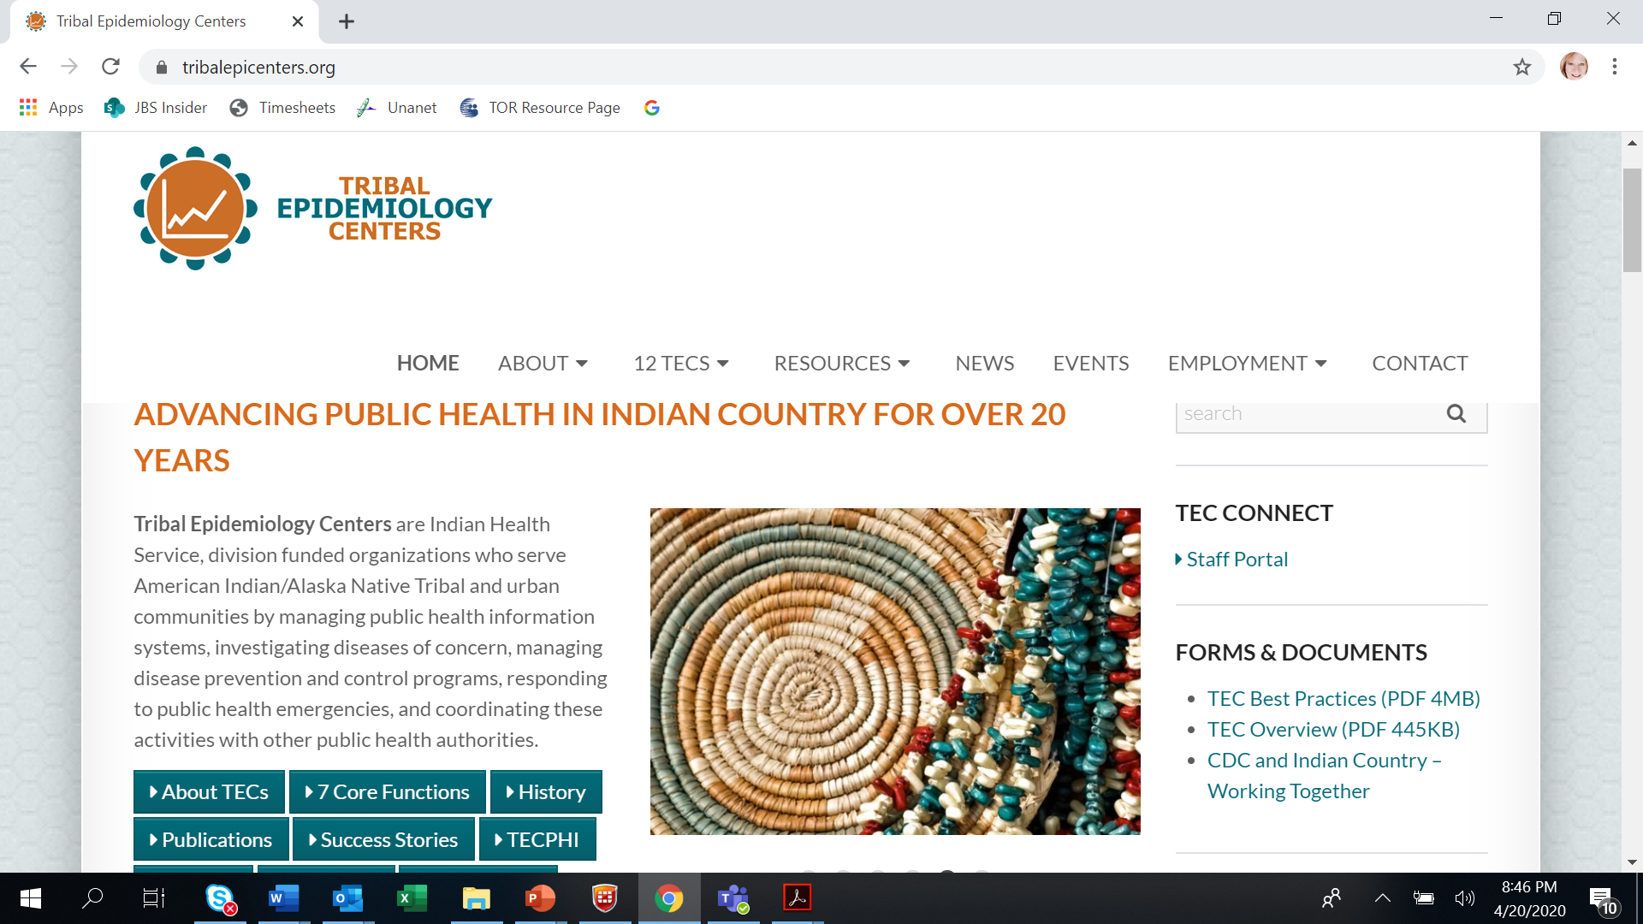
Source: 8
Notes:
Talking points: Talk about the TECs
Source: https://tribalepicenters.org/

Slide 11
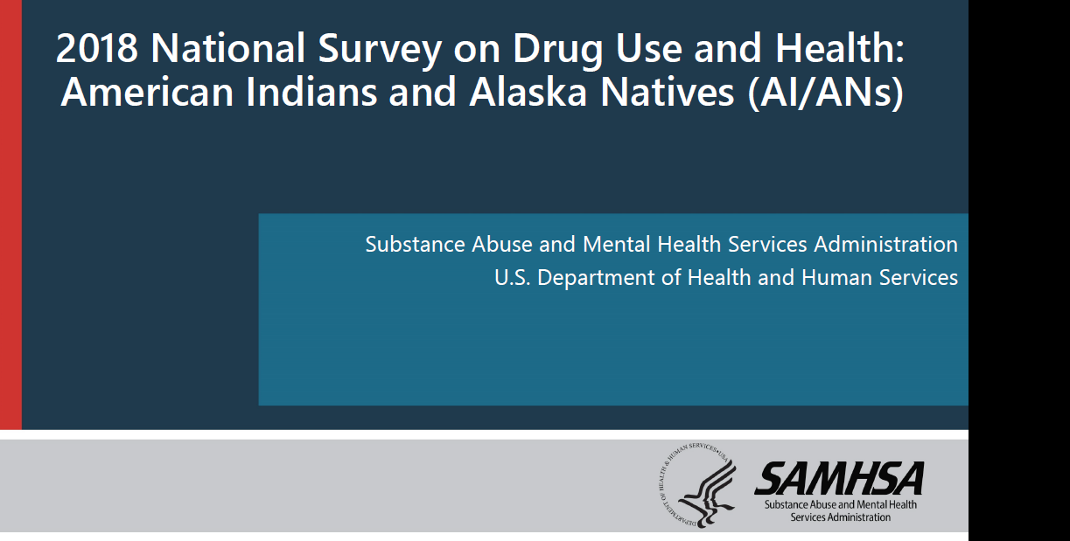
While not tribe-specific, this is a great AIAN substance use prevalence data source³
https://www.samhsa.gov/data/sites/default/files/reports/rpt23246/1_AIAN_2020_01_14_508.pdf
Notes:
Talking points: This prevalence data could be applied against your tribal population to provide some general idea of the potential issue (while there is nothing wrong with this approach you should disclose your use of this process if doing such so you are clear about using a synthetic estimate rather than actual from our tribe). Let’s look at some of the data this resource provides.
Source: https://www.samhsa.gov/data/sites/default/files/reports/rpt23246/1_AIAN_2020_01_14_508.pdf

Slide 12
Notes:
Talking points: If you do not have tribal specific data, you could apply these national data against your population of 18+

Slide 13
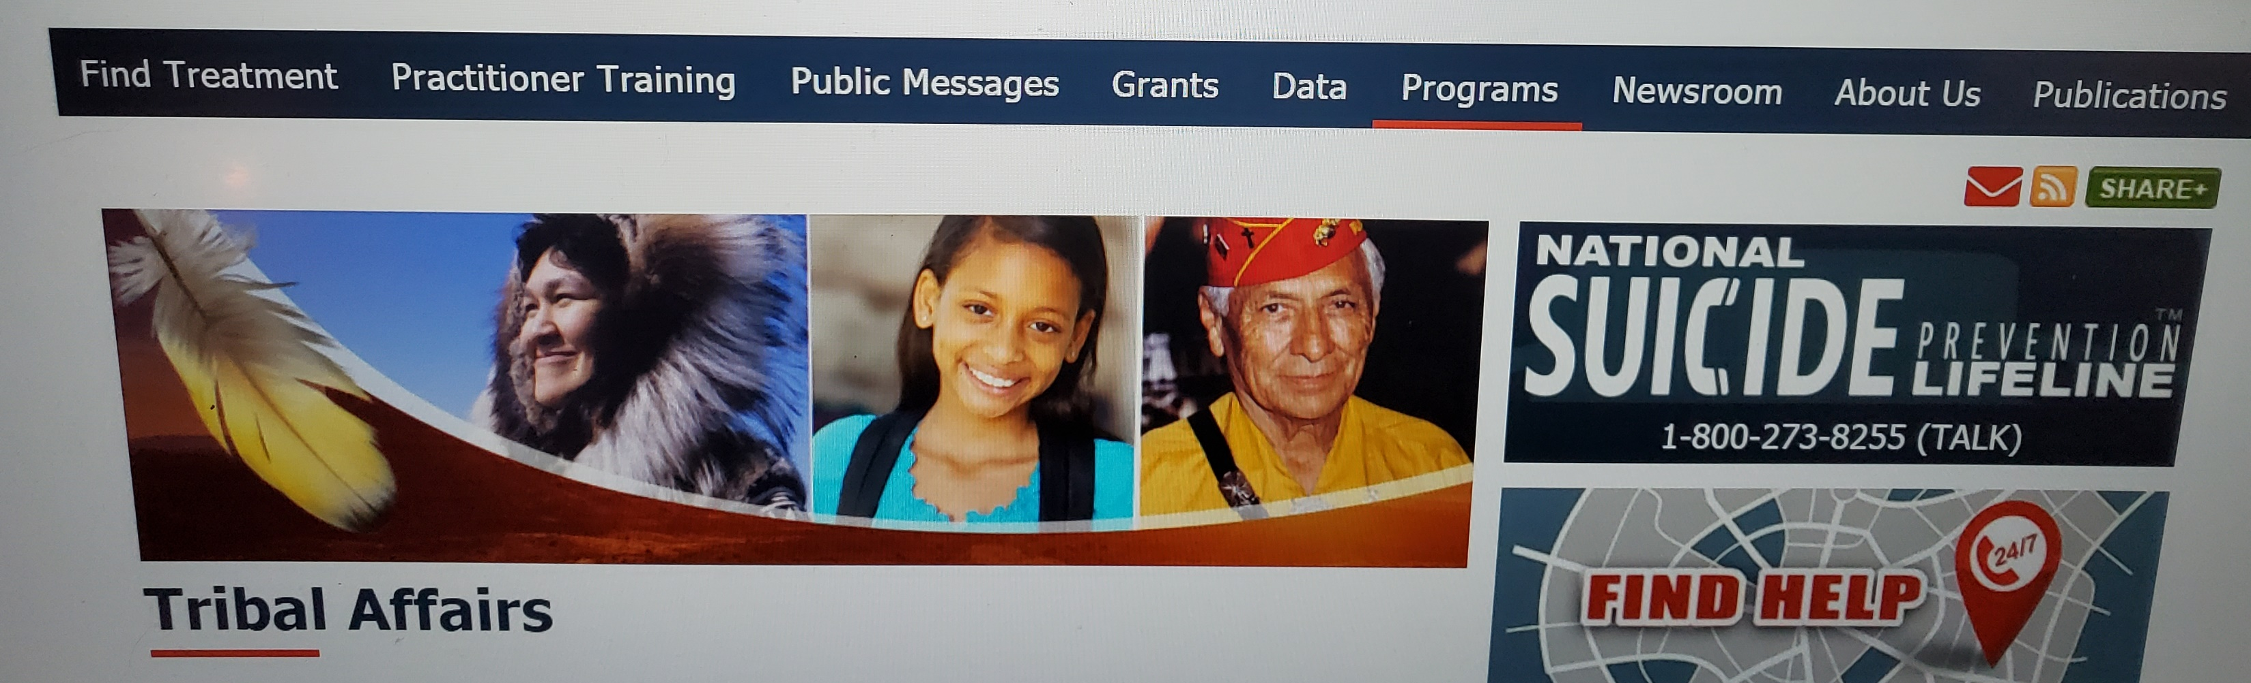
SAMHSA Office of Tribal Affairs and Policy (OTAP)
https://www.samhsa.gov/tribal-affairs

Slide 14
Section B:

Slide 15
Required Activities
SAMHSA Goals: To reduce unmet treatment need and opioid overdose-related deaths through the provision of prevention, treatment, and recovery support services for OUD and, if so desired, stimulant misuse and use disorders.
Increase access to culturally appropriate and evidence-based treatment, including medication-assisted treatment (MAT) using Food and Drug Administration (FDA)-approved medications for the treatment of opioid use disorder (OUD).
See Funding Opportunity Announcement (FOA) pages 7-9. Select specific activities from there.
These activities can become your project objectives and you can cluster them under a small number of relevant goals.

Slide 16
Tribal Behavioral Health Agenda
The TBHA can be found at https://store.samhsa.gov/product/The-National-Tribal-Behavioral-Health-Agenda/PEP16-NTBH-AGENDA

Slide 17
Section C:

Slide 18
Evidence-based Treatment and Prevention
To reduce unmet treatment need and opioid overdose-related deaths through the provision of prevention, treatment, and recovery support services for OUD and, if so desired, stimulant misuse and use disorders.
Culturally appropriate
You proposed EBP/Ts should relate to these areas.
Can include any of the 3 FDA-approved opioid treatment medications (methadone, buprenorphine, naltrexone).
The Resource Center, at www.samhsa.gov/ebp-resource-center

Slide 19
ONE example: Contingency Management (CM)
CM typically modifies behavior by delivering tangible reinforcements (e.g., prizes, vouchers, or monetary reinforcement) in exchange for evidence of the desired behavior (e.g., abstinence, decreased drug use, consumption of prescribed opioid treatment meds/MAT) or by withholding those reinforcers in instances of undesired behavior (e.g., drinking/drug use). The AI/AN ATTC has a webinar series on this model.
Notes:
Source: https://www.ncbi.nlm.nih.gov/pmc/articles/PMC4818164/pdf/nihms-762798.pdf

Slide 20
Section D:

Slide 21
Staffing reminders
The key personnel for this program will be the Project Director at a 0.5 FTE level of effort.
1-page job description
2-page resume
Proposed Staff | Qualifications/Level of Effort (LOE) | Role/Responsibilities
Dara Yazzie | 100% FTE; LCSW; 3 yrs. experience w/proposed Native populations with SUD | Proj. Dir. will provide clinical supervision…..

Slide 22
Section E:

Slide 23
Performance Assessment/GPRA
Recipients may use a combined total of up to 25 percent of their grant award for Data Collection and Performance Assessment and Infrastructure Development.
See page 10 of the FOA.
Examples of the type of data collection tools required can be found here. Data will be collected via a face-to-face interview using this tool at three data collection points: intake to services, six months post intake, and at discharge. Recipients will be expected to do a GPRA interview on all clients receiving treatment, and recovery support services and are also expected to achieve a follow-up rate of 80 percent. GPRA training and technical assistance will be offered to recipients.

Slide 24

Questions?
Notes:
SAMHSA GPOs are also on the line for questions.

Slide 25

You've got this and we are here to help!
THANK YOU!!! CALL IF YOU HAVE QUESTIONS: Jeff Ledolter at
jeff-Ledolter@uiowa.edu
319-321-2555

