Slide 1
Stigma and Substance Use Disorders (SUDs)
Presented by:
Mountain Plains ATTC Staff
University of North Dakota
Grand Forks, ND 58202
701-777-4520

Slide 2
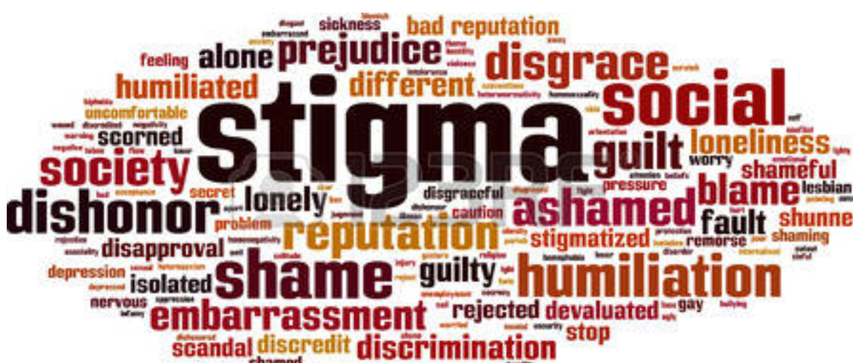
What is Stigma?
Stigma is defined as a mark of disgrace or infamy, a stain of reproach, as on one's reputation (SAMHSA, 2018)
Stigma remains the biggest barrier to addiction treatment faced by patients/clients (naabt.org)
Notes:
“Stigma remains the biggest barrier to addiction treatment faced by patients. The terminology used to describe addiction has contributed to the stigma. Changing the stigma will benefit everyone. It will allow patients to more easily regain their self esteem, allow lawmakers to appropriate funding, allow doctors to treat without disapproval of their peers, allow insurers to cover treatment, and help the public understand this is a medical condition as real as any other” (naabt.org).
Source:
The National Alliance Of Advocates For Buprenorphine Treatment.NAABT.org (2008). Retrieved from http://file:///C:/Users/cjord/Downloads/NAABT_Language.pdf
http://www.apnc.org

Slide 3
FACTS
Substance Use Disorder (SUD) is among the most stigmatized conditions in the U.S. and around the world
Healthcare providers might treat patients/clients with substance use disorders differently due to stigma
People with a substance use disorder who expect or experience stigma have poorer healthcare outcomes (SAMHSA, 2018)

Slide 4
Burden of Stigma
Upon diagnosis of a disease or substance use disorder, there may be a perceived implication that the patient has control over the condition and is at fault for acquiring it. condition.
Hard to treat Cancers
SUD
Notes:
SAMHSA’S CENTER FOR THE APPLICATION OF PREVENTION TECHNOLOGIES: “For people with a substance use disorders, stigma disproportionately influences health outcomes and mental well-being. Fear of being judged and/or discriminated against can prevent people with substance use disorders, or who are at risk of substance use disorders, from getting the help they need.” The consequences of stigma of substance abuse are identified as “ Poor mental and Physical health, non-completion of substance use treatment delayed recovery and reintegration processes, and increased involvement in risky behavior”.
Source: samhsa.gov

Slide 5
Negative Consequences of Stigma
Drug addiction is viewed more negatively than mental illness.
(Johns Hopkins HUB, October 1, 2014)
People who experience stigma are less likely to seek treatment. (SAMHSA’s Center For The Application Of Prevention Technologies, 2017)
Trickle Down Effect:
Less willing to access healthcare
Harm reduction is impaired
Negative effect on self-esteem and mental health

Slide 6
Role of Prevention Providers
Reduce stigma surrounding substance misuse
Challenge providers and communities to be aware of unintentional bias
Use appropriate language in formal and informal conversations when discussing SUDs to decrease stigma by:
Removing labels
Using “person first” language
Review the MPATTC “Language Matters” slideDeck4U presentation at mtplainsattc.org

Slide 7
Role of Prevention Providers
Substance misuse is often linked to trauma
Notes:
View the MPATTC Trauma Informed Care: One-on-One with Specialist Dr. Tami DeCoteau. Linked in slide above and can be found at: http://attcnetwork.org/regional-centers/content.aspx?rc=mountainplains&content=STCUSTOM5

Slide 8
Addressing Stigma with Language
Terms that promote stigma:
Addict/Junkie/User/Alcoholic
Addiction/Substance Abuse
Bad Mother/Father
Clean/Dirty (in relation to urine test)
Clean (in relation to the person)
Terms to decrease stigma:
Person with a substance use disorder
Substance Use Disorder (SUD)
Negative/Positive (in relation to urine test)
In recovery
Hazardous/Risky/Harmful

Slide 9
Reminders
Substance Use Disorder (SUD) is a chronic disease. . . as are diabetes, depression and hypertension
Substance use falls along a continuum
Use ranges from abstinence/low-risk to chronic dependence and encompasses all stages in between
Relapse and lapse are a part of the disease process
As many other chronic diseases can be managed, SUD can also be managed through appropriate treatment -- even during pregnancy
Successful treatment for SUD means the person is in recovery; it does not mean they are “cured”
Notes:
“There are 2 main factors that influence stigma: cause and controllability. Stigma decreases when people perceive that the individual is not responsible for causing his/her problem and when he or she is unable to control it.” Education and changing terminology used will influence perceptions.
Source. Kelly, J.F., Walkerman, S.E., & Saitz, R. (2015, January). Stop talking 'dirty': clinicians, language, and quality of care for the leading cause of preventable death in the United States. The American Journal of Medicine, 128(1), 8-9.
Source: Buchman, D.Z., Leece, P., & Orkin, A. (2017, Winter). The epidemic as stigma: the bioethics of opioids. Journal of Law, Medicine, & Ethics, 45(4), 607-611.

Slide 10
Reminders (continued)
Embrace positive change: Treatment for substance use disorders has historically been viewed as binary, with addiction and abstinence as a person’s only two options
Don’t create a dichotomy of “someone is using or not using.” There are many positive changes a person can make to reduce negative consequences
Don’t convey the impression that abstinence is the only goal
Don’t assume there is only one “right” way to address substance misuse
Notes:
“There are 2 main factors that influence stigma: cause and controllability. Stigma decreases when people perceive that the individual is not responsible for causing his/her problem and when he or she is unable to control it.” Education and changing terminology used will influence perceptions.
Source. Kelly, J.F., Walkerman, S.E., & Saitz, R. (2015, January). Stop talking 'dirty': clinicians, language, and quality of care for the leading cause of preventable death in the United States. The American Journal of Medicine, 128(1), 8-9.
Source: Buchman, D.Z., Leece, P., & Orkin, A. (2017, Winter). The epidemic as stigma: the bioethics of opioids. Journal of Law, Medicine, & Ethics, 45(4), 607-611.

Slide 11
References
Addiction-stigma(2017). Retrieved from http://www.drugabuse.com.
Adlaf, E.M., Hamilton, H.A., Wu, F., & Noh, S. (2009). Adolescent stigma towards drug addiction: Effects of age and drug use behavior. Addictive Behaviors, 34(), 360-364.
Brown, S.A. (2011). Standardized measures for substance use stigma. Drug and Alcohol Dependence, 116(), 137-141.
Browne, T., Priester, M., Clone, S., & Iachini, A., DeHart, D., & Hock, R. (2015). Barriers and facilitators to substance use treatment in the rural south: A qualitative study. The Journal of Rural Health, 32(), 92-101.
Buchman, D.Z., Leece, P., & Orkin, A. (2017, Winter). The epidemic as stigma: the bioethics of opioids. Journal of Law, Medicine, & Ethics, 45(4), 607-611.
Johns Hopkins HUB. (October 1, 2014). Drug addiction viewed more negatively than mental illness, Johns Hopkins study shows.
Kelly, J.F., Walkerman, S.E. & Saitz, R. (2015, January). Stop talking 'dirty': clinicians, language, and quality of care for the leading cause of preventable death in the United States. The American Journal of Medicine, 128(1), 8-9.
Kramlich, D., Kronk, R., Marcellus, L., Colbert, A., & Jakub, K. (2018). Rural Postpartum Women With Substance Use Disorders. Qualitative Health Research, (), 1-13.
Notes:
.

