Slide 1
The Rural Impact on Stigma and Substance Use Disorders (SUDs)
Prepared by
Mountain Plains ATTC
University of North Dakota
Grand Forks, ND 58202
701-777-4520

Slide 2
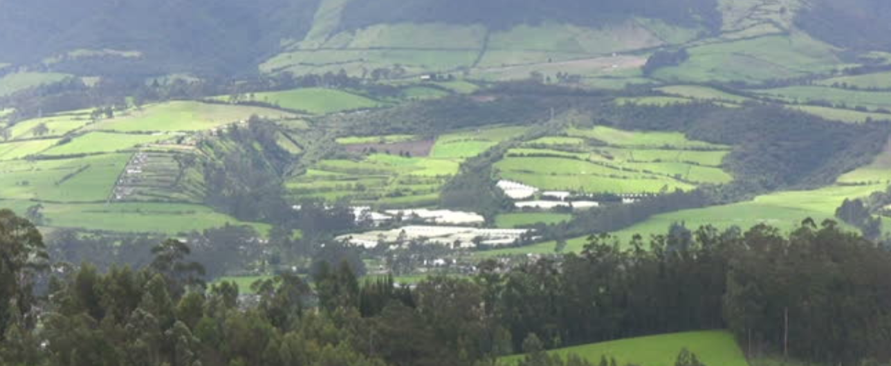
Rural Areas
Rural communities are more geographically dispersed
There tend to be fewer public transportation options
There may be a lack of local, or even close distance, treatment facilities – therefore, people in rural communities may not seek SUD treatment
Notes:
Source: ruralhealth info.org., & Browne, T., Priester, M., Clone, S., Iachini, A., DeHart, D., & Hock, R. (2016). Barriers and facilitators to substance use treatment in the rural south: A qualitative study. The Journal of Rural Health, 32(), 92-101.
https://www.ruralhealthinfo.org/toolkits/substance-abuse/4/stigma
In small rural communities where there is little anonymity, people who use drugs may not seek treatment. Rural programs are also addressing stigma through Good Samaritan protections at the local level. Rural communities are more geographically dispersed and have fewer public transportation options. A lack of treatment facilities nearby often means that people must travel great distances, often to neighboring counties, in order to access services.
Source:
www.ruralhealthinfo.org, & Pullen, E., & Oser, C. (2014). Barriers to Substance Abuse Treatment in Rural and Urban Communities: A Counselor Perspective. Subst Use Misuse, 49(7), 891-901.

Slide 3
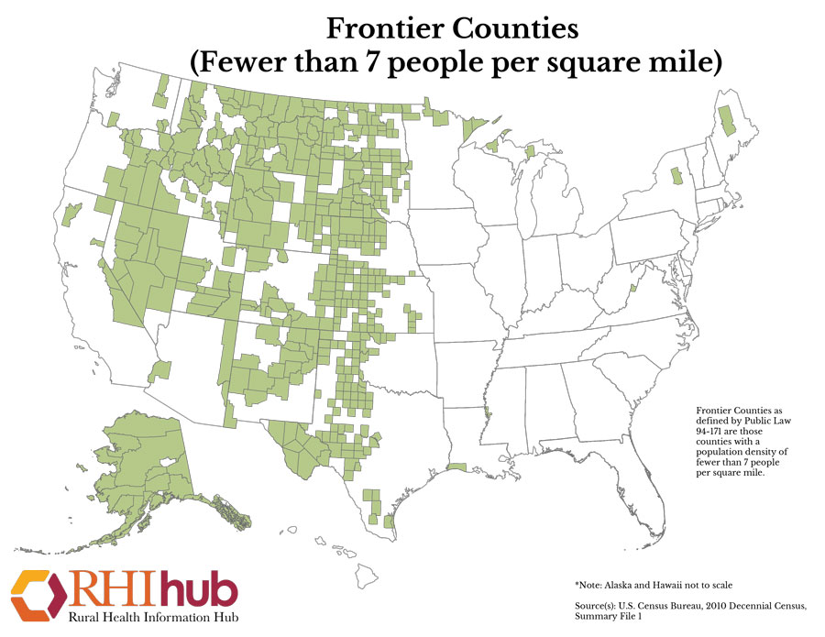
Notes:
The areas of on this map in gray designate frontier counties, which have be defined as having less than 7 people per square mile. According to the 2010 US Census, there are 518 counties in the US that meet the definition of frontier, with approximately 1.8 percent of the total US population living in these counties.
Ask participants to express their thoughts after viewing the map.
It is easy to see that the Midwest and Western parts of the US have the majority of states with frontier counties which certainly impacts service delivery.
If participants are interested in knowing what counties in their state meet the criteria for frontier, the link on the slide (and below) goes to an Excel spread sheet that includes all counties by state that are frontier.
The other link listed below refers to the Rural Health Information Hub where the map can be found.
References
National Center for Frontier Communities. (2014). Mapping Process and Data. Retrieved from http://frontierus.org/mapping-process-and-data/
RHIhub. (n.d.). Frontier Counties (Fewer than 7 people per square mile). Retrieved from https://www.ruralhealthinfo.org/rural-maps/mapfiles/frontier.jpg

Slide 4
SUD Stigma in Rural Areas may be Heightened Secondary to:
Diminished privacy and difficulty maintaining confidentiality
“Everyone knows each other”
The local healthcare provider serves on the school board with you
You are friends with clinic staff
Your neighbors know your vehicle – which means they know when you are at the clinic!

Slide 5
How do Rural Areas Begin to Combat Stigma Challenges?
Address barriers and challenges
Cultural sensitivity trainings
Offer technical assistance to healthcare providers, supporting people with substance abuse issues
Is telehealth an option in your rural community?
Implement evidence-based methods to reduce the stigma of SUDs

Slide 6
Evidence-Based Methods to Reduce the Stigma of SUDs
For those with SUDs:
Acceptance and Commitment Therapy
Skills training
Vocational counseling program
(Livingston, J., Milne, T., Fang, M.L., & Amari, E., 2011)
Notes:
A significant gap exists in the research to reduce the stigma of SUD. A review of 13 studies consistently found that these methods were successful to educate both the person with SUC and the general public.
Source: Livingston, J., Milne, T., Fang, M.L., & Amari, E. (2011). The effectiveness of interventions for reducing stigma related to substance use disorders: a systematic review. Addiction, 107(), 39-50.

Slide 7
Evidence-Based Methods to Reduce the Stigma of SUDs
To Initiate Harm Reduction:
Needle exchanges
Substitution therapies
Safe drug consumption rooms that are designed to decrease the risk associated with drug use
(Livingston, J., Milne, T., Fang, M.L., & Amari, E., 2011)

Slide 8
Evidence-Based Methods to
Reduce the Stigma of SUDs
For the Public:
Educational fact sheets
Leaflets of positive stories of individuals with SUD who are in recovery
(Livingston, J., Milne, T., Fang, M.L., & Amari, E., 2011)
Notes:
Discussion:
What might be some effective ways of decreasing the stigma associated with SUD in rural areas?

Slide 9
Rural Programs can also Address Stigma through Good Samaritan Protections
Good Samaritan Drug Overdose Laws: Provide immunity from criminal prosecution to individuals experiencing an overdose or their companion to request emergency services during an overdose in an effort to prevent overdose-related fatalities
These laws can also help to support naloxone expansion programs by providing immunity from criminal prosecution to individuals experiencing an overdose or their companion to request emergency services during an overdose in an effort to prevent overdose-related fatalities.
Retrieved from https://www.ruralhealthinfo.org/toolkits/substance-abuse/2/harm-reduction/naloxone#good-samaritan
Notes:
Retrieved from https://www.ruralhealthinfo.org/toolkits/substance-abuse/2/harm-reduction/naloxone#good-samaritan

Slide 10
Case Study
Case Study
for Discussion
Notes:
Discussion:
Use the following case study for discussion purposes

Slide 11
Case Study
Overview
Chris is a person with SUD, who lives in a community of 1,000 people.
The nearest SUD counseling services are an hour drive away from Chris’ home community, and the nearest facility which provides medication assisted treatment (MAT) services is over two hours away.
The only provider in Chris’ home community is a family practice physician, who is not waivered to prescribe MAT. His kids play basketball with one of Chris’ kids, and the office manager in his practice is Chris’ cousin.
Chris once tried to bring up concerns about drug usage with the local minister, but the minister’s stance is that misuse of drugs and alcohol is a sin.
Notes:
Discussion:
What might be some factors related to Chris’ situation which contribute to stigma?
What are some of the barriers that Chris faces when trying to access treatment services for her SUD?
How does living in a rural community make it more difficult for Chris to access treatment services?

Slide 12
Case Study
Or perhaps. . .
Imagine now that Chris is a single mother of two young children, and is pregnant with a third.
Notes:
Discussion:
What might be some factors related to Chris’ situation which contribute to stigma?
What are some of the barriers that Chris faces when trying to access treatment services for her SUD?
How does living in a rural community make it more difficult for Chris to access treatment services?

Slide 13
References
Browne, T., Priester, M., Clone, S., Iachini, A., DeHart, D., & Hock, R. (2016). Barriers and facilitators to substance use treatment in the rural south: A qualitative study. The Journal of Rural Health, 32(), 92-101.
Livingston, J., Milne, T., Fang, M.L., & Amari, E. (2011). The effectiveness of interventions for reducing stigma related to substance use disorders: a systematic review. Addiction, 107(), 39-50.
Luoma J, Kohlenberg B, Hayes S, Bunting K, Rye A. Reducing self-stigma in substance abuse through acceptance and commitment therapy: Model, manual development, and pilot outcomes. Addiction Research & Theory. April 2008;16(2):149-165. Available from: Health Source: Nursing/Academic Edition, Ipswich, MA. Accessed June 4, 2018.
National Center for Frontier Communities. (2014). Mapping Process and Data. Retrieved from http://frontierus.org/mapping-process-and-data/
Prevention Collaboration in Action: Collaborating to Address the Opioid Crisis: Engaging People Who Use Drugs in Prevention Efforts: Strategies for Reducing Stigma. Retrieved from http://captcollaboration.edc.org/sites/captcollaboration.edc.org/files/attachments/engaging-people-who-use-drugs-strategies-reducing-stigma_0.pdf
Pullen, E., & Oser, C. (2014). Barriers to Substance Abuse Treatment in Rural and Urban Communities: A Counselor Perspective. Subst Use Misuse, 49(7), 891-901.
Rural Health Information:stigma(2017). Retrieved from http://www.ruralhealthinfo.org
Samhsa’s Center For The Application Of Prevention Technologies. (2017). Retrieved from http://www.samhsa.gov/capt/
Smith, L.R., Earnshaw, V.A., & Copenhaver, M.M. (2016, May). Substance use stigma: Reliability and validity of a theory-based scale for substance-using populations. Drug and Alcohol Dependence, 162(1), 34-43.
The National Alliance Of Advocates For Buprenorphine Treatment.NAABT.org (2008). Retrieved from http://file:///C:/Users/cjord/Downloads/NAABT_Language.pdf

Slide 14
References
RHIhub. (n.d.). Frontier Counties (Fewer than 7 people per square mile). Retrieved from https://www.ruralhealthinfo.org/rural-maps/mapfiles/frontier.jpg
Rural Health Information:stigma(2017). Retrieved from http://www.ruralhealthinfo.org
Samhsa’s Center For The Application Of Prevention Technologies. (2017). Retrieved from http://www.samhsa.gov/capt/
Smith, L.R., Earnshaw, V.A., & Copenhaver, M.M. (2016, May). Substance use stigma: Reliability and validity of a theory-based scale for substance-using populations. Drug and Alcohol Dependence, 162(1), 34-43.
The National Alliance Of Advocates For Buprenorphine Treatment.NAABT.org (2008). Retrieved from http://file:///C:/Users/cjord/Downloads/NAABT_Language.pdf

