Slide 1
screening, brief intervention, and referral to treatment
the SBIRT referral process
Lecture 4.1

Slide 2
only 3-4% of those screened in primary care will require a referral

Slide 3
screening decision tree
Screening
Universal
Low Risk
No Intervention
Moderate Risk
Brief Intervention
Mod-High Risk
Brief Treatment
Severe Risk; Dependency
Referral
or reinforce their healthy use

Slide 4
who requires a referral?
only 3-4% of those screened will require a referral
who should be referred:
people meeting criteria for an alcohol use disorder (AUD) (those meeting DSM-5 criteria)
those with a comorbid mental health disorder
high-risk users (e.g. individuals driving under the influence, those who have contracted an infectious disease, etc.)

Slide 5
motivational enhancement techniques
precede referral with a motivational interaction:
“What would prevent you from following through on this referral? What barriers do you anticipate?” How can I help you address those?
“How do you think you might benefit if you attend the initial intake appointment and perhaps some follow-up appointments? What do you have to gain from engaging in a treatment program?”
“Who will hold you accountable for showing up for your appointment?”
“When I follow-up with you how can we determine if you’ve been successful?”

Slide 6
warm handoff
transportation
call together to make
initial intake appointment
provide written information for the provider

Slide 7
address barriers
cost/insurance
Are you referring them to site that takes their insurance or accepts private pay?
transportation
Do they have the means to get to their appointment?
Is there a provider closer to them?

Slide 8
follow-up
call and verify they attended their appointment
track referral data (preferably electronically)
check in at follow-up appointment
may want to schedule the follow-up appointment so there is accountability for following through on the referral

Slide 9
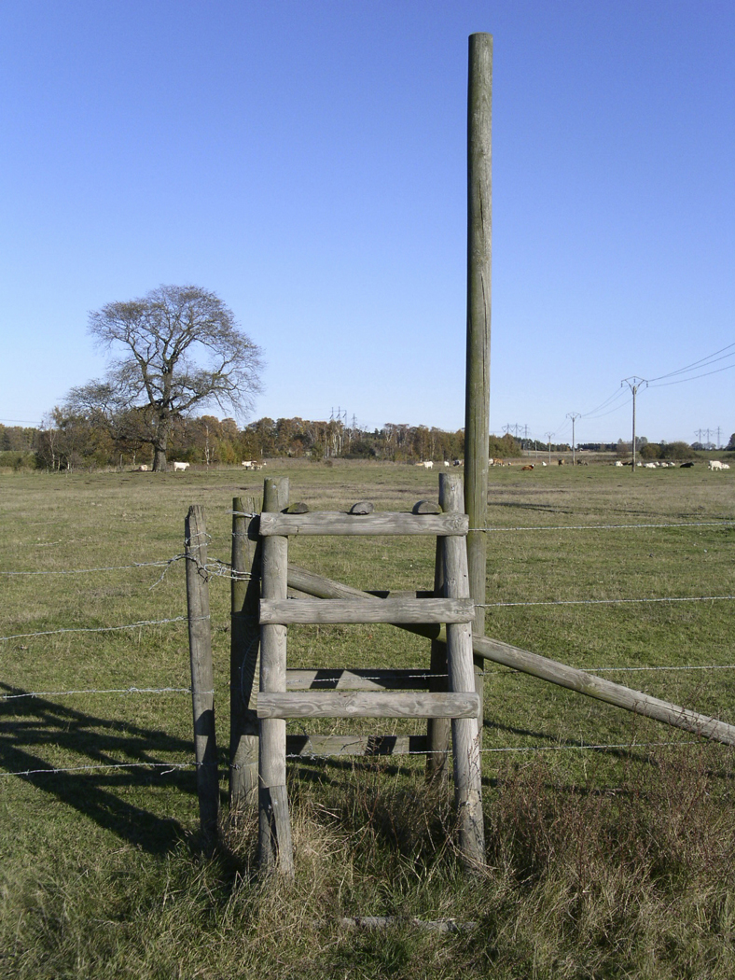
considerations for rural areas
if it appears a referral is warranted, but no provider is available in the immediate vicinity, provide brief intervention or brief treatment onsite

