Slide 1
screening, brief intervention, and referral to treatment
drug & tobacco screening tools
Lecture 6.2

Slide 2
screening tools
tools covered in previous lectures:
ASSIST
CDS-5
CAGE
CRAFFT

Slide 3
screening tools (cont’d)
Fagerstrom Test for Nicotine Dependence (FTND)
older test; widely used internationally
captures how soon someone smokes after waking, total daily cigarettes, continues to smoke when ill, etc.
6 items
scoring: sum items, score of 0-10
levels of dependence:
0-2 = very low
3-4 = low
5 = moderate
6-7 = high
8-10 = very high

Slide 4
there are no ‘safe’ or ‘healthy’ levels of tobacco use; all tobacco users should get a brief intervention

Slide 5
alcohol and drug screening tools
Drug Abuse Screening Test-10 (DAST-10)
10 items
captures drug use/misuse
topics: poly-substance use, relational problems, withdrawal, etc.
self-administered or interview
appropriate for adults
yes = 1 point (except #3, no = 1 point)
scoring (degree of problems related to use): 1-2 (low); 3-5 (moderate); 6-8 (substantial), 9-10 (severe)

Slide 6
screening tools (cont’d)
NIDA Modified ASSIST (NM ASSIST)
adapted from the ASSIST
goal: reduce time it takes to administer
web-based, auto-scored
provides risk level and suggestions for interventions
HIPAA compliant (does not store any patient information)
http://www.drugabuse.gov/nmassist/

Slide 7
NIDA Quick Screen

Slide 8
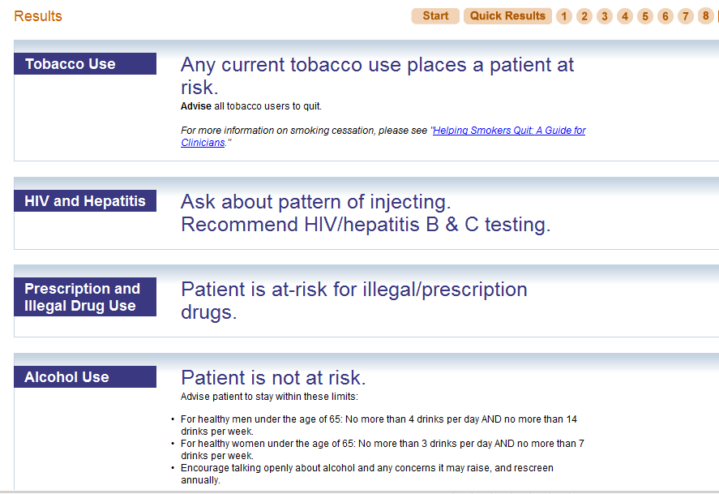
NM ASSIST - results

Slide 9
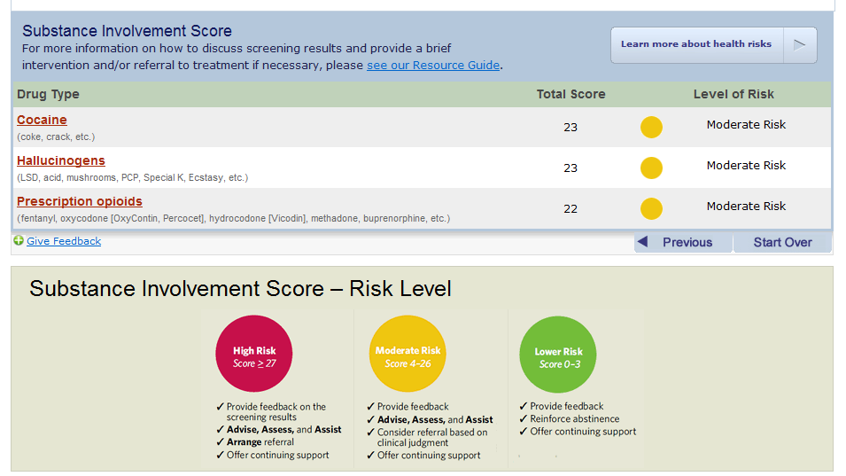
NM ASSIST – risk level

