Slide 1
Pregnant and Parenting Families with SUD: Evidence-Based Treatment, Neonatal Opioid Withdrawal and Supporting the Infant-Parent Relationship
Presented by
Sharon A. Hesseltine, BSW
Intentional Beginnings/ Intentional Development

Slide 2
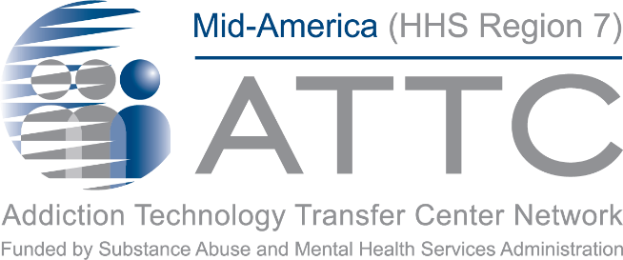
This training is brought to you by:
Notes:
PAT:

Slide 3
Mid-America Addiction Technology Transfer Center
The purpose of the Technology Transfer Centers (TTC) program is to develop and strengthen the specialized behavioral healthcare and primary healthcare workforce that provides substance use disorder (SUD) and mental health prevention, treatment, and recovery support services.
Help people and organizations incorporate effective practices into substance use and mental health disorder prevention, treatment and recovery services.
Notes:
Erika

Slide 4
Missouri Hospital Association
Non-profit membership association, MHA represents every acute care hospital in the state, as well as most of the federal and state hospitals and rehabilitation and psychiatric care facilities.
Provide services to member hospital organizations, and partners with various state and community-based organizations to improve healthcare across the state.
MHA advocates for policies that improve health and health care in the state, and provides data, decision-support tools and operational resources to help hospitals and health systems deliver care.

Slide 5
Housekeeping Items
Slides for today’s session are available:
Mid-America ATTC www.attcnetwork.org/midamerica
Missouri Hospital Association Maternal-Child Health - MHA (mhanet.com)
Participant Manual coming soon!
We will provide a FAQ at the end of the series
Please ask questions in the chat
Please keep stay on mute and turn on your cameras

Slide 6
Disclaimer and Funding Statement
This presentation was prepared for the Mid-America Addiction Technology Transfer Center and the under a cooperative agreement from the Substance Abuse and Mental Health Services Administration (SAMHSA). All materials appearing in this presentation, except that taken directly from copyrighted sources, are in the public domain and may be reproduced or copied without permission from SAMHSA or the authors. Citation of the source is appreciated. Do not reproduce or distribute this presentation for a fee without specific, written authorization from Mid-America Addiction Technology Transfer Center.
At the time of this presentation, Tom Coderre served as SAMHSA Acting Assistant Secretary. The opinions expressed herein do not reflect the official position of the Department of Health and Human Services (DHHS), or SAMHSA. No official support or endorsement of DHHS, SAMHSA, for the opinions described in this presentation is intended or should be inferred.
The work of the Mid-America ATTC is supported by grant 1H79TI080208-01. Funded by the Department of Health and Human Services, Substance Abuse and Mental Health Services Administration.
Notes:
Pat –
Today’s presentation is provided free of charge by the Mid-America ATTC and the Missouri Hospital Association. Today’s presentation is available in the public domain and should Not be distributed for a fee without the express written permission of the Mid-America ATTC.
The views and opinions expressed during today’s presentation are those of our presenters and do not reflect the official position of the Department of Health and Human Services or SAMHSA. No official support or endorsement of DHHS or SAMHSA is intended or should be inferred. Please contact us with any questions you may have.

Slide 7
Disclosures
Successful Completion:
This live webinar offers up to 1.5 contact hours. To receive contact hours, participants must attend the activity in full and complete the Evaluation and Request for Credit Form. CNE, CME and CHES Certificates along with Certificates of Attendance will be emailed within 4 – 6 weeks after submitting the Evaluation/request for Credit form.
Commercial Support/Sponsorship:
There is no commercial support for this training.
Non-Endorsement of Products:
The University of Missouri-Kansas City School of Nursing and Health Studies, the American Academy of Family Physicians the American Nurses Credentialing Center do not approve or endorse any commercial products associated with this activity.

Slide 8
Disclosures
Conflict of Interest:
In accordance with continuing education guidelines, the speaker and planning committee members have disclosed commercial interests/financial relationships with companies whose products or services may be discussed during this program.
Speakers: Sharon A. Hesseltine, BSW has nothing to disclose.
Planning Committee:
Pat Stilen, Kelsey Simpson Hussey, Erika Holliday, Bree Sherry, Sharon Colbert, Angela Bolen have nothing to disclose. Jacki Witt serves on the advisory board for Mayne Pharmaceuticals (Resolved). Kristin Metcalf-Wilson serves on the advisory board for Mayne and Afaxys Pharmaceuticals. (Resolved).

Slide 9
Accreditation Statements
Continuing Medical Education
The AAFP has reviewed The Brain, Substance Use Disorders and Parenting: A Health Care Professional's Guide and deemed it acceptable for up to 1.50 Online Only, Live AAFP Elective credit. Term of Approval is from 05/26/2021 to 05/26/2021. Physicians should claim only the credit commensurate with the extent of their participation in the activity.
Continuing Nursing Education
The University of Missouri-Kansas City School of Nursing and Health Studies is accredited as a provider of continuing nursing professional development by the American Nurses Credentialing Center’s Commission on Accreditation.
This program offers up to 1.5 contact hour for nurses.
Certified and Master Certified Heath Education Specialists (CHES & MCHES)
Sponsored by the University of Missouri-Kansas City School of Nursing and Health Studies, a designated provider of continuing education contact hours (CECH) in health education by the National Commission for Health Education Credentialing, Inc. This live webinar is designated for Certified Health Education Specialists (CHES) and/or Master Certified Health Education Specialists (MCHES) to receive up to 1.5 total Category I continuing education contact hours.

Slide 10
Other CEs
Iowa Board of Certification
Missouri Credentialing Board
Kansas Behavioral Sciences Regulatory Board
Nebraska (deemed alcohol and drug specific – accepted for continuing education for licenses alcohol and drug counselors in NE)
Notes:
Certificates of attendance or CEUs –
Instructions for completing required evaluations will be discussed at the end of today’s session.
Need to view the entire live session of the presentation
You are required to complete a follow-up survey
CANNOT receive credit for watching a recording of the session
CE certificates will be emailed in 4-6 weeks

Slide 11
Today’s Learning Objectives
Describe
Describe evidence-based treatment for pregnant women with an opioid use disorder
Recognize
Recognize the impact of parent involvement in the care of newborns experiencing Neonatal Opioid Withdrawal Syndrome
Develop
Apply skills and strategies to positively impact the parent-child relationship among parents with a substance use disorder

Slide 12
Comprehensive Care Begins with Screening
Screening should be conducted universally as opposed to being driven by specific risk factors
Screening based upon risk factors can lead to missed cases and carries the potential for stereotyping and stigma
The goal of screening during pregnancy is to identify those women with substance use disorders and to help all such women receive treatment if needed
All women should be routinely asked about their use of alcohol and drugs, including prescription opioid and other medications use for nonmedical reasons
A caring and non-judgmental approach is essential
Routine screening should rely on validated screening tools
ACOG advocates the administration of a brief substance use screening questionnaire to all pregnant women that would trigger a brief behavioral intervention and referral, if warranted
SBIRT is the acronym that stands for Screening, Brief Intervention and Referral for Treatment – On-line SBIRT training is available at no cost through the Mid-America ATTC - https://attcnetwork.org/centers/mid-america-attc/online-courses
ACOG, 2017. Society for Maternal Fetal Medicine. J Ecker et al, 2019. AAP, 2020

Slide 13
OB Providers
Play a critical role as a bridge to treatment for opioid use disorder (OUD)
Prevent dire consequences of untreated OUD (overdose death, fetal loss, and preterm birth) by implementing universal screening for SUD per ACOG recommendations
Can couple screening with the provision of or referral to treatment that includes MOUD
Have an opportunity to expand care to include MOUD per new DHHS Practice Guidelines
Can establish partnerships with local SUD treatment providers to facilitate a “warm” referral process to assure patients with OUD have access to evidence-based treatment that includes MOUD
AAP 2020, ACOG 2017

Slide 14
Evidence Based Treatment for Pregnant Women With an Opioid Use Disorder

Slide 15
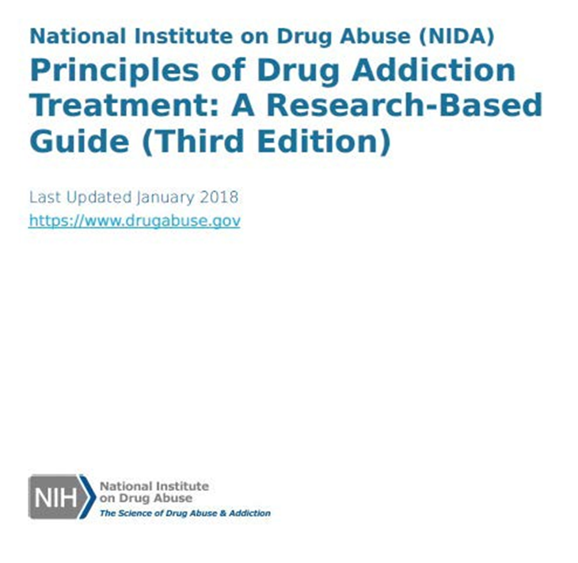
Treatment
The National Institute on Drug Abuse (NIDA) outlines 13 principles for effective treatment of drug addiction in their 2018 publication “Principles of Drug Addiction Treatment: A Research-Based Guide (Third Edition)”
NIDA, 2018

Slide 16
Principles of Effective Treatment
Addiction is a complex but treatable disease that affects brain function and behavior
No single treatment is appropriate for everyone
Treatment needs to be readily available
Effective treatment attends to multiple needs of the individual, not just his or her substance use disorder
Remaining in treatment for an adequate period of time is critical
Behavioral therapies—including individual, family, or group counseling—are the most used forms of treatment
Medications are an important element of treatment for many patients, especially when combined with counseling and other behavioral therapies
NIDA, 2020

Slide 17
Principles of Effective Treatment – Cont.
Approximately 50% of individuals with a substance use disorder also have other mental disorders
Medically assisted detoxification is only the first stage of addiction treatment and by itself does little to change long-term drug abuse
Treatment does not need to be voluntary to be effective
Drug use during treatment must be monitored continuously, as lapses during treatment do occur
Treatment programs should test patients for the presence of HIV/AIDS, hepatitis B and C, tuberculosis, and other infectious diseases as well as provide targeted risk-reduction counseling, linking patients to treatment if necessary
NIDA, 2020

Slide 18
Treatment
The National Institute of Drug Abuse (NIDA) emphasizes that treatment of addiction is a long-term process that involves multiple interventions and regular monitoring.
NIDA outlines an approach to comprehensive treatment in the diagram to the right
(NIDA, 2018)
Notes:
Presenter
2020-06-16 14:57:59
--------------------------------------------
Citation:
NIDA. (2018, January 17). Principles of Drug Addiction Treatment: A Research-Based Guide (Third Edition). Retrieved from https://www.drugabuse.gov/publications/principles-drug-addiction-treatment-research-based-guide-third-edition on 2020, June 5

Slide 19
Treatment of OUD
Most effective treatment for OUD involves a combination of several approaches:
Medication for Opioid Use Disorder involves use of medications in combination with intervention to increase adherence to medications
Psychosocial/behavioral approach focused on helping patients develop skills necessary to maintain abstinence
Self Help/Mutual Help support groups form social network supportive of recovery
Recovery-oriented activities help patients develop satisfying lives
SAMHSA, TIP 63, 2020

Slide 20
American College of Obstetricians and Gynecologists (ACOG) Committee Opinion – August 2017
Opioid agonist pharmacotherapy is the recommended therapy and preferable to medically supervised withdrawal because:
Medically supervised withdrawal is associated with higher rates of recurrence
More research is needed to assess the safety, efficacy, and long-term outcomes of medically supervised withdrawal
Infants born to women who used opioids during pregnancy should be monitored by a pediatric care provider for neonatal abstinence syndrome
Obstetric care providers have an ethical responsibility to their pregnant and parenting patients with substance use disorder to discourage the separation of parents from their children solely based on substance use disorder, either suspected or confirmed

Slide 21
Why Medication?
Current data does not support a reduction in NAS with medically assisted withdrawal (MAW) compared to medication
Medically assisted withdrawal increases risk of maternal return to use and poor treatment engagement and does not improve newborn health
Close to half of pregnant women who completed a MAW protocol (48%) returned to active use, significantly increasing risk for OD, HIV, Hep C and infection
Jones et al, Addiction Medicine March/April 2017, HE Jones, Approaches in Women with Substance Use Disorders Who Become Pregnant
Opioid Use Disorders in Pregnancy: Management Guidelines for Improving Outcomes- Cambridge University Press 2018 pp 76-77. ACOG Committee Opinion # 711, 2017.

Slide 22
Addiction Medicine During Pregnancy
Concurrent use of multiple substances during pregnancy coupled with environmental factors during early childhood make it difficult to demonstrate a simple linear cause-and-effect relationship between either NAS diagnosis or prenatal opioid exposure and compromised developmental outcomes
Advantages of buprenorphine include lower risk of OD, fewer drug interactions, evidence of less severe neonatal abstinence syndrome (NAS) as opposed to methadone
Pregnant women who stop using opioids and subsequently experience recurrence are at greater risk of overdose death
Research shows that a combination of medication and behavioral therapies is most successful for substance use disorder treatment
Jones et al, Journal of Addiction Medicine 2019
Source: ACOG Committee Opinion Number 524, May 2012,
SAMHSA - A Collaborative Approach to the Treatment of Pregnant Women with Opioid Use Disorders, 2016

Slide 23
Risks of Returning to Use
MAT decreases likelihood of a return to use and its dangers including:
Rape
Prostitution
Assault
Disease exposure (STI, HIV, Hep C)
Lifestyle associated with active addiction is a bigger risk than fetal exposure (exception is alcohol)
Reducing stress, eating well, exercise and consistent prenatal care are all conducive to a healthy baby and not part of a lifestyle in active opioid addiction
Overdose & death most significant risk following a period of abstinence

Slide 24
Medication to Treat Opioid Use Disorder (MOUD)
Success rate of IV opioid addiction without MOUD is approximately 10%
MOUD increases the rate of success by 50% and reduces risk of OD by 50%
Helps establish:
normal brain functioning after years of substance misuse
reduces cravings
prevents recurrence
reduces HIV, hepatitis C, and other physical health complications related to IV use
National Academies of Sciences, Engineering, and Medicine, 2019

Slide 25
A Word on Medication Dosage
Reducing the dose of medication does not reduce NAS expression or severity
No relationship was found between either methadone or buprenorphine dose and significant infant outcomes, including NAS expression or severity
Dose of medication should be individualized to suppress withdrawal symptoms, minimize cravings and prevent a return to substance use
SAMHSA. Clinical Guidance for Treating Pregnant and Parenting Women With Opioid Use Disorder and Their Infants.
HHS Publication No. (SMA) 18-5054. Rockville, MD: Substance Abuse and Mental Health Services Administration, 2018.
Notes:
Again, in the field we sometimes find a bias toward using less than a clinically optimal dosage of medication to treat OUD among pregnant women, the research does not bear out any benefit to the baby when this is done.
https://store.samhsa.gov/shin/content/SMA18-5054/SMA18-5054.pdf

Slide 26
Goals of Medication for OUD
Reduce mortality
All cause and drug-related
Reduce associated morbidity
Transmission of blood-borne viruses
Infectious complications from IV drug use
Reduce opioid use
Increase retention in addiction treatment
Improve general health and well-being
Reduce drug-related crime
Source: Volkow, et al, NEJM. 2016

Slide 27
FDA Approved Medications to Treat Opioid Use Disorder
Vivitrol
Methadone
Buprenorphine

Slide 28
Vivitrol (Sole Source)
©️
Opioid antagonist obtained by prescription
Once-monthly injectable
Requires detox
Not a narcotic
Non-addictive
Helps prevent relapse
Treatment includes counseling
Not FDA approved and should not be prescribed for pregnant women

Slide 29
Methadone
Opioid agonist medication
Reduces withdrawal symptoms
Used as a pain reliever for detoxification and maintenance
Daily dose
Treatment includes counseling
Creates physiological dependence
Requires detox
Prescription required or registration with a Methadone clinic
Dosage typically needs to be increased in the 3rd trimester

Slide 30
Buprenorphine
©️
Sublingual tablet, sublingual film (Suboxone ), extended-release injection (Sublocade )
Used in the induction and maintenance treatment of opioid dependence
Treatment of opioid dependence
Reduces withdrawal symptoms
Daily dose
Prescription required
Treatment includes counseling
©️

Slide 31
Exceptions to Buprenorphine DATA 2000 Waiver – April 28, 2021
Under certain conditions, new Practice Guidelines exempt eligible practitioners from the certification requirements related to training, counseling and other ancillary services related to the prescribing of buprenorphine
Practitioners licensed under state law, and who possesses a valid DEA registration under 21 U.S.C. 823(f), may become exempt from the certification requirements related to training, counseling, and other ancillary services
Needed in order to expand access to buprenorphine for opioid use disorder treatment
Exemption allows practitioners to treat patients with buprenorphine without certifying as to their capacity to provide counseling and ancillary services
Practitioners must submit a Notice of Intent (NOI) in accordance with current procedures in order to be covered under this exemption and receive a waiver.
If a practitioner selects a patient limit of 30 in the NOI, the practitioner will not need to certify as to the training, counseling, or other ancillary services requirements
https://www.federalregister.gov/documents/2021/04/28/2021-08961/practice-guidelines-for-the-administration-of-buprenorphine-for-treating-opioid-use-disorder

Slide 32
Disease Course and Medications
The longer the patient remains on the medication, the better chance of benefiting from treatment:
It is not known if there is a duration of medications for addiction treatment (MAT) that would eliminate the risk of return to use
The risk of return to use should always be considered to be greater once the medication is stopped
A decision to discontinue medications after a period of successful treatment should occur only after a careful discussion of risks between the clinician and the patient

Slide 33
Appropriate Treatment Length = Better Outcomes
Outcomes are contingent on adequate treatment length
For residential or outpatient treatment, participation for less than 90 days is of limited effectiveness
Treatment lasting significantly longer is recommended for maintaining positive outcomes
NIDA, 2020

Slide 34
Disease Course and Long-Term Management
Long-term management rather than repeated episodes of acute treatment should be a primary strategy
Post-stabilization monitoring, education, and linking with community supports
Medical, psychosocial, and environmental interventions should be utilized over a lifetime with intensity matching the severity of symptoms
Frequent checkups to monitor stability/adjust medications
Focus on treating consequences and minimizing risk factors
Helping patient develop self-monitoring and self-care strategies

Slide 35
Neonatal Opioid Withdrawal Syndrome, Newborns & Parenting

Slide 36
Neonatal Abstinence Syndrome
Collection of symptoms babies experience as they withdrawal from drugs they were chronically exposed to in utero
Clinical diagnosis
There can be symptoms of withdrawal from substances other than opiates – such as nicotine or anti-depressants
Has not been demonstrated to cause long-term neurodevelopmental deficits
Is a short period of time in the larger continuum of an infant’s life

Slide 37
SYMPTOMS of NAS/NOWS
Neurological
Tremors
Gastrointestinal
Poor feeding
Irritability
Increased wakefulness
High-pitched crying
Increased muscle tone
Hyperactive deep tendon reflexes
Exaggerated Moro reflex
Seizures
Frequent yawning and sneezing
Uncoordinated & constant sucking
Vomiting
Diarrhea
Dehydration
Poor weight gain
Increased sweating
Nasal stuffiness
Fever
Mottling
Temperature instability
Source: Hudak. Pediatrics February 2012

Slide 38
Factors Contributing to Severity of NOWS
Genetics
Other substances
Tobacco use
Benzodiazepines (alprazolam, diazepam, clonazepam)
SSRIs (i.e., specific types of antidepressants)
Gabapentin
Birth weight
Hospital Protocols
NICU setting
NAS medication choice
NAS medication and weaning protocols
Not breastfeeding
Separation of baby from mother
Jansson and Velez, Curr. Opin. Pediatrics, 2012, Sanlorenzo, Stark and Patrick, Pediatrics 2018
Notes:
Benzodiazepines (Xanax, Valium, Klonopin)
Slide 32 – benzodiazepines – replace Xanax with alprazolam, replace Valium with diazepam, replace Klonopin with clonazepam – can put brand names in speakers’ notes and verbally say, ‘Alprazolam – an example would be Xanax…’
=

Slide 39
How Severity of NOWS/ NAS is Determined
Multiple assessment tools are in use across the country
Finnegan Neonatal Abstinence Score (FNAS) used most
Researchers and clinicians have not come to a common agreement on how to best assess NAS/NOWS
Eat, Sleep, Console (ESC) assessment approach is showing promise for guiding the management of infants exposed to opioids during pregnancy
Babies whose care was guided by the ESC approach had a shorter length of hospital stay and fewer infants were treated with medication
Westgate & Gomez-Pomar, 2017, Grossman et al, 2018, Spence, 2020
Notes:
Role of the peer

Slide 40
Importance of Parental Involvement
Full rooming in leads to decreased hospital costs and length of stay
Parental presence associated with reduced days of opioid medication for newborn (5.7 fewer days)
Maximal parental presence associated with fewer opioid treatment days for neonate
Strategies that promote rooming-in and minimize separation of mother and infant benefit both mother and baby
Priority should be placed on non-pharmacological interventions and effective nonpharmacologic care that engages the mother is an essential foundation to the care of an infant with opioid exposure
Sanlorenzo, Stark and Patrick, Curr Opin. Pediatrics, April 2018. Spence, 2020. AAP October 2020.

Slide 41
What About Breastfeeding?
Has positive physical and behavioral health results for mother and baby
Most of the time breastfeeding is encouraged for women on methadone & buprenorphine
Breastfeeding is not safe if someone is HIV positive or using illicit drugs
Only very small amounts of methadone &/or buprenorphine get into the baby’s system
Decreases NAS severity, reduces the infant’s need for pharmacological treatment, and decreases the length of pharmacological therapy and hospitalization
Introduce the concept of breastfeeding in the last trimester
Source: ASAM Pamphlet “Childbirth, Breastfeeding and Infant Care: Methadone and Buprenorphine, SAMHSA. Clinical Guidance for Treating Pregnant and Parenting Women With Opioid Use Disorder and Their Infants. HHS Publication No. (SMA) 18-5054. Rockville, MD: Substance Abuse and Mental Health Services Administration, 2018.

Slide 42
Infants With NAS Struggle With Regulation
Behaviors regulate internal states & interactions with environment
NAS behaviors indicate dysregulation of behavioral repertoire and functioning
Conceptualize newborn behavior in terms of ability to regulate responses
Regulation vs. dysregulation
Responds to typical parental interactions (eye contact, light touch, vocalization) with:
Irritability
Exaggerated reflex responses
Spitting up
Loose stools
Hiccups

Slide 43
Non-Pharmacologic Supports For Infants
Touch: Gentle, slow
Visual: Dim environment, lower lights
Sounds: Speak quietly, soft music
Movement: Hold close, up/down
Multiple sensitivity: Swaddling
Needs pacifier
Loves being held close
Feels more secure when swaddled
Rocking – Up & down not side to side
Likes motion
Over- reactivity to sensory stimulation
Motor/ Tone/ Movement
Signs of Stress
Sleep/Wake Control
Assist with transition
Gentle handling – take it slow
Not too much stimulation in room (quiet, low lights)
Promote rest
Adjust environment and stimuli
Watch and notice what baby doesn’t like
Understand limits of what baby can tolerate
Do everything slow motion and one step at a time
Velez, M. and Jansson, L Journal of
Addiction Medicine 2008 September 1; 2(3)

Slide 44
From Dr. Hendree E. Jones et al, 2019:
“Use of a NAS or NOWS diagnosis as a main indicator of adverse developmental outcomes poses potential radiating harm to the child and the family and misses the opportunity to see the complexities of interpersonal, intrapersonal and environmental factors that contribute to the long-term developmental trajectories of children.”

Slide 45
Promoting Parent Child Relationships: The Key Role of the Health Care Team

Slide 46
Recovery & Parenting
Equally relevant
Worked on simultaneously
Focus on the parent-child relationship promotes and actually enhances recovery
Relates to the relationship between the reward pathways in the brain
Pathways are “competing” between investment in substances or investment in caring for the infant
As mothers become invested in their infants the focus of the reward system is “reset”
Mentalizing-Based Intervention with Mother-Baby Dyads, M. Pajulo and M. Kalland

Slide 47
Cumulative Challenges
Recognizing and dealing with emotions
Trauma history
Mental health issues
Feelings of shame and guilt
Poor relationship history (romantic and family)
Difficulties in social relationships
Lack of trust and confidence in own maternal abilities
High expectations for self and children
Easily disappointed in self and child

Slide 48
Supporting Parents with SUD
Begins during pregnancy
Must build capacity to read and interpret baby’s states
Also supports mothers in processing and changing own emotional reactions
Strengthen mother’s ability to soothe infant and build confidence
Builds ability to manage daily cycles and rhythms of feeding, sleep and play for infants
Must respect what we know about regulation for mom and baby while also supporting development of co-regulation

Slide 49
Wondering About Baby Together
Staff:
Waits for the parent to comment and then reinforces or expands on the parent’s comment;
Asks open ended questions (What do you think is going on for her right now? What might she be telling us?)
Wonders out loud about specific infant behaviors (When she saw your face, her eyes brightened, her breathing became steadier, and she kept her focus on you; I wonder what she is telling you right now)
Serves as a collaborative observer who wonders aloud about what the baby may be telling the mother

Slide 50
As we watch Hudson post two “wondering” questions in the chat that you might pose if watching this IRL (in real life)!

Slide 51
Let’s Take Another Look at Hudson
As you watch this video, please type your observations in the chat
What is Hudson trying to tell us?
What feeling words would you use to describe him?

Slide 52
Experiential Education
Partner with parents to observe together
for early feeding cues such as:
Licking lips or smacking
Fists moving to mouth or sucking on hands/fingers
Becoming more alert and active
Opening and closing the mouth
Sticking the tongue out
Moving the head from side to side as if looking for something - called the rooting reflex
Crying is considered a late cue and waiting until baby begins crying can make successful feeding more challenging
WIC/USDA

Slide 53
Building Capacity For Parental Empathy
Think together about the baby’s emotional experience
Support mothers to connect how their actions impact the baby’s emotional experience
Build an environment where parents support each other to recognize and respond to infants
Regularly ask parents about what infants are experiencing in real time

Slide 54
Feelings Questions:
What do you think your baby is feeling right now?
What is she doing that is clueing you in to this feeling?
How are you feeling right now, and could your feelings be impacting baby?
What is going on around us right now and could that be impacting baby’s feelings?
Because of how he is feeling does he need anything from you right now?
Because of how she is feeling is there anything going on around us that needs to change right now?

Slide 55
Feeling Words for Young Children
Babies Feel
Joy
Pain
Toddlers Also Feel
Fear
Excitement
Frustration
Discomfort
Fear
Boredom
Contentment
Anger
Loneliness
Being Loved
Curious
Tired
Hungry
Happiness
Pride
Jealousy
Frustration
Exhaustion
Surprise
Love
Shame

Slide 56
Being A Regulatory Partner
Children need adults to partner with them in order to build their capacity for self-regulation
As human beings we are wired to regulate better when supported by another person
Our capacity for problem solving and other executive thinking is significantly diminished is a state of emotional arousal

Slide 57
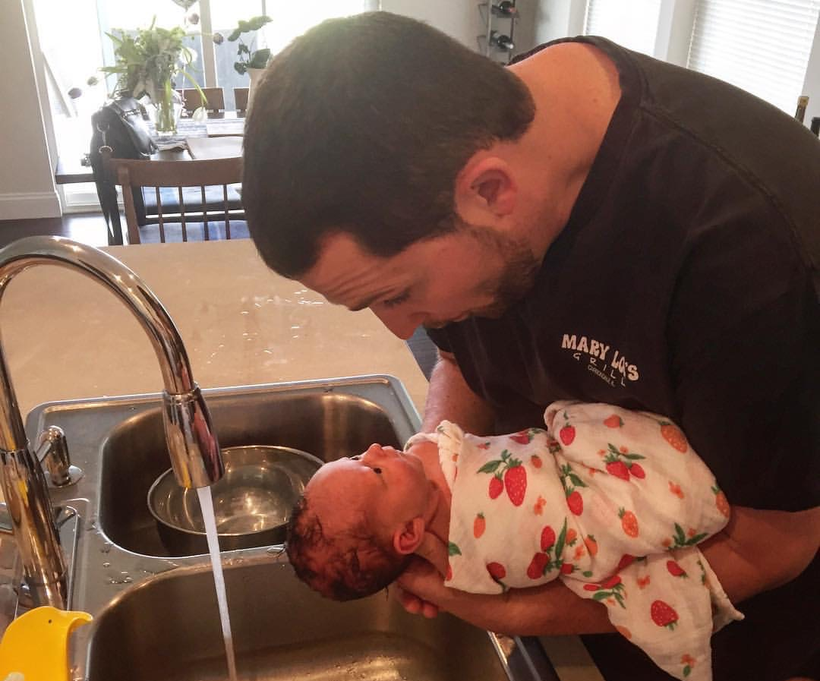
Don’t just do something – stand there and pay attention ~Sally Provence

Slide 58
Affirmations – With Benefits
Step 1: Pay attention to what is going well
Step 2: State it out loud & be specific
Step 3: Note how child benefits
“Wow! Your baby is so much calmer when you hold her and gently rock her, she feels so safe and secure in your arms.”

Slide 59
Do unto others as you would have others do unto you ~Jaree Pawl
Notes:
Ultimately it comes down to this.

Slide 60
References
NIDA. 2020, September 18. Principles of Effective Treatment. Retrieved from https://www.drugabuse.gov/publications/principles-drug-addiction-treatment-research-based-guide-third-edition/principles-effective-treatment on 2021, April 5
Neonatal Drug Withdrawal Mark L. Hudak, Rosemarie C. Tan, THE COMMITTEE ON DRUGS, THE COMMITTEE ON FETUS AND NEWBORN Pediatrics Feb 2012, 129 (2) e540-e560; DOI: 10.1542/peds.2011-3212
Velez M, Jansson LM. The Opioid dependent mother and newborn dyad: non-pharmacologic care. J Addict Med. 2008 Sep;2(3):113-20. doi: 10.1097/ADM.0b013e31817e6105.
Jones, Hendrée E. PhD; Kaltenbach, Karol PhD; Benjamin, Tara MD; Wachman, Elisha M. MD; O’Grady, Kevin E. PhD Prenatal Opioid Exposure, Neonatal Abstinence Syndrome/Neonatal Opioid Withdrawal Syndrome, and Later Child Development Research: Shortcomings and Solutions, Journal of Addiction Medicine: March/April 2019 - Volume 13 - Issue 2 - p 90-92 doi: 10.1097/ADM.0000000000000463
Westgate, Philip & Gomez Pomar, Enrique. (2017). Judging the Neonatal Abstinence Syndrome Assessment Tools to Guide Future Tool Development: The use of Clinimetrics as Opposed to Psychometrics. Frontiers in Pediatrics. 5. 204. 10.3389/fped.2017.00204.
National Academies of Sciences, Engineering, and Medicine; Health and Medicine Division; Board on Health Sciences Policy; Committee on Medication-Assisted Treatment for Opioid Use Disorder; Mancher M, Leshner AI, editors. Medications for Opioid Use Disorder Save Lives. Washington (DC): National Academies Press (US); 2019 Mar 30. 2, The Effectiveness of Medication-Based Treatment for Opioid Use Disorder. Available from: https://www.ncbi.nlm.nih.gov/books/NBK541393/

Slide 61
References Continued
Jansson LM, Velez M. Neonatal abstinence syndrome. Curr Opin Pediatr. 2012 Apr;24(2):252-8. doi: 10.1097/MOP.0b013e32834fdc3a. PMID: 22227786.
Grossman MR, Lipshaw MJ, Osborn RR, Berkwitt AK. A Novel Approach to Assessing Infants With Neonatal Abstinence Syndrome. Hosp Pediatr. 2018 Jan;8(1):1-6. doi: 10.1542/hpeds.2017-0128. PMID: 29263121.
Substance Abuse and Mental Health Services Administration. Medications for Opioid Use Disorder. Treatment Improvement Protocol (TIP) Series 63. Publication No. PEP20-02-01-006. Rockville, MD: Substance Abuse and Mental Health Services Administration, 2020.
ACOG Committee Opinion #711 Retrieved April 28, 2021 from: https://www.acog.org/clinical/clinical-guidance/committee-opinion/articles/2017/08/opioid-use-and-opioid-use-disorder-in-pregnancy
Ecker J, Abuhamad A, Hill W, Bailit J, Bateman BT, Berghella V, Blake-Lamb T, Guille C, Landau R, Minkoff H, Prabhu M, Rosenthal E, Terplan M, Wright TE, Yonkers KA. Substance use disorders in pregnancy: clinical, ethical, and research imperatives of the opioid epidemic: a report of a joint workshop of the Society for Maternal-Fetal Medicine, American College of Obstetricians and Gynecologists, and American Society of Addiction Medicine. Am J Obstet Gynecol. 2019 Jul;221(1):B5-B28. doi: 10.1016/j.ajog.2019.03.022. Epub 2019 Mar 27. PMID: 30928567.

Slide 62
References Continued
Patrick SW, Barfield WD, Poindexter BB, AAP COMMITTEE ON FETUS AND NEWBORN, COMMITTEE ON SUBSTANCE USE AND PREVENTION. Neonatal Opioid Withdrawal Syndrome. Pediatrics. 2020;146(5):e2020029074
Spence K, Boedeker R, Harhausen M, Kaushal G, Buchanan P, Josephsen J. Avoiding NICU Transfers for Newborns With Neonatal Opioid Withdrawal Syndrome (NOWS): A Quality Improvement Initiative to Manage NOWS on the Mother-baby Unit. J Addict Med. 2020 Sep/Oct;14(5):401-408. doi: 10.1097/ADM.0000000000000607. PMID: 31972766.
Sanlorenzo, L. A., Stark, A. R., & Patrick, S. W. (2018). Neonatal abstinence syndrome: an update. Current opinion in pediatrics, 30(2), 182–186. https://doi.org/10.1097/MOP.0000000000000589
Pajulo, M., & Kalland, M. (2013). Mentalizing-based intervention with mother-baby dyads. In N. E. Suchman, M. Pajulo, & L. C. Mayes (Eds.), Parenting and substance abuse: Developmental approaches to intervention (p. 282–302). Oxford University Press. https://doi.org/10.1093/med:psych/9780199743100.003.0014

Slide 63
GPRA Evaluation
https://ttc-gpra.org/P?s=423844

