Slide 1

Community Perceptions of Opioid Overdoses:
Brains, Bias, and Best Practices
Erika Holliday, Bree Sherry, Jennifer Wolfe
Mid America Addiction Technology Transfer Center
June 2, 2021
Notes:
Erika does Intro

Slide 2
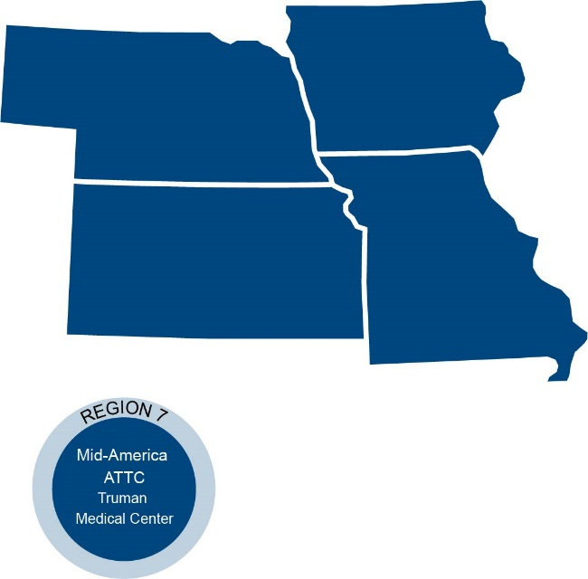
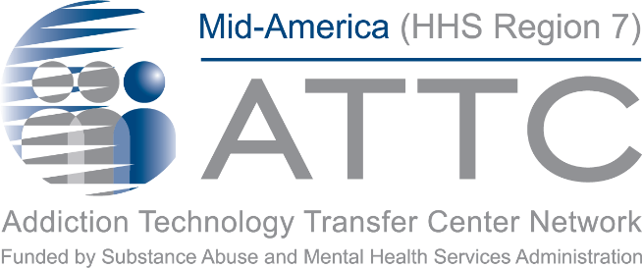
Mid-America ATTC
Notes:
The Mid-America Addiction Technology Transfer Center is one of 12 centers that make up the larger ATTC network.
The TTC Network is funded by the Substance Abuse and Mental Health Services Administration (SAMHSA) to provide training, resources, and technical assistance to individuals serving persons with mental health and substance use disorders.
The Mid-America ATTC serves the states of Iowa, Kansas, Missouri, and Nebraska and is in Kansas City, Missouri co-located at both Truman Medical Center Behavioral Health and the University of Missouri Kansas City’s School of Nursing and Health Studies.

Slide 3
Mid-America Addiction Technology Transfer Center
The purpose of the Technology Transfer Centers (TTC) program is to develop and strengthen the specialized behavioral healthcare and primary healthcare workforce that provides substance use disorder (SUD) and mental health prevention, treatment, and recovery support services.
Help people and organizations incorporate effective practices into substance use and mental health disorder prevention, treatment and recovery services.
Notes:
Erika

Slide 4

HHS Regions
10 Regional Centers
REGION 10
REGION 1
REGION 8
REGION 5
REGION 2
REGION 3
REGION 9
REGION 4
REGION 6
REGION 7
Notes:
The Technology Transfer Center (TTC) Network is a national network of training and technical assistance centers serving the needs of mental health, substance use and prevention providers. The centers are funded by the Substance Abuse and Mental Health Services Administration (SAMHSA).

Slide 5
Disclaimer and Funding Statement
This presentation was prepared for the Mid-America Addiction Technology Center under a cooperative agreement from the Substance Abuse and Mental Health Services Administration (SAMHSA). All materials appearing in this presentation, except that taken directly from copyrighted sources, are in the public domain and may be reproduced or copied without permission from SAMHSA or the authors. Citation of the source is appreciated. Do not reproduce or distribute this presentation for a fee without specific, written authorization from Mid-America Addiction Technology Transfer Center.
At the time of this presentation, Tom Coderre served as SAMHSA Acting Assistant Secretary. The opinions expressed herein do not reflect the official position of the Department of Health and Human Services (DHHS), or SAMHSA. No official support or endorsement of DHHS, SAMHSA, for the opinions described in this presentation is intended or should be inferred.
The work of the Mid-America ATTC is supported by grant 1H79TI080208-01. Funded by the Department of Health and Human Services, Substance Abuse and Mental Health Services Administration.
Notes:
Today’s presentation is provided free of charge and is available in the public domain.
The views and opinions expressed during today’s presentation are those of our presenters and do not reflect the official position of the Department of Health and Human Services or SAMHSA. No official support or endorsement of DHHS or SAMHSA is intended or should be inferred. Please contact us with any questions you may have.

Slide 6
Introductions
University of Missouri Kansas City
School of Nursing and Health Studies
Collaborative to Advance Health Services
Erika Holliday, Senior Program Coordinator
Bree Sherry, Program Manager
EPICC/CommCARE
Jennifer Wolfe, Certified Peer Specialist
Bree Sherry
Program Manager
Mid America Addiction Technology Transfer Center
Notes:
Erika/Bree/Jennifer

Slide 7
Objectives
Participants can associate the effects using substances has on the brain, to the actions made by a person who has Substance Use Disorder.
Participants will be able to describe 3 different types of stigma and how they contribute to societal norms.
Participants will be able to identify at least 2 evidence base practices that can increase lasting recovery connections and decrease stigma for people with substance use disorder.
Notes:
Erika

Slide 8
Let’s Start with Jennifer’s Story . . .
Notes:
Jennifer tells part 1 of her story
Part 1 includes:
-What life looked like before she starting using
-What led her to begin to use alcohol or drugs a more of a necessity
-Details about how use increased in both quantity and type
-How this eventually led to overdosing
**Key to show timeline here of how change in use (share how substance type increased, ex. Went from wine to pills to heroin) and how behaviors changed with that shift.
Pause after description of how you thought you were being attacked but it was first responders telling you overdosed and were dead for a moment

Slide 9

Addiction and the Brain
Notes:
Erika
We are going to take a pause in Jennifer’s story, we’ve heard a lot about what is happening outside the body in decision making and behaviors. But we want to take a quick moment to explain what’s happening inside in the brain that is causing these changes. I’m going to start off by showing a couple of pictures, and I want you to pay attention to who these make you feel.

Slide 10

Ice Cream

Slide 11

Baby

Slide 12
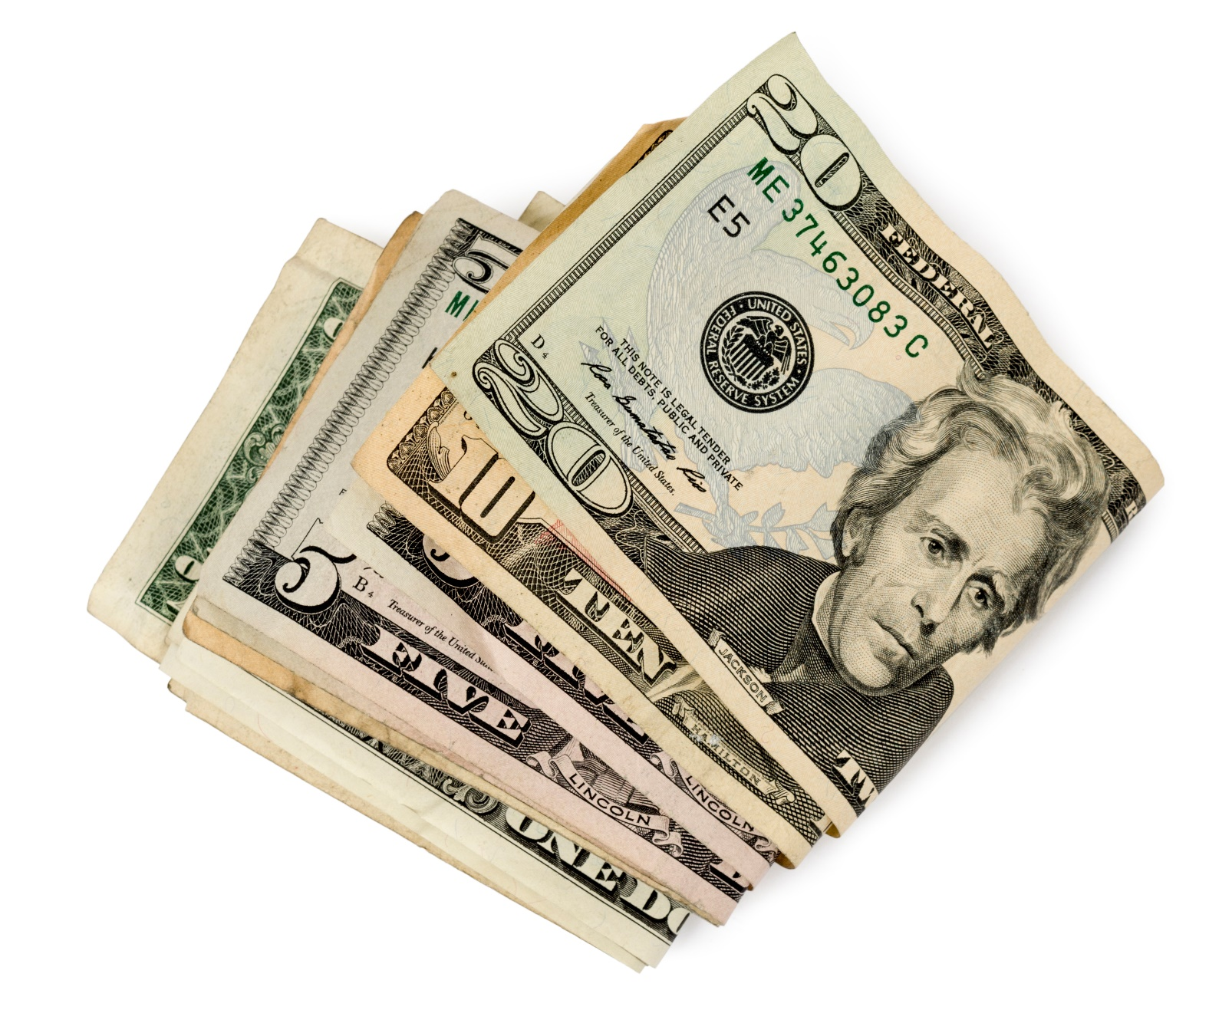
$$$$

Slide 13
This is dopamine.
Notes:
My hope is that most of you felt a feeling of lightness or joy maybe in your shoulders, or a release in your brain. That is the feeling of dopamine being released in your brain. Dopamine is released whenever something happens to you that makes you feel good. Kind of like the creator of that good feeling.
At the same time, another part of the brain called the hippocampus is creating a memory, like a lock and key, of the thing that releases dopamine and makes you happy. So whenever someone is having a rough day and needs a joy boost, they can remember the thing that releases dopamine to make them feel good.

Slide 14
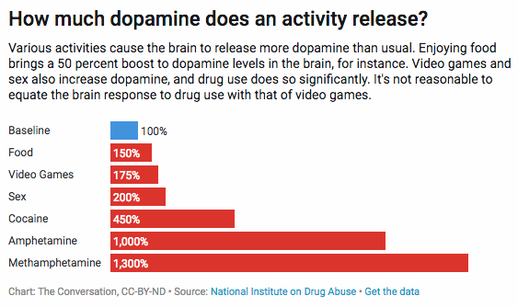
Dopamine Levels Compared
http://econintersect.com/pages/contributors/contributor.php?post=201806211729
Notes:
Erika
We all start at this baseline, I like call it “fine.” We are all at a level of fine from our day to day, then certain things release certain levels of dopamine, and different activities can differ in the intensity level of dopamine released. And thanks to that hippocampus memory, we know what types of things get our dopamine levels up for us. This is especially helpful when we are having a rough day and know that eating at our favorite restaurant, or calling our good friend will help us get back to that level of “fine.”
But there is an unfortunate reality that we are all human, and sometimes our level of “fine” is changed, when life takes a harder toll than we anticipated. When we have a surgery to fix an injury, but it’s months later and the physical pain hasn’t really gone away. When we have the loss of loved one who we were extremely close to. When a relationship that we thought would be a long-term partner ends.
Suddenly, our fine isn’t at 100% anymore, but it goes back the other direction, and we find ourselves at say -500% every day. Suddenly eating our favorite foods or playing our favorite games, isn’t enough to get us back to that original baseline of feeling okay. That is where we work more towards the bottom of the chart. As you can see, harder drugs such as cocaine, amphetamines, and meth, heroin isn’t on this particular chart, but I would put it right down there with meth, releases around 1000% more dopamine than one is usually used to. Not only is that going to leave someone feeling euphoric but putting that type of intensity on the amount of dopamine in the brain, can’t not have an affect on the brains functioning.

Slide 15
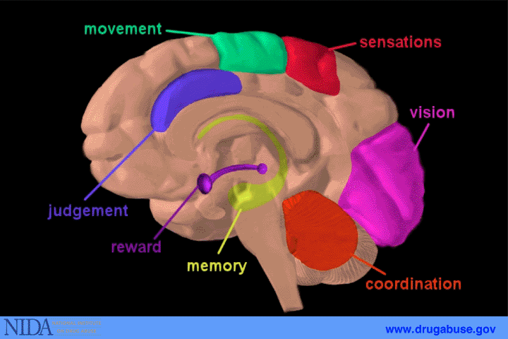
What Do Substances Do to the Brain?
Notes:
Erika
Jennifer jumps in at end to provide example of how judgement section of brain is dulled
We include this picture of a brain to demonstrate the effect substances can have after continued use. The primary parts I want to point are obviously, the purple representing the rewards section. This becomes incredibly strong when someone is using drugs. Again it almost takes over the brain, and gets stronger as the languages changes from I want this to I need this, as someone becomes more reliant on use.
I also want to point out the blue section of judgement. When someone is using stronger substances such as heroin, meth, or fentenyal, this part of the brain shuts down. Often times people say things like “how could someone choose drugs instead of picking their kids up from school, or keeping their job.” But remember, their usual brain isn’t in the drivers seat anymore. There is one primary message completely taking over describing what is right and what is wrong.

Slide 16

However…
The extreme amount of dopamine the brain gets from drugs has a backwards swing to it.
After continued use of a substance, the brain becomes reliant on it.
The large amount of dopamine is now what the brain needs for the body to survive.
Notes:
Erika
Repeated exposure to an addictive substance or behavior causes nerve cells continues to make the effects on the brain more extreme.

Slide 17

Withdrawal: Why it’s so hard to stop
When drug use stops, the brain is overwhelmed by a sudden overabundance of neurochemicals,
This produces extreme:
Anxiety
Agitation
Flu like symptoms
Insomnia
Since many people use substances or activities to “self-medicate” for psychological issues, such as depression, these moods will be particularly noticeable during withdrawal.
https://medlineplus.gov/ency/article/000949.htm
Notes:
Erika
Jennifer provides her thoughts and details on withdrawal

Slide 18
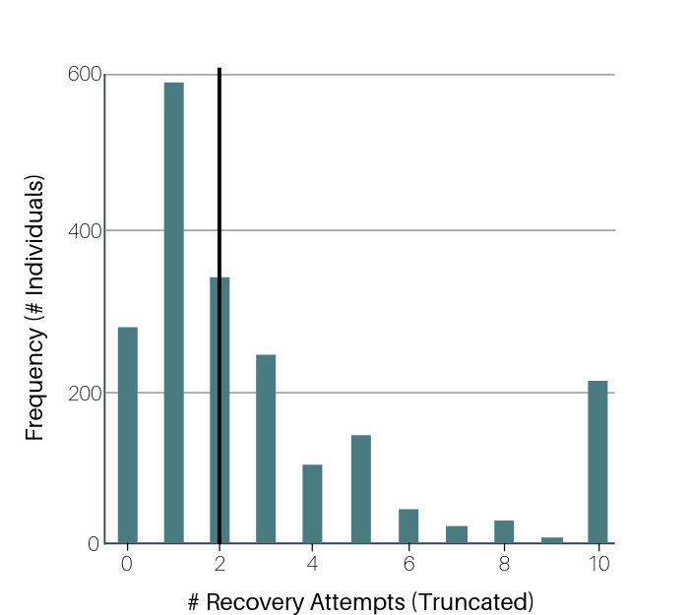
Recovery attempts
On average, it takes someone around 5 serious attempts at sobriety for it to stay. This number increases with the more psychological distress someone has.
Over 21 million individuals aged 12 and older having a diagnosable SUD, fewer than 3.8 million receive treatment each year
https://www.recoveryanswers.org/research-post/recovery-attempts-review/
Ashford, Brown and Curtis, 2018
Notes:
Erika
Psychological distress can show up in the form of mental health disorders, but also from effects from not having a place to live, stable relationships in their life, unemployment, or unaware of where their next meal will come from.
https://www.recoveryanswers.org/research-post/recovery-attempts-review/
Another angle** the average of this study was 5, but the median was 2. When someone has care and support from people around them, these attempts drop by 3.

Slide 19
FAQ
Why can’t someone just stop using? Especially if it’s hurting their kids and their families?
Why would someone steal from loved ones just to get a drug?
Why do people start using if they know how bad drug addiction is?
Notes:
Jennifer addresses each question
*Includes comparison of her experience with SUD and how her sister did not have the same experiences
Genetics account for 40% -60%

Slide 20
ACE Questions
ACE Questions Focus On Occurrences Before The Age Of 18
Personal
Family Members
Physical abuse
Verbal abuse
Sexual abuse
Physical neglect
Emotional neglect
Mother is a victim of domestic violence
Family member in jail
Parent with a substance use disorder
Family member with mental illness
Disappearance of parent through divorce, death or abandonment

Slide 21
ACE’s Increase Chronic Disease
No ACEs
33%
1 in 16 smokes; 1 in 14 has heart disease
1 in 96 has attempted suicide
1-3 ACEs
51%
With 3 ACES, 1 in 9 smokes, 1 in 7 heart disease
1 in 9 is alcoholic, 1 in 43 uses IV drugs
4-10 ACEs
16%
With 7+ ACEs, 1 in 6 smokes, 1 in 6 has heart disease
1 in 6 is alcoholic, 1 in 30 uses IV drugs
1 in 69 is alcoholic; 1 in 480 uses IV drugs
1 in 10 has attempted suicide
1 in 5 has attempted suicide

Slide 22
Why Do Only Some People Become Addicted?
No single factor
More risk factors = a more vulnerable brain
Protective factors decrease chance of brain becoming addicted
Genetics account for 40% - 60%
Adolescents & people with mental illness are at greater risk
In many ways addiction is a disease that originates in adolescence

Slide 23
Pause: Back to Jennifer’s Story
Notes:
Jennifer tells part 2 of her story
Part 2 includes:
-Care she received after her overdose (what interactions with various first responders and ER docs were like)
-Her boyfriends and her future plans and his eventual overdose
-How they were both treated by professionals during that time
-Her downward spiral until her arrest
-Her decision to make changes while in jail and the help that came from the officer in jail

Slide 24
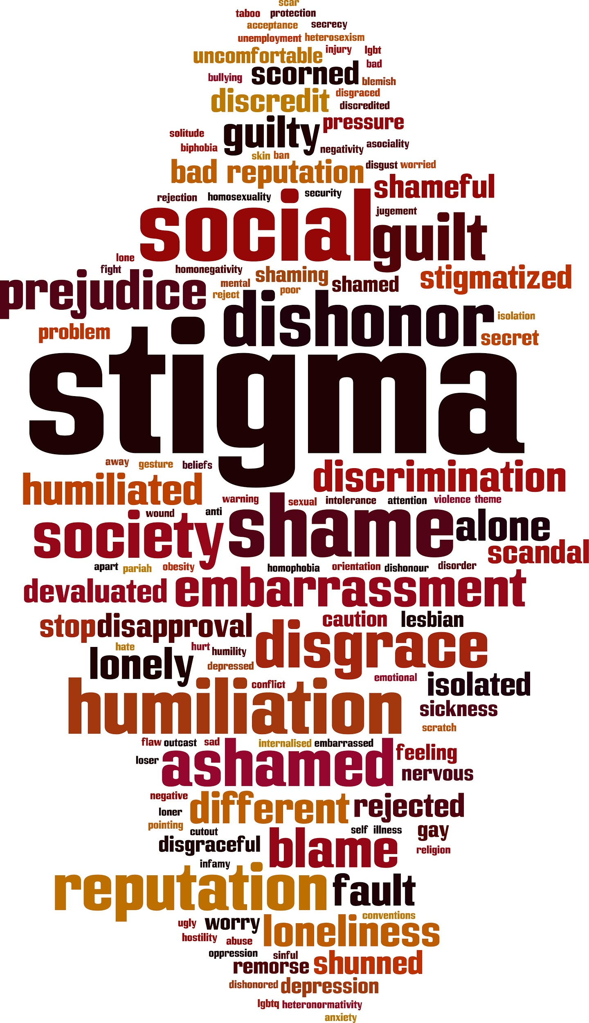
Stigma
Notes:
Bree
Before we dive into what stigma is and definitions
Picture someone with a SUD and consider what do you see- what do they look like, what are you feeling when you see this person, ex joy, heaviness, stress in your shoulders or neck
What surrounds them?
As we go through the definitions, you can jot down if you have seen these in Jennifer’s story, or in your on thoughts, or other people’s actions

Slide 25
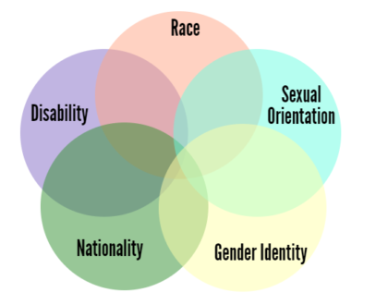
Intersectionality
It is important to note that stigma towards people with SUD is increased when the following identities are also held:
Women
People of Color
People who are pregnant and/or parenting
LGBTQIA
People who have income below the poverty line
https://pubmed.ncbi.nlm.nih.gov/31254965/
Notes:
According to Merriam Webster, the definition of intersectionality is the complex, cumulative way in which the effects of multiple forms of discrimination (such as racism, sexism, and classism) combine, overlap, or intersect especially in the experiences of marginalized individuals or groups
We acknowledge that we didn’t capture all of the marginalized groups in this slide. Please type in the chat any groups that are not listed

Slide 26
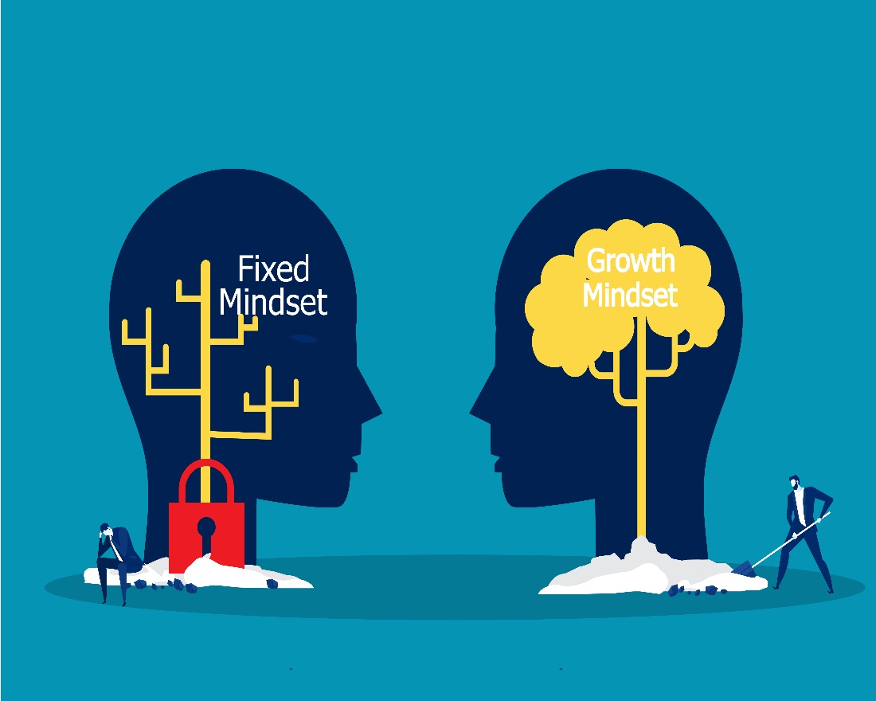
What is Stigma?
Definition: the complex of attitudes, beliefs, behaviors, and structures that interact at different levels of society (i.e., individuals, groups, organizations, systems) and manifest in prejudicial attitudes about and discriminatory practices against people with mental and substance use disorders.
Committee on the Science of Changing Behavioral Health Social Norms; Board on Behavioral, Cognitive, and Sensory Sciences; Division of Behavioral and Social Sciences and Education; National Academies of Sciences, Engineering, and Medicine.
Washington (DC): National Academies Press (US); 2016 Aug 3.
Notes:
Bree
Simplified Definition: A negative belief about a
person or group that can cause negative consequences

Slide 27

Types of Stigma
Institutional
Public
Self
Notes:
Bree
We are going to define each type in the next few slides with examples and I invite you to reflect on ways you have maybe seen stigma in your thoughts or other people's words or actions
I’d also like you to notice how one type of stigma can lead to another type and how they keep the stigma cycle going

Slide 28

Public Stigma
Definition: a set of negative attitudes and beliefs that motivate individuals to fear, reject, avoid and discriminate against people with mental illness (or substance use disorder)
Corrigan PW, Penn DL Am Psychol. 1999 Sep; 54(9):765-76
Notes:
Bree

Slide 29
What does Public Stigma look like?
Persons are violent, unsafe, criminals and should be kept out of the community
Persons are lazy, don’t care, if they did, they would stop using and be with their family and friends
Persons use the system and any “handouts” just to get money for more drugs
Notes:
Bree
Jennifer will chime in with any way she experienced this type of stigma
Think about if you have ever had these thoughts- these thoughts are common- it is a part of being human
Acknowledging stigma is a necessary first step- you have to be aware of it so you don’t act on it
Pause and ask them to jot down any time they have seen public stigma in their own thoughts or in other people’s actions

Slide 30

Self Stigma
Definition: the process in which a person becomes aware of public stigma, agrees with those stereotypes, and internalizes them by applying them to oneself.
Corrigan, P. W., Larson, J. E., & Rüsch, N. (2009). Self-stigma and the "why try" effect: impact on life goals and evidence-based practices. World psychiatry : official journal of the World Psychiatric Association (WPA), 8(2), 75–81. https://doi.org/10.1002/j.2051-5545.2009.tb00218.x
Notes:
Bree

Slide 31
What does Self Stigma Look Like?
I am not worthy of treatment because I am someone who uses drugs
I lost the privilege to ask for help when I abandoned my family and friends for drugs
Drugs are the only thing that will be there for me at the end of the day
An estimated 28% of those who do not seek treatment (but recognize the need), report reasons related to stigma for not accessing or engaging in care.
Ashford, Brown and Curtis, 2018
Notes:
Bree
Jennifer will chime in with any way she experienced this type of stigma
Addiction is an isolating disease and self-stigma compounds that because of the shame it can cause. This and can make entering into recovery more difficult. We know that housing, food, and employment are critical to recovery- and so is having the support of loved ones – self-stigma can make this challenging.
I am going to pause and would like you to jot down if you have seen self-stigma in Jennifer’s story so far of if you have experienced self-stigma in your own life

Slide 32

Institutional Stigma
Definition: policies and procedures that intentionally or unintentionally limit opportunities for people with mental illness or substance use disorder.
Adapted from the American Psychiatric Association, 2020
Notes:
Bree

Slide 33
What does Institutional Stigma Look Like?
People with a drug conviction aren’t allowed in recovery housing
People with a drug conviction aren’t allowed to get food stamps
Notes:
Bree
Jennifer will chime in with any way she experienced this type of stigma
I understand the need for rules but I just want to note that it is very hard to enter into or sustain recovery without food or housing
I am going to pause here for you to jot down some examples of institutional stigma that you have seen in Jennifer’s story or in your own life. This could look hiring policies, laws,
Pause and ask them to write down any time they have seen institutional stigma. Examples- Hiring Policies, Laws

Slide 34
Barriers to Treatment
Stigma is one of the biggest barrier to those seeking addiction treatment
• Inability to afford the cost of care (48%)
• Believing that the problems could be handled without treatment (26.5%)
• Not knowing where to go for services (25%)
• Inadequate or no coverage of mental health treatment (6% to 9%)
• Thinking that treatment would not help (9%)
• Concerns about confidentiality (10%)
• Fear that it might cause neighbors or the community to have a negative opinion(10%)
• Fear that it might cause a negative effect on a person's job (8%)
• Fear of being committed (10%)
https://www.ncbi.nlm.nih.gov/books/NBK384923/
Notes:
Stigma is one of the biggest barriers to those seeking treatment for SUD. Look at the data below for barriers to treatment. Some of these barriers are about access to care but many are directly tied to stigma. And I would argue that most of these are tied to stigma if you look deeper at why these systems are built this way. The word stigma word may not be listed here but it has its name written all over this slide
I am going to pause and give you a minute reflect, think about and if you would like type in the chat some of the barriers linked to stigma that are listed on this slide

Slide 35
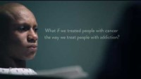

Local Resource Video
https://youtu.be/aTZGfe2Q_6c
Notes:
Bree will introduce this video, comparing the similarities of SUD to cancer (and not so much diabetes). When someone is experiencing a behavioral crisis it affects your entire life- just like cancer
Jennifer allows a pause for audience to sit with the video
Jennifer will close, explaining how she relates to this video (note if any of the examples given in the previous stigma slides would better fit here, to save them for this explanation.)
15 minutes or less – don’t show the video

Slide 36
Where do Stress and Stigma Intertwine?
When a person is experiencing higher feelings of stress, the critical thinking and decision-making part of their brain is affected.
Stress can enhance Stigma.
We are hoping that by utilizing some of the programs explained, some of the stress experienced by health professionals will decrease.
This will also affect stigma held by everyone involved.
Notes:
Erika
This presentation was created for folks in extremely stressful jobs. First responders, people who work in social services, emergency room employees. They’re stressful and they’re busy, especially right now in covid. We don’t present this information with the intention of adding anything to anyone’s plate. Our hope is that by explaining these evidence-based practices, combined with firsthand experience explaining their success, we can begin a conversation people have outside of this presentation around how these procedures could look in their workplace. Or around what local resources exist? Where can agencies get Narcan to carry, if they don’t already? What organizations exist in my community that can offer connections to certified peer support specialists?
We believe that by doing the extra work in the beginning, or finding someone to champion these efforts, it will lead to fewer overdoses, or at least fewer repeated overdoses in the future, which would ideally lower the stress of people in these areas.

Slide 37
Where is Jennifer Now?
Notes:
Jennifer tells final part of her story
Final section includes
-The story of Jennifer’s recovery process
-What she does now
-What a certified peer specialist is and why they are important

Slide 38
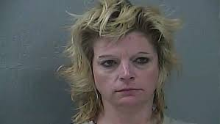
Jennifer Photo
Notes:
Notes for Jen:
Speaks about how this is what she looked like at the time of her arrest
Transition for next slide:
Before we transition to our section on stigma, I would like you to take a moment to reflect on this photo of me.
Take a look at type in the chat if you’re comfortable, the reactions you have to this picture. How does it make you feel? What would you think of this person if you saw them at this time in their lives?

Slide 39
Evidence Based Practices for Overdose Response

Slide 40
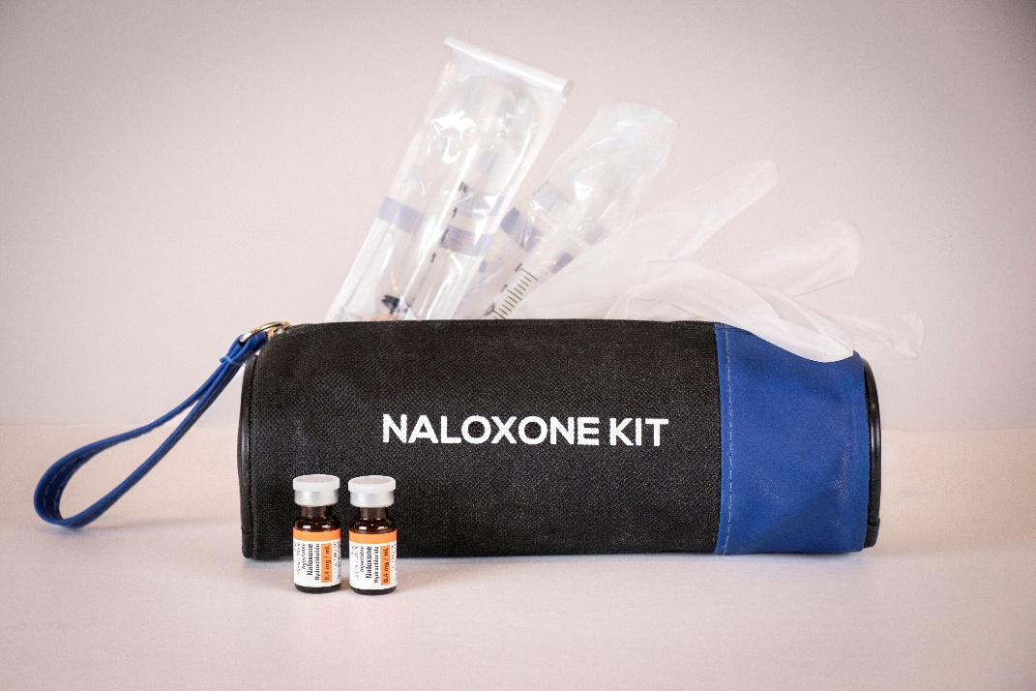
Narcan 101
Only reverses opioid overdoses
No effect if you do NOT have opioids in your body
No abuse potential
  Can’t get high, or modified for recreational use
Not a scheduled drug
Pregnancy Category C
          Recommended for suspected overdose emergencies
Shelf life = 18-24 months
1 death can be prevented for every 227 naloxone kits distributed
3. Coffin, P. O., & Sullivan, S. D. (2013). Cost-effectiveness of distributing naloxone to heroin users for lay overdose reversal. Annals of Internal Medicine, 158(1), 1-9. doi:10.7326/0003-4819-158-1-201301010- 00003
Notes:
Erika

Slide 41
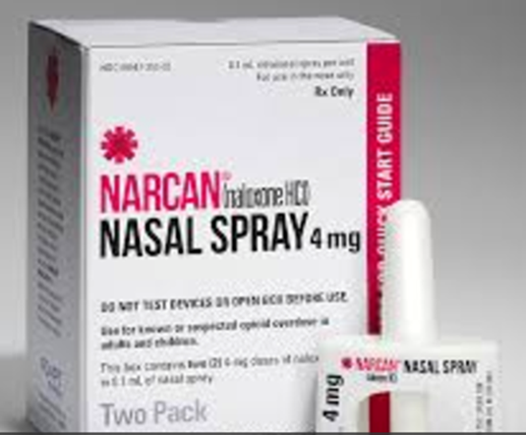
Narcan Leave Behind Programs
Leave Behind Programs are when first responders offer a free naloxone kit to a patient who was revived from an opioid overdose.
The kit contains two doses of nasal naloxone, use instructions, and referral information for treatment or follow-up care.
Notes:
Erika

Slide 42

Certified Peer Support Specialists
Certified Peer Specialists respond to referrals from local hospitals for patients suffering from high-risk opioid use disorder (OUD).
Best practice programs offer 24/7 referral and linkage to services
CPS assist community members to find recovery resources and walk with them for up to 12 months to ensure stabilization, helping them with goals including harm reduction strategies, recovery support, stable housing, medication for addiction treatment, employment, and mental and physical health.
https://www.commcare1.org/epicc
Notes:
Erika

Slide 43
Helpful Data
Studies have found overdose patients whose naloxone kits were provided directly to family members on the scene experienced 5.16x higher odds of being connected to treatment connections (Scharf, 2020)
This same study found that utilizing take home naloxone programs also strengthened the relationship between local first responders and Certified Peer Specialists.
https://mdsoar.org/bitstream/handle/11603/18879/Best%20Practices%20for%20A%20Novel%20EMS%20Based%20Naloxone%20Leave%20Behind%20Program.pdf;jsessionid=844D31EE0D3FB769FF15659FB96C950F?sequence=1
Notes:
Erika

Slide 44
Language Matters
Notes:
Bree
We are going to shift topics and start discussing language. Using person centered language is a simple way all of us can help reduce stigma for those with substance use disorders

Slide 45
Do:
Put people first: Do say “A person with a behavioral health condition” or “a person diagnosed with …”
Emphasize abilities - focus on what is strong such as the person’s strengths, skills & passions
Focus on language that is respectful, clear and understandable, free of jargon, confusing data, and speculation
Focus on language that is non-judgmental and carries a sense of commitment, hope and opportunity
Adapted in 2019 from Wahl, O. (2010). Recovery Language.
Adapted from Burge, M. /Consumer Advocate (2010). Excerpt from speech given at The MHS Conference 2010
Notes:
Bree

Slide 46
Changing the Narrative:
Deficit-Based
An addict/junkie
Strengths-Based
A person diagnosed with an substance use disorder or long term recovery
Substance abuser
Treatment Team
Relapse
Not ready/not willing
Non-compliant
Recovery Team, Recovery Support System
Return to use/ re-emergence of symptoms
Experiencing ambivalence
Experience challenges around . . .
Janis Tondora, Psy.D.
Notes:
Bree

Slide 47
Changing the Narrative Continued:
Deficit-Based
Drug abuse
Strengths-Based
Drug misuse, harmful use
Clean
Dirty
MAT
Former addict
Abstinent, not actively using, negative for
Actively using, presence of, positive for
Medication to treat SUD/ OUD
Person in recovery
Janis Tondora, Psy.D.
Notes:
Bree

Slide 48
Questions?

Slide 49
Thank You!
Erika Holliday
hollidaye@umkc.edu
Bree Sherry
sherry@umkc.edu
Jennifer Wolfe
jwolfe@commcare1.org

