Slide 1
ADDRESSING METHAMPHETAMINE USE DISORDER
Ed Parsells
Native CARE
October 7, 2021

Slide 2
Intervention
Personal Strategies
Assertive Communication
“It breaks my heart to see you put your drug before your family/kids/school/job/health/etc.”
I feel (emotion) Because You (concrete)
Tough Love, Do Not:
Enable – supply the drug, give cash
Cushion Consequences, Bail em out, make excuses
Take Responsibility for the addict, pay bills, taxi
Be complicit in criminal activity

Slide 3
Intervention
Personal Strategies Cont.
Prompt, motivate, encourage action
Assessment
Treatment options
Facilitate follow through
Impose Consequences for Failure
Safety – Don’t antagonize if they are intoxicated
Pain is the addicts best friend
Do not give in or take back consequences you imposed or threatened.
Report crime

Slide 4
Intervention
Community Strategies
Zero tolerance drug related crime
Report – Intoxication, trafficking, theft, retaliation, gang activity, assault,
Prosecute
Jail is good for the addict, not the punishment but the pain can serve as a wake up call
Incarceration protects the community and the offender
Incarceration serves as the initiation of detox
Incarceration can be detox

Slide 5
Intervention
Community Strategies Cont.
Use the law
Court order assessment
Assess while incarcerated
Prosecution and Defense Considerations
What's best is best for the client, court, community
Deferred prosecution
Deferred sentence
Detox and Acute Care
Detoxification – 30 days
Mental Health – Screening, Assessment, Evaluation, Psychosocial, Diagnosis, Treatment

Slide 6
Novelty
The study revealed three major findings. First, as expected, when people were highly curious to find out the answer to a question, they were better at learning that information. More surprising, however, was that once their curiosity was aroused, they showed better learning of entirely unrelated information (face recognition) that they encountered but were not necessarily curious about. People were also better able to retain the information learned during a curious state across a 24-hour delay. Curiosity may put the brain in a state that allows it to learn and retain any kind of information.

Slide 7
NOVELTY
When curiosity is stimulated, there is increased activity in the brain circuit related to reward
When curiosity motivated learning, there was increased activity in the hippocampus, a brain region that is important for forming new memories, as well as increased interactions between the hippocampus and the reward circuit. "So curiosity recruits the reward system, and interactions between the reward system and the hippocampus seem to put the brain in a state in which you are more likely to learn and retain information, even if that information is not of particular interest or importance
Matthias J. Gruber, Bernard D. Gelman, Charan Ranganath. States of Curiosity Modulate Hippocampus-Dependent Learning via the Dopaminergic Circuit.Neuron, 2014 DOI: 10.1016/j.neuron.2014.08.060

Slide 8
THE SCIENCE OF RECOVERY: NEUROPLASTICITY
THE NUCLEUS BASALIS IS…
THE MODULATORY CONTROL CENTER FOR PLASTICITY
NOVELTY

Slide 9
NEUROPLASTICITY
YOU ARE NEUROPLASTICIANS!
WHAT ENHANCES PLASTICITY?
NOVELTY
THERAPEUTIC RELATIONSHIPS
PHYSICAL EXERCISE
MINDFULNESS
SPIRITUAL EXPERIENCES

Slide 10
NEUROPLASTICITY
BRAIN AT ALL AGES IS RESPONSIVE TO ENVIRONMENTAL STIMULI
SYNAPSES CAN CHANGE IN MINUTES WHEN STIMULATED
NEUROPLASTICITY IS MODULATED BY
GENETIC FORCES
EPIGENETIC FORCES
THESE FACTORS INFLUENCE THE EXPRESSION OF GENES WITHOUT CHANGING THE DNA SEQUENCE

Slide 11
GENETICS
Social interventions can change neurobiology
Behavioral interventions could counteract the aversive effects of drug abuse and reinforce the power of group approaches

Slide 12
THE POWER OF GROUPS
Compared group memberships to the number of friends people had, and found that having a large network of friends did not predict self-esteem, but belonging to multiple groups did. Groups provide benefits that interpersonal ties alone do not; namely, meaning, connection, support and a sense of control over our lives.

Slide 13
THE POWER OF GROUPS
Groups often have rich value and belief systems, and when we identify with groups, these can provide a lens through which we see the world. For example, religious groups or organizations striving toward a goal such as reducing poverty can provide a greater sense of purpose.
Jolanda Jetten, Nyla R. Branscombe, S. Alexander Haslam, Catherine Haslam, Tegan Cruwys, Janelle M. Jones, Lijuan Cui, Genevieve Dingle, James Liu, Sean Murphy, Anh Thai, Zoe Walter, Airong Zhang. Having a Lot of a Good Thing: Multiple Important Group Memberships as a Source of Self-Esteem. PLOS ONE, 2015; 10 (5): e0124609 DOI:10.1371/journal.pone.0124609

Slide 14
GLUTAMATE
TWO STAGE MODEL OF THE PROGRESSION OF USE DISORDER
STAGE 1-OCCASIONAL DRUG USE BECOMES INCREASINGLY CHRONIC AND UNCONTROLLED. THE NEUROBIOLOGICAL SOURCE OF THESE SYMPTOMS IS DRUG-INDUCED DEREGULATION OF THE BRAIN’S REWARD CENTER
DOPAMINE
STAGE2-ADDITIONAL FEATURES INCLUDE WITHDRAWAL SYMPTOMS, PERSISTENT VULNERABILITY TO RELAPSE WITH ALTERATIONS IN DECISION MAKING AND OTHER COGNITIVE PROCESSES
DRUG-INDUCED SIGNALS BY NEUROTRANSMITTER GLUTAMATE FROM BRAIN AREAS PRIMARILY ASSOCIATED WITH JUDGMENT

Slide 15
GLUTAMATE
ADDICTS CAN LEARN A NEW RULE BUT RUN INTO PROBLEMS WHEN THE RULES CHANGE
COCAINE AND ALCOHOL ABUSERS WERE ASKED TO PRESS A KEY EACH TIME THEY SAW A GREEN RECTANGLE ON THE SCREEN
AFTER 500 REPETITIONS TOLD NOT TO PRESS KEY WHEN SAW GREEN RECTANGLE
CONTROLS EASILY ADAPTED WHILE ADDICTS KEPT PUSHING THE KEY EVEN AFTER GIVEN FEEDBACK
IMPAIRED REVERSAL LEARNING DUE TO DRUG USE AND NOT GENETICS

Slide 16
FIRST CONSIDERATION
HABILITATION
OR
REHABILITATION

Slide 17
SECOND CONSIDERATION
STAGE OF CHANGE
MOTIVATIONAL STRATEGY

Slide 18
METHAMPHETAMINE USE DISORDER: Childhood Trauma History
44% of women and 24% of men entering treatment for methamphetamine addiction report childhood sexual abuse
32% of women and 34% of men report childhood physical abuse
56% reported parental alcohol and/or drug problems
Multigenerational
Brown University Digest of Addiction Theory and Application. May 2004

Slide 19
METHAMPHETAMINE MODE OF ACTION
The major action of amphetamines is to release norepinephrine & dopamine from storage vesicles
Because amphetamines resemble neurotransmitters, they displace those molecules from their storage sites
Both inhibit the pump that ordinarily inactivates norepinephrine & dopamine
same action as tricyclic anti-depressants

Slide 20
METHAMPHETAMIE SYNDROMES INCLUDING THE ACUTE ABSTINENCE SYNDROME (AAS)
TOXICITY CRASH AAS
“THE WALL” POST ACUTE WITHDRAWAL

Slide 21
METHAMPHETAMINE TOXICITY
Increased levels of Norepinephrine and Dopamine
Hyper-arousal
Pleasure
Paranoia
Increased levels of Serotonin
Reduced hunger
Difficulty sleeping

Slide 22
METHAMPHETAMINE TOXICITY
Paranoid psychosis
Homicidal and suicidal thought, rage, violence and hallucinations
Generally angry toward people they know and paranoid toward strangers or strange situations
Damage to dopamine-producing neurons
Damage to serotonin-producing neurons
Effects on cognition and affect (depression)
Damage to heart and blood vessels
Skin abscesses and skin infections
Increased risk of Hepatitis B and C, HIV

Slide 23
METHAMPHETAINE CRASH
Reduced levels of Norepinephrine and Dopamine
Dysphoria
Depression
Anhedonia
Reduced levels of Serotonin
Mood swings
Sleep disturbances

Slide 24
ACUTE ABSTINENCE SYNDROME
Dysphoric mood
Anhedonia
Fatigue
Vivid, unpleasant dreams
Insomnia or hypersomnia
Increased appetite especially for highly refined sugars
Psychomotor retardation or agitation

Slide 25
ACUTE ABSTINENCE SYNDROME
Reduced Noradrenergic activity (EXAMPLE-Locus Coeruleus)
Day 1 to 4 after toxicity abates
Low stimulant craving
High carbohydrate craving
Day 4 to 10 after toxicity abates
Free floating anxiety
Euphoric dreams
Drug cravings
EXAMPLE: Treated with neuroleptics for three days, day 4-7 low craving with high carbohydrate craving, day 8-14 cravings and free floating anxiety

Slide 26
STAGES OF RECOVERY
BEGINNING
MIDDLE
ADVANCED
(1-6 Weeks)
(6-20 Weeks)
(20+ Weeks)
Withdrawal
Engagement
Adjustment
Honeymoon
The Wall
PAW
Notes:
Speaking of the roadmap for recovery, it looks something like this. While the timetable often varies from person to person, the Withdrawal Stage usually lasts from 3 to 10 days. The most severe symptoms are craving and depression, but many people also experience low energy, difficulty sleeping, increased appetite, and difficulty concentrating. The Honeymoon is characterized by increased energy, enthusiasm, and optimism and lasts up to six weeks. Many people think this is the end of the recovery process and that things will remain very positive from here on. Unfortunately, the hardest part of the recovery is still to come.
The Wall, lasting from 6 weeks to about 4 months, brings with it some annoying and troublesome emotional and thinking difficulties. Commonly patients experience depression, irritability, difficulty concentrating, low energy, and a general lack of enthusiasm. Risk of relapse is very high during this period, but with support and lots of exercise completion of this stage brings on the Adjustment and Resolution Stages. Knowing about these stages helps people understand what to expect and be ready for the various symptoms, which is a sign of the brain’s healing. Staying focused on each day as it comes and on getting through each day drug/alcohol free is the key to reaching the Adjustment Stage when everyone begins to readjust to a normal lifestyle. After the first year of sobriety, during the Resolution Stage, it is usually safe to begin to deal with some of the marital and psychological issues that may have been postponed until a stable sobriety is achieved.

Slide 27
HONEYMOON
Overconfidence
Difficulty Concentrating
Continued Memory Problems
HONEYMOON
Intense Feelings
Mood Swings
Other Substance Abuse
Inability to Prioritize
Notes:
Slide 9
Early Abstinence Features (Honeymoon) include:
Overconfidence
Continued Memory Problems
Intense Feelings
Mood Swings
Alcohol and Secondary Drug Abuse

Slide 28
THE WALL AND PAW
PROTRACTED ABSTINENCE
Return to Old Behaviors
Anhedonia
Anger
Depression
Emotional Swings
Unclear Thinking
Isolation
Family Problems
Cravings Return
Irritability
Abstinence Violation
THE WALL
Notes:
Slide 22
Protracted abstinence, or the Wall, is the “main event” of the recovery process.
A. During the Wall, there is a shift back from the high of the Honeymoon phase to a point, not as low as Withdrawal, but still not “normal.”
B. After abstaining for some time, it may not be obvious that there may be some feelings still related to the after-effects of drug and alcohol use. The person in recovery needs to be reminded that the Wall is temporary and that it is a sign of the brain “getting well.”
C. A person in the Wall typically experiences a lack of energy and an emotional state ranging from apathy to depression.
1. It is important to continue the behavioral changes that have developed to this point.
2. A sequence of inertia, boredom, loss of recovery, focus, relapse justification, and finally relapse can be prevented.
D. The addicted brain may begin to influence behavior, and using drugs and alcohol can seem to start making sense again.
E. Things can be kept in check if treatment contact is continued.
1. Treatment termination is a threat during the Wall.
2. Preparation for these feelings during the Honeymoon period and constant encouragement during the Wall are critical to ensure treatment continuation.

Slide 29
WHAT IS POST ACUTE WITHDRAWAL (PAW)
STRESS SENSITIVE
NEUROLOGICAL SYNDROME
STARTS AFTER THE ACUTE ABSTINENCE SYNDROME
LASTS FOR MONTHS (SOMETIMES MORE) INTO RECOVERY
FOR METH 6-20 WEEKS

Slide 30
P.A.W. CORE SYMPTOMS
SYMPTOM SEVERITY BASED ON LEVEL OF NEUROLOGICAL DYSFUNCTION AND DEGREE OF PSYCHOSOCIAL STRESS
Restlessness and Irritability
Euphoric Content Dreams
Anxiety
Distractibility
Intense Craving
Executive Functioning

Slide 31
MANAGEMENT OF PAW (NEUROPSYCHOLOGICAL REHABILITATION)
RELATIONAL AND SPIRITUAL
EDUCATION
MANAGEMENT OF CRAVING AND PAW
LIFESTYLE ASSESSMENT
NUTRITIONAL
SLEEP/WAKE
BEHAVIORAL MANAGEMENT
FOUNDATION PROGRAM
SAFETY PLAN
PHARMACOLOGICAL

Slide 32
WORKING WITH NARCISSISM Traits and Characteristics
“Hooking” grandiosity
Working with sensitivity to criticism
Understanding empathy
Grandiosity as a cover for the hurt and loneliness the person feels on the inside

Slide 33
CRAVING
CLASSIFIACTION OF CRAVING
Situational triggers
Environment (People, Places And Things)
Emotional triggers
Internal (Hungry, Angry, Lonely, Tired, Reward and Bored)
Acute Abstinence Syndrome
Stress

Slide 34
CRAVING: MOST COMMON CRAVING TRIGGERS
In presence of:
Alcohol and drugs
Alcohol and drug users
Places where used to use or purchase
Negative feeling states particularly anger but also:
Boredom
Loneliness
Fear
Anxiety

Slide 35
MOST COMMON CRAVING TRIGGERS
Positive feeling states
SEXUAL
Physical pain
Use of mood-altering prescription drugs
Suddenly having a lot of cash
Complacency
Insomnia
Sexual functioning
WEIGHT GAIN

Slide 36
CRAVING MANAGEMENT
Psychotherapy
Group Approaches-FOCUS ON UNMANAGEABILITY AND POWERLESSNESS ORIENTED GROUPS
Behavior Therapy
Structure
Recovery Foundation Program
Changing patterns
Safety Plan
Pharmacotherapy

Slide 37
NALTREXONE AND METHAMPHETAMINE
Researchers analyzed 22 men and eight women who use methamphetamine an average of three to four days a week.
During a four-day hospital stay, each person was each given either Naltrexone -- 25 milligrams the first two days, 50 milligrams on days three and four -- or a placebo daily. Ten days later, the subjects were readmitted to the hospital for four more days; those who had taken Naltrexone earlier were given placebos, and vice versa.
On the last day of each hospital visit, all participants were given intravenous doses of methamphetamine. Three hours later, the researchers asked how they felt and how much they wanted more of the drug.

Slide 38
NALTREXONE AND METHAMPHETAMINE
The scientists found that Naltrexone significantly reduced the subjects' craving for methamphetamine, and that it made them less aroused by methamphetamine: Subjects' heart rates and pulse readings both were significantly higher when they were given the placebo than when they took Naltrexone. In addition, participants taking Naltrexone had lower heart rates and pulses when they were presented with their drug paraphernalia than those who were given placebos.
Lara A Ray, Spencer Bujarski, Kelly E Courtney, Nathasha R Moallem, Katy Lunny, Daniel Roche, Adam M Leventhal, Steve Shoptaw, Keith Heinzerling, Edythe D London, Karen Miotto. The Effects of Naltrexone on Subjective Response to Methamphetamine in a Clinical Sample: a Double-Blind, Placebo-Controlled Laboratory Study.Neuropsychopharmacology, 2015; DOI: 10.1038/npp.2015.83

Slide 39
CHANGING BEHAVIORAL PATTERNS
31 yo Nicki-a is recovering from methamphetamine use disorder, just got her first paycheck. She cashed her check and cruised thru the neighborhood where she used to score dope. Rock music blared from her speakers. Soon she was thinking, "I worked hard all week. I deserve a little fun.”
What needs to change?
PEOPLE, PLACES AND THINGS

Slide 40
BEHAVIORAL FOUNDATION PROGRAM
In an inpatient setting the patient schedule serves this purpose
On an outpatient basis or upon discharge from inpatient a recovery plan or contract is appropriate
Remember that persons in early recovery have little or no experience living a drug free lifestyle

Slide 41
BEHAVIORAL SAFETY PLAN
CT: “Last night I had a dream that I was getting ready to shoot dope-it was all on the table in front of me. It was like five minutes before I knew it was a dream.”
TH: “Congratulations on not using, tell the group what you did to deal with the craving.”
CT: “ I went into the kitchen and wrote in my journal everything that happened. Then I said a prayer.”

Slide 42
BEHAVIORAL SAFETY PLAN
TH: What else could you have done?
CT: “I know that I can always call my sponsor or my spiritual leader. I can also read from a book that I have on recovery or a book of affirmations that I like.”
TH: “That’s great. Now let’s make a safety plan from what you have discovered.”

Slide 43
BEHAVIORAL SAFETY PLAN ON 3X5 INDEX CARD
TH: “On the back of the index card, come up with a saying or a prayer that gives you comfort and strength.”
CT: “ I like ‘Creator, help me to be the best possible person I can be today’.”

Slide 44
METHAMPHETAMINE AND COGNITIVE FUNCTION
Cognitive deficits in chronic drug abuse
Withdrawal produces cognitive symptoms
Cocaine-deficits in cognitive flexibility
Amphetamine-deficits in attention and impulse control
Opioids-deficits in cognitive flexibility
Ethanol-deficits in working memory and attention
Cannabis-deficits in cognitive flexibility and attention
Nicotine-deficits in working memory and declarative learning

Slide 45
METHAMPHETAMINE AND COGNITIVE FUNCTION
Cognitive deficits in chronic drug abuse (continued)
In general, there is a problem with learning new patterns of thought and behavior
Methamphetamine-at 6 months still problems with motor functions, memory of spoken words; when retested at 12-17 months both of the above approached normal

Slide 46
METHAMPHETAMINE AND COGNITIVE FUNCTION
Dr. Ruth Salo and colleagues at the University of California, Davis, extended previous findings that biochemical markers for nerve damage and viability persist in the brain through 6 months of abstinence from methamphetamine, but normalize after longer abstinence

Slide 47
METHAMPHETAMINE AND COGNITIVE FUNCTION
The brain chemistry among those with meth use disorder who had been abstinent for a year or more was the same as in the group that had never taken the drug
Paying attention, making decisions, inhibiting responses, and detecting and controlling emotions all depend on the anterior cingulate cortex
Patients in the early stages of treatment for stimulant misuse may require support to stay focused on recovery when they make decisions
Drug and Alcohol Dependence 113(2-3):113-138, 2011

Slide 48
PATIENT EDUCATION
A 60 minute didactic or video
OR
A new format
15-20 minute simple didactic
How to participate/engage treatment
10 minute questionnaire
30 minute discussion group

Slide 49
QUESTIONAIRE
I THINK………..
I FEEL…………..
I LEARNED……
MY FUTURE BEHAVIOR WILL CHANGE…

Slide 50
SPIRITUAL RECOVERY
EGO SELF
EGO SELF
EGO SELF

Slide 51
WORLDVIEW
GRATITUDE, GENEROSITY, HUMILITY, RESPECT
A CHANGE IN WORLDVIEW
GRANDIOSITY SELFISH, SELF-CENTERED
(CHARACTER DEFECTS, THINKING ERRORS)

Slide 52
THE EGO-THE”VICTIM”
MY PAST…
SHOULD HAVE…
COULD HAVE…
WOULD HAVE…
MY FUTURE…
WOULD BE DIFFERENT

Slide 53
THE EGO-THE “VICTIM”
EMOTION, ESPECIALLY NEGATIVE EMOTION ARE “TOOLS” OF THE EGO
REJECTION
EGO ANGER,PREJUDICE, ETC.
SECONDARY GAIN RESENTMENT

Slide 54
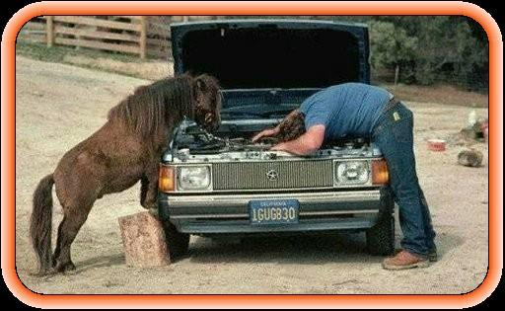
Equine Assisted Counseling with MI Horse and Therapist Partnership

Slide 55
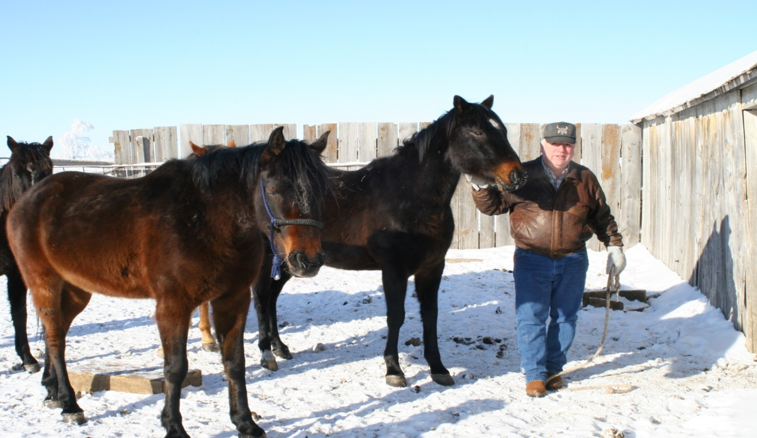
EQUINE THERAPY
Experiential Therapy – “Old Tapes” Family of Origin Issues, Patterns
Rational Emotive Behavioral Therapy – Grief, Anger, Shame, Rejection
Motivational Interviewing Enhanced – Communication and Interaction
Sunka Wakan Assisted Therapy (SWAT)
Spiritual Values Based – Lakota,12 Step and/or Christianity

Slide 56
Horses (Co-Therapist)

Slide 57
MI Lakota Enhanced
Rational Emotive Behavioral Therapy
Irrational Thoughts and Beliefs
Unresolved Anger,
Unresolved Grief,
Toxic Shame
Experiential Therapy
Unconscious to Conscious,
Behavioral Patterns,
Family of origin issues
Spirituality-Values
Motivational Interviewing

Slide 58
Sunka Wakan Assisted Therapy Activities Teach Lakota Values
Gratitude –The horse is a gift.
Respect & Trust are earned.
Courage is gained by overcoming fear.
Humility, unpretentious confidence is developed by negotiating results with horses.
Generosity The more you give the more you get!
Fortitude and Wisdom are developed by learning to:
Set the goal,
Gain knowledge,
Make the commitment,
Implement a plan,
Evaluate the results,
Enjoy the rewards of success.

Slide 59
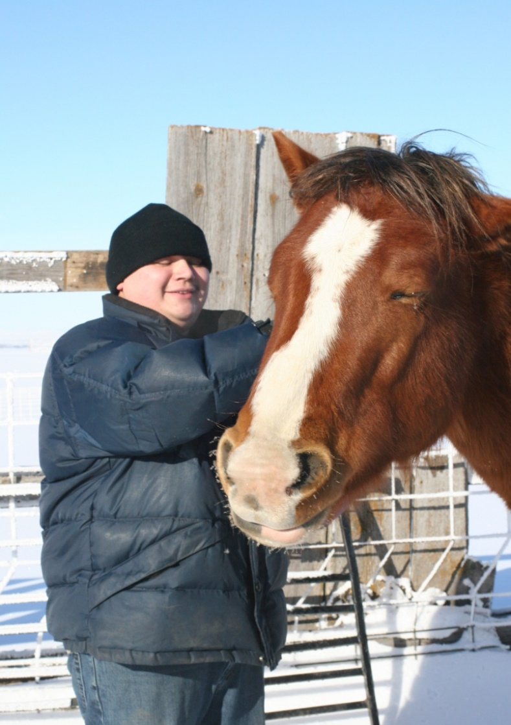
How it Equine Assisted Counseling Works
Horses serve as a mirror to reflect emotions and behavior.
Horses are very perceptive, they are acutely in tune with humans.
How a client interacts with a horse will reveal issues.
The horse will “sense” a client’s thoughts and feelings. The horse gives instant, honest, and objective feedback.
The therapist reads the feedback and observations are shared with the client in group counseling.

Slide 60
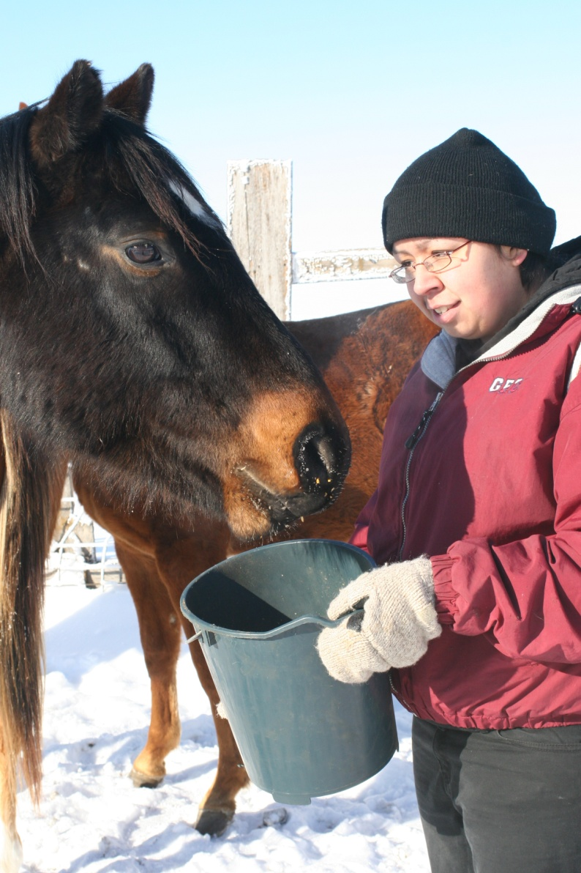
Benefits from Equine Therapy
It’s fascinating and the experience is lasting.
Horses give non-judgmental feedback.
Working with a horse provides an immediate cause/effect experience.
This type of active learning aids retention.
It’s just plain fun to work with horses.

Slide 61
WORKING THE STEPS
WE SUFFER TO GET WELL
GIVE UP CONTROL TO BE UNDER CONTROL
WE SURRENDER TO WIN
WE DIE TO LIVE
WE GIVE IT AWAY TO KEEP IT

Slide 62
WORKING THE STEPS
STEPS ONE THROUGH THREE
THE PARADOX OF CONTROL
STEPS FOUR THROUGH NINE
CLEANING HOUSE
STEPS TEN THROUGH TWELVE
THE DIVINE PARADOX

Slide 63
WORKING THE STEPS
Not free to be honest because most of our “stuff’ is in the unconscious mind
Therefore, it is essential to find a spiritual program that reaches the hidden level
If not, nothing really changes
Need something strong enough to force us to look inside
“Motivational crisis”

Slide 64
WORKING THE STEPS
All hurts, motivations, opinions, and prejudices are stored in the unconscious
Have to go to the “inner room”
We need a spirituality that will move us into the mystical or nonlinear level of consciousness
If not, we are trying to fix the problem using the same mind that is a part of the problem

Slide 65
TWELVE STEPS: CYCLE ONE
1st Step- We admitted we were powerless that our lives had become unmanageable. (ADMIT)
2nd Step- Came to believe that a Power greater than ourselves could restore us to sanity. (ASK)
3rd Step- Made a decision to turn our will and our lives over to the care of God as we understood him. (ACT)
4th Step- Made a searching and fearless moral inventory of ourselves. (ACT)

Slide 66
TWELVE STEPS OF AA:CYCLE TWO
5th Step- Admitted to God, to ourselves, and to another human being the exact nature of our wrongs. (ADMIT)
6th Step- Were entirely ready to have God remove all these defects of character.(ASK)
7th Step- Humbly asked Him to remove our shortcomings. (ASK)
8th Step- Made a list of all persons we had harmed, and became willing to make amends to them all.(ACT)
9th Step- Made direct amends to such people wherever possible, except when to do so would injure them or others.(ACT)

Slide 67
TWELVE STEPS OF AA:CYCLE THREE
10th Step- Continued to take personal inventory and when we were wrong promptly admitted it. (ADMIT)
11th Step- Sought through prayer and meditation to improve our conscious contact with God as we understood Him, praying only for knowledge of His will for us and the power to carry that out. (ASK)
12th Step- Having had a spiritual awakening as the result of these steps, we tried to carry this message to alcoholics, and to practice these principles in all of our affairs. (ACT)

Slide 68
TWELVE STEPS OF AA: PROMISES
Freedom (__)
Happiness (__)
Absence of regrets (__)
Serenity or peacefulness (__)
How much your experience benefits other people (__)
Absence of self-pity (__)
Interest in other people (__)
Absence of selfishness (__)

Slide 69
TWELVE STEPS OF AA: PROMISES
9. A more positive attitude about life (__)
10. Absence of fear of people (__)
11. Absence of fear of economic security (__)
An ability to handle situations that used to be difficult (__)
Awareness of a Higher Power in your life (__)
THE PROMISES ARE THE SYMPTOMS OF RECOVERY

Slide 70
INFORMATION FOR PATIENTS
Screening for Suicide Risk in Adolescents, Adults, and Older Adults in Primary Care (U.S. Preventive Services Task Force) - PDF
Suicide Warning Signs (Substance Abuse and Mental Health Services Administration) - PDF Also in Spanish
Suicide: What to Do When Someone Is Suicidal (Mayo Foundation for Medical Education and Research) Also in Spanish

Slide 71
INFORMATION FOR PATIENTS
After an Attempt: A Guide for Taking Care of Yourself After Your Treatment in the Emergency Department (Substance Abuse and Mental Health Services Administration) - PDF
Are You Thinking about Suicide? How to Stay Safe and Find Treatment (Mayo Foundation for Medical Education and Research)
National Suicide Prevention Lifeline (Substance Abuse and Mental Health Services Administration) Also in Spanish
NIMH Answers Questions about Suicide (National Institute of Mental Health)
Suicide and Suicidal Thoughts (Mayo Foundation for Medical Education and Research) Also in Spanish

Slide 72
REFERENCES
Cozolino, L. (2002). The neuroscience of psychotherapy: Building and rebuilding the human brain, New York: W.W. Norton & Company.
D’Elia, G. (2001). Attachment: A biological basis for the therapeutic relationship. Nordic Journal of Psychiatry, 55, 329–336.
Hertzman, C (1999). The biological embedding of early experiences and its effects on health in adulthood. Annals of the New York Academy of Sciences, 896, 85–95.
Horvath, A., & Symonds, D. (1991). Relation between working alliance and outcome in psychotherapy: A meta-analysis. Journal of Counseling Psychology, 38(2), 139–149.
Horvath, A. (2000). The therapeutic relationship: From transference to alliance. Psychotherapy in Practice, 56(2), 163–173

Slide 73
REFERENCES
Kohut, H. (1977). The restoration of the self, Connecticut: International University Press, Inc: Madison.
Panksepp, J. (1998). Affective neuroscience: The foundations of human and animal emotions, New York: Oxford University Press.
Rogers, C. (1957). The necessary and sufﬁcient conditions of therapeutic personality change. Journal of Consulting Psychology, 64, 95–103.
Rogers, C. (1961). On becoming a person: A therapist’s view of psychotherapy, Boston: Houghton Mifﬂin.
Schore, A. (1994). Affect regulation and the origin of the self: The neurobiology of emotional development, New Jersey: Lawrence Erlbaum Associates.

Slide 74
REFERENCES
Schore, A. (2001b). The effects of early relational trauma on right brain development, affect regulation, and infant mental health. Infant Mental Health Journal, 22(1–2), 201–269.
Schore, A. (2001a). Effects of a secure attachment relationship on right brain development, affect regulation, and infant mental health. Infant Mental Health Journal, 22(1–2), 7– 66.
Schore, A. (2002). The neurobiology of attachment and early personality organization. Journal of Prenatal Psychology and Health, 16(3), 249–263.
Schore, A. (2003). Affect regulation and the repair of the self, New York: W.W. Norton and Company.
Siegel, D. (1999). The developing mind: Toward a neurobiology of interpersonal experience, New York: Guilford Press.
Siegel, D. (2001). Toward an interpersonal neurobiology of the developing mind: Attachment relationships, ‘‘mindsight,’’ and neural integration. Infant Mental Health Journal, 22(1–2), 67–94.

Slide 75
REFERENCES
Strupp, H. (1970). Speciﬁc vs nonspeciﬁc factors in psychotherapy and the problem of control. Archives of General Psychiatry, 23, 393–401.
Van Goozen, S., Matthys, W., Cohen-Kettenis, P., Buitelaar, J., & Van Engeland, H. (2000). Hypothalamic–pituitary–adrenal axis and autonomic nervous system activity in disruptive children and matched controls. Journal of the American Academy of Child and Adolescent Psychiatry, 39(11), 1438–1445.
Butler, S., & Strupp, H. (1986). Speciﬁc and nonspeciﬁc factors in psychotherapy: A problematic paradigm for psychotherapy research. Psychotherapy, 23(1), 30–40.
Martin, D., Garske, J., & Davis, K. (2000). Relation of the therapeutic alliance with outcome and other variables: A meta-analytic review. Journal of Consulting and Clinical Psychology, 68(3), 438–450.

Slide 76
REFERENCES
Cook-Greuter, S. R. (2004). Making the case for a developmental perspective. Industrial and commercial training, 36(7), 275-281.
Dweck, C. S. (2006). Mindset: The new psychology of success. Random House Incorporated.
Kegan, R. (1982). The evolving self: problem and process in human development. Cambridge, MA: Harvard University Press.
Kegan, R. (1994). In over our heads: The mental demands of modern life. Cambridge, MA: Harvard University Press.

Slide 77
REFERENCES
Kegan, R., & Lahey, L. L. (2009). Immunity to change: How to overcome it and unlock potential in yourself and your organization. Boston, MA: Harvard Business Press.
Norcross, J. C. (2001). Purposes, processes and products of the task force on empirically supported therapy relationships. Psychotherapy: Theory, Research, Practice, Training, 38(4), 345.
Panepinto, John C. “Vertical Development: 5 Ways for Practitioners to Grow Personally and Professionally.” Psych Central Professional, 2018.

Slide 78
REFERENCES
Centers for Disease Control and Prevention. 10 leading causes of death by age group, United States – 2016. https://www.cdc.gov/injury/wisqars/pdf/leading_causes_of_death_by_age_group_2016-508.pdf. Accessed November 7, 2018.
2. Walsh CG, Ribeiro JD, Franklin JC. Predicting suicide attempts in adolescents with longitudinal clinical data and machine learning. J Child Psychol Psychiatry. 2018 Apr 30. [Epub ahead of print]
3. Carr MJ, Ashcroft DM, Kontopantelis E, et al. Premature death among primary care patients with a history of self-harm. Ann Fam Med. 2017;15:246-254.
4. National Action Alliance for Suicide Prevention: Research Prioritization Task Force. A prioritized research agenda for suicide prevention: An action plan to save lives. 2014:1-172. www.suicide-research-agenda.org. Accessed November 7, 2018.

Slide 79
REFERENCES
Asarnow JR, Babeva K, Horstmann E. The emergency department: challenges and opportunities for suicide prevention. Child Adolesc Psychiatr Clin N Am. 2017;26:771-783.
Asarnow JR, Baraff LJ, Berk M, et al. An emergency department intervention for linking pediatric suicidal patients to follow-up mental health treatment. Psychiatr Serv. 2011;62:1303-1309.
Ougrin D, Tranah T, Stahl D, et al. Therapeutic interventions for suicide attempts and self-harm in adolescents: systematic review and meta-analysis. J Am Acad Child Adolesc Psychiatry. 2015;54:97-107.e2.
Huey SJ Jr, Henggeler SW, Rowland MD, et al. Multisystemic therapy effects on attempted suicide by youths presenting psychiatric emergencies. J Am Acad Child Adolesc Psychiatry. 2004;43:183-190.
Linehan MM. Diagnosis and Treatment of Mental Disorders. Cognitive-Behavioral Treatment of Borderline Personality Disorder. New York, NY: Guilford Press; 1993.

Slide 80
REFERENCES
Mehlum L, Ramberg M, Tørmoen AJ, et al. Dialectical behavior therapy compared with enhanced usual care for adolescents with repeated suicidal and self-harming behavior: outcomes over a one-year follow-up. J Am Acad Child Adolesc Psychiatry. 2016;55:295-300.
McCauley E, Berk MS, Asarnow JR, et al. Efficacy of dialectical behavior therapy for adolescents at high risk for suicide: a randomized clinical trial. JAMA Psychiatry. 2018;75:777-785.
Haga E, Aas E, Grøholt B, et al. Cost-effectiveness of dialectical behaviour therapy vs. enhanced usual care in the treatment of adolescents with self-harm. Child Adolesc Psychiatry Ment Health. 2018;12:22.
Asarnow, Hughes JL, Babeva KN, Sugar CA. Cognitive-behavioral family treatment for suicide attempt prevention: a randomized controlled trial. J Am Acad Child Adolesc Psychiatry. 2017;56:506-514.
Esposito-Smythers C, Spirito A, Kahler CW, et al. Treatment of co-occurring substance abuse and suicidality among adolescents: a randomized trial. J Consult Clin Psychol. 2011;79:728-739.

Slide 81
REFERENCES
Rossouw TI, Fonagy P. Mentalization-based treatment for self-harm in adolescents: a randomized controlled trial. J Am Acad Child Adolesc Psychiatry. 2012;51:1304-1313.e3
Brent DA. Antidepressants and suicidality. Psychiatr Clin North Am. 2016;39:503-512.
Birmaher B, Brent D; AACAP Work Group on Quality Issues, et al. Practice parameter for the assessment and treatment of children and adolescents with depressive disorders. J Am Acad Child Adolesc Psychiatry. 2007;46:1503-1526.
Lock J, Walker LR, Rickert VI, Katzman DK. Suicidality in adolescents being treated with antidepressant medications and the black box label: position paper of the Society for Adolescent Medicine. J Adolesc Health. 2005;36:92-93.
Brent DA, Brown CH. Effectiveness of school-based suicide prevention programmes. Lancet. 2015;385:1489-1491.

Slide 82
REFERENCES
Centers for Disease Control and Prevention. CDC WISQARS: Leading causes of death reports, 1981–2016. Available from: https://webappa.cdc.gov/sasweb/ncipc/leadcause.html.
2. U.S. Department of Health and Human Services. Healthy People 2020: Mental health status improvement. 2010. Available from: https://www.healthypeople.gov/2020/topics-objectives/topic/ mental-health-and-mental-disorders/objectives.
3. Hedegaard H, Curtin SC, Warner M. Suicide rates in the United States continue to increase. NCHS Data Brief, no 309. Hyattsville, MD: National Center for Health Statistics. 2018. Available from: https://www.cdc.gov/nchs/data/databriefs/db309.pdf.
4. Curtin SC, Warner M, Hedegaard H. Increase in suicide in the United States, 1999–2014. NCHS Data Brief, no 241. Hyattsville, MD: National Center for Health Statistics. 2016. Available from: https://www.cdc.gov/nchs/data/databriefs/db241.pdf.

Slide 83
REFERENCES
Robins E, Murphy GE, Wilkinson RH, et al. Some clinical considerations in the prevention of suicide based on a study of 134 successful suicides. Am J Pub Health. 1959;49:888-899.
Barraclough B, Bunch J, Nelson B, Sainsbury P. A hundred cases of suicide: clinical aspects. Br J Psychiatry. 1974;125:355-373. Pompili M, Rihmer Z, Innamorati M, et al. Assessment and treatment of suicide risk in bipolar disorders. Exp Rev Neurother. 2009;9:109-136.
Baldessarini RJ, Tondo L. Psychopharmacology for suicide prevention. In: Pompili M, ed. Suicide: A Global Perspective. London: Bentham Science Publishers Ltd; 2012.
Angst J, Angst F, Gerber-Werder R, Gamma A. Suicide in 406 mood-disorder patients with and without long-term medication: 40 to 44 years’ follow-up. Arch Suicide Res. 2005;9:279-300.

Slide 84
REFERENCES
Calabrese JR, Keck PE Jr, Macfadden W, et al. A randomized, double-blind, placebo-controlled trial of quetiapine in the treatment of bipolar I or II depression. Am J Psychiatry. 2005;162:1351-1360.
Thase ME, Macfadden W, Weisler RH, et al; BOLDER II Study Group. Efficacy of quetiapine monotherapy in bipolar I and II depression: a double-blind, placebo-controlled study (the BOLDER II study) [published correction appears in J Clin Psychopharmacol. 2007;27:51]. J Clin Psychopharmacol. 2006;26:600-609.
Young AH, McElroy SL, Bauer M, et al; EMBOLDEN I (Trial 001) Investigators. A double-blind, placebo-controlled study of quetiapine and lithium monotherapy in adults in the acute phase of bipolar depression (EMBOLDEN I). J Clin Psychiatry. 2010;71:150-162.

Slide 85
REFERENCES
McElroy SL, Weisler RH, Chang W, et al; EMBOLDEN II (Trial D1447C00134) Investigators. A double-blind, placebo-controlled study of quetiapine and paroxetine as monotherapy in adults with bipolar depression (EMBOLDEN II). J Clin Psychiatry. 2010;71:163-174.
Jamison KR. Suicide and bipolar disorders. Ann N Y Acad Sci. 1986;487:301-315.
Baldessarini RJ, Tondo L, Hennen J. Effects of Lithium treatment and its discontinuation on suicidal behavior in bipolar manic-depressive disorders. J Clin Psychiatry. 1999;60(suppl 2):77-84.

Slide 86
REFERENCES
Alexander BK, Coambs RB, Hadaway PF. The effect of housing and gender on morphine self-administration in rats. Psychopharmacol 1978; 58:175–9.
2. Hadaway PF, Alexander BK, Coambs RB, et al. The effect of housing and gender on preference for morphine-sucrose solutions in rats. Psychopharmacol 1979; 66:87–91.
3. Alexander BK, Beyerstein BL, Hadaway PF, et al. Effect of early and later colony housing on oral ingestion of morphine in rats. Pharmacol Biochem Behav 1981; 15:571–6.

Slide 88
REFERENCES
Brave Heart, M.Y.H. (1999) Gender differences in the historical trauma response among the Lakota. Journal of Health and Social Policy, 10(4), 1-21.
Brave Heart, M.Y.H. & Spicer, P. (1999). The sociocultural context of American Indian Infant Mental Health. World Association of Infant Mental Health Handbook of Infant Mental Health. J.D. Osofsky & H.E. Fitzgerald (Eds.). John Wiley & Sons.
Brave Heart, M.Y.H., & De Bruyn, L. (1998). The American holocaust: Historical unresolved grief among native American Indians. National Center for American Indian and Alaska Native Mental Health Research Journal, 8(2), 56-78.

Slide 89
REFERENCES
Beals, J., Manson, S., Whitesell, N. Spicer, P., Novins, D. & Mitchell, C. (2005). Prevalence of DSM-IV disorders and attendant help-seeking in 2 American Indian reservation populations. Archives of General Psychiatry, 162, 99-108.
• Duran, BM, Sanders, M, Skipper, B, Waitzkin, H, Malcoe, LH, Paine, S, & Yager, J. (2004). Prevalence & correlates of mental disorders among Native American women in primary care. American Journal of Public Health, 94(1), 71-77.
• Shear, K., Frank, E., Houck, P.R., and Reynolds, C.F. Treatment of complicated grief: A randomized controlled trial, 2005, JAMA, 293 (21), 2601-2608.
• Walls, ML. and Whitbeck, LB, (2012). Advantages of Stress Process Approaches for Measuring Historical Trauma. The American Journal of Drug and Alcohol Abuse, 38(5): 416-420

Slide 90
REFERENCES
Brave Heart, M.Y.H., Bird, D.M., Altschul, D., & Crisanti, A. (in process). Wiping the Tears of American Indian and Alaska Native youth: Suicide risk and prevention in J.Ross (Ed), American Indians at Risk.
• Brave Heart, M.Y.H. (2003) The Historical Trauma Response Among Natives and Its Relationship with Substance Abuse: A Lakota Illustration, Journal of Psychoactive Drugs, 35 (1), 7-13.
• Brave Heart, MYH (1998). The return to the sacred path: Healing the historical trauma response among the Lakota. Smith College Studies in Social Work, 68(3), 287305
• Brave Heart, M.Y.H. (1999) Oyate Ptayela: Rebuilding the Lakota Nation through addressing historical trauma among Lakota parents. Journal of Human Behavior and the Social Environment, 2(1/2), 109-126.
Brave Heart, M.Y.H. (2000) Wakiksuyapi: Carrying the historical trauma of the Lakota. Tulane Studies in Social Welfare, 21-22, 245-266.
• www.historicaltrauma.com

