Slide 1
Clinical Evaluation: Assessment
Goals:
Define Assessment Process
Identify Assessment Instruments
Define DSM-5 criteria for Substance Abuse and Dependence, specifiers and multi-axial assessment
Describe ASAM levels of care and diagnostic and dimensional criteria

Slide 2
What is Assessment?
Assessment is the systematic process of interaction with an individual to observe, elicit, and subsequently assemble the relevant information required to deal with his or her case, both immediately and for the foreseeable future
This information gathering interaction with the patient is the clinical building block for everything we do moving forward, without an initial assessment we are flying blind…
Notes:
Purpose of screening is to determine whether an individual needs an assessment.
The purpose of assessment is to gather the detailed information needed to develop a treatment plan that meets the individual needs

Slide 3

Sequential Assessment
Screening
Problem Assessment
Personal Assessment
Notes:
Screening is the process of evaluating the possible presence of a particular problem. This outcome is normally gathered by a simple yes or no.
Assessment is the process of defining that issue, determining a diagnosis, and developing specific recommendations and an individualized treatment plan to address the issue/s or diagnosis.

Slide 4
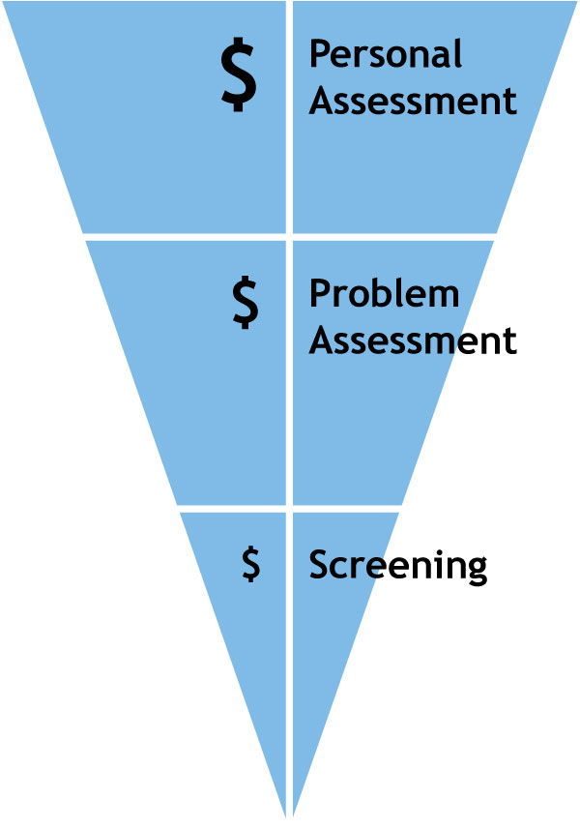
Extent of information vs. cost
Sequential assessment. As one moves from screening to problem assessment to personal assessment, the extent of information developed is greater but the costs of assessment are also greater. Performing an assessment sequentially ensures that further information is necessary and justifies its increased cost (adapted from Skinner, 1981a:30; 1981b:330).
Notes:
From Screening to Assessment, the amount of information and time needed accumulates over time

Slide 5
Multi-dimensional Assessment
Information is sought along 3 dimensions:
The use of alcohol and drugs
The signs and symptoms of alcohol and drug use
The consequences of alcohol and drug use
Notes:
An initial step is to ensure that the patient meets level of care by gathering the patient's medical history, such as previous treatments, current therapy, or prior use.
Including- medical, behavioral, social, and financial
Use- What they are using, amounts, length of time, age of use, how often?
Signs and Symptoms- blackouts, brown outs, meeting social/familial, work obligations
Consequences- Arguments, employment loss, cultural loss, spiritual loss, education loss.
Establishes the severity of an identified problem (i.e., mild, moderate, intermediate, or severe
determine appropriate level of care, Guides treatment planning, Relapse potential or continued use potential

Slide 6

Content of Screening
A brief process that answers two questions:
Whether an alcohol and/or drug problem is present
If so, whether it is likely to require brief intervention or specialized treatment

Slide 7

Quiz Question #1
True or False:
Collateral information when assessing a patient’s needs is rarely required to determine an accurate diagnosis
Notes:
False: Collateral information is vital to help in determining a Dx and course of Tx

Slide 8
Content of Problem Assessment
Examines problems attributable to alcohol and/or drug consumption
Three techniques are available:
Retrospective methods
Prospective methods
Laboratory determinations
Notes:
Retrospective is the past. What led to what is happening now.
Prospective is the future, Possible Outcomes
Lab results, UA’s, Breathalyzers, Swabs, all determined by time and specific factors

Slide 9

Content of Problem Assessment
Signs and symptoms of alcohol and/or drug use disorder (p. 490-491 of DSM-5, the Big Eleven)
These make up DSM-5 criteria
Self-report questionnaires can be used
Notes:
Cross referencing self-reports, with collateral reports (e.g. arrest records), and lab results can often offer a more accurate clinical picture of the patient’s overall AOD use Hx.
11 criterion used to determine SUD severity. Another common Dx for SUDS is Unspecified XX (e.g. Alcohol) –Related Disorder F10.99 (ICD code)

Slide 10
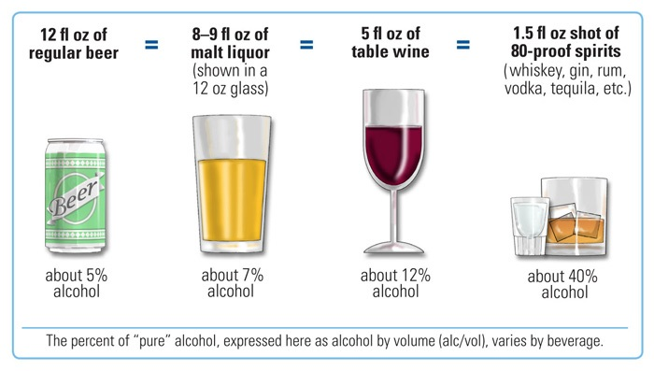
Alcohol Equivalencies and Drinking
Notes:
Remember that the amounts do matter, One drink is not a large bottle or man-can of beer, or glass of liquor.

Slide 11
Content of Problem Assessment
Consequences of alcohol and/or drug use
Examples include:
Michigan Alcoholism Screening Test (MAST)
Drug Abuse Screening Test (DAST)
  Now called: Drug use questionnaire
Alcohol Use Inventory (AUI)
Alcohol Use Disorder Identification Test (AUDIT)
Addiction Severity Index (ASI)
Notes:
MAST, 22 Q, past 12 mos.
Alcohol Use Disorders Identification Test (AUDIT) 10 items
Drug Abuse Screening Test (DAST) 20 questions

Slide 12

Content of Personal Assessment
Examines problems to determine if they are attributable to use
Medical status
Psychiatric status
Vocational issues
Personal problems
Sexual problems
Social support
Family structure
Need for Recovery Support

Slide 13
Content of Personal Assessment (continued)
Use of leisure time
  Exercising
Demographics
Family history
Prior treatment history
Intelligence
Cognitive functioning
Personality
Treatment Goals
Social Stability
Situational Factors
Spirituality
Notes:
Where they come from, population, communities
Cognitive functions encompass reasoning, memory , attention, and language and lead directly to the attainment of information thus, knowledge.

Slide 14
Overview of Assessment Process
Six step process consisting of:
Detection
Classification
Functional Assessment
Functional Analysis
Treatment Planning
Recovery Capital
Notes:
action or process of classifying something according to shared qualities or characteristics.
classifying, grouping, , ranking
approach to figuring out the reasons an individuals behaves certain ways
resources (social, physical, human and cultural, spiritual), which are necessary to begin and maintain recovery
Recovery capital is the depth and breadth of internal and external resources that can be used by someone to begin and sustain wellness from addiction.

Slide 15
Drug screening

Slide 16

Quiz Question #2
What is the most common form of drug screening test performed in most substance abuse treatment centers in the US?
Saliva testing
Blood testing
Urine analysis
Sweat patch
Notes:
Answer: c

Slide 17
Detection
Identify patients with potential problem
Past and current use of alcohol, tobacco or other substances
Lab tests to screen for substance use
Negative consequences
Notes:
Observable issues that indication active use: Are they shaking, having difficulty concentrating?
Looking at this, if a patient is coming off alcohol, they may feel very alert, while substances such as meth, they may be tired.
Can you smell any substances?

Slide 18

Classification
Assess possible DSM diagnoses
Rate worst period of use
Use multiple sources of information
Notes:
DSM can also be used to rule out a SUD.
Often focus on the previous 12 months
Collateral information is key to making an informed, accurate, and objective classification (i.e. SUD diagnosis)

Slide 19
Functional Assessment
Obtain patient information
Use all available collateral sources
Assess the patient’s range of different needs
Identify the patient’s strengths
Identify the patient’s support system
Identify the patient’s recovery capital
Notes:
Strengths can be of use to get patients to remain on track
Culture is seen as a strength. Prevention tool.

Slide 20
Functional Analysis
Identify factors that maintain substance abuse
Explore possible motives
View identified motives and costs as working hypotheses, not facts
Notes:
Family, Friends, home environment, leisure- such as watching games with friends whom use- The game itself may become attributed with use.
Depression- alcohol is a depressant, so it can actually make matters worse.
Recent break-up, divorce, loss of loved one- Reliance upon a crutch or coping tool like this may lead to consequences.

Slide 21

Methods of Obtaining Assessment Information
Face-to-face interviewing
Semi-structured interview and structured interview
Paper-and-pencil tests
Computerized assessments
Notes:
Face to Face allows for the use of micro-counseling skills.
Body language – posture ( Crossing arms, sitting up straight ) Gestures ( hands are expressive), Facial Expression ( anger, fear) Eye movements.
You are gathering comprehensive information; you must try to stay objective and on task during the assessment process.

Slide 22
Assessment Tools

Slide 23
Addiction Severity Index (ASI)
Semi-structured interview assessing:
  Medical status
  Employment and support
  Drug use
  Alcohol use
  Legal status
  Family/social status
  Psychiatric status
Notes:
The ASI is used exclusively in the Accucare system with IHS.
Rule 25 assessment

Slide 24
Comprehensive Drinking Profile (CDP)
Structured intake interview
  History and current status of drinking problems and related manners
  Consumption and problematic behaviors

Slide 25

Timeline Follow-Back (TLFB)
Analyzes:
  Patterns
  Intensity
  Frequency
Connections between use and significant events established
Notes:
Using a calendar or common holidays or seasons can also be an effective means to establish an accurate timeline (i.e temporal anchors)

Slide 26
Inventory of Drinking Situations (IDS)
Assess situations of heavy drinking
Examines 8 categories:
  Negative emotional states
  Urges and temptations
  Negative physical states
  Interpersonal conflict
  Positive emotional states
  Social pressure to drink
  Testing personal control
  Positive social situations

Slide 27
Situational Confidence Questionnaire (SCQ)
Self-report instrument
patients imagine themselves in each situation
  Rate on scale of 0-100, (0=not confident to 100=very confident)
  How likely they will be able to resist the urge to use heavily in that situation

Slide 28

Substance Abuse Subtle Screening Inventory (SASSI)
One-page self report screening
Resistance to faking
Identifies individuals in denial or deliberately trying to conceal chemical dependence

Slide 29
Global Appraisal of Individual Needs (GAIN)
Eight core sections:
Background
Substance use
Physical health
Risk behaviors
Mental health
Environment
Legal
Vocational

Slide 30
DSM-5

Slide 31
Substance-Related Disorders in DSM-5
The DSM-5 chapter on Substance-Related and Addictive Disorders includes 10 substance-related disorders:
  Alcohol-Related Disorders
  Caffeine-Related Disorders
  Cannabis-Related Disorders
  Hallucinogen-Related Disorders
  Inhalant-Related Disorders
  Opioid-Related Disorders
  Sedative-, Hypnotic-, or Anxiolytic-Related Disorders
  Stimulant-Related Disorders
  Tobacco-Related Disorder
  Other Substance-Related Disorders.

Slide 32

Quiz Question #3
How many diagnostic criteria are listed in the DSM-5 in the section for Substance Use Disorders?
9
11
8
None of the above
Notes:
Answer: b) 11

Slide 33
Substance Use Disorders
Almost all substance-related disorders in DSM-5 include:
  Substance use disorders
  Substance intoxication
  Substance withdrawal
Almost all specify that the substance use disorders be rated mild, moderate, or severe.
Exceptions include:
  Caffeine-Use Disorders: no severity ratings
  Hallucinogen-Use Disorders: no intoxication or withdrawal
  Inhalant-Use Disorder: no intoxication
  Tobacco-Use Disorder: no intoxication

Slide 34
Alcohol Use Disorders
Alcohol-Related Disorders include:
  Alcohol Use Disorders (mild, moderate, and severe)
  Alcohol Intoxication
  Alcohol Withdrawal
  Unspecified Alcohol-Related Disorder
The distinction between alcohol abuse and dependence has been eliminated in DSM-5.

Slide 35

Quiz Question #4
If a patient has a diagnosis of Alcohol Use Disorder (Moderate) how many DSM-5 criterion would they need to currently meet?
2-3
4-5
At least 5
6 or more
Notes:
Answer: b

Slide 36
Alcohol Use Disorders
Mild Alcohol Use Disorder
  2-3 symptoms present
Moderate Alcohol Use Disorder
  4-5 symptoms present
Severe Alcohol Use Disorder
  6 or more symptoms present
Notes:
A mild alcohol use disorder reflects the presence of 2-3 symptoms; a moderate alcohol use disorder reflects 4-5 symptoms; a severe alcohol use disorder reflects 6 or more symptoms.
11 DSM-5 symptoms overall.

Slide 37

Alcohol Use Disorder
Alcohol use disorder is a problematic pattern of alcohol use leading to clinically significant impairment or distress, as manifested by:
at least 2 of 11 listed symptoms
occurring within a 12-month period.

Slide 38
Symptoms of Alcohol Use Disorder
Often taking alcohol in larger amounts or over a longer period than intended
  “Even when I go out to a bar or a party having resolved to drink no more than three beers or spend no more than two hours, by the end of the evening I discover I’ve consumed 10 beers over four hours.”
A persistent desire or unsuccessful efforts to cut down or control alcohol use
  “Time and again, I’ve tried to control my drinking, but I’ve never been able to do so.”
Spending a great deal of time in activities necessary to obtain alcohol, use alcohol, or recover from its effects
  “Alcohol takes up a lot of time in my life, what with getting the money to buy it, spending time at bars consuming it and talking to friends, and then getting over whatever hangover I might have developed from my drinking.”

Slide 39

Symptoms of Alcohol Use Disorder
Craving, or a strong desire or urge to use alcohol (New Symptom)
  “When I haven’t been drinking for a day or two, I’ll begin to experience strong craving for alcohol, which stays with me until I take a drink to get rid of the craving.”
Recurrent alcohol use resulting in a failure to fulfill major role obligations at work, school, or home
  “It will sometimes happen that my drinking makes it impossible for me to go to work or take care of my family. This makes me feel terrible, but I still do it. Why?”

Slide 40
Symptoms of Alcohol Use Disorder
Continued alcohol use despite having persistent or recurrent social or interpersonal problems caused or exacerbated by the effects of alcohol
  “Even though I have a tendency to become angry and, sometimes, violent when I’ve been drinking, I continue to drink and then to suffer the consequences of my anger and fights.”
Important social, occupational, or recreational activities are given up or reduced because of alcohol use
  “I used to like to dance and visit with my friends and family but since I’ve started to drink so much, I’ve given up almost everything that doesn’t involve drinking.”
Recurrent alcohol use in situations in which it is physically hazardous
  “I’ve had three OWIs and have been in two accidents because of my drinking in which I was pretty seriously injured. But every time I can drive, I’ve been drinking.”
Notes:
Tolerance, as defined by either of the
following:
a. A need for markedly increased
amounts of alcohol to achieve
intoxication or desired effect.
b. A markedly diminished effect with
continued use of the same amount of
alcohol.

Slide 41

Symptoms of Alcohol Use Disorder
Alcohol use is continued despite knowledge of having a persistent or recurrent physical or psychological problem that is likely to have been caused or exacerbated by alcohol
  “Even though I almost always get very depressed after I’ve been drinking for some time, I continue to drink. I don’t know why. It doesn’t make sense to me.”

Slide 42
Symptoms of Alcohol Use Disorder
Tolerance
A need for markedly increased amounts of alcohol to achieve intoxication or desired effect, or
A markedly diminished effect with continued use of the same amount of alcohol
Withdrawal
The characteristic withdrawal syndrome for alcohol, or
Alcohol (or a closely related substance, such as a benzodiazepine) is taken to relieve or avoid withdrawal symptoms
Notes:
Remember: Withdrawal from Alcohol or Benzodiazepines can be life-threating. Medical stabilization, must be a priority
Benzo tapers are also commonly used to manage acute alcohol withdrawal Sxs

Slide 43
Course Specifiers
DSM-5 simplified Remission Specifiers
Early Remission (patient not meeting any SUD criterion for at least 3 months, but less than 12)
Sustained Remission (not meeting any SUD criterion for at least 12 months)
“Early partial,” “early full,” “sustained partial,” and “sustained full” remission language is removed.

Slide 44
Quiz Question #5
Which of the following substances can cause life threatening physical withdrawal symptoms?
Alcohol
Opioids
Benzodiazepines
a and c
All of the above
Notes:
D

Slide 45
Recovery-Oriented Systems of Care (ROSC)
Notes:
45
Thinking about the future in our field, I see one new trend that holds promise, and that is the recent shift in thinking away from the clinical treatment model and toward recovery and recovery-oriented systems of care. This shift is leading us to see recovery less as an event and more as a process. The recovery paradigm also invites us to move from a narrow focus on the deficits that accompany SUDs to the strengths that come with recovery. We focus less on pathology, more on wellness. We focus not only on recovery from SUDs and its negative effects, but also on recovery of a meaningful life in the community.

Slide 46

Recovery Oriented Systems of Care: A Paradigm Shift
Recovery-Oriented Systems of Care shifts the question from:
“How do we get the patient into treatment?”
To: “How do we support the process of recovery within the person’s environment?”

Slide 47

Quiz Question #6
Which if the following is not a key component of the ROSC approach?
Various support systems need to work separately with the patient
Builds on strengths and resilience of the patient
Offer comprehensive menu of services that can be adjusted to meet the needs of the patient
Adjustable to the patient’s pace and recovery process
Notes:
Answer: a

Slide 48
Recovery Oriented Systems of Care
Treatment agencies are considered one of many resources for the patient
No one source is more important than another
Various support systems need to work together very closely with the patient

Slide 49
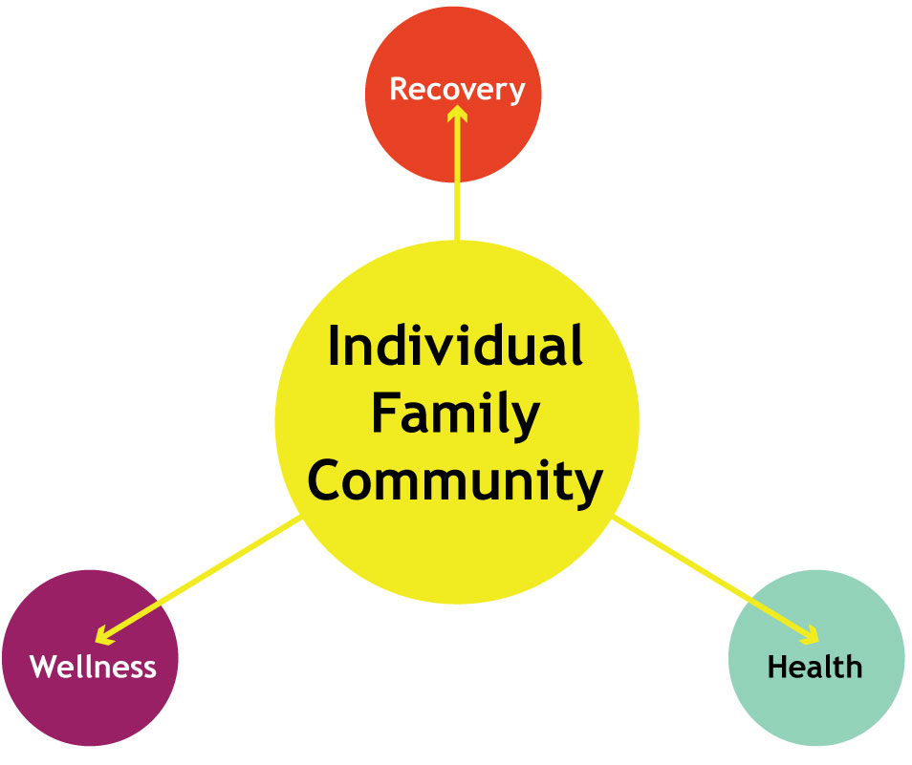
ROSC support person-centered and self-directed approaches to care that build on the personal responsibility, strengths, and resilience of individuals, families and communities to achieve health, wellness, and recovery from substance related disorders

Slide 50
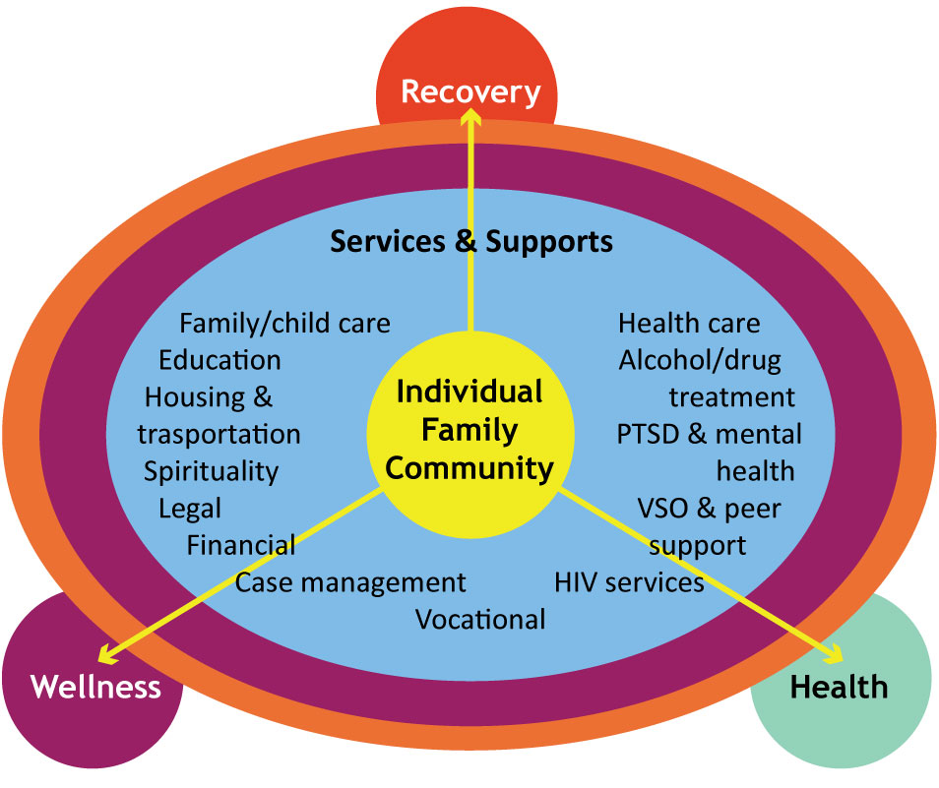
ROSC offer a comprehensive menu of services and supports that can be combined and readily adjusted to meet the individual’s needs and chosen pathways to recovery

Slide 51
Recovery Oriented Systems of Care
Person centered and self-directed care
  Building on strengths and resilience in the patient
  Involving families and communities to take some responsibilities for their health, wellness and recovery from mental illness
  Offer comprehensive menu of services that can be adjusted to meet the needs of the patient
  Adjustable to the patient’s pace and recovery process

Slide 52
Recovery Oriented Systems of Care
Encompass and coordinate the operations of multiple systems, providing responsive, outcomes-driven approaches to care
Require an ongoing process of systems improvement that incorporates the experiences of those in recovery and their family members
Effect our involvement in the assessment process: patient is an equal partner in the assessment process

Slide 53

Elements of
Recovery Oriented Systems of Care
Person centered
  Individualized
  Responsive to culture and personal belief systems
  Community based
  Commitment to peer services
  Involvement of families and other allies
  Ongoing monitoring and outreach

Slide 54
Elements of
Recovery Oriented Systems of Care
Cost effective
  Outcomes oriented
  Integration of services resulting in no duplication of services
  Competency based
  Effective use of collaborators and partners
  System-wide education and training
  Continuum of care
  Research based
  Flexible funding

Slide 55
ASAM Criteria
Dimensions, Risk-ratings, and Levels of Care
Notes:
ASAM (American Society of Addiction Medicine)

Slide 56

Quiz Question #7
What does ASAM stand for?
Association of Substance Abuse Measurement
Addiction Society of American Medicines
American Society of Addiction Medicine
Alternative Source for Addictive Maladies
Notes:
Answer: c

Slide 57
ASAM criteria background
Around 1981, NAATP and ASAM assemble taskforce to integrate two existing admission/continued stay criteria sets:
  The Cleveland Criteria
  The NAATP Criteria
NAATP decided to relinquish any ownership/branding of the criteria
4th Edition is due for release in 2023
Notes:
NAATP= National Association of Addiction Treatment Providers

Slide 58

Goal of the ASAM Criteria:
To unify the addiction field around a single set of criteria

Slide 59
Levels of Care .05 thru 4
Early Intervention (Level .05)
  Pre-treatment (Early Intervention Services)
  Basic Education, risk assessment screening
Outpatient treatment (Level 1, 2.1, and 1)
  Extended Outpatient treatment
  Intensive Outpatient
  Continuing Care Outpatient
Partial Hospitalization (Level 2.5)
Residential/Inpatient treatment (Level 3.1, 3.5, 3.3, 4, and 3.7)
  Low-Intensity Residential treatment
  Medium-Intensity Residential treatment
  High-Intensity Residential treatment
  Medically Monitored Intensive Inpatient treatment
  Detoxification
OTP
  Opioid Treatment Program (Level 1)

Slide 60
ASAM Criteria-Six Dimensions
Dimension 1: Acute intoxication and/or withdrawal
Dimension 2: Biomedical conditions and complications
Dimension 3: Emotional/ behavioral/ cognitive conditions
Dimension 4: Readiness to change
Dimension 5: Relapse, continued use or continued Problem Potential
Dimension 6: Recovery/living environment

Slide 61

Quiz Question #8
Which ASAM Dimension is associated with determining a patient’s willingness to engage in the treatment process?
Dimension 2
Dimension 6
Dimension 1
Dimension 4
None of the above
Notes:
Answer: d Readiness to Change

Slide 62
Risk ratings 0-4a/b
The ASAM risk rating system are based on a 0-4a/4b scale.
This risk ratings act as a guide for Clinician’s, Managed Care Providers, Medical Staff, and support staff.
A rating of 0 may indicate no concerns or stable condition in that given dimension.
A rating of 4a or 4b may indicate a significant concern and the presence of an acute condition(s) in the dimension
Risk rating are based on direct observations, current patient information derived from a multitude of sources as well as historical information from the patient’s records/ self-reports.

Slide 63
ASAM Risk Ratings
When assigning a risk rating in each dimension, remember;
Definition for the assigned risk rating (RR) may not match word for word, just focus on selecting the RR that most accurately reflects the patient’s condition for each dimension at the time of the review (assessment).
RRs are not static, they will likely change over time (i.e. continued stay review), but the RR at the time of your assessment will help decide the best LOC for the patient.
RRs for MHD and SUDs are assigned separately in Dimensions 4, 5, and 6, but will often interact/ influence each other at the time of assessment and/or throughout a patient’s treatment stay.

Slide 64
ASAM Criteria-Six Dimensions and Related Risk Ratings
Dimension 1: Acute intoxication and/or withdrawal
0) The patient is fully functioning and demonstrates good ability to tolerate and cope with withdrawal discomfort. No signs or symptoms of intoxication or withdrawal are present, or signs or symptoms are resolving.
1) The patient demonstrates adequate ability to tolerate and cope with withdrawal discomfort. Mild to moderate intoxication or signs and symptoms interfere with daily functioning, but do not pose an imminent danger to self or others. There is minimal risk of severe withdrawal.
2) The patient has some difﬁculty tolerating and coping with withdrawal discomfort. Intoxication may be severe, but responds to support and treatment sufﬁciently that the patient does not pose an imminent danger to self or others. Moderate signs and symptoms, with moderate risk of severe withdrawal
Notes:
Note for OTP patients:
DM 1/ RR 0- For patients in Opioid Treatment Programs (OTP), the dose is well stabilized, with no opioid intoxication or withdrawal
RR 1- For patients in Opioid Treatment Programs (OTP), the dose is inadequately stabilized, and the patient has mild symptoms of withdrawal, or occasional compensatory use of opioids or other drugs.
RR 2- Opioid Treatment Programs (OTP), the dose is inadequately stabilized, and the patient has moderate symptoms of withdrawal, or frequent compensatory use of opioids or other drugs.

Slide 65

ASAM Criteria-Six Dimensions and Related Risk Ratings
Dimension 1: Acute intoxication and/or withdrawal
3) The patient demonstrates poor ability to tolerate and cope with withdrawal discomfort. Severe signs/symptoms of intoxication indicate that the patient may pose an imminent danger to self or others, and intoxication has not abated at less intensive levels of service. There are severe signs/symptoms of withdrawal, or risk of severe but manageable withdrawal; or withdrawal is worsening despite withdrawal management at a less intensive level of care.
4) The patient is incapacitated, with severe signs and symptoms. Severe withdrawal presents danger, such as seizures. Continued use poses an imminent threat to life
Notes:
Note for OTP:
DM 1/ RR 3- Opioid Treatment Programs (OTP), the dose is inadequately stabilized, and the patient has severe symptoms of withdrawal, or frequent, signiﬁcant, and ongoing compensatory use of opioids or other drugs.
DM 1/ RR 4- Opioid Treatment Programs (OTP), the dose is inadequately stabilized, and the patient has repeated, signiﬁcant concurrent use of opioids or other drugs. Such use is unresponsive to treatment interventions, dose adjustments, and increasing sanctions.

Slide 66
ASAM Criteria-Six Dimensions
Dimension 2: Biomedical conditions and complications
0) The patient is fully functioning and demonstrates good ability to cope with physical discomfort. No biomedical signs or symptoms are present, or biomedical problems
1) The patient demonstrates adequate ability to tolerate and cope with physical discomfort. Mild to moderate signs or symptoms (such as mild to moderate pain) interfere with daily functioning.
2) The patient has some difﬁculty tolerating and coping with physical problems, and/or has other biomedical problems. These problems may interfere with recovery and mental health treatment. The patient neglects to care for serious biomedical problems. Acute, non-life threatening medical signs and symptoms (such as acute episodes of chronic, distracting pain, or signs of malnutrition or electrolyte imbalance) are present.

Slide 67
ASAM Criteria-Six Dimensions
Dimension 2: Biomedical conditions and complications
3) The patient demonstrates poor ability to tolerate and cope with physical problems, and/or his or her general health condition is poor. The patient has serious medical problems, which he or she neglects during outpatient or intensive outpatient treatment. Severe medical problems (such as severe pain requiring medication, or brittle diabetes) are present but stable.
4) The patient is incapacitated, with severe medical problems (such as extreme pain, uncontrolled diabetes, GI bleeding, or infection requiring IV antibiotics).

Slide 68
ASAM Criteria-Six Dimensions
Dimension 3: Emotional, behavioral/cognitive conditions/ complications
0) The patient either has no mental health problems or has a diagnosed but stable mental disorder.
1) The patient has a diagnosed mental disorder that requires intervention but does not signiﬁcantly interfere with addiction treatment.
2) This risk rating implies chronic mental illness, with symptoms and disability that cause signiﬁcant interference with addiction treatment, but do not constitute an immediate threat to safety and do not prevent independent functioning.
Notes:
A risk rating if often only assigned in Dimension 3 if there is a formal MH Dx. The clinician may note concerns related to MH issues, however a risk-rating is only assigned when a formal MH Diagnosis can be confirmed. “have you ever been diagnosed with a MHD by a physician, psychologist, or licensed MH provider?”
Notes for RR 0/ DM-3:
Dangerousness/Lethality: Good impulse control and coping skills.
Interference with Addiction Recovery Efforts: Ability to focus on recovery, identify appropriate supports and reach out for help.
Social Functioning: Full functioning in relationships with signiﬁcant others, coworkers, friends, etc.
Ability for Self-Care: Full functioning, with good resources and skills to cope with emotional problems. Course of Illness: No emotional or behavioral problems, or problems identiﬁed are stable (eg, depression that is stable and managed with antidepressants). No recent serious or high-risk vulnerability.
Notes for RR 1/ DM-3:
Dangerousness/Lethality: Adequate impulse control and coping skills to deal with any thoughts of harm to self or others. Interference with Addiction Recovery Efforts: Emotional concerns relate to negative consequences and effects of addiction. The patient is able to view these as part of addiction and recovery.
Social Functioning: Relationships or spheres of social functioning (as with signiﬁcant others, friends, coworkers) are being impaired but not endangered by patient’s substance use (eg, no imminent divorce, job loss, or coping in homeless situations). The patient is able to meet personal responsibilities and maintain stable, meaningful relationships despite the mild symptoms experienced (eg, mood or anxiety symptoms subthreshold for DSM diagnosis or, if meeting diagnostic criteria, patient is able to continue in essential roles).
Ability for Self-Care: Adequate resources and skills to cope with emotional or behavioral problems.
Course of Illness: Mild to moderate signs and symptoms (eg, dysphoria, relationship problems, work or school problems, or problems coping in the community) with good response to treatment in the past. Any past serious problems have a long period of stability (eg, serious depression and suicidal behavior 15 years ago) or past problems are chronic but not severe enough to pose any high-risk vulnerability (eg, superﬁcial wrist scratching, but no previous hospitalization or life-threatening behavior).
Notes for RR 2/ DM-3:
Dangerousness/Lethality: Suicidal ideation; violent impulses; signiﬁcant history of suicidal or violent behavior requires more than routine monitoring.
Interference with Addiction Recovery Efforts: Emotional, behavioral, or cognitive problems distract the patient from recovery efforts.
Social Functioning: Relationships or spheres of social functioning (as with signiﬁcant others, friends, coworkers) are being impaired by substance use, but also are linked to a psychiatric disorder (eg, a patient with depression or anxiety disorder is unable to sleep or socialize). Symptoms are causing moderate difﬁculty in managing relationships with signiﬁcant others; social, work, or school functioning; or coping in the community, but not to a degree that they pose a signiﬁcant danger to self or others, or that the patient is unable to manage activities of daily living or basic responsibilities in the home, work, school, or community.
Ability for Self-Care: Poor resources, with moderate or minimal skills to cope with emotional or behavioral problems. Course of Illness: Frequent and/or intensive symptoms (eg, frequent suicidal or homicidal ideation, vegetative signs, agitation or retardation, inconsistent impulse control), with a history that indicates signiﬁcant problems that are not well stabilized (eg, psychotic episodes with frequent periods of decompensation). Acute or acute-on-chronic problems pose some risk of harm to self or others, but the patient is not imminently dangerous (eg, hallucinations and delusions invoke homicidal ideation, but the patient has no plan or means to harm others).

Slide 69

ASAM Criteria-Six Dimensions
Dimension 3: Emotional, behavioral/cognitive conditions/ complications
3) This risk rating is characterized by severe psychiatric symptomatology, disability, and impulsivity, but the patient has sufficient control that he or she does not require involuntary conﬁnement.
4) Patients have severe psychiatric symptomatology, disability, and impulsivity, and require involuntary conﬁnement.
Notes:
A risk rating is only assigned in Dimension 3 if there is a formal MH Dx. The clinician may note concerns related to MH issues; however a risk-rating is only assigned when a formal MH Diagnosis can be confirmed. “have you ever been diagnosed with a MHD by a physician, psychologist, or licensed MH provider?”
Notes for RR 3/ DM-3:
Dangerousness/Lethality: Suicidal ideation; violent impulses; signiﬁcant history of suicidal or violent behavior requires more than routine monitoring.
Interference with Addiction Recovery Efforts: Emotional, behavioral, or cognitive problems distract the patient from recovery efforts.
Social Functioning: Relationships or spheres of social functioning (as with signiﬁcant others, friends, coworkers) are being impaired by substance use, but also are linked to a psychiatric disorder (eg, a patient with depression or anxiety disorder is unable to sleep or socialize). Symptoms are causing moderate difﬁculty in managing relationships with signiﬁcant others; social, work, or school functioning; or coping in the community, but not to a degree that they pose a signiﬁcant danger to self or others, or that the patient is unable to manage activities of daily living or basic responsibilities in the home, work, school, or community.
Ability for Self-Care: Poor resources, with moderate or minimal skills to cope with emotional or behavioral problems.
Course of Illness: Frequent and/or intensive symptoms (eg, frequent suicidal or homicidal ideation, vegetative signs, agitation or retardation, inconsistent impulse control), with a history that indicates signiﬁcant problems that are not well stabilized (eg, psychotic episodes with frequent periods of decompensation). Acute or acute-on-chronic problems pose some risk of harm to self or others, but the patient is not imminently dangerous (eg, hallucinations and delusions invoke homicidal ideation, but the patient has no plan or means to harm others).
Notes for RR 4/ DM-3:
Dangerousness/Lethality: Severe psychotic, mood, or personality disorder, which presents acute risk to the patient, such as immediate risk of suicide; psychosis with unpredictable, disorganized, or violent behavior; or gross neglect of self-care.
Interference with Addiction Recovery Efforts: Risk in this domain does not inﬂuence type and intensity of services needed.
Social Functioning: Risk in this domain does not inﬂuence type and intensity of services needed.
Ability for Self-Care: Risk in this domain does not inﬂuence type and intensity of services needed.
Course of Illness: High risk and signiﬁcant vulnerability for dangerous consequences. The patient exhibits severe and acute life-threatening symptoms (eg, dangerous or impulsive behavior or cognitive functioning) that pose imminent danger to self or others. Symptoms of psychosis include command hallucinations or paranoid delusions. History of instability is such that high intensity services are needed to prevent dangerous consequences (eg, the patient is not responding to daily changes in medication at less intensive levels of service, with escalating psychosis).

Slide 70
ASAM Criteria-Six Dimensions
Dimension 4: Readiness to change (RR for SUD and MHD
0) Substance Use Disorders: The patient is willingly engaged in treatment as a proactive, responsible participant, and is committed to changing his or her alcohol, tobacco, and/or other drug use.
Mental Health Disorders: The patient is willingly engaged in treatment as a proactive, responsible participant, and is committed to changing his or her mental functioning and behavior.
1) Substance Use Disorders: The patient is willing to enter treatment and to explore strategies for changing his or her substance use, but is ambivalent about the need for change. He or she is willing to explore the need for treatment and strategies to reduce or stop substance use. Or the patient is willing to change his or her substance use, but believes it will not be difﬁcult to do so, or does not accept a full recovery treatment plan.
Mental Health Disorders: The patient is willing to enter treatment and to explore strategies for changing his or her mental functioning, but is ambivalent about the need for change. He or she is willing to explore the need for treatment and strategies to deal with mental disorders. The patient’s participation in mental health treatment is sufﬁcient to avert mental decompensation.
Notes:
(Consider assigning both a SUD and MHD risk-rating, if a formal MHD is noted in Dimension 3)

Slide 71
ASAM Criteria-Six Dimensions
Dimension 4: Readiness to change (RR for SUD and MHD)
2) Substance Use Disorders: The patient is reluctant to agree to treatment for substance use problems. He or she is able to articulate the negative consequences of substance use, but has low commitment to change his or her use of alcohol or other drugs. The patient is assessed as having low readiness to change and is only passively involved in treatment, and is variably compliant with attendance at outpatient sessions or meetings of self/mutual help or other support groups.
Mental Health Disorders: The patient is reluctant to agree to treatment for mental disorders. He or she is able to articulate the negative consequences of his or her mental health problems, but has low commitment to therapy. The patient is assessed as having low readiness to change and is only passively involved in treatment (eg, is variable in follow through with use of psychotropic medications or attendance at therapy sessions).
Notes:
(Consider assigning both a SUD and MHD risk-rating, if a formal MHD is noted in Dimension 3)

Slide 72
ASAM Criteria-Six Dimensions
Dimension 4: Readiness to change
3) Substance Use Disorders: The patient exhibits inconsistent follow through and shows minimal awareness of his or her substance use disorder and need for treatment. He or she appears unaware of the need to change, and thus is unwilling or only partially able to follow through with treatment recommendations.
Mental Health Disorders: The patient exhibits inconsistent follow through and shows minimal awareness of his or her mental disorder and need for treatment. He or she appears unaware of the need to change, and thus is unwilling or only partially able to follow through with treatment recommendations.
Notes:
(Consider assigning both a SUD and MH risk-rating, if a formal MHD is noted in Dimension 3)

Slide 73
ASAM Criteria-Six Dimensions
Dimension 4: Readiness to change
4a) Substance Use Disorders: The patient is unable to follow through, has little or no awareness of substance use problems and any associated negative consequences, knows very little about addiction, and sees no connection between his/ her suffering and substance use. He or she is not imminently dangerous or unable to care for self, and is not willing to explore change regarding his or her illness and its implications (for example, he or she blames others for legal or family problems, and rejects treatment).
Mental Health Disorders: The patient is unable to follow through, has little or no awareness of a mental disorder and any associated negative consequences, knows very little about mental illness, and sees no connection between his or her suffering and mental health problems. He or she is not imminently dangerous or unable to care for self, is not willing to explore change regarding his or her illness and its implications.
Notes:
(Consider assigning both a SUD and MH risk-rating, if a formal MHD is noted in Dimension 3)

Slide 74
ASAM Criteria-Six Dimensions
Dimension 4: Readiness to change
4b) Substance Use Disorders: The patient is unable to follow through with treatment recommendations. As a result, his or her behavior represents an imminent danger of harm to self or others, or he or she is unable to function independently and engage in self-care. For example, the patient repeatedly demonstrates inability to follow through with treatment, continues to use alcohol and/or other drugs, and to become violent, suicidal, or to drive dangerously.
Mental Health Disorders: The patient is unable to follow through with treatment recommendations. As a result, his or her behavior represents an imminent danger of harm to self or others, or he or she is unable to function independently and engage in self-care. For example, the patient refuses all medications and is overtly psychotic, so that his or her judgment and impulse control is severely impaired.
Notes:
(Consider assigning both a SUD and MH risk-rating, if a formal MHD is noted in Dimension 3)

Slide 75
ASAM Criteria-Six Dimensions
Dimension 5: Relapse, continued use or continued Problem Potential
0) Substance Use Disorders: The patient has no potential for further substance use problems or has low relapse potential and good coping skills.
Mental Health Disorders: The patient has no potential for further mental health problems or has low potential and good coping skills.
1) Substance Use Disorders: The patient has minimal relapse potential, with some vulnerability, and has fair self-management and relapse prevention skills.
Mental Health Disorders: The patient has minimal relapse potential, with some vulnerability, and has fair self-management and relapse prevention skills.

Slide 76
ASAM Criteria-Six Dimensions
Dimension 5: Relapse, continued use or continued Problem Potential
2) Substance Use Disorders: The patient has impaired recognition and understanding of substance use relapse issues, but is able to self-manage with prompting.
Mental Health Disorders: The patient has impaired recognition and understanding of mental illness relapse issues, but is able to self-manage with prompting.
3) Substance Use Disorders: The patient has little recognition and understanding of substance use relapse issues, and has poor skills to cope with and interrupt addiction problems, or to avoid or limit relapse.
Mental Health Disorders: The patient has little recognition and understanding of mental illness relapse issues, and has poor skills to cope with and interrupt mental health problems, or to avoid or limit relapse.

Slide 77

ASAM Criteria-Six Dimensions
Dimension 5: Relapse, continued use or continued Problem Potential
4a) Substance Use Disorders: Repeated treatment episodes have had little positive effect on the patient’s functioning. He or she has no skills to cope with and interrupt addiction problems, or to prevent or limit relapse. However, the patient is not in imminent danger and is able to care for self.
Mental Health Disorders: Repeated treatment episodes have had little positive effect on the patient’s functioning. He or she has no skills to cope with and interrupt mental health problems, or to prevent or limit relapse. However, the patient is not in imminent danger and is able to care for self.

Slide 78
ASAM Criteria-Six Dimensions
Dimension 5: Relapse, continued use or continued Problem Potential
4b) Substance Use Disorders: The patient has no skills to arrest the addictive disorder, or to prevent relapse to substance use. His or her continued addictive behavior places the patient and/or others in imminent danger.
Mental Health Disorders: The patient has no skills to arrest the mental illness, or to prevent relapse to mental health problems. His or her continued psychiatric disorder places the patient and/or others in imminent danger.

Slide 79
ASAM Criteria-Six Dimensions
Dimension 6: Recovery/living environment
0) Substance Use Disorders: The patient has a supportive environment or is able to cope with poor supports.
Mental Health Disorders: The patient has a supportive environment or is able to cope with poor supports.
1) Substance Use Disorders: The patient has passive support, or signiﬁcant others are not interested in his or her addiction recovery, but he or she is not too distracted by this situation and is able to cope.
Mental Health Disorders: The patient has passive support, or signiﬁcant others are not interested in an improved mental health environment, but he or she is not too distracted by this situation and is able to cope.

Slide 80

ASAM Criteria-Six Dimensions
Dimension 6: Recovery/living environment
2) Substance Use Disorders: The patient’s environment is not supportive of addiction recovery, but, with clinical structure, the patient is able to cope most of the time.
Mental Health Disorders: The patient’s environment is not supportive of good mental health, but, with clinical structure, the patient is able to cope most of the time.

Slide 81
ASAM Criteria-Six Dimensions
Dimension 6: Recovery/living environment
3): Substance Use Disorders: The patient’s environment is not supportive of addiction recovery and he/she ﬁnds coping difficult, even with clinical structure.
Mental Health Disorders: The patient’s environment is not supportive of good mental health and he/she finds coping difficult, even with clinical structure.

Slide 82
ASAM Criteria-Six Dimensions
Dimension 6: Recovery/living environment
4a) Substance Use Disorders: The patient’s environment is not supportive and is chronically hostile and toxic to addiction recovery or treatment progress (eg, the patient has many drug-using friends, or drugs are readily available in the home environment, or there are chronic lifestyle problems but not acute conditions). The patient is unable to cope with the negative effects of this environment on his or her recovery.
Mental Health Disorders: The patient’s environment is not supportive and is chronically hostile and toxic to good mental health (eg, the patient is homeless and unemployed and has chronic lifestyle problems but not acute conditions). The patient is unable to cope with the negative effects of this environment on his or her recovery.

Slide 83
ASAM Criteria-Six Dimensions
Dimension 6: Recovery/living environment
4b) Substance Use Disorders: The patient’s environment is not supportive and is actively hostile to addiction recovery, posing an immediate threat to the patient’s safety and wellbeing.
Mental Health Disorders: The patient’s environment is not supportive or is actively hostile to a safe mental health environment, posing an immediate threat to the patient’s safety and well-being.

Slide 84

Quiz Question #9
True or False:
ASAM’s 6 dimensions and 0-4 risk-rating system are designed as a stand-alone assessment tool to guide the clinician in determining diagnosis and course of treatment
Notes:
Answer: False ASAM criteria is designed a supplemental set of standardized guidelines to assist the clinician in the LOC placement needs and course of treatment. Further, it allows for the clinician to monitor patient progress, justify LOC changes including a referral to a higher LOC or discharge/ transfer from current LOC.

Slide 85
Levels of Care-
Level 0.5 Early Intervention
One-on-one counseling and educational programs
Patients do not meet criteria for Substance-Related Disorder
Problems in Dimensions 1, 2 or 3 are stable or being addressed
Notes:
4-week EIS group, mostly pyscho-educational with a therapeutic component, including family involvement and/or drug screening.

Slide 86
Levels of Care:
Level 1- Outpatient Treatment
Therapies include:
Individual and group counseling
Motivational enhancement
Opioid substitution therapy
Family therapy
Educational groups
Occupational and recreational therapy
Psychotherapy
Other therapies

Slide 87
Level 1- Outpatient Treatment
Dimensional Admission Criteria
Dimension 1: RR (0) No withdrawal Sxs
Dimension 2: RR (0) Biomedical concerns stable
Dimension 3: (RR 0-2)
  0- Diagnosed but stable mental disorder or NO mental health diagnosis
  1- Mental disorder requires intervention, but does not interfere with addiction treatment
  2- Persistent mental illness, with symptoms and disability that cause significant interference with addiction treatment,

Slide 88
Level 1- Outpatient Treatment
Dimensional Admission Criteria
Dimension 4: RR 0-2
  0-Willingly engaged in treatment as a proactive, responsible participant
  1- Willing to enter treatment, and to explore strategies for changing substance use and/or tobacco, but ambivalent about the need for change
  2- Reluctant to treatment, low commitment to change substance use, variably compliant with attendance

Slide 89
Level 1- Outpatient Treatment
Dimensional Admission Criteria
Dimension 5: RR 0-2
  0- No potential for further SA problems or has low relapse potential and good coping skills.
  1-Minimal relapse potential, with some vulnerability, fair self-management and relapse prevention skills.
  2- Impaired recognition and understanding of SA relapse issues but can self manage with prompting.

Slide 90
Level 1- Outpatient Treatment
Dimensional Admission Criteria
Dimension 6: RR 0-2
  0-Client has a supportive environment or can cope with poor supports.
  1-Passive Support or significant others not interested in recovery efforts; client can cope.
  2-Client’s environment non-supportive of addition recovery, but, with clinical structure, client can cope most of the time.
Notes:
Think of this dimension from a bio-pyscho-social-spiritual perspective

Slide 91

Level 2.1 Intensive Outpatient
Dimensional Admission Criteria
Dimension 1: RR 0-1
0-No withdrawal signs or symptoms
1-adequate ability to cope with withdrawal discomfort
Dimension 2: RR 0-1
0-Biomedical stable or monitored concurrently with no interference
1- adequate ability to cope with physical discomfort

Slide 92
Level 2.1 Intensive Outpatient
Dimensional Admission Criteria
Dimension 3: RR 2-3
  2- Persistent MHD with symptoms, but does not interfere with addiction treatment
  3- Diagnosed severe emotional, behavioral or cognitive disorder that not require involuntary confinement
Dimension 4: RR 2-3
  2- Reluctant to treatment, low commitment to change substance use, variable
  3- Inconsistent follow through, minimal awareness of substance disorder, unaware of need to change, unwilling or partially able to follow through
Notes:
Remember; these are guidelines to assist you in making the best treatment recommendation during the assessment process. There will always be exceptions to the guidelines

Slide 93
Level 2.1 Intensive Outpatient
Dimensional Admission Criteria
Dimension 5: RR 2-3
  2- Impaired recognition and understanding of SA relapse issues but is able to self manage with prompting.
  3- Little recognition and understanding of SA relapse issues, poor skills to cope with and interrupt addiction problems or to avoid or limit relapse
Dimension 6: RR 2-3
  2- Client’s environment non-supportive of addition recovery, but, with clinical structure, client can cope most of the time.
  3- Client’s environment non-supportive of addiction recovery, client finds coping difficult even with clinical structure.

Slide 94
Level 3.5-3.7 Residential’ Detox
Dimensional Admission Criteria
Dimension 1: RR 2-4
  2- Difficult coping with withdrawal discomfort
  3- Poor ability to cope with withdrawal discomfort
  4- Incapacitated with severe signs and symptoms
Dimension 2: RR 0-4
  0- Fully functioning good ability to cope with physical discomfort
  1- Ability to cope with physical discomfort
  2- Difficulty coping with physical problems and or has other biomedical problems
  3- Poor ability to tolerate physical problems
  4- Incapacitated , with severe medical problems
Notes:
Note: Often detoxification protocols are required when assessing a 3.5 residential recommendations

Slide 95
Level 3.5 Residential
Dimensional Admission Criteria
Dimension 3: RR 1-3
  1- Mental disorder requires intervention, not interfering with Tx
  2- Persistent mental health issue
  3- Severe psychiatric symptomatology
Dimension 4: RR 2-4
  2- Reluctant to treatment low commitment to change
  3- Inconsistent follow through , minimal awareness of substance use disorder
  4- Unable to follow through, has little or no awareness of substance use disorder

Slide 96
Level 3.5 Residential
Dimensional Admission Criteria
Dimension 5: RR 2-4
  2- Impaired recognition and understanding of substance use disorder relapse issues
  3- Little recognition and understanding of substance use disorder relapse issues
  4- Repeated treatment episodes have had little positive effect on patient functioning
Dimension 6: 2-4
  2- Patient environment non supportive of recovery, but can cope with clinical structure
  3- Patient environment non supportive of recovery, patient finds coping difficult
  4- Non supportive chronically hostile, toxic to recovery

Slide 97
Withdrawal Management Overview
Components of WM Services: WM services (Levels 1, 2, 3.2, 3.7 and 4 in ASAM) are provided as part of a continuum of five WM levels in the American Society of Addiction Medicine (ASAM).
WM criteria include a continuum of care that ensures that patients can enter SUD treatment at a level appropriate to their needs and step up or down to a different intensity of treatment levels.

Slide 98
Withdrawal Management (cont.)
Intake: The process of admitting a patient into a substance use disorder (SUD) treatment program. This includes the substance abuse evaluation (SAE), the diagnosis of SUD, the assessment of treatment needs, and may include a physical examination and/or laboratory testing
Observation: The process of monitoring the patient’s course of withdrawal as frequently as deemed medically appropriate. This may include, but is not limited to, observation of the patient’s health status.
Medication Services: The prescription or administration related to SUD treatment services, and/or the assessment of the side effects and results of that medication.
Discharge Services: Preparing the patient for referral into another level of care, post treatment return, or re-entry into the community, and/or the linkage of the individual to community treatment, housing, and human services.

Slide 99

Withdrawal Management (cont.)
Licensing and Certification Requirements;
In order to provide withdrawal management/detoxification services providers must obtain specific licensing and certification requirements according to the level of service provided.
Notes:
Notes: Example- 3.7 – WM Medically Monitored Inpatient Withdrawal Management
Severe withdrawal, needs 24- hour nursing care & physician visits; unlikely to complete withdrawal management without medical monitoring.
Chemical Dependency Recovery Hospital or Free-Standing Psychiatric Hospital
Licensure by Department of Public Health

Slide 100
ASAM risk ratings and LOC
General ASAM RR (Risk Rating)guidelines are as follows:
  RR 0-1 = .05 EIS or Level 1 Continuing Care
  RR 1-2 = Level 1 EOP
  RR 2-3 = Level 2.1 IOP
  RR 3-4a/4b = 3.5 Residential
Notes:
ASAM risk ratings can assist the evaluator in making consistent, accurate, and objective decisions about patient’s level of care and related treatment services.
Note: There will always be exceptions to these guidelines, but using the risk ratings in your assessments will provide you with an additional layer of insight when determining your patient’s immediate treatment needs (Here and now)

Slide 101
Clinical Evaluation: Assessment
Summary
Assessment Process
Assessment Instruments
DSM-5 Diagnostic criteria
ASAM Levels of Care and Criteria
Assessment Process
Assessment Instruments
DSM-5 Diagnostic criteria
ASAM Levels of Care and Criteria

Slide 102

Quiz Question #10
If a patient has at least one RR of “3” which LOTC should be considered during your assessment process?
Level 2.1 (Intensive Outpatient)
Level 1 (Extended Outpatient)
Level 3.5 (Residential)
Level .05 (Early Intervention)
Notes:
Answer: a (Intensive Outpatient)

Slide 103

Questions?
Comments?
Thoughts?
Ideas?

Slide 104
References
American Psychiatric Association. (2013). Diagnostic and Statistical Manual of Mental Disorders (5th ed.)
American Society of Addiction Medicine (2013) The ASAM Criteria, Treatment Criteria for Addictive Substance-Related and Co-Occurring Conditions (3rd ed.)
https://www.asam.org/education/live-online-cme/fundamentals-program
https://www.eventscribe.com/2020/ASAM/
https://www.eventscribe.com/2019/ASAMReviewCourse/
https://www.davidmeelee.com
https://www.ASAMCriteria.org
https://www.asamcontinuum.org
https://instituteforwellness.com

