Slide 1
Easier Together:
Partnering with Families to
Make Recovery Possible
Notes:
Welcome to Module 3 of “Easier Together: Partnering with Families to Make Recovery Possible.”

Slide 2
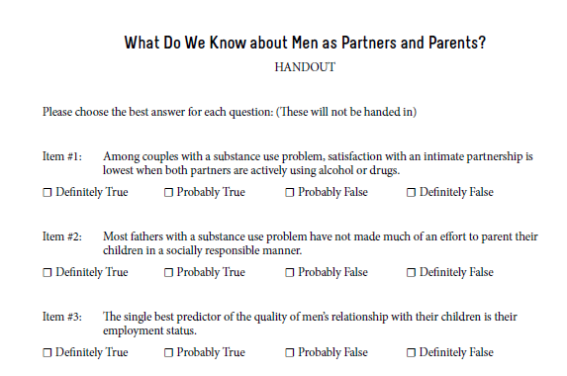
Please complete questionnaire:
“What do we know about men as partners and parents?”
Pages 92- 93 in participant manual
Notes:
While we are waiting for everyone to join us, please complete the checklist, “What do we know about men as partners and parents?” on pages 92-93 of the participant manual. We will review the results of this checklist later in the module.

Slide 3
Module 3:
Building Programs for Fathers
Notes:
During Module 3, we are going to discuss why it is important to engage fathers, review the evidence base for involving them, and identify considerations and cautions when developing programming for fathers.

Slide 4
Acknowledgements
Thomas McMahon, PhD Yale University School of Medicine
Notes:
Our thanks to Thomas McMahon, PhD for his expertise, guidance, and many contributions in the development of this module. Dr. McMahon is a Professor in Psychiatry and the Child Study Center at the Yale University School of Medicine. Dr. McMahon is interested in ways in which the principles of developmental psychopathology can be used to expand understanding of the impact that parental addiction has on family process and child development. He has worked on the development of gender-specific parent interventions for men enrolled in addiction treatment. Dr. McMahon is also interested in the psychological assessment and treatment of children, adolescents, and young adults who have been abused or neglected in the context of parental addiction, as well as clinical and research training on the roles that genetic liability and family process play in the intergenerational transmission of developmental psychopathology. Dr. McMahon completed his doctoral training in clinical child and school psychology at New York University in 1994. Since 1998, he has been the recipient of several grants from the National Institute on Drug Abuse. With his colleagues, he has published more than 75 peer-reviewed papers and book chapters.

Slide 5
Introductions
Name
Field
One word to describe “father”
Notes:
Before we get started, I’d like to do some brief introductions.
Trainer: introduce yourself
Now I’d like everyone to introduce yourself and share the first word you think of to describe the word “father.”
Have everyone say their name and one word to describe a “father.”
Instruction to trainer: based on the group, you’re welcome to modify this introduction activity.

Slide 6
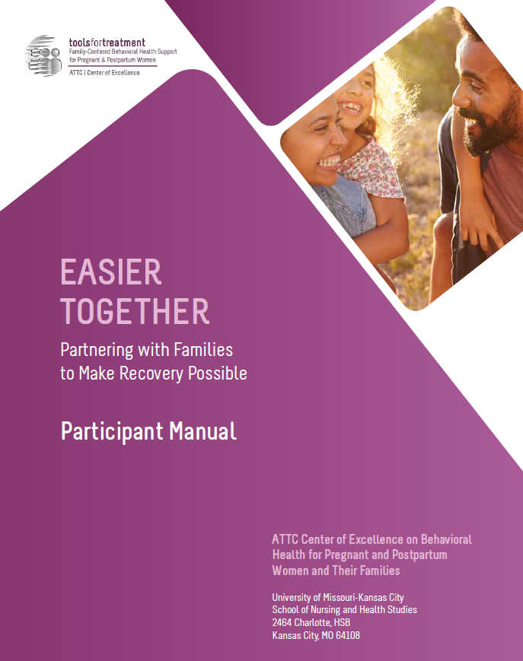
Hands-On Review of Participant Manual
Participant Manual
Each module contains:
Training goals and objectives
Copy of slides
Resources – worksheets, activities, assessments, recommended reading, reference list
Notes:
As part of this curriculum, you all have a participant manual. I’d like us to do a hands-on review of this module’s content so you are familiar:
On page 74, the module begins with the training goals and objectives.
Next on page 75 you will find all of the presentation slides with room for taking notes.
Then on page 90 you will find the resources section, which contains a collection of handouts, worksheets, activities, assessments, recommended reading, and a reference list for that module.

Slide 7
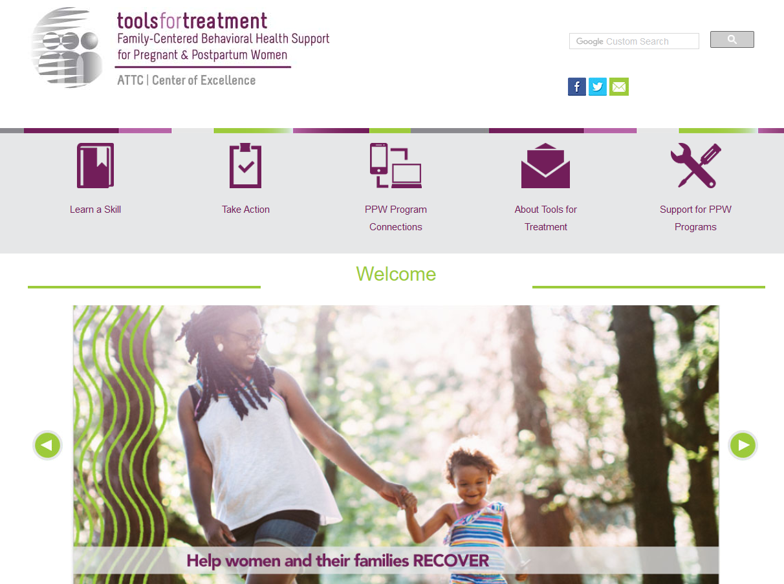
Visit www.attcppwtools.org for More Resources
Training Curriculum
Online Courses
300+ Program Resources Library
Recorded Presentations
Videos
Notes:
For additional resources, visit www.attcppwtools.org. Here you can download the “Easier Together” curriculum and access other resources such as:
Training curriculum
Online courses
300+ resources in the Program Resources library
Recorded presentations
Videos

Slide 8
Goal and Objectives
Goal: Help programs begin to meet expectations for programming that addresses the needs of fathers/male partners and co-parents.
Objectives: Participants will be able to:
Explain why engaging fathers is important.
Describe the evidence base for involving fathers, male co-parents, and male partners.
List considerations and cautions when developing programming.
Notes:
The goal of this module is to help programs begin to meet expectations for PPW programming that addresses the needs of fathers/male partners and co-parents.
These are our learning objectives for Module 3.

Slide 9
New PPW Goals
From Purpose (2017 FOA p.5)
“…Services should be extended, when deemed appropriate, to fathers of the children…”
From Required Activities (2017 FOA p.7)
“Implement service(s) or practice(s), including strategies to stabilize, strengthen, preserve, and reunite families, for the women, their minor children, fathers of the children…”
From Purpose (2017 FOA p.5)
“Increase the number of fathers reunited with their children… Increase the number of individualized/family service plans that include engagement and active involvement of fathers of the children…”
Notes:
Given the changes in the field, PPW funding and programming now includes a focus on reaching the whole family. Particular emphasis is being placed on the development of ways to more effectively involve the fathers of the clients’ children. This emphasis is evident throughout the most recent funding opportunity announcement (FOA) issued by SAMHSA for continued funding of the PPW program.

Slide 10
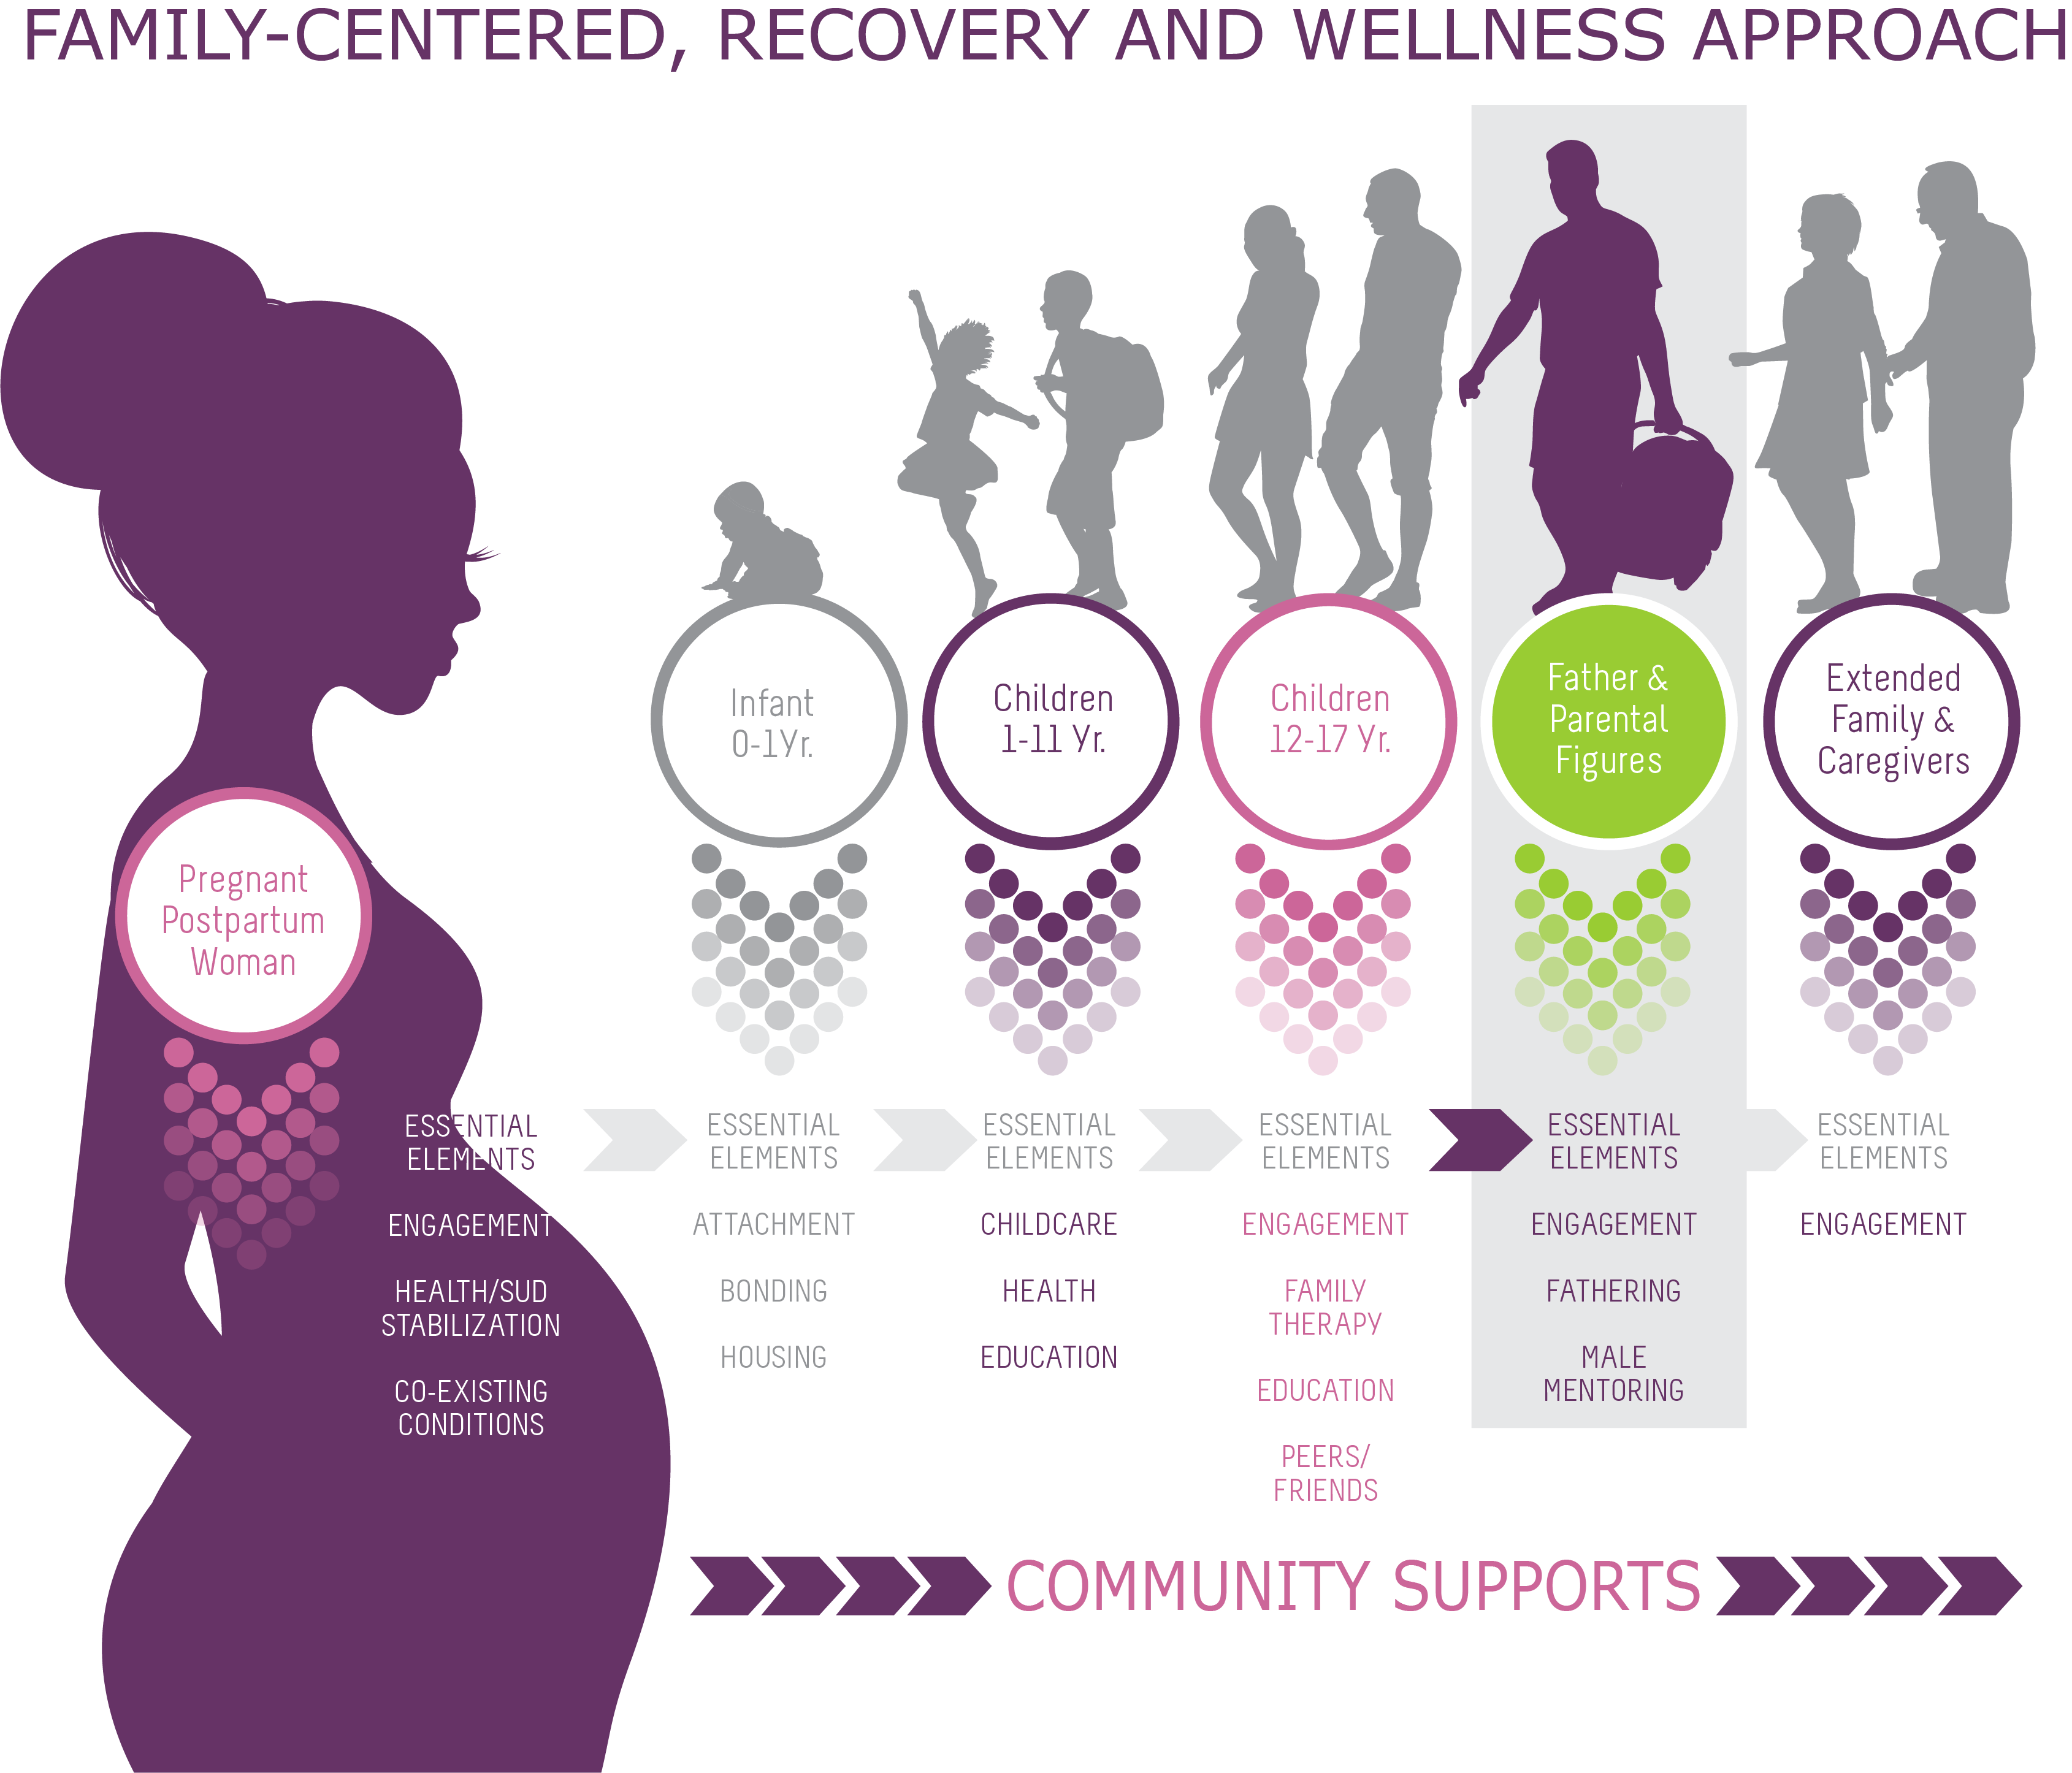
Page 91 in participant manual
Notes:
A version of this family-centered care graphic was introduced during module 2. As you can see, our focus today is on fathers and parental figures.
While it is clear that not all partners and co-parents of the women in PPW programs are men, this module was designed in response to the recent focus on fathers.
This graphic also shows how the Recovery-Oriented System of Care is transforming the vision of programs from a focus on treatment to a focus on stable, long-term recovery. It’s all about partnering, not only with the woman, but with all the relationships in her life that are going to impact her ability to address her addiction, prevent relapse, and promote stable recovery.
Note to trainer: This is available as a handout on page 91 of the participant manual.

Slide 11
Why Engage Fathers?
Father
Mother
Child
Everyone
Loses
Everyone
Wins
-- Positive Paternal +
Involvement
Page 96 in participant manual for benefits of including fathers
Notes:
What is the justification for developing programing to more effectively engage men in programs for women?
Research shows that when men are absent or involved in a negative way, the mother, father, and child all lose socially, psychologically, and economically.
Research indicates that there are social, psychological, and economic benefits for the mother, father, and child when men can be involved in a positive way. Please look on page 96 of the participant manual for a list of some of these potential benefits. There are also other documents in the manual that describe this research in more detail.
So, programs need to consider:
What can be done to minimize the absence or negative involvement by the men in the families in your program?
What can be done to promote family involvement by the men that can benefit everyone in the family?

Slide 12
Where to Begin?
Values, Stereotypes, Stigma
Dispensable
Disinterested
Irresponsible
Incompetent
Dangerous
- Throwaway Dads (Parke & Brott, 1999)
Notes:
In our culture, men who need help as parents are often considered dispensable, disinterested, irresponsible, incompetent, and dangerous. These attitudes have influenced how fathers are treated in our systems of care.
Since the early 1970s, there has been a concerted effort to do everything possible to support women experiencing substance use and psychiatric difficulty in their role as parents. Until recently, however, there has been very little interest in supporting men experiencing social and psychological difficulty in their role as parents.
While policymakers, researchers, and providers expressed concern about absent fathers, they tended to only talk about absent fathers as a risk factor for children. Writing about the issue almost 20 years ago, Ross Parke and Armin Brott referred to these men as “throw-away dads.” They argued that, as a culture, we have been more interested in blaming these men and labeling these men than we have been in actually helping them.
Most systems of care in this culture are oriented toward helping mothers be more effective parents. People like Ross Parke and Armin Brott have highlighted that these systems, including our criminal justice, child protection, child guidance, educational, social service, primary care, mental health, and substance use disorder treatment systems rarely acknowledge that many of the men involved in those systems are fathers.

Slide 13
Tales from the Field
“Men were often viewed as so dangerous to women seeking services that we didn’t allow them to enter the campus of a residential treatment program, regardless as to whether or not there was a history that supported the concern…”
Kimberly Craig, BA, BS, LSAT
CEO, CHEEERS Recovery Center
Former PPW grantee, Phoenix, AZ
Notes:
Many of the pioneers in the field such as Kimberly Craig, CEO of CHEEERS Recovery Center, and a former PPW grantee, in Phoenix, AZ, have become part of the change in how men are viewed. She recalls that: (READ QUOTE BELOW)
“Men were often viewed as so dangerous to women seeking services that we didn’t allow them to enter the campus of a residential treatment program, regardless as to whether or not there was a history that supported the concern. Not many of us would tolerate a policy such as that for the women we serve. As providers many of us believed that engaging men in services or allowing them to have contact with the woman in the program increased her likelihood of leaving treatment before she completed it. Our policy was really driven by fear around her leaving treatment. Somehow we thought if we could just keep him away we could break the spell…I think most of us that have worked in the field for many years know that was flawed thinking.“
Do you have any thoughts about what Kimberly shared?

Slide 14
What do we know about fathers that has implications for treatment?
Notes:
So what do we know about fathers that has implications for treatment?

Slide 15
About Fathers
Fathering is a developmental concern for men.
Fathering affects the behavioral health of men and the behavioral health of men affects fathering.
Men have less social support for fathering than women do for mothering.
Notes:
What do we know about men as parents that has implications for assessment and treatment?
Fathering is a developmental concern for men. Even as boys, young men think about partnerships and parenting as a developmental concern for them as men.
Fathering affects the behavioral health of men and the behavioral health of men affects their capacity to be an effective parent. Research suggests that the mental/behavioral health of men deteriorates following separation from their children. For example, men become more depressed and are more likely to use substances after being separated from their children because of a marital separation. We also know that, like women, men with mental/behavioral health problems have difficulty functioning effectively as a parent. One implication is the possibility of creating cycles of improvement for men, such that improvements in the mental/behavioral health of men lead to improvements in their parenting which lead to further improvements in their mental/behavioral health over time.
Men have less social support for fathering than women do for mothering. Partially because of the way women are socialized, women have greater support from grandmothers, aunts, sisters, friends etc. around parenting than men do. Generally parenting is not an issue that men talk about when they are out socially as a group. There has been increasing call for finding ways to get men social supports in a formal or informal way.

Slide 16
About Fathers Cont.
Fathering is vulnerable to:
The quality of the co-parenting relationship(s),
Employment status of the father, and
The biological status of the child.
Absent fathers are often more present than policymakers and providers believe.
Human service systems more actively engage women in their roles as mothers than they engage men in their roles as fathers.
Notes:
4. Fathering is vulnerable to:
a) Quality of relationship with co-parent – When men are involved in conflictual relationships with their partner, they tend to withdraw from their role with their children. Particularly when a couple ends their sexual partnership, the single best predictor of whether men will remain involved with their children in a positive manner is the quality of his relationship with the mother of his children. If the parents can somehow get along as parents, men are more likely to remain involved. If they cannot, men are more likely to stay away to avoid conflict with the mothers of their children.
b) Employment status of the father – If men are not employed and not able to contribute financially, then they are more likely to withdraw from parenting roles.
c) Age and biological status of the child – Men are also generally more likely to be involved with younger children and with children who are their biological children.
5. Absent fathers are more present than policymakers and providers believe they are. Fathers who who we think are “absent” have repeatedly been found to be far more present in the lives of women and children than policy makers and providers believe.
6. Most human service systems more actively engage women in their roles roles as mothers than they engage men in their roles as fathers.

Slide 17
Activity - Questionnaire
On pages 108-115 in the participant manual are the answers to the “What do we know about men as partners and parents?” questionnaire you filled out at the start of our session.
How did your answer compare?
Which of these answers do you think programs find most surprising?
Notes:
Remind participant about the “What do we know about men as partners and parents?” questionnaire they filled out at the start of the session.
Have them turn to page 108-115 in participant manual to view the correct responses and explanations. Give participants a few minutes to read over the responses.
Ask if anyone got them all correct? All but one correct? Reward with small candy or treat.
Ask, “Which of these answers do you think programs find most surprising?” Have them work in dyads or table groups for 1 minute or less.
Elicit quick sharing of results with larger group from a couple of dyads or tables and ask for show of hands of others with similar answers. Reward those who share with small candy or treat.
Note and elicit from group any patterns in the answers that emerge.
Note to trainer: Modify this activity based on the audience and time constraints.

Slide 18
Tales from the Field
“What if we made no assumptions or judgments regarding men who are not currently parenting their children? What if we approached all men with the same unconditional positive regard we have extended women for years? Would it change things in our program?”
Kimberly Craig, BA, BS, LSAT
CEO, CHEEERS Recovery Center
Former PPW grantee, Phoenix, AZ
Notes:
Kimberly Craig, CEO of CHEEERS Recovery Center, and a former PPW grantee, has some thoughts on changing how we regard men and fathers in our programs:
When we look at what is “real” about fathering and male involvement, it may be useful to make comparisons to what we as providers know or believe to be true about the women we serve in our programs. For example, we know that sometimes women decide not to parent, and not all women are born with maternal desire or instinct. Could we say the same about men?
As women’s service providers we are too savvy to make statements, assumptions, or stereotype that all women want to parent. So, it seems fair to say not all men want to parent.
We also know that often women who chose to not parent their children, or who are struggling with the devastation and consequences of a substance use disorder which has resulted in separation from their children, are often judged harshly by society. Do we agree on that? Perhaps we do, and now let’s consider if we believe men are judged as harshly for not fulfilling paternal roles and responsibly? Perhaps men receive a different form of stereotyping and judgment from society?
As women’s service providers many of us are highly aware of the societal pressures and stigma that women face around parenting and we would not tolerate or allow anyone to make assumptions about a woman’s maternal instinct or ability to parent her children when she is active with her illness of substance use disorder or mental health issues. What if we extended that belief and position to men and fathers? What if we made no assumptions or judgments regarding men who are not currently parenting their children? What if we approached all men with the same unconditional positive regard we have extended women for years? Would it change things in our program?”

Slide 19
Services for Fathers and Partners
https://vimeopro.com/attcnetwork/bring-them-all/video/236123916
Notes:
So, what is a PPW program that actively includes fathers like? What perspectives can they offer about including fathers? This video features senior staff at Shields for Families, a program that has been delivering family-centered care to pregnant and postpartum women for 25 years. (Provide a little background on Shields if group has not seen “Bring Them All” documentary or completed the Family-Centered Care Modules). Let’s listen.
Note to trainer: This video is 3:07 minutes long and also available online at https://vimeopro.com/attcnetwork/bring-them-all/video/236123916.

Slide 20
Activity
Group 1: What were your thoughts as you listened to the staff perspectives about including fathers/partners in their program?
Group 2: If these staff members spent a few days observing your program, what would the procedures and language of your program reflect about the attitudes toward the fathers?
Jot down 3-5 key words and be prepared to explain them when timer goes off.
Notes:
ACTIVITY:
Quickly divide participants in two large groups (eg. left side and right side of room, every other table, etc.).
Assign each group one of two questions (see below).
In dyads or at their table, have participants discuss the question for 2-3 minutes and then report out.
Group 1: What were your thoughts as you listened to the staff perspectives about including men in their program?
Group 2: If these staff members spent a few days observing your program, what would the procedures and language of your program reflect about the attitudes toward the fathers?
Ask them to jot down 3-5 key words and be prepared to explain them when timer goes off.
Elicit sharing with larger group after 3 minutes.
Probe, if needed, regarding:
Differences between the video’s program and participants’ programs regarding attitudes, values, and integration of fathers into programming
Patterns in the participant responses

Slide 21
Considerations and Cautions: Things to Keep in Mind Regarding Interventions and Materials
Notes:
As you develop programming for fathers, there are several considerations and lessons learned by other programs you may want to keep in mind.

Slide 22
General Considerations
Clarify risk and create safe environments
Couples → Co-Parenting → Parenting → Family
Group vs. individual format
Specific, realistic goals
Notes:
Clarify risk and create safe environments – Safety assessment and safety management are necessities. These need to considered from the perspective of the mothers, fathers, and children. As noted previously, the first goal of any family-centered intervention has to be the creation of physically and psychologically safe, supportive environments for everyone involved.
Many programs consider offering parenting intervention to men first or exclusively. When engaging fathers, it may be more effective to consider a progression of interventions that address couples’ issues when the couple is together, co-parenting issues whether or not the couple is together, parenting issues, and then family issues in that order. Depending on the need of an individual client and her family, it may be possible to pursue some interventions simultaneously.
A group versus individual format – As programs develop a continuum of family-centered intervention, it is important to note that there are advantages and disadvantages to using both a group and individual format. For example, group interventions can be more economical in terms of cost and time, and there can be advantages in terms of providing empathy for common experiences. Sometimes, however, it can be difficult to fully address the specific needs of an individual client within a group intervention.
Because many women come to treatment with a complex array of family problems, it can feel overwhelming to think about how to address all of them. Programs have found it is helpful instead to set very specific, realistic goals that can be addressed in a specific time period. It can be helpful to make a list of goals to be pursued over time, order them in terms of urgency, and then decide which goals can be realized while the client is in her current level of care, and which goals may have to be deferred to later phases of treatment.

Slide 23
General Considerations Cont.
Traditional masculine ideology (see page 97 of participant manual)
Ghosts from the past
Guilt and shame
Relational vs. behavioral focus
Cultural considerations
Notes:
(Continued)
There is growing literature, primarily in counseling psychology, about how men and women’s ideas about what it means to be a man influences what men do as partners and parents. A list of some of these overvalued ideas about men and masculinity is on page 97 of the participant manual. When working with men, it is important that clinicians have a good basic understanding of these ideas and an awareness how they influence our thinking about men in systems of care.
Another consideration is when and how to address the “ghosts in the nursery” that may be influencing the partnerships and parenting of men and women across generations. There are differences of opinion regarding the extent to which counselors and clinicians should focus on the impact of the past on the present in different types of family-centered intervention. Some people suggest that when childhood experiences seem to be clearly interfering with current functioning, the counselor or clinician may have to address the link between the past and the present. Similarly, counselors and clinicians should be aware that even when someone says, “I want to be a better father to my child than my father was to me,” that father may, because of his experience as a child, not clearly understand how to do that.
Guilt and shame are ever-present issues for programs to consider. Generally, some guilt can be a positive influence in the lives of men and women because guilt is often associated with a message that I have done something wrong and I need to repair a relationship. Shame on the other hand can be problematic because it is often associated with a message that there is something wrong with me. It often motivates people to flee, externalize blame, blame others, and aggressively defend themselves.
Issues related to having a relational focus versus a behavioral focus also need to be considered, particularly within parent interventions for men. Men and women with substance use disorders may need very basic parenting skills. For example, before learning to give a child a time out, men may need to learn very basic relationship skills, like being consistent with visitation with children, learning how to talk with children, how to spend time, and play with children. Without some positive parent-child relationship, the use of time out is not likely to be effective. Other more basic skills need to come first.
Again, any family-centered assessment and intervention will be pursued in a cultural context. Counselors and clinicians must be competent to deliver culturally and linguistically sensitive services to clients entering the program.

Slide 24
Consider Prior to Implementation
Political ideology
Secular focus
Cost
Training
Efficacy
Effectiveness
Notes:
Several structured group programs are available for delivery to couples and fathers. Organizations may make these materials available to programs like yours. When choosing a program and materials for use with clients, consider:
Political ideology – Examine carefully the values that underlie any program. What are the implications for use of these with the people you serve? Some popular programs have been criticized because they are grounded in very traditional political ideology about the nature of family and family life.
Secular focus – Do these ideologies represent a clear religious belief system that may not be acceptable within your agency or to your clients?
Cost – Most of these curricula have a cost attached.
Training – Some programs require that a staff person or group of staff be trained in the use of the program before the materials can be released to you.
Efficacy – Although several of these programs have become quite popular, they are relatively new, so there is often little known regarding their efficacy and effectiveness. Efficacy addresses how well the program or intervention delivers the expected positive outcomes under “ideal” conditions, i.e. how the program was evaluated. Make sure to examine the conditions under which these outcomes were obtained, such as characteristics of the target audience, the skill level and expertise of those implementing the program, the length of time, additional staff, and incentives or supports used. How closely can your agency duplicate these?
Effectiveness – Effectiveness addresses how well the program or intervention delivers the expected outcomes under every-day or “real world” conditions. Is the program likely to produce the desired outcomes under the “real world” clinical conditions at your agency? For the populations you serve?

Slide 25
The Culture Conversation
The Culture Conversation
Removing barriers to care
Increasing successful engagement
Culturally adaptive services
Recovery does not only occur with the individual in treatment
See page 94 of participant manual
Notes:
The hope of family-centered care is to increase inclusion of partners/fathers. We aim to remove the following barriers to care:
Stigma
Biases
Cultural misconceptions
Labeling of parents
Defining family systems through our/practitioner lens vs. the family/parents/fathers lens
We know recovery is not just about the individual in treatment—it also is about the family/parents/fathers. As the individuals in treatment heal, they must establish new ways of communicating for their family and partnerships.
As a result, the natural step is inclusion of the partners/fathers in treatment to allow for a sharing of activities in healthy ways. In addition, it is the identification of unhealthy partners/fathers in their lives. Through treatment planning and activities, clients can work on better ways to manage these individuals.
The focus is on successful engagement and inclusion of culturally responsive/adaptive services for individuals, families, and fathers. The role of the parent/father has different meanings in every family and culture. Simply by listening to the story of the individual and working with them, we take the steps to family, parent/father inclusive services.

Slide 26
Wrap-Up
Notes:
We’ve spent time discussing some of the whys and hows of building programming for fathers.
How has your impression of family-centered programming for fathers changed?

Slide 27
Next Modules
Module 4: Implementing Family-Centered Programming
Module 5: Family-Centered Clinical Interventions
Module 6: Case-Based Application
Notes:
These are the next modules in this training series. Make sure to check your participant manual for more information and resources.

Slide 28
References
For complete reference list, please see pages 168-171 in Participant Manual.

