Slide 1
An Overview of HIV and HCV in Adolescents and Young Adults
Cathryn L. Samples, MD, MPH, AAHIVS
Director, Boston HAPPENS
Boston Children’s Hospital
Presented at: Improving Care for Substance Use, HIV and HCV in Adolescents:
Effective Approaches to Assessing, Treating, and Engaging teens
Masantucket Pequot Museum

Slide 2
Learning Objectives
Briefly describe the epidemics of HIV and HCV among US adolescents and young adults with regional examples.
Describe the HIV continuum of care for Adolescents and Young Adults.
Describe the value of HIV treatment, and current antiretroviral treatment guidelines and recent updates in care and treatment
Discuss how to incorporate HIV and HCV prevention, screening and linkage to care into Your work with youth.

Slide 3
Why Youth are Different than Adults: Stages of Adolescence
Physical, Emotional, Cognitive, Family, Peer and Sexual Relationships
Early (10-13) – Growth spurt, and the beginnings of sexual maturation. Young people starting to think abstractly, but still concrete.
Mid (14-17) - Physical changes of puberty complete. Stronger sense of identity and relates more strongly to peer group. Thinking more reflective.
Late (18-24) – “Emerging adulthood” is the new term. The body fills out and takes its adult form. The individual now has a distinct identity and more settled ideas and opinions. Judgment more mature by mid-20’s, but impaired by presence of peers.

Slide 4
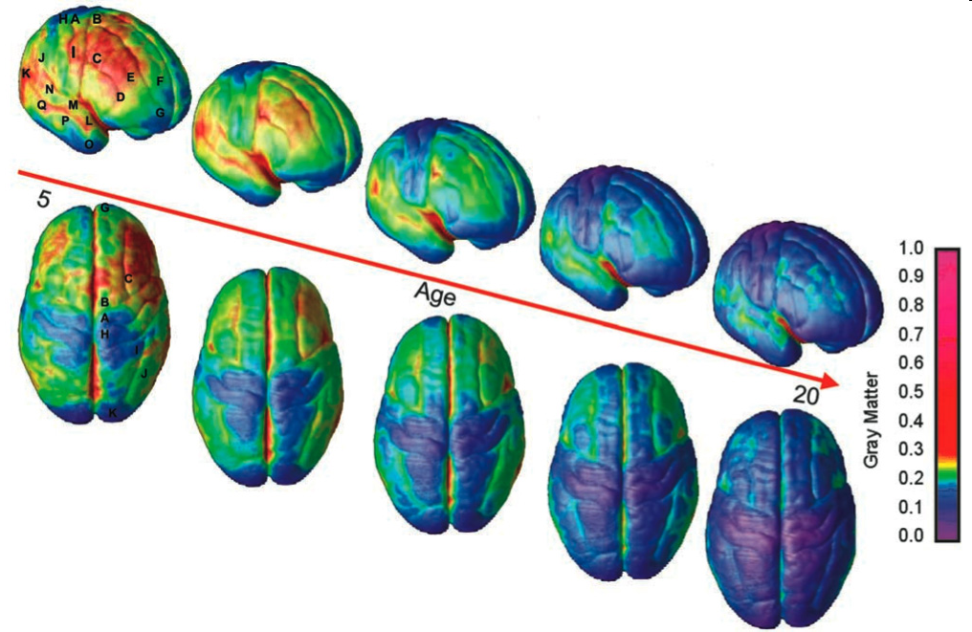
Why are Youth Brains Different?
Youth rely more on their amygdala than their prefrontal cortex for making decisions, especially in the presence of peers or high levels of emotion.
As the prefrontal cortex matures, teenagers and young adults can reason better, develop more control over impulses and make judgments better.
After a period of pruning, Last areas to develop (in the mid-20’s) are emotional control, planning, reasoning, and judgment.
Notes:
4
Other parts of the brain also undergo refinement during the teen years. Areas associated with more basic functions, including the motor and sensory areas, mature early. Areas involved in planning and decision-making, including the prefrontal cortex -- the cognitive or reasoning area of the brain important for controlling impulses and emotions -- appear not to have yet reached adult dimension during the early twenties. The brain's reward center, the ventral striatum, also is more active during adolescence than in adulthood, and the adolescent brain still is strengthening connections between its reasoning- and emotion-related regions.
Scientists believe these collective findings may indicate that cognitive control over high-risk behaviors is still maturing during adolescence, making teens more apt to engage in risky behaviors. Also, with the brain's emotion-related areas and connections still maturing, adolescents may be more vulnerable to psychological disorders.
Current research is looking at the manifestations of psychological disorders in adolescents, particularly schizophrenia and bipolar disorder. Large imaging studies have shown that brain changes associated with schizophrenia typically begin in adolescence when the brain undergoes the normal pruning sequence of myelination growth spurts and gray matter loss. It appears that a larger and more severe wave of gray matter loss occurs in the brains of adolescents developing schizophrenia, which eventually engulfs much of the cortex after a period of five years.
Scientists believe that the natural teenage process of pruning may be accelerated or otherwise altered in schizophrenia, bipolar disorder, and other neurodevelopmental disorders.
This research is leading to treatment implications, including a newer antipsychotic medication that, if administered early, may prevent or slow the severe wave of gray matter loss in schizophrenia and keep the disorder from progressing. Scientists also are exploring the use of low doses of medication to prevent the functional alterations in brain cells in bipolar disorder.

Slide 5
Trends in Estimated HIV among Youth
U.S. Incidence (2010):
25.7% of people newly infected were age 13-24
57% African American ; 20% Latino; 20% White
About 72% of new youth infections are in MSM
U.S. Prevalence Estimates (2009-2010):
69.5 (2.3-562.8) /100,000 13-24 year olds are living with HIV (LWH)
6.7% of all people LWH in US were age 13-24
59.5% unaware of their infection
  CDC. Vital Signs: HIV Infection, Testing, and Risk Behaviors Among Youths —US. MMWR 61(47) 2012
Notes:
5

Slide 6
MA Reports of HIV:
Newly Diagnosed Youth
12% of newly diagnosed persons reported in MA 2009-2011 were age 13-24 at diagnosis
Of those, 35% were non-Hispanic Black, 26% Latino
77% Male and 23% Female
Mode of Transmission (for newly diagnosed youth):
  60% MSM (78% of Males)
  7% Heterosexual or Presumed Heterosexual
  4% IDU (1% of Males. 15% of females))
  17% Undetermined mode

Slide 7
Youth Living with HIV in MA
About 2% of people known to be living with HIV in MA (410) are now (as of 12/2012) age 13-24 years
These known HIV+ 13-24 year olds are:
51% Male (50% of 13-19 y/o)
42% Black; 31% Latino (52% Black; 32% Latino of 13-19 y/o)
Mode of transmission:
  23% MSM (35% of young men); 1%IDU
  59% of MA youth living with HIV were perinatally exposed (78%of those Black or Latino)
  92% of all 337 youth with perinatal infection are now 13-24 years old (31% 13-19, 40% 20-24, 21% age 25+)
  These youth more likely to be female and non-white
Source: MA DPH Fact Sheet 2013 (http://www.mass.gov/eohhs/docs/dph/aids/2012-profiles/adolescents-young-adults.pdf )
7

Slide 8
What About Hepatitis C?
HCV: It’s not just for IDU and baby boomers any more, some unanswered questions.

Slide 9
HCV Trends, 2006-2011

Slide 10
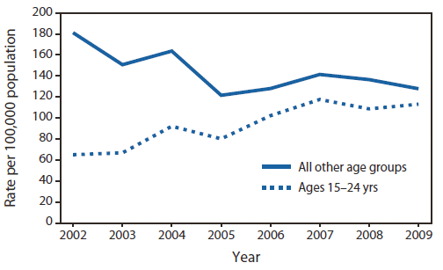
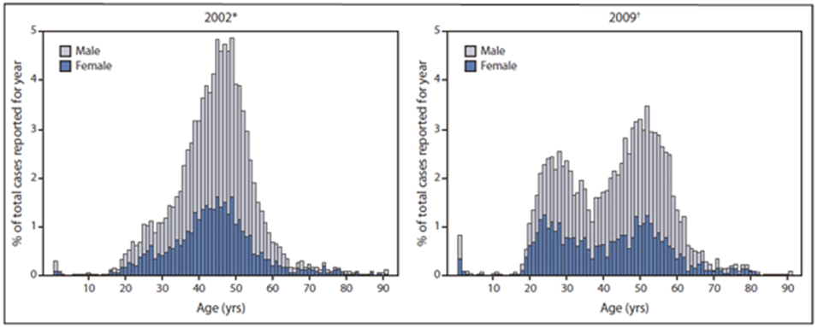
Age distribution of new HCV infection --- Massachusetts, 2002 and 2009

Slide 11
HCV Trends
2.9 – 3.9 million people living with chronic HCV in US
75% age 45-65 in 2012
45-85% of those living with HCV unaware
Recent reports of increases in new infections among youth and young adults.
Massachusetts, New York state, and Wisconsin have all reported increases and/or outbreaks of HCV among under-30-year-old injection drug users.
Rhode Island: Increased prevalence of HCV among incarcerated 18-28 year olds
Increased prevalence in suburban and rural youth
Treatment improving, and cure with oral medications increasingly feasible
MA DPH now offers combined HIV/HCV testing

Slide 12
Increased Risk for MSM?
Case control study in Netherlands
82 HIV+ MSM with new HCV compared to 131 HCV-uninfected HIV-positive MSM controls.
Factors associated with the following magnitudes of likeliness of contracting hep C:
  Ulcerative STI were 5.26 times as likely to contract hep C;
  Receptive condomless anal intercourse, 5.05 times as likely
  Sharing sex toys, 3.98 times as likely
  Sharing straws when snorting drugs, 3.46 times as likely;
  Having a lower CD4 count at last read before testing positive for hep C also linked to a raised risk of hep C
  Douching, rectal bleeding, number of partners, IDU (small N of 12), group sex, not associated with increased risk in this study

Slide 13
Why Screen for HIV?
Unaware of
HIV infection
Access to Care + Treatment
= Prevention!
21% ( 48% of youth)
Those who do not Know
account for 48-54% of all
new
sexually transmitted HIV
Aware of
HIV infection
79%
Effective treatment decreases transmission by 96%
Source: CDC. MMWR. 2008;57:1073-6.
Notes:
Cathryn L. Samples, MD, MPH, AAHIVS
5-13-2011
Adolescent Summit: Plenary
13
1
The CDC estimates that about one-fifth of persons living with HIV are unaware of their HIV infection. Those who are unaware are more likely to transmit, and to develop AIDS before they are diagnosed. 54% OF NEW INFECTIONS COME FROM THE UNDIAGNOSED.
CDC: More than half of all new sexually transmitted cases arise from HIV+ persons who do not know their status
Greatest Gaps in knowledge of HIV status: (% Undiagnosed)
Blacks and Hispanics (22%)
Heterosexual Men w/o other risk (MSF-27%)
Men having sex with men (MSM-24%)
Youth have the greatest gap (48% undiagnosed)
Need interventions to increase testing and knowledge of status in youth of color, MSF MSM, and first-time testers

Slide 14
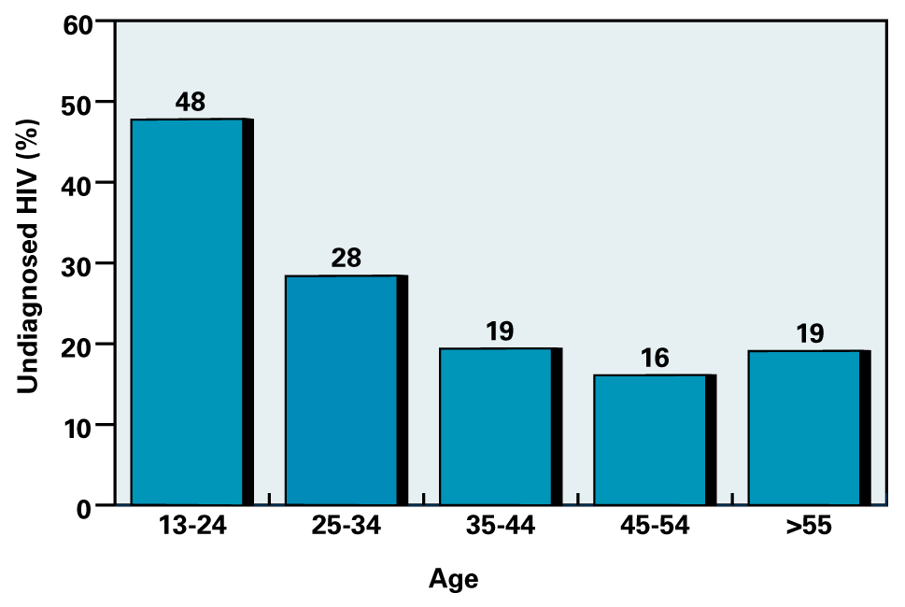
Undiagnosed HIV Infection in US
Percent by Age, at End of 2006
Source: Campsmith M, et al. CROI 2009. Abstract 1038.
Notes:
1
However, among young people, the CDC estimates a significantly higher proportion of those unaware of their HIV status, than among all other age groups.

Slide 15
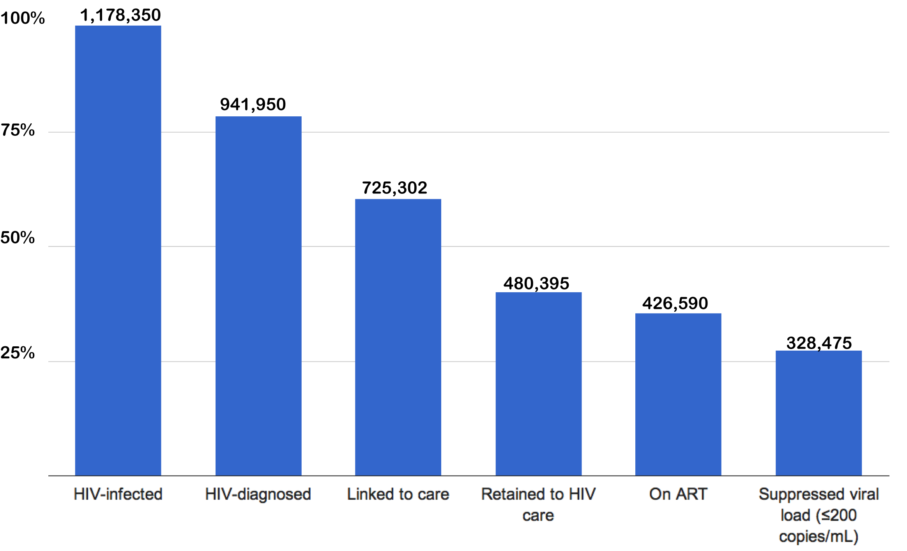
The Continuum of HIV Care in the US
80%
Percentage
77%
66%
89%
77%
Engagement in HIV care
Of all with HIV infection, 850,000 individuals do not have suppressed HIV RNA (72%)
MMWR (60), 2011
Notes:
15

Slide 16
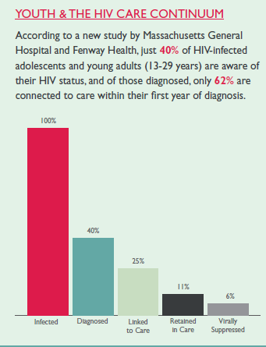
Early Diagnosis Benefits All
(If the Continuum Is Effective)
Effective care and treatment improves health, longevity, and future options
Awareness of status aids risk reduction
Treatment decreases risk of transmission by 96%
But, youth have more barriers to care
13 -29 year olds

Slide 17
Continuum of Care: Is There Data on Youth Linkage and Retention?
?
Extrapolated from Hall, HI et al. CDC. Contiuum of HIV Care: Differences in Care and Treatment. Presented at AIDS 2012

Slide 18
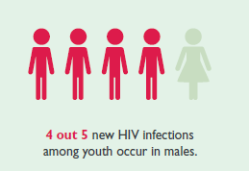
Current HIV Screening Recommendations
CDC 2006: Routine opt-out voluntary screening for all patients age 13-64 yrs:
  Unless prevalence <0.1%
  All patients with TB, STI, pregnancy, Hepatitis B, regardless of age
  Re-test high-risk persons at least annually; test new couples; test with STI
  MSM at high risk
  Increasing incidence
    Youth of color
    Young MSM

Slide 19
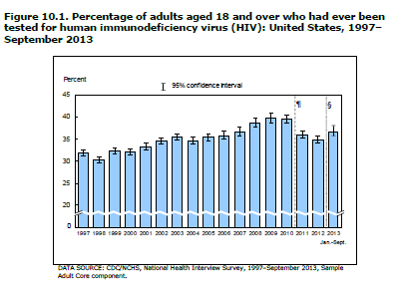
But Even Now, HIV Testing Is Still Not Universal
38% of adults ever had HIV test by 2013
Just 34% of 18-24 year olds had ever tested
26% of young men
Testing rates higher among Black (57%) and Hispanic/Latino (39%) adults
CDC: Early Release of NHIS data, 3/27/2014

Slide 20
Other Recommendations
ACOG (2014): Test all women 13-64 at least once, rescreen annually if at risk. Have a plan for immediate action if positive.
ACP (2009): Adopt and encourage routine screening and rescreen based on risk
AAP (2011): Routine Screening once by age 16-18 years, and routinely if at risk (youth consent enough)
USPSTF (April 2013): Screen all 15-64 year olds, all pregnant women, and older and younger patients at risk. Category A now.

Slide 21
HCV Screening Recommendations
Born between 1945 and 1965*, one time screen.
Other persons at risk (b/o behavior, exposure or other):
  Injection-drug use (current or ever, including once)
  Intranasal illicit drug use
  Long-term hemodialysis (ever)
  Getting a tattoo in an unregulated setting
  Occupational exposure
  Children born to HCV-infected women
  Prior recipients of transfusions or organ transplants, including persons who:
    were notified that they received blood from a donor who later tested positive for HCV infection
    Transfusion or transplant before July 1992
    received clotting factor concentrates produced before 1987
  Persons who were ever incarcerated

Slide 22
HCV Screening Recommendations
Other
  HIV infection
  Unexplained chronic liver disease and chronic hepatitis
  Solid organ donors (deceased and living)
Annual Screening Recommended:
  Injection Drug Users
  HIV+ MSM
Screening with Antibody unless:
  History of prior HCV infection and suspect reinfection
  Acute liver disease present and recent exposure
  Immunodeficiency
If screen positive, ensure quantitative RNA to see if infection present and counsel on need for expert staging, care and how to maintain health

Slide 23
The HIV Test Is Positive:
What does Care involve?
Medical history (previous testing, reason for testing, symptom assessment, past medical and psychiatric history, medications, review of systems, growth and development, immunization, nutrition, when and how infected)
Coping - Social history (living situation, social support, disclosure of status genogram, school, employment, legal status, entitlements, violence or abuse history)
Sexual risk assessment (voluntary debut, recent and current sexual partners (gender, practices, use of barriers, disclosure status, contraceptive use and plans, sexually transmitted disease history, partner status)
Substance and tobacco use and treatment history

Slide 24
What does the Team do Next?
Support and Education and linkage to care
Physical Exam
Laboratory and other testing
Prevention: Risk reduction, immunization, nutrition, physical activity, tobacco and substance use
Time for Questions and Answers and Resources
Client-centered Team approach helps

Slide 25
Explaining HIV
CD4 Cell Count (cells/mm³)
Acute Infection
Asymptomatic HIV Infection
AIDS
1,000
CD4 cell count
500
200
high risk of opportunistic infections
4-8 Weeks
Up to 12 Years
2-3 Years
Time

Slide 26
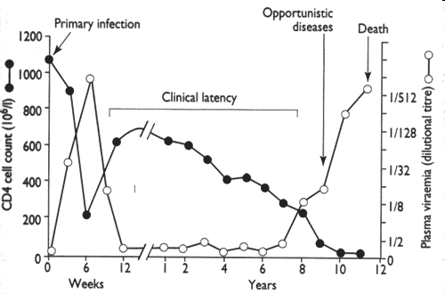
Treatment Alters HIV Course
(and maintains health and decreases transmission)
Treatment Initiated
Fig. 1 - Changes in CD4 cell counts and plasma viraemia during HIV infection (modified
from Fauci(5) with permission).. Jolles, S. et al. BMJ 1996;312:1243-1244

Slide 27
Initial Care for HIV Infected Youth
Assess and educate about immune function and viral load
Assess presence/absence of symptoms and signs
Assess presence of or risk for opportunistic infection (OI)
Screen for coexisting active or latent conditions
  Infections, STD’s (all exposed sites), hepatitis B, C, toxoplasmosis
  Substance use/abuse
  Psychosocial issues
  Treatment readiness
  Barriers to care and adherence
Staging and prognosis enable plan of care
Psychosocial risk assessment, support and education promote engaging and staying in care
Notes:
Cathryn L. Samples, MD, MPH, AAHIVS
5-13-2011
Adolescent Summit: Plenary
27

Slide 28
Initial Physical Exam
Skin (seborrhea, acne, molloscum, fungal infection common)
Lymph
Oral (thrush, ulcers, herpes and other STI, gum and dental condition)
Cardiovascular, respiratory, abdomen
Genital (STD signs, vaginitis)
Rectal (screen for STI if receptive anal sex)
Neurological exam, mental status, screen for depression and anxiety
Notes:
Cathryn L. Samples, MD, MPH, AAHIVS
5-13-2011
Adolescent Summit: Plenary
28

Slide 29
Lab Tests: Order and Explain
Confirmatory HIV antibody test, if not already done
Immune function: CD4 t-lymphocyte count and percent (t-cell profile)
Viral burden: HIV-RNA testing (twice); Genotype (up to 30% of youth inherit resistant virus)
Blood count, chemistries, urinalysis, antibody screens (toxoplasmosis, hepatitis B, C, varicella, CMV)
STD screening for gonorrhea and chlamydia (site specific), vaginal wet preps, serologic test for syphilis, pregnancy test, HSV 2 serology
Cervical pap smear for young women (annual once normal q/ 6 months twice). Anal pap smear for MSM, Others?
Tuberculosis test (PPD skin test or x-ray if PPD positive)
Share Results and Follow-up Plan
Notes:
Cathryn L. Samples, MD, MPH, AAHIVS
5-13-2011
Adolescent Summit: Plenary
29

Slide 30
Primary Care: Prevention and Intervention
Food safety and healthy nutrition
Pet (especially cat) safety
STI screening (all exposed sites); risk reduction
Monitor for new co-infections (TB, CMV, HSV, Toxo, Hep C)
Monitor for cardiovascular risk factors: obesity (BMI), lipids, lipodystrophy, hyperlipidemia, hypertension, insulin resistance
Monitor for hepatotoxicity, renal dysfunction, reduced bone density (aseptic necrosis of hip can occur), vitamin D deficiency
Encourage exercise and healthy lifestyle; peer support may aid some youth
Smoking cessation very important

Slide 31
Treatment As Prevention (TAP)
Viral Load of HIV+ Partner (copies per mL) | Risk for Transmission (rate ratio: 95% CI)
< 3500 | Referent (one)
3500-9999 | 5.80 (2.26-17.80)
10,000-49,999 | 6.91 (2.96-20.15)
> 50,000 | 11.87 (5.02-34.88)
Per log increment viral load | 2.45 (1.85-3.26)
HPTN 052 [1763 serodiscordant couples: early vs late (<250 CD4) ARV treatment] | 96 % less transmission in early treatment group. (P≤0.0001).
(Sources: Advancing HIV Prevention, the Science Behind the Initiative. CDC, 9/2003 and Quinn TC. NEJM 1996, and Cohen et al, NEJM 7/28/2011)
31
Notes:
Cathryn L. Samples, MD, MPH, AAHIVS
5-13-2011
Adolescent Summit: Plenary
31

Slide 32
HPTN 052:
HIV Transmission Reduced by 96% in 1763 Serodiscordant Couples
Total HIV-1 Transmission Events: 39
(4 in immediate arm and
35 in delayed arm; P < .0001)
Linked Transmissions: 28
Unlinked or TBD Transmissions: 11
Delayed Arm: 27
Immediate Arm: 1
Single transmission in patient in immediate HAART arm believed
to have occurred close to time therapy began and prior to suppression of genital tract HIV
P < .001
Cohen MS, et al. N Engl J Med. 2011;365: 493-505..

Slide 33
Goals of Therapy & Tools to Achieve Goals
GOALS
Reduce HIV-related morbidity; prolong duration and quality of survival
Restore and/or preserve immunologic function
Maximally and durably suppress HIV viral load
Prevent Transmission
TOOLS
Selection of ARV regimen
Maximizing adherence
Pretreatment resistance testing
Use of CD4 count to guide therapy decisions
Use of HIV RNA (viral load, HIV-1) to guide therapy decisions and assess treatment efficacy
Notes:
33

Slide 34
DHHS Guidelines:
Changing Criteria for Initiating ART
CD4+ Count, cells/mm³ | 1998 | 2001 | 2006 | 2008 | 2009 | 2013
> 500 | Offer if VL > 20,000 | Offer if VL > 55,000 | Consider if VL ≥ 100,000 | Consider in certain groups | Consider | Treat
350-500 | Offer if VL > 20,000 | Consider if VL > 55,000 | Consider if VL ≥ 100,000 | Consider in certain groups | Treat | Treat
200-350 | Offer if VL > 20,000 | Offer, but controversy exists | Offer after discussion with patient | Treat | Treat | Treat
< 200 or symptomatic disease | Treat | Treat | Treat | Treat | Treat | Treat
Source: Clinical Care Options-HIV
Notes:
ART, antiretroviral therapy; DHHS, Department of Health and Human Services; VL, viral load.
An overview of the DHHS guidelines over time highlights the evolution in both our understanding of the natural history of HIV and the advances in HIV therapy. Generally, there has been a movement toward recommending antiretroviral therapy for broader populations of patients over time. Looking specifically at patients with high CD4+ cell counts (> 500 cells/mm³), one sees that the threshold for considering initiation of antiretroviral therapy increased from 1998-2006, reflecting an increasing recognition of the long-term toxicities associated with the available regimens. However, more recent data indicate that there are benefits to starting antiretroviral therapy at high CD4+ cell counts both for maintaining strong immune function and reducing the likelihood of treatment-related adverse events. Moreover, the introduction of less toxic antiretroviral agents has somewhat diminished that concern. These factors have led to the movement toward treating nearly all patients, including those with higher CD4+ cell counts.
At the other end of the spectrum, antiretroviral therapy has always been recommended for patients with low CD4+ cell counts or, notably, those with symptomatic disease. Thus, even before the recommendation to initiate antiretroviral therapy regardless of CD4+ cell count, a patient with a high CD4+ cell count would still be recommended to start antiretroviral therapy on the basis of even subtle HIV-related symptoms, which could include chronic fatigue, night sweats, diarrhea, weight loss, or others.

Slide 35
May 2014 Recommendations
Antiretroviral therapy (ART) is recommended for all HIV-infected individuals to reduce the risk of disease progression.
  The strength of and evidence for this recommendation vary by pretreatment CD4 T lymphocite (CD4) cell count: CD4 count <350 cells/mm³ (AI); CD4 count 350–500 cells/mm³ (AII); CD4 count >500 cells/mm³ (BIII).
ART also is recommended for HIV-infected individuals for the prevention of transmission of HIV.
  The strength of and evidence for this recommendation vary by transmission risks: perinatal transmission (AI); heterosexual transmission (AI); other transmission risk groups (AIII).
Patients starting ART should be willing and able to commit to treatment and understand the benefits and risks of therapy and the importance of adherence (AIII). Patients may choose to postpone therapy, and providers, on a case-by-case basis, may elect to defer therapy on the basis of clinical and/or psychosocial factors.

Slide 36
Summary Indications for Initiating ART:
2014 Guidelines for Asymptomatic HIV
Category and/or CD4 Count | Recommendation
CD4 < 350 cells/mm³ (AI) CD4 350-500 (AII) CD4 > 500 cells/mm³ (BIII) Prevention of transmission Pregnant women (AI) Sexual transmission Heterosexual (AI) Other sexual (AIII) | Initiate ART (If ready, willing and able, and life circumstances permit)
12/07
Notes:
36
The decision to begin therapy for the asymptomatic
patient is complex and must be made in the setting of
careful patient counseling and education.
Considerations of initiating antiretroviral therapy
should be primarily based on the prognosis of diseasefree
survival as determined by baseline CD4+ T cell
count [60-62] (Figure A and Tables 4a, 4b). Also
important are baseline viral load [60-62], readiness of
the patient to begin therapy; and assessment of
potential benefits and risks of initiating therapy for
asymptomatic persons, including short-and long-term
adverse drug effects; the likelihood, after counseling
and education, of adherence to the prescribed treatment
regimen.
Recommendations vary according to the CD4 count
and viral load of the patient, as follows.
<200 CD4+ T cell count, with AIDS-defining illness,
or symptomatic. Randomized clinical trials provide
strong evidence of improved survival and reduced
disease progression by treating symptomatic patients
and patients with <200 CD4+ T cells/mm3 [63-66].
Observational cohorts indicate a strong relationship
between lower CD4+ T cell counts and higher plasma
HIV RNA levels in terms of risk for progression to
AIDS for untreated persons and antiretroviral-naïve
patients beginning treatment. These data provide strong
support for the conclusion that therapy should be
initiated in patients with CD4+ T cell count <200
cells/mm3 (Figure A and Table 4a) (AI) [60, 61].
200-350 CD4+ T cell count, patient
asymptomatic. The optimal time to initiate
antiretroviral therapy among asymptomatic patients
with CD4+ T cell counts >200 cells/mm3 is unknown.
For these patients, the strength of the recommendation
for therapy must balance other considerations, such as
patient readiness for treatment and potential drug
toxicities.
After considering available data in terms of the relative
risk for progression to AIDS at certain CD4+ T cell
counts and viral loads, and the potential risks and
benefits associated with initiating therapy, most
specialists in this area believe that the evidence supports
initiating therapy in asymptomatic HIV-infected persons
with a CD4+ T cell count of 200-350 cells/mm3 (BII).
There is a paucity of data from randomized, controlled
trials concerning clinical endpoints (e.g., the
development of AIDS-defining illnesses or death) for
asymptomatic persons with >200 CD4+ T cells/mm3 to
guide decisions on when to initiate therapy.
Observational data from cohorts of HIV-infected
persons provide some guidance to assist in risk
assessment for disease progression.
One source of observational data comes from cohorts
of untreated individuals with regular measurements of
CD4+ T cell counts and HIV RNA levels. Table 4b is
taken from a report by the CASCADE Collaboration,
composed of 20 cohorts in Europe and Australia [62].
The information in this table provides an estimate of
the short-term (6-month) risk of AIDS progression
according to CD4+ T cell count, HIV RNA level, and
age. These estimates can be considered in making the
decision about whether to start antiretroviral therapy
before the next clinic visit.
Another source of observational data is from cohorts
that follow patients after the initiation of antiretroviral
treatment. A pooled analysis of 13 cohorts from
Europe and North America provide the most precise
information on prognosis following the initiation of
treatment [61]. These data indicate that CD4+ T cell
count is a much more important prognostic indicator
than viral load for those initiating therapy. In this
study, risk of progression was also greater for those
with a viral load >100,000, older patients, those
infected through injecting drug use, and those with a
previous diagnosis of AIDS. The following chart
shows the risk of progression to AIDS or death after 3
years, according to CD4+ T cell count and HIV RNA
level at the time antiretroviral therapy was initiated.
These data are from a large subset of patients less than
50 years old and without a history of an AIDSdefining
illness or injection drug use:
CD4+ T cell count 3 yr-probability
VL <105 VL >105
0 - 49 cells/mm3 16 % 20%
50 - 99 cells/mm3 12 % 16%
100 - 199 cells/mm3 9.3 % 12%
200 - 349 cells/mm3 4.7 % 6.1%
>350 cells/mm3 3.4 % 4.4%
These data provide strong support for the
recommendation, based on observational cohort , that
therapy should be initiated before the CD4+ T cell
count declines to <200 cells/mm3. However,
differences in risk for those with CD4+ T cell counts
between 200–350 and >350 cells/mm3 are based on too
few events, and too short a follow-up period, to make
reliable statements about when treatment should be
started.
Athough there are clear strengths to these
observational data, there are also important
limitations. Uncontrolled confounding factors could
impact estimates in both studies. Furthermore, neither
study provides direct evidence on the optimum CD4+
T cell count to begin therapy. Such data will have to
come from studies that follow patients who start
therapy at different CD4+ T cell counts greater than
200 cells/mm3 and compare them with a similar group
of patients (e.g., with similar CD4+ T cell count and
HIV RNA level) who defer treatment. To completely
balance the benefits and risks of therapy, follow-up
will have to examine progression to AIDS, major
toxicities, and death.
>350 CD4+ T cell count, patient asymptomatic.
There is little evidence on the benefit of initiating
therapy in asymptomatic patients with CD4+ T cell
count > 350 cells/mm3. Most clinicians would defer
therapy.
• The deferred treatment approach is based on the
recognition that robust immune reconstitution still
occurs in the majority of patients who initiate
treatment while CD4+ T cell counts are in the 200–
350 cells/mm3range. Also, toxicity risks and
adherence challenges generally outweigh the
benefits of initiating therapy at CD4+ T cell counts
>350 cells/mm3. In the deferred treatment approach,
increased levels of plasma HIV RNA (i.e., >100,000
copies/mL) are an indication for monitoring of
CD4+ T cell counts and plasma HIV RNA levels at
least every three months, but not necessarily for
initiation of therapy. For patients with HIV RNA
<100,000 copies/mL, therapy should be deferred
(DII).
• In the early treatment approach, asymptomatic
patients with CD4+ T cell counts >350 cells/mm3
and levels of plasma HIV RNA >100,000
copies/mL would be treated because of the risk for
immunologic deterioration and disease progression
(CII).
An estimate of the short term risk of AIDS progression
may be useful in guiding clinicians and patients as they
weigh the risks and benefits of initiating versus
deferring therapy in this CD4 cell range. As cited above,
Table 4b provides an analysis of data from the
CASCADE Collaboration, demonstrating the risk of
AIDS progression within 6 months for different strata of
CD4+ T cell count, viral load, and age. As seen in Table
4b, a 55 year old with a CD4+ T cell count of 350 and a
HIV viral load of 300,000 copies/mL has a 5% chance
of progression to an AIDS-defining diagnosis in 6
months, compared with a 1.2% chance for a similar
patient with a viral load of 3,000 copies/mL.

Slide 37
Clinical or personal factors may support waiting to start
If CD4 count is low, deferral should be considered only in unusual situations, and with close follow-up
  Keep clients engaged in care if they refuse ART
When there are significant barriers to adherence
If co-morbidities or their treatment complicate or prohibit ART
“Elite controllers” and long-term non-progressors
  Case Examples

Slide 38
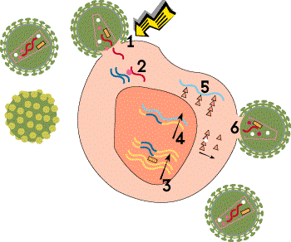
ARV (antiretroviral) Drugs:
Now Work on Four Different HIV Life Cycle Stages
Binding (Entry Inhibitors)
Reverse Transcription (NRTI, NNRTI)
Integration (Integrase Inhibitors)
Transcription
Translation
Viral Assembly and Maturation (Protease Inhibitors)

Slide 39
Current ARV Medications (26)
NRTI Abacavir (ABC) Didanosine (ddI) Emtricitabine (FTC) Lamivudine (3TC) Stavudine (d4T) Tenofovir (TDF) Zidovudine (AZT, ZDV) NNRTI Delavirdine (DLV) Efavirenz (EFV) Etravirine (ETR) Nevirapine (NVP) Rilpivirine (RPV) | PI Atazanavir (ATV) Darunavir (DRV) Fosamprenavir (FPV) Indinavir (IDV) Lopinavir/r (LPV/r*) Nelfinavir (NFV) Ritonavir (RTV) Saquinavir (SQV) Tipranavir (TPV) *r= Ritonavir booster | Integrase Inhibitor (II) Raltegravir (RAL) Elvitegravir **(EVG) Dolutegravir*** (DTG) Fusion Inhibitor Enfuvirtide (ENF, T-20) CCR5 Antagonist Maraviroc (MVC) ** EVG currently available only in coformulation with cobicistat (COBI)/TDF/FTC
February 2013. Updated *** October 2013
www.aidsetc.org

Slide 40
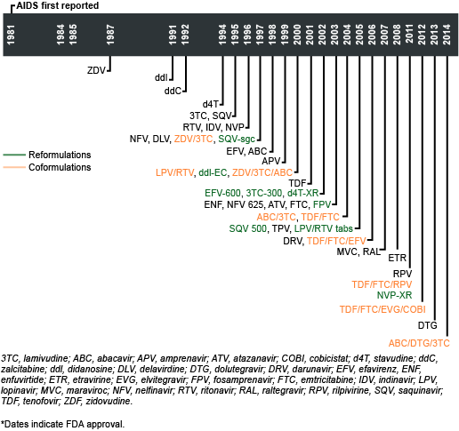
Drug Development Timeline (Plus 2 more coformulations in 3/2015!)
2015
COBI/DAR
ATV/COBI

Slide 41


Considerations When Selecting First-line Antiretroviral Therapy
Patient/Viral Factors
Antiretroviral Drug Factors
Baseline CD4+ cell count/ HIV-1 RNA level
Age
Sex
Occupation (eg, work schedule)
Comorbid conditions (eg, CV risk)
Plans for pregnancy
Access to care
Concurrent medications
Adherence to other medications
Genetics (eg, HLA-B*5701)
Viral tropism Disclosure
Efficacy
Baseline drug susceptibility/ resistance
Tolerability
Long-term toxicity, metabolic effects
Drug interactions
Dosing frequency
Pill burden
Pharmacokinetics
Cost / Insurance coverage/ copays?
Source: CCOHIV Slideset, Practical Skills…
Notes:
CV, cardiovascular.
This slide outlines some of the patient, viral, and medication factors that may drive the choice of therapy.

Slide 42
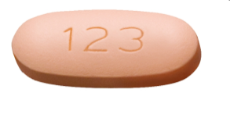

2014 Guidelines: Preferred Initial Regimens
(There are alternative and acceptable ones too)
NNRTI based | EFV/TDF/FTC^{1,2} 1 pill once a day
PI based | ATV/r³ + TDF/FTC² 3 pills once daily ____________________________ DRV/r (QD) + TDF/FTC² 3 pills once daily
II based | RAL bid + TDF/FTC once daily
Avoid if planned pregnancy or non-contraception 2. FTC and 3TC interchangeable in efficacy
3. Not with omeprazole
Notes:
Cathryn L. Samples, MD, MPH, AAHIVS
5-13-2011
Adolescent Summit: Plenary
42
Lopinavir / ritonavir no longer a preferred initial regimen except for pregnant women. ODIN trial showed once daily DAR/r not only non-inferior in naiive patients, but also in treatment experienced

Slide 43


More Preferred Initial Regimens
Integrase Inhibitors
 | EVG/COB/TDF/FTC (once daily with food -fixed dose) [IF good renal function]
 | DTG + ABC/3TC (was 2 pills once daily, now 1) [IF HLA-B*5701 negative]
 | DTG + TDF/FTC (2 pills once daily)

Slide 44


Also Recommended, but only IF Viral Load < 100,000
NNRTI-Based Regimens:
 | EFV¹ + ABC/3TC [IF HLA-B*5701 negative]
 | RPV + TDF/3TC [IF CD4 Tcell >200]
PI-Based Regimens
 | ATV/r +ABC/3TC [IF HLA-B*5701 negative]

Slide 45
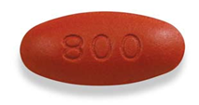



2014 DHHS Alternative Initial ARV
PI based | (DRV/r + ABC/3TC^{2,3} 3 pills once a day) LPV/r (800/200 QD if not pregnant)+ (ABC/3TC or TDF/FTC) (5 pills once a day) 1 pill of 200/50 at right 4 X + or [LPV/r must be 400/100 bid if pregnant]
II based | RAL bid + ABC/3TC 1/day
Notes:
Cathryn L. Samples, MD, MPH, AAHIVS
5-13-2011
Adolescent Summit: Plenary
45
1. EFV should not be used during the first trimester of pregnancy or in women trying to conceive or not using effective and consistent contraception.
2. 3TC can be used in place of FTC and vice versa.
3. ABC should not be used in patients positive for HLA B*5701; caution if HIV RNA >100,000 copies/mL, or if high risk of cardiovascular disease. 4. NVP should not be started if pre-ARV CD4 >250 in women or >400 in men. 5. QD LPV/r not recommended in pregnancy.

Slide 46
Preventing HIV Transmission While Attempting Conception
Inform HIV-infected women of options to prevent sexual transmission of HIV while attempting conception
Possible interventions
  Start maximally suppressive ART
  Consider PrEP in discordant couples
  Artificial insemination, including self-insemination
Counsel about reproductive issues on an ongoing basis
24. DHHS Guidelines for Antiretroviral Therapy in Adults and Adolescents. February 2013.
25. DHHS Perinatal Guidelines. July 2012.
Notes:
ART, antiretroviral therapy; PrEP, pre-exposure prophylaxis.
In addition to updates regarding the care of older patients, the 2012 DHHS guidelines also provide updated guidance for the care of HIV-infected women. One important aspect of care for women of childbearing age relates to the central issue of reproductive choice. More HIV-positive women today are considering the possibility of motherhood, and women in discordant couples are seeking guidance on how to attempt conception while preventing sexual transmission of HIV. This important issue is addressed by the DHHS antiretroviral guidelines^{[24]} and is covered in greater depth in the recently updated DHHS perinatal guidelines.^{[25]}
Women should be informed of the range of options available to minimize the risks of unprotected intercourse for the purpose of conception, which include ensuring the HIV-infected partner is receiving virologically suppressive antiretroviral therapy and considering pre-exposure prophylactic therapy for the HIV-negative partner, which has been shown to significantly reduce the risk of HIV acquisition through sexual transmission.^{[26]} Another option is artificial insemination, including self-insemination, which can be a more economical alternative for HIV-infected women with an HIV-uninfected partner.
An important point raised in the guidelines is that, for women of childbearing age, reproductive issues should be discussed on an ongoing basis.

Slide 47
The HCV Screen is Positive
Educate about risk of transmission and safe needle use
Confirm whether virus present with a PCR (viral load), check genotype if viremia
Refer to a specialist if symptomatic, liver dysfunction, or measurable viral load
Monitor for coinfections, including HIV
Acute HIV and Acute HCV can look alike.
Some youth clear infection on their own, but reinfection can occur with repeated risk
Youth with active virus present need monitoring, and assessment for possible teratment

Slide 48
Hepatitis C Treatment
New better tolerated drugs can CURE infection for many
Success rate depends on genotype of the virus
SVR (sustained virologic response) possible in most
Cost is a major factor
Timing of treatment often linked to advancement of liver disease versus the Treat early to prevent body damage and transmission in HIV
Much research in progress – watch for new developments

Slide 49

Treatment vs Delay Considerations
Ready for treatment?
No? Motivational Interviewing may help
Who knows dx?
Lifestyle and schedule
Tolerable drug interactions, side effects
Able to reach for follow-up and communication?
Access to care, insurance, transportation
Access to prescriptions
Able to swallow pills?

Slide 50
What Are Barriers to Screening Youth?

Slide 51
Practice Tips
Anticipatory Guidance as part of all adolescent encounters: see 2008 USPSTF Guidelines on sexually transmitted infection prevention
Know local resources for intensive science-based prevention and risk reduction counseling
Discuss confidentiality (and exceptions) with patient and parent at first visit as teen (or age 12+); provide privacy and identify confidential counseling and care resources
Sample adolescent billing and coding tips and case vignettes at http://www.adolescenthealth.org/clinicalcare.htm

Slide 52
Coding Guide
Can use with RHCM CPT codes or problem visits or Preventive Medicine Codes (99381-99397, 99401-999412).
Screening
V74.5: Screen for STI
V01.6: Contact with or exposure to STI
V65.45: Counseling on other STI (non-specific)
V65.44: HIV counseling (if provided during the test or results visit)
V73.89: Visit specifically for HIV testing (special viral screening)
Rapid Test (POCT) in office (if billing for the test)
86703 +92 modifier (Antibody; HIV-1 and HIV-2, single assay)
HIV positive
V08: Asymptomatic HIV (positive results
042: HIV Disease (AIDS or symptomatic
HCV
86803 (+92 modifier if rapid);
Screening codes: 070 (symptoms), V69.8 (lifestyle), V02.6, V01.79
Available at http://aahivm.org/images/stories/pdfs/brochure_reimburse_guide_routinehivtest.pdf.
ICD-10 codes available in new 5/14/14 CDC PrEP guidelines (see refs)

Slide 53
Readiness Steps: Make HIV Screening Routine in Your Practice or Program?
Know state laws, regulations and institution policies re: consent, reporting and partner notification
(National HIV/AIDS Clinicians’ Consultation Center web resource):
http://www.nccc.ucsf.edu/consultation_library/state_hiv_testing_laws
Discuss and choose what test(s) you will offer and how to document and fund the test and/or link youth to free testing sites by referral or co-location
Notes:
(If selecting Rapid Test as point of Care, process for CLIA waiver, confirmatory testing of reactives, and cross-training of staff in testing and Quality Control)

Slide 54
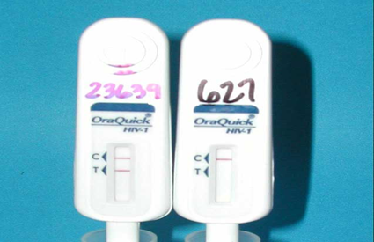
What Technology is Available?
(and What’s at Your Lab?)
Preferred non-rapid test is now a 4th generation Antigen/Antibody test (p24 Antigen if negative HIV1 and HIV 2 Antibody) detects HIV after 2-3 weeks. No confirmation required, if positive.
Antibody immunoassay (3rd generation)
  EIA or CIA (HIV 1 / 2)
  Requires Reflex Western Blot (may be pos, neg or Indet)
Rapid Testing (6 now licensed; 4 POCT)
  Requires CLIA waiver, QC protocols. Preliminary results in 10-20 minutes, if reactive→
  Confirmatory test (preferably 4th Gen), very sensitive
Home Rapid Testing: OraQuick In-Home HIV Test (approved July 2012) for age >17.
  Like a POCT rapid test, confirmatory
  test (and support) essential
Notes:
expanded
The most common HIV test is the antibody screening test (immunoassay), which tests for the antibodies that your body makes against HIV. The immunoassay may be conducted in a lab or as a rapid test at the testing site. It may be performed on blood or oral fluid (not saliva). Because the level of antibody in oral fluid is lower than it is in blood, blood tests tend to find infection sooner after exposure than do oral fluid tests. In addition, most blood-based lab tests find infection sooner after exposure than rapid HIV tests.
Several tests are being used more commonly that can detect both antibodies and antigen (part of the virus itself). These tests can find recent infection earlier than tests that detect only antibodies. These antigen/antibody combination tests can find HIV as soon as 3 weeks after exposure to the virus, but they are only available for testing blood, not oral fluid.
The rapid test is an immunoassay used for screening, and it produces quick results, in 30 minutes or less. Rapid tests use blood or oral fluid to look for antibodies to HIV. If an immunoassay (lab test or rapid test) is conducted during the window period (i.e., the period after exposure but before the test can find antibodies), the test may not find antibodies and may give a false-negative result. All immunoassays that are positive need a follow-up test to confirm the result.
Follow-up diagnostic testing is performed if the first immunoassay result is positive. Follow-up tests include: an antibody differentiation test, which distinguishes HIV-1 from HIV-2; an HIV-1 nucleic acid test, which looks for virus directly, or the Western blot or indirect immunofluorescence assay, which detect antibodies.
Immunoassays are generally very accurate, but follow-up testing allows you and your health care provider to be sure the diagnosis is right. If your first test is a rapid test, and it is positive, you will be directed to a medical setting to get follow-up testing. If your first test is a lab test, and it is positive, the lab will conduct follow-up testing, usually on the same blood specimen as the first test.
Currently there are only two home HIV tests: the Home Access HIV-1 Test System and the OraQuick In-home HIV test. If you buy your home test online make sure the HIV test is FDA-approved.
The Home Access HIV-1 Test System is a home collection kit, which involves pricking your finger to collect a blood sample, sending the sample to a licensed laboratory, and then calling in for results as early as the next business day. This test is anonymous. If the test is positive, a follow-up test is performed right away, and the results include the follow-up test. The manufacturer provides confidential counseling and referral to treatment. The tests conducted on the blood sample collected at home find infection later after infection than most lab-based tests using blood from a vein, but earlier than tests conducted with oral fluid.
The OraQuick In-Home HIV Test provides rapid results in the home. The testing procedure involves swabbing your mouth for an oral fluid sample and using a kit to test it. Results are available in 20 minutes. If you test positive, you will need a follow-up test. The manufacturer provides confidential counseling and referral to follow-up testing sites. Because the level of antibody in oral fluid is lower than it is in blood, oral fluid tests find infection later after exposure than do blood tests. Up to 1 in 12 people may test false-negative with this test.
RNA tests detect the virus directly (instead of the antibodies to HIV) and thus can detect HIV at about 10 days after infection—as soon as it appears in the bloodstream, before antibodies develop. These tests cost more than antibody tests and are generally not used as a screening test, although your doctor may order one as a follow-up test, after a positive antibody test, or as part of a clinical workup.

Slide 55
What Mode of Testing is Available?
Routine medical
Publicly funded
Provider ordered tests
  In office rapid POCT
  In house lab
  Reference lab
Opt-out screenings offered by support staff at urgent or well visits
Payment, insurance, confidentiality issues
Know which test(s) are offered
Now mainly 4th generation to improve surveillance for acute HIV
Integrated screening models (PICSR)
Combined screening for HCV and HIV (MA)
Know resources:
http://www. gettested.cdc.gov/
http://www.cdc.gov/actagainstaids/

Slide 56
How to Make HIV/HCV Screening Routine? Bring it UP!
Research local HIV/AIDS care and service providers and youth-friendly HIV specialists and support providers
  Resources: Ryan White funded programs, HIV Specialist registries: American Academy of HIV Medicine (AAHIVM), and HIV Medical Association (HIVMA) websites http://hab.hrsa.gov/gethelp/index.html and the www.aids.gov locater can identify local resources
Contact local publicly funded HIV and HCV screening and care providers to learn how to access screening and /or services quickly (and their comfort with youth)

Slide 57
How to Make HIV, HCV Screening, Prevention and Linkage to Care Routine?
Plan/develop a referral process for: linkage to care and treatment, support, partner notification and mental health, substance abuse services
Use a negative test as a trigger for risk reduction; some clients need intensive prevention (including behavioral or biologic such as nPEP, PrEP, needle exchange)
Behavioral health services can incorporate and normalize prevention and referral for screening and care

Slide 58
MA Public Health Approaches
Phasing out public health funding of Rapid Testing
Linking HIV 4th generation and Hepatitis C Antibody testing
Should more rapidly identify new positives and allow planning for care and treatment capacity
What is happening in your state?

Slide 59
Incorporate Risk Assessment and STI/ Hepatitis C Screening and Treatment into Urgent Care and Sexual Health Services
STI screening or Family Planning an opportunity for behavior-specific prevention
Identification and treatment of STI (including extragenital STI) decreases transmission risk
Risk assessment for substance use aids harm reduction
Counsel about NPEP and PrEP when applicable

Slide 60
HIV Transmission Risk
Risk Factor/Sex Act | Relative Risk of Getting HIV
Insertive Oral | 1
Receptive Oral | 2
Insertive Vaginal | 10
Receptive Vaginal | 20
Insertive Anal | 13
Receptive Anal | 100
Condom Use?
YES | 1
NO | 20
(Modified from Varghese)
Notes:
4/8/2015
Cathryn L. Samples, MD, MPH
60

Slide 61
Living with HCV?
Counsel on Transmission Risk
Avoid sharing toothbrushes and dental or shaving equipment
Cover any bleeding wound
Stop using illicit drugs and enter substance abuse treatment
Those who continue to inject drugs should be counseled to:
  Avoid reusing or sharing syringes, needles, water, cotton, and other drug preparation equipment;
  Use new sterile syringes and filters and disinfected cookers;
  Clean the injection site with a new alcohol swab;
  Dispose of syringes and needles safely
Know not to donate blood and to discuss HCV serostatus prior to donation of body organs, other tissue, or semen.
Persons with HIV and /or multiple sexual partners or sexually transmitted infections should be encouraged to use barrier precautions to prevent sexual transmission. Other persons with HCV infection should be counseled that the risk of sexual transmission is low and may not warrant barrier protection.
Household surfaces and implements contaminated with visible blood should be cleaned using a dilution of 1 part household bleach to 9 parts water. Gloves should be worn when cleaning up blood spills.

Slide 62
The Test is Negative:
Risk Reduction Opportunities
Safer sex counseling, safer injection practices, harm reduction, motivational interviewing
Individualized plan for re-testing based on risk and circumstances
Linking infected partners to effective treatment and care
Diagnosing and treating STI, substance abuse, mental health issues
Advocating for access to health care services
Work to eliminate stigma and health disparities
Educate about symptoms of Acute HIV and HCV, and methods of biological HIV prevention (nPEP, PrEP) in select circumstances; vaccine and microbicide trials

Slide 63
Pre-Exposure Prophylaxis (HIV PrEP)
Before PrEP
During PrEP
Document negative HIV status
Confirm that patient is at risk
Document the pregnancy intention of the patient
Determine method of contraception
Prescribe 90-day supply of PrEP medication
Hepatitis B: screen and vaccinate
Screen and treat for STIs
Ensure renal function adequate (PrEP contraindicated if CrCl<60)
Discuss plan of care
HIV-antibody test every 2–3 months
Evaluate medication adherence at each visit
Assess risk behaviors and provide risk-reduction counseling and condoms every 2–3 months
Test and treat for STI
Discontinuing PrEP
D/C if patient requests, safety issues or HIV+
Test for ARV resistance and refer for care, if HIV +
Continue risk-reduction counseling, if HIV negative
ACOG Committee Opinion 595-May2014. and CDC Interim Guidance. MMWR Morb Mortal Wkly Rep 2012;61:586–9.

Slide 64
CDC New PrEP Guidelines (5/14/2014)
“Preexposure Prophylaxis for the Prevention of HIV Infection in the US – 2014 Clinical Practice Guidelines”
  Available at http://www.cdc.gov/hiv/pdf/PrEPguidelines2014.pdf
  Clinical Providers’ Supplement (checklist, MSM screen, and patient fact sheets on PrEP and acute HIV) http://www.cdc.gov/hiv/pdf/PrEPProviderSupplement2014.pdf
Includes risk and eligibility criteria, and Rx, lab, and F/U schedule
  Rx maximum of 90 day supply; HIV test and risk reduction before PrEP and every 3 months
  Assess Hep B status (and vaccinate if susceptible) prior to initiation
  3 site STI screen baseline and 6 months
  Renal function at 0,3,6, and every 6 months
  Coding Guide with new relevant ICD-10 codes compared to old ICD-9

Slide 65
Offer Hope, Support
HIV+ Youth diagnosed early and able to access care and treatment and support CAN:
  Have a long life
  Control their virus and Avoid immunodeficiency
  Safely have children, be parents
HCV+ youth have new opportunities for treatment and possibility of cure
But their success is impaired by their youth and environment, by trauma and stigma, and by social inequities and systems that provide barriers, so age-appropriate risk reduction, support and care is needed
Thank you for working on this issue and for Bringing it Up through risk assessment, screening and linkage to care!

Slide 66

Links to Specialized Care: Our Services
Free HIV Rapid testing; Linked HCV/HIV 4th Gen. Testing
Free STI screening (DPH funding)
MD/NP for Primary Care, Consultation and rapid entry to HIV Care, Urgent Care 617-355-2735
Case Management and Support, team approach
Integrated Mental Health with onsite LICSW
Risk Reduction counseling, STI and Rapid HIV screening for partners
Pageable staff
Post-Exposure Prophylaxis (NPEP) and follow-up for discordant partners and sexual assault survivors; education and access to PrEP and nPEP
Individual and Group Therapy (Life Skill focus)
Competency building and training for providers, pediatric residents
Assistance with transitions from Pediatric to Adolescent and Adolescent/Young Adult to Adult care systems
http://www.childrenshospital.org/happens
Notes:
66
BMC
4/8/2015
Cathryn L. Samples, MD, MPH
66

Slide 67
Resources
National AIDS Education and Training Center: (See the AETC NRC Web Site for the most current version of slides on treatment guidelines, nPEP and transition) http://www.aids-etc.org
Local provider education from New England AIDS Education and Training Center http://www/neaetc.org
Treatment Guidelines, Drug information and interactions, and treatment fact sheets and glossaries available from http://www.aidsinfo.nih.gov
Immunization recommendations: http://hab.hrsa.gov/deliverhivaidscare/clinicalguide11/cg-304_immunizations.html#t-1
And: http://www.aidsetc.org/aidsetc?page=cg-304_immunizations
Primary Care manual: HRSA Guide for HIV/AIDS Clinical Care http://www.aidsetc.org/aidsetc?page=cg-00-00
Hepatitis C Recommendations: http://www.hcvguidelines.org/full-report/testing-and-linkage-care-box-summary-recommendations-testing-and-linkage-care
Notes:
67

