Slide 1





Overview & Implementing
Evidence-Based Practices in Faith-based and Community
Treatment Settings
PSATTC Reentry Best Practices in
Addiction Treatment
Faith-Based Series
Cheryl A. Branch, MS
Community Trainer
May 17, 2013
Notes:
Opening/Title Slide

Slide 2
Evidence-Based Practices,
What Are they?
Interventions that show consistent scientific evidence of being related to preferred client outcomes.
Notes:
Explain history of EBPs (i.e. 1998 IOM report on bridging the gap in practice/research). Include few examples progress made in past 15 years in SUD(local ones are best). LAM congregations use the UCLA-ISAP PRC conducted in Los Angeles 2000-2010, of which LAM’s director C. Branch was co PI for nine years. Mention how long it takes to develop EBPs in partnership with scientists/researchers- so prepare for long term. Few communities of color/faith in urban areas achieve the strategic partnerships needed to publish and institutionalize their work. Mention LAM theory of change to explain and promote faith-based participation in PRC and adopting EBPs in SUDs. (LAM theory of change includes epistemology, culture and historical analysis as basis for change in AA populations)- we have some evidence approach holds when applied to other populations

Slide 3
How Are Evidence-Based Practices Documented?
Gold Standard
    Multiple randomized clinical trials
Second Tier
    Consensus reviews of available science
Third Tier
    Expert opinion based on clinical observation
Notes:
Explain levels of EBPs and mention cultural competence and it’s a huge area of growth in years ahead (partly due to ACA and integration, EHRs)
Source: Drake, et al. 2001. Implementing evidence based practices in routine mental health service settings. Psychiatric Services, 52, 179 – 182

Slide 4
The Five Stages of Implementation
Successfully implementing a program that fits your organization's needs is a process - not a single event - that occurs in multiple stages of planning, purposeful action, and evaluating.
Notes:
(Fixsen, Naoom, Blase, Friedman, & Wallace, 2005)

Slide 5
The Five Stages of Implementation
It is not enough to simply select a proven evidence-based program and assume success will automatically follow. Good implementation strategies are essential..
Notes:
(Fixsen, Naoom, Blase, Friedman, & Wallace, 2005)

Slide 6
The Five Stages of Implementation
The National Implementation Research Network (NIRN) reviewed more than 2,000 articles on the implementation of programs and identified five main stages of successful implementation, which are all interrelated:
    Exploration
    Installation
    Initial Implementation
    Full Implementation
    Program Sustainability
Notes:
(Fixsen, Naoom, Blase, Friedman, & Wallace, 2005)

Slide 7
The Five Stages to Implementation
Since the stages are connected, issues addressed (or not addressed) in one stage can affect another stage. Moreover, changes in your organization or community may require you to revisit a stage and address activities again to maintain the program.
Notes:
(Fixsen, Naoom, Blase, Friedman, & Wallace, 2005)

Slide 8
Exploration: Getting Started
The goal of the Exploration Stage is to select the right evidence-based
program. Your organization will strive to identify the best program fit, which
is the match between needs and resources and the characteristics of the
program . Four main activities are involved :
  Identify your community's needs to determine the type of program that will be most appropriate.
  Assess your organizational capacity including financial resources, organizational commitment, and community buy-in to determine your ability to implement a program with fidelity.
  Search program registries to select a program that matches your community needs, your organization's available resources, and available programs.
  Understand this stage:
  program fidelity and program adaptation.
Notes:
Focusing on these activities to identify a good program fit is part of ensuring successful implementation.

Slide 9
Installation: Launching Your Program
Once a program has been selected and materials purchased, the process of installing a program begins. Installation refers to making the structural and instrumental changes necessary to implement the program within an organization.
Establishing an Implementation Team within your organization will be critical at this stage. The Implementation Team is a core set of individuals charged with providing guidance through full implementation of the program. This team helps ensure engagement of the stakeholders, creates readiness for implementation, ensures fidelity to the program, monitors outcomes, aligns systems, and removes barriers to implementation. An organization can choose to develop the Implementation Team during the Exploration Stage; however, the participants may change as you move into the Installation Stage.
Notes:
Focusing on these activities to identify a good program fit is part of ensuring successful implementation.

Slide 10
Initial Implementation: Expect the Unexpected
During the initial implementation stage, individuals begin to put into practice all that has been planned for during exploration and installation. Practitioners and staff will be changing their behavior, using new skills for the first time, and incorporating new practices into their everyday routine.
This stage is often awkward because people are now expected to perform new skills and engage in new processes, which may lead them to perform in an uncoordinated or hesitant fashion. Practicing and implementing new skills with fidelity will take time.
Notes:
Focusing on these activities to identify a good program fit is part of ensuring successful implementation.

Slide 11
Full Implementation: The Program is in Place
Full implementation occurs when the program is integrated into the service, organization, and system settings. The processes and procedures to provide the selected program are now in place.
    Staffing is complete
    Caseloads are full
    Services are provided
    Funding streams are in place
  It now becomes important to maintain and improve the program through
  excellent monitoring and purposeful improvement to avoid entering
  program drift (that is, edging toward a lack of fidelity). Your program or
  service is ready to be evaluated, with a focus on assessing program
  fidelity. Fidelity measures, which can be provided by the program
  developer, are commonly used at this point to determine if the program
  is being delivered as intended.
Notes:
Focusing on these activities to identify a good program fit is part of ensuring successful implementation.

Slide 12
Program Sustainability: Maintaining Your Program's Success
Sustainability is only possible when full implementation has been achieved. Sustaining change can be difficult. Your program is not frozen in time and must adapt continually to changes in the community, funding streams, and organizational priorities. Organizational culture, leadership, and staff need to be nurtured and maintained. The involvement of high-level administrators in a continuous feedback loop with the Implementation Team, providers, and recipients is critical.
At this stage, an organization should institutionalize a quality assurance mechanism to evaluate use of data. This will facilitate assessing the effectiveness and quality of the program.
Most importantly, sustainability can and should be planned for early in the implementation process and examined at each stage.
Notes:
"The bridge from science to service must be built, repaired, maintained, and improved." - NIRN Brief, January 2009

Slide 13
Keys to Success
How a new practice is introduced into an organization can make a big difference. Often, training is too limited, just one or two sessions. This has no staying power.
A new practice must be “infused” into an organization.
Training must be seen as an ongoing process, not a one-shot deal.
Notes:
Discuss organization and leader capacity needed to implement; and adopt EBPs
Based on LAM’s ten years of services in promoting SUD

Slide 14
Keys to Success
‘Champion’ in organization
Learning Organization (i.e. likes to research/read articles and visit websites)
Local Practice Improvement Intermediaries like LAM and AAAOD to help promote understanding, motivation and adoption of EBPs (if none exists in your town, start one)
Data collection and reporting infrastructure
Notes:
Discuss organization and leader capacity needed to implement; and adopt EBPs
Based on LAM’s ten years of services in promoting SUD

Slide 15
What Does All This Mean?
We have an opportunity to improve treatment services.
There are effective and cost-efficient treatments available for alcohol and drug dependence.
Need solutions for Changing Environment in local agencies (i.e. ADPA, DMH)
Notes:
(Institute of Medicine, 1998. Bridging the Gap Between Practice and Research.
Washington, DC: National Academy Press)- key goal of practice to research and blending initiatives in late 1990s and early 2000s
Emphasize how this is not an exact science. We can conduct evaluation –which is another capacity- to help FBOs create a picture of client outcomes and results.

Slide 16
Community and Faith-based Considerations in Adopting EBPs
Notes:
Transition slide

Slide 17
EXTERNAL FACTORS
Notes:
Overview of external factors impacting development and adoption of EBPs (include description of impacts on both sides 1) practice and 2) research and now 3) dissemination-mention dissemination and archiving is now a growing segment of managing EBPs

Slide 18
Get Over the Barriers!
Administrative philosophy
Organizational policy
System structure
Unclear literature
Agency staff
Client population
Notes:
Discuss organization leadership; vision; values and capacity to implement EBPs.
Refer to 2013 UCLA-ISAP white paper on SUD Workforce Development and CAADE standards for counselor certification – more emphasis on formal education and training. Try not to preach –rather suggest workforce development’s role in effective counseling and treatment, preventoion
http://caade.org/sites/default/files/UCLA_Workforce%20Development%20White%20Paper_FINAL.pdf

Slide 19
Slow Adoption Time Frame
Difficult to implement
  specialized training and supervision may be required
Organization of care
  inadequate access to physicians for medications
Financing issues
  approaches may not be reimbursed
Perceived incompatibility with current agency values
Technology and costs change rapidly
Notes:
Discuss organization leadership; vision; values and capacity to implement EBPs. Some of this is a repeat of former slides. Mention nuisances and reason for emphasis of these ideas.
Refer to 2013 UCLA-ISAP white paper on SUD Workforce Development and CAADE standards for counselor certification – more emphasis on formal education and training. Try not to preach –rather suggest workforce development’s role in effective counseling and treatment, prevention
http://caade.org/sites/default/files/UCLA_Workforce%20Development%20White%20Paper_FINAL.pdf

Slide 20
So, how do you decide what to do?
????
Notes:
Transition slide- check on audience and time

Slide 21
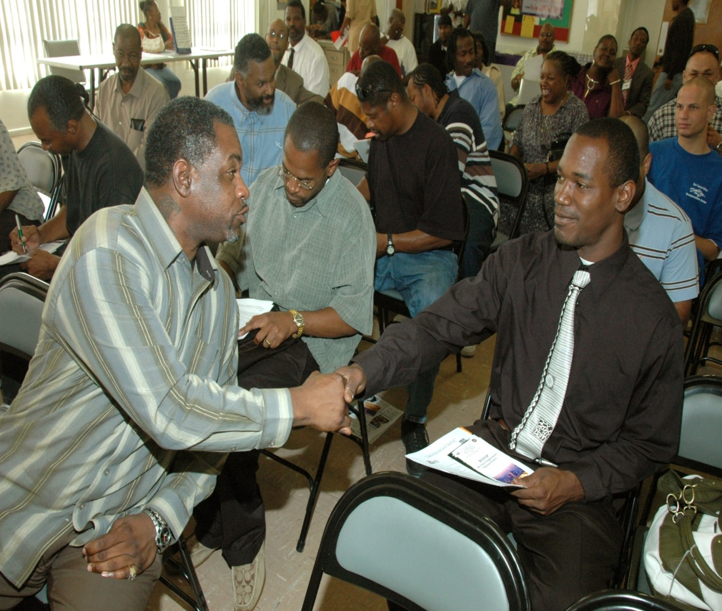
Use FB ‘First Responder’ Role as Foundation to Take First Steps
Build your own roundtable of academics, researchers, clergy, laity, consumers, family members, businesses, public health and system leaders
Try to Learn from other agencies
No need to reinvent the wheel
Notes:
Explain if you want to develop or adopt an evidence based practice in SUD and alcohol, then you need “braintrust” to help your congregation do it. This is not solo work. Even in the adoption of EBPs – you will be served well to organize and sustain a “EBPs ‘ministry team’ or ‘committee’ to help with adoption and implementation. Recommend conduct a thorough internal assessment of capacity for this step in alcohol and drug counseling, treatment and reco ver support.

Slide 22
Manualized
Treatment
Protocols
Notes:
Transition slide – changing focus and topic
Examples of EBPs

Slide 23
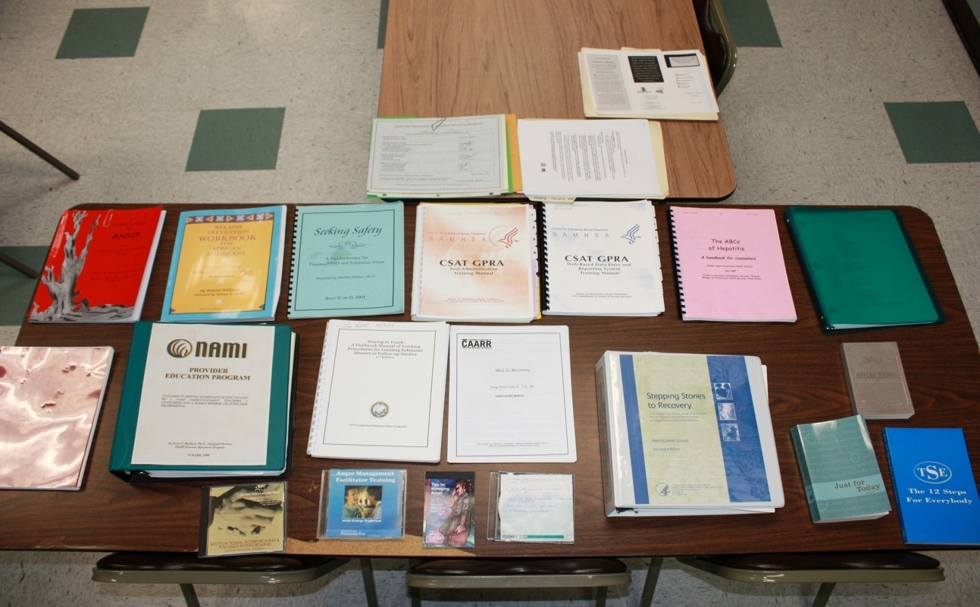
Overview
SAMHSA Compendium of EBPs
Notes:
Examples of EBPs – use local examples when you can.

Slide 24
What Counselors Say About Using Treatment Manuals
Like the structure and consistency
Easy to use
They help focus a session
Can be restrictive
Need to incorporate personal style and creativity
Need to provide flexibility
Notes:
Godley, S.H., et al (2001) Therapist Reactions to Manual-Guided Therapies for the Treatment of Adolescent Marijuana Users. Clin Psychol Sci Prac 8: 405-417

Slide 25
Counselor Recommendations for Manuals
Include underlying philosophy
Explain how assessment information can be used within an intervention
Give detailed instructions for procedures
Provide specific examples
Notes:
Godley, S.H., et al (2001) Therapist Reactions to Manual-Guided Therapies for the Treatment of Adolescent Marijuana Users. Clin Psychol Sci Prac 8: 405-417

Slide 26
Counselor Recommendations for Manuals
Use appropriate language for audience
Include samples of dialogue and paperwork
Provide directions for deviating from the manual
Notes:
(Godley, S.H. et al, 2001)

Slide 27
Ambivalence is Appropriate
Evidence-based practices impose burdens
Evidence-based practices require change
Notes:
(Godley, S.H. et al, 2001)

Slide 28
What Is Our Goal?
To provide persistent, incremental improvements in the quality and effectiveness of substance abuse treatment which results in better quality recovery for more people.
Notes:
Transition slide – check audience
Reinforce the purpose of EBPs- to improve treatment outcomes in everyday practice
if you really feel you have time include examples on cost of treatment with examples on how the new paying system has directly impacted the ‘how’ we do our work- tie to Ethics principle in SUD counselors, etc.

Slide 29
Change Process -
Stage of Change Action Principle
Pre-contemplation | Always assess and re-assess readiness to change and develop a plan based on stages of change | Bi-directional
Contemplation Preparation | Develop a vision that everyone understands and supports | Clear Bi-directional Relevant Timely
Action | Build on what you have and what is already in place Integrate what you know with the technology you want to apply | Relevant Credible Clear
Notes:
Discuss how to create ‘Lessons Learned’ and what to do with what we think we know. This is the part of treatment that we can discuss our faith. Hard to measure faith, but we know it works towards abstinence and recovery- we just don’t know facts of how it works and why

Slide 30
Change Process
Stage of Change Action Principle
Preparation Action | It is a process It’s a long-term effort achieved by meeting short-term objectives | Multi-faceted
Action | “Wrap it pretty” Use incentives and reinforcements What comes off the plate when new responsibilities are added? | Multi-faceted Continuous
Notes:
Discuss how to create ‘Lessons Learned’ and what to do with what we think we know. This is the part of treatment that we can discuss our faith. Hard to measure faith, but we know it works towards abstinence and recovery- we just don’t know facts of how it works and why

Slide 31
Change Process
Stage of Change Action Principle
Action Maintenance | Comprehensive and long-term effort Utilize new training webinars for groups of staff and individuals Use training, manuals, supervision, consultation Use a variety of methods to present information Build partnerships with customers, funders, stakeholders Capitalize on staff strengths Establish a systematic problem-solving process | Multi-faceted Continuous Bi-directional Credible
Notes:
Discuss how to create ‘Lessons Learned’ and what to do with what we think we know. This is the part of treatment that we can discuss our faith. Hard to measure faith, but we know it works towards abstinence and recovery- we just don’t know facts of how it works and why
Mention all the new webinars and encourage online surfing for resources and no cost methods to counsel parishioners

Slide 32
Change Process
Stage of Change Action Principle
Maintenance Relapse | Anticipate barriers and relapse Respond with strength-based approaches and interventions based on the stages of change Back to precontemplation and contemplation | Continuous Bi-directional
Notes:
Discuss how to create ‘Lessons Learned’ and what to do with what we think we know. This is the part of treatment that we can discuss our faith. Hard to measure faith, but we know it works towards abstinence and recovery- we just don’t know facts of how it works and why
Mention all the new webinars and encourage online surfing for resources and no cost methods to counsel parishioners

Slide 33
Core Components of Comprehensive Services
Medical
Financial
Mental Health
Group/Individual Counseling
Housing &
Transportation
Core
Treatment
Vocational
Urine Monitoring
Abstinence
Based
Intake
Assessment
Case Management
Child Care
Pharmaco-therapy
Educational
Treatment
Plans
Continuing Care
Self-Help
(AA/NA)
Family
Legal
AIDS / HIV Risks
Etheridge, Hubbard, Anderson, Craddock, & Flynn, 1997 (PAB)
Notes:
Back to basics – NIDA principles (TCU model)

Slide 34
Principles of Effective Treatment
1. No single treatment is appropriate for all
2. Treatment needs to be readily available
3. Effective treatment attends to the multiple needs of the individual
4. Treatment plans must be assessed and modified continually to meet changing needs
5. Remaining in treatment for an adequate period of time is critical for treatment effectiveness
Notes:
”First things first”. NIDA Principles- explain.

Slide 35
Principles of Effective Treatment
6. Counseling and other behavioral therapies are critical components of effective treatment
7. Medications are an important element of treatment for many patients
8. Co-existing disorders should be treated in an integrated way
9. Medical detox is only the first stage of treatment
10. Treatment does not need to be voluntary to be effective
Notes:
”First things first”. NIDA Principles- explain.

Slide 36
Principles of Effective Treatment
11. Possible drug use during treatment must be monitored continuously
12. Treatment programs should assess for HIV/AIDS, Hepatitis B & C, Tuberculosis and other infectious diseases and help clients modify at-risk behaviors
13. Recovery can be a long-term process and frequently requires multiple episodes of treatment
Notes:
”First things first”. NIDA Principles (1999)- explain.

Slide 37
Evidence-Based Practices for Alcohol Treatment
Brief intervention
Social skills training
Motivational enhancement
Community reinforcement
Behavioral contracting
Notes:
Miller et al., (1995) What works: A methodological analysis of the alcohol treatment outcome literature. In R. K. Hester & W. R. Miller (eds.) Handbook of Alcoholism Treatment Approaches: Effective Alternatives. (2nd ed., pp 12 – 44). Boston: Allyn & Bacon.

Slide 38
Scientifically-Based Approaches to Addiction Treatment
Cognitive–behavioral interventions
Community reinforcement
Motivational enhancement therapy
12-step facilitation
Contingency management
Pharmacological therapies
Systems treatment
Notes:
L. Onken (2002). Personal Communication. National Institute on Drug Abuse.
Principles of Drug Addiction Treatment: A research-based guide (1999). National Institute on Drug Abuse

Slide 39

An Evidence-Based Treatment Model for Improving Practice
D. Dwayne Simpson
and Colleagues
Texas Christian University
Notes:
Credit to D. Dwayne Simpson and Colleagues Texas Christian University
Simpson, 2001 (Addiction)

Slide 40
Elements of a Treatment
Process Model
Patient
Factors
Detox
?
Psychological
Functioning,
Motivation,
& Problem
Severity
OP-DF
Sufficient
Retention
Drug
Use
TC/Res
Crime
OP-MM
Social
Relations
Posttreatment
Cognitive and behavioral
components with therapeutic impact
Notes:
Credit to D. Dwayne Simpson and Colleagues Texas Christian University
Simpson, 2001 (Addiction)

Slide 41

TCU Treatment Process Model
Motiv
Early
Engagement
Early
Recovery
Patient
Attributes
at Intake
Program
Participation
Behavioral
Change
Sufficient
Retention
Drug
Use
Crime
Therapeutic
Relationship
Psycho-Social
Change
Social
Relations
Posttreatment
Engagement
Notes:
Credit to D. Dwayne Simpson and Colleagues Texas Christian University
Simpson, 2001 (Addiction)

Slide 42
“Sequence” of Recovery Stages
Patient
Readiness
for Tx
Program
Participation
Behavioral
Change
Drug
Use
Adequate
Stay in Tx
Crime
Therapeutic
Relationship
Cognitive
Change
Social
Relations
Targeted Interventions
Posttreatment
Get Focused!!
Notes:
Credit to D. Dwayne Simpson and Colleagues Texas Christian University
Simpson, 2001 (Addiction)

Slide 43
Interventions Should
Maintain This Process
Motiv
Early
Engagement
Early
Recovery
Patient
Attributes
at Intake
Program
Participation
Behavioral
Change
Sufficient
Retention
Drug
Use
Crime
Therapeutic
Relationship
Psycho-Social
Change
Social
Relations
Posttreatment
Notes:
Credit to D. Dwayne Simpson and Colleagues Texas Christian University
Simpson, 2001 (Addiction)

Slide 44
Induction to Treatment
(Motivational Enhancement)
Motiv
Early
Engagement
Early
Recovery
Patient
Attributes
at Intake
Program
Participation
Behavioral
Change
Sufficient
Retention
Drug
Use
Problem
Recognition
Crime
Therapeutic
Relationship
Psycho-Social
Change
Desire
for Help
Social
Relations
Readiness
for Treatment
Posttreatment
Notes:
Credit to D. Dwayne Simpson and Colleagues Texas Christian University
Simpson & Joe, 1993 (Pt); Blankenship et al.,1999 (PJ); Sia, Dansereau, & Czuchry, 2000 (JSAT)

Slide 45
Counseling Enhancements
(Cognitive “Mapping”)
Motiv
Early
Engagement
Early
Recovery
Patient
Attributes
at Intake
Program
Participation
Behavioral
Change
Sufficient
Retention
Drug
Use
Crime
Therapeutic
Relationship
Psycho-Social
Change
Social
Relations
Posttreatment
Notes:
Credit to D. Dwayne Simpson and Colleagues Texas Christian University
Dansereau et al., 1993 (JCP), 1995 (PAB); Joe et al., 1997 (JNMD); Pitre et al., 1998 (JSAT)

Slide 46
Contingency Management
(Token Rewards)
Motiv
Early
Engagement
Early
Recovery
Patient
Attributes
at Intake
Program
Participation
Behavioral
Change
Sufficient
Retention
Drug
Use
Crime
Therapeutic
Relationship
Psycho-Social
Change
Social
Relations
Posttreatment
)
Notes:
Credit to D. Dwayne Simpson and Colleagues Texas Christian University
Rowan-Szal et al., 1994 (JSAT); 1997 (JMA); Griffith, Rowan-Szal et al., 2000 (DAD

Slide 47
Specialized Interventions
(Skills-Based Counseling Manuals)
Early
Engagement
Early
Recovery
Supportive
Networks
Motiv
Patient
Attributes
at Intake
Program
Participation
Behavioral
Change
Sufficient
Retention
Drug
Use
Crime
Therapeutic
Relationship
Psycho-Social
Change
Social
Relations
Posttreatment
Notes:
Credit to D. Dwayne Simpson and Colleagues Texas Christian University
Bartholomew et al., 1994 (JPD); 2000 (JSAT); Hiller et al., 1996 (SUM)

Slide 48
Evidence-Based Treatment Model
Behavioral
Strategies
Induction
Family &
Friends
Personal Health Services
Early
Engagement
Early
Recovery
Supportive
Networks
Motiv
Patient
Attributes
at Intake
Program
Participation
Behavioral
Change
Sufficient
Retention
Drug
Use
Program
Characteristics
Staff
Attributes
& Skills
Crime
Therapeutic
Relationship
Psycho-Social
Change
Social
Relations
Posttreatment
Enhanced
Counseling
Social Skills
Training
Social Support Services
Notes:
Credit to D. Dwayne Simpson and Colleagues Texas Christian University
Simpson, 2001 (Addiction Enhanced Counseling)

Slide 49




In Summary
Notes:
Now, let’s look at the principles necessary to effective technology transfer initiatives.

Slide 50
Sources of Evidence-Based Information on the Web
Managed Care
  samhsa.gov/mcnew
Dual Disorders
  dartmouth.edu/~psychrc
Stimulant Treatment
  matrixcenter.com
Drug Abuse Treatment
  ibr.tcu.edu
Notes:
Discuss resources, how to find online (bring wireless card to demonstrate in class)
Engage audience here

Slide 51
Sources of Evidence-Based Information on the Web
Drug Abuse Treatment
  nida.nih.gov
Alcoholism Treatment
  niaaa.nih.gov
Addiction Medicine
  asam.org
HIV/AIDS
  cdc.gov/idu/
Notes:
Discuss resources, how to find online (bring wireless card to demonstrate in class)
Engage audience here
Government and universities have literally tons of information, manuals and resources - USE THEM! Mention to audience many are FREE/NO COST

Slide 52
Sources of Evidence-Based Information on the Web
Prevention
  unr.edu/westcapt
Technology Transfer
  nattc.org
Addiction Science
  utexas.edu/research/asrec
Notes:
Discuss resources, how to find online (bring wireless card to demonstrate in class)
Engage audience here
Government and universities have literally tons of information, manuals and resources - USE THEM! Mention to audience many are FREE/NO COST

Slide 53
Resources for EBPs
-http://gainscenter.samhsa.gov/topical_resources/ebps.asp
-http://store.samhsa.gov/list/series?name=Evidence-Based-Practices-KITs
-http://www.nrepp.samhsa.gov/Learnlanding.aspx
-http://www.nrepp.samhsa.gov/Courses/Implementations/NREPP_0101_0010.html
Notes:
Discuss resources, how to find online (bring wireless card to demonstrate in class)
Engage audience here
Government and universities have literally tons of information, manuals and resources - USE THEM! Mention to audience many are FREE/NO COST

Slide 54
The End.
Notes:
End.

