Slide 1
Easier Together:
Partnering with Families to
Make Recovery Possible
Notes:
Welcome to Module 6 of “Easier Together: Partnering with Families to Make Recovery Possible.”

Slide 2
Module 6: Case-Based Application
Where to begin
Questions to consider
Developing a family-centered case plan
Notes:
During Module 6 of the “Easier Together” curriculum, we will discuss how one can begin to apply family-centered principles and clinical interventions.
We will also review some questions one can consider for applying family-centered care.
Afterwards, we will go through the framework and work through a case study in small groups to assist us with developing a family-centered case plan.

Slide 3
Acknowledgements
Diana Kramer, MA, BHT
SAMHSA PPW Program Manager
Native American Connections
Phoenix, AZ
Kimberly Craig, BA, BS, LSAT
CEO, CHEEERS Recovery Center
Former PPW grantee
Phoenix, AZ
Notes:
Our thanks to Diana Kramer and Kimberly Craig for their expertise and many contributions in the development of this module.
Diana Kramer currently works with Native American Connections as the SAMHSA Program Director of the Pregnant and Postpartum Women’s Project with a focus on improving the lives of individuals, children, and families with the integration of physical, mental, and behavioral health services. Previously, Ms. Kramer worked at the Arizona Department of Health Services, Division of Behavioral Health Services as the Cultural Competency and Workforce Development Manager.
Kimberly Craig is the CEO/President of the CHEEERS Recovery Center in Phoenix, Arizona where she leads an organization that meets the needs of individuals who have serious mental illness and substance use disorders. Prior to CHEEERS, Kimberly served as Vice President of Women’s and Children’s Programs for 11 years with Center for Hope in Phoenix, where she developed and managed evidenced-based programs for pregnant and post-partum women and their families. This program was a recipient of SAMHSA PPW funding in 2011 and successfully expanded services to engage fathers and the younger and older children of the women.

Slide 4
Introductions
Name
How many family members are in your family?
Describe family using one word.
Notes:
Before we get started, I’d like to do some brief introductions.
Trainer: introduce yourself
Now I’d like everyone to introduce their self. This curriculum is meant to be interdisciplinary and collaborative, let’s get to know what is important to you with family-centered services.
Have everyone say their name, how many family members are in your family, and describe family using one word.
For example: My name is Jane, there are 3 in my family, and my word is loving.
Note to trainer: You can modify this activity based on your audience.

Slide 5
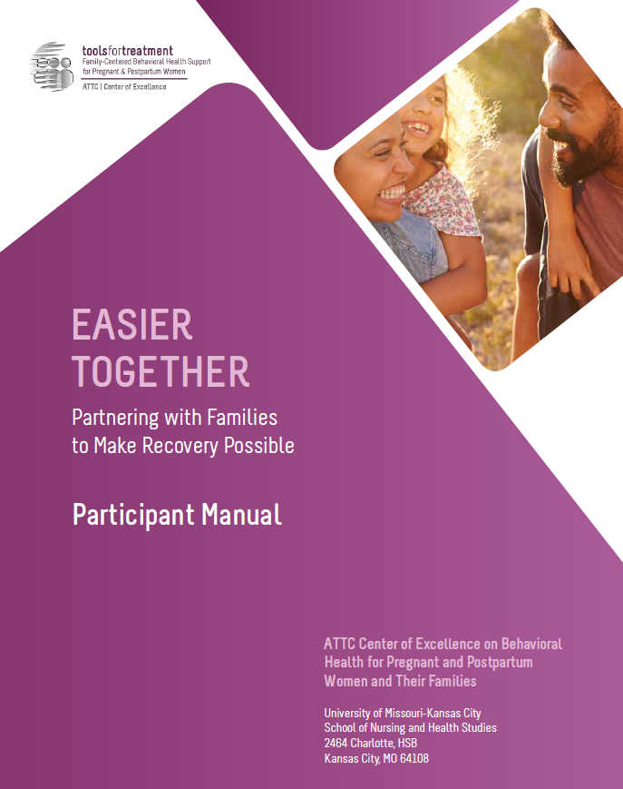
Hands-On Review of Participant Manual
Participant Manual
Each module contains:
Training goals and objectives
Copy of slides
Resources – worksheets, activities, assessments, recommended reading
Reference list
Notes:
As part of this curriculum, you all have a participant manual. I’d like us to do a hands-on review of this module’s content so you are familiar:
On page 174, the module begins with the training goals and objectives.
Next on page 175 you will find all of the presentation slides with room for taking notes.
Then on page 188 you will find the resources section, which contains a collection of handouts, worksheets, activities, assessments, recommended reading, and a reference list for that module.

Slide 6
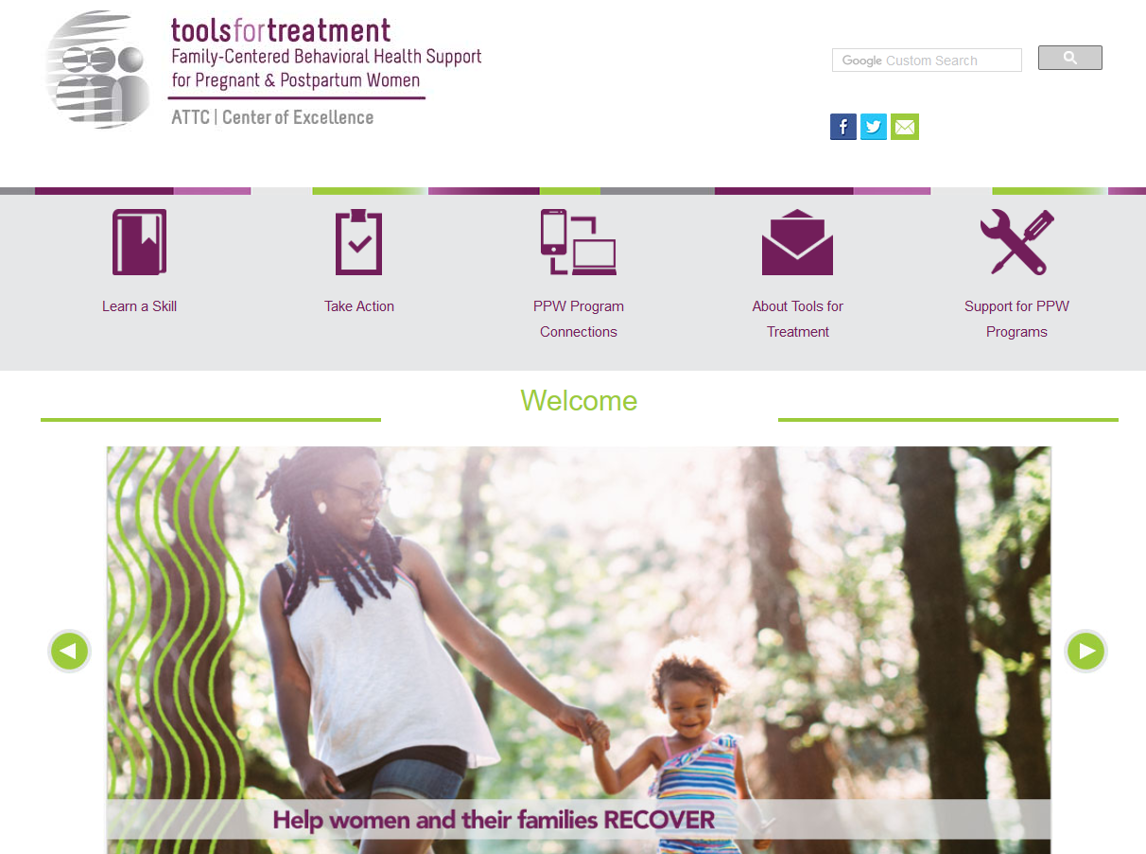
Visit www.attcppwtools.org for More Resources
Training Curriculum
Online Courses
300+ Program Resources Library
Recorded Presentations
Videos
Notes:
For additional resources, visit www.attcppwtools.org. Here you can download the “Easier Together” curriculum and access other resources such as:
Training curriculum
Online courses
300+ resources in the Program Resources library
Recorded presentations
Videos

Slide 7
Goal and Objectives
Goal: Help programs apply family-centered concepts, principles, and interventions through the use of a client case study.
Objectives: Participants will be able to:
Apply steps for developing family-centered interventions using a fictional client case study.
Apply the principles and interventions to a case study using a culturally inclusive and family-centered approach.
Use a case study exercise to inform decisions at both an organizational and clinical level.
Notes:
The goal of this module is to help programs understand family-centered concepts, principles, and interventions through the use of a client case study.
These are our learning objectives for Module 6:
Apply steps for developing family-centered interventions using a fictional client in a case study.
Apply the principles and interventions to a case study using a culturally inclusive and family-centered approach.
Use a case study exercise to inform decisions at both an organizational and clinical level.

Slide 8
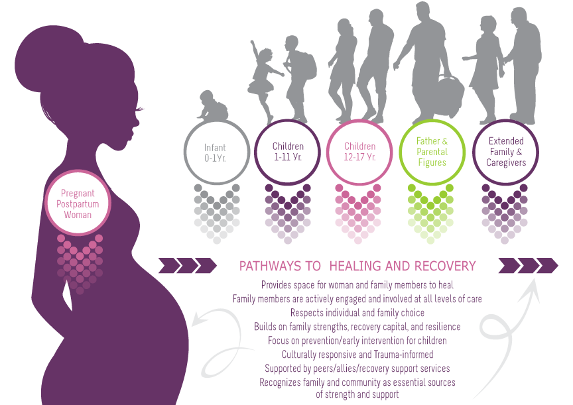
Family-Centered Recovery & Wellness Principles
Page 69 in participant manual
Notes:
This is a graphic that was developed to embody family-centered care and was presented in earlier modules. In this graphic, you can see that the woman is the vehicle of entry for all family members. She is the initial client that comes into the program to receive services, but through her, our view expands to include all family members. The family becomes the client and we wrap services around all family members to support family strengthening and healing.
Additionally, this graphic outlines “family-centered, recovery and wellness principles.” It is imperative to view family-centered care through the lens of recovery and wellness, not just as a treatment episode. Family-centered care sets families up for sustainable recovery and wellness long after treatment ends.
Note to trainer: This is available as a handout on page 69 of the participant manual.

Slide 9
How to Begin?
Notes:
This module is designed to assist all in attendance regardless of discipline, role or professional orientation the opportunity to look at family-centered care and intervention by applying it to a case study.
Today’s session will illustrate how the family-centered principles and interventions can be applied to real life scenarios including the decision-making processes on the administrative and clinical intervention levels for programs.
We anticipate that the application of these principles through the provided case study will highlight or reveal the information, provisions, or even changes that are needed to implement family-centered care in one’s programming
.
Before we begin reviewing the case study, we are going to briefly review the six steps of family-centered invention on page 160 in the participant manual that were discussed in module 5.
Note to trainer: This module applies the core principles and interventions that were discussed in Modules 4 and 5. In order for participants to find this module meaningful and fully participate in the exercise, they must be familiar with the content in Module 4 and 5 prior to this session.

Slide 10
Page 160 in participant manual
Notes:
As reminder, the 6 steps listed here are the identified components we must consider when implementing family-centered care in our programming. Programs for families must contain the following elements:
Individual Assessment: For purposes of this training the woman is the person who completes an individual assessment. The individual assessment gathers her background, mental and physical health history, social and economical status, cultural considerations, and establishes a diagnosis.
Definition of Family: Implementation of family-centered care requires that we work with the individual to establish a definition of family. It is important to note that clinicians should work with clients to broadly define family in a cultural context. The definition of family may differ considerably for mothers, fathers, and children in response to differences in race, ethnicity, religion, marital status, sexual orientation, socioeconomic status, and other sociocultural influences. In general, the definition of family involves two questions:
Who defines family?
Who will be considered family during the period of treatment for purposes of the family assessment and intervention?
Family Assessment: After the family members have been identified in a broad, culturally sensitive, and inclusive manner there needs to be a decision about who will be included and involved in the family assessment. Just as the individual assessment identifies the needs of the individual, the family assessment will identify the needs of the family members. One of the goals of a family assessment is to collaboratively decide what type of family intervention may be helpful and who should be involved.
Safety Planning: Another key component of effective family-centered care must involve safety planning for the entire family. This includes assessing risk concerns and planning with the entire family what the safety and contingency plans will be in order to reduce, prevent, and lessen harm to any single family member including children, mothers and extended family members. This requires input and understanding of any person’s legal status, involvement of Child Protective Services, presence of restraining orders, etc.
Clinical Interventions: This step refers to the actual services that will be provided to the individual family members. Because family-centered care requires a variety of services to meet the family’s need, a clinical intervention is no longer limited to individual or group counseling for the primary individual. We will review these interventions briefly as well.
Evaluation and Clinical Outcomes: Family-centered care must also include evaluation of the clinical outcomes. This is done at both the program and individual level. For the family-centered plan, we need to think about what the goal is for the family as a unit. Also, what do we hope the outcome for the family will be? This will inform our decisions around service and intervention planning.

Slide 11
Types of Family-Centered Clinical Interventions
Notes:
These are the core services that that need to provided or that programs need to make provisions for implementing and delivering family-centered care. It is important to remember the program offering family-centered care does not need to be the only service provider. Community connections and collaboration with a variety of service providers may be how these services are provided.
Marital – Partner Interventions: This refers to interventions designed and provided to couples who intend to pursue, or maintain a relationship. Areas addressed may include: intimate partner violence, continued substance use as a couple, questions about whether to remain together, communication problems, and concerns about fidelity.
Co-parenting Interventions: These interventions may be part of a marital-partner intervention or may be the primary form of intervention for couples who have ended their sexual relationship or partnership. The development of a parenting plan may be done without marital or partner inventions. Sometimes programs will decide that couple’s counseling is not going to be an option and a parenting plan and co-parenting intervention is the least that can be done.
Parenting Interventions: It is important to note that family-centered care differs from traditional women-centered programming in that it provides direct parenting interventions for everyone that will parent the child. Family-centered care involves parenting classes for fathers, and could also include parenting classes for the caregivers of the children as identified in the family assessment. There are father-specific parenting interventions and resources available. Please note that safety planning for the family must include parenting education and interventions. We know for this population in particular that risk of abuse increases when expectations are unrealistic and when there is a fundamental lack of understanding as to the developmental stages (age appropriate activity and behavior) for children. This is true for all care givers involved with the children.
Child Interventions: This refers to services provided directly to the children to address any and all developmental, behavioral, or support issues that are needed. Services must be provided based on what is developmentally appropriate. Provisions for meeting the needs of older children up to the age of 17 years should be included. Programs will also need to consider as a part of their “defining family” if children who are no longer in the care of the mother will receive services such as in the case of mothers who have contact with children but have lost parental rights. Will these children be considered a part of the family-centered interventions? Consider that with kinship placement, regardless of legal status, the mother may be involved in the lives of the older children and it may be appropriate to provide services to them.
Family Intervention: This refers to interventions designed for the parents and children in whatever configuration there may be such as mom and children, dad and children, or mom and dad and children. This may include therapeutic interactions and parent-child therapy.

Slide 12
The Culture Conversation
The Culture Conversation
Families are different and unique in every continent, state, county, city, community, and home.
The people who come to see us bring us their stories, they hope they tell them well enough so that we understand the truth of their lives, they hope we know how to interpret their stories correctly, we have to remember that what we hear is their story. – Robert Coles
^{Page 189 in participant manual}
Notes:
According to SAMHSA, cultural competence is the ability to interact effectively with people of different cultures. In practice, both individuals and organizations can be culturally competent. A family’s culture must be considered at every step. “Culture” is a term that goes beyond just race or ethnicity. It can also refer to such characteristics as age, gender, sexual orientation, disability, religion, income level, education, geographical location, or profession. It is an integrated pattern of human behavior which includes but is not limited to: communication, thoughts, languages, beliefs, values, practices, customs, courtesies, rituals, manners of interacting, roles, relationships, spirituality, and expected behaviors of racial, ethnic, religious, social, or political groups.
Our families are different and unique in every continent, state, county, city, community, and home. They all have a culture. We must listen, be understanding, open, and willing to experience the discomfort of different.
When we are working with:
Various racial/ethnic communities (African-American, American-Indian/Native American/Alaska Native, Asian-American, Hispanic, Multi-Race, Pacific Islander, White)
Varying types of parents (single parent, multiple parent, co-parent, same sex, divorced)
Income levels (low income, middle income, high income)
Tribal and non-tribal communities
Types of families (younger, communal, religions, patriarchal, matriarchal)
We must begin the conversation with the individual and listen to their story of their family. Our family plan works in collaboration with the individuals we serve and the interventions we develop and refine together.
Now let’s move on and see how cultural considerations work across all the family-centered intervention steps with a case study and family-centered plan.

Slide 13
Client Case Study
Notes:
In this next section, we will review a client case study and determine the overall family-centered case plan in small groups.
Note to trainer: Depending on the group size, please have the teams break into groups of 5 or 6. Encourage those in attendance to choose their group by having representation from various disciplines or departments if possible. Each group will develop a family-centered case plan for our case study.

Slide 14
Worksheet: Questions to Consider
Family-Centered Intervention: Questions to Consider Worksheet
Pages 190-191 in participant manual
Craig & Kramer, 2017
Notes:
Before we take a look at the case study, we are going to review some useful worksheets to help you develop a family-centered case plan. Please turn to Family-Centered Intervention: Questions to Consider worksheet on pages 190-191 of the participant manual.
On this page are the core components of family-centered interventions and some questions that I would like you to consider as you review the case study. These questions will assist in the development of a family-centered and culturally inclusive case plan.
For example, as you review the case study in your group, think about the key issues or things that are significant about the person in each of the areas. Since you only have a summary of the individual assessment and case plan, write down notes about the key information that will be important to include or address in each of these areas.
This worksheet is only intended to assist you in applying family-centered care and practices to a case.
Here are some key questions you should consider:
Of the information provided, what is significant or key information?
How did the client define family based on the information you have?
Who would you include in the family assessment?
What factors need to be considered in terms of safety, and what additional information do you need to develop a safety plan?
What interventions will you recommend for the family?
What might be the goal for this family?
What are the cultural considerations to note for the development of a family-centered plan?

Slide 15
Worksheet: Family-Centered Case Plan
Family-Centered Case Plan Worksheet (blank)
Page 192 in participant manual
Example Family-Centered Case Plan Worksheet (completed with examples)
Pages 193-195 in participant manual
Craig & Kramer, 2017
Notes:
Another tool you can use is the Family-Centered Case Plan Worksheet. The participant manual contains a blank worksheet (page 192), as well as a completed worksheet with examples to give you ideas of possible family-centered interventions (pages 193-195).
Please turn to page 192 so we can review the blank worksheet. This tool helps one prioritize needs and interventions at different levels for families. At the top of the page, write down any cultural considerations for this family that should be kept in mind as the interventions are considered. The first column is the Identified Strength or Need. In this column, you can make notes on the needs and strengths of the family members. The second column is the Intervention and Recommendation. Under this column, you would note the services, programs, counseling, etc. needed to help meet the identified need or strength. In the third column you indicate whether the identified issue is a strength or challenge (indicate with plus or minus sign). When you have finished filling out the first three columns, proceed to prioritizing the interventions using the fourth column. Anything that should be addressed as soon as possible should be noted with an “I” for immediate and high priority. If the need is significant, but not urgent, you can note it with an “S,” which indicates that the need should be addressed within six months. If the need doesn’t require action for the next six months or if there isn’t a recommended intervention at the time, note that need with a letter N for “noted.”
Let’s briefly discuss examples of how you could populate this worksheet. On pages 193-195 of the participant manual, you will find an example of a completed Family-Centered Case Plan to provide ideas of what you might include.

Slide 16
Exercise: Review Case, Questions to Consider
1) Review case study:
Module 6 Case Study
Page 196 in participant manual
2) Complete this worksheet in your group:
Family-Centered Intervention: Questions to Consider
Page 190-191 in participant manual
3) Larger group discussion
Notes:
Now, let’s learn more about our fictional client by reviewing the case study on page 196 of the participant manual. Let’s take 3 minutes to read the case individually, and then each group will have a 5-minute discussion about the case using the Family-Centered Intervention: Questions to Consider worksheet on pages 190-191 of the participant manual. Please identify a group member who will report out to the larger group.
Note to trainer:
Have participants review case individually for 3 minutes.
After 3 minutes, have previously assigned groups get together to discuss the case and take notes on the Family-Centered Intervention: Questions to Consider worksheet on pages 190-191 of the participant manual.
After 5 minutes, come back together in a large group and share what you discussed in your small groups. Have groups identify a representative from who will serve as the spokesperson and provide a brief summary about each group’s discussion (discussion instructions on next slide).

Slide 17
Debrief: Questions to Consider
Page 190-191 in participant manual
Craig & Kramer, 2017
Notes:
Now let’s talk about the activity we just completed. Some of you may have felt as if the case study didn’t provide all the information we needed, and therefore, didn’t feel as if you could develop a comprehensive assessment. This is why it’s important to have a complete and comprehensive assessment process for both the individual and family. It is often said in the field that our service planning is only as good as the assessment we have, and the same is often true of the outcomes. If we do not know what the issues are, it’s unlikely that interventions will promote any successful outcome for the family.
Note to trainer: Listed below are questions to help guide your discussion. This exercise may create more questions than answers, but is intended to get both clinical/direct service staff and program administrators thinking about what programming elements they may need to expand or revise or incorporate to gather information to develop the family-centered plan.
When you were applying these questions or reading the case study, did you feel you were using the family-centered perspective or lens?
How many of you felt you had enough information in the case study?
What information was missing or what did you need more information about?
Where would this missing information be available?
How would you go about obtaining the information?

Slide 18
Exercise: Develop Family-Centered Case Plan
Page 192 in participant manual
Notes:
In our small groups, let’s practice developing a family-centered plan using our case study.
As previously mentioned, the Family-Centered Case Plan worksheet on page 192 is designed to help you identify the strengths and needs of the family in order to determine what culturally sensitive services or interventions will be needed within a certain time frame. We will be using this worksheet for this part of the activity.
Using information gathered from the case study, identify the strengths and needs for the family in each of the intervention areas as well as the intervention you are recommending for each.
Then note a (+) or (–) in the third column to indicate whether the issue is a strength or challenge.
Do not prioritize the interventions until you have completed the list. After your group has identified the needs in each area, determine which interventions are a priority, which are significant, and which ones are just note-worthy and will not require action or recommendation. Use the key at the top of the fourth column to note the priority levels.
To give you an idea of what this may look like, refer to the Example Family-Centered Case Plan on page 193 of your participant manual.
You will have 10 minutes to complete this worksheet within your group.
Note to trainer: You can modify the time for this activity based on your group size and schedule.

Slide 19
Debrief: Family-Centered Case Plan
What strengths and needs were you able to identify for the family?
What challenges did you find?
What information was missing?
How will you use this exercise to implement family-centered care in your work?
Notes:
Let’s discuss what your groups came up with. Who would like to share with the larger group what your group came up with?
Note to trainer: Listed below are some additional questions to help guide your group discussion.
Besides having some limited information in the case, what were some other challenges you experienced while doing this exercise?
Was this activity helpful for understanding family-centered care?
Based on this activity, what information do you now know you will need to gather to complete a family-centered case plan?
Regardless of our role in the agency or system, what changes will you or your team need to make to provide family-centered care?
What might the challenges be, and what are your easy shifts?
What partners might you consider bringing to the table to provide information? Where might this information be available now?
What collaborations will be important to have, improve, or maintain?
Family-centered care requires collaboration, not just cooperation or coordination of care. What does collaboration mean for your agency or program?

Slide 20
Outcomes and Evaluation
In terms of applying outcomes to family-centered care, we want to think about it in two ways….
What are the outcomes we hope for the entire family?
What are the outcomes for the program?
Notes:
The final step in family-centered care consists of outcomes and evaluations.
We know that outcomes and program evaluation can be challenging, but it is very important.
When applying outcomes to family-centered care, we want to consider two things:
1. What are the outcomes we hope for the entire family
2. And what are the outcomes for the program.
How we measure and look at outcomes for the family is important not only for the program’s success, but most importantly for the family. Too often in our field, outcomes are defined and set by the programs and not the individuals, which is problematic. It is important to remember that the family needs to determine what their end goal and successful outcome will be. Also, it’s important that families define and experience success.
For example, a goal for one family might be family reunification, while another family may have a goal to establish a long term parenting plan without reunification.
Helping families determine their goals and positive outcomes can be a part of the service planning process. Family-centered care requires a broad family goal that considers the strengths, needs, and preferences for the family unit, including the mother, father, children, and extended family.
There may also be some cultural considerations. For example, culture can influence one’s definition of nuclear family, concepts of shared parenting, and positive outcomes.
All of this requires an evaluation of our mission, values, services, and barriers.
Some examples of program outcomes in family-centered care can be:
Increase the number of family members who actually receive services specific to parenting.
Increase the number of parenting plans completed by families.
Development of safety planning that encompasses all systems and family members to reduce the likelihood of harm.
Development of a family-friendly environment and program that encourages father and family member involvement.

Slide 21
Discussion and Wrap-Up
Notes:
We are nearing the end of this module.
With a show of hands:
How many can take away at least one thing from the training?
How many thought of ways you can improve your program and looked for ways to “make it happen,” versus reasons it can’t happen?

Slide 22
Culture Conversation: Shift to Collaboration
The Culture Conversation
Notes:
As a reminder, many states, cities, agencies, and/or communities may have family inclusion services or work with families whose culture or practice are family-centered or communal families.
This does not mean we are all working together using the same language, interventions, or practices for family-centered care.
The hope is to shift together and continue to grow our collaborations to utilize family-centered interventions, techniques, and practices which utilize similar languages and concepts that support our families from a global perspective.
There will always be cultural considerations and adaptations for families and the communities we serve. This is core to family-centered programming.
When we utilize a common language and have a common goal which unites us such as family-centered care, we are stronger.
When we focus on the unique needs of the individual and family we are working with, they are stronger.

Slide 23
Resources
SAMHSA Cultural Competency- https://www.samhsa.gov/capt/applying-strategic-prevention/cultural-competence
SAMHSA HRSA Center for Integrated Health Solutions- http://www.integration.samhsa.gov/workforce/cultural-competence-adaptation
Notes:
This concludes the sixth module in this training series.
These are the resources used for this module. You can refer to these sites for further information on cultural competency.

