Slide 1
Easier Together:
Partnering with Families to
Make Recovery Possible
Notes:
Welcome to “Easier Together: Partnering with Families to Make Recovery Possible.” This curriculum contains six modules that will describe a family-centered approach to treatment. It will allow you to consider how you might use this approach in your work to improve care for pregnant and postpartum women and their families.

Slide 2
Module 1: Introduction to “Easier Together” Curriculum
Explanation of curriculum and audience
Why does this matter?
Defining family-centered care
Language, stigma, and obstacles
Notes:
During module 1 of the “Easier Together” curriculum, I will:
provide an introduction to this training series
discuss why this topic is important
describe the definition of family-centered care, and
review language, stigma, and obstacles.

Slide 3
Acknowledgements
Kathryn Icenhower, PhD CEO and Co-founder
SHIELDS for Families Compton, CA
Notes:
Our thanks to Kathryn Icenhower, PhD, CEO and Co-founder of SHIELDS for Families, for her expertise and many contributions in the development of this module. Dr. Kathryn Icenhower is the Co-founder and Chief Executive Officer of SHIELDS for Families, a private non-profit organization with 340 staff, a $30 million dollar budget and 38 programs that serve over 10,000 families annually in South Los Angeles. She received her BSSW from Ohio State University and her MSW and PhD from the University of Southern California. Dr. Icenhower sits on numerous local, state, and federal coalitions and advisory boards, including the California State Child Welfare Council and SAMHSA’S Advisory Council for Women’s Services. She has been recognized by numerous entities for her piloting work in the substance use and child welfare fields including an Innovator Award from CSAT for her work in Family Centered Treatment, the James Irvine Foundation Leadership Award, the Visionary Award from the National Association of Minority Contractors, and named as one of the 50 most influential women in Los Angeles by Los Angeles Magazine.

Slide 4
Introductions
Name
Field
Top area of expertise
Notes:
Before we get started, I’d like to do some brief introductions.
Trainer: introduce yourself
Now I’d like everyone to introduce yourself. This curriculum is meant to be interdisciplinary and collaborative, so it would also be helpful to learn about the field you work in and your top area of expertise. For instance, my name is Sarah, I work in child welfare, and my top area of expertise is family preservation.
Have everyone say their name, field, and area of expertise.
Instruction to trainer: based on the group, you’re welcome to modify this introduction activity.

Slide 5
Introduction to “Easier Together” Curriculum
Comprised of 6 Modules:
Module 1 — Introduction (45 min)
Module 2 — Family-Centered Care (45 min)
Module 3 — Building Programs for Fathers (45 min)
Module 4 — Implementing Family-Centered Programming (45 min)
Module 5 — Family-Centered Clinical Interventions (45 min)
Module 6 — Case-Based Application (45 min)
Notes:
So let’s get started with the “Easier Together” curriculum. It is comprised of 6, 45-minute modules:
The first module is an introduction to this training series, why this topic is important, how we define family-centered care, and a review of language, stigma, and obstacles.
In module 2, we will dive deeper into family-centered care by watching a documentary produced for this curriculum that tells the story of family-centered care through the perspectives of clients and staff at a treatment program in Compton, CA. We will go through a series of discussion questions to explore the central principles of family-centered care and see how they might apply to your work.
In module 3, we will review why programs should involve fathers.
In module 4, we will discuss how to implement family-centered programming at the agency level.
In module 5, we will review the types of family-centered clinical interventions that can be implemented.
In module 6, we will apply the content of modules 1-5 to a client case.

Slide 6
Target Audience
The primary audience of the “Easier Together” curriculum is addiction treatment providers who are working with pregnant and postpartum women with substance use disorders. The secondary audience is their community partners, including professionals from the fields of:
Mental health
Healthcare
Child welfare
Child development
Housing/vocational services
Other community partners
Notes:
The primary audience of the “Easier Together” curriculum is addiction treatment providers who are working with pregnant and postpartum women with substance use disorders. The secondary audience is their community partners, including professionals from the fields of:
Mental health
Healthcare
Child welfare
Child development
Housing/vocational services
Other community partners

Slide 7
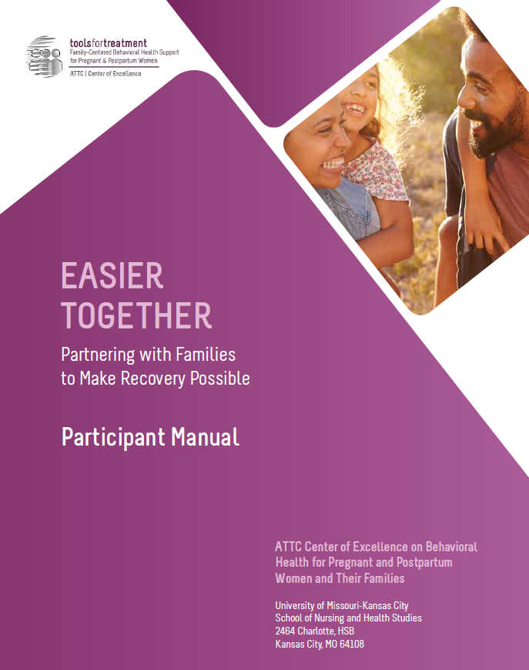
Hands-On Review of Participant Manual
Participant manual
Each module contains:
Training goals and objectives
Copy of slides
Resources – worksheets, activities, assessments, recommended reading, reference list
Notes:
As part of this curriculum, you all have a participant manual. Please bring this manual with you to all sessions, as it will be referenced frequently. I’d like us to do a hands-on review on the manual so you are familiar with all of its content. Please turn to page 4 so we can review what’s in the participant manual:
On page 4, the module begins with the training goals and objectives.
Next on page 5 you will find all of the presentation slides with room for taking notes.
Then on page 24 you will find the resources section, which contains a collection of handouts, worksheets, activities, assessments, recommended reading, and a reference list for that module.
This structure is repeated for each module.

Slide 8
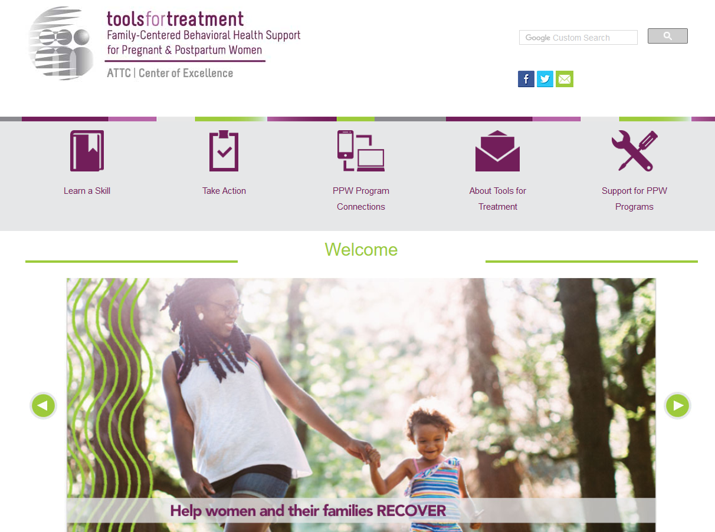
Visit www.attcppwtools.org for More Resources
Training Curriculum
Online Courses
300+ Program Resources Library
Recorded Presentations
Videos
Notes:
For additional resources, visit www.attcppwtools.org. Here you can download the “Easier Together” curriculum and access other resources such as:
Training curriculum
Online courses
300+ resources in the Program Resources library
Recorded presentations
Videos

Slide 9
Goal and Objectives
Goal: Help programs understand family-centered care and the implications of stigmatizing language and myths.
Objectives: Participants will be able to:
Explain why family-centered care matters.
Define family-centered care in the context of pregnant/postpartum women’s (PPW) addiction treatment.
Evaluate the impact of language, myths, and stigma on care for pregnant/postpartum women (PPW) with substance use disorders and their families.
Notes:
The goal for Module 1 is to help programs understand family-centered care and the implications of stigmatizing language and myths.
These are our learning objectives for Module 1.

Slide 10
Key Question
Why does this topic matter?
Notes:
So why does family-centered care matter? We’re all at different levels of experience with it, and some of you may feel like you’re doing much of this already. However, if we’re still talking about it, we could always do it more effectively and enhance our services to be more family-centered. We’re hoping this curriculum will provide new insights for even those of you who have worked in this area for a number of years.

Slide 11
Why Does This Matter?
____ % of U.S. treatment facilities offer at least one special program or group for pregnant/postpartum women.
a ) 10% b) 21% c) 45% d) 60%
(SAMHSA N-SSATS, 2016)
Notes:
Does anyone know what percentage of U.S. treatment facilities offer at least one special program or group for pregnant/postpartum women?
Answer: b – 21%
Treatment services tailored for pregnant/postpartum women are surprisingly limited, despite the importance of addressing substance use during this time period.

Slide 12
Why Does This Matter?
____ % of U.S. treatment facilities offer childcare services.
a ) 6% b) 18% c) 35% d) 50%
(SAMHSA N-SSATS, 2016)
Notes:
Does anyone know what percentage of U.S. treatment facilities offer childcare services?
Answer: b – 6%
So few programs offer childcare services, making it extremely challenging for women to participate in treatment. And this number only includes childcare services; therapeutic and child development services for clients’ children are even scarcer.

Slide 13
Why Does This Matter?
____ % of U.S. treatment facilities offer residential beds for clients’ children.
a ) 3% b) 18% c) 35% d) 50%
(SAMHSA N-SSATS, 2016)
Notes:
Does anyone know what percentage of U.S. treatment facilities offer residential beds for clients’ children?
Answer: b – 3%
Not letting women bring their children to treatment is a huge barrier. Again, a lot of us think family-centered care is widespread and what we’ve always been doing. However, the data tells a different story. This approach is actually very uncommon.

Slide 14
Why Does This Matter?
Family-centered care results in:
Improved treatment and retention outcomes for individual women
Improved outcomes for children and other family members
(Werner, Young, Dennis & Amatetti, 2007)
Notes:
Family-centered care has impressive outcomes. Current data has shown:
It results in improved treatment and retention outcomes for individual women.
Children and other family members also have improved outcomes.

Slide 15
What is Family-Centered Care for Pregnant/Postpartum Women with Substance Use Disorders?
Notes:
So let’s discuss what family-centered care is all about and where this concept came from.

Slide 16
Definition
Family-Centered Care:
Providing services for the whole family to make recovery possible; although the mother is the entry point, the family becomes the client
Notes:
There are many definitions and philosophies about family-centered care as it applies to different fields. In the context of pregnant and postpartum women’s addiction treatment, it is providing services for the whole family to make recovery possible. Although the mother is the entry point, the family becomes the client. This includes the father and/or partner, children of all ages, and other extended family members or friends who are an integral part of the woman’s family.

Slide 17
The Culture Conversation
The Culture Conversation
Language and culture may influence . . .
Health, healing, and wellness belief systems
How illness, disease, and their causes are perceived
How treatment is sought
Delivery of healthcare services by providers
p. 27 of participant manual
Notes:
As part of family-centered care, we have to consider the culture of the families we serve and our own cultural competence as professionals. Understanding the importance of language and culture is key in eliminating health disparities:
Health, healing, and wellness belief systems; how health services are delivered and created for the populations they serve.
How illness, disease, and their causes are perceived; both by the individual and the healthcare system.
How treatment is sought; the behaviors of individuals seeking healthcare and their attitudes toward healthcare providers.
The delivery of healthcare services by the providers who look at the world through their own set of values, which can compromise access for individuals from other cultures.
By understanding, valuing, and incorporating the cultural differences of diverse populations and examining one's own values and beliefs, healthcare organizations, practitioners, and others can support a whole healthcare system which responds appropriately to and directly serves the unique needs of populations.
Note to trainer: For more on culture, see the handout on page 27 of your participant manual.
Reference: http://minorityhealth.hhs.gov/templates/

Slide 18
Historical Influences: Family-Centered Care
Notes:
Family-centered care is not a new idea. It has evolved across many disciplines, including mental health, child welfare, and pediatrics. Let’s review its historical influences.

Slide 19
Historical Influences
Family Preservation and Support Services Program (1993)
Comprehensive Community Mental Health Services for Children and Their Families Program (1994)
Family-Centered Practice (child welfare field, 2001)
Family-Centered Care (pediatrics field, 2003)
Notes:
Our definition of family-centered care builds on all of these perspectives. These are some programs and fields that have contributed to the development of family-centered care. You’ll notice that different fields are based on the perspectives of different family members. While pregnant/postpartum women’s addiction treatment focuses on the perspective of the mother, many of these fields have focused on the child’s perspective.
Family Preservation and Support Services Program (1993)
This program officially recognized the practice of family preservation.
It expanded the scope from children’s services to include family support services.
Communities were encouraged to build a system of family support services to “assist vulnerable children and families in an effort to prevent child maltreatment.”
[McGowan, B. G. (2010). An historical perspective on child welfare: An international perspective on knowledge in the service of policy.]
Comprehensive Community Mental Health Services for Children and Their Families Program (1994)
This framework also emerged from emphasis at the federal level on family-centered and family-focused approaches to providing care for children with severe emotional disturbances and their families. Established in 1994, the Comprehensive Community Mental Health Services for Children and Their Families Program was administered by the Center for Mental Health Services (CMHS) of SAMHSA. Child welfare and U.S. Child Health Policy has incorporated and funded it.
Family-Centered Practice (child welfare, 2001)
The child welfare field defines family-centered practice as “A way of working with families, both formally and informally, across service systems to enhance their capacity to care for and protect their children. Family-centered practice includes a range of strategies, including advocating for improved conditions for families, supporting them, stabilizing those in crisis, reunifying those who are separated, building new families, and connecting families to resources that will sustain them in the future.”
[https://www.childwelfare.gov/aboutus/faq/famcentered/]
Family-Centered Care (pediatrics, 2003)
Family-centered care is a term used in the pediatrics field. It is an innovative approach to the planning, delivery, and evaluation of health care that is grounded in a mutually beneficial partnership among patients, families, and providers that recognizes the importance of the family in the patient's life.
[American Academy of Pediatrics, Institute for Family-Centered Care, PEDIATRICS Vol. 112 No.3 Sep 2003]

Slide 20
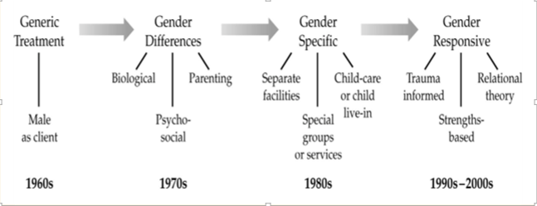
Gender-Specific & Responsive Approaches
Notes:
Family-centered care in the context of pregnant and postpartum women’s addiction treatment is also heavily rooted in gender-specific and responsive approaches. Up until the 1960s, treatment was designed for male clients. However:
Women’s specific services began emerging in the 1970s as research documented the differences between men’s and women’s substance use.
In the 1980s, gender-specific services were developed to reflect these gender differences. Examples include creating separate facilities for men and women, offering childcare, and having groups focused on women’s issues.
Gender-responsive approaches were developed in the 1990s to early 2000s. These approaches integrated trauma-informed care, relational theory, and a strengths-based perspective.
I want to note that when we’re saying “gender” in this context, we mean women/females.
Graphic source: Grella, C. E. (2008). From generic to gender-responsive treatment: Changes in social policies, treatment services, and outcomes of women in substance abuse treatment. Journal of Psychoactive Drugs, SARC Supplement 5, 327-343.

Slide 21
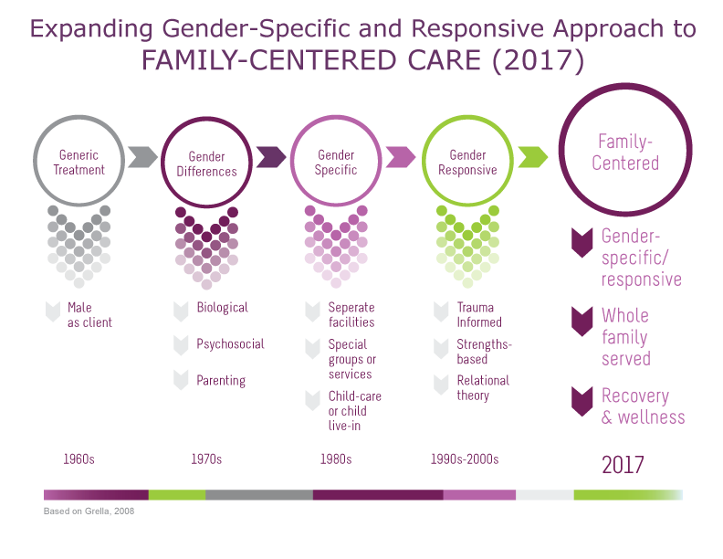
Expanding Gender-Specific & Responsive Approach to FAMILY-CENTERED CARE (2017)
Expanding Gender-Specific & Responsive Approach to FAMILY-CENTERED CARE (2017)
p. 25 of participant manual
Notes:
Family-centered care in the context of pregnant/postpartum women’s addiction treatment is a natural expansion from gender-specific and responsive approaches. It builds on those principles by providing wraparound services for the entire family and uses a recovery approach to support long-term wellness.
Graphic based on: Grella, C. E. (2008). From generic to gender-responsive treatment: Changes in social policies, treatment services, and outcomes of women in substance abuse treatment. Journal of Psychoactive Drugs, SARC Supplement 5, 327-343.
Note to trainer: This handout is available on page 25 of the participant manual.

Slide 22
How Do We Make This Shift?
Gender-Specific & Responsive Approach
Family-Centered Care
FROM: How can we address the woman’s unique experiences?
TO: How do we provide space for the woman and family members to heal?
Notes:
So how do we make this shift?
In a gender-specific and responsive approach, we address women’s unique experiences and multiple needs; provide a healing, safe, and healthy environment; and use relational approaches to provide gender-specific treatment.
However, for pregnant and postpartum women and mothers in general, it is integral to also consider the needs of family members, including fathers/partners and children.
In family-centered care, we consider how we can provide a space for the woman AND family members to heal, how we can actively involve family members, how we can recognize the importance of family in the woman’s life, and how we can support the woman in negotiating her relationships.
Family-centered care is a natural and necessary extension of a gender-specific and responsive approach that benefits the mother and family as a whole.
The “Easier Together” curriculum will provide some practical ideas on how we can make this shift.

Slide 23
What Do You Think?
Family-centered care decreases focus on the woman.
Agree?
Disagree?
Not sure?
Notes:
I want to stop and get your thoughts on making this shift. What do you think? Does family-centered care decrease focus on the woman?
Raise your hand if you agree
Raise your hand if you disagree
Raise your hand if you’re not sure
Those of you who agree, would you talk about some of your concerns? *Note to trainer: Ask, “Those of you with your hands up, would you be willing to tell us why you responded this way?”
Those of you who are unsure, would you describe why? *Note to trainer: Ask, “Those of you with your hands up, would you be willing to tell us why you responded this way?”
Those of you who disagree, would you share your thoughts? *Note to trainer: Ask, “Those of you with your hands up, would you be willing to tell us why you responded this way?”
I appreciate the group for responding to this question. There aren’t clear answers to this statement. We hope you get some clarity as we further explore family-centered care throughout this training.

Slide 24
Language, Myths, Stigma, and Obstacles
Notes:
There are a lot of myths, stigmatizing language, and obstacles relating to family-centered care and pregnant/postpartum women with substance use disorders in general. We have a long history of emotional reactions to substance use issues. Media portrayals influence our perceptions with emotionally charged language that is often without sufficient evidence or data. The resulting attitudes and the impact of these attitudes are often long lasting. Providers are not immune. Media misrepresentation and stigmatizing characterizations are barriers to treatment and long-term recovery.
Now let’s unpack some of these issues by deciding whether statements are facts or myths.
While we do this, here are some questions to consider: What effects do these attitudes and perceptions have on providers? On pregnant and postpartum women? On their families?
Note to trainer: See handout, “Open Letter to the Media and Policy Makers Regarding Alarmist and Inaccurate Reporting on Prescription Opioid Use by Pregnant Women,” on pages 28-35 of participant manual for discussion on the implications of inaccurate and emotionally charged language.

Slide 25
Fact or Myth 1
Babies are born addicted to the substances they were exposed to in utero.
Example in the media:
“Born addicts, opioid babies in withdrawal from first breath”
Source: The Washington Times, 2/18/17
Notes:
Is this a fact or myth?
Babies are born addicted to the substances they were exposed to in utero. This statement is used frequently in the media, such as in this headline: “Born addicts, opioid babies in withdrawal from first breath.”
Example in the media:
“Born addicts, opioid babies in withdrawal from first breath.”
Source: The Washington Times, 2/18/17, http://www.washingtontimes.com/news/2017/feb/18/born-addicts-opioid-babies-in-withdrawal-from-firs/
Thumbs up if you think this is a fact. Thumbs down if you think this is a myth.

Slide 26
Myth
No baby is born “addicted.” Meeting criteria for a substance use disorder involves a number of behaviors related to substance use despite experiencing negative consequences.
Evidence of physiologic dependence on opioids is called neonatal abstinence syndrome (NAS), a condition that can be diagnosed and effectively treated with protocols that have been available for decades.
Appropriate care such as breastfeeding and “comfort care” (swaddling, skin-to-skin contact, etc.) is often sufficient to prevent or minimize signs of distress.
Notes:
This is a myth.
No baby is born “addicted.” Meeting the criteria for a substance use disorder involves a number of compulsive behaviors related to substance use despite experiencing negative consequences. For example, babies are not drug-seeking.
Evidence of physiologic dependence on opioids is called neonatal abstinence syndrome (NAS), a condition that can be diagnosed and effectively treated with protocols that have been available for decades.
Appropriate care such as breastfeeding and “comfort care” (swaddling, skin-to-skin contact, etc.) is often sufficient to prevent or minimize signs of distress in the baby.
What effects do these attitudes and perceptions have on providers? On pregnant/postpartum women with SUDs? On their families?

Slide 27
Fact or Myth 2
Methadone and buprenorphine are safe medications for addiction treatment during pregnancy.
Example in the media:
“Medication-assisted treatment is the path recommended [for pregnant women with opioid use disorders] based on current scientific evidence.”
- Source: 89.3 WFPL, 6/23/17
Notes:
Is this a fact or myth?
Methadone and buprenorphine are safe medications for addiction treatment during pregnancy.
Example in the media:
“Medication-assisted treatment is the path recommended [for pregnant women with opioid use disorders] based on current scientific evidence.”
Source: 89.3 WFPL, 6/23/17, http://wfpl.org/pregnant-women-addicted-opioids-choosing-treatment-plan-comes-access/
Thumbs up if you think this is a fact. Thumbs down if you think this is a myth.

Slide 28
Fact
The evidence for the efficacy of methadone maintenance treatment – most particularly its use in the care of pregnant women – has been overwhelmingly consistent for almost half a century.
Buprenorphine is another safe and effective medication for use during pregnancy and has been shown to have additional benefits for the infants, including milder NAS.
Notes:
This is a fact.
The evidence for the efficacy of methadone maintenance treatment – most particularly its use in the care of pregnant women – has been overwhelmingly consistent for almost half a century. (https://www.drugabuse.gov/news-events/nida-notes/2012/07/buprenorphine-during-pregnancy-reduces-neonate-distress)
Buprenorphine is another safe and effective medication for use during pregnancy and has been shown to have additional benefits for the infants, including milder NAS. (https://www.drugabuse.gov/news-events/nida-notes/2012/07/buprenorphine-during-pregnancy-reduces-neonate-distress)
Despite this evidence, some media portrayals have been misleading and stigmatizing. This is particularly true with the media portrayals of babies with NAS.
What effects do these attitudes and perceptions have on providers? On pregnant/postpartum women with SUDs? On their families?

Slide 29
Fact or Myth 3
Labeling a child as a “crack baby,” “addicted baby,” “meth baby,” “victim” etc. puts the child at risk for health and social consequences later in life.
Example in the media:
“’Crack baby’ brings to mind hopeless, damaged children with birth defects and intellectual disabilities who would inevitably grow into criminals.”
- Source: The Atlantic, 7/16/17
Notes:
Is this a fact or myth?
Labeling a child as a “crack baby,” “addicted baby,” “meth baby,” “victim” etc. puts the child at risk for health and social consequences later in life.
Example in the media:
“’Crack baby’ brings to mind hopeless, damaged children with birth defects and intellectual disabilities who would inevitably grow into criminals.”
Source: The Atlantic, 7/16/17, https://www.theatlantic.com/politics/archive/2017/07/what-the-crack-baby-panic-reveals-about-the-opioid-epidemic/533763/
Thumbs up if you think this is a fact. Thumbs down if you think this is a myth.

Slide 30
Fact
Labeling a child as a “crack baby,” “addicted baby,” “meth baby,” “victim” etc. puts the child at risk for:
Stigma and discrimination in school starting at pre-school.
Medical misdiagnosis.
Separation from supportive families as a result of inappropriate child welfare interventions.
Notes:
This is a fact.
These labels put the child at risk for all three: stigma and discrimination in school starting in pre-school, medical misdiagnosis, and separation from supportive families as a result of inappropriate child welfare interventions.
What effects do these attitudes and perceptions have on providers? On pregnant/postpartum women with SUDs? On their families?

Slide 31
Words Have Power. People First.
p. 26 of participant manual
Using affirmative language to inspire hope and advance family recovery.
Stigmatizing Language | Current Language
Addict | Person with a substance use disorder
Addicted infant | Infant with Neonatal Abstinence Syndrome (NAS)
Addicted to [alcohol/drug]. . . | Has a [alcohol/drug] use disorder
Alcoholic | Person with an alcohol use disorder
Clean | Abstinent
Clean screen | Substance-free
Crack Babies | Substance-exposed infant or Substance–affected infant
Lapse / Relapse / Slip | Resumed/experienced a recurrence
Medication-Assisted Treatment (MAT) | Medications for Addiction Treatment (MAT)
Opioid replacement | Medications for Addiction Treatment (MAT)
Opioid Replacement Therapy (ORT) | Medications for addiction treatment (MAT)
Pregnant Opiate Addict | Pregnant woman with opioid use disorder
Reformed addict or alcoholic | Person in recovery
Substance Abuse | Substance use disorder
Substance abuse/abuser | Person with a substance use disorder
Substance Misuse | Substance use / non-medical use
Victims / “tiny victims” | Prenatally exposed to [drug name]
Notes:
A lot of these facts versus myths have demonstrated how language matters. Using affirmative language inspires hope and advances family recovery. Our words have power and we should use person-first language when describing these complex issues.
This table summarizes commonly used stigmatizing language and how we can shift these terms to preferred language. It is adapted from a publication produced by the Office of National Drug Control Policy in 2015.
If you want to learn more about language and addiction, www.recoveryanswers.org/addiction-ary/ is a great resource.
Do any of these stand out to you?
Note to trainer: This is a handout in the participant manual on page 26.

Slide 32
Wrap-Up
“Demonizing pregnant women creates an environment where punishment rather than support is the predominant response, and will inevitably serve to discourage women from seeking care.”
- “Open letter…” (p. 28-35 of participant manual)
Notes:
As we close this module, I’d like to end with a powerful quote from the open letter we talked about earlier. A full copy is available on pages 28-35 of your participant manual.
The quote says: “Demonizing pregnant women creates an environment where punishment rather than support is the predominant response, and will inevitably serve to discourage women from seeking care.”
As advocates for women and their families dealing with addiction, it is important to remember the power of language. Not only can we ensure the language we use is affirming and evidence-based, but we can also advocate to others about the importance of using person-first language and challenge non-scientific portrayals of these issues.
What closing comments do you have before we talk about next steps?

Slide 33
Next Modules
Module 2: Family-Centered Care
Module 3: Building Programs for Fathers
Module 4: Implementing Family-Centered Programming
Module 5: Family-Centered Clinical Interventions
Module 6: Case-Based Application
Notes:
These are the next modules in this training series. Make sure to check your participant manual for more information and resources.

Slide 34
References
Child Welfare Information Gateway. (2014). Parental substance use and the child welfare system. Washington, DC: U.S. Department of Health and Human Services, Children’s Bureau.
Gillespie, L. (Producer). (2017, June 23). For pregnant women addicted to opioids, lack of providers limits treatment options [Radio broadcast]. Louisville, KY: 89.3 WFPL.
Grella, C. E. (2008). From generic to gender-responsive treatment: Changes in social policies, treatment services, and outcomes of women in substance abuse treatment. Journal of Psychoactive Drugs, SARC Supplement 5, 327-343.
Newkirk, V. (2017, July 16). What the 'Crack Baby' panic reveals about the opioid epidemic. The Atlantic. Retrieved from https://www.theatlantic.com/politics/archive/2017/07/what-the-crack-baby-panic-reveals-about-the-opioid-epidemic/533763/

Slide 35
References Cont’d
Substance Abuse and Mental Health Services Administration. (2017). National Survey of Substance Abuse Treatment Facilities (N-SSATS): 2016, Data on substance abuse treatment facilities. Retrieved from https://www.samhsa.gov/data/substance-abuse-facilities-data-nssats
Substance Abuse and Mental Health Services Administration. (2014). Results from the 2013 National Survey on Drug Use and Health: Summary of national findings (NSDUH Series H-48, HHS Publication No. (SMA) 14-4863). Rockville, MD: Substance Abuse and Mental Health Services Administration, 2014.
Wenner, D., (2017, February 18). Born addicts, opioid babies in withdrawal from first breath. Washington Times. Retrieved from http://www.washingtontimes.com/news/2017/feb/18/born-addicts-opioid-babies-in-withdrawal-from-firs/
Werner, D., Young, N. K., Dennis, K, & Amatetti, S. (2007). Family-Centered Treatment for Women with Substance Use Disorders – History, Key Elements and Challenges. Department of Health and Human Services, Substance Abuse and Mental Health Services Administration.

