Slide 1
Easier Together:
Partnering with Families to
Make Recovery Possible
Notes:
Welcome to module 2 of “Easier Together: Partnering with Families to Make Recovery Possible.”

Slide 2
Please complete checklist:
“Is it Family-Centered Care?”
Pages 67-68 in participant manual
Notes:
While we are waiting for everyone to join us, please complete the checklist, “Is it Family-Centered Care?” on pages 67-68 of the participant manual. We will review the results of this checklist later in the module.

Slide 3
Module 2:
Family-Centered Care
More about family-centered care
“Bring Them All” documentary discussion
Notes:
During Module 2, we are going to take a more in-depth look at family-centered care by exploring some of its key principles and outcomes.
Then we will watch a brief documentary produced for this curriculum that tells the story of family-centered care through the perspectives of clients and staff at a treatment program in Compton, CA.
Afterwards, we will go through a series of discussion questions to explore the central principles of family-centered care and see how they might apply to your work.

Slide 4
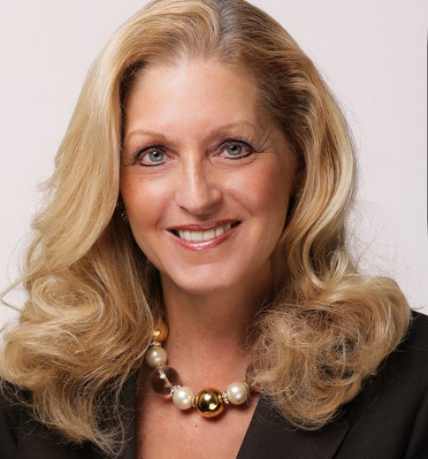
Acknowledgements
Kathryn Icenhower, PhD CEO and Co-founder
SHIELDS for Families Compton, CA
Notes:
Our thanks to Kathryn Icenhower, PhD, CEO and Co-founder of SHIELDS for Families, for her expertise and many contributions in the development of this module. Dr. Kathryn Icenhower is the Co-founder and Chief Executive Officer of SHIELDS for Families, a private non-profit organization with 340 staff, a $30 million dollar budget and 38 programs that serve over 10,000 families annually in South Los Angeles. She received her BSSW from Ohio State University and her MSW and PhD from the University of Southern California. Dr. Icenhower sits on numerous local, state, and federal coalitions and advisory boards, including the California State Child Welfare Council and SAMHSA’S Advisory Council for Women’s Services. She has been recognized by numerous entities for her piloting work in the substance use and child welfare fields including an Innovator Award from CSAT for her work in Family Centered Treatment, the James Irvine Foundation Leadership Award, the Visionary Award from the National Association of Minority Contractors, and named as one of the 50 most influential women in Los Angeles by Los Angeles Magazine.

Slide 5
Introductions
Name
Where you were born
Notes:
Before we get started, I’d like to do some brief introductions.
Trainer: introduce yourself
Now I’d like everyone to introduce themselves. Please say your name and where you were born.
Note to trainer: You can modify this activity based on your audience.

Slide 6
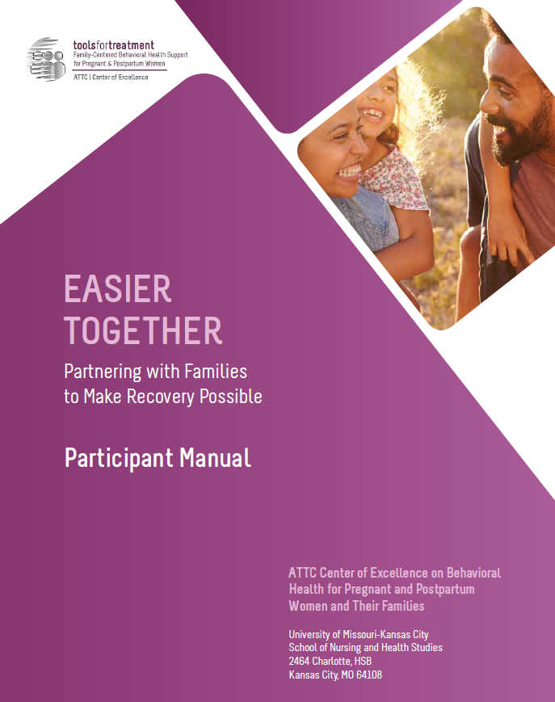
Hands-On Review of Participant Manual
Participant Manual
Each module contains:
Training goals and objectives
Copy of slides
Resources – worksheets, activities, assessments, recommended reading
Reference list
Notes:
As part of this curriculum, you all have a participant manual. I’d like us to do a hands-on review of this module’s content so you are familiar:
On page 52, the module begins with the training goals and objectives.
Next on page 53 you will find all of the presentation slides with room for taking notes.
Then on page 66 you will find the resources section, which contains a collection of handouts, worksheets, activities, assessments, recommended reading, and a reference list for that module.

Slide 7
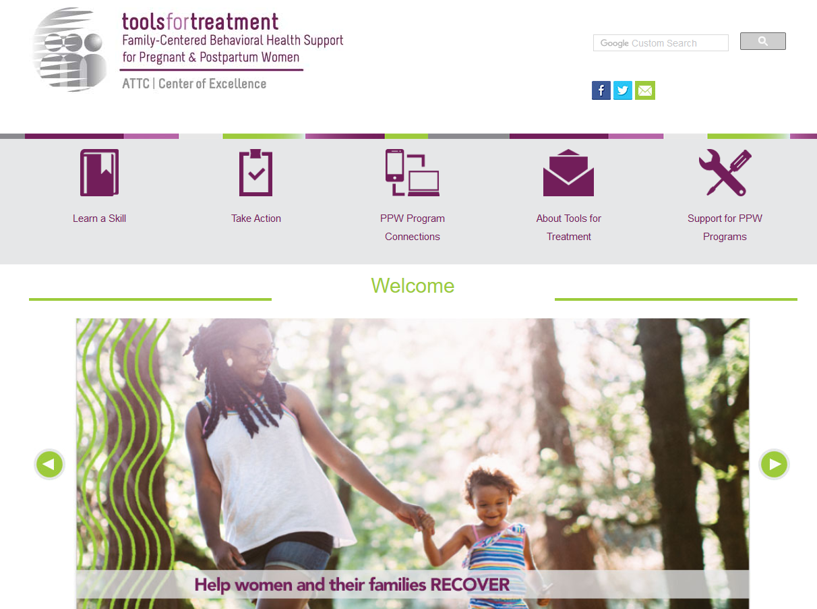
Visit www.attcppwtools.org for More Resources
Training Curriculum
Online Courses
300+ Program Resources Library
Recorded Presentations
Videos
Notes:
For additional resources, visit www.attcppwtools.org. Here you can download the “Easier Together” curriculum and access other resources such as:
Training curriculum
Online courses
300+ resources in the Program Resources library
Recorded presentations
Videos

Slide 8
Goal and Objectives
Goal: Help programs learn the intricacies and philosophy of family-centered care so they can apply its principles to their work.
Objectives: Participants will be able to:
Demonstrate understanding of family-centered, recovery and wellness principles.
Identify family and staff outcomes of family-centered care.
Analyze how the principles of the family-centered, recovery and wellness approach were applied to a program in California.
Examine application of family-centered, recovery and wellness principles in your own work.
Notes:
The goal of this module is to help programs learn the intricacies and philosophy of family-centered care so they can apply its principles to their work.
These are our learning objectives for Module 2.

Slide 9
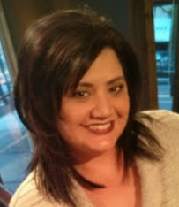
Family-Centered Care and Culture
Aren’t we already doing it?
Diana Kramer, MA, BHT
SAMHSA PPW Program Manager
Native American Connections
Phoenix, AZ
Notes:
As we talk about family-centered care, a lot of us think our agencies are already doing it. And we might be to some extent. Many of the client cultaural groups we serve value family and our communities already feel family-centered. However, working with clients from family-centered cultural groups is not the same as having family-centered services in our agencies. This hasn’t always translated into the treatment system.
We are going to listen to a 3-minute audio clip from Diana Kramer. She is a cultural competency expert and SAMHSA PPW Program Manager at Native American Connections in Phoenix, AZ. She shares her thoughts on this distinction between cultures that value family and agencies that implement family-centered services.
Do you have any thoughts about what Diana shared?
Note to trainer: Hover over the audio icon and press the play button to play the audio clip.

Slide 10
The Culture Conversation
The Culture Conversation
The Family as a Mobile
Pages 70-71 of participant manual
Notes:
Continuing our discussion about culture, we know that across cultures, the family unit is recognized as the cornerstone of society. In “What Is a Family?,” Edith Schaeffer (2001) compares the family with a mobile: “What is a family? A family is a mobile. A family is the most versatile, ever-changing mobile that exists”(pp. 17–22).
Substance use by one family member affects the whole family mobile. When a parent has a substance use disorder, it can corrupt the harmonious spinning of all of the parts, break some of the strings that tie the mobile together, and fracture individual sculptures as they fall. Substance use disorders are family diseases because there can be an intergenerational transmission that affects the entire family unit and its individual members. Family-centered care promotes the delivery of comprehensive services that can transform these families into healthy, functioning entities that can raise children, reach their economic goals, and support the wellbeing of all members.
Note to trainer: For more on culture, see the handout on pages 70-71 of your participant manual.
Reference: https://www.samhsa.gov/sites/default/files/family_treatment_paper508v.pdf

Slide 11
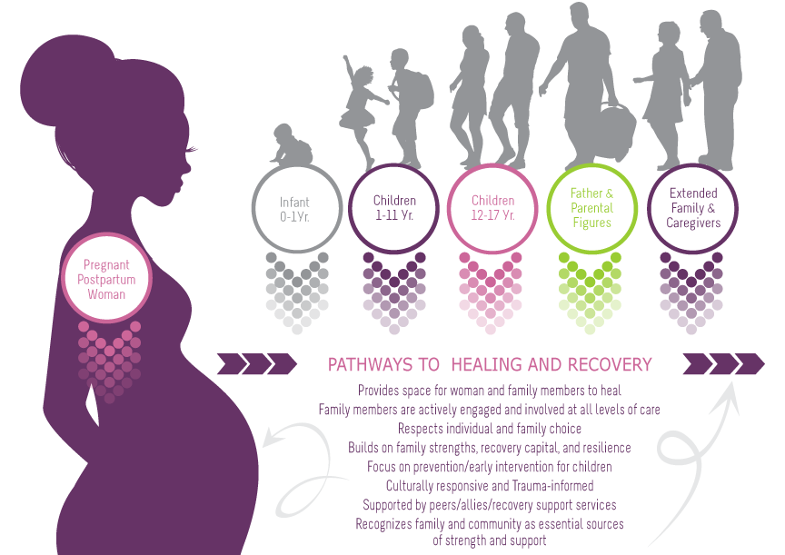
Family-Centered, Recovery & Wellness Principles
Page 69 in participant manual
Notes:
This is a graphic that was developed to embody family-centered care in pregnant/postpartum women’s treatment. In this graphic, you can see that the woman is the vehicle of entry for all family members. She is the initial client that comes into the program to receive services, but through her, our view expands to include all family members. The family becomes the client and we wrap services around all family members to support family strengthening and healing.
Additionally, this graphic outlines “family-centered, recovery and wellness principles.” It is imperative to view family-centered care through the lens of recovery and wellness, not just as a treatment episode. Family-centered care sets families up for sustainable recovery and wellness long after treatment ends.
Note to trainer: This is available as a handout on page 69 of the participant manual.

Slide 12
Core Principles
of Family-Centered Care, Recovery, and Wellness
Provides space for family healing
Family members are actively engaged
Respects individual and family choice
Builds on family strengths
Focus on prevention/early intervention for children
Culturally responsive and trauma-informed
Supported by peers/allies/recovery support services
Recognizes family and community are essential sources of strength and support
Notes:
Let’s dive deeper into the principles of a family-centered, recovery and wellness approach:
Provides space for the woman and her family members to heal
Family members are actively engaged and involved at all levels of care
Respects individual and family choice
Builds on family strengths, recovery capital, and resilience
Focus on prevention/early intervention for children
Culturally responsive and trauma-informed
Supported by peers/allies/recovery support services (e.g., housing, employment, medical care)
Recognizes family and community are essential sources of strength and support
Do any of these resonate with you?

Slide 13
Outcomes
of Family-Centered Care, Recovery, and Wellness
Family Outcomes
Focus on (re)building a life in the community
Improve client and family engagement
Promote recovery, health and well-being
Address psychosocial and developmental needs of children
Increase client and family satisfaction
Build family and community strength
Activated clients
Notes:
A family-centered, recovery and wellness approach to addiction treatment can result in:
Focus on (re) building a life in the community
Improve client and family engagement (partnership with program staff)
Promote recovery, health and well-being of all family members
Address psychosocial and developmental needs of infant/children
Increase client and family satisfaction
Build family and community strengths (recovery capital)
Activated clients (clients are empowered to take responsibility for and guide their recovery)

Slide 14
Outcomes
of Family-Centered Care, Recovery, and Wellness
Staff Outcomes
Stronger partnership with client/family
Increased understanding of families’ and communities’ recovery capital
Improved care planning
Improved communication with clients, coworkers, and partner organizations
Reduced burnout
Stronger linkages/partnerships with the natural supports in the community
Notes:
This approach also produces a number of benefits for staff:
Stronger partnership with client and commitment to the client and family choice.
Increased understanding of families’ and communities’ recovery capital.
Uses a strengths-based approach and supports sustainable recovery after treatment episode.
Improved care planning when developed in collaboration with family/peer support (team is expanded to include family).
Improved communication with families, coworkers, and partner organizations.
Family-centered approach requires multidisciplinary team to work together to wrap services around family members and meet their different needs (e.g., early childhood, fathering/parenting programs, etc.).
Increased professional self-efficacy; reduced burnout.
Reduced burden on staff when families are experts in their own lives.
Stronger linkages/partnerships with the natural supports in the community.
Build good relationships with community partners so your program doesn’t have to do everything itself. Partnerships allow you to provide families with all the different services they need. Also, building strong partnerships with child welfare, justice system, education system, and others allows you to help families navigate potential challenges.

Slide 15
www.BringThemAll.org
Link to Video
Notes:
Sometimes the best way to learn about something is to see it in action. This brief documentary shows what family-centered care is like from the perspectives of clients and staff at SHIELDS for Families in Compton, CA. Let’s watch this 17-minute documentary, then afterwards we’ll discuss its content.
Link to documentary: https://vimeo.com/233560293/bc3c8dd057

Slide 16
Tying it all Together: Family-Centered Care Principles and “Bring Them All”
Notes:
Let’s debrief about what we just watched, keeping in mind the family-centered care principles we discussed earlier.
Note to trainer: Questions may arise about SHIELDS for Families, the program featured in the documentary. Here is a description of the agency: Established in 1991, the organization has grown to serve more than 10,000 families each year, employing more than 350 full-time staff, with an annual budget of more than $30 million from federal, state, and local funding sources. SHIELDS operates 38 programs and serves as the lead agency with four collaborative networks. Programs are collaborative and comprehensive, spanning across three main divisions including community and family, behavioral health, and supportive services. More information is available on their website at www.shieldsforfamilies.org. Additionally, a brief vignette on “How They Did It” is available at www.BringThemAll.org.

Slide 17
Discussion
What are your first impressions after watching that?
What did you learn about family-centered care that surprised you?
Notes:
What are your first impressions after watching that? What did you learn about family-centered care that surprised you?

Slide 18
Discussion
Family-Centered Principle: Family members are actively engaged and involved at all levels of care
What are some examples from the documentary of this principle in action?
Notes:
Let’s revisit one of the most important family-centered principles: family members are actively engaged and involved at all levels of care.
What are some examples from the documentary of this principle in action?
Trainer note: These are some points you can reference if needed:
CEO Kathryn Icenhower discussed the Exodus program, where a mother can bring her whole family to live and receive services on-site.
Staff member Colette talked about how it is different working with all family members, not just one client. It was an adjustment for her at first since she had previously worked with individual clients. Now she works as part of a multidisciplinary team to serve all the different needs of families.
Staff member Danielle talked about how staff value the opinions of the families because the program is for them.
Staff member Danielle talked about how staff are “on demand” for families.
Male client talks about how much it means to have staff care about him and his kids.
Client talks about what it was like to find a program that let her bring her kids.
CEO Kathryn Icenhower talks about how “it’s much easier to let people in than keep people out” in reference to accepting families where they’re at.
CEO Kathryn Icenhower talks about the importance of designing a program that meets the needs of the families in your community.

Slide 19
Discussion
Please turn to your completed “Is it Family-Centered Care?” checklist on pages 67-68 of the manual.
How does your agency compare to the family-centered items on the checklist?
How are your current program approaches similar and/or different to what you saw in the documentary?
Notes:
Please turn to your completed “Is it Family-Centered Care?” checklist on pages 67-68 of the manual.
How does your agency compare to the family-centered items on the checklist?
How are your current program approaches similar and/or different to what you saw in the documentary?

Slide 20
Discussion
The documentary showed an approach that works for families in Compton, CA.
In a perfect world, what adaptations would you make in your program or community to better serve the needs of its families?
Notes:
The documentary showed an approach that works for families in Compton, CA. But we also know that every community is very different.
In a perfect world, what adaptations would you make in your program or community to better serve the needs of its families?

Slide 21
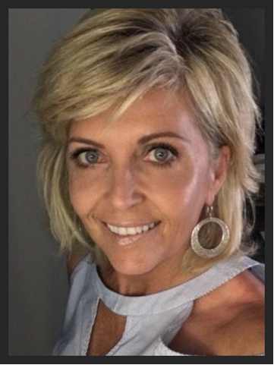
Tales from the Field
Kimberly Craig, BA, BS, LSAT
CEO, CHEEERS Recovery Center
Former PPW grantee
Phoenix, AZ
Notes:
In addition to SHIELDS for Families, many other programs have used innovative strategies to develop and fund family-centered services.
We are going to listen to a 2-minute audio clip from Kimberly Craig. She is CEO of CHEEERS Recovery Center, a former PPW grantee, in Phoenix, AZ. She shares a creative way that her agency has developed family housing in collaboration with the police department and city.
Do you have any thoughts about what Kimberly shared?
Note to trainer: Hover over the audio icon and press the play button to play the audio clip.

Slide 22
Wrap-Up
Notes:
After processing all of this information, how has your impression of family-centered care changed?
That concludes the second module in this training series. We took a deeper exploration of what family-centered care really means and saw it in action at one treatment program.

Slide 23
Next Modules
Module 3: Building Programs for Fathers
Module 4: Implementing Family-Centered Programming
Module 5: Family-Centered Clinical Interventions
Module 6: Case-Based Application
Notes:
These are the next modules in this training series. Make sure to check your participant manual for more information and resources.

