Slide 1
Easier Together:
Partnering with Families to
Make Recovery Possible

Slide 2
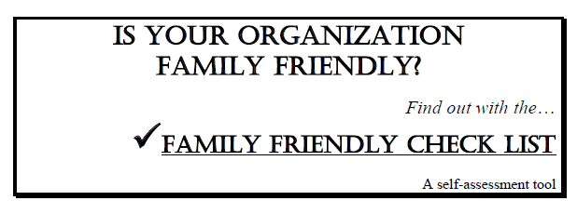
Please complete checklist:
“Is Your Organization Family Friendly?”
Pages 133-138 in participant manual
Notes:
Before we begin, please take a few minutes to complete the checklist, Is Your Organization Family Friendly?, on pages 133-138 of your participant manual.

Slide 3
Module 4:Implementing Family-Centered Programming
Notes:
Welcome to Module 4: Implementing Family-Centered Programming. During Module 4, we will take a program-level view and review the steps agencies can take when developing programming that includes fathers and other family members.

Slide 4
Acknowledgements
Thomas McMahon, PhD Yale University School of Medicine
Notes:
Our thanks to Thomas McMahon, PhD for his expertise, guidance, and many contributions in the development of this module. Dr. McMahon is a Professor in Psychiatry and the Child Study Center at the Yale University School of Medicine. Dr. McMahon is interested in ways in which the principles of developmental psychopathology can be used to expand understanding of the impact that parental addiction has on family process and child development. He has worked on the development of gender-specific parent interventions for men enrolled in addiction treatment. Dr. McMahon is also interested in the psychological assessment and treatment of children, adolescents, and young adults who have been abused or neglected in the context of parental addiction, as well as clinical and research training on the roles that genetic liability and family process play in the intergenerational transmission of developmental psychopathology. Dr. McMahon completed his doctoral training in clinical child and school psychology at New York University in 1994. Since 1998, he has been the recipient of several grants from the National Institute on Drug Abuse. With his colleagues, he has published more than 75 peer-reviewed papers and book chapters.

Slide 5
Introductions
Name
Field
One word to describe “family”
Notes:
Before we get started, I’d like to do some brief introductions.
Trainer: introduce yourself
Now I’d like everyone to introduce yourself and share the first word you think of to describe the word “family.”
Have everyone say their name one word to describe a “family.”
Note to trainer: You can modify this activity based on your audience.

Slide 6
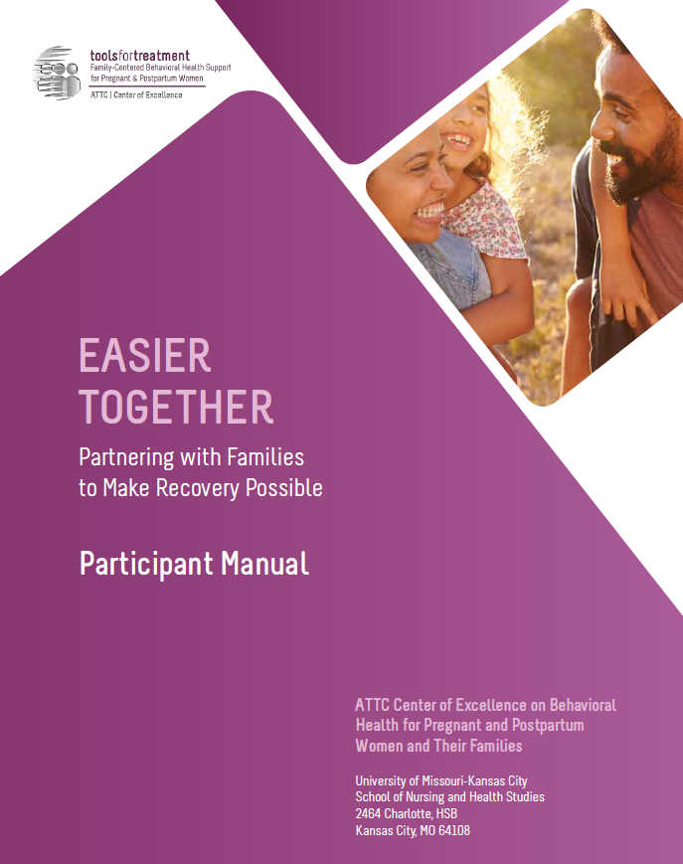
Hands-On Review of Participant Manual
Participant Manual
Each module contains:
Training goals and objectives
Copy of slides
Resources – worksheets, activities, assessments, recommended reading
Reference list
Notes:
As part of this curriculum, you all have a participant manual. I’d like us to do a hands-on review of this module’s content so you are familiar:
On page 116, the module begins with the training goals and objectives.
Next on page 117 you will find all of the presentation slides with room for taking notes.
Then on page 132 you will find the resources section, which contains a collection of handouts, worksheets, activities, assessments, recommended reading, and a reference list for that module.

Slide 7
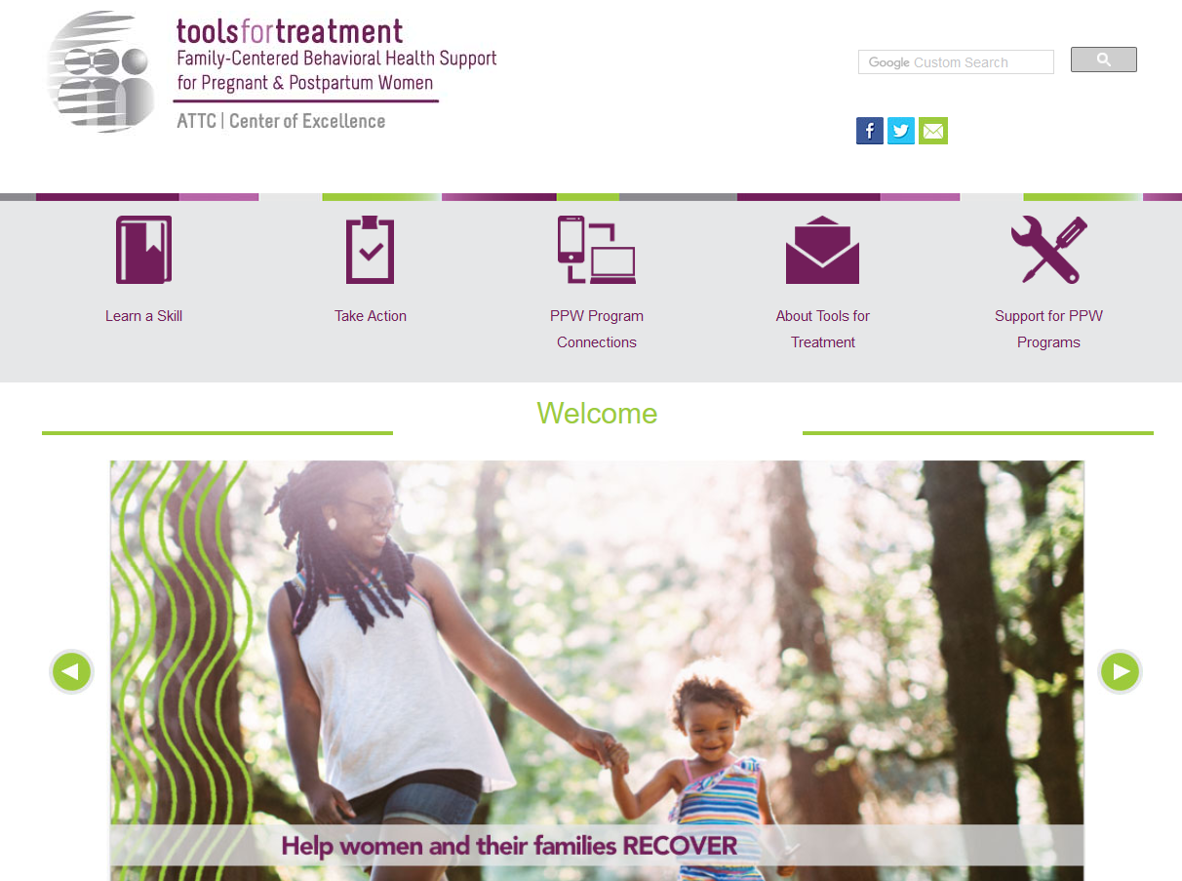
Visit www.attcppwtools.org for More Resources
Training Curriculum
Online Courses
300+ Program Resources Library
Recorded Presentations
Videos
Notes:
For additional resources, visit www.attcppwtools.org. Here you can download the “Easier Together” curriculum and access other resources such as:
Training curriculum
Online courses
300+ resources in the Program Resources library
Recorded presentations
Videos

Slide 8
Goal and Objectives
Goal: Provide a basic blueprint for development of family-centered programming.
Objectives: Participants will be able to:
Identify the steps programs need to consider when developing family-centered programming.
Describe some of the cultural considerations involved in family-centered programming.
Identify important safety concerns.
Examine own work setting in terms of family-centered criteria.
Notes:
The goal of this module is to provide a basic blueprint that agencies can follow when developing family-centered programming.
These are our learning objectives for module 4:
Identify the steps programs need to consider when developing family-centered programming.
Describe some of the cultural considerations involved in family-centered programming.
Identify important safety concerns.
Examine own work setting in terms of family-centered criteria.

Slide 9
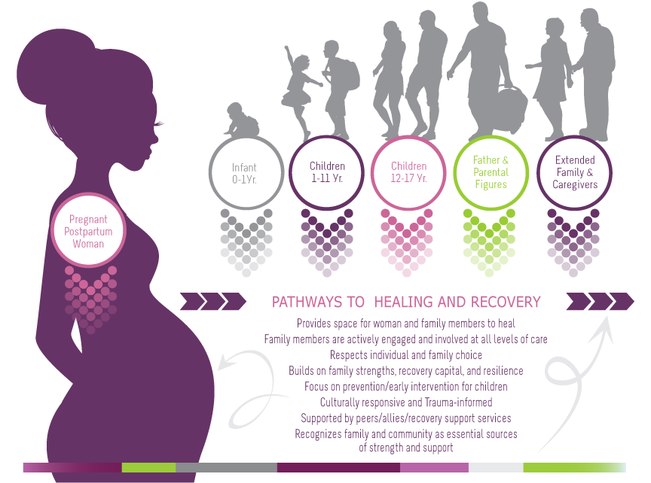
Family-Centered, Recovery & Wellness Principles
Family-Centered Recovery & Wellness Principles
Page 69 in participant manual
Notes:
This is a graphic that was developed to embody family-centered care and was presented in earlier modules. In this graphic, you can see that the woman is the vehicle of entry for all family members. She is the initial client that comes into the program to receive services, but through her, our view expands to include all family members. The family becomes the client and we wrap services around all family members to support family strengthening and healing.
Additionally, this graphic outlines “family-centered, recovery and wellness principles.” It is imperative to view family-centered care through the lens of recovery and wellness, not just as a treatment episode. Family-centered care sets families up for sustainable recovery and wellness long after treatment ends.
Note to trainer: This is available as a handout on page 69 of the participant manual.

Slide 10
Discussion
Please turn to your completed “Is Your Organization Family Friendly?” checklist on pages 133-138 of the manual.
How does your agency compare to the family-centered items on the checklist?
In a perfect world, what adaptations would you make in your program or community to better serve the needs of its families?
Notes:
Please turn to your completed “Is Your Organization Family Friendly?” checklist on pages 133-138 of the manual.
How does your agency compare to the family-centered items on the checklist?
How are your current program approaches similar and/or different?
In a perfect world, what adaptations would you make in your program or community to better serve the needs of it’s families?

Slide 11
The 7 Steps
Notes:
Regardless of where an agency or institution is in the process of implementing family-centered programming , there are 7 steps that are helpful for an agency to consider.

Slide 12
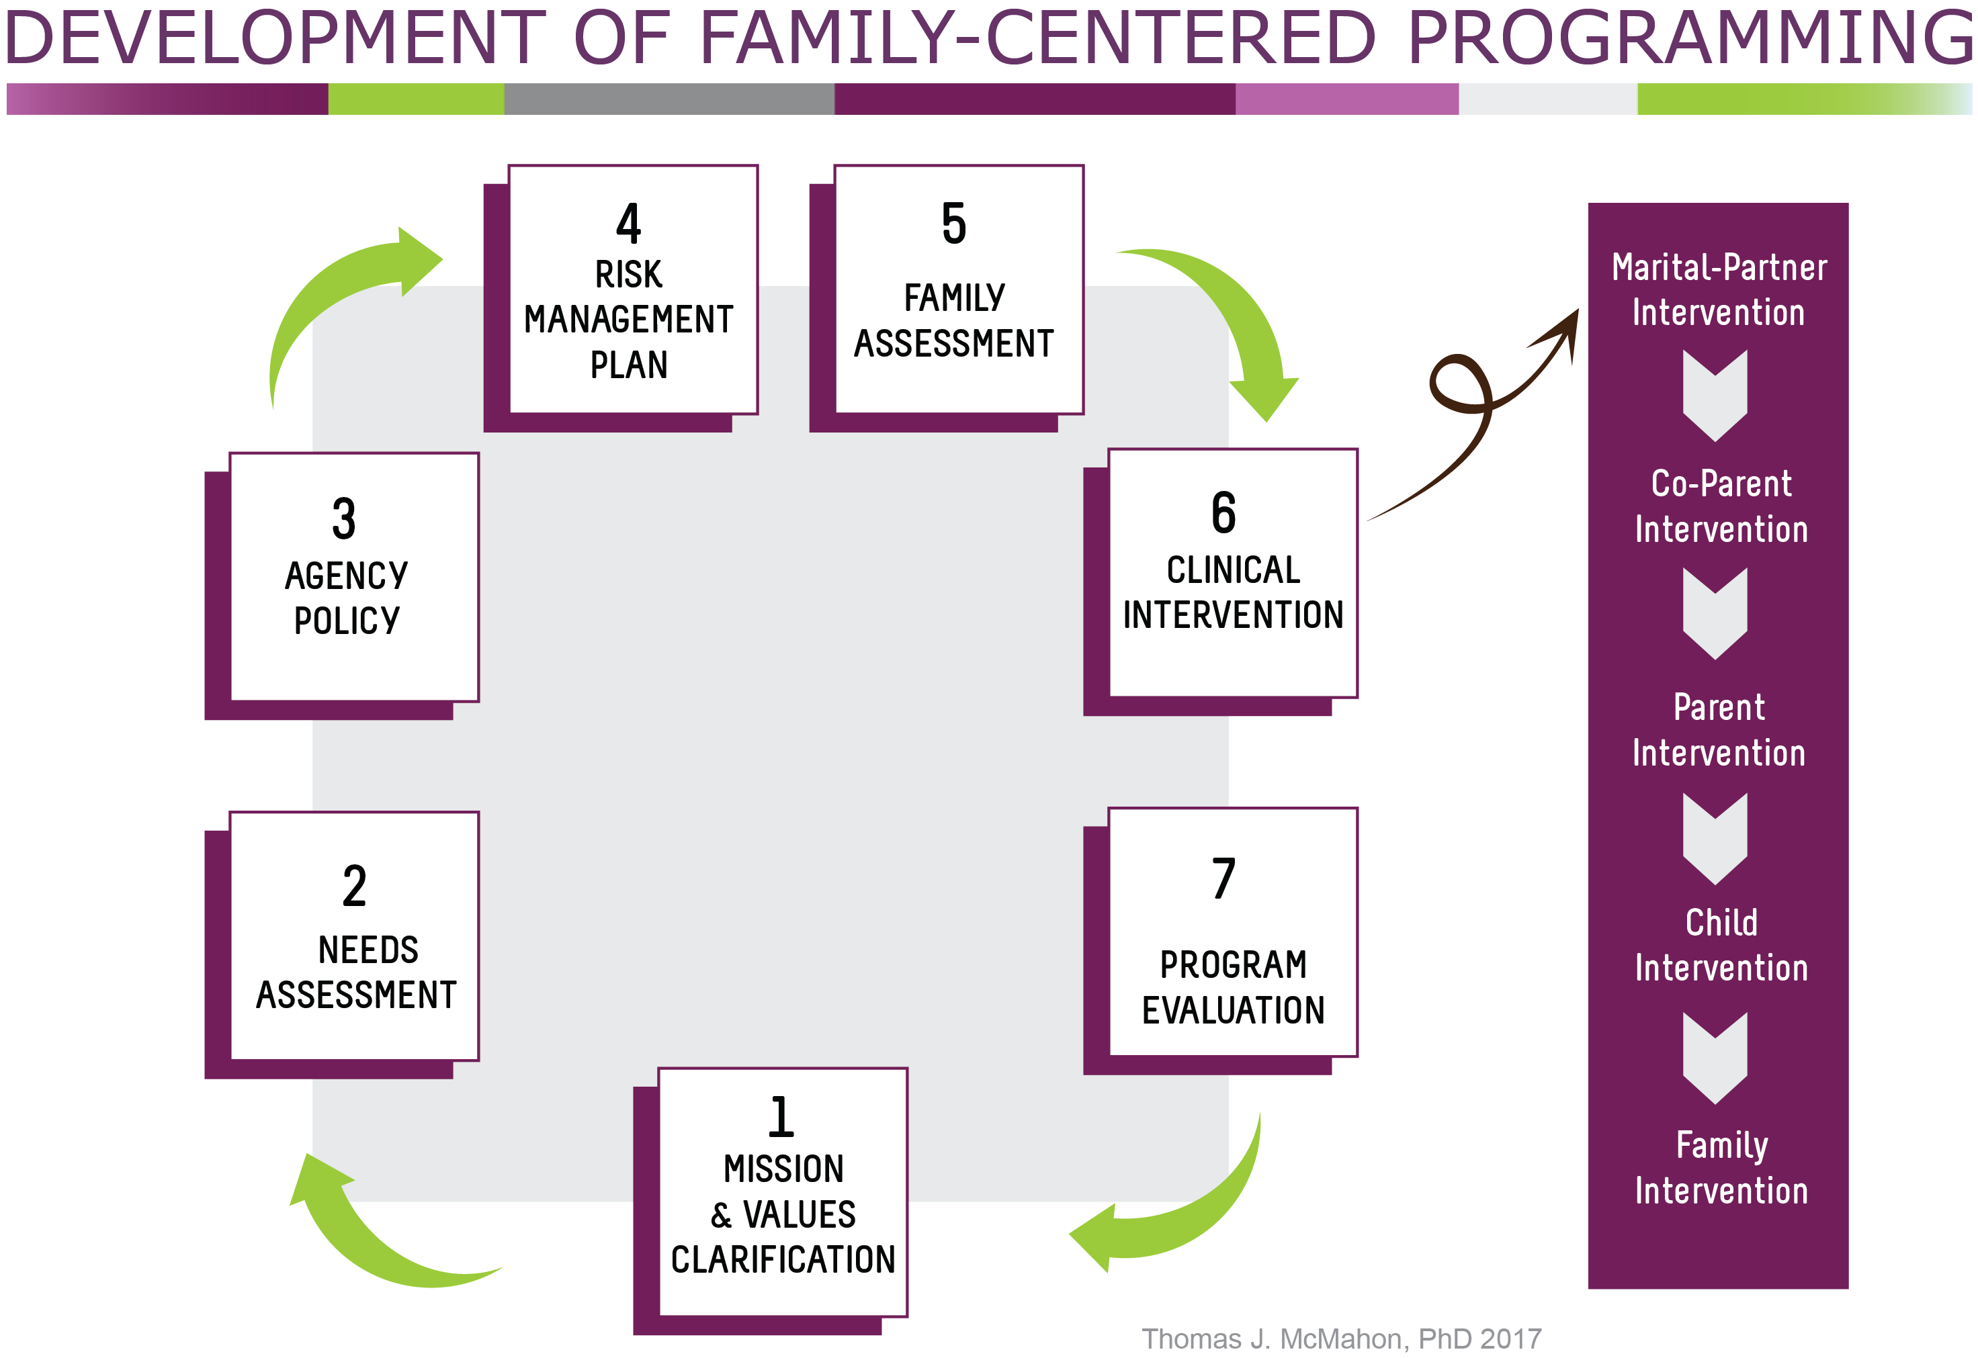
Page 140 in participant manual
Notes:
This visual provides a basic "How To" blueprint that programs can follow. The steps are listed in their recommended order. We will take a closer look at each step.
This graphic is available on page 140 of your participant manual.

Slide 13
Notes:
Step 1. Clarify mission, values and attitudes -
Because PPW programs have been historically developed by women for women, it is useful to spend some time exploring and talking about the values and attitudes in your program, especially feelings and concerns regarding beginning or continuing to include men and others in programming.
Useful tools for this process, such as program “father-friendliness” assessments are included on pages 100-106 in your participant manual as well as in the list of resources.
It is recommended that staff and administrators sit and actually write down a policy about values, goals, and expectations for a program that intends to better engage men and others considered family.

Slide 14
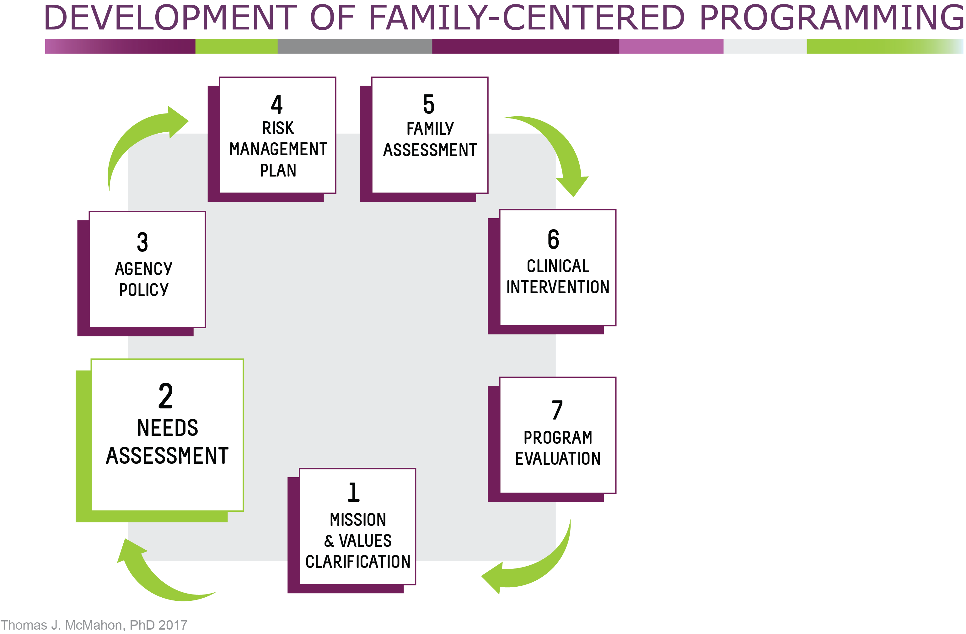
Notes:
Step 2. Conduct needs assessment
Look at the needs of the women in terms of the partners and co-parents in their lives.
Look at needs of your program. What would be helpful for your program to do to develop more programming for men and other family members?
What information does your program already gather on the fathers and other individuals considered family?
What additional information would be useful?
If your agency cannot meet the identified needs, could they be met by current partners or potential partners of your agency?

Slide 15
Tales from the Field
“…we had to look at every aspect of our program… our environment, policies and even our language. For example, we used the word “screening” to describe a father’s first face-to-face interaction with the counseling staff… Screening definitely did not say, ‘Welcome, we are a father-friendly environment.’ ”
Kimberly Craig, BA, BS, LSAT
CEO, CHEEERS Recovery Center
Former PPW grantee, Phoenix, AZ
Notes:
Pioneers in the field such as Kimberly Craig, CEO of CHEEERS Recovery Center, and a former PPW grantee, in Phoenix, Arizona, can offer insights on this process.
“A needs assessment can also include the use of some tools provided in your manual about assessing your organization on Father / Family Friendliness or Readiness. After years of running a program for just women and their children, we had to look at every aspect of our program to include our environment, policies and even our language. For example, we used the word “screening” to describe a fathers first face to face interaction with the counseling staff. Men had to complete a “Screening” appointment before they were allowed on the campus for visitation with their children. It was common to use this “screening” as a way for staff to say no, he wasn’t allowed to visit. It was always the first question, “has he completed a screening?“ Screening definitely did not say, “welcome, we are a father friendly environment”. We also had to look at what our environment said about fathering; did we have pictures, magazines and space that was welcoming and inviting for men? Did we have posters or pictures, printed materials that had images of men parenting? As programs looking to implement family centered care and in particular father/male involvement we have to look at everything top to bottom; and through the lens of those we are hoping to engage in services.

Slide 16
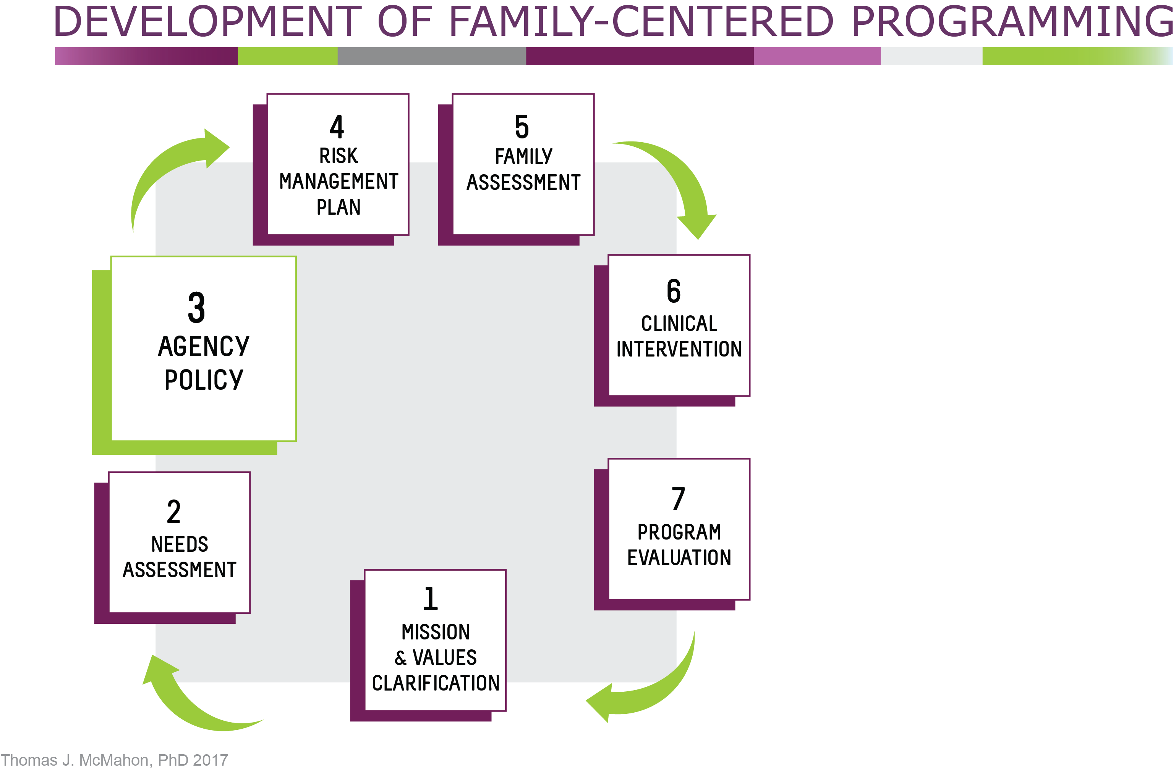
Notes:
Step 3. Clarify Agency Policy
Think about legal and ethical issues you are likely to encounter when you engage and include services for fathers, partners or co-parents. How will you deal with these?
Examples include: A father, who is not your patient, comes for a visit intoxicated. A woman in your program reveals her partner has a substance use disorder and asks for help.
It’s recommended that staff and administrators sit and actually create a policy concerning the involvement of fathers, partners, co-parents and other identified family members. Such a policy should outline the values, goals, expectations, and procedures relevant to their involvement. Generally, a good policy statement would indicate why a program believes it is important to involve the fathers, co-parents, partners, or other identified family member, and how they intend to do so. Other programs have found that the process of putting their ideas about how to do this on paper was very useful and helped focus the process.

Slide 17
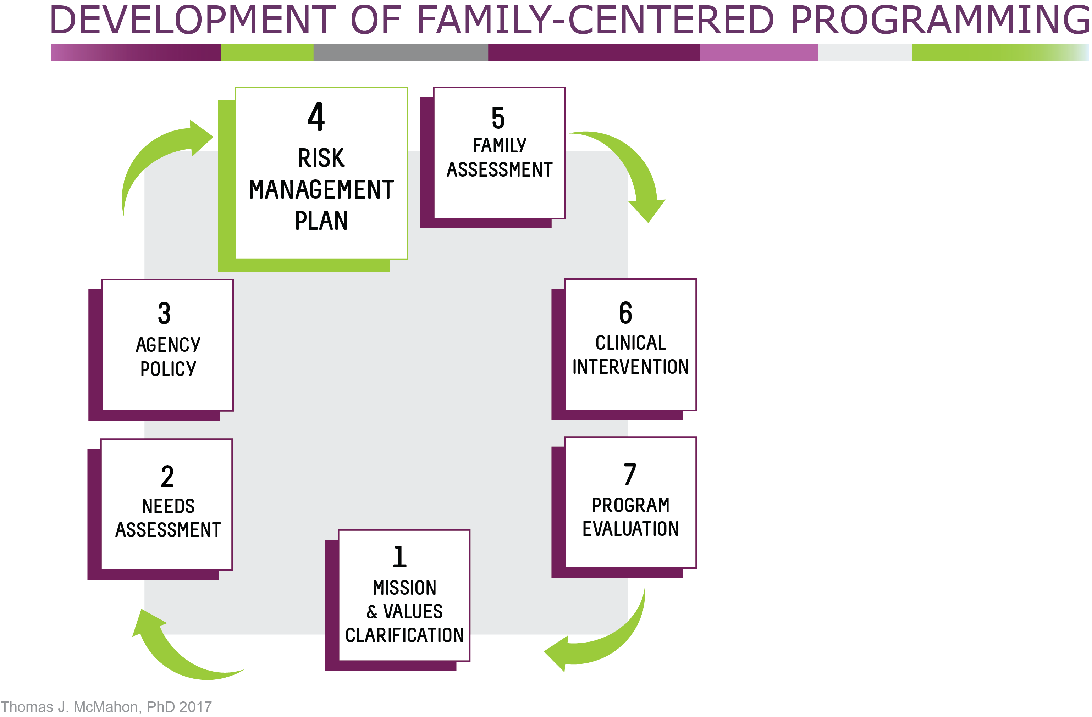
Notes:
Step 4. Think about procedures for safety and risk management.
Assessment and treatment of PPW with substance use disorders involves elements of risk. Increasing the involvement of fathers and others identified as family may also involve elements of risk. It is best to be proactive about the development of safety procedures to manage the risks inherent in the work an agency does. As more family-oriented interventions are developed, it may be useful to consider how to minimize the risks known to be associated with substance use for everyone in the family.
Safety management procedures and policies for inside the program consider how to handle clients as well as those who are considered visitors.
Examples include:
Will you allow fathers or co-parents to attend a family event before they have had an individual, couple’s, or family meeting with a counselor or clinician?
How will your program respond to couples when there has been a history of intimate partner violence?
How will your program help a client who wants to end a sexual partnership with the father of her child?
How would your program respond to a father, partner, or co-parent who is not your patient and presents for a family visit intoxicated?
Safety management must also include procedures and planning as the woman moves back into the community.
And as programs develop outpatient services (which is where the field appears to be moving), safety management policies and procedures must also be included.

Slide 18
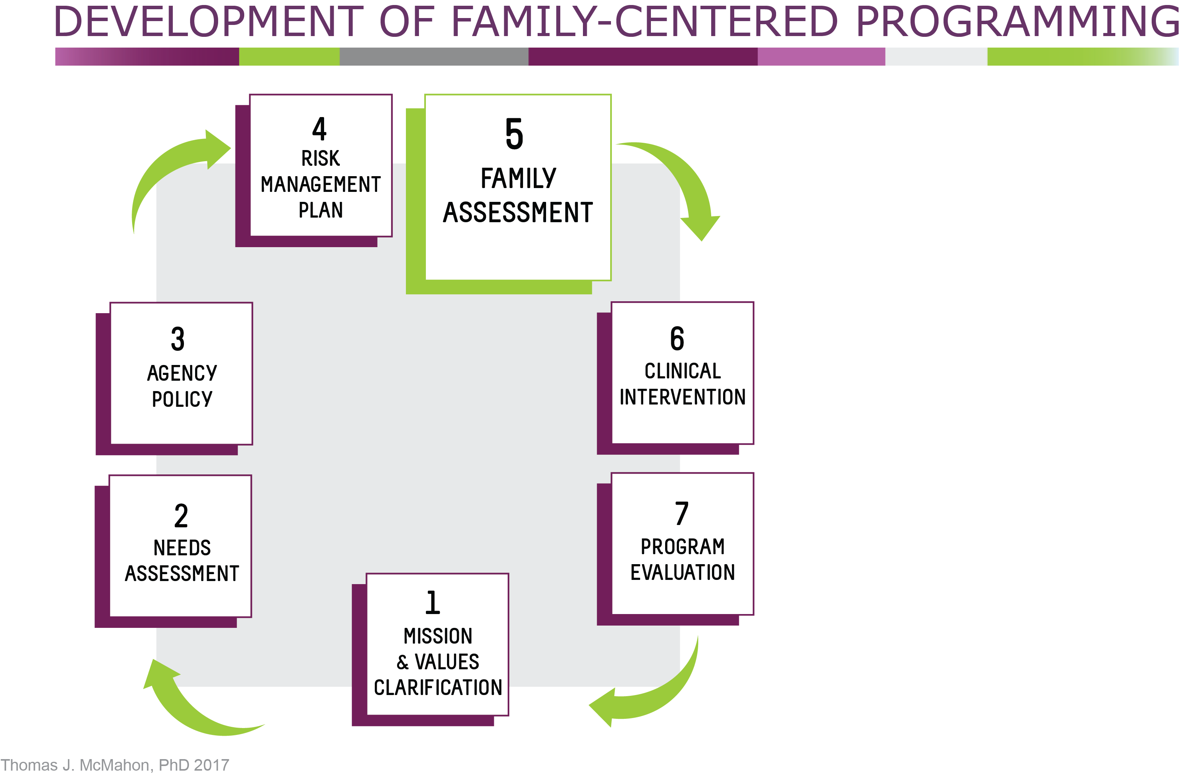
Notes:
Step 5. Family Assessment
Who defines who can be considered family?
What if the program has an interest in or a requirement to communicate with the father even though mom may not want to include him?
What if the definition of family from mom’s perspective differs from that of her child or children?
How will families be assessed?
Formal initial family assessment typically begins with mom and expands over the rest of mom’s time in treatment as more is learned about the family.
Given the principles of family-centered care, the family assessment focuses not only on the problems but also the strengths of the family.
The assessment also gathers information on the family’s cultural and socioeconomic background so it can place the family in a cultural and socioeconomic context. As mentioned earlier, definition of family may differ considerably for mothers, fathers, and children in response to differences in race, ethnicity, religion, marital status, sexual orientation, socioeconomic status, and other sociocultural influences.

Slide 19
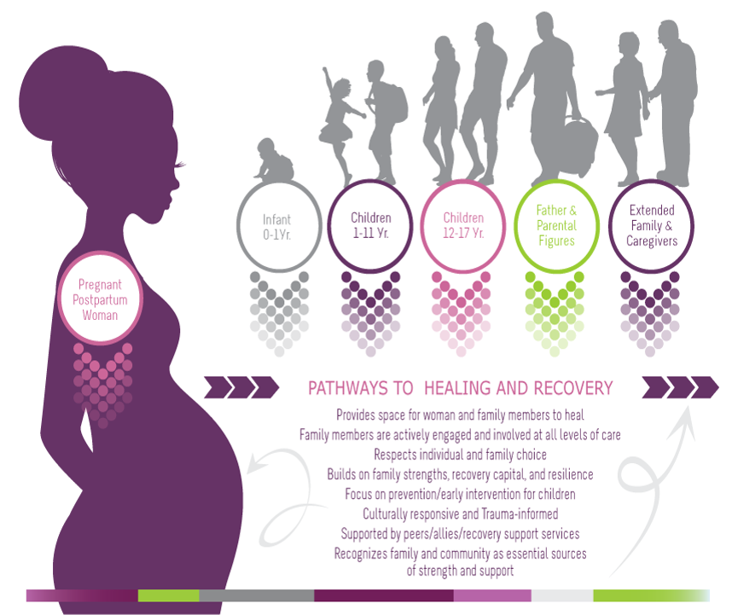
The Culture Conversation
The Culture Conversation
Family-Centered Programming= The Family
^{Page 139 in participant manual}
Notes:
Although we are reviewing a “blueprint” for family-centered programming, it’s important to remember that there is no “blueprint” for families. Families are diverse in landscape, constantly in flux, and dynamic in nature. Culture and the family requires awareness and understanding that “all families are not the same.” This concept may be acknowledged, however, it is by looking at the levels within cultural constructs that we can discover the depths of levels within the families and populations we work and serve.
For example:
Individualistic and Collective cultures/families
Mainstream and Non-Mainstream cultures/families
Nuclear and Extended Family cultures/families
Multi-generational cultures/families within one house
It is defining with the individuals who and what family is and means to them. It is having the conversation from their perspective and working from there.
Understanding the populations and communities which are accessing services is paramount. This means more than knowing the demographics, it is looking at demographics and asking oneself “What is missing?” It is recognizing the areas which are working effectively and saying, “What else can we do?” Setting aside the time to focus on what is not working and saying, “How can we do this better?”

Slide 20
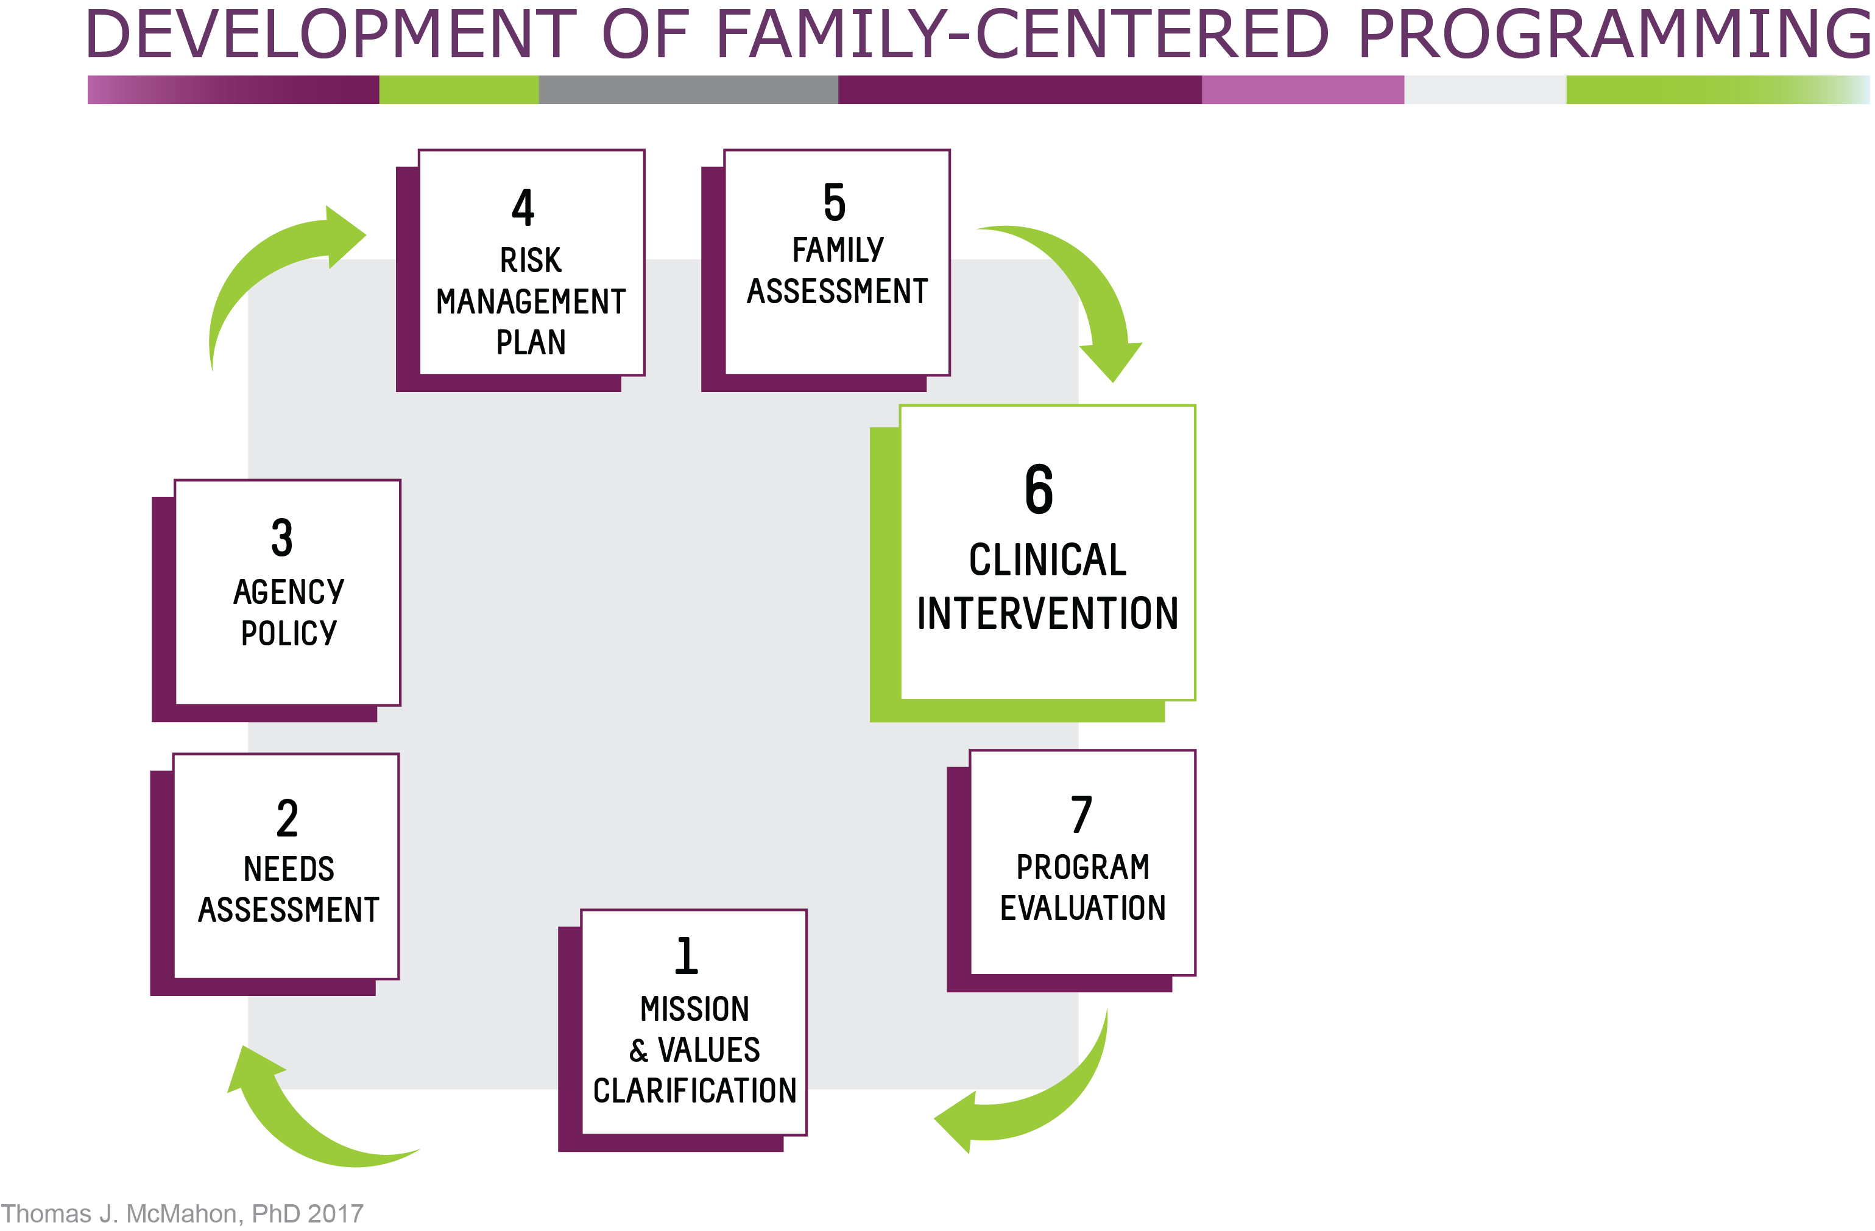
Notes:
Step 6. Define Clinical Interventions
What interventions will you offer for families including fathers and other family members?
Which interventions will you provide in-house? What additional services are needed so that families can easily access services offered by partners and not in-house?
Let’s look at the most common types of interventions more closely.

Slide 21
Types of Interventions
Notes:
Interventions here are listed in the order that problems typically should be addressed.
Marital – Partner Interventions – is for couples choosing to remain together and experiencing difficulties other than parenting. E.g. Difficulties with intimate partner violence, continued substance use as a couple, questions about whether to remain together, communication problems, concerns about fidelity.
Co-parenting Interventions - It may be one dimension of a marital-partner intervention or it may be the primary form of intervention for couples who have ended their sexual relationship or partnership.
Parenting Interventions – These would match, for the fathers and co-parents, the parenting interventions being done with the mothers. Links to some of the more popular interventions for use with fathers are in the resources list for this module. There has been work on defining the components of these programs for men, and there is evidence that men like them, but evidence on whether they really work as advertised is evolving.
Child Intervention - Some programs include interventions where children of parents who are in treatment meet without the parents. It is separate from family interventions. Such groups give a child a place to talk about what it has been like to live with a parent with a substance use disorder . It is also an opportunity to educate children in a developmentally appropriate way about the nature of addiction. Some programs also offer summer camps with daylong programming for kids who have a parent with substance use issues.
Family Intervention – These are carried out with parent and children in whatever configuration there is – mom and children, dad and children, or mom and dad and children.

Slide 22
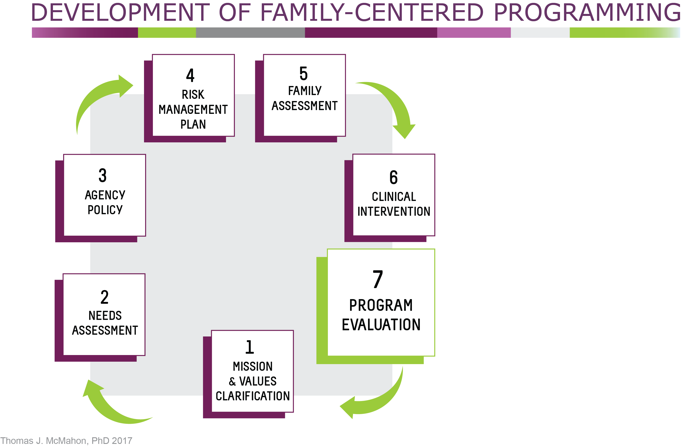
Notes:
Step 7. Evaluation
Any program of assessment and intervention designed to better meet the needs of fathers should include some simple, but formal way to assess what is being done both in terms of:
how it is being received by the men and other members identified as family?
the extent to which it is promoting change within the families you are working with.
These outcomes should align with the values, goals and expectations that were set in Step 1, the values clarification step.
Results from the evaluation would lead to a re-examination of the values and goals and expectations at the beginning of the cycle. Do these stay the same or do they need to be clarified further?
The cycle of steps starts again with a re-examination of the needs assessment, agency policy, and on through the cycle.

Slide 23
Notes:
Ask participants to keep that page open as they answer the question on the next slide.
Note to trainer: A full size copy of the complete graphic is included on page 140 of the participant manual.

Slide 24
Discussion
Which of the elements just covered are already in place at your agency?
Which need to be developed?
Why?
Notes:
Think of the 7 steps in terms of the system or program you work in. If your system or program embarked on this process of greater inclusion of fathers and family, which of the elements just covered are already in place?
Which would need to be developed further?
Would any of you be willing to tell us why?
Note to trainer: You can have people respond or you can point to each step on the visual and ask for a show of hands.
This activity can be modified based on the audience and time constraints.

Slide 25
Wrap Up
Notes:
How has your impression of family-centered programming changed?

Slide 26
Next Modules
Module 5: Family-Centered Clinical Interventions
Module 6: Case-Based Application
Notes:
These are the next modules in this training series. Make sure to check your participant manual for more information and resources.

Slide 27
References
For complete reference list, please see pages 168-171 in Participant Manual.

