Slide 1
Easier Together:
Partnering with Families to
Make Recovery Possible
Notes:
Welcome to module 5 of “Easier Together: Partnering with Families to Make Recovery Possible.”

Slide 2
Module 5:
Family-Centered Clinical Interventions
Notes:
In Module 5, we take a client-level view and concentrate on the steps that can guide development of family-centered interventions for the individual families you serve.

Slide 3
Acknowledgements
Thomas McMahon, PhD Yale University School of Medicine
Notes:
Our thanks to Thomas McMahon, PhD for his expertise, guidance, and many contributions in the development of this module. Dr. McMahon is a Professor in Psychiatry and the Child Study Center at the Yale University School of Medicine. Dr. McMahon is interested in ways in which the principles of developmental psychopathology can be used to expand understanding of the impact that parental addiction has on family process and child development. He has worked on the development of gender-specific parent interventions for men enrolled in addiction treatment. Dr. McMahon is also interested in the psychological assessment and treatment of children, adolescents, and young adults who have been abused or neglected in the context of parental addiction, as well as clinical and research training on the roles that genetic liability and family process play in the intergenerational transmission of developmental psychopathology. Dr. McMahon completed his doctoral training in clinical child and school psychology at New York University in 1994. Since 1998, he has been the recipient of several grants from the National Institute on Drug Abuse. With his colleagues, he has published more than 75 peer-reviewed papers and book chapters.

Slide 4
Introductions
Name
Field
Favorite thing about working with families
Notes:
Before we get started, I’d like to do some brief introductions.
Trainer: introduce yourself
Now I’d like everyone to introduce yourself and share your favorite thing about working with families.
Have everyone say their name, field, and favorite thing about working with families.
Note to trainer: You can modify this activity based on your audience.

Slide 5
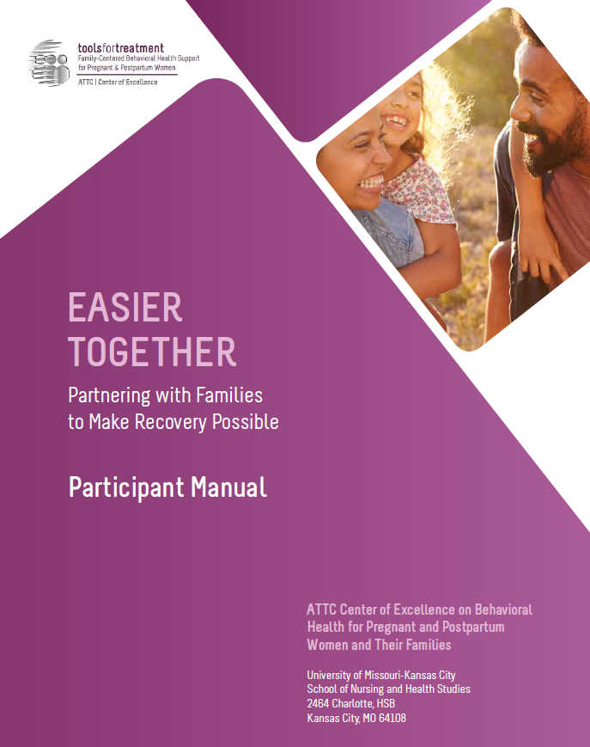
Hands-On Review of Participant Manual
Participant Manual
Each module contains:
Training goals and objectives
Copy of slides
Resources – worksheets, activities, assessments, recommended reading
Reference list
Notes:
As part of this curriculum, you all have a participant manual. I’d like us to do a hands-on review of this module’s content so you are familiar:
On page 144, the module begins with the training goals and objectives.
Next on page 145 you will find all of the presentation slides with room for taking notes.
Then on page 158 you will find the resources section, which contains a collection of handouts, worksheets, activities, assessments, recommended reading, and a reference list for that module.

Slide 6
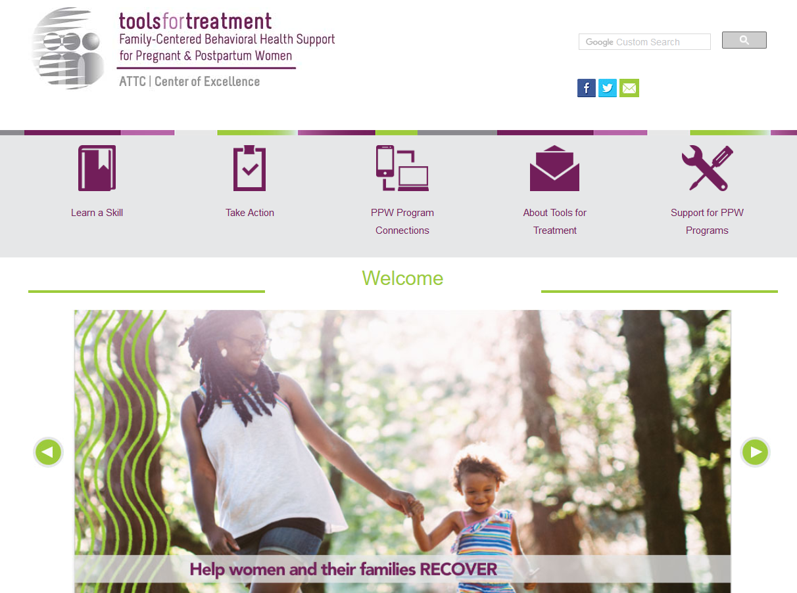
Visit www.attcppwtools.org for More Resources
Training Curriculum
Online Courses
300+ Program Resources Library
Recorded Presentations
Videos
Notes:
For additional resources, visit www.attcppwtools.org. Here you can download the “Easier Together” curriculum and access other resources such as:
Training curriculum
Online courses
300+ resources in the Program Resources library
Recorded presentations
Videos

Slide 7
Goal and Objectives
Goal: Provide a framework for development of family-centered interventions.
Objectives: Participants will be able to:
Identify the steps for developing family-centered interventions.
Describe some of the cultural considerations family-centered interventions involve.
Identify important safety concerns.
Examine own practice in terms of family-centered criteria.
Notes:
The goal of this module is to provide a framework for development of family-centered interventions.
These are our learning objectives for Module 5.

Slide 8
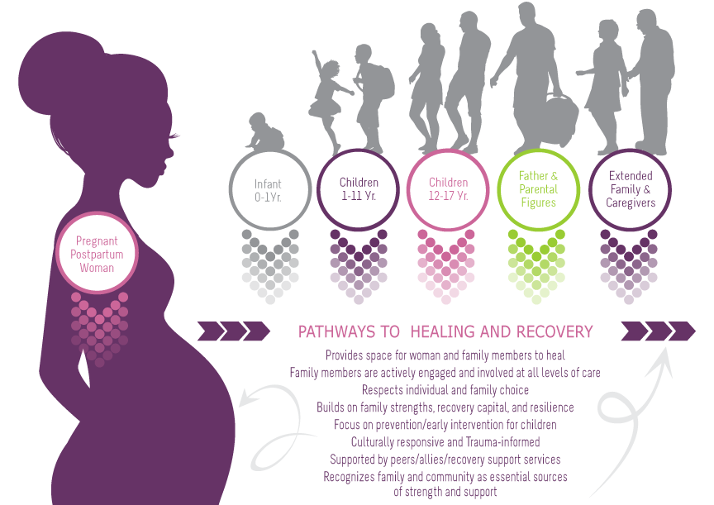
Family-Centered Recovery & Wellness Principles
Page 69 in participant manual
Notes:
This is a graphic that was developed to embody family-centered care and was presented in earlier modules. In this graphic, you can see that the woman is the vehicle of entry for all family members. She is the initial client that comes into the program to receive services, but through her, our view expands to include all family members. The family becomes the client and we wrap services around all family members to support family strengthening and healing.
Additionally, this graphic outlines “family-centered, recovery and wellness principles.” It is imperative to view family-centered care through the lens of recovery and wellness, not just as a treatment episode. Family-centered care sets families up for sustainable recovery and wellness long after treatment ends.
Note to trainer: This is available as a handout on page 69 of the participant manual.

Slide 9
The Culture Conversation
The Culture Conversation
whānau
^{Page 159 in participant manual}
Notes:
For this module’s Culture Conversation, we’re going to discuss one culture’s view of family. This is an image of harakeke: The harakeke (flax) plant represents the whānau (family) in Māori thought. The rito (shoot) is the child. It is protectively surrounded by the awhi rito (parents). The outside leaves represent the tūpuna (grandparents and ancestors). Strength is created through Whânaungatanga - connections with the Whânau; this encompasses everyone who is connected to the individual and recognizes the wide diversity of families within their communities. The family/whanau is crucial in developing and maintaining resilience.
This is an example of one culture, one community, and one understanding of the impact of family.
How is the family understood within our agencies, our communities, and families we serve?
As we have shared previously, the family can encompass:
Parents
Partners
Siblings
Grandparents
Aunts
Uncles
Cousins
Friends
Neighbors
Community supports
Biological links and non-biological links
As we develop family-centered interventions, we need to constantly evaluate how each family defines itself from its unique cultural lens.

Slide 10
Family-Centered Clinical Interventions: 6 Steps to Working with Women and Men as Family
Notes:
In this section, we will look at how the steps that guide development of family-centered programming in an agency (presented in the previous module) can be adapted to guide development of family-centered interventions.

Slide 11
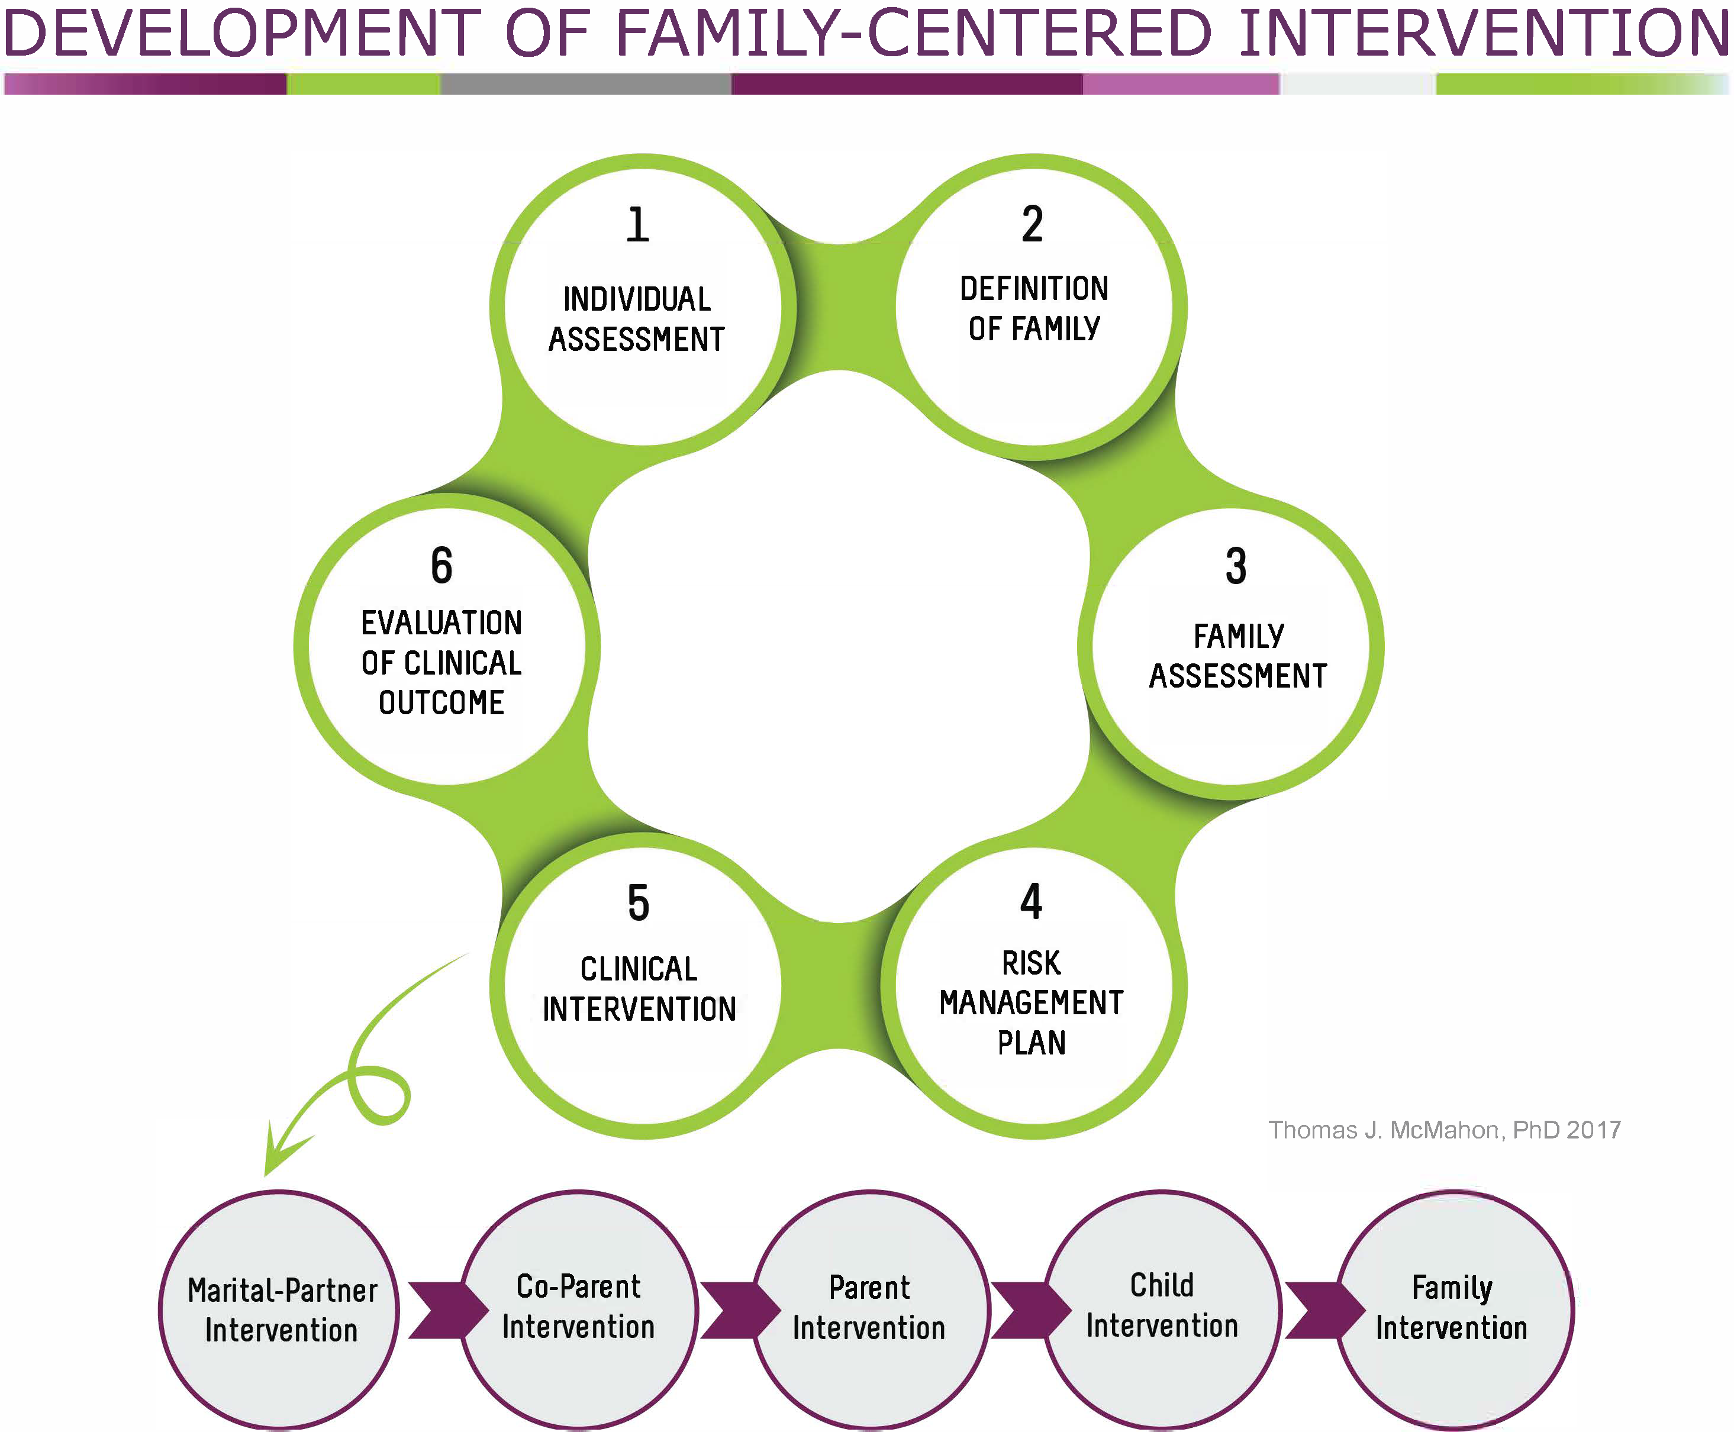
Page 160 in participant manual.
Notes:
This visual adapts the cycle we examined in Module 4 for development of family-centered programming into a 6-step framework for development of family-centered clinical interventions for a specific family. We will take a look at each of the components.
Note to trainer: This handout is available on page 160 in the participant manual.

Slide 12
Notes:
1. The first step is Individual Assessment. In this step, the assessment of the mother is likely be carried out upon entry into the PPW program. She is likely also the primary contributor to any initial family assessment.

Slide 13
Notes:
2. The second step is Definition of Family.
It is important to note that clinicians should work with clients to broadly define family in a cultural context. Definition of family may differ considerably for mothers, fathers, and children in response to differences in race, ethnicity, religion, marital status, sexual orientation, socioeconomic status, and other sociocultural influences.
Definition of family involves two questions:
Who defines family? and
Who will be considered family during the period of treatment for purposes of the family assessment and intervention?
We will examine these questions next.

Slide 14
Definition of Family
Who defines family?
Who will be considered in the family assessment?
Notes:
Who defines family? Generally, the client defines her family with a counselor or clinician for the purposes of family assessment or intervention. This may be complicated by several ethical and legal issues. For example, there are ethical issues concerning the definition of family for counselors and clinicians who work with children.
Who decides how family is defined for the child?
Who decides who participates in family assessment and intervention pursued on behalf of the child?
What happens when definition of family differs for different members of the same family?
How do legal mandates influence definition of family?
What happens if a mother prefers a father not be involved in a child’s life, but there is a legal mandate stipulating a right to visit?
The point here is that the client generally defines her family for herself, but her ability to do so for others may be limited and complicated by ethical and legal issues involving the rights and obligations of others, including their children and the fathers of their children.
Who will be considered in the family assessment? This may change with time. When mom enters treatment, her vision of the people and relationships that must be included to ensure that her treatment and long-term recovery can succeed may be limited. She may not be able to see past herself and her unborn child. Over time, however, clinicians can help her broaden her perspective to include the people and relationships that must be addressed to ensure that her long-term recovery is successful and not derailed post-treatment. The father of her child/children is one of these important relationships to consider. Learning how to make problematic relationships more workable is best done with the safety and support that a program and its staff can offer.

Slide 15
Notes:
3. The third step is Family Assessment. This starts with the clinician reviewing with the mother her relationship with the people who would ordinarily be defined as family and deciding who should be included in a broader assessment of her family system during her current treatment episode.
Someone involved in her family assessment may not necessarily be involved in her family-centered intervention. One of the goals of a family assessment is to collaboratively decide what type of family interventions may be helpful and who should be involved. Comprehensive family assessments must always be pursued with sensitivity to ways that cultural factors influence the structure and functioning of family systems.
Methods and tools: As noted in the participant manual, genograms, timelines, ecomaps, structured tasks, and survey measures can be useful tools to integrate into a family assessment.
Genograms are an easy way to diagram family relationships over generations. Timelines illustrate a family’s history. There is an excerpt of a TIP on pg. 161-166 in your participant manual with more information. Self-report measures can be used with individuals and couples (to get both sides). Family-centered tasks offer clinicians an opportunity to watch how a couple or a family operates.
Including at least one member of the previous generation in the assessment can bring to light intergenerational trauma, IPV, mental health problems, and substance use.
Safety: Assessments needs to include any risk for harm to self and others due to substance use (and other risks). This should lead to planning of how to ensure safety:
Within the program - requires understanding people’s legal status, involvement of CPS, presence of restraining orders, etc.
Outside the program - how will the risk for harm to family members be managed if the family is outpatient or when the family leaves the program?

Slide 16
Static and Dynamic Factors
Static factors don’t change:
What has already happened
Seriousness
Dynamic factors can change:
Increase or decrease the risk of previous behaviors being repeated
Notes:
Our next step will be development of a risk management or safety plan for the family in question. What is needed to ensure safety and plan for how possible risks will be managed both in the program and in the community?
Both static factors and dynamic factors need to be considered.
Static factors – are things that don’t or can’t change, such as what has already happened and its seriousness. Example: the father or partner has punched the mother and broken her cheekbone, or the mother has stabbed the father. These are markers of what might happen between this couple (worst scenarios). The program needs to know what people are capable of doing.
Dynamic factors – are those things that can change. Example: the same couple has a heated argument due to stress because the father lost his job. Given their past behaviors, this change in job status may increase the likelihood of previous violent behaviors being repeated. The program must pay attention to the direction behaviors are moving in. If the father gets a new job, things will likely move in the direction of decreasing the likelihood of those behaviors being repeated. Safety management requires paying attention to where things stand regarding dynamic factors and watching for signs of movement of how things are changing over time to increase or decrease safety.

Slide 17
Notes:
4. A Risk Management Plan is a comprehensive safety plan developed collaboratively with the client, a treatment team, and significant others to decrease risk for a specific adverse or undesirable event for this family. A safety plan usually focuses on using available resources to decrease, as much as possible, the potential influence of risk factors and increase, as much as possible, the potential influence of protective factors.
Part of managing risk may be clarifying what is the Child Protective Services plan around visitation? What are the conditions of a restraining order if one is place? Does there need to be additional clarification regarding what the visitation plans are?
Also important is understanding when it is appropriate to get legal support or have legal mandates put in place. Example: there is a restraining order in place, but the couple has decided to resume their relationship while mom is in treatment. They ignore the order thinking it no longer applies since they are on better terms. Violating the restraining order puts them at risk. If they should have a serious fight, then they could not only be arrested for assault, but also for violating the restraining order, which may be a more complicated offense.
Do family members need to better understand what needs to be in place for the future, such as helping mom prepare for discharge from a residential program? Example: mom is planning on moving back in with the father at the end of treatment. She also has a restraining order against him. Does she need to withdraw this restraining order so they will not be violating it? Such clarification is part of managing risk.

Slide 18
Partnering with Child Welfare
https://vimeopro.com/attcnetwork/bring-them-all/video/236123169
Notes:
Partnering with child welfare is essential when providing family-centered care. In this video clip, Kathryn Icenhower of SHIELDS for Families, a program in Compton, CA, and Blanca Vega of the LA Department of Children and Family Services talk frankly about the significant challenges and benefits such a partnership presented for them personally and for their agencies.
Note to trainer: This video is 4:12 minutes long and also available online at https://vimeopro.com/attcnetwork/bring-them-all/video/236123169. If time allows, ask, “Any thoughts about what you just heard in the video?”

Slide 19
Notes:
5. Clinical interventions selection is the next step. Agencies may make different types of family-centered interventions available in either a group or individual format. It is important to note again that family-centered interventions must always be pursued with sensitivity to the ways family structures, values, and functioning vary with cultural context. Let’s look at the basic types of interventions more closely.

Slide 20
Types of Clinical Interventions
Notes:
When working with an individual family, the identified needs are specific. Some or all of the needed interventions may be provided in-house. Some may have to be accessed externally.
Marital – Partner interventions – For couples choosing to remain together and experiencing difficulties other than parenting. E.g. Difficulties with intimate partner violence, continued substance use as a couple, questions about whether to remain together, communication problems, concerns about fidelity, etc.
Co-parenting interventions - It may be part of a marital-partner intervention or it may be the primary form of intervention for couples who have ended their sexual relationship or partnership.
Parenting interventions – For the fathers and other co-parents, the parenting interventions would match what is being done with the mothers. Links to some of the more popular interventions for use with fathers are in the resources section. There has been work on defining the components of these programs for men, and there is evidence that men like them, but evidence on whether they really work as advertised is evolving.
Child intervention - Some programs include interventions where children of parents who are in treatment meet without the parents. It is separate from family interventions. In a moment, we’ll look at a short video about these.
Family intervention – These are carried out with parental figures and children in whatever configuration there is – mom and children, dad and children, mom and dad and children, etc.

Slide 21
Services for Children
https://vimeopro.com/attcnetwork/bring-them-all/video/236123803
Notes:
Services for children, such as those offered by SHIELDS for families in Compton, CA, give a child a place to talk about what it has been like to live with a parent with a substance use disorder. It is also an opportunity to educate children in a developmentally appropriate way about the nature of addiction. Some programs also offer summer camps with daylong programming for kids who have a parent with substance use issues.
Note to trainer: This video is 3:17 minutes long and also available online at https://vimeopro.com/attcnetwork/bring-them-all/video/236123803.

Slide 22
Notes:
6. Evaluation of Clinical Outcomes is the sixth step - How will the clinical outcomes be evaluated for this family? What markers will you use?
Any program of assessment and intervention designed to better meet the needs of families should include some simple but formal ways to assess what is being done both in terms of how it is being received by the family members involved and the extent to which it is promoting change within the family you are working with.

Slide 23
Tales from the Field
“…In many ways we need to give ourselves permission to change with the times and accept that what was once the best we could do with the information we had, is now old information. “
Kimberly Craig, BA, BS, LSAT
CEO, CHEEERS Recovery Center
Former PPW grantee, Phoenix, AZ
Notes:
Pioneers in the field such as Kimberly Craig, CEO of CHEEERS Recovery Center, and a former PPW grantee, in Phoenix, AZ, can offer insights on the evaluation process:
“It was over 15 years ago that we moved our programs toward being gender-specific and trauma-informed - which for many programs meant WOMEN only - and eventually and slowly we added her children. Our service delivery methods have changed over time and continue to change. As recently as 5 years ago, family-centered care for many of us meant we made some outreach phone calls to family members to tell them about the holiday dinner and visitation hours at our treatment facility, or we mailed them a family packet with program rules, do’s and don'ts. It was also common (and may still be) that males (fathers) and extended family members were not allowed on the campus of our programs and certainly not without an escort. Now we are asking that actual services be provided to the entire family, not just outreach and courtesy calls. In many ways we need to give ourselves permission to change with the times and accept that what was once the best we could do with the information we had, is now old information. We have new information in front of us and we have to embrace it, believing we will improve our programs and outcomes for families as a result.”

Slide 24
Discussion
What are your thoughts regarding Kimberly’s observations?
Would you place your agency’s level of family-centeredness closer to the past (how things used to be) or closer to the future?
Where would you place the level of family-centeredness of your own practice?
Notes:
Ask participants:
What are your thoughts regarding Kimberly’s observations?
Would you place your agency’s level of family centeredness closer to the past (how things used to be) or closer to the future?
Where would you place the level of family-centeredness of your own practice?
Note to trainer: Modify this activity based on the audience and time constraints.

Slide 25
Wrap-Up
Notes:
How has your impression of building family-centered programming changed?
Note to trainer: Modify this activity based on the audience and time constraints.

Slide 26
Next Modules
Module 6: Case-Based Application
Notes:
This is the next module in this training series. Make sure to check your participant manual for more information and resources.

