Slide 1
Cultural Change and Family Transformation
Module 2
New England ATTC
Haner Hernández, Ph.D., CPS, CADCII, LADCI

Slide 2
Disclosures
The development of these training materials were supported by grant H79 TI080209 (PI: S. Becker) from the Center for Substance Abuse Treatment, Substance Abuse and Mental Health Services Administration, United States Department of Health and Human Services. The views and opinions contained within this document do not necessarily reflect those of the US Department of Health and Human Services, and should not be construed as such.

Slide 3
Goal
To transfer the knowledge in the Cultural Elements in treating Hispanic and Latino populations to frontline clinicians thereby initiating application of culturally competent approaches to the treatment of Hispanic and Latino clients with substance use disorders.

Slide 4
Objectives
Demonstrate understanding of how culture change affects Hispanics and Latinos and their substance use.
Identify and address barriers faced by Hispanics and Latinos around access and readiness for treatment and recovery.
Explain the relationship between culture and treatment.

Slide 5
Objectives
Describe common themes among Hispanic and Latino populations.
Explain how family transformation influences the ability of Hispanics and Latinos to access, participate, complete and sustain recovery.

Slide 6
Cultural Competence
Includes being able to recognize and respond to health-related beliefs and cultural values, disease incidence and prevalence, and treatment efficacy.
Source: OMH, 2001
Notes:
6

Slide 7
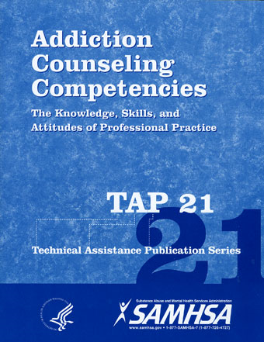
Addiction Counseling Competencies (TAP 21)
Disciplines that center on addiction are based on four common foundations
Understanding addiction
Knowledge about treatment
Application into practice
Professional education and training
Source: CSAT, 2006

Slide 8
Culture and Treatment
Considerations of common culture characteristics for Hispanics and Latinos in the U.S. in the context of substance use disorders treatment.

Slide 9
Culture and Treatment
Distinguish the content of a client’s history from the environment in which their recovery occurs.

Slide 10
Culture and Treatment
Understand the importance of culture by inquiring about it.

Slide 11
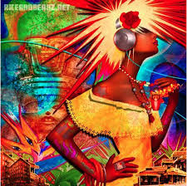
Principles for Culturally Competent Treatment Services for Hispanic and Latino Populations
Culture plays a key role in our ability to influence behavior in a patient. However, we cannot afford to let cultural barriers limit our ability to meet the needs of our patients, or reduce their opportunity to benefit from the services we can provide.

Slide 12
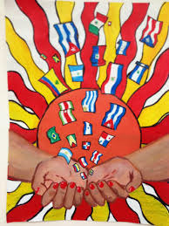
Common Cultural Themes for Hispanic and Latinos in the United States
Family or familia (familismo)
Respect or respeto
Personal relationships or personalismo
Trust or confianza
Spirituality or espiritualidad
Source: Falicov, 1998; Santiago-Rivera et.al, 2002, Pajewski & Enriquez, 1996 & Bracero, 1998

Slide 13
Familismo-Definition
“A cultural value that involves individuals’ strong identification with and attachment to their nuclear and extended families, and strong feelings of loyalty, reciprocity, and solidarity among members of the same family”
Source: Marín & Marín, 1991
Notes:
13

Slide 14
Familismo
“I do not belong to the culture of 911, there is always a relative I can depend on to rescue me.”
A Hispanic client
Source: Falicov, 1998

Slide 15
Familismo
Traditionally, Hispanic and Latinos include many people in their extended families, not only parents and siblings, but grandparents, aunts, uncles, cousins, close friends, and godparents of the family's children.
Family involvement often is critical in the health care of the patient.
Source: Santiago-Rivera, Arredondo & Gallardo-Cooper, 2002
Notes:
Latinos are known for having strong family ties. Latinos reference to familia may often expand beyond nuclear and extended family to include close friends. This bond often creates an obligation felt by fellow members to help and support each other when experiencing challenging life issues such as financial struggles, health concerns, and/or unemployment. Many Latinos will put the family’s needs before the individual’s. Latinos may choose to keep their sufferings to themselves in order not to inconvenience or worry loved ones; especially in situations where it is perceived that the family is struggling as a whole. This behavior can indirectly cause additional problems for the family, as the individual may not receive help until the problem has become exacerbated.
The multidimensional value of familism (or familismo) is broadly defined as “prioritizing one’s family over oneself” (Schwartz, 2007, p. 101), but also includes characteristics like family support, familial honor, loyalty, reciprocity, interdependence, family as referents, and obligation to the family (Lugo Steidel & Contreras, 2003; Sabogal, Marin, Otero-Sabogal, Marin, & Perez-Stable, 1987; Schwartz, 2007). Because some investigators identify family support and cohesiveness as the most predominant factor of familism, these are often utilized as a proxy for familism (Hovey & King, 1996; Miranda, Estrada, & Firpo-Jimenez, 2000; Sabogal et. al, 1987). The value of familism has also been expressed by non-Hispanic groups, as well as likened to collectivism and filial piety, especially when demonstrated as “sacrificing one’s own needs to meet those of one’s family” (Schwartz, 2007, p. 113). As Fuligni, Tseng, and Lam (1999) point out, when children are socialized within the values of familism, they are “asked to make personal sacrifices by sublimating their wishes and desires for the greater good of the larger family” (p. 1031). This concept of sacrifice permeates familism research, and it is also linked with some other Hispanic cultural constructs.
Familism/familismo suggests collectivism and interdependence. Many family functions are shared. The emphasis is on collective rather than individual ownership or obligations, affiliation and cooperation rather than confrontation and competition

Slide 16
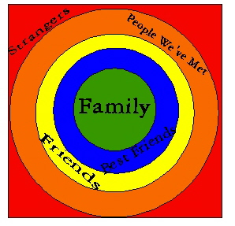
Familismo
Flexible boundaries
Avoid pathologizing closeness
Notes:
Familism/familismo encompasses meanings about inclusiveness and participation in large family networks. In many Hispanic and Latino extended families, visits are frequent and helpful exchanges commonplace. Unlike the dominant culture, boundaries around the Hispanic and Latino nuclear family are flexible, expanding to include grandparents, aunts, uncles or cousins with natural ease (Alvarez, Bean & Williams, 1981; Keefe, 1984; Ramirez & Are, 1981; Vega, 1990 in Falicov, 1998)

Slide 17
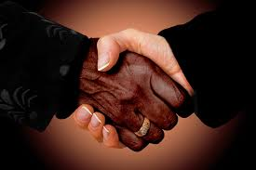
Respect
Defer to those in positions of authority
Reciprocal
Notes:
Respecto means that each person is expected to defer to those who are in a position of authority because of age, gender, social position, title, economic status, etc. Healthcare providers, and doctors especially, are viewed as authority figures. Thus, Latino patients/parents will tend to demonstrate respecto in healthcare encounters. They may be hesitant to ask questions or raise concerns about a doctor’s recommendations, being fearful that doing so might be perceived as disrespectful. They may nod to demonstrate careful listening and respect when a doctor is talking, rather than agreement about treatment. Respecto is also expected on a reciprocal basis by Latinos when dealing with healthcare professionals. This is especially the case when a young doctor is treating an older Latino patient. It is important to approach Latino patients/parents in a somewhat formal manner, using appropriate titles of respect (Senor [Mr.] and Senora [Mrs.] and appropriate greetings [good morning or good afternoon]. This is especially true with older Latinos. U.S. Americans are recognized the world over as being highly informal. We jump to a first name basis with strangers almost immediately, signaling a collapse of status differences by doing so. Good intentions aside, people from many traditional cultures will not appreciate this informality. It will make them uncomfortable and may even be seen as rude behavior in certain situations.

Slide 18
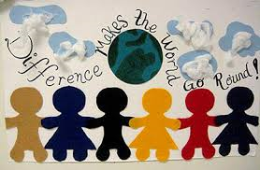
Respect
Implies a mutual and reciprocal deference, and dictates appropriate deferential behavior towards others based on age, sex, social position, economic status, and authority.
Older adults expect respect from those younger, men from women, adults from children, teachers from students, employers from employees.
Source: Santiago-Rivera, Arredondo & Gallardo-Cooper, 2002
Notes:
For Hispanic/Latinos the intimate confines of extended families, close-knit Hispanic/Latino communities, and traditional patriarchal networks are mediated by respect. Respect implies a mutual and reciprocal deference and dictates appropriate deferential behavior towards others based on age, sex, social position, economic status, and authority. Older adults expect respect from those younger, men from women, adults from children, teachers from students, employers from employees, and so on.
Respect is important for Hispanics/Latinos. It manifests in many ways. For a service provider that speaks some Spanish, it is crucial to speak with elders in the “usted” manner instead of “tu”. “Usted” is equivalent to speaking with someone in English and using “sir” to address them. The “tu” tense is informal and could be construed as disrespectful.
In a culture that emphasizes cooperation and respect for authority, clients may feel that it is impolite to openly disagree with the therapist. Falicov (1998) suggests that therapists encourage Hispanic clients to discuss both their positive and negative reactions to the process in order to establish mutuality.

Slide 19
Personalismo/Personal Relationships
Formal friendliness
Simpatía- kindness
Notes:
Latinos tend to be more focused on relationships. The word simpatia means “kindness” and refers to an emphasis on politeness and pleasantness even in the face of stress. Hispanics and Latinos are respectful of others in an effort to create effective bonds. In turn, Latinos expect that others demonstrate simpatia and personalismo which translates into “formal friendliness.” This includes healthcare providers.

Slide 20
Personal Relationships/Personalismo
Hispanic and Latinos expect health providers to be warm, friendly, and personal, and to take an active interest in the patient's life.
Source: Santiago-Rivera, Arredondo & Gallardo-Cooper, 2002
Notes:
Latinos may read the neutral or businesslike affect of some professionals as negative. If the physician seems hurried, detached and aloof, the Latino patient/parent may experience resentment and be dissatisfied with care. This of course reduces the likelihood of compliance with the doctor’s recommendations for treatment, engagement with the process and follow-up. Professionals should be attentive, take their time, show respect, and if possible communicate in Spanish. Physical gestures such as handshakes or even placing a hand on the shoulder help to communicate warmth. Latinos also expect their healthcare provider to exhibit confidence.
Latino patients view physicians as important authority figures with rank on the level of priests. Although expecting an authoritative expert, Latinos also want a friend they can talk to in their physician. In Spanish, this is best described by the term personalismo. The impersonal characteristics that frequently accompany modem American medicine are not acceptable in Latino culture. Physicians may be evaluated on the basis of their verbal communication skills rather than their medical knowledge.
A cultural trait or value reflected is the tendency for Hispanic and Latino clients to relate to the service provider personally, rather than in an institutional or interpersonal manner. Hispanic and Latino clients may expect appropriate physical contact, such as a hand shake or a hand on the shoulder, in some circumstances.
Personal relationships are crucial with Hispanics and Latinos. A good example is the need to have agreements on a face-to-face basis. Many Hispanics and Latinos prefer to meet with service providers in person rather than through a telephone call. If they have to leave a message, sometimes they will do it in person, as it gives the relationship much more of a priority.
The importance of personal relationships is stressed which is why Hispanics and Latinos are reliant on community-based organizations and clinics. An expectation of warmth and friendliness is what Hispanic and Latino consumers have when it comes to working with providers. Sincerity and genuineness are part of being personal with clients.
Many Hispanic and Latino families tend to connect with people whom they consider to be like them. It can be as simple as talking about where someone was born or from the place their parents are from. Hispanic and Latino families appreciate self disclosure keeping in mind the dangers of transference and counter-transference. A practitioner must understand which information is important, but not “too much” and which information is appropriate.

Slide 21
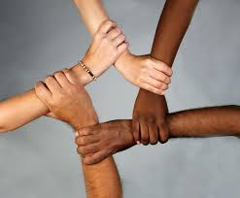
Trust
Building trust has been described as the earliest developmental task and the foundation on which all others are built
Establishing trust is broadly accepted as fundamental to the development of a therapeutic relationship
Source: Erickson, 1980

Slide 22
Trust
Over time, by respecting the patient's culture and showing personal interest, a treatment provider can expect to win a patient's trust.
Notes:
Falicov (1998) discusses the issues of trust as a challenge for the psychotherapists who are members of the dominant culture. It is not easy for an outsider to imagine what it is like to live the experiences of the other. The Spanish word confianza is a concept of trust that grows as a result of gradual development of a relationship based on personalismo. The psychotherapist, according to Falicov, must be respectful of the client’s dignity by communicating kindness, fairness, and basic courtesy of personal interest rather than by outcomes. She suggests that the psychotherapist be open and honest about the clinical setting, the goals of therapy and offer to answer any questions that may arise. A confrontational approach is not valued and small disclosures are important in order to establish a therapeutic alliance. Confianza will further create a space where therapeutic goals are more easily obtained.
Bracero (1998) explains that the quality of optimal relatedness is termed confianza and that this is the standard by which all social relationships (personal, professional or familial) may be measured. Therefore, trust becomes a critical component in relationships. The collective nature of engagement among Hispanics and Latinos; including thinking, feeling and behaving promotes a continuous demonstration that those who I relate with are moral and trustworthy. Due to high levels of interdependence among Hispanics, trust is a crucial factor. It is important for the psychotherapist working with Hispanics and Latinos to be aware of this interpersonal concept in order to overcome possible resistance to treatment.
Over time, by respecting the patient's culture and showing personal interest, a treatment provider can expect to win a patient's trust. When there is trust, Hispanic and Latinos will value the time they spend talking with their treatment provider and believe what they say. Trust means that the provider will have their best interests at heart. Providers who are able to develop a bond of trust (confianza) may notice a level of improvement in treatment
In establishing trust, a provider may focus on such things as sincerity, being present, being invested, and being real which in turn will improve outcomes significantly.
As mentioned previously, lack of trust is one of the major issues as to why consumers and their families do not participate in treatment. Once trust is established, a therapeutic bond is formed and treatment can commence.
A good example of trust establishment is to use a conocimiento approach. The conocimiento or “knowledge”, part of information gathering is where a practitioner collects information informally through a discussion-type interaction even before the formal process of questions begin. This is not small talk but rather, a time where connection occurs and takes many forms and much information exchange. The focus is establishment of trust.

Slide 23
Spirituality
Personal relationship that is transcendent or beyond the self
Powerful instrument for recovery
Recognized as a protective factor
Notes:
Spirituality has been recognized as powerful tool for people in recovery. It pertains to a personal relationship that is transcendent or beyond the self (Cook, 2004 in Heinz , A.J.; Disney, E.R., Epstein, D.H.; Gleen, L.A.; Clark, P.I. & Preston, K.L., 2010). Studies have associated spirituality to better treatment outcomes and fewer relapses (Avants, Warburton, and Margolin, 2001; Carter, 1998; Heinz, Epstein, and Preston, in press; Kendler, Gardner, and Prescott, 1997; Piedmont, 2004 in Heinz et. al, 2010). However, certain studies have also found discrepancies between clinicians’ perceptions of their clients’ spirituality and patients’ perceptions as well as less value of spirituality as a strength factor for recovery than patients Goldfarb, Galanter, McDowell, Lifshutz, and Dermatis, 1996 in Heinz et. al, 2010).
Approximately 25 million Hispanics and Latinos identify as Catholics whereas 9 million identify as Pentecostal or Charismatic (Espinoza, Elizondo & Miranda, 2003 in Campesino, M.; Belyea, M. & Schwartz, G., 2009). Although there are differences in religious practices related to class, immigration processes, acculturation and country of origin; there are similarities due to shared historical experiences such as colonization and discrimination. As a group that emphasizes collectivism, Hispanics and Latinos’ spirituality and religious practices manifest in family and community settings. According to Magaña & Clark in Campesino et. al, 2009), religiosity among Hispanics and Latinos is resistant to cultural imposition and may be a key protective health factor.

Slide 24
Spirituality
Spirituality is strong with Hispanics and Latinos and combing faith with science is not uncommon. Faith is a key component of recovery.
Hispanics and Latinos respect mainstream medicine and will rarely question recommendations. Instead, they might augment the medical treatment they are receiving with herbal remedies by going to a (Yerbero) which is an herbalist.
Notes:
A client’s strong spirituality or religion may provide a foundation to build on but there are dangers. Religion can cut both ways and stressing religion rather than spirituality can be counterproductive when family members have condemned a family member with SUD precisely because of their religious beliefs. Surprisingly, even in families with troubled histories and relations their symbolic importance can remain very high and a valuable tool in shaping motivation for Latino clients. In clients and families where religion influences how one's behavior is seen as sinful or operates outside of the religious beliefs of the family, there is a stressor associated with resolving, absolving, releasing or healing from the dysfunctional or destructive consequences of behaviors stemming from substance use. Violence towards family members, deceit and breaking trust within the family can have a spiritually compromising effect on the interpersonal balance or interaction between family relations. Concurrently, the strong role that religion plays in Latino culture and the support that religious institutions provide during periods of stress can and do play for the individual and family.
Hispanics and Latinos may combine respect for the benefits of mainstream medicine, tradition, and traditional healing, with a strong religious component. Also they may bring a broad definition of health to the clinical setting.
As previously mentioned, spirituality is strong with Hispanics and Latinos and combing faith with science is not uncommon. Faith is a key component of recovery. A good example is that Hispanics and Latinos respect mainstream medicine and will rarely question recommendations. Instead, they might augment the medical treatment they are receiving with herbal remedies by going to a (Yerbero) which is an herbalist.

Slide 25
Curanderismo
Curanderismo is a form of folk healing that includes various techniques such as prayer, herbal medicine, healing rituals, spiritualism, massage and psychic healing. It is a system of traditional beliefs that are common in Latino communities. It is practiced in several Latin American countries, as well as in the U.S., particularly in the southwest. This is according to the American Cancer Society. Therefore, this is something that is utilized in all health related fields including behavioral health.
Notes:
Some Hispanics and Latinos are knowledgeable about curanderismo while others have no idea about what it is. A way to describe it is “Folk Healing”. In 2009, Dr. Víctor García and Laura Gonzalez, Ph.D. published an article on the manner in which Mexican sojourners used their traditional religious beliefs and practices in the United States to deal with and overcome substance abuse and other health problems. In particular, the use of juramentos (ritual promises) by Mexican immigrants and migrants to abstain from drinking were of interest as were the migrants' wives and mothers who made mandas (requests/pleas) to specific saints on their behalf. They go on to note that juramentos and mandas are common practices among Mexican migrants and immigrants. Some Hispanics and Latinos will use these other healing practices along with the recommended treatment to improve their probabilities of success.
Curanderos' knowledge of healing may be passed down from close relatives or learned through apprenticeships with experienced healers. On a healing level, the Curandero views life as a whole (mind-body-spirit). The three connected is what creates life. Treatment may involve physical, spiritual and mental approaches. The Curandero treats the person on 3 levels: the Plática (learns about the patient through stories; also part of educating the patient); the Limpia (starts the healing of the soul, the mind and the body); the Soul Retrieval (Curandero attempts to find where the soul was lost). Closely related are 'yerberos' (herbalists) and 'sobadores' (who use massage, bone manipulation and acupressure), each of whom treat more specific problems.
Opportunity to study cultural differences will lay groundwork for developing new prevention and treatment strategies. Better understanding on how factors such as acculturation, stigma, racism, spirituality

Slide 26
Spirituality
Providers often work within the structures of mainstream medicine, which provides separate physical and mental health care.
Hispanic and Latino culture, on the other hand, tends to view health from a holistic point of view. This view implies a continuum of body, mind, and spirit.
Pajewinski & Enriquez, 1996
Notes:
Hispanics and Latinos may combine respect for the benefits of mainstream medicine, tradition, and traditional healing, with a strong religious component. Also they may bring a broad definition of health to the clinical setting.
Opportunity to study cultural differences will lay groundwork for developing new prevention and treatment strategies. Better understanding on how factors such as acculturation, stigma, racism, spirituality, and others provide protection from or risk from mental health issues and substance use.

Slide 27
Other Culture-Related Issues in Treatment
Immigration
Family difficulties
Gender roles
Language selection and recovery
Adolescents
LGBTTQ

Slide 28
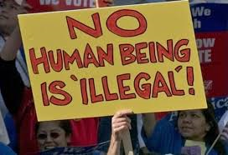
Immigration
May represent two major sources of stress:
Family dislocation, fragmentation, and reconstruction.
Culture change for individuals and across generations.

Slide 29
Family Difficulties
Family conflicts (including intergenerational conflicts).
Neglect and physical abuse.
Domestic violence and sexual abuse.

Slide 30
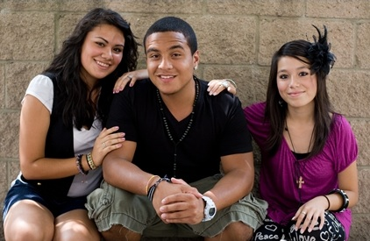
Latino Adolescents and Substance Use
Acculturation gaps

Slide 31
Gender Roles
May be particularly difficult cases to treat primarily because families stigmatize women in a more complete and isolating manner than they do male family members.

Slide 32
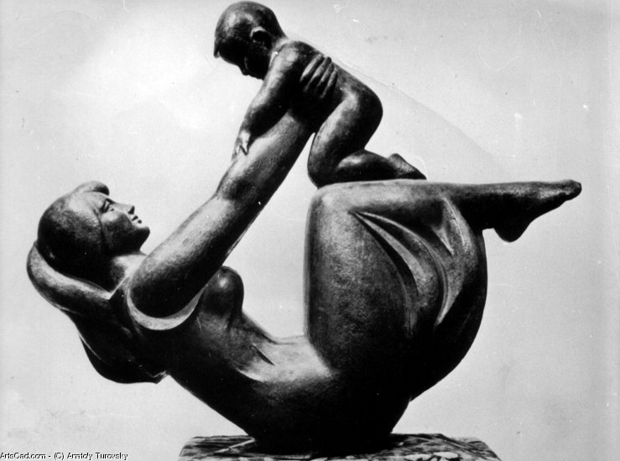
Motherhood and Associated Roles
The expectation of self-sacrifice of a mother on behalf of her children is prescribed by cultural convention and reinforced through families, social networks, religion, and public imagery in mass media.
This concept is also known as “marianismo.”
Notes:
Motherhood is fundamental for the formation of Latina self-concept. Motherhood is nearly a sacred status. This is doubly the case among lower income Latinas that have few or no viable alternatives to motherhood as a source for positive self-valuation and actualization. Women with substance use disorders who are mothers pose a particularly difficult situation because they will experience guilt about neglecting their children or because they have been separated from them and their parents will scorn them for failing to be good mothers. If a woman with SUD has children there is often a romantic partner who uses substances and he poses a myriad of problems for the prospects of recovery. The father of her children may make continuing efforts to reestablish a romantic relationship, or at least a parental role, which will require regular contact with the family. That father figure may be completely rejected, or even forbidden to enter the home of the mother’s family of origin, because he will be seen as the seed of their daughter’s SUD (National Hispanic and Latino ATTC, 2013).

Slide 33
Machismo
Significantly influences behavior and attitudes of adolescent males during time of identity formation.
Distinction between the sexes.
Includes dignity in personal conduct, respect and respect for others.
Source: Rivera. & Rogers-Adkinson, 1997
Notes:
Machismo plays a significant role among Hispanic groups. It may be used as a flattering term amonh Hispanic Americans. It significantly influences behavior and attitudes of adolescent males during time of identity formation. It represents a distinction between the sexes where males enjoy privileges denied to women. Boys and girls learn that machismo refers to male’s manhood, courage to fight, honor and digmity, keeping one’s word and protecting one’s name. It includes dignity in personal conduct, respect for others, love for the family and affection for others (Rivera & Rogers-Adkinson, 1997).
The cultural value of machismo is a value of strength. When applied out of context its takes on a negative connotation. The context in which this value is viewed can help or get in the way of effective treatment and recovery. Morales (1996) defined machismo as a gender specific value that applies to Hispanics and refers to a man’s responsibility to provide for, protect and defend his family. Service providers should be aware that there is currently some debate surrounding the negative connotations of machismo, including sexual aggressiveness, male domination and arrogance. The cultural value of machismo is a value of strength. When applied out of context its takes on a negative connotation. The context in which this value is viewed can help or get in the way of effective treatment and recovery.

Slide 34
Machismo
“Gender specific value that applies to Hispanics and refers to a man’s responsibility to provide for, protect and defend his family”.
Source: Morales, 1996

Slide 35
LGBTTQ
17% of LGBTTQ Americans are Hispanic
Acceptance increases through immigrant generations
Higher levels of substance use among Hispanic LGBTTQ
Immigration and homophobia
Source: Pew Hispanic Research Center, 2011, 2013; Díaz & Ayala, 2001; Hunt, 2012
Notes:
In a survey on LGBT American performed by the Pew Research Center (2013), 17% of LGBT Americans are Hispanic. Among gay and bisexual men, one of the groups most impacted by
HIV in the US, the HIV epidemic is becoming an epidemic of mostly ethnic minority men. According to the CDC, in 2009, Hispanic men accounted for 79% of new HIV infection cases among the Hispanic population. The infection rate was two and a half times higher than that of White men. During this same year, Hispanic men who have sex with men (MSM) accounted for 81% of new infection cases among Hispanic men and for 20% of all men’s new infection cases. Forty five percent of these were among men under the age of 30 (CDC, 2011).
In a study by Diaz & Ayala (2001), men spoke about their need to immigrate in order to live openly gay lives; whereas others mentioned living double lives in order to prevent homophobic experiences. The study reviewed homophobia, poverty and racism as important variables that may be related to substance use and high risk behaviors among Hispanic gay men. The consequences of multiple stressors, such as racial/ethnic discrimination within sexual minority communities and antigay values within Hispanic communities, may lead to an increased risk of poor physical and mental health. Furthermore, Hispanic sexual minority women may experience additional stressors if they are perceived to violate conventional feminine norms in Hispanic communities.
In terms of religion and sexual orientation, approximately 68% of Hispanics identify as Catholic (Pew Hispanic Research Center, 2013). The Catholic Church’s position on homosexuality has been associated with sin. The Catholic Church’s position is based on distinguishing the person with the act; accepting one but not the other, which may seem confusing resulting in a mixed set of emotions regarding sexuality and the possibility of coming out for many Hispanic LGBT.
In a study performed by the Pew Hispanic Research Center (2011), when asked whether homosexuality should be accepted or discouraged by society, majorities of Latinos (59%) and of the U.S. general public (58%) say it should be accepted. Meanwhile, 30% of Latinos and 33% of the general public say homosexuality should be discouraged.
The study further revealed that views on homosexuality vary somewhat by immigrant generation. Just over half (64%) of immigrant Hispanics say homosexuality should be accepted. Among second-generation Hispanics, this share rises to 68%. Among third-generation Hispanics, it is 63%. Also, among Hispanics, women more than men say homosexuality should be accepted by society—62% versus 55%. A similar pattern exists among the general public: 64% of women say homosexuality should be accepted by society, compared with 52% of men (Pew Research Center for the People & the Press, 2011).
And just as with the general public, younger Hispanics are more likely than older Hispanics to say homosexuality should be accepted by society. Nearly seven-in-ten (69%) 18- to 29-year-old Hispanics say this, as do 60% of Hispanics ages 30 to 49 and 54% of Hispanics ages 50 to 64. By contrast, among Hispanics ages 65 and older, 41% say homosexuality should be accepted by society, while 44% say it should not be. Among the general public, majorities of those ages 18 to 29 (69%), ages 30 to 49 (59%) and ages 50 to 64 (55%) say homosexuality should be accepted by society. Among those ages 65 and older, fewer than half (47%) say the same (Pew Research Center for the People & the Press, 2011) .
According to Hunt (2012), there is a higher rate of tobacco, alcohol, and substance use in lesbian, gay, bisexual, transgender and transsexual (LGBTT) people, compared with heterosexuals; often associated with high levels of stress that comes from social prejudice and oppression, stigmatization, marginalization, and violence, and because of discrimination in employment, housing, relationship lack of recognition and health care.
Stress that comes from daily battles with discrimination and stigma is a principle driver of the higher rates of substance use, as LGBTT people turn to tobacco, alcohol, and other substances as a way to cope with this challenges (Hunt, 2012).
Prejudice and discrimination that people from this population regularly experience have been shown to have negative psychological effects³ such as anxiety and depression symptoms or disorders, and suicidal ideation (Diaz, Bein & Ayala, 2006).
Mental health disorders are often related to limited family support, minority status, shame, isolation, fear, and secrecy associated with life as a lesbian, gay, bisexual, transgender and transsexual (De Santis, 2009).
Hispanics and Latinos
Hispanic and Latino members of the LGBTT community may face additional stress associated to racism, often experiencing discrimination not only from the general population, but from mostly White LGBTT people (Diaz, Bein & Ayala, 2006).
Behavioral Healthcare Services
Lesbian, gay, bisexual, transgender and transsexual Hispanics and Latinos may be hesitant to utilize behavioral healthcare services that can help them recover because they fear an unwelcoming environment or services that are inadequate and not culturally appropriate.
Service providers can create change, ensuring that they receive easily accessible, affordable, comprehensive, recovery-oriented and culturally and linguistically competent (supportive of an individual’s identity) services as everyone else.

Slide 36
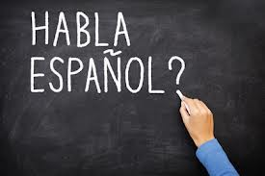
Language Selection and Recovery
Spanish speaking or highly bilingual clients can be assumed to possess more knowledge about Hispanic and Latino culture and this may provide some cultural information for more accurate interpretation of information.
Never assume that a patient that speaks some Spanish is knowledgeable about Hispanic and Latino culture.

Slide 37
Culturally Competent Treatment Services
Involve family members
Show respect
Get personal
Respect traditional healing approaches
Encourage the asking of questions.

Slide 38
Involve Family Members
Allow for several family and friends to participate in a consultation, and communicate with the group. The patient may not be the key decision-maker for describing symptoms, deciding among treatment options, or complying with recommended treatment.

Slide 39
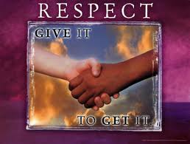
Show Respect
Always be respectful, and explain without condescending. Health providers, as authority figures, need to take seriously the responsibility and respect conferred on them by many Hispanic and Latino patients.

Slide 40
Get Personal
Lean forward
Be comforting
Use gestures that indicate interest

Slide 41
Respect Traditional Healing Practices
Hispanic and Latino patients may combine respect for the benefits of mainstream medicine, tradition, and traditional healing, with a strong religious component.
They may bring a broad definition of health to the clinical or diagnostic setting. Respecting and understanding this view can prove beneficial in treating and communicating with the patient.

Slide 42
Encourage the Asking of Questions
There is a cultural taboo against expressing negative feelings directly. This taboo may manifest itself in a patient's withholding information, not following treatment orders, or terminating medical care.

Slide 43
Remember
Common themes among Hispanics and Latinos may play a part in terms of substance use, access, readiness and recovery.
By recognizing and addressing such themes, counselors can be more effective in their interventions with Hispanic and Latino populations.
Explore how cultural circumstances are related to your client’s presenting problems.

Slide 44
References
Bracero, W. (1998). Intimidades: confianza, gender and hierarchy in the construction of Latino-Latina therapeutic relationships. Cultural Diversity and Mental Health, 4(4)264-277
Caribbean Basin and Hispanic Addiction Technology Transfer Center. (2006). Cultural elements in treating Hispanic popultaions: Dialogue on Science and addiction. Bayamón, PR: Author.
Center for Substance Abuse Treatment. Addiction Counseling Competencies: The Knowledge, Skills, and Attitudes of Professional Practice. Technical Assistance Publication (TAP) Series 21. DHHS Publication No. (SMA) 06-4171. Rockville, MD: Substance Abuse and Mental Health Services Administration, 2006.
Diaz, R., Ayala, G., Hein, J. & Marin, B. (2001). The impact of homophobia, poverty and racism on the mental health of gay and bisexual Latino men: findings from 3 US cities. American Journal of Public Health, 91(6)927-932.
Falicov, C.J. (1998). Latino families in therapy: a guide in multicultural practice. New York, NY: The Guilford Press.
Marin G, Marin BV. Research with Hispanic populations. Newbury Park, CA: Sage; 1991.
Morales, E. (1996). Gender roles among Latino gay and bisexual men: Implications for family and couples relationships. In J. Laird & R.J. Green (Eds.), Lesbians and gays in couples and families: A handbook for therapists (pp. 272-297). San Francisco: Jossey-Bass.
National Hispanic and Latino ATTC. (2013). Cultural elements in treating Hispanic and Latino populations (revision 2013). Bayamón, PR: Universidad Central del Caribe.
Pajewski, A., & Enriquez, L. (1996). Teaching from a Hispanic perspective: A handbook for non-Hispanic adult educators. Phoenix, AZ: Arizona Adult Literacy and Technology Resource Center.
Pew Hispanic Research Center (2013)

Slide 45
References
Pew Hispanic Reseach Center (2011). Latinos changing views on same sex marriage.
Rivera, B.D., & Rogers-Adkinson, D. (1997). Culturally sensitive interventions: Social skills training with children and parents from culturally and linguistically diverse backgrounds. Intervention in School and Clinic. 33(2), 75-80.
Santiago-Rivera, A.L., Arredondo, P. & Gallardo-Cooper, M. (2002). Counseling Latinos and la familia: A practical guide. Thousand Oaks, CA: Sage Publications.
Substance Abuse and Mental Health Services Administration, Leading Change: A Plan for SAMHSA’s Roles and Actions 2011-2014. HHS Publication No. (SMA) 11-4629. Rockville, MD: Substance Abuse and Mental Health Services Administration, 2011.
U.S. Department of Health and Human Services, Office of Minority Health. (2013). National Standards for CLAS in Health and Health Care: A Blueprint for Advancing and Sustaining CLAS Policy and Practice. Retrieved from: www.ThinkCulturalHealth.hhs.gov
U.S. Department of Health and Human Services, Office of Minority Health. (2005). What is cultural competency? Retrieved from http://minorityhealth.hhs.gov/templates/browse.aspx?lvl=2&lvlID=11

