Slide 1
screening, brief intervention, and referral to treatment
epidemiology of substance use
Lecture 1.1

Slide 2
{
substances affect the brain
chemically
structurally
behaviorally

Slide 3
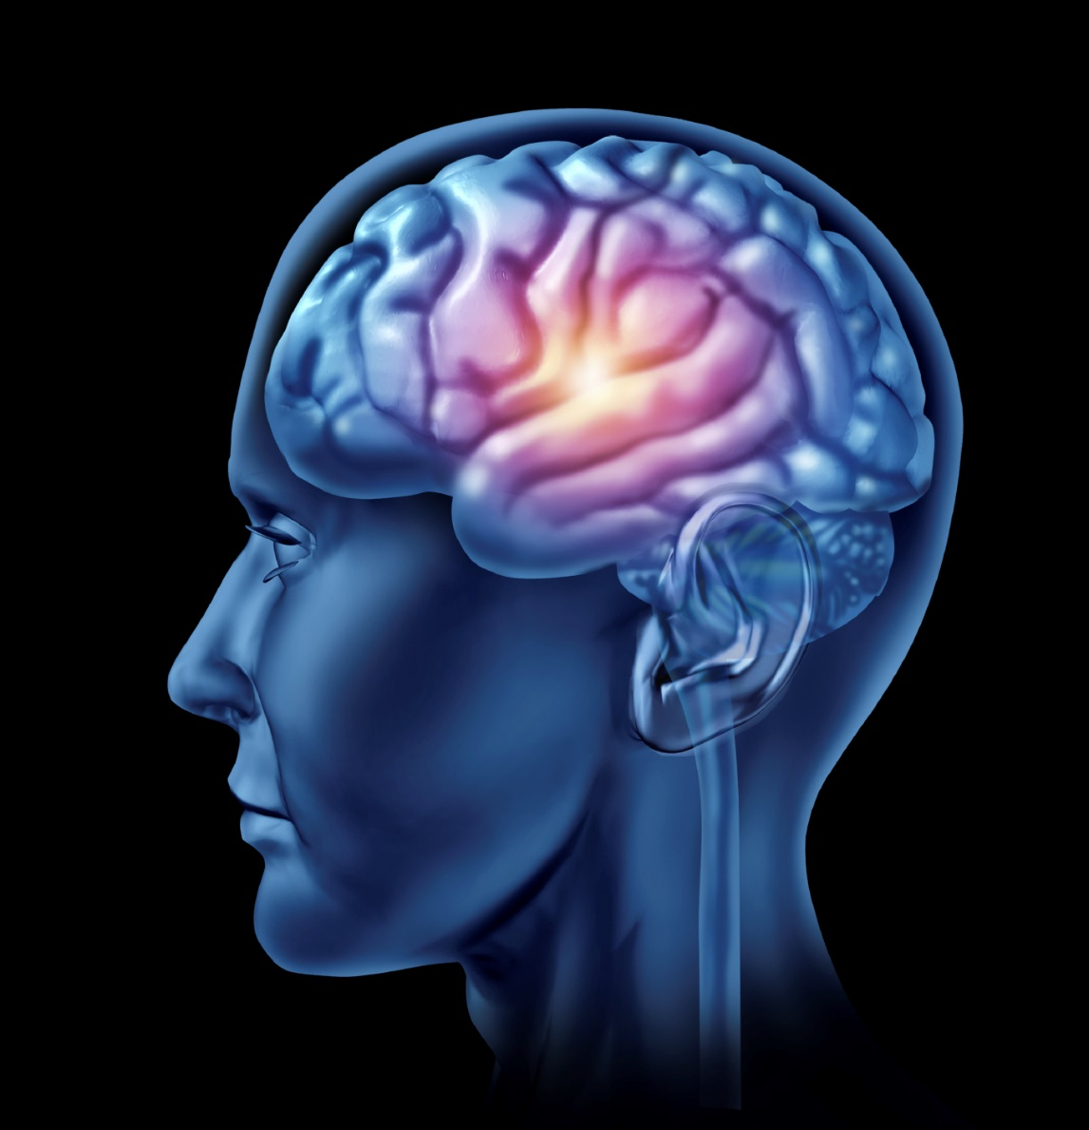
the reward pathway
drugs & alcohol act on the reward pathway, the same region activated by:
eating
sex
drinking
other pleasurable activities

Slide 4
chemical changes

Slide 5
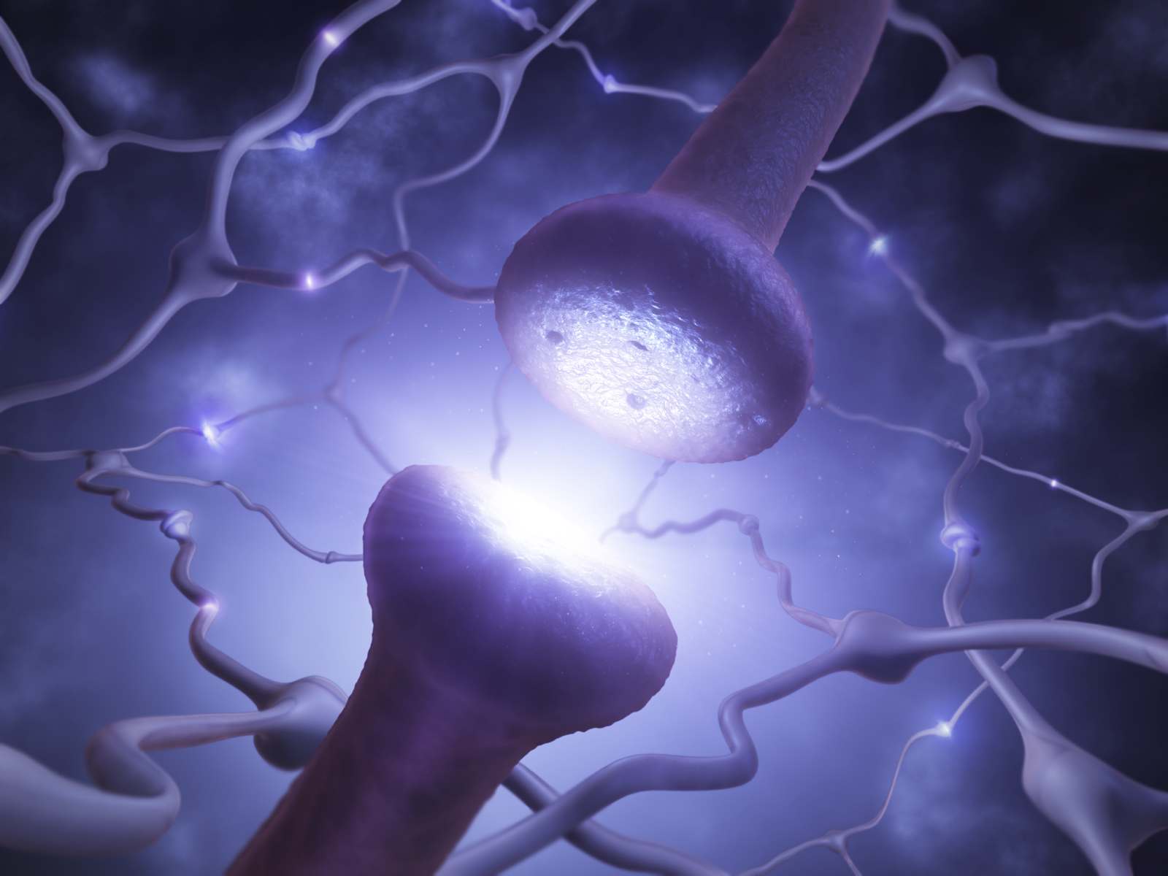
the role of dopamine
increase in available dopamine
results in pleasurable feelings
the behavior is reinforced
the effect of previously pleasurable activities is blunted

Slide 6
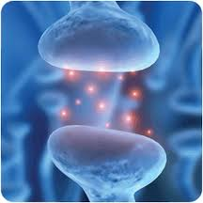
dopamine (cont’d)
substances that result in excess dopamine:
alcohol
heroin
marijuana
cocaine
nicotine
dysfunction in dopamine system
causes:
mood disruptions
memory difficulties
attention deficits
impaired decision making

Slide 7
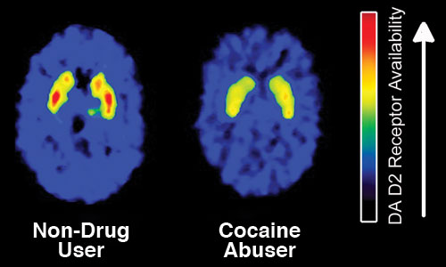
non-drug user
drug
user
(National Institute on Drug Abuse, 2010)

Slide 8
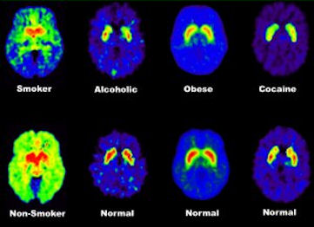
tobacco user
heavy alcohol user
obese patient
cocaine user
healthy control
healthy control
healthy control
healthy control
(Volkow, 2001)

Slide 9
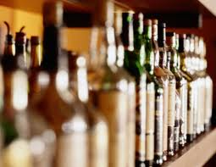
effects of alcohol use
release of:
GABA – feelings of
relaxation, wellbeing
glutamate – feelings of being energized, excited, elated
dopamine – pleasure
endogenous opioids – reduction in pain, feelings of pleasure

Slide 10
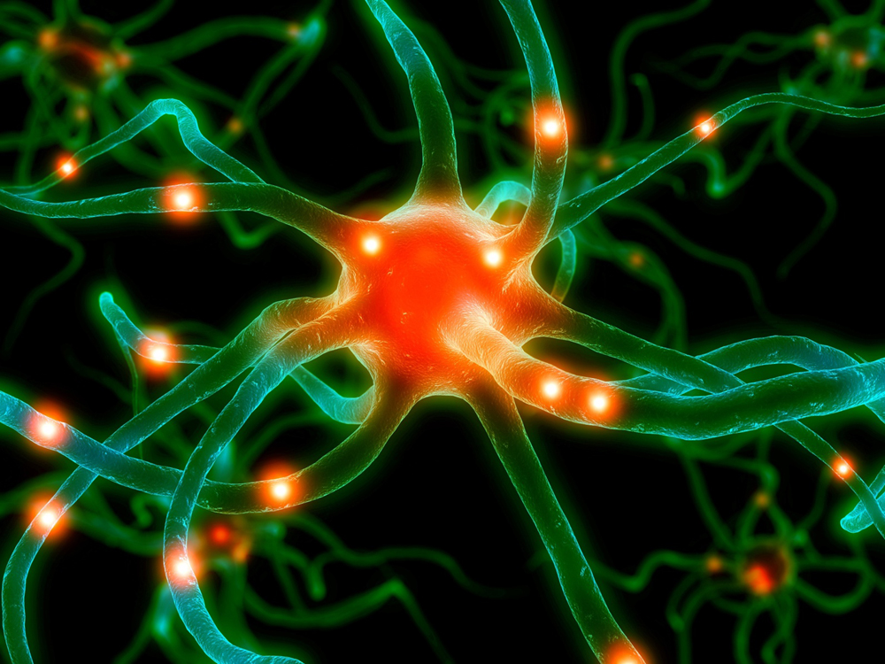
serotonin
glutamate
endogenous opioids
GABA

Slide 11
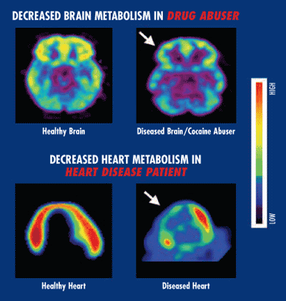
Decreased Brain Metabolism in Drug User
healthy brain
diseased brain/
cocaine user
Decreased Heart Metabolism in
Heart Disease Patient
healthy heart
diseased heart
(National Institute on Drug Abuse, 2010)

Slide 12
structural changes

Slide 13
healthy elderly person
person with Alzheimer’s disease
heavy drinker
(National Institute on Alcohol Abuse & Alcoholism, 2004)

Slide 14
brain of heavy alcohol
user
brain of healthy control
Oscar-Berman, M., Valmas, M., Sawyer, K.S., Ruiz, S.M., Luhar, R., & Gravitz, Z. (2014). Profiles of impaired, spared, and recovered neuropsychological processes in alcoholism. In Pfefferbaum, A. & Sullivan, E.V. (Eds.), Handbook of Clinical Neurology: Alcohol and the Nervous System. Edinburgh: Elsevier (in press).

Slide 15
control brain
alcoholic brain
(National Institute on Alcohol Abuse & Alcoholism, 2004)

Slide 16
behavioral changes

Slide 17
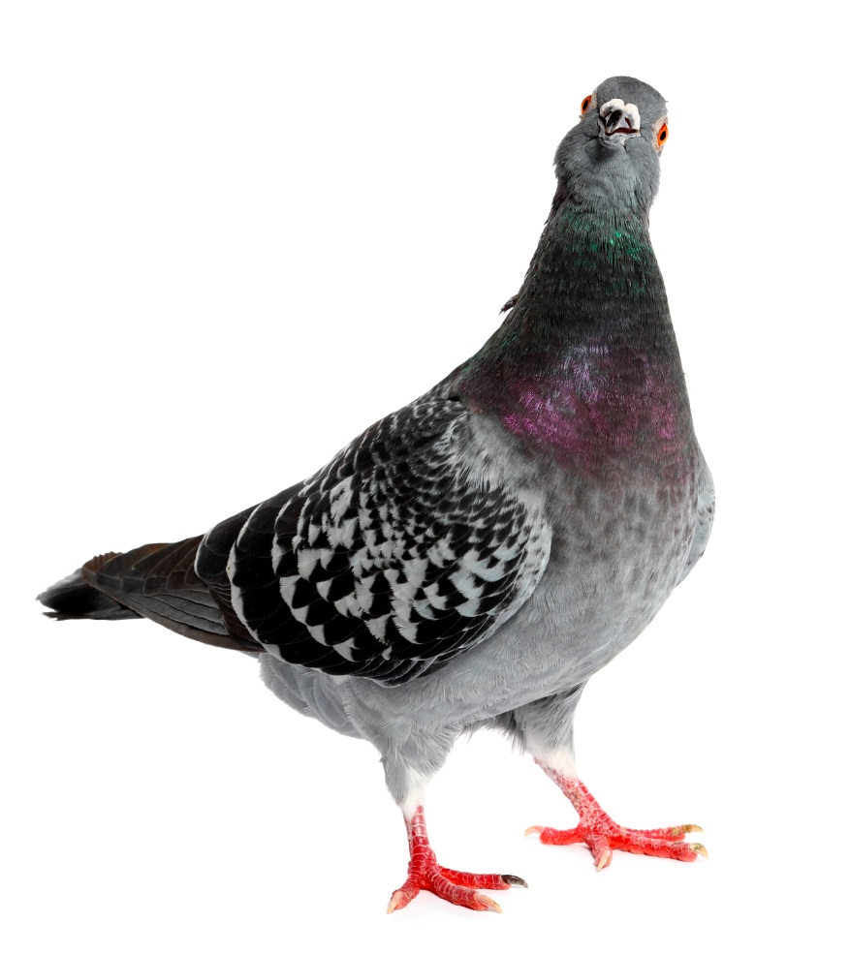
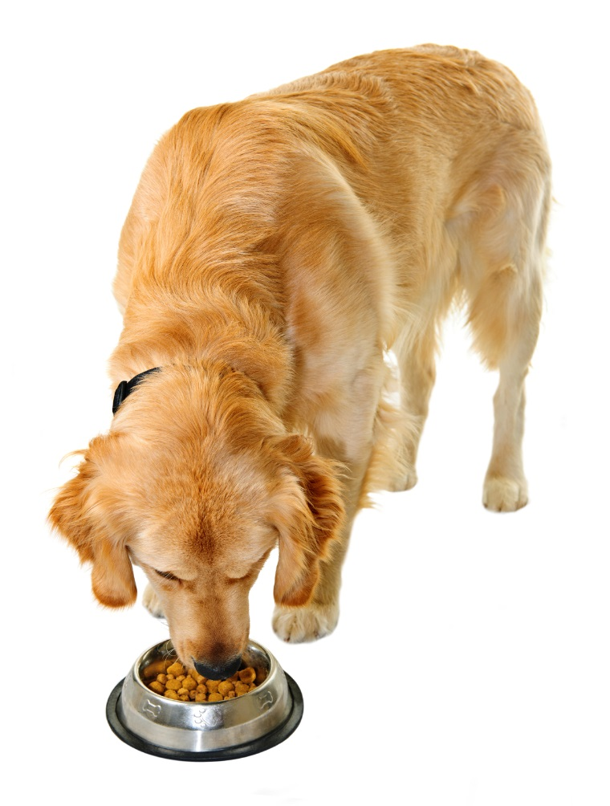
behaviors that are rewarded are likely to be repeated
classical and operant conditioning

Slide 18
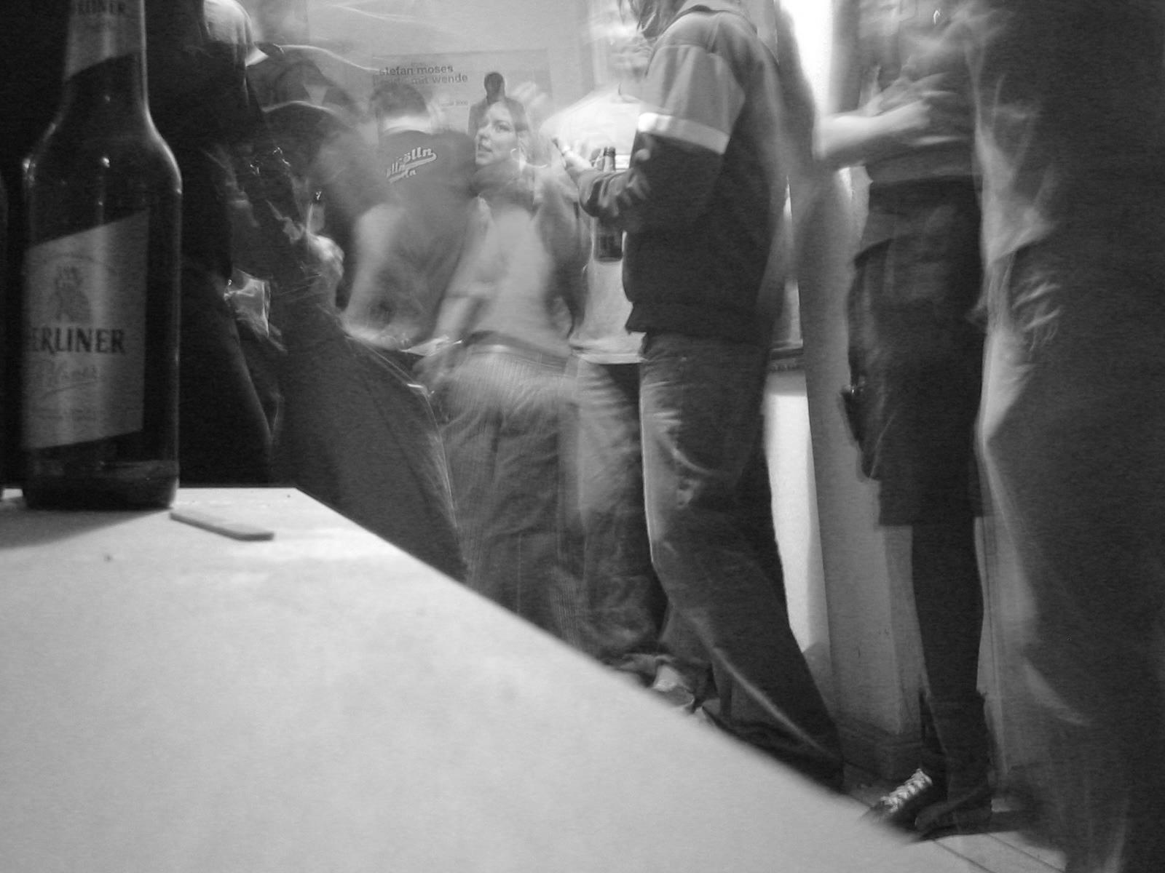
positive reinforcement

Slide 19
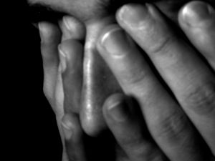
negative reinforcement

Slide 20
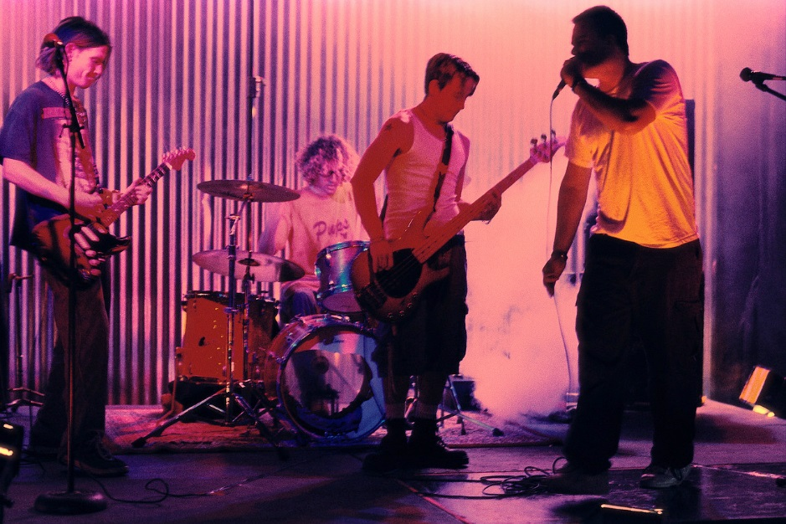
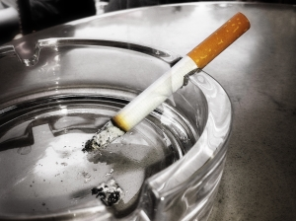
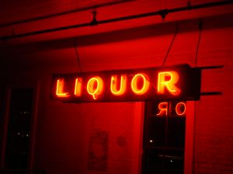
environmental cues

Slide 21
recovery

Slide 22
healthy brain
level of brain activity
(low to high)
cocaine user (10 days abstinent)
cocaine user (100 days abstinent)
(National Institute on Drug Abuse, 2007)

Slide 23
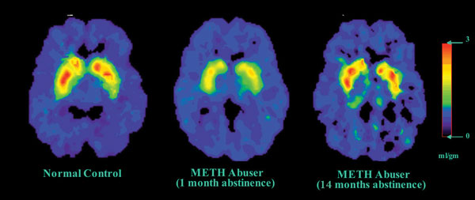
healthy control
meth user
(1 month of abstinence)
meth user
(14 months of abstinence)
(National Institute on Drug Abuse, 2002)

Slide 24
“disease” – to be or not to be
debate over whether substance use should be deemed a ‘disease’
proponents: acknowledgment of physiological affects; comparison to other disease states
opponents: emphasis on personal responsibility, choice, ability to change (empowerment)
take away: substances
affect the brain chemically
and structurally

