Slide 1
screening, brief intervention & referral to treatment
the substance use continuum
Lecture 1.2

Slide 2
substance use falls along a continuum

Slide 3
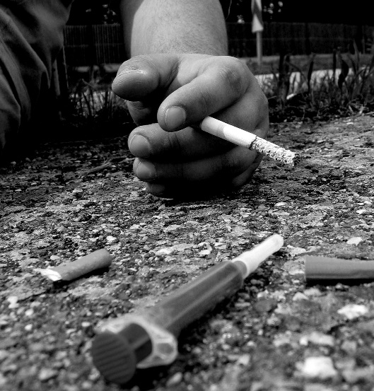
the substance use continuum
social
impairment
non-use
addiction
healthy use
risky use

Slide 4
definitions
tolerance: the need to increase one’s use of a substance to have the same/previous effect
withdrawal: physiological and psychological symptoms results from a decrease in use or cessation of the substance

Slide 5
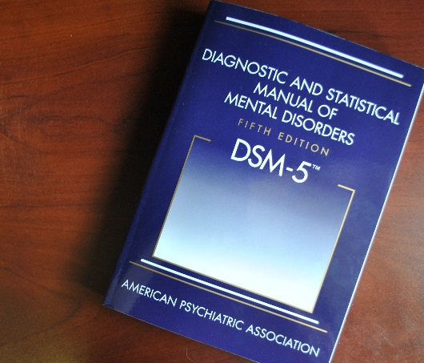
substance use disorders
DSM 5 Criteria:
1) increased use over time
2) unsuccessful attempts to stop using or cut back
3) excessive amounts of time devoted to use
4) cravings
5) not meeting obligations (e.g. occupationally)
6) cont’d use despite problems
7) abandonment or reduction of social/recreational activities
8) cont’d use in risky situations
9) cont’d use regardless of physical or psychological problems
10) tolerance
11) withdrawal symptoms
impaired control
social impairment
risky use
pharmacological criteria

Slide 6
safe drinking limits
Body text
More body text
Even more body text
In case that wasn’t enough
Almost done
Sooooo close
FINALLY finished

Slide 7
illicit drug use
is it ‘problematic’ because it is illegal?
some argue minimal use is ‘experimental’ or ‘social’
some argue all adolescent use is problematic
think of problem use in terms of: What problems is the use causing for the patient? (i.e. health problems, marital problems, etc.)…

Slide 8
identifying the at-risk user
at ‘moderate’ risk for a substance use disorder
patients who are not dependent
at increased risk for health problems (i.e. hypertension, liver damage, etc.)
at increased risk for mental health problems
may be sufficient to provide brief intervention without a referral (i.e. education)
Primary target for a brief intervention

Slide 9
common mistake: not intervening because the client/patient is not dependent

