Slide 1
screening, brief intervention, and referral to treatment
introduction to enhancing motivation
Lecture 3.2

Slide 2
What is the primary predictor of clinical success?

Slide 3
YOU
(the “therapeutic alliance”)
(the “therapeutic relationship”)

Slide 4
helping styles
following
directing
guiding

Slide 5
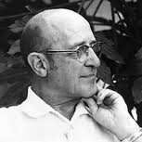
following helping style
Think Carl Rogers….

Slide 6
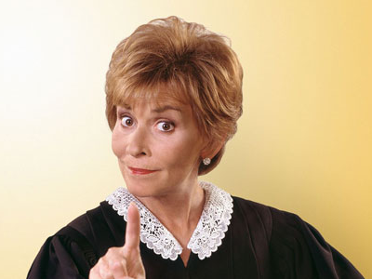
“righting reflex”
our innate tendency to ‘correct’ other people’s behavior
premise: “I have the answer, if you just do things this way, things will get better for you.”
this is well-intended, the intent is to help
in MI we try to repress this reflex

Slide 7
disengagement
breakdown
in relationship
pessimism
defensiveness
hostility
directing helping style results in
tension
hostility
anger
frustration
no-shows

Slide 8
guiding helping style
Think Bill Miller….

Slide 9
likelihood of returning
optimism
empowerment
engagement
trust
guiding helping style results in
talkative client
receptiveness
good rapport

Slide 10
MI definition….
“person-centered counseling method for addressing the common problem of ambivalence about behavior change.”
(Miller & Rollnick, 2010)

Slide 11
MI explained…
“MI is one style of helping others make changes in their behavior. It contrasts with the more typical directing helping style where the health care provider tries to install knowledge or motivation. It is similar to a guiding helping style where the health care provider collaborates with the client to explore and experiment with changes. However, a health care practitioner who uses an MI style goes beyond just guiding when he or she tries to solicit from the client his or her desires and reasons for engaging in the health promoting behavior. There are two aspects of MI that are significant and often overlooked. One is responding to the client as a person who is competent rather than someone who needs to be rescued or is incapable of making health promoting decisions. The second is compassion; motivational interviewing is not something one does to someone, does in order to get to some goal of the health care provider, or does as part of selling the client on something. MI is intended to help the client.”
Bill Miller & Steve Rollnick (2010)

Slide 12
“MI Spirit”
Acceptance
accepting the person without judgment (without condoning their behavior)
Compassion
≠ sympathy
Evocation
evoking change talk
Partnership
collaborating
working as equals
remaining outside of the ‘expert’ role
eliciting the person’s reasons for change
advocating for the person
empathizing with the person
avoiding confrontation

Slide 13
HIV risk
drug misuse
public health
gambling
treatment adherence
alcohol
diet/exercise
smoking
3 months
avg. effect size: .77
20-30% improvement in health behaviors
increased retention
increased adherence
HIV risk
drug misuse
public health
gambling
treatment adherence
alcohol
diet/exercise
smoking
Follow-up
Hettema, J., Steele, J. & Miller, W. (2005). A meta-analysis of research on motivational interviewing treatment effectiveness (MARMITE). Annual Review of Clinical Psychology, 1, 91-111.

Slide 14
the evidence (cont’d)
large meta-analysis of 119 MI studies
results:
3/4’s of the sample (75%) demonstrated improvement
resulted in improvement across many target behaviors (treatment retention, reduced substance use, etc.)
MI took less time, but produced equivalent results to CBT, 12-Step, etc.
MI improved one’s intention to change
effects often maintained over time (up to two years after intervention)
(Lundahl, Kunz, Brownell, Tollefson, & Burke, 2010)

Slide 15
goal is for clients to talk themselves into changing

Slide 16
target behaviors

Slide 17
how do we get to the target behavior?
1. increasing Change Talk
2. decreasing Sustain Talk
change talk can be increased by using open questions and reflections

Slide 18
change talk
anything the patient says that indicates they’re moving toward the behavior we want them to engage in…
examples:
I could try.
A few years ago I was really consistent about exercising; I was going to the gym almost every day.
I could probably manage to take my medications for the next 2 weeks.

Slide 19
sustain talk
anything the client says that indicates they’re moving away from the target behavior…
examples:
I don’t know why I can’t do it.
I just can’t seem to lose weight.
I don’t have the energy to exercise at night and I don’t have the time in the morning.

Slide 20
ambivalence
+ righting reflex
= sustain talk

Slide 21
the key to MI
we believe what we say, not what we hear
our job is to arrange conversations so that clients talk themselves into changing
we do this by bringing out more “change talk” and cutting out “sustain talk”

Slide 22
there is evidence that reflective listening alone is insufficient to produce change

Slide 23
helper style predicts change talk
change talk is strongly correlated with change

