Slide 1
screening, brief intervention, and referral to treatment
medication-assisted treatment
Lecture 4

Slide 2
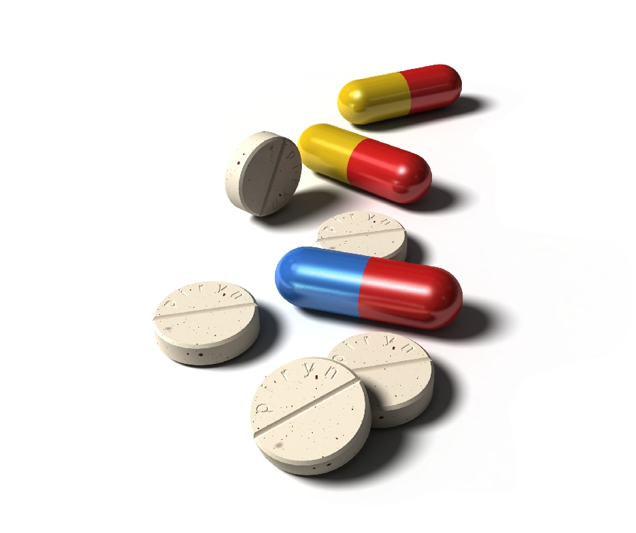
“…treatment for a substance use disorder that includes a pharmacological intervention as part of a comprehensive substance use treatment plan...”

Slide 3
{
eases withdrawal
reduces cravings
induces illness
how MAT works

Slide 4
myth #1: MAT is just replacing one drug with another.

Slide 5
MAT vs. illicit drugs
prescribed/monitored by a medical provider
FDA-approved
regulated potency
curbs cravings and withdrawal symptoms
obtained by illegal means
not legally permitted
potency varies
results in euphoria or a “high”

Slide 6
myth #2: MAT doesn’t work.

Slide 7
to be approved by the FDA, medications must be shown to be safe, but also effective

Slide 8
{
increased treatment retention
decrease in self-reported cravings
decreased illicit opioid use
treatment outcomes for buprenorphine/ naloxone (Suboxone)

Slide 9
{
increased treatment retention
decreased illicit opioid use
8-10 fold decrease in drug-related deaths
increase in employment rates
decrease in criminal activities
treatment outcomes for methadone

Slide 10
reduces total number of drinking days
reduces number of heavy drinking days
increased likelihood for abstinence; reduces the risk of relapse
reductions in criminal recidivism
{
treatment outcomes
for alcohol medications

Slide 11
myth #3: If someone is sober, they don’t need MAT.

Slide 12
drug overdose is one of the leading causes of death for individuals being released from prison or jail

Slide 13
Drug overdose was the leading cause of death for those released from Washington State prisons between 1999 and 2003 (Binswanger et al., 2007).
Before…
Homicides,
Suicides,
Heart disease, and…
Motor vehicle accidents
Reductions in Mortality

Slide 14
myth #4: MAT is too expensive

Slide 15
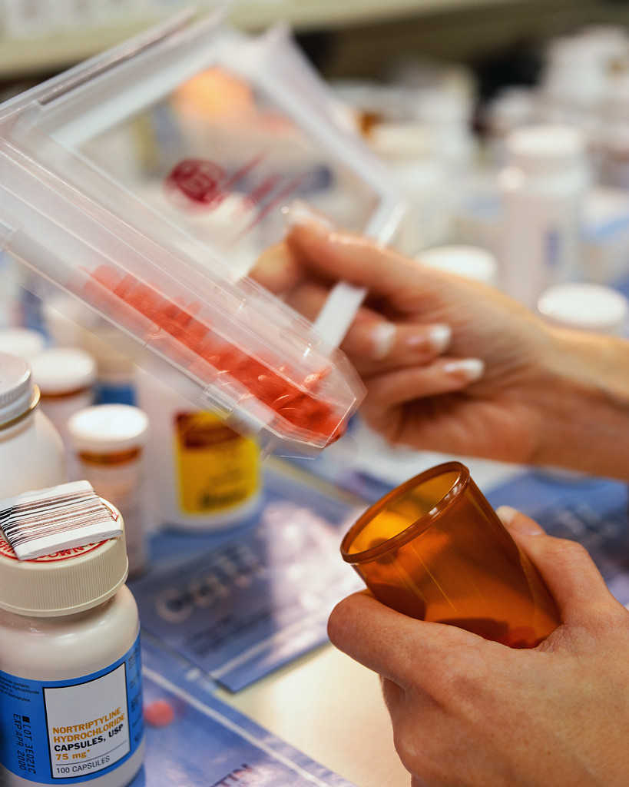
many MAT medications can be found on
state Medicaid/
Medicare
formularies

Slide 16
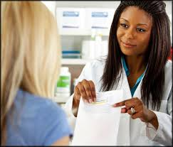
for those
patients who
do not qualify
for Medicaid or Medicare many patient assistance programs are available through the medication manufacturers

Slide 17
additional MAT funding sources
{
grant funding
private insurance
prescription discount cards
tribal funds

Slide 18
health exchanges
changes in age restrictions
Medicaid expansion
healthcare reform implications
employer mandates
substance use treatment parity

Slide 19
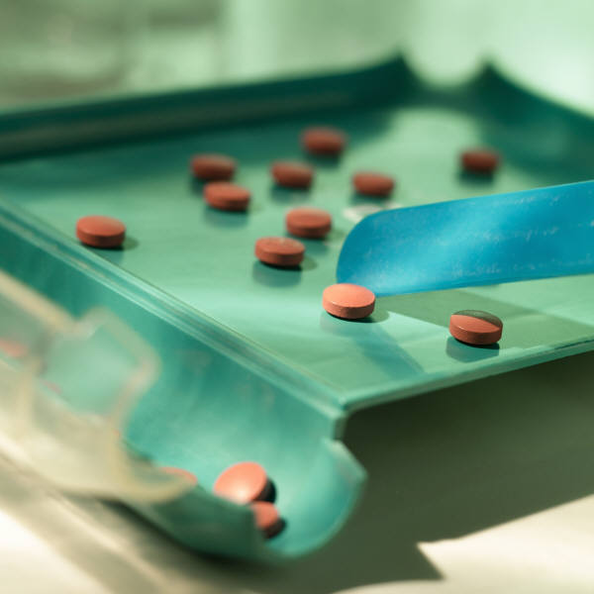
Part 2
the medications
uses and considerations

Slide 20
{
naltrexone
acamprosate
disulfiram
medications for alcohol use disorder

Slide 21
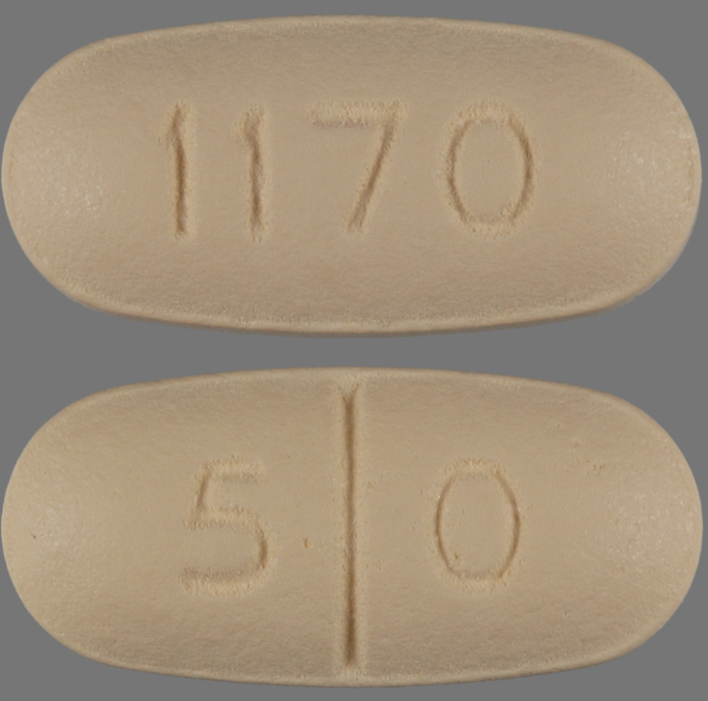
naltrexone (Depade®, ReVia®, Vivitrol®)
mechanism: blocks the pleasurable effects of alcohol; reduces alcohol cravings
pros can be used for alcohol & opioid dependence, non-addictive,
reduces drinking episodes
& volume, extended release
available
cons non-adherence

Slide 22
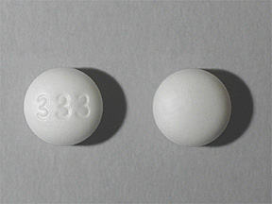
acamprosate (Campral®)
mechanism: assists in post-acute withdrawal symptoms (e.g. irritability, anxiety, agitation)
pros non-addictive, can assist patient in maintaining abstinence,
not easily abused/
misused, affordable
cons patient must be
abstinent to begin
treatment

Slide 23
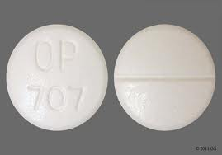
disulfiram (Antabuse®)
mechanism: makes patient physically ill when ingesting alcohol
pros non-addictive, affordable ($60/mos), useful with alcohol use disorders
cons non-adherence,
risk of death for those
with existing health
conditions, may not be appropriate for SMI px’s

Slide 24
{
methadone
buprenorphine
naltrexone
medications for opioid use disorders

Slide 25
how do opioids work?
full agonist
(e.g., methadone)
opioid
effect
partial agonist
(e.g. buprenorphine)
antagonist
(e.g. naloxone)
dose of opioid

Slide 26
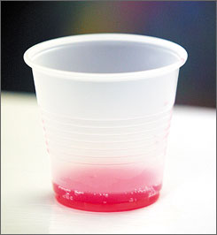
methadone (Methadose®, Dolophine®)
mechanism: full agonist (acts on opioid receptors), alleviates withdrawal symptoms & cravings
pros affordable (usually gov’t subsidized), convenient dosing (1x/day), demonstrated safety for pregnant women
cons intoxication with too high a dose,
risk of overdose

Slide 27
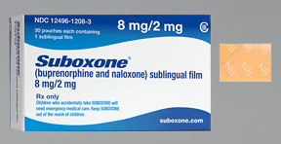
buprenorphine (Subutex®)
buprenorphine/naloxone (Suboxone®)
mechanism: partial agonist - blocks euphoric effects of opioids, alleviates withdrawal, assists with cravings
pros easier to taper than methadone, less risk of OD than methadone, available in a sublingual film, naloxone discourages IV use
cons costly $$$

Slide 28
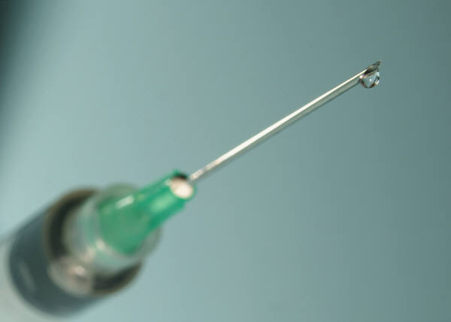
naltrexone (Depade®, ReVia®, Vivitrol®)
mechanism: full antagonist (blocks opioid receptors)
pros prevents euphoric effects of opioids; non-addictive; extended release available
cons
non-adherence

Slide 29
Part 3
building a case for MAT
a review of the evidence and patient benefits

Slide 30
reduced criminal activity
reduced substance use
improved treatment retention
benefits of MAT
lower risk of
overdose
improved functioning
employment

Slide 31
reductions in substance use

Slide 32
interim methadone treatment
762 patients
(Schwartz, Jaffe, Grady, Das, Highfield, & Wilson, 2009)

Slide 33
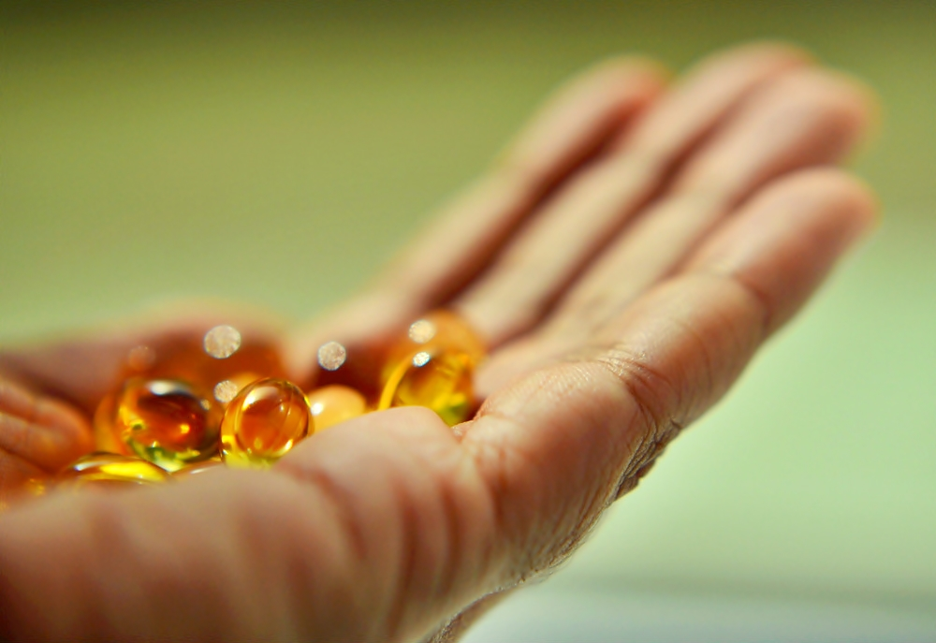
24
4,500
buprenorphine clinical trials
patients with opioid use disorders
buprenorphine
was significantly
more effective at reducing
illicit opiate use
than placebo
(Mattick, Kimber, Breen & Davoli, 2008)

Slide 34
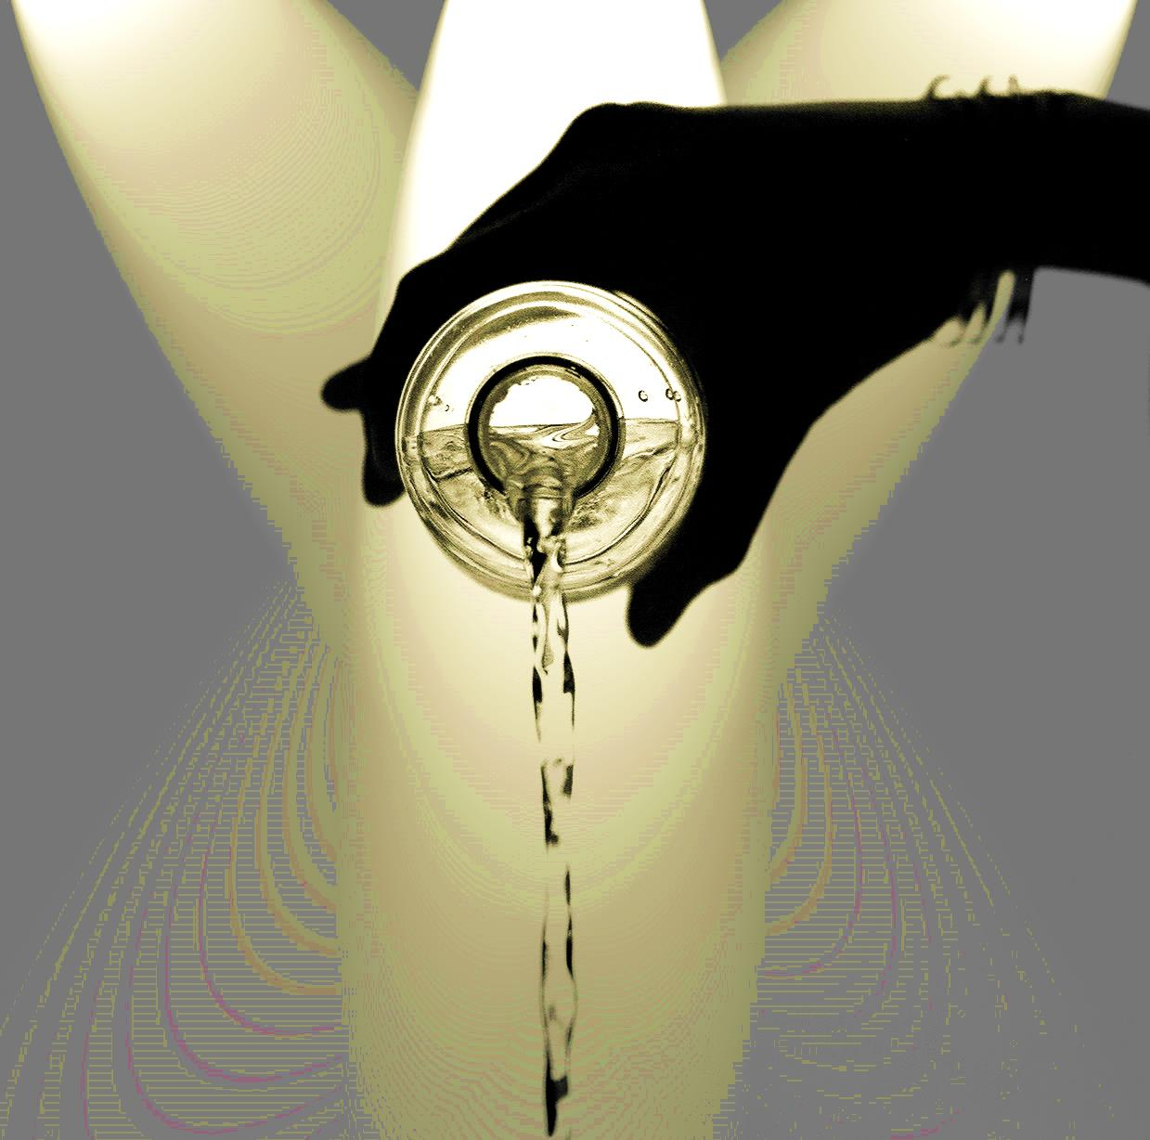
naltrexone v placebo
fewer slips
fewer significant relapses
fewer total drinking days
(O’Brien, Volpicelli, &
Volpicelli, 1996)
naltrexone v
placebo
reduced consumption
fewer relapses
cont’d abstinence
(O’Malley et al., 1992)

Slide 35
reduced mortality

Slide 36
8-10
13x
higher mortality rate for opiate users than non opiate users
fold reduction in deaths for opiate dependent individuals using methadone
(Hulse et al., 1999; Degenhardt et al., 2009)
Notes:
Add citations

Slide 37
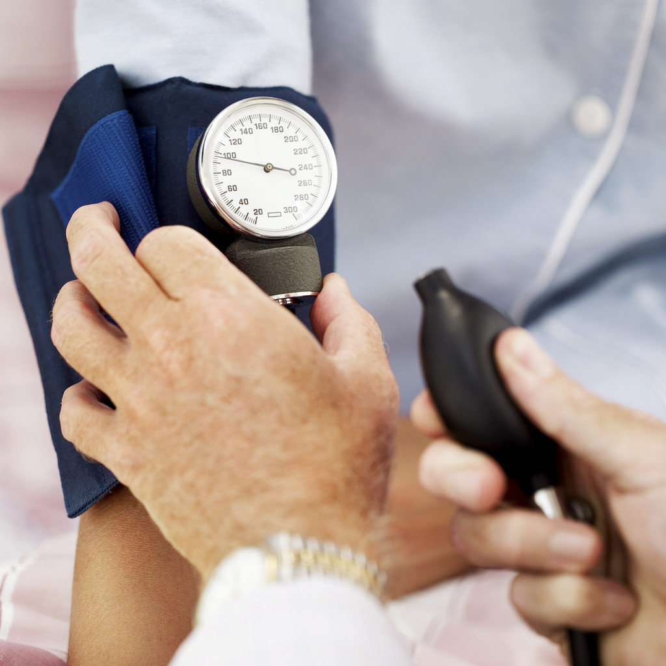
MAT has also been found to reduce…
risky behaviors
-IV drug use
-unprotected sex
reducing…
-HIV
-Hepatitis C
(Mattick, Breen, Kimber & Davoli, 2003; SAMHSA, 2005)

Slide 38
improvements in employment status

Slide 39
↑ functioning
↑ employment outcomes
(Mattick, Breen, Kimber & Davoli, 2003; SAMHSA, 2005)
Notes:
Px is better able to maintain a job if not actively using, not suffering from withdrawal symptoms of post-acute withdrawal symptoms or cravings

Slide 40
Part 4
MAT referral process simplified
identifying appropriate candidates and locating providers

Slide 41
identifying MAT candidates

Slide 42
appropriate MAT candidates
history of use
previous failed treatment attempts
openness to try MAT

Slide 43
active psychosis
serious health conditions
dependent on multiple substances
inappropriate
MAT candidates

Slide 44
medical professionals will make the ultimate determination around eligibility…

Slide 45
locating an MAT provider

Slide 46
www.samhsa.gov/medication-assisted-treatment
The Substance Abuse and Mental Health Services Administration’s buprenorphine physician locator and Opioid Treatment Program (OTP) locator can be utilized to identify providers in your area.
Notes:
Check Resources

Slide 47
the Single-State Agency (SSA) for substance use treatment providers for your state can point you to MAT providers in your area…

