Slide 1
screening, brief intervention, and referral to treatment
alcohol screening
Lecture 5.2

Slide 2
screening for alcohol might involve biological markers, a review of standard drink sizes, and validated screening tools

Slide 3
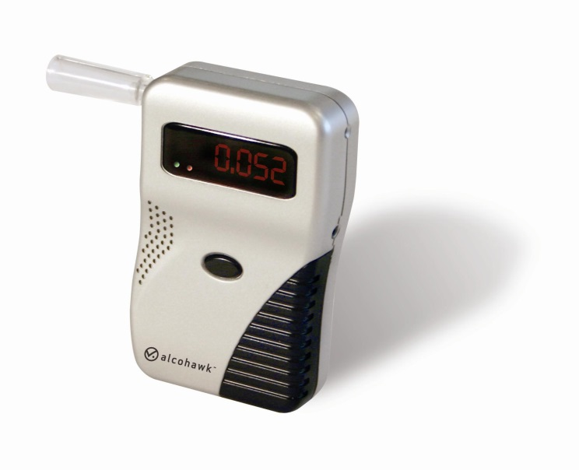
biological markers
Breath Alcohol Concentration (BrAC)
    -known as a ‘breathalyzer’
    -often used by law enforcement
    -short half life; measures recent drinking
Blood Alcohol Concentration (BAC)
    -also called blood alcohol content
    -percentage of one’s blood that is alcohol
  -.08 considered intoxication in most states
urine analyses
SCRAM bracelet

Slide 4
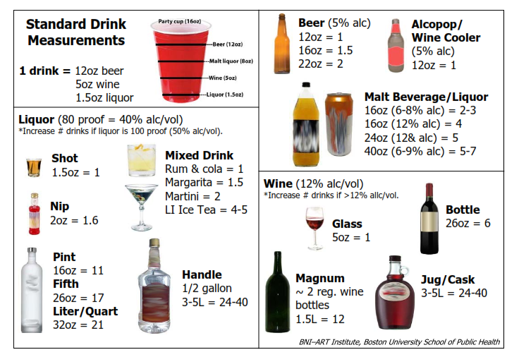
standard drink sizes

Slide 5
7 or more
drinks per week for women is considered risky drinking.
14 or more
drinks per week for men is considered risky drinking.

Slide 6
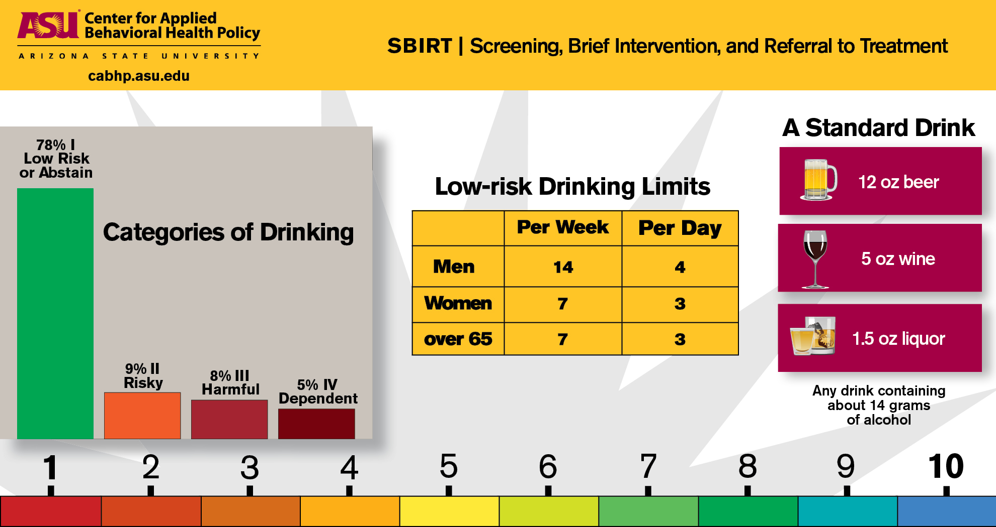
low risk drinking limits
Body text
  More body text
    Even more body text
  In case that wasn’t enough
Almost done
  Sooooo close
  FINALLY finished

Slide 7

screening tools
previously reviewed tools:
  prescreens
  AUDIT
  AUDIT-C
  ASSIST
  CAGE

Slide 8
screening tools (cont’d)
Short Michigan Alcoholism Screening Test (SMAST)
useful for capturing dependence not moderate risk users
self-administered or an interview
13 items; 5 minutes to administer; 2 minutes to score
items: others complaining about your drinking, blackouts, relational problems related to drinking, drinking before noon, alcohol DTs, etc.
scoring: yes = 1
scores ≤4 indicate alcohol abuse

Slide 9
screening tools (cont’d)
Fast Alcohol Screening Test (FAST)
designed for the general population & ED patients
administered as an interview
4 items; approximately 1 minute to administer; 1 minute to score
sensitivity: 93%; specificity: 88%
covers binge drinking, blackouts, failing to meet responsibilities & others concerns about the patient’s drinking
scores range from 0-16, scores ≤3 are considered ‘hazardous drinking’

Slide 10
insomnia
dilated pupils
seizures
irritability
nightmares
alcohol withdrawal
increased heart rate
nausea
hallucinations
hand tremors
vomiting
fever

Slide 11
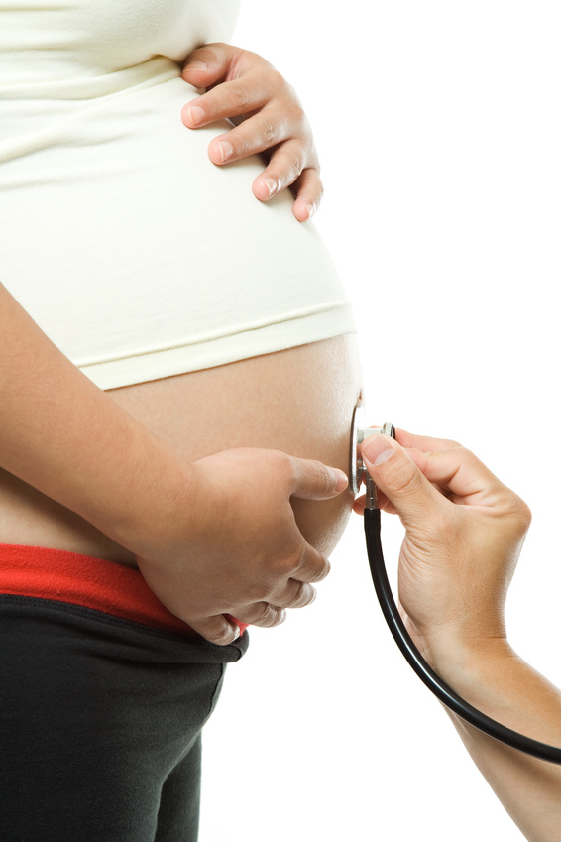
cutting down vs. abstinence
which patients should be encouraged to be abstinent?
  pregnant women
  those at high risk for a substance use disorder
  those susceptible to a medication interaction
  those with a health or mental health condition exacerbated by alcohol
encourage cutting down if they are not open to abstinence (remember stages of change)

Slide 12

interventions for moderate risk drinkers
The U.S. Preventative Services Task Force (USPSTF) recommends:
  feedback about their current level of use and normative data
  encouragement to reduce use
  behavior plan

Slide 13
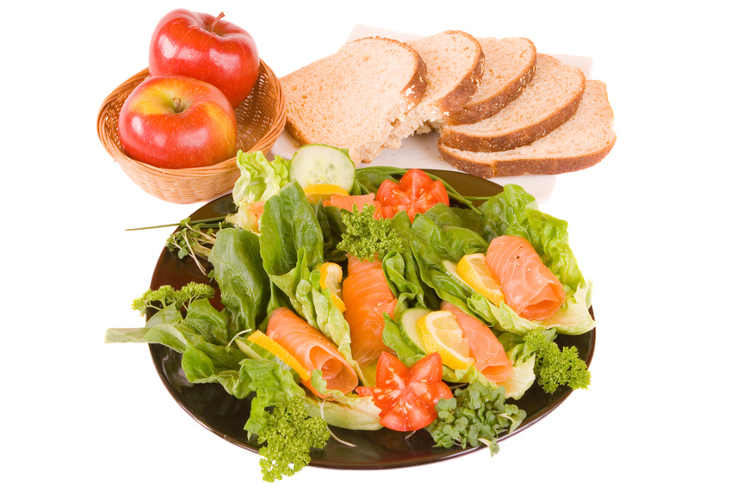
cutting down for moderate risk users
recording alcohol intake
measuring drinks
pacing use
working in food/meals
circumvent triggers

Slide 14
interventions for individuals with a substance use disorder
motivational enhancement intervention
onsite brief treatment
warm handoff to an offsite treatment provider
referral for MAT
resources for support groups (12-Step, SMART Recovery)
follow-up

Slide 15

treatment for alcohol use disorders
inpatient treatment
outpatient treatment
self-help/peer-support groups (e.g. Alcoholics Anonymous, SMART Recovery, Moderation Management)
medications

Slide 16
MAT for alcohol
who is a good candidate?
  previous failed treatment attempts
  not improving with traditional treatment approaches
  repeated relapses or slips
treatment dosage
  minimum of 3 months
should receive MAT in conjunction with a treatment program
behavioral health provider role: ongoing treatment/psychotherapy, medication management, liaison between patient and MAT provider/prescriber

Slide 17

medications to treat alcohol use disorders
acamprosate (Campral)
  -approved for those who are abstinent when commencing the medication
  -reduces post-acute withdrawal symptoms (i.e. insomnia, anxiety)
disulfiram (Antabuse)
  -for abstinent individuals only
  -patient becomes sick when ingesting alcohol
  -often used in community corrections
naltrexone (Depade, ReVia, Vivitrol)
  -blocks opioids involved in ‘rewarding’ alcohol use & cravings
  -daily pill form or monthly injections

