Slide 1
screening, brief intervention, and referral to treatment
special populations
Lecture 5.3

Slide 2
young adults often engage in binge drinking

Slide 3
alcohol and young adults
motor vehicle accidents
binge drinking
risky sexual behavior
violence
crime
academic difficulties
suicide attempts

Slide 4
alcohol & young adults (cont’d)
According to the National Institute on Alcohol Abuse & Alcoholism (NIAAA), annually:
nearly 700,000 students will be assaulted by another student
nearly 600,000 students will be injured
1,825 will die from accidental injuries
nearly 100,000 will be victims of a sexual crime
1.2% - 1.5% will attempt suicide as a result of their drug/alcohol use
approximately 3 million will drive while intoxicated

Slide 5
CRAFFT
C – Have you ever ridden in a CAR driven by someone (including yourself) who was high or had been using alcohol or drugs?
R – Do you ever use drugs or alcohol to RELAX, feel better about yourself, or fit in?
A – Do you ever use drugs or alcohol while you are by yourself, ALONE?
F – Do you ever FORGET things you did while using alcohol or drugs?
F – Do your family or FRIENDS ever tell you you should cut down on your drinking or drug use?
T – Have you gotten into TROUBLE while you were using drugs or alcohol?

Slide 6
CRAFFT (condensed)
3 pre-screening questions:
during the past 12 months did you:
drink any alcohol?
smoke any marijuana or hashish?
use anything else to get high?
all no responses continue to C (CAR) item only
all yes responses continue with 5 additional items
each item is worth 1 point
≤2 is a positive screen

Slide 7
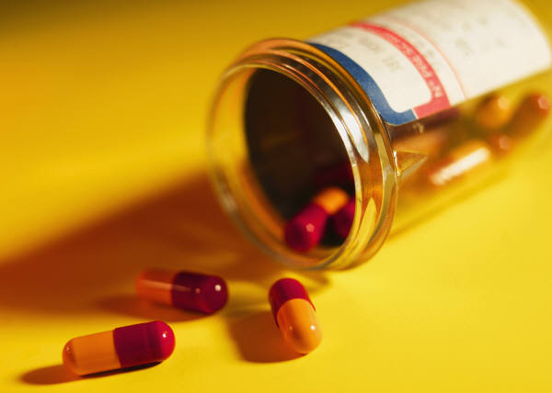
alcohol & prescription drugs
individuals who misuse alcohol are 18x more likely to misuse prescription drugs (McCabe et al., 2006)
highest rates of dual misuse seen with those under 25 years of age
most commonly misused medications:
prescription opioids (i.e. Vicodin, Oxycontin)
prescription stimulants (i.e. Ritalin, Adderal)
prescription sleep aids (i.e. (Ambien, Restoril)
take home: screen alcohol dependent patients or those at moderate to high risk for dependence for prescription drug misuse

Slide 8
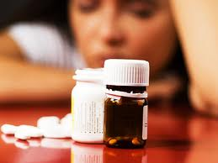
prescription drugs & alcohol use
‘alcohol benzo cocktail’
both benzodiazepines and alcohol affect the neurotransmitter GABA
results in CNS depression
risk for accidental
overdose
common means of suicide

Slide 9
older adults are susceptible to alcohol-related medication interactions, slips/falls, and depression

Slide 10
alcohol & older adults
often mistaken for dementia/Alzheimer's
medication interactions
using alcohol for pain management
using alcohol as a sedative
depression & suicide attempts
worsening of health conditions:
osteoporosis
diabetes
hypertension
liver disease
combination of alcohol & aspirin (intestinal bleeding)
metabolize alcohol differently than younger adults

Slide 11
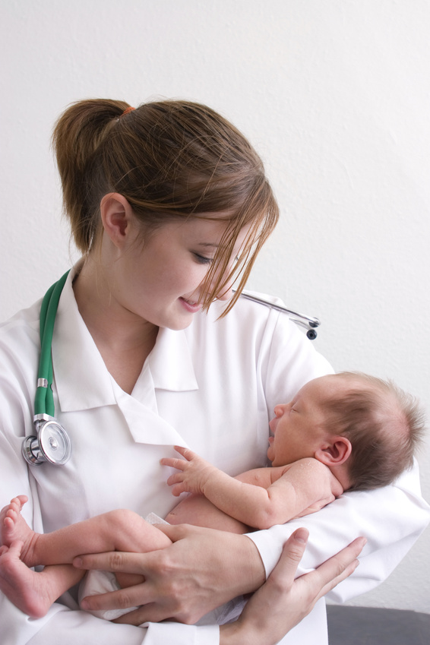
alcohol & women
Fetal Alcohol Spectrum Disorders (FASD)
risk factors:
maternal binge drinking
maternal heavy alcohol use
effects on the infant:
premature birth
structural facial differences
cognitive deficits
immunodeficiencies
coordination deficits

Slide 12
screening pregnant women
TWEAK
Tolerance
Worried
Eye Opener
Amnesia
Cut down
self-administered or an interview
sensitivity: 79%; specificity: 83%
5 minutes to administer; 2 minutes to score
≤2 = ‘at-risk drinker’

