Slide 1
screening, brief intervention, and referral to treatment
introduction to drug use
Lecture 6.1

Slide 2
part I: drug use prevalence & cost

Slide 3
drug use costs the US $193 billion per year

Slide 4
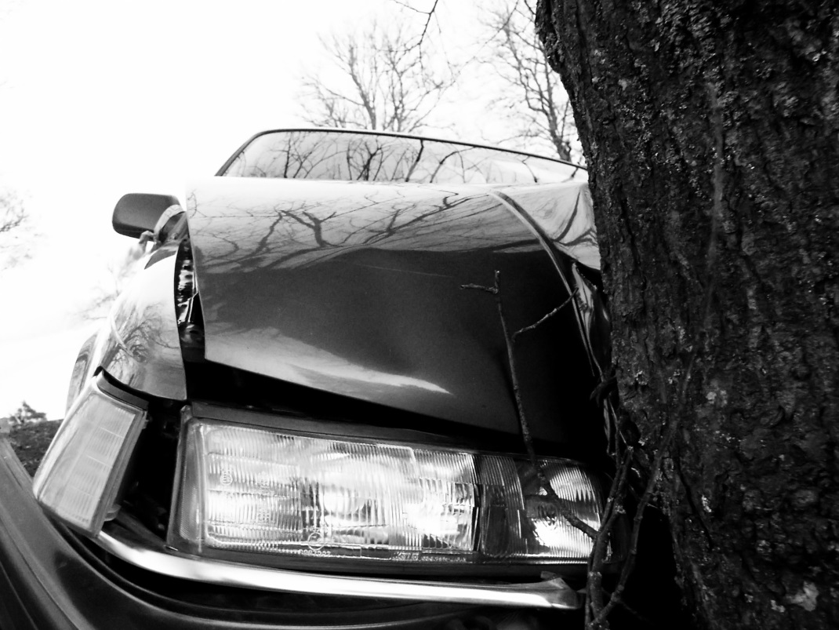
costs of drug use
accidents and injuries
motor vehicle accidents
criminal justice costs (incarceration, court costs)
mortality
comorbid health conditions
(HIV/AIDS, Hepatitis C,
hypertension, liver failure)
absenteeism
presenteeism

Slide 5
why intervene?
drug use is undertreated
health consequences
goal: prevent drug use disorders
studies show screenings and referrals to treatment in medical settings can be effective
cost savings
reduction in MVAs
decrease in criminal justice costs
reduction in mortality
reduction in comorbid health conditions

Slide 6
why universally screen for tobacco use?
health consequences
smoking tied to 90% of lung cancer cases
other illnesses: emphysema, CVD, bronchitis, asthma, low birth weight infants, miscarriage, stroke, pneumonia
nearly 50,000 people die annually from second hand smoke related illnesses
usually require multiple attempts to quit
5% success rate when smokers try to quit ‘cold turkey’ with no external support/assistance
brief interventions for tobacco use have been shown to be effective

Slide 7
drug use prevalence rates
illicit drug use usually commences in adolescence
highest prevalence rates amongst young adults
illicit drug use is on the rise; 9% of the population reports illicit drug use in the previous month
with marijuana being the most commonly used drug
marijuana use is on the rise
use of other illicit drugs
4.6 million ED visits involving drugs, misuse of prescription drugs or polysubstance use in 2009
prescription opioids responsible for more deaths than any illicit drug, across all age groups

Slide 8
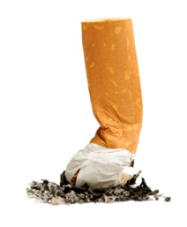
tobacco prevalence rates
70 million Americans report using tobacco in the last 30 days (National Survey on Drug Abuse and Health)
nearly 20% of high school seniors report having used cigarettes
disproportionate rates amongst patients with mental illness
the good news: tobacco use has been on the decline since the mid-1990s (but the rate of decline is slowing)

Slide 9
the CDC reports 1 in 5 U.S. deaths is tied tobacco use

Slide 10
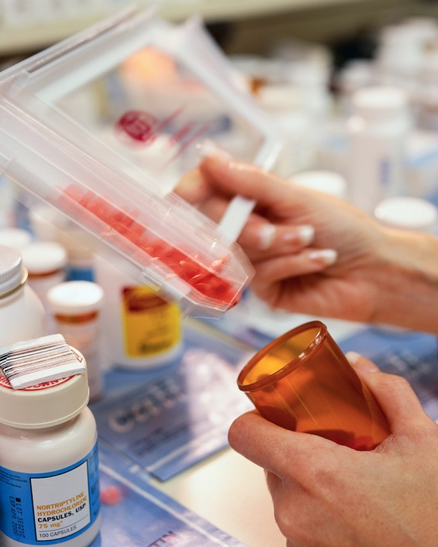
Controlled Substances Act, 1970
Controlled Substances Act, 1970
to control the manufacturing and distribution of drugs
intended to merge contradictory drug laws into one comprehensive federal policy
brought drugs under federal
jurisdiction
placed drugs on 1 of 5 schedules based on level of risk

Slide 11
drug schedules
Controlled Substances Act, 1970
Schedule I
high risk of misuse
has not been shown to be safe; no medical use
e.g. heroin, marijuana
Schedule II
high risk of misuse, but less dangerous than Schedule 1
e.g. cocaine, oxycodone (Oxycontin)
Schedule III
moderate risk for misuse
e.g. hydrocodone (Vicodin), anabolic steroids
Schedule IV
low potential for misuse
e.g. alprazolam (Xanax), zolpidem (Ambien)
Schedule V
low potential for misuse; low narcotic content
e.g. Robitussin

Slide 12
part II: opioids overview

Slide 13
euphoria
constipation
drowsiness/“nodding off”
cough suppression
disorientation
physical effects
respiratory depression
nausea
pain reduction
vomiting
dizziness

Slide 14
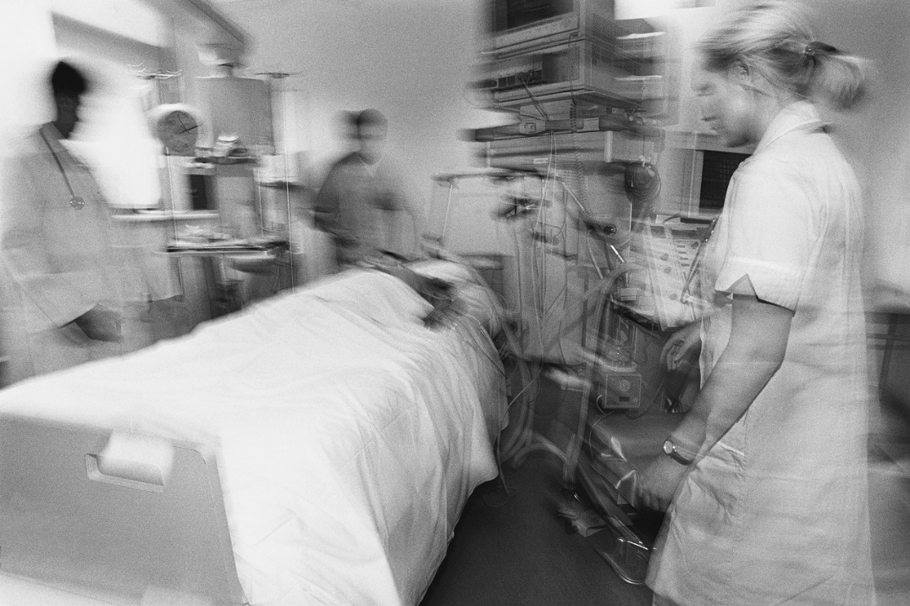
health consequences of intravenous opioid use
high risk for developing an opioid use disorder
risk for infectious disease (e.g. HIV, HCV)
respiratory depression/risk of OD
abscesses
MRSA infections
collapsed veins
liver disease
kidney disease
pneumonia

Slide 15
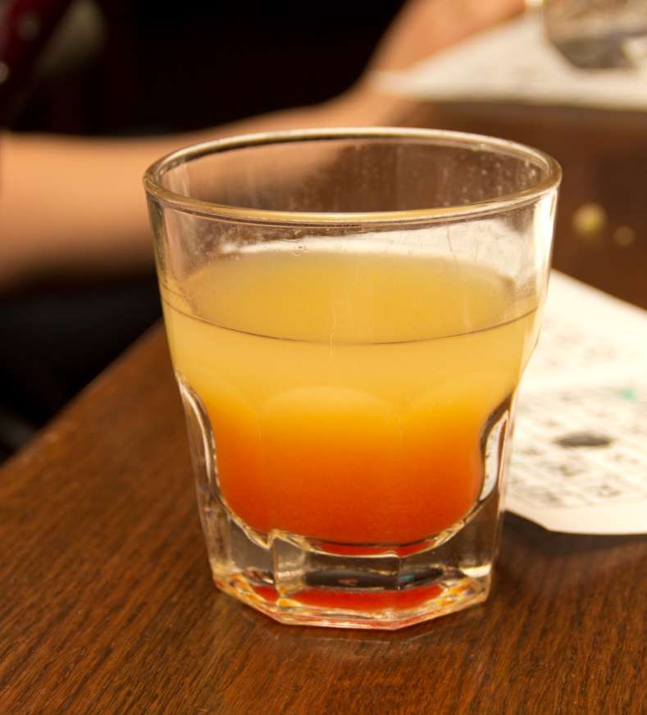
risk of overdose
risk of overdose from illicit or prescription opioids is higher when combined with other substances, such as:
alcohol
benzodiazepines (e.g. Valium, Xanax)
antihistamines
sedatives

Slide 16
prescription opioids are used for legitimate purposes, most often pain management

Slide 17
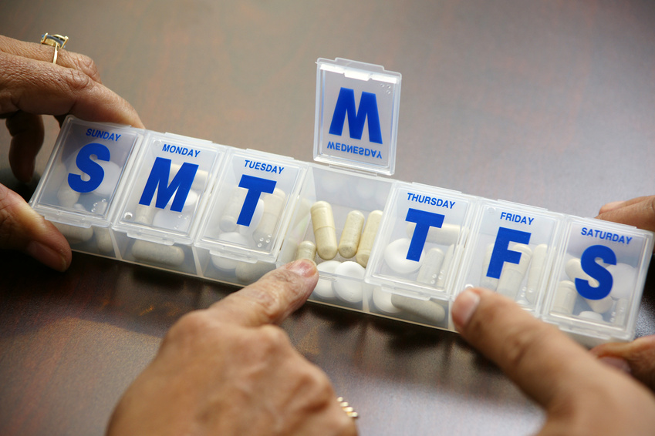
the risk for addiction can be lessened by taking medications on a schedule and as prescribed

Slide 18
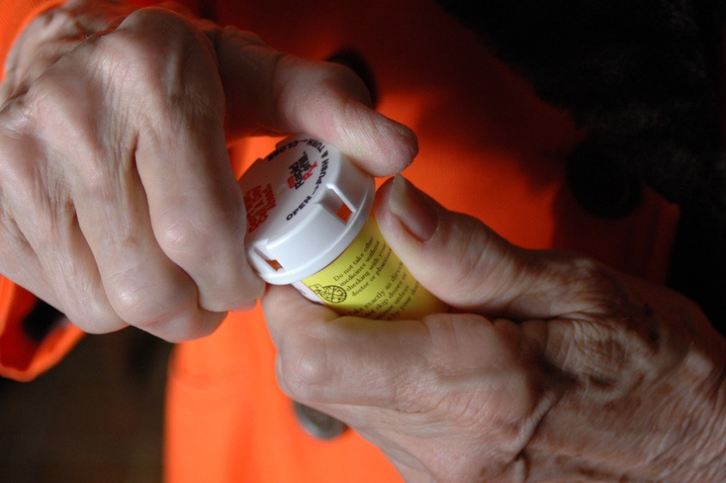
common prescription opioids
codeine (generic only)
hydrocodone (Vicodin)
meperidine (Demerol)
morphine (Avinza, Kadian, MS Contin, Ora-Morph SR)
oxycodone (OxyContin)
oxycodone & acetaminophen (Percocet)
methadone (Methadose)

Slide 19
1.9 million
Americans meet the criteria for prescription opioid misuse

Slide 20
prescription drugs are involved in a large number of emergency room visits

Slide 21
27.1%
of emergency room visits in 2009 involved the misuse of pharmaceuticals

Slide 22
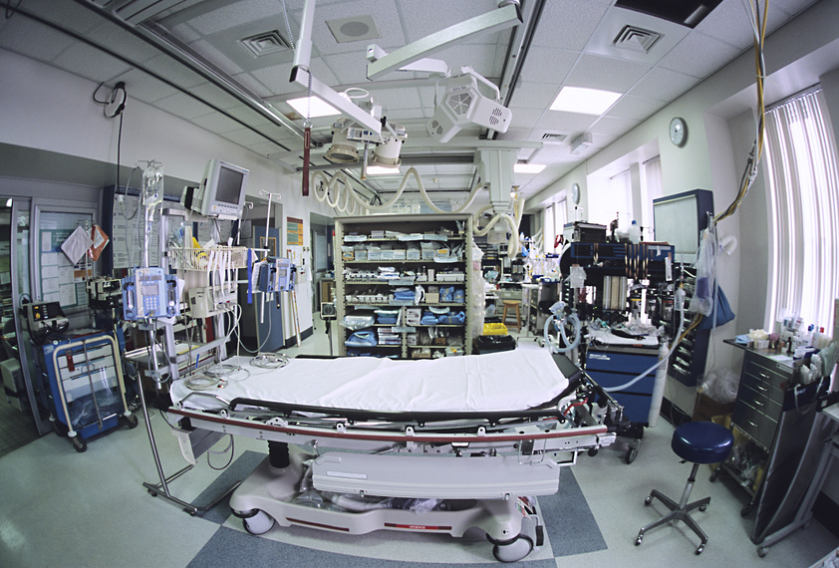
prescription drug related emergency room visits increased by 98%
between
2004 and
2009

Slide 23
part III: stimulants overview

Slide 24
increased blood pressure
euphoria
panic
exhilaration
aggression
hallucinations
physical effects
restlessness
paranoia
increased heart rate
rapid speech
dizziness
decreased appetite

Slide 25
health consequences of stimulant use
high risk for physiological dependence
high risk of overdose when combined with other drugs
risk for infectious disease (e.g. HIV, HCV)
cardiac arrest
stroke
seizures
malnourishment
nasal problems

Slide 26
part IV: marijuana overview

Slide 27
paranoia
increased blood pressure
altered mood
impaired coordination
physical effects
increased heart rate
euphoria
hallucinations
heightened perception
sleep disturbance
increased appetite

Slide 28
health consequences
diminished intellectual capacity
long-term memory and learning deficits
infertility
lung cancer/oral cancer
bronchitis
pneumonia
mood changes/suicidality
withdrawal
increased BP/increased risk for heart attack

Slide 29
withdrawal symptoms
insomnia
irritability
anxiety/restlessness
decreased appetite
marijuana cravings
= risk factors for relapse

Slide 30
part V: emerging drugs

Slide 31
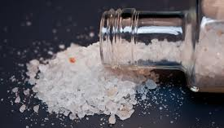
“bath salts” overview
made up of amphetamine-like components derived from the Khat plant
administration: smoked, snorted, injected
effects: increased HR, increased BP, hallucinations
presentation may mimic stimulant or hallucinogen use

Slide 32
paranoia
talkativeness
delirium
elation
physical effects
violence/aggression
hallucinations
increased sexual behavior
psychosis

Slide 33
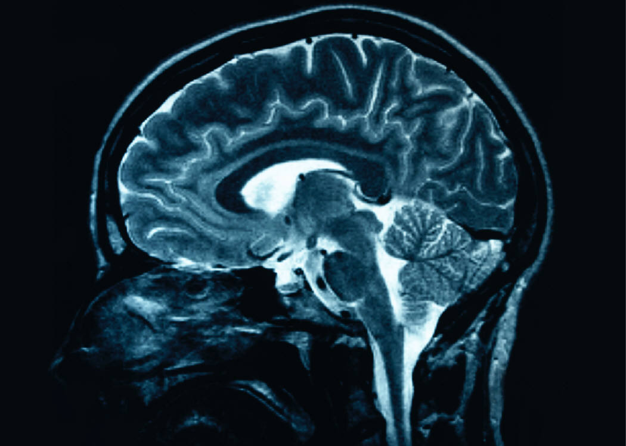
{
increase in dopamine & norepinephrine
possible increase in serotonin
similar effects to MDMA, cocaine, meth
effects on the brain

Slide 34
potential health impacts
excited delirium
panic attacks
dehydration
fatal overdose
cardiovascular symptoms/events
kidney failure
tolerance
dependence
withdrawal symptoms

Slide 35
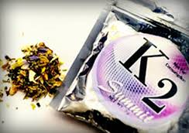
K2/spice overview
synthetic marijuana
advertised as incense
administration: smoked,
consumed in a beverage
effects: hallucinations, paranoia, psychosis
2nd most common illicit drug used by high school seniors
purchased in smoke shops or online

Slide 36
{
acts on the same receptors as marijuana
has a stronger effect on these receptors than THC
results in greater response than marijuana use
effects on the brain

Slide 37
nausea
restlessness
vomiting
increased blood pressure
physical effects
increased heart rate
hallucinations
disorientation
decreased blood supply

Slide 38
potential health impacts
tolerance/dependence
accidental overdose
potential exposure to carcinogens
psychiatric disturbances

Slide 39
prevention challenges
manufacturers continually change the chemical compounds in bath salts and spice to evade authorities
products are marketed as other goods (e.g. “incense,” “jewelry cleaner,” “plant food”)
manufacturers often include disclaimer “not for human consumption” on packaging
widely available on the internet

