Slide 1
screening, brief intervention, and referral to treatment
drug & tobacco interventions
Lecture 6.3

Slide 2
5 A’s
Ask – ask about their substance use or smoking
Advise – advise patient to quit or cut back
Assess – assess how willing the patient is to make changes in their use
Assist – assist with a behavior plan or additional resources
Arrange – arrange for a follow-up visit and/or referral

Slide 3
5 R’s
Relevance – why is quitting relevant to the patient?
Risks – what risks is the patient exposing him or herself to?
Rewards – what are the rewards for the patient if they quit?
Roadblocks – what are the barriers to quitting?
Repetition – remind patient most smokers require multiple attempts before successfully quitting

Slide 4
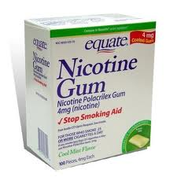
nicotine treatment
Nicotine Treatments (NTs)
nicotine patch
may be useful for early morning cravings if worn overnight
nicotine gum or lozenge
faster delivery of nicotine than the patch
nicotine inhaler
addresses tactile functions of smoking
nicotine nasal spray
fastest delivery among nicotine treatment products

Slide 5
patients are commonly underdosed on NTs

Slide 6
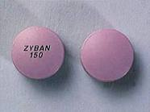
medications for tobacco use disorder
bupropion (Wellbutrin, Zyban)
taken orally
commence 2 weeks before quitting
reduces cravings and withdrawal symptoms
can combine with nicotine treatment
varenicline (Chantix)
taken orally
commence 1 week before quitting
blocks the pleasurable effects of nicotine
risk for suicide

Slide 7
consider a referral for medication-assisted treatment for patients with a substance use disorder

Slide 8
clinical notes
What should be included in a clinical note for a brief substance use intervention?
biological markers
screening results
risk level
behavior plan
referral information
plan for follow-up

Slide 9
critical finding
Saitz et al. (2014) – Boston University
N=528
marijuana, cocaine & opioid users
3 study groups:
BI
longer MI intervention
no intervention
no significant differences in frequency of use or health consequences between study groups
conclusion:
“Brief intervention did not have efficacy for decreasing unhealthy drug use in primary care patients identified by screening. These results do not support widespread implementation of illicit drug use and prescription drug misuse screening and brief intervention.”

