Slide 1
screening, brief intervention, and referral to treatment
introduction to SBIRT for adolescents
Lecture 7.1

Slide 2
adolescents are less likely to have a substance use disorder & more likely to be engaging in risky use

Slide 3
half of the adolescents coming into emergency rooms will screen positive for alcohol

Slide 4
adolescent alcohol use patterns
alcohol is typically the first substance used by an adolescent (usually around 14 years of age)
1 out of 3 youth will consume alcohol by the 8th grade
half of those report they have previously been drunk
approximately 70% of high school seniors report having drank alcohol
a quarter of high school seniors report binge drinking in the previous 2 weeks
male youth more commonly binge drink than female youth

Slide 5
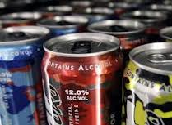
adolescent alcohol use patterns
often consuming beer, liquor or flavored beverages
lower consumption of wine
energy drinks containing alcohol gaining popularity
youth may not ‘feel’ as intoxicated, but are impaired

Slide 6
adolescent binge drinking
(NIAAA, n.d.)

Slide 7
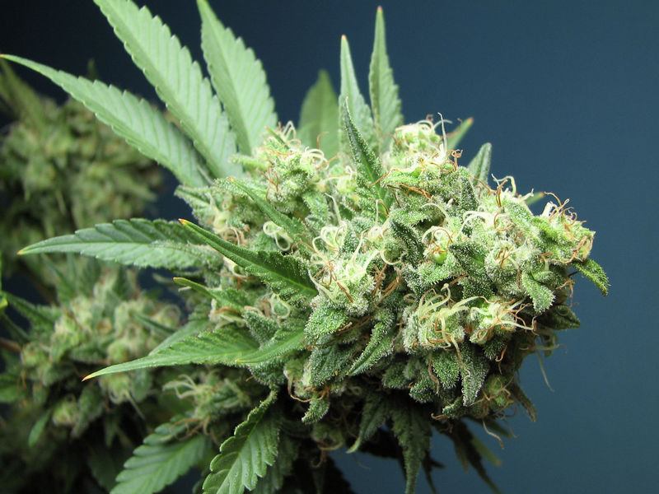
adolescent drug use patterns
rates of adolescent drug use are increasing
primarily accounted for by the increase in marijuana use
teens are more likely to smoke marijuana than cigarettes
increase in the use of synthetic marijuana (“spice”)
prescription drug misuse rising among youth
preferred medications: Vicodin & Adderall
reduction in crack cocaine & inhalants
cigarette use is decreasing; other forms of tobacco gaining in popularity (e.g. hookahs, e-cigarettes)

Slide 8
prescription drugs are being increasingly misused by young people

Slide 9
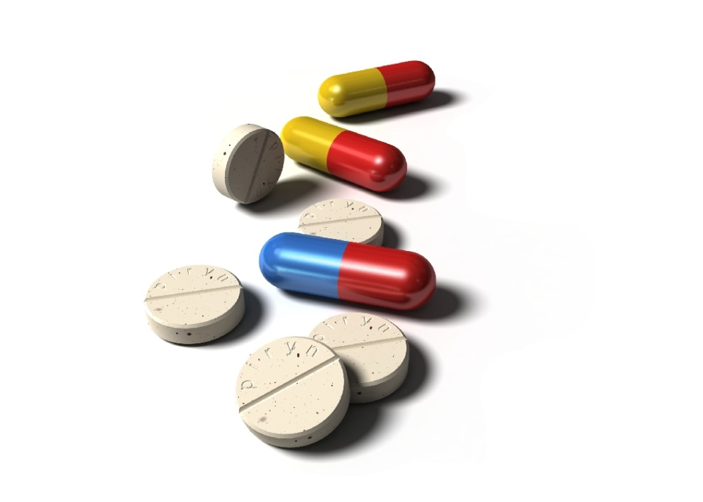
1 in 12 high school seniors report having used Vicodin for nonmedical
purposes

Slide 10
prescription drugs are one of the most commonly misused
drugs by high school seniors

Slide 11
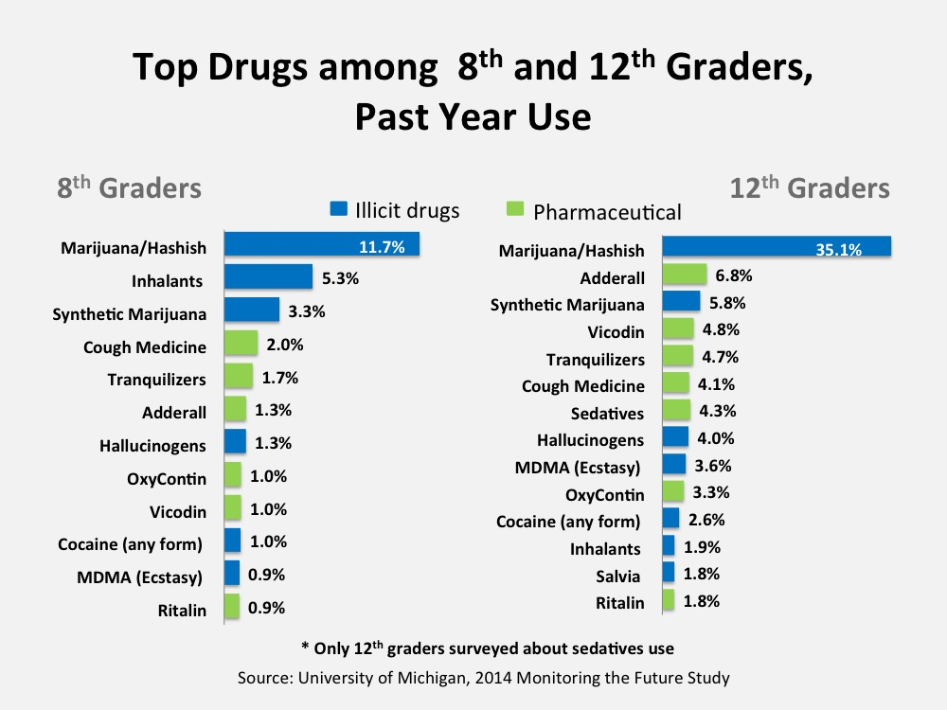
trends

Slide 12
trends

Slide 13
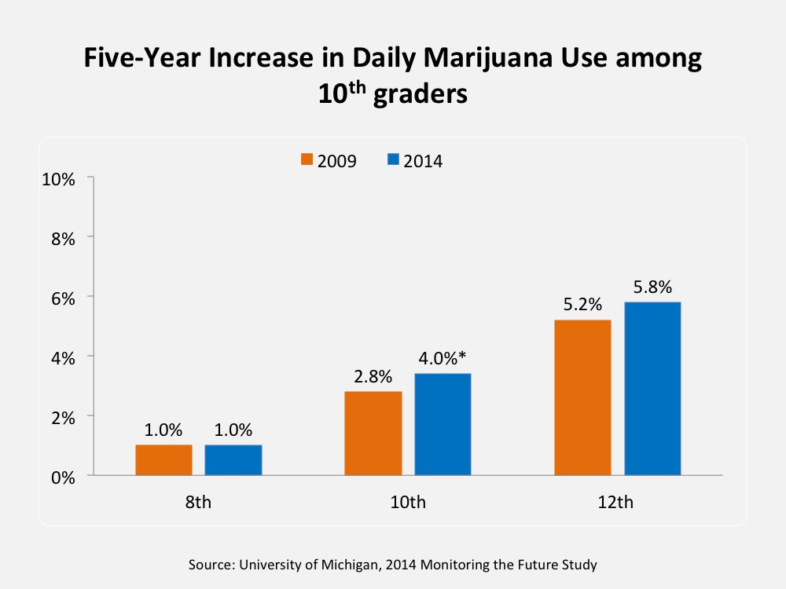
trends

Slide 14
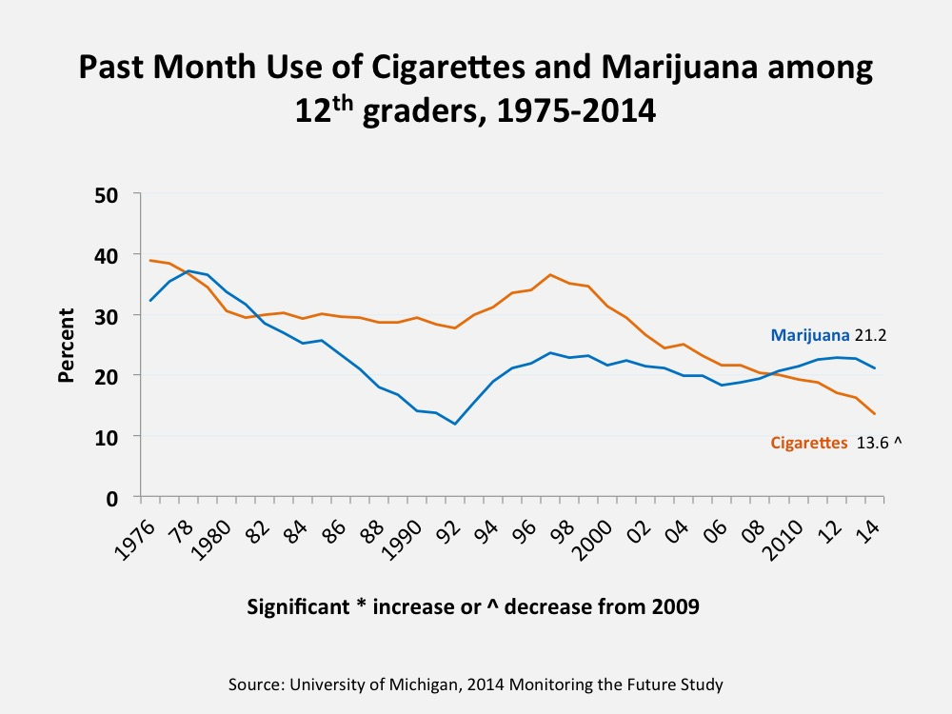
trends

Slide 15
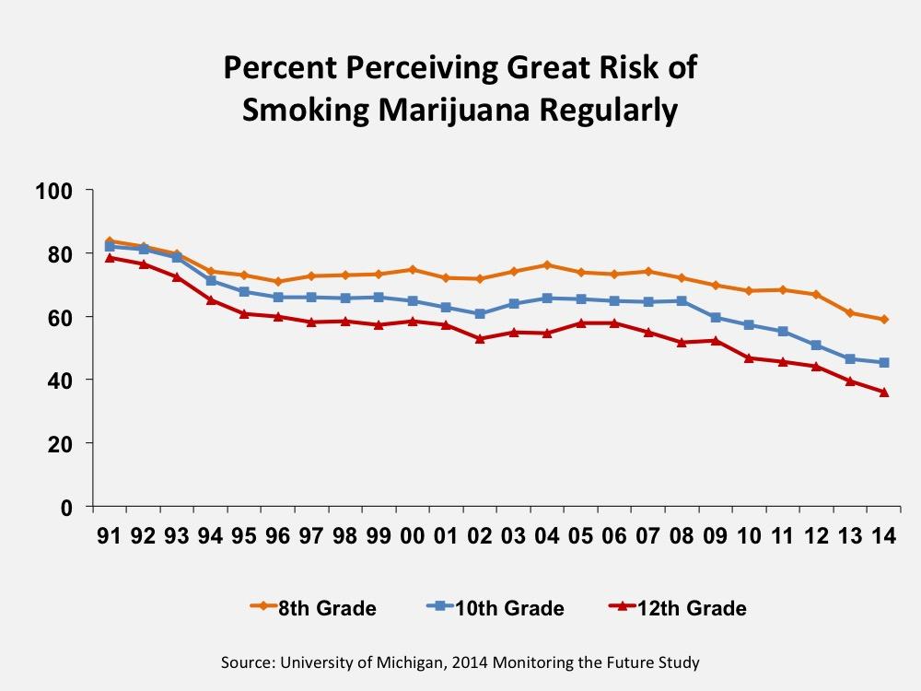
trends

Slide 16
consequences
sexually transmitted diseases
unplanned pregnancies
academic difficulties
increased risk for alcohol use disorder
violence/aggression
effects on brain development
injuries
death
correlates with other risky behaviors (e.g. smoking, drug use, unprotected sex)

Slide 17
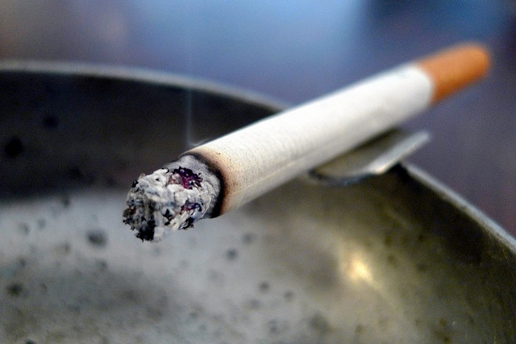
target groups for screening
ADD/ADHD patients
youth with conduct disorders
depressed/anxious youth
unplanned pregnancies
patients with STDs/STIs
accident/injury victims
those engaging in other risky behaviors (e.g. smoking)
recent behavior changes (e.g. poor grades, mood changes, truancy, etc.)

Slide 18
most adolescents report they are willing to discuss their substance use with their doctor

Slide 19
most physicians do not ask about adolescent substance use, noting concerns about knowing how to properly do so

Slide 20
only 1 in 20 adolescents who are have a substance use disorder or high-risk will receive treatment

