Slide 1
screening, brief intervention, and referral to treatment
SBIRT in acute care settings
Lecture 7.3

Slide 2
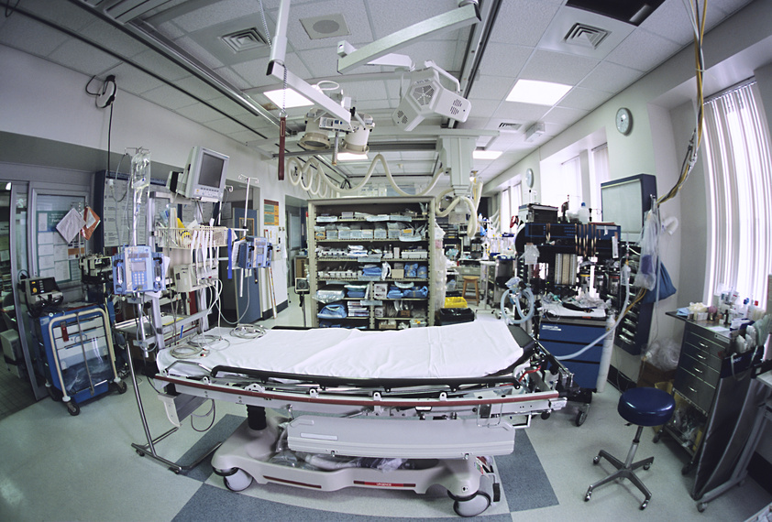
acute care settings
acute care: treating a (usually serious) injury or illness (or recovery from surgery) on a short-term basis
hospitals
emergency departments
trauma centers
intensive care units
surgery centers

Slide 3
40% of motor vehicle accidents involve alcohol

Slide 4
alcohol is the primary contributing factor to injuries

Slide 5
rationale for acute care interventions
accreditation requirements
drugs & alcohol are involved in a great number of accidents & injuries (“reachable moments”)
patient surveys indicate patients are comfortable discussing their use & view it as important
patients may begin experiencing potentially lethal withdrawal symptoms in acute care settings and need to be identified
alcohol and benzodiazepine withdrawal can be life threatening
alcohol/drug use can complicate other conditions
CMS reimbursement

Slide 6
return on investment
(Gentilello et al., 2005)
cost-benefit analysis of brief interventions for alcohol use
included direct medical costs only
patients had endured an injury
patients had positive screen on screening tool or biological marker
assumptions: 20-30 minute intervention delivered by a psychologist
cost savings: $89 per screened patient, $330 for patients receiving a brief intervention (nearly $4 in savings for every $1 spent)
potential nationwide cost savings: $1.8 billion a year

Slide 7
target groups
universal screening (if possible)
biological markers indicate substance use
positive screen
accident/injury victims
patients with a substance use disorder

Slide 8
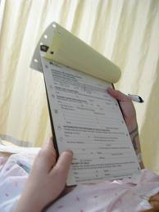
screening tools
screening tools previously reviewed:
AUDIT
CAGE
ASSIST

Slide 9
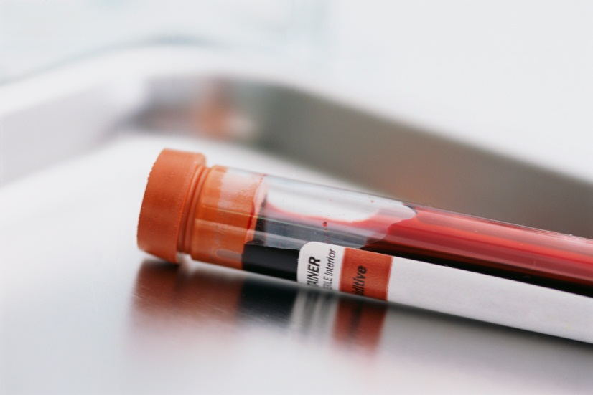
blood alcohol concentration (BAC)
amount of alcohol (ethanol) in the patient’s blood
measured in grams
measures current level of intoxication not regular use
impaired driving: ≤.08
add 15mg for each hour
that has elapsed since the
patient’s accident/injury for
a more accurate reading

Slide 10
rapid alcohol problems screen
Rapid Alcohol Problems Screen: Quantity & Frequency (RAPS4 – QF)
1) During the last year have you had a feeling of guilt or remorse after drinking? (Remorse)
2) During the last year has a friend or a family member ever told you about things you said or did while you were drinking that you could not remember? (Amnesia)
3) During the last year have you failed to do what was normally expected from you because of drinking? (Perform)
4) Do you sometimes take a drink when you first get up in the morning? (Starter)
OR
During the last year do you drink as often as once a month? (Frequency) AND
During the last year have you had 5 or more drinks on at least one occasion? (Quantity)

Slide 11
RAPS-QF scoring
1 yes response is a positive screen
1-2 minutes to administer & score
validated with men & women & various ethnic groups
more sensitive tool than the CAGE
more relevant for substance use disorders than problem drinking

Slide 12
considerations
UNIVERSAL screening is ideal
the staff member who delivers the screening does not need to be the individual who conducts the brief intervention
timing
coverage of all shifts
training, training, training
stress delivery matters (e.g. ‘bedside manner’)

