Slide 1
screening, brief intervention, and referral to treatment
SBIRT implementation
Lecture 8

Slide 2
getting buy-in
obtaining leadership support
move away from the physician-centric/physician-heavy model
thoughtful selection of screening tools
emphasize expected implications from health care reform
push for a medical home model
push for integrated care
more federal funding for FQHCs
parity for substance use tx = increased revenue
make the literature available to staff

Slide 3
getting buy-in (cont’d)
cost-effectiveness
Cowell, Bray, & Hinde (2011)
cost-effectiveness of screening & brief interventions in an employee assistance program
able to screen employees for $.64
brief interventions were $2.52
total training cost: $82/interventionist
conclusion: even with modest outcomes the intervention would be cost effective

Slide 4
getting buy-in (cont’d)
cost-effectiveness (cont’d)
Parthasarathy, Weisner, Hu, & Moore (2000)
sample of 1,011 dependent patients at Sacramento Kaiser Permanente; matched control group
patients took part in an outpatient treatment program
reviewed medical utilization 18 mos before and after tx
results
39% reduction in ED visits
35% reduction in inpatient visits
26% reduction in medical costs

Slide 5
getting buy-in (cont’d)
cost-effectiveness (cont’d)
Rooke, Thorsteinssen, Karpin, Copeland, & Allsop (2010)
reviewed 32 RCTs of computer-based alcohol & tobacco interventions
sample of over 10,000 patients
average effect size = .20; substance use was significantly reduced
no significant differences in effect size based on # of sessions, inclusion of a discussion component, location of completion (intervention completed at home or at the research site), or emphasis on relapse prevention
conclusion: minimal computer-based interventions lead to positive outcomes and are cost-effective

Slide 6
arguments to anticipate
“There isn’t enough time.”
“We’re not behavioral health providers.”
“Patients don’t want to talk about their substance
use.”
“I haven’t been trained to do this.”
“It will damage the “clinician-patient relationship.”
“It raises privacy concerns.”
“Universal screening isn’t necessary.”
Review SBIRT Colorado’s “The Truth” at: http://improvinghealthcolorado.org/the-truth-home/

Slide 7
training & coaching
demonstration videos
forms of coaching
review of recorded interventions
live observation
role play
web-based trainings
ATTC training
Kognito avatar trainings
SBIRT Oregon modules
Motivational Interviewing
MINT training calendar: http://www.motivationalinterviewing.org/calendar

Slide 8
training & coaching (cont’d)
What elements should be addressed in a training?
rationale/evidence for SBIRT
review of and practice with screening tools
clinical flow
experiential practice conducting brief interventions
how outcomes will be measured
billing and charting issues
Q&A; venue to voice concerns
who to address future questions to
Program Director?
SBIRT liaison?

Slide 9
planning
how will you disseminate the information to staff?
who will be screened and when?
conducting a walk-through
NiaTx – www.niatx.net
linkages & MOUs with offsite providers
networking with other sites who have implemented SBIRT successfully
make reference sheets & readiness rulers available to staff

Slide 10
planning
Who will provide the intervention?
nurses (Broyles & Gordon, 2010), PCPs, DBH provider, medical assistant, health educator, others
should be an interdisciplinary approach
considerations:
who has the time?
who has the skills? (think MI)
willingness? interest?
need for ‘champions’
credibility with other staff
passionate about the intervention
ability to communicate across disciplines

Slide 11
reimbursement
interventions must be a min. of 15 mins.
must utilize an evidence-based tool (e.g. AUDIT, DAST)
can bill for follow-up if 15 mins. or longer
Medicare codes for non-hospital/outpatient settings
Tobacco interventions must involve poly-substance use (otherwise utilize ICD-9/ICD-10 codes)
not all states have approved Medicare/Medicaid SBI codes
alternative: not billing for SBIRT services; funding via cost-offset

Slide 12
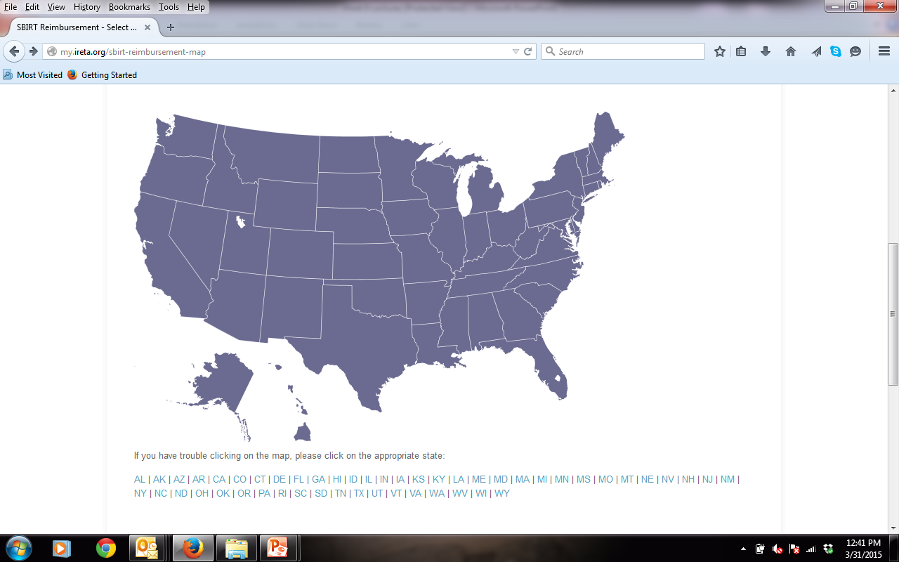
IRETA reimbursement map:
http://my.ireta.org/sbirt-reimbursement-map

Slide 13
fidelity & sustainability
data collection & evaluation (Davoudi et al., 2001)
process measures
who is conducting the screen?
who is performing the intervention?
screening tools utilized
# of patients screened
outcome measures
reductions in substance use
reductions in accidents/injuries
reductions in ED visits
improvements in mental health
improvements in health outcomes

Slide 14
fidelity & sustainability (cont’d)
ongoing technical assistance
how do you fund the interventions when grant funding runs dry?
have billing procedures in place before grant funds expire
incorporate into your EHR
ease of record keeping
prompts for level of intervention needed
ability to measure outcomes

Slide 15
global considerations
incorporating SBIRT training into medical school curricula and residencies
promoting SBIRT with professional organizations
expansion of online screening tools and web-based interventions
expansion of SBIRT in nontraditional settings
employee assistance programs
schools
jails/detention centers

