Slide 1
Buprenorphine Treatment for Young Adults
Findings and strategies from a NIDA Clinical Trials Network Study

Slide 2
NIDA/SAMHSA Blending Initiative
According to the Webster Dictionary definition
To Blend means:
a. combine into an integrated whole;
b. produce a harmonious effect
Notes:
2

Slide 3
NIDA/SAMHSA Blending Initiative
Developed in 2001 by NIDA and SAMHSA/CSAT, the initiative was designed to meld science and practice to improve addiction treatment.
Blending Teams develop methods for dissemination of research results for adoption and implementation into practice.
Scientific findings are able to reach the frontline service providers treating people with substance use disorders. This is imperative to the success of drug abuse treatment programs throughout the country.
Notes:
3

Slide 4
Blending Team Members
Thomas Freese, Ph.D. – Chair – Pacific Southwest ATTC
Michael Bogenschutz, M.D. – CTN Southwest Node
Thomas Durham, Ph.D. – Central East ATTC
Shannon Garrett, LGSW, CSC-AD – CTP Mid-Atlantic Node
Laura McNicholas, M.D., Ph.D. – CTN Delaware Valley Node
Beth Rutkowski, M.P.H. – Pacific Southwest ATTC
Susan Storti, Ph.D., R.N. – Synergy Enterprises, Inc.
Geetha Subramaniam, M.D. – CTN Mid-Atlantic Node
Pamela Waters, M.Ed., CAC, CPP – Southern Coast ATTC
ATTC representative NIDA representative/Community treatment provider
Notes:
4

Slide 5
Objectives for the Training
Define prevalence and treatment admission rates of opioid use for young adult population
To describe the mechanism of action of buprenorphine/naloxone
Understand the results of new research on the use of buprenorphine to treat opioid addiction in young adults
Describe the implications of these findings for the treatment of opioid addiction in young adults
Notes:
5

Slide 6
Introductions
Please introduce yourself:
Your name and the organization in which you work
Experience with opioid treatment
Your expectations for this training
Richell
Bob
Mary
Jose
Derrick
Sherry
Bethany
Tom
Notes:
6

Slide 7
So who are the participants
in this endeavor?

Slide 8
An Introduction to
SAMHSA/CSAT
Notes:
8

Slide 9
SAMHSA/CSAT
CSAT’s Mission:
To improve the lives of individuals and families affected by alcohol and drug abuse by ensuring access to clinically sound, cost-effective addiction treatment that reduces the health and social costs to our communities and the nation.
CSAT's initiatives and programs are based on research findings and the general consensus of experts in the addiction field that, for most individuals, treatment and recovery work best in a community-based, coordinated system of comprehensive services.
Because no single treatment approach is effective for all persons, CSAT supports the nation's effort to provide multiple treatment modalities, evaluate treatment effectiveness, and use evaluation results to enhance treatment and recovery approaches.
Notes:
9

Slide 10
The ATTC Network
Notes:
10

Slide 11
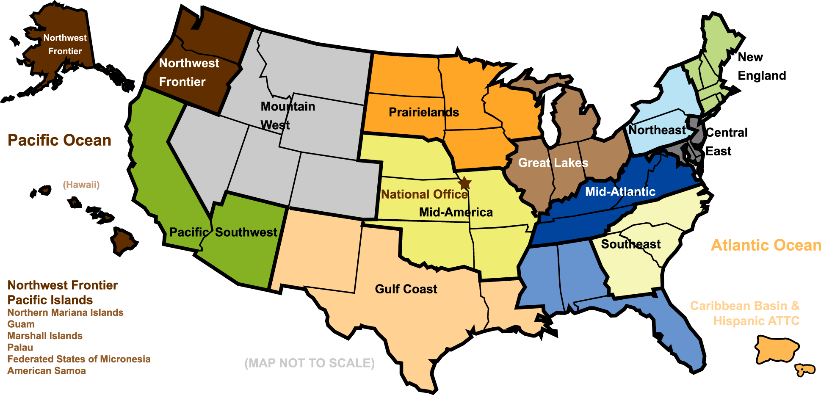
The ATTC Network
Notes:
11

Slide 12
An Introduction to NIDA
Notes:
12

Slide 13
The Mission of the National Institute on Drug Abuse
To lead the Nation in bringing the power of science to
bear on drug abuse and addiction
This charge has two critical components.
Strategic support and conduct of research across a broad range of disciplines
Ensuring the rapid and effective dissemination and use of the result of that research to significantly improve prevention, treatment and policy as it relates to drug abuse and addiction
Notes:
13

Slide 14
So what is this thing called the CTN?
Notes:
14

Slide 15
NIDA’s Clinical Trials Network
Established in 1999
NIDA’s largest initiative to blend research and clinical practice by bringing promising therapies to community treatment providers
Network of 16 University-based Regional Research and Training Centers (RRTCs) involving 240 Community Treatment Programs (CTPs) in 23 states, Washington D.C., and Puerto Rico
Notes:
15

Slide 16
CTN Node
Community
Treatment
Program
Community
Treatment
Program
Community
Treatment
Program
Regional
Research &
Training Center
Community
Treatment
Program
Community
Treatment
Program
Community
Treatment
Program
Community
Treatment
Program
Community
Treatment
Program
Notes:
16

Slide 17
Why Focus on Young Adults?
Notes:
17
17

Slide 18
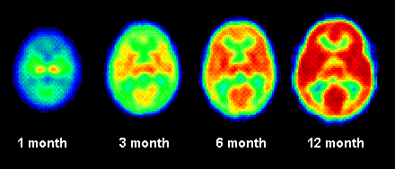
The Brain Undergoes Tremendous Changes During Development
Increase of brain activity that accompanies
the growth of the brain, in the same patient, from the age of 1 to 12 months.
Information taken from NIDA’s Science of Addiction http://www.drugabuse.gov/ScienceofAddiction/
Notes:
18

Slide 19
Continuing Brain Development During Adolescence
Strengthening the Circuitry
Synaptic connections are strengthened
Pruning Unused Connections
Adolescent brain is in a unique state of flux
Neurons are eliminated, pruned and shaped
This process is influenced by interactions with the outside world (Gogtay et al., 2004)
Pruning occurs from back to front so frontal lobes mature the last.
Other brain areas are also growing during adolescence (e.g., sub-cortical areas, receptors)
Notes:
19

Slide 20
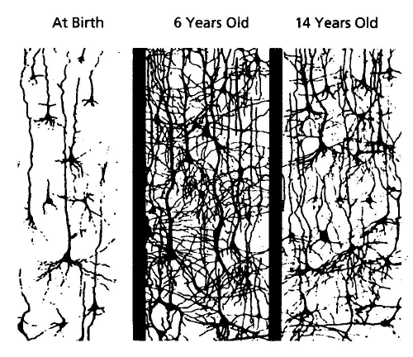
Continuing Brain Development
Early in development, synapses are rapidly created and then pruned back. Children’s brains have twice as many synapses as the brains of adults. (Shore, 1997)
Notes:
20

Slide 21
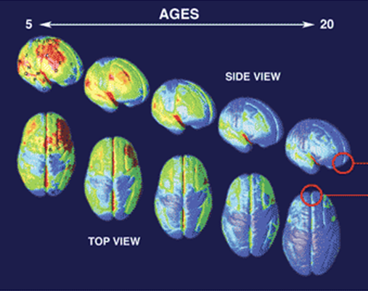
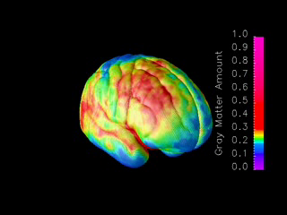
Brain Development Ages 5-20 years
`
MRI scans of healthy children and teens compressing 15 years of brain development (ages 5–20).
Red indicates more gray matter, blue less gray matter.
Neural connections are pruned back-to-front.
The prefrontal cortex ("executive" functions), is last to mature.
Information taken from NIDA’s Science of Addiction
http://www.drugabuse.gov/ScienceofAddiction/
Gagtay, N., et al. PNAS, 101, 8174-8179
Notes:
21
Constructed from MRI scans of healthy children and teens, the time-lapse "movie", from which the above images were extracted, compresses 15 years of brain development (ages 5–20) into just a few seconds. Red indicates more gray matter, blue less gray matter. Gray matter wanes in a back-to-front wave as the brain matures and neural connections are pruned. Areas performing more basic functions mature earlier; areas for higher order functions mature later. The prefrontal cortex, which handles reasoning and other "executive" functions, emerged late in evolution and is among the last to mature. Studies in twins are showing that development of such late-maturing areas is less influenced by heredity than areas that mature earlier.
Source: Paul Thompson, Ph.D. UCLA Laboratory of Neuroimaging
21

Slide 22
The interaction between the developing nervous system and drugs of abuse leads to:
Difficulty in decision making
Difficulty understanding the consequences of behavior
Increased vulnerability to memory and attention problems
This can lead to:
Increased experimentation
Opioid (and other substance) addiction
(Fiellin, 2008)
Notes:
22

Slide 23
Young Brains Are Different from Older Brains
Alcohol and drugs affect the brains of adolescents and young adults differently than they do adult brains
Adolescent rats are more sensitive to the memory and learning problems than adults*
Conversely, they are less susceptible to intoxication (motor impairment and sedation) from alcohol*
These factors may lead to higher rates of dependence in these groups
(Hiller-Sturmhöfel and Swartzwelder, 2004/2005)
Notes:
23
23

Slide 24
Why Focus on Young Adults?
Let’s look at opioid use
in this age group
Notes:
24

Slide 25
Prevalence of Use
Rates of heroin use are declining among youth -
8th grade use peaked in 1996
10th grade use peaked in 1997
12th grade use peaked in 2000
Rates of non-medical use of opioids are increasing
Rates in all ages peaked in 2007
Rates highest in 18-25 year olds
(Johnston et al., 2009; SAMHSA, OAS, NSDUH, 2009)
Notes:
25

Slide 26
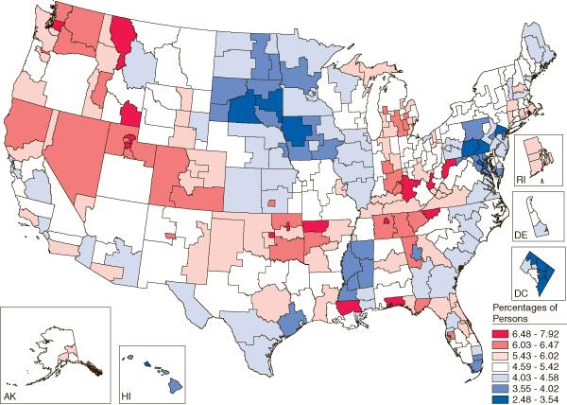
Non-Medical Pain Reliever Use in Past Year, among persons aged 12 and older
7 of 15 lowest regions in South; 4 in Midwest; 3 in Northeast and 1 in West
Lowest rate = 2.48% in Washington, DC
10 of top 15 regions in Southern states
Highest rate = 7.92 % in Northwest Florida
SOURCE: SAMHSA, NSDUH, 2008.

Slide 27
Rates of Current Heroin Use
Drug demand data show that, nationally, current heroin use is stable or decreasing.
Rates of Past-Year Heroin Use – NSDUH, 2009
% of US population | 2003 | 2004 | 2005 | 2006 | 2007 | 2008
Individuals (12 & older) | 0.1 | 0.2 | 0.2 | 0.2 | 0.1 | 0.2
Adolescents (12-17) | 0.1 | 0.2 | 0.1 | 0.1 | 0.1 | 0.2
Adults (18-25) | 0.3 | 0.4 | 0.5 | 0.4 | 0.4 | 0.5
Adults (26 & older) | 0.1 | 0.1 | 0.1 | 0.2 | 0.1 | 0.3
(SAMHSA, 2009)
Notes:
27

Slide 28
Non-Medical Use of Prescription Drugs
 | 12-17 | 18-25 | 26+ | 12+ overall
Pain relievers | 2.3 | 4.6 | 1.4 | 1.9
OxyContin | 0.2 | 0.4 | 0.1 | 0.2
Tranquilizers | 0.6 | 1.7 | 0.6 | 0.7
Stimulants | 0.5 | 1.1 | 0.2 | 0.4
Sedatives | 0.1 | 0.2 | 0.1 | 0.1
Percent of U.S. Population 12 and older reporting past month non-medical use of psychotherapeutic medications in 2008.
(SAMHSA, OAS, NSDUH, 2009)
Notes:
28

Slide 29
New Non-Medical Users of Pain Relievers
In 2008 – 2.2 million new non-medical users (a decline from 2.5 million in 2003, but still a lot!)
6,000 new users per day
Among youth aged 12-17, females more likely to use non-medically
Among young adults aged 18-25, males more likely to use non-medically (SAMHSA, OAS, NSDUH, 2009)
From 2004 to 2006, emergency department visits involving hydrocodone/combinations increased 44% and oxycodone/combinations increased 56% (DAWN, 2006)
Notes:
29

Slide 30
Lifetime Non-medical Use of Pain Relievers Among Young Adults
Drug | 2002 | 2007 | % Change
Darvocet/Darvon | 12.2% | 11.4% | -0.8%
Percocet/Percodan | 7.4% | 8.8% | +1.4%
Vicodin/Lortab | 13.3% | 17.9% | +4.6%
Codeine | 6.1% | 5.7% | -0.4%
Hydrocodone | 5.0% | 7.8% | +2.8%
OxyContin | 2.6% | 5.2% | +2.6%
Morphine | 2.1% | 2.7% | +0.6%
Prevalence and Patterns of Nonmedical Use of OxyContin and Other Pain Relievers, Ages 18-25.
Which is most prevalent
among Young Adults?
Vicodin/Lortab
Hydrocodone
OxyContin
(SAMHSA, OAS, NSDUH, 2008)
Notes:
30

Slide 31
Other National Data Sources
The Monitoring the Future survey showed nearly 10% of 12th graders reported past year nonmedical use of Vicodin and 4.7% reported OxyContin use in 2008.
The Treatment Episode Data Set reported a 450% increase in treatment admissions for abuse of other opiates/synthetics between 1997-2007.
(Johnston et al., 2009; SAMHSA, OAS, TEDS, 2009)
Notes:
31

Slide 32
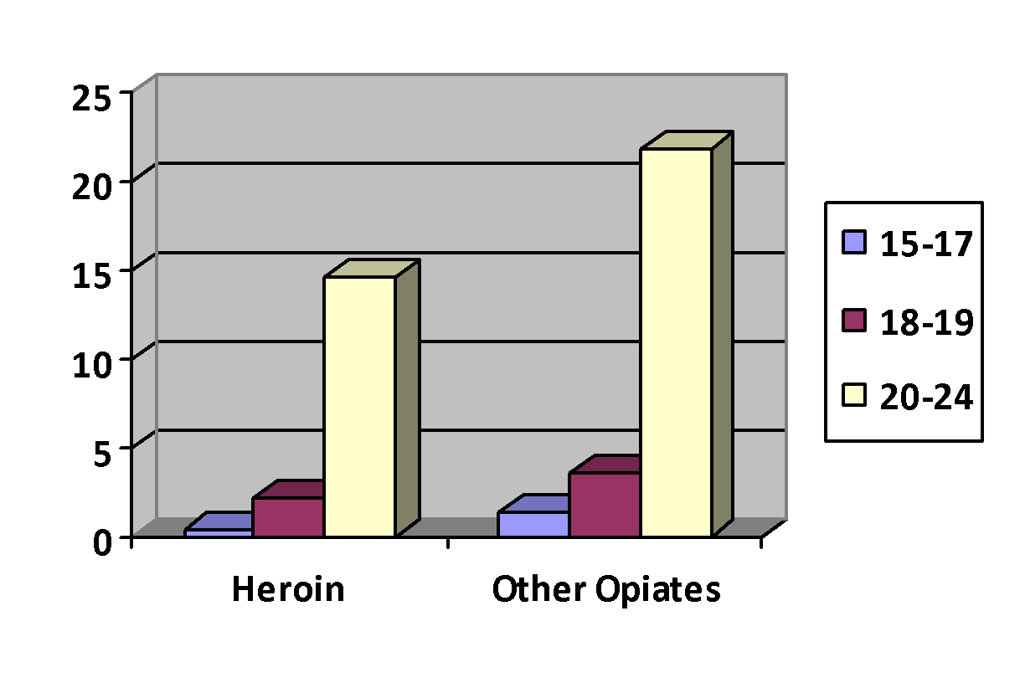
National Treatment Admissions for Heroin and Other Opiates in 2007
Percentage of Treatment Admissions by Age
(SAMHSA, OAS, TEDS, 2009)
Notes:
32

Slide 33
Treatment for Opioid Addiction
Usual treatment for young adults is short-term detoxification and individual or group therapy
Buprenorphine originally studied in adults with long-term addiction
Buprenorphine is FDA-approved for opioid dependent persons age 16 and older
NIDA has recently completed a clinical trial of buprenorphine for opioid-addicted young adults
Notes:
33

Slide 34
Views on Medication-Assisted Treatment
1 – 2 – 3 -4 -5 -6 -7 -8 – 9 - 10
What do You Think?
20-30 minutes
Notes:
34

Slide 35
The Big Question…
Should we really be using Buprenorphine
with Young Adults? One provider’s reaction.
Shannon Garrett
Program Director of Adolescent Services
Mountain Manor Treatment Center
Baltimore, MD
What do you think?
Notes:
35

Slide 36
Areas of Concern
Appropriate dosing
Duration of treatment for young adults
Side effects, interactions with other drugs, and other safety issues
Adolescents and young adults present with multiple co-occurring problems at treatment admission according to NIDA CTN funded research (Subramaniam et al., 2009; Subramaniam & Stitzer, 2009)
Notes:
36

Slide 37
Areas of Potential Concern about Using Buprenorphine with This Population
General philosophical opposition to medication-assisted substance abuse treatment
Denial of severity of addiction by family
Poor medication compliance among youth
Hampered ability to determine efficacy
Effect on the young adult brain of exposure to long periods of illicit or prescribed opioids (including partial agonists) is unknown
Notes:
37

Slide 38
The Medication Buprenorphine/Naloxone
Notes:
38

Slide 39
Partial vs. Full Opioid Agonist
and Antagonist
Full Agonist
(e.g., methadone)
Opioid
Effect
Partial Agonist
(e.g. buprenorphine)
Antagonist
(e.g. naloxone)
Dose of Opioid
Notes:
39
39
.

Slide 40
Buprenorphine
Partial Opioid Agonist
Has effects of typical opioid agonists at lower doses
Produces a ceiling effect at higher doses
Binds strongly to opioid receptor and is long-acting
Safe and effective therapy for opioid maintenance and detoxification in adults
Slow to dissociate from receptors so effects last even if one daily dose is missed (reduced effects may be felt few days after prolonged use).
FDA approved for use with opioid dependent persons age 16 and older
Notes:
40
40

Slide 41
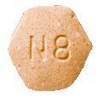
Development of Tablet Formulations of Buprenorphine
Buprenorphine is currently marketed for opioid treatment under the trade names:
Over 25 years of research
Over 5,000 patients exposed during clinical trials
Proven safe and effective for the treatment of opioid addiction
Subutex®
(buprenorphine)
Suboxone® (buprenorphine/naloxone)
Notes:
41
41

Slide 42
Buprenorphine: A Science-Based Treatment
Clinical trials with opioid dependent adults have established the effectiveness of buprenorphine for the treatment of heroin addiction. Effectiveness of buprenorphine has been compared to:
Placebo (Johnson et al., 1995; Kakko et al., 2003; Ling et al., 1998)
Methadone (Fischer et al., 1999; Johnson, Jaffee, & Fudula, 1992; Ling et al., 1996;
Schottenfield et al., 1997; Strain et al., 1994)
Methadone and LAAM (levo-alpha-acetyl-methadol)
(Johnson et al., 2000)
Notes:
42

Slide 43
Buprenorphine Research Outcomes
Buprenorphine is as effective as moderate doses of methadone (Fischer et al., 1999; Johnson, Jaffee, &Fudula, 1992; Ling et al., 1996; Schottenfield et al., 1997; Strain et al., 1994).
Buprenorphine is as effective as moderate doses of LAAM (Johnson et al., 2000).
Buprenorphine's partial agonist effects make it mildly reinforcing, encouraging medication compliance (Ling et al., 1998).
After a year of buprenorphine plus counseling, 75% of patients retained in treatment compared to 0% in a placebo-plus-counseling condition (Kakko et al., 2003).
Notes:
43

Slide 44
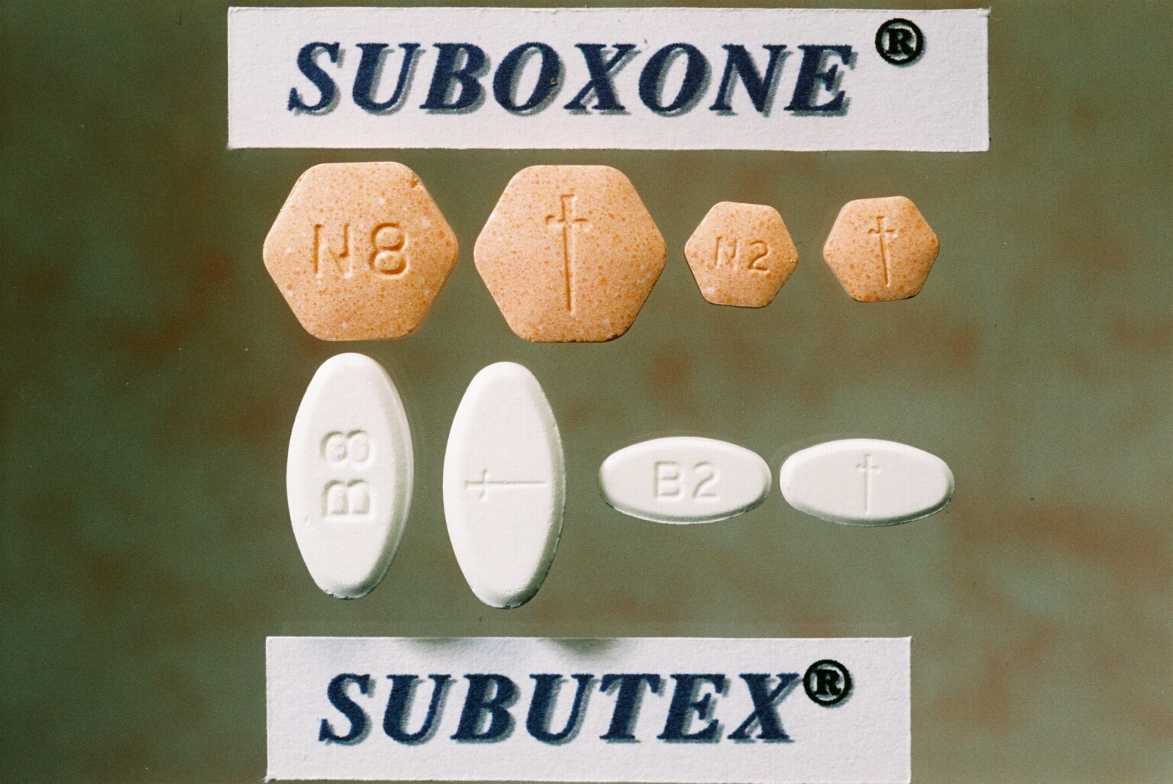
Why did they make two formulations?
Buprenorphine/ Naloxone
Buprenorphine
Notes:
44
44

Slide 45
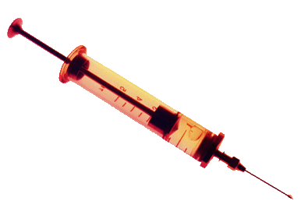
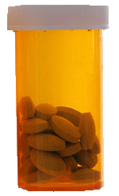
Advantages of Buprenorphine/Naloxone
Discourages IV use
Diminishes diversion
Notes:
45

Slide 46
Use of Buprenorphine: Studies on Cost-Effectiveness
Medication costs are only one factor. Costs of providing treatment also include costs associated with clinic visits, staff time, etc. These costs are greater for methadone.
While not yet studied in young adults, research on adult populations has demonstrated cost effectiveness of buprenorphine across several indicators.
Notes:
46

Slide 47
Use of Buprenorphine: Studies on Cost-Effectiveness
A cost effective comparison of buprenorphine versus methadone for opioid dependence both demonstrated increases in heroin-free days.
There no statistical significance between the cost-effectiveness for buprenorphine and methadone.
(Doran et al., 2003)
Notes:
47

Slide 48
Use of Buprenorphine: Studies on Cost-Effectiveness, cont’
Treatment with buprenorphine-naloxone was associated with a reduction in opioid utilization and cost in the first year of follow-up (Kaur &McQueen, 2008).
Systematic review found good studies supporting buprenorphine as a cost effective approach to opioid treatment (Doran, 2008).
Notes:
48

Slide 49
Use of Buprenorphine: Studies on Cost-Effectiveness, cont’
Another study in Australia found buprenorphine demonstrated lower crime costs and higher quality adjusted life years (QALY), concluding the likelihood of net benefits from substituting buprenorphine for methadone.
(Harris, Gospodarevshaya, & Ritter, 2005)
Notes:
49

Slide 50
What is the Ratio of Buprenorphine to Naloxone in the Combination Tablet?
Each tablet contains buprenorphine and naloxone in a 4:1 ratio
Each 8 mg tablet contains 2 mg of naloxone
Each 2 mg tablet contains 0.5 mg of naloxone
Ratio was deemed optimal in clinical studies
Preserves buprenorphine’s therapeutic effects when taken as intended sublingually
Sufficient dysphoric effects occur if injected by some physically dependent persons to discourage abuse
Notes:
50
50

Slide 51
Why Combining Buprenorphine and Naloxone Sublingually Works
Buprenorphine and naloxone have different sublingual (SL) to injection potency profiles that are optimal for use in a combination product.
SL Bioavailability
Buprenorphine 40-60%
Naloxone 10% or less
Potency
Buprenorphine ≈ 2:1
Naloxone ≈ 15:1
(Chiang & Hawks, 2003)
Notes:
51
51

Slide 52
Buprenorphine/Naloxone:
What You Need to Know
Basic pharmacology, pharmacokinetics, and efficacy is the same as buprenorphine alone
Partial opioid agonist; ceiling effect at higher doses
Blocks effects of other agonists
Binds strongly to opioid receptor, long acting
Notes:
52
52
Binds strongly = affinity

Slide 53
NIDA-Supported Research Study:
Buprenorphine for Adolescents
with Opioid Use Disorder
Duration: 28-day Out-patient Detoxification Program
Sample size = 38 Adolescents - Ages: 13-17
Treatment Groups: 6-8mg Buprenorphine SL vs.
Clonidine 0.1-0.3mg P.O.
Results:
Greater Treatment Retention
Buprenorphine vs. Clonidine
(72% compared to 39%)
Greater Percent of Opioid Negative Urines
(64% compared to 32%)
(Marsch et al., 2005)
Notes:
53

Slide 54
Extended vs. Short-term
Buprenorphine-Naloxone for Treatment of Opioid-Addicted Young Adults
The NIDA CTN Clinical Trial
G. Woody, MD
Principal Investigator
Delaware Valley Node
(Woody, et al., 2008)

Slide 55
The Context of the Study
Usual treatment for opioid-addicted young adults:
Short-term withdrawal
Individual or group counseling in residential or outpatient settings
Duration is several weeks or months
Study Objective:
Compare 2 strategies for using buprenorphine
Short-term withdrawal
Continuing treatment for 12 weeks
Notes:
55

Slide 56
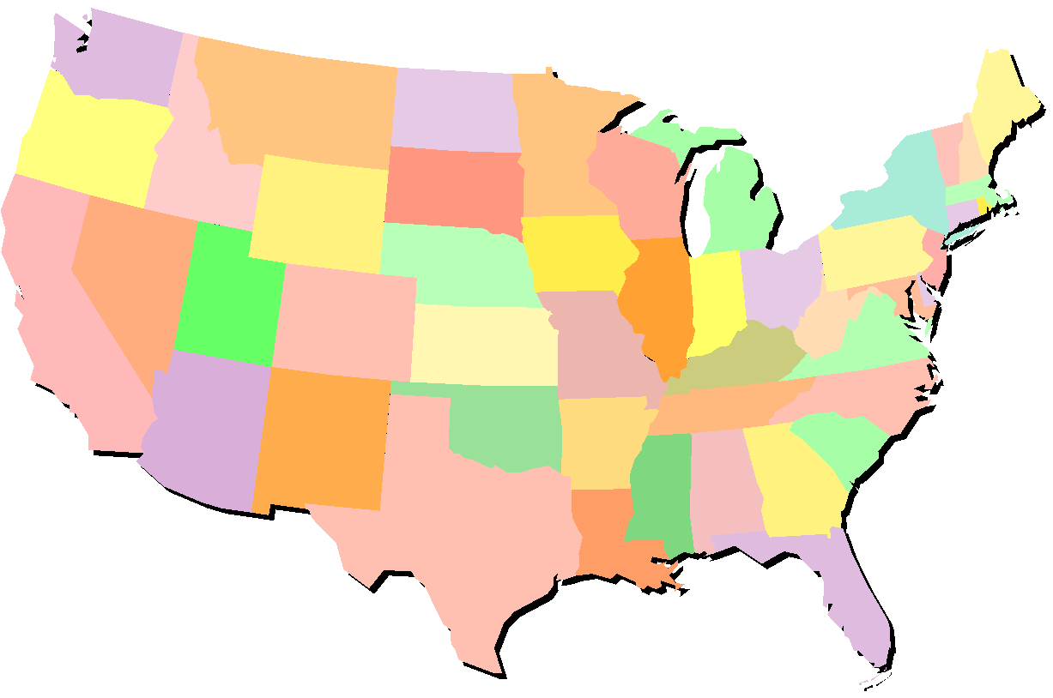
Study Locations
Mercy Recovery
Westbrook, ME
Brandywine Counseling
Newark, DE
Ayudante
Española, NM
Mountain Manor Treatment Ctr Baltimore, MD
Duke Addictions Program
Durham, NC
UNM Addiction and Substance
Abuse Programs, Albuquerque, NM
Notes:
56

Slide 57
Inclusion Criteria
Age 14-21
DSM-IV criteria for Opioid Dependence
Provided Informed consent
Assent + Parental consent if under 18
Exclusion Criteria
Medical/ psychiatric making participation unsafe
Receiving psych meds (except SSRI)
Abuse of alcohol/sedatives
Sedative OD in past 6 months
Using benzodiazepines more than 15 of the previous 28 days
Unable to give UA negative for benzo/methadone
Being incarcerated or likely to leave area
Pregnant or breastfeeding
Unable/unwilling to use birth control
Successfully complete study quiz
Study Participants
Notes:
57

Slide 58
Counseling
1 individual and 1 group session per week minimum
More frequent sessions provided, as needed
Counseling methods drawn from NIDA manuals:
CBT interventions,
Referral to treatment
Referral to age-appropriate self-help groups
58
58
http://www.flickr.com/photos/kjarrett/2336010260/
Notes:
58

Slide 59
Study Design
Screening (N=236)
Randomization (N=154)
Detox (n=80)
12-Week (n=74)
Withdrew (n=62)
Withdrew (n=22)
Completed Tx (n=16)
Completed Tx (n=52)
Included in Primary
Analysis (n=78)*
Included in Primary Analysis (n=74)
* 2 excluded never entered tx
32 Nonadherent to dosing schedule 16
23 Enrolled in other treatment 4
2 Voluntarily withdrew 1
5 Incarcerated 0
0 Died (early dropout/methadone OD) 1
Notes:
59

Slide 60
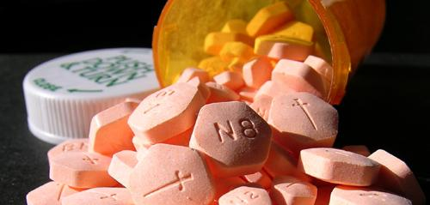
Medication Dosages
Medication administered on site 5-7 days per week
On-site doses were directly observed by study personnel
Take home doses given when clinic was closed
Notes:
60

Slide 61
Medication Dosages
Day 1:
2 mg administered and observed for 1.5 – 2 hours
A second dose of 2-6 mg administered as appropriate
Day 2:
Received dose from day 1 unless adjustment needed and observed for 1.5 – 2 hours
Additional 2-6 mg could be administered as needed
Day 3:
Received dose from day 2 unless adjustment needed and observed for 1.5 – 2 hours
Additional 2-6 mg could be administered as needed
Notes:
61

Slide 62
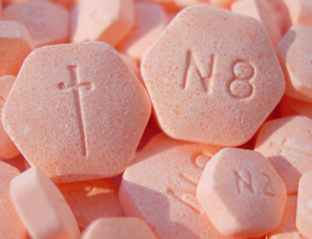
Medication Dosages
Detoxification Group
Maximum dose = 14 mg
Taper began immediately and ended by Day 14
12-week Group
Maximum dose = 24 mg
Taper began at Week 9 and ended by Week 12
Notes:
62

Slide 63
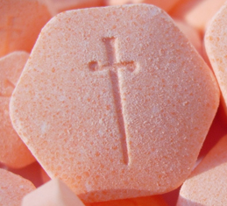
Medication Dosages
Medication was stopped if three (3) consecutive missed doses
For detoxification group, not restarted
For 12-week group, restarted if returned within 7
days
When restarted, administered half of last dose
Observed for 1.5 – 2 hours
If well tolerated, received remaining portion of medication dose
Patients encouraged to continue counseling if medication stopped
Notes:
63

Slide 64
Study Design
Screening (N=236)
Randomization (N=154)
Detox (n=80)
12-Week (n=74)
Withdrew (n=62)
Withdrew (n=22)
Completed Tx (n=16)
Completed Tx (n=52)
Included in Primary
Analysis (n=78)*
Included in Primary Analysis (n=74)
*2 excluded (never entered tx)
Notes:
64

Slide 65
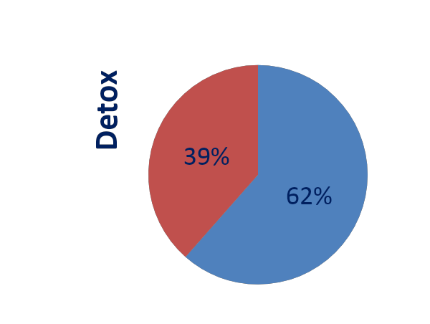
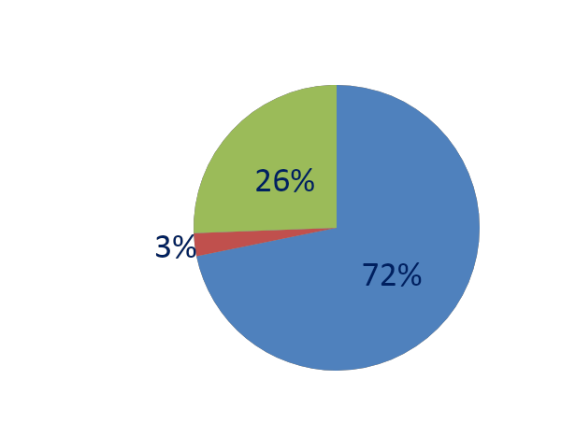
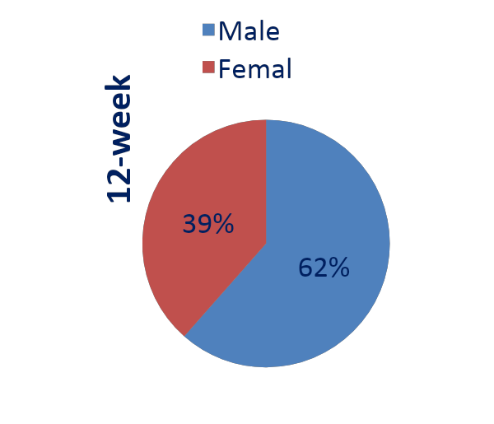
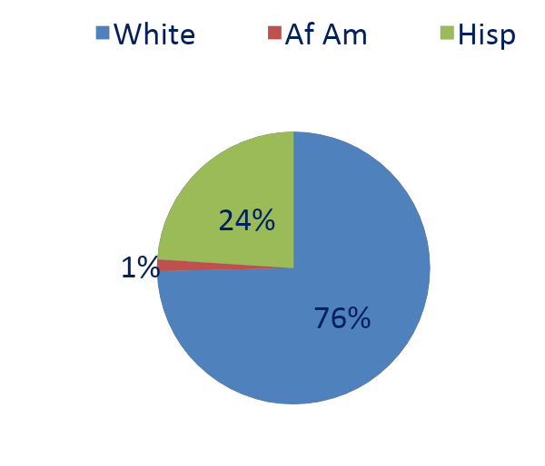
Participant Demographics
18%
<18 years old
16%
Notes:
65
65

Slide 66
The Results Opioid Positive Urine Tests
Notes:
66

Slide 67
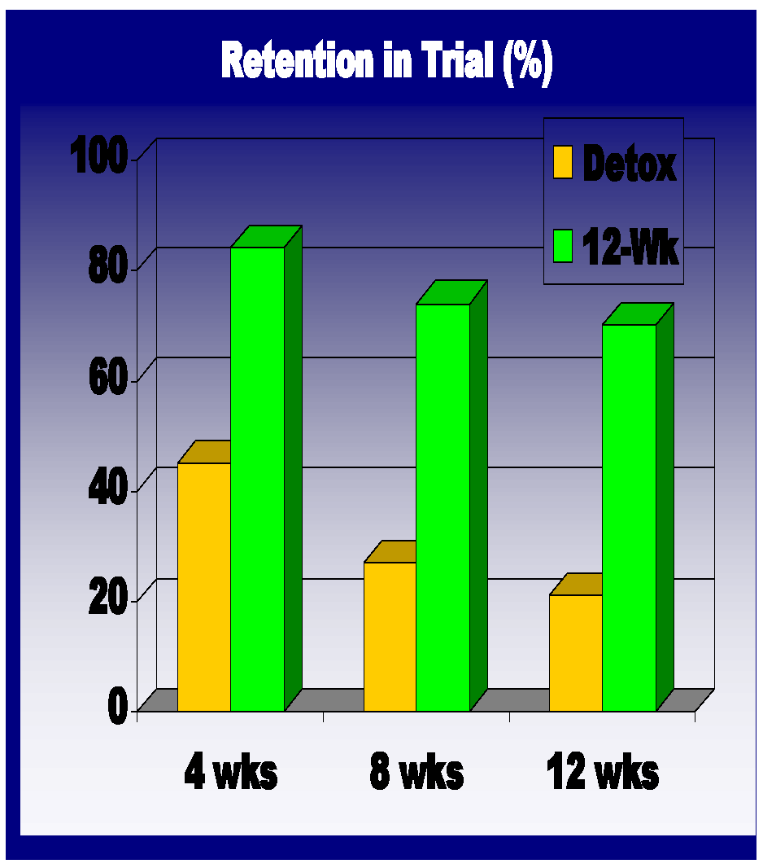
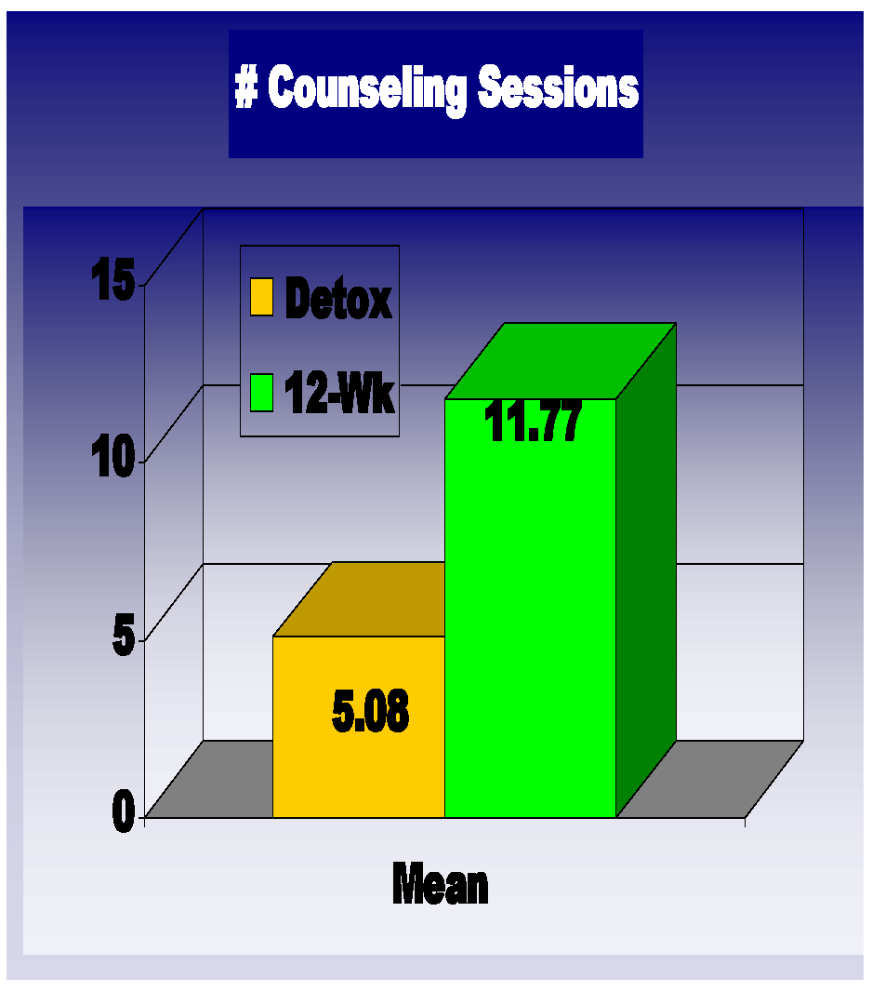
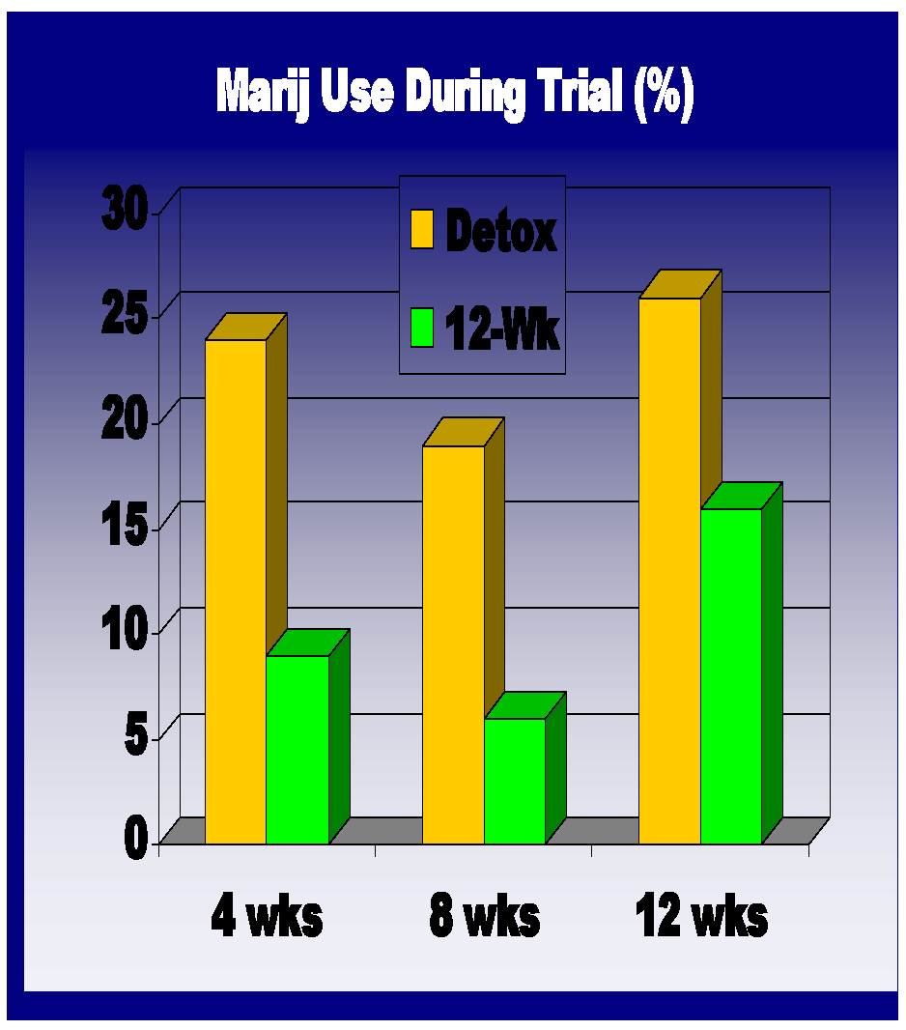
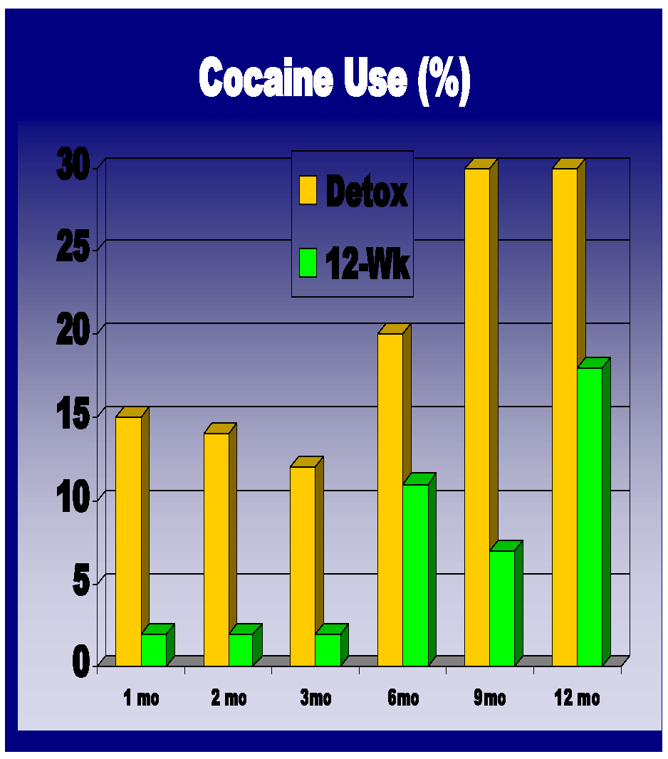
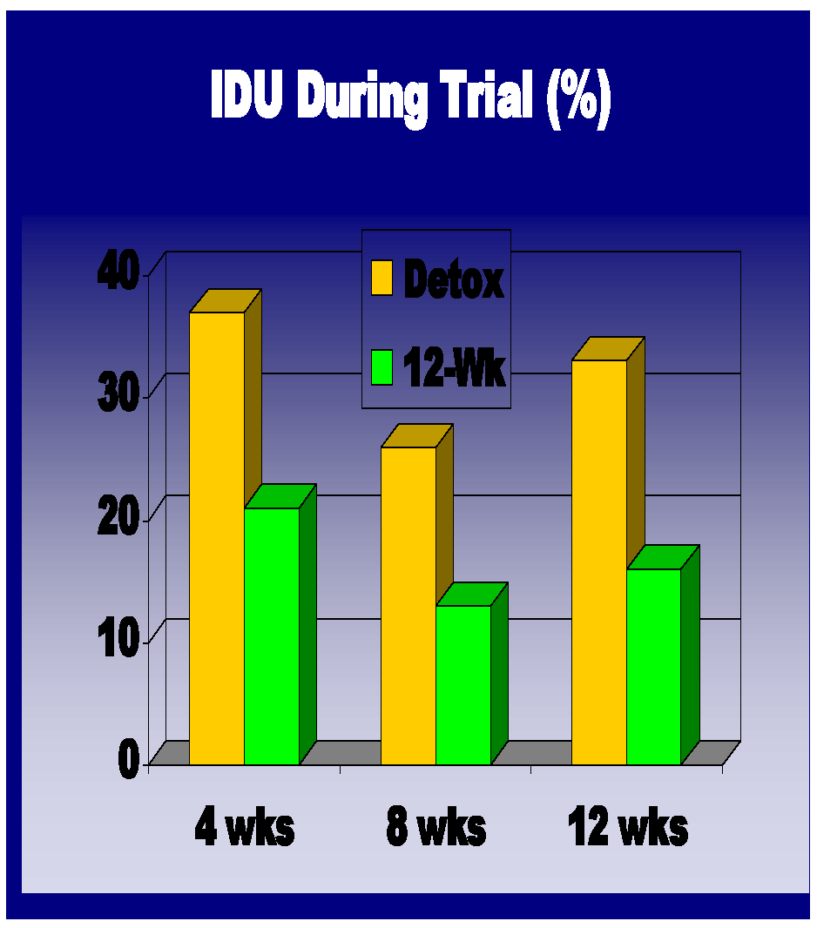
What About Other Indicators?
 | Detox | 12-Wk
Retention in Trial* |  | +
# Counseling Sessions Attended (Mean)** |  | +
Additional Addiction Tx (after Trial)
Alcohol Use During Trial
Alcohol Use After Trial
Marijuana Use During Trial* | +
Marijuana Use After Trial
Cocaine Use During Trial* | +
Cocaine Use After Trial* | +
IDU During Trial* | +
IDU After Trial
* p<.01, **p=.10 (trend)
Notes:
67

Slide 68
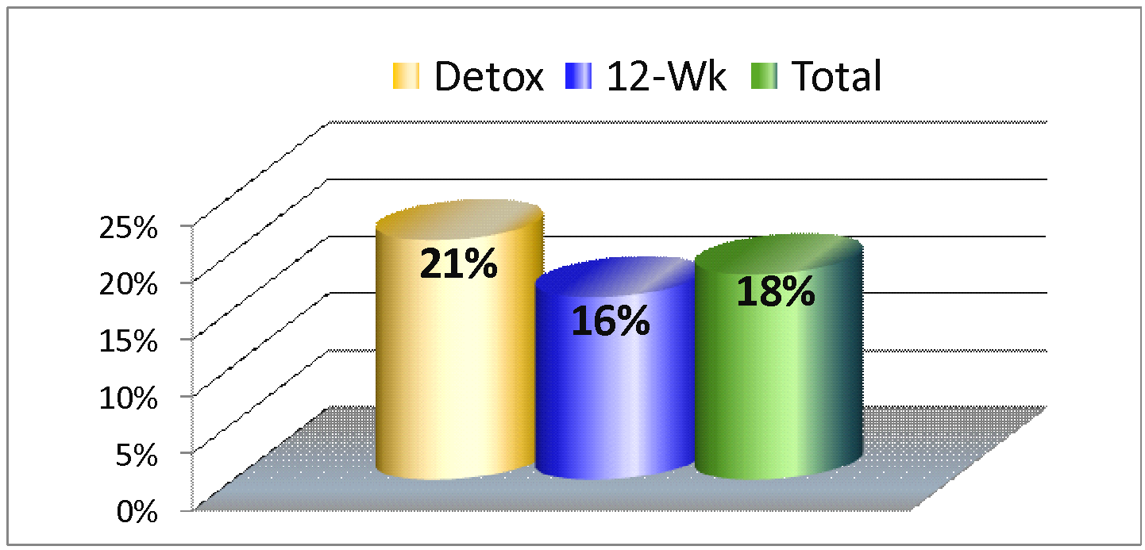
Baseline Hepatitis C Rates
Additionally, 4 of 83 patients (5%) converted from negative to positive during the trial.
Indicates benefits of medication use over extended periods as part of standard treatment
Notes:
68

Slide 69
Implications of the Study

Slide 70
High Prevalence among Young Adults
Heroin use stable
Non-medical use of prescription opioids increasing
Willingness for experimentation among young adults
Long-term prognosis among addicted young adults is unknown. Outcomes with addicted adults are poor
High rates school drop out, legal problems, psychiatric problems, HIV-risk behaviors
Notes:
70

Slide 71
High Prevalence among Young Adults
Low rates of admission for young adults to treatment programs for primary opioid addiction
Methadone is not available in all areas
limited number of programs
not an option if under 16
for those between 16 and 18 years, standard care requires 2 failed behavioral treatments and legal guardian consent
Notes:
71

Slide 72
One Provider’s Perspective on How to Make Buprenorphine Effective as Possible
Shannon Garrett
Program Director of Adolescent Services
Mountain Manor Treatment Center
Baltimore, MD
Notes:
72

Slide 73
So What Did We Learn?

Slide 74
Lessons Learned
Longer treatment seems to be better than a quick detoxification for these opioid addicted young adults
When compared to those in the detoxification group, patients in 12-week condition showed:
Fewer opioid positive urines
Greater retention in active treatment phase
Lowered use of marijuana and cocaine use and injection drug use
Effect only during active treatment with buprenorphine
Notes:
74

Slide 75
Lessons Learned
Return to opioid use in both groups after this fairly brief medical treatment is concerning given
Young age
Short duration of opioid use
Adult trials have consistently shown better outcomes with longer treatment
Young adults will likely need long-term opioid agonist treatment
Hepatitis C rates and conversion of 4 participants make need for treatment even more urgent
(Fiellin, 2008; Woody, et al., 2008)
Notes:
75

Slide 76
Lessons Learned
Once DSM-IV Criteria met for opioid dependence are met, course of addiction similar to adults
Frequent relapse after withdrawal in this sample could encourage caution when tapering young adult patients.
While tapering, these patients need:
Drug abuse counseling
Close monitoring for relapse
When tapering is clinically indicated, consider using Naltrexone following withdrawal.
(Fiellin, 2008; Woody, et al., 2008)
Notes:
76

Slide 77
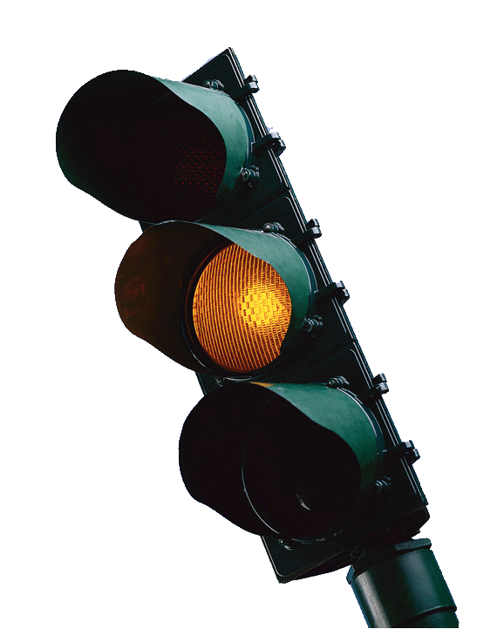
Limitations of the Study
The sample for this study was small (N=152). However, it is important to note that this is the largest study to date with this population.
Low number of participants under 18
Very few African American participants. While similar to demographics of opioid users (primarily White) difficult to know how results apply to this population
Notes:
77

Slide 78
Additional Limitations of the Study
Medication was dispensed and directly observed rather than providing by prescription as in routine clinical care
No medication offered after buprenorphine taper
(Fiellin, 2008)
Notes:
78

Slide 79
Further Research Needed
Explore opioid initiation among young adults and use the information to develop prevention strategies
Studies comparing buprenorphine and/or methadone with:
antagonist medications (naltrexone)
non-medication approaches (e.g., partial hospitalization)
Notes:
79

Slide 80
Further Research Needed
Safety and efficacy of longer-term medication treatment for young adults
Optimal length of treatment with buprenorphine and/or other medications
Impact of ongoing medication treatment on high risk behaviors for HIV, HCV, overdose, etc.
Efficacy of long-term medication assisted treatment integrated with other forms of psychosocial treatments - CBT, motivational incentives, etc.
Notes:
80

Slide 81
Closing Exercise: “Gallery Walk”
Instructions:
Form five groups. Each group will go to an easel pad
Respond to question posed on the pad
Rotate every five minutes until groups go to all stations
Process as a large group
Notes:
81

Slide 82
Closing Exercise: “Gallery Walk”
Questions for easel pad:
Before today, what were your thoughts about medication- assisted treatment for young adults?
What challenges do you see regarding the provision of extended care medication-assisted treatment for this age group?
What are the advantages of medication-assisted treatment for young adults?
http://www.flickr.com/photos/p_d_gibson/493026122/in/set-72057594075234044/
Notes:
82

Slide 83
Closing Exercise: “Gallery Walk”
What further research do you think is needed regarding medication- assisted treatment for this age group?
As a result of this workshop how have your opinions changed regarding extended term medication-assisted treatment for this age group?
http://www.flickr.com/photos/p_d_gibson/493383064/sizes/l/in/set-72057594075234044/
Notes:
83

Slide 84
A Challenge to Providers from Shannon Garrett
Shannon Garrett
Program Director of Adolescent Services
Mountain Manor Treatment Center
Baltimore, MDs
Notes:
84

Slide 85
Buprenorphine Treatment for Young Adults
Findings and strategies from a NIDA Clinical Trials Network Study

