Slide 1



SAMHSA’s Revised Treatment Locator
Notes:
This slide deck is part of the Slidedecks4U products created by the Mountain Plains Addiction Technology Transfer Center (MPATTC) that serves Region 8 (Colorado, Montana, North Dakota, South Dakota, Utah, and Wyoming). Disseminating information about SAMHSA’s new treatment locator site is important as according to the National Health and Drug Use Survey, 20.3 million people aged 12 or older had a substance use disorder in 2018 making access to information about how to seek treatment essential. Each slide has notes for the presenter to provide guidance if necessary. If you require further information on this topic, please do not hesitate to contact the MPATTC. You are free to use these slides and pictures but please give credit to the MPATTC by keeping the logo on each slide and referencing the ATTC at the beginning of your presentation.
MPATTC is part of the SAMHSA-funded ATTC network that offers training/technical assistance (TA) services through a partnership between the University of North Dakota and University of Nevada Reno. The goal of the MPATTC is to improve the capacity of Region 8’s SUD treatment/recovery services workforce by using state-of-the-art training/TA, innovative web-based tools, and proven workforce development activities to expand access to learning, change clinician practice, and advance provider efficiencies, resulting in improved client outcomes. MPATTC training/TA recipients include behavioral health/SUD treatment and recovery administrators, managers, counselors, clinical supervisors, and recovery specialists; health professions academic educators; tribal health professionals; and key stakeholders from related systems of care (e.g., opioid treatment providers); state and local governments; provider associations; and specialized behavioral/primary healthcare providers. You can access additional information at www.mpattc.org.
On October 30, 2019 SAMHSA launched Findtreatment.gov, a new and improved, modern, easily accessible means of finding treatment for millions of Americans struggling with a SUD. The intent of this slide deck is to promote the new treatment locator. Four of the slides highlight the look and feel of the website and the sections of the locator.
Please take some time to visit this site and spread the word: https://www.findtreatment.gov/ . If you have access to the web you can walk students, training participants, and/or colleagues through the site and show how it works. If you have feedback for SAMHSA after using the site, a link exists on the site to provide feedback as this is a new design they are testing.
Reference. Substance Abuse and Mental Health Services Administration. (2019). Key substance use and mental health indicators in the United States: Results from the 2018 National Survey on Drug Use and Health (HHS Publication No. PEP19‑5068, NSDUH Series H‑54). Rockville, MD: Center for Behavioral Health Statistics and Quality, Substance Abuse and Mental Health Services Administration. Retrieved from https://www.samhsa.gov/data/

Slide 2
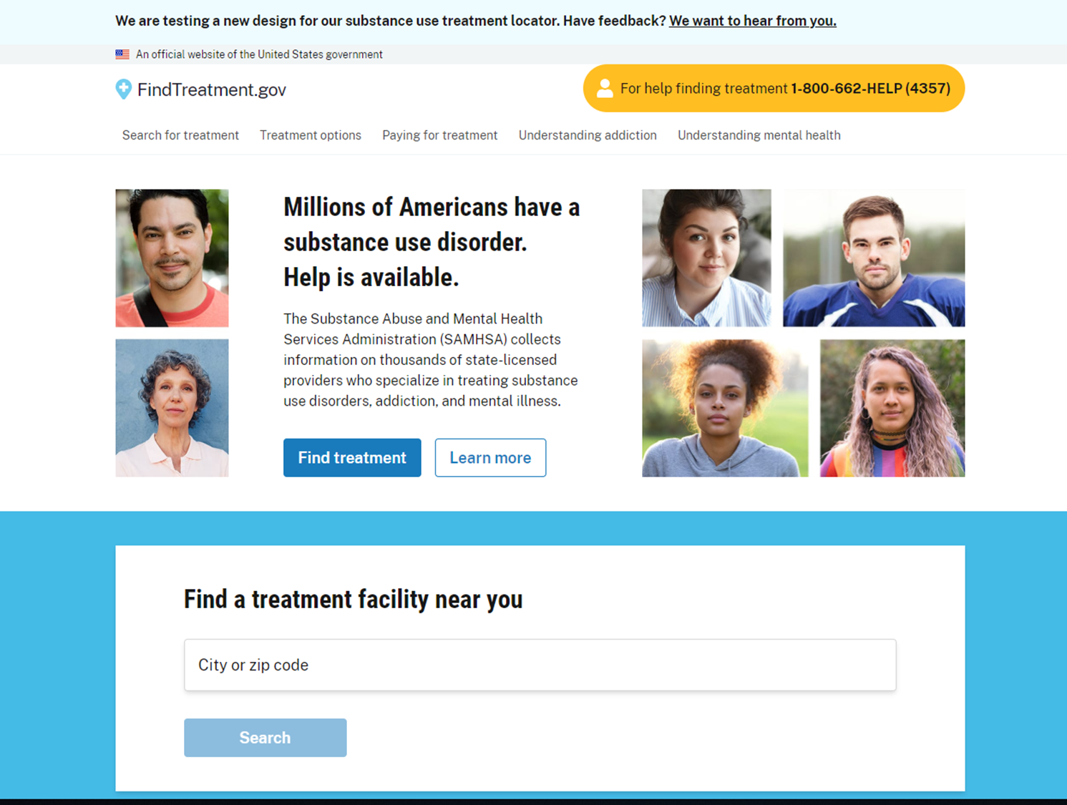

This is how the new site looks …
Visit the Treatment Locator
Notes:
This slide is a screen shot of the website. It is recommended that you highlight the url address in your presentation and how to start the search process.

Slide 3
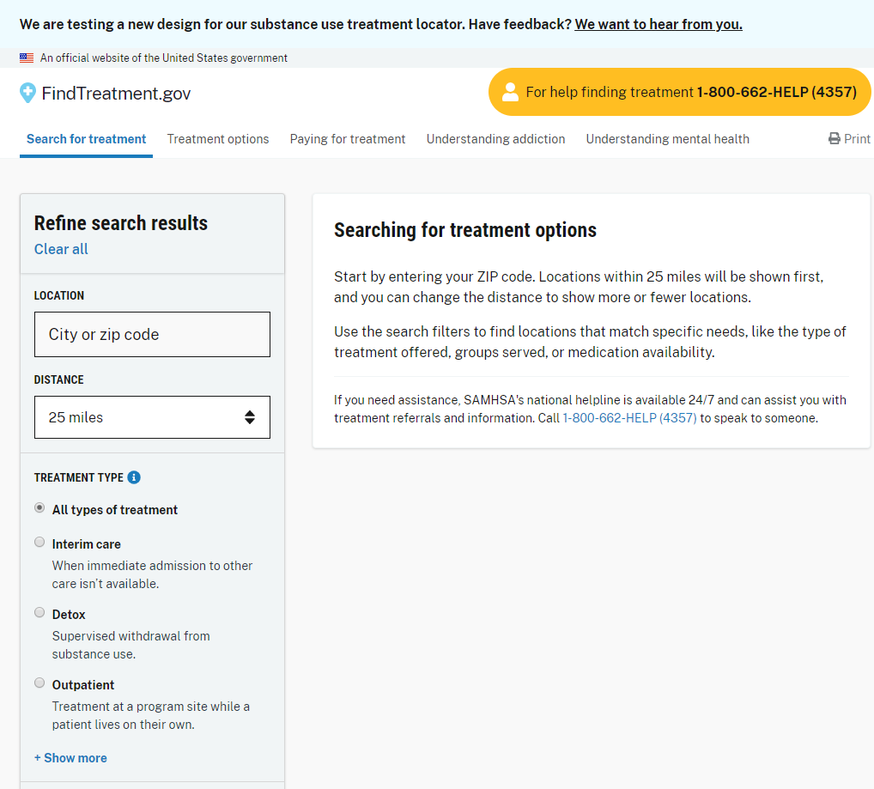

This is what the new site looks like …
Notes:
This slide shows the beginnings of the treatment providers search process. Review the directions for the search.

Slide 4
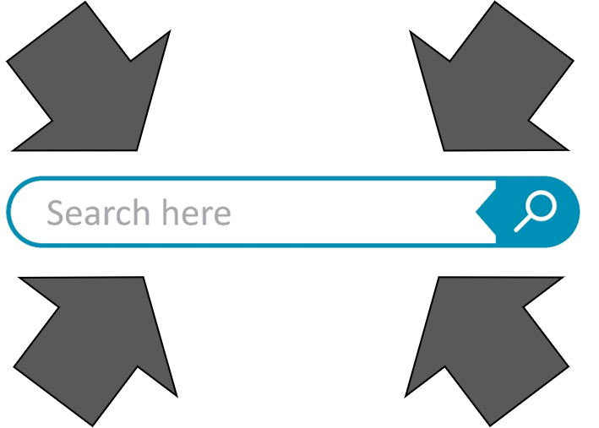
Treatment Locator - Search Features
Treatment Types
Payment Options
Ages
Special Programs
Medication Assisted Care
Notes:
The Treatment Locator now allows individuals to search these categories. The following provides more details on the search features under each category.
Treatment Types: Interim care, Detox, Outpatient, Hospital Inpatient, Residential, Transitional Housing, Co-Occurring Mental Health and Substance Use Treatment, and Telemedicine.
Payment Options: Private Health Insurance, Medicaid, Free or No Cost Care, Medicare, Payment Assistance Available, Sliding Fee Scale, Cash or Self-Payment, Military Insurance (TRICARE), and HIS/Tribal/Urban (ITU) funds
Ages: Adults- (18 and older) and Youth (under 18)
Special Programs: Veterans, LGBT, and Services for the Deaf and Hard of Hearing
Medication Assisted Treatment: Methadone, Buprenorphone, and Naltrexone
The search options are comprehensive and now include medication-assisted care.

Slide 5
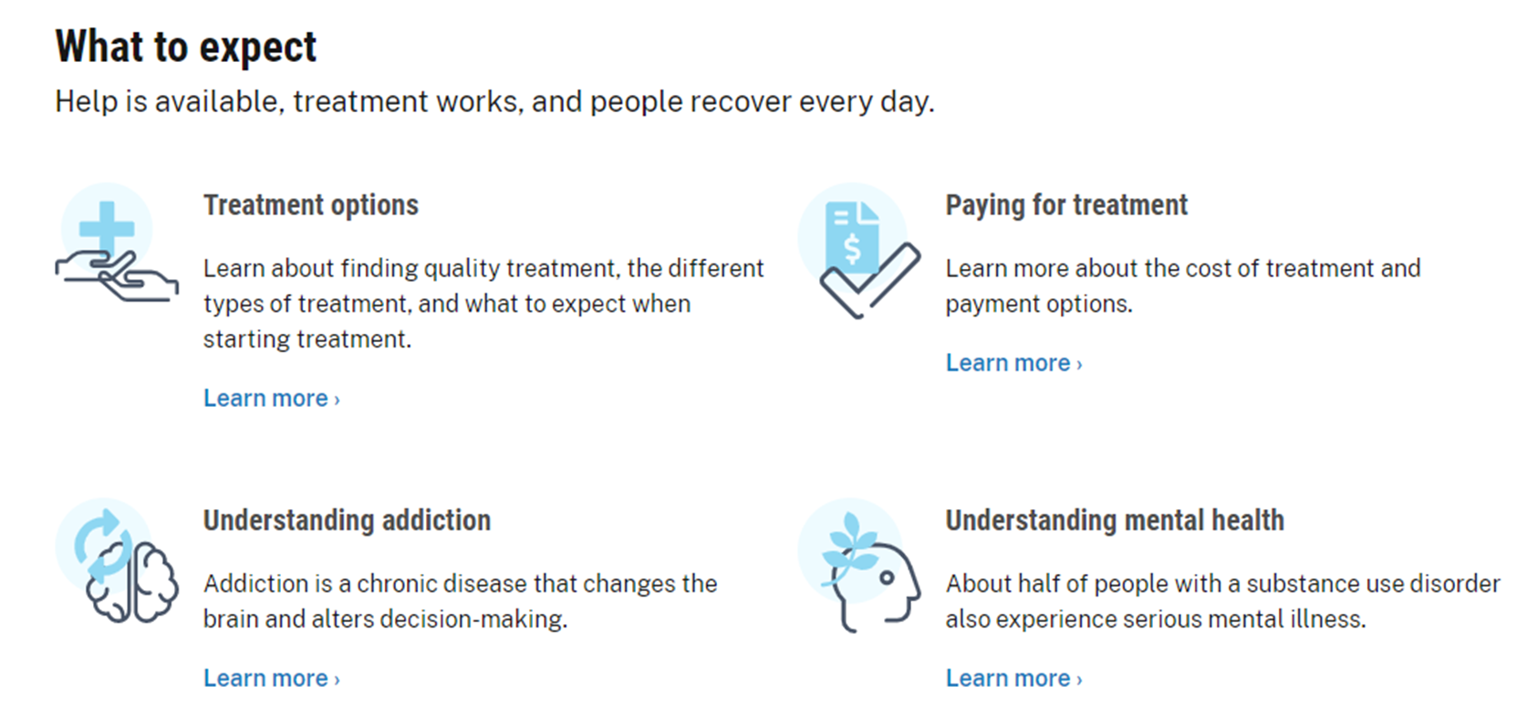
Also Included on the Site are Links to:
Notes:
At the bottom of the site are links that provide more information on treatment options, paying for treatment, understanding addiction, and understanding mental health. These links offer important additional information for individuals or family members seeking help. Once again, if you have access to the web you can show students, participants, and/or colleagues these sites.

Slide 6
For more information, contact
Thomasine Heitkamp, PI/Co-Director
University of North Dakota
thomasine.heitkamp@und.edu
Nancy Roget, Co-Director
University of Nevada, Reno
nroget@casat.org
www.mpattc.org
Notes:
If you as the presenter, have additional questions about how to use this slide deck please do not hesitate to contact the Mountain Plains ATTC. You can contact Nancy Roget, Co-Director, or Thomasine Heitkamp, PI/Co-Director. The contact information on the slide can be used for both students, participants, and/or colleagues. In addition, if you are interested in attending additional trainings/workshops or have questions please do not hesitate to contact us. The website for the Mountain Plains is www.mpattc.org .

