Slide 1
Spirituality, Substance Use and Recovery Presenter Dr. Tracy Nichols

Slide 2
The ATTC Network is comprised of:
1 Network Coordinating Office
10 Domestic Regional Centers
6 International HIV Centers (PEPFAR funded)
1 National American Indian and Alaska Native ATTC
1 National Hispanic and Latino ATTC
About SATTC –

Slide 3
Domestic ATTCs’ Mission
Established in 1993 by SAMHSA, the domestic ATTCs:
Accelerate the adoption and implementation of evidence‐based and promising addiction treatment and recovery-oriented practices and services;
Heighten the awareness, knowledge, and skills of the workforce that addresses the needs of people with substance use and/or other behavioral health disorders; and
Foster regional and national alliances among culturally diverse practitioners, researchers, policy makers, funders, and the recovery community.

Slide 4
OBJECTIVES
Learn the benefits of Spirituality in recovery.
Learn how to implement Spirituality through recovery.
Learn different ways of embracing Spirituality.
Learn how to connect to your higher power within you.

Slide 5
"The greatest revolution of our
generation is the discovery
that human beings,
by changing the
INNER ATTITUDES OF THEIR MINDS, can change the
OUTER ASPECTS OF THEIR LIVES."
- William James

Slide 6
What is Spirituality?
What is Substance Use?
Spirituality is the experience and integration of meaning and purpose in life through connectedness with self, others, art, music, literature, nature or a power greater than oneself
(Burkhart and Solari-Twadell).
Addiction is characterized by inability to consistently abstain, impairment in behavioral control, craving, diminished recognition of significant problems with one’s behaviors and interpersonal relationships, and a dysfunctional emotional response.
Three dimensional cognitive–behavioral process-relationship with self, others, and a higher power (Brown, Peterson, & Cunningham,1988).
What is Recovery?
Recovery is a process of change through which individuals improve their health and wellness, live a self-directed life, and strive to reach their full potential.

Slide 7
FEATURES OF SPIRITUALITY
Hope
Meaningful connection
Meaning and purpose
Forgiveness/Acceptance
Sense of belonging
Relationships/Community
FEATURES OF SUBSTANCE USE
Fear
Secrets and Hiding
Self-ridicule
Shame (action against morals)
Barriers to intimacy (self, others and Spirit)
Disconnection/Isolation
WHY SPIRITUALITY IS IMPORTANT IN DRUG SUBSTANCE RECOVERY?
Addiction takes away our ability to be spiritual.
It disconnects us from our spirituality
It does not let people connect with powers, people, and things outside of ourselves.
To fully recover from our addiction we must reconnect to our spirituality,
our search for purpose in our life, and connections beyond ourselves.

Slide 8
FACTS ABOUT SUBSTANCE USE
20 Million
Americans over the age of 12 have an addiction.
2.6 Million
People with addictions have a dependence on both alcohol and illicit drugs.
6.8 Million
People with an addiction have a mental illness.
Over 90%
Of those with an addiction began drinking, smoking or using illicit drugs before the age of 18.

Slide 9
BENEFITS OF SPIRITUALITY IN RECOVERY
Researchers have well established that spirituality and religious involvement play a role in reducing substance abuse. It can give:
A more optimistic, hopeful outlook on life
An increased sense of social support
Less anxiety
Greater resilience to stress
Helps the participants gain better coping skills, which in turn helps them to remain sober
Provides them with strength to remain abstinent.
Helps protect program participants from feelings of panic that may accompany sobriety

Slide 10
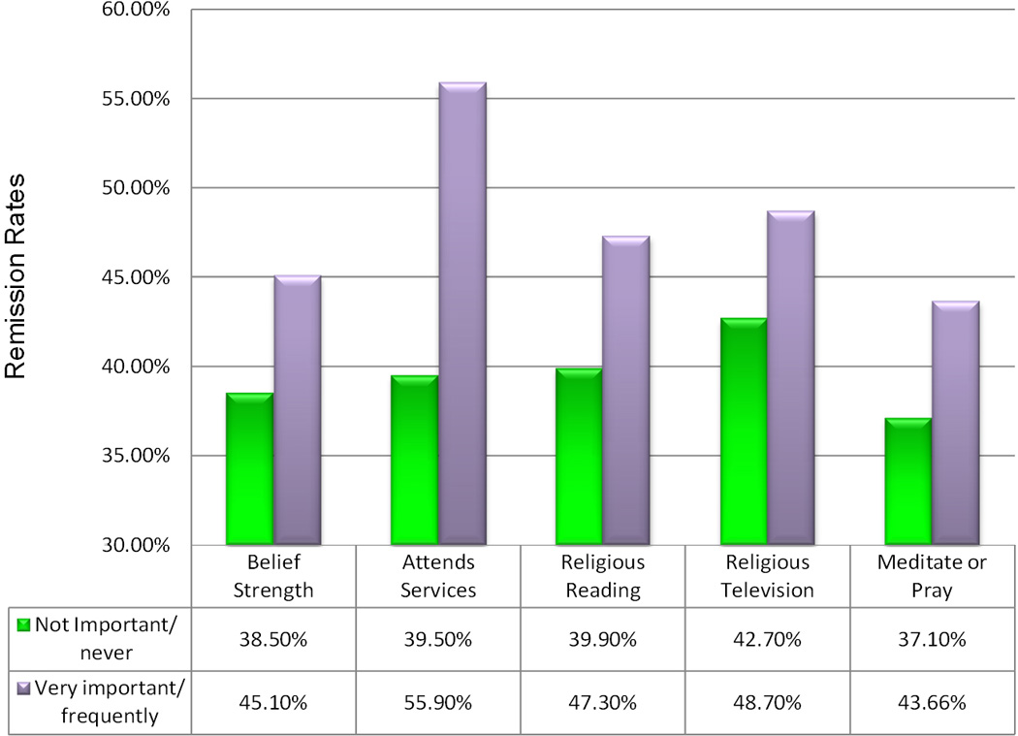
BENEFITS OF SPIRITUALITY IN RECOVERY
While early stages of SUBSTANCE USE treatment consist of abstaining from substances and fixing the damage caused by substance abuse, once a participant is sober, they may experience anxiety and wonder what to do next, now that they’ve reached their initial recovery goals. Spirituality can help individuals navigate their new lives, creating a framework to guide them down the path of recovery.
Remission rates associated with five different measures of spirituality

Slide 11
IMPLEMENTING SPIRITUALITY THROUGH RECOVERY
Support and Community
Go outside as much as possible
Peers can help strengthen resolve and reinforce belief systems
Spend more time with loving and encouraging family and friends
Observe your thoughts about the people around you
Peers can act as a protective buffer against the urge to abuse substances.
Reduce distractions (Phone, TV, Internet, News)
Look at art, listen to music, sing and dance
Drug addiction education and counseling
Participate in recovery community Play
Be intentional about prayer and meditation
Find ways to “be” without having to “do” something

Slide 12
IMPLEMENT SPIRITUALITY THROUGH RECOVERY
Helping others overcome addiction
Helping others overcome addiction
Relapse prevention training and techniques
Relapse prevention training and techniques
Detox and guided withdrawal process
Right Livelihood
12 Step Approach
Carrying the message to others suffering from addiction
Selfless Service
Develop Compassion

Slide 13
THE 12 STEP APPROACH TO SUBSTANCE USE RECOVERY
“We admitted we were powerless over alcohol—
that our lives had become unmanageable.”
Admission of powerlessness is the first step in liberation.
1
2
What can we believe in?
Importance of an open mind.
Turning our will over to a Higher Power.
“Come to believe that a Power greater than ourselves could restore us to sanity.”
3
“Made a decision to turn our will and our lives over to the care of God, as we understand Him.”
How shall we let God into our lives?
Willingness is the key.
Sustained and personal exertion necessary to conform to God's will
4
How instincts can exceed their proper function?
Step four is an effort to discover our liabilities.
“Made a searching and fearless moral inventory of ourselves.”

Slide 14
5
“Admitted to God, to ourselves, and to another human being the exact nature of our wrongs.”
Confession is an ancient discipline. Without fearless admission of defects, few could stay sober.
6
Step Six necessary to spiritual growth.
Recognition of difference between striving for objective—and perfection.
We’re entirely ready to have God remove all these defects of character.”
Humbly asked Him to remove our shortcomings.
Step Seven is change in attitude which permits us to move out of ourselves toward God.
7
Step Eight is the beginning of the end of isolation.
“Made a list of all persons we had harmed, and became willing to make amends to them all.
8
“Made direct amends to such people wherever possible, except when to do so would injure them or others.”
Readiness to take consequences of our past and to take responsibility for well-being of others is the spirit of Step Nine.
9

Slide 15
“Continued to take personal inventory and when we were wrong promptly admitted it.”
10
Self-searching becomes a regular habit.
Self restraint first objective.
“Sought through prayer and meditation to improve our conscious contact with God as we understood Him, praying only for knowledge of His will for us and the power to carry that out.”
11
Meditation has no boundaries.
Meditation and prayer to the main channels
to Higher Power.
“Having had a spiritual awakening as the result of these steps, we try to carry this message to alcoholics, and to practice these principles in all our affairs.”
12
What is spiritual awakening? A new state of consciousness and being is received as a free gift.

Slide 16
DIFFERENT WAYS OF EMBRACING SPIRITUALITY
.
This Step
Makes You
1. RECOGNIZE YOUR CREATOR.
Humble.
2.SEEK OPPORTUNITIES TO PUT MORE LOVE INTO THE WORLD.
Loving And Lovable
4. SET ASIDE TIME EACH DAY TO SPEND IN SPIRITUAL REFLECTION AND CONTEMPLATION.
3.RECOGNIZE YOUR MISTAKES.
Responsible
Strong
5. FORGIVE ANYONE YOU HAVE NOT FORGIVEN.
Kind
6. BECOME MORE ACCEPTING.
Gracious.
7. TRY TO SEE THE GOOD IN OTHERS
Positive.
.
8. TAKE STOCK OF YOUR THOUGHTS AND BEHAVIOR
Grow.
9.USE EACH INTERACTION TO BE THE BEST, MOST POWERFUL VERSION OF YOURSELF
A Conduit Of God's Love
.
.

Slide 17
DIFFERENT WAYS OF EMBRACING SPIRITUALITY
Humility is recognition to see our self, as we are, visitors in this life, and, as guests, to recognize the opportunity and gifts the surround us—simply to be thankful for everything and everyone. By feeling thankful for the gift of life and the opportunities it brings, we show that we know life is not only about us. We are not weak or passive but aware, appreciative, and sensitive to all that surrounds us.
PROPHETIC COURAGE
HOLINESS
HUMILITY
Prophetic courage
is our affirmation to declare what’s right.
It is the strength, the confidence to persevere granted to us by our beliefs.
It draws out clarity about the things that we believe. It permits us to define ourselves in the face of opposition, not to be subdued by forces that might lead us to compromise our Truth. Courage points us to our goal and to the revolutionary, transformative challenges of our beliefs.
Spirituality transforms us by allowing us to participate in that which is holy. . When we connect to God, the growth of our True Self leads us to fulfillment through awareness and conviction. In holiness we participate in the Good, the Truth, the Absolute; we take part in the awesome mystery of life’s Force. Holiness is distinct from simple good feelings and virtues; in holiness, as a contract with God, we are transformed by participation in His Presence.
Spirituality is not “spiritualism,” a system of belief that diminishes the significance of our responsibility to make a difference; rather, it is behavior promoting to Power the Spirit. Faith and belief must be lived; otherwise it is poetry and philosophy. Spirituality devoid of action is like medicine in a bottle: to be of use, it must be embodied. Spirituality as action is a conviction that connects physical life to the light of God.
ACTION

Slide 18
HOW TO CONNECT TO YOUR HIGHER POWER WITHIN YOU
The following 3 concepts will help you get success in grasping the 12 step approach
ACCEPTANCE
Realizing that substance use is a chronic disease and that willpower alone will not be enough to overcome it. Abstinence from drugs and alcohol is the only way to be free of the disease.
SURRENDER
Giving up control to a higher power and accepting the support of other recovering addicts and group activities set forth by the 12-step support group.
ACTIVE INVOLVEMENT
Being fully engaged in each group meeting and any 12-step group activities.

Slide 19
RELIGION VS SPIRITUALITY
Religion
A set of beliefs, rituals and practices regarding belief in God or gods to be worshipped.
Spirituality
A personal search for meaning in life, for connection with all things and for the experience of a power beyond oneself
Spirituality does not mean to follow religion only but can also be experienced through other ways.
You have the ability to choose your own higher power.
No one else can do that for you and there are no limits or restrictions on what you choose to designate as your higher power.

Slide 20
If Struggling To Define Higher Power Through The 12 Step Approach, You Can Find Higher Power Within These Four Concepts.
Reality
You will lose your husband and children if you don’t commit to a life of recovery.
Choosing to believe in reality as a higher power may be the perfect choice for someone who does not believe in a God.
Believing in the idea that you physically cannot take a drink of alcohol without going overboard
–
MUSIC
Powerful force.
Calming/restful experience a guiding force easier to believe for those who take morning walk
Watching the sunrise
Soak up all the beauty of the animals and the plants
Powerful force
Brings people together
Fosters mutual respect Kindness, happiness
Treat others with more dignity and compassion
Love yourself
Listening/ creating music a spiritual experience
Relieve stress
Reduce anxiety
Help people express strong emotions that some people may attempt to cloak with drug and alcohol abuse.
LOVE
NATURE

Slide 21
References
Addiction. (n.d.). In American Society of Addiction Medicine online. Retrieved from https://www.asam.org/docs/default-source/public-policy-statements/1definition_of_addiction_long_4-11.pdf?sfvrsn=a8f64512_4
Anonymous, A. Twelve steps and twelve traditions. [PDF document]. Retrieved from http://www.portlandeyeopener.com/AA-12-Steps-12-Traditions.pdf
Chirban, J, (2013). Embracing genuine spirituality. Retrieved from https://www.psychologytoday.com/us/blog/alive-inside/201305/embracing-genuine-spirituality
How spirituality helps with addiction.[PowerPoint slides]. Retrieved from http://sharc.org.au/wp-content/uploads/2017/06/Spirituality-and-addiction-Alternatives-in-Treatment.pdf
Linda L. Smith. Spirituality and health/recovery. [PowerPoint slides]. Retrieved from http://www.alternativeprograms.org/resources/conf2016/material/lsmithpdf.pdf
McCormick, Donald, (1994). Spirituality and management. Journal of Managerial Psychology.
Nova Recovery Center, (2018). Define your “higher power” in drug and alcohol rehab. Retrieved from https://novarecoverycenter.com/treatment/define-higher-power/
Recovery Connection, (2012). A new definition of recovery from addiction. Retrieved from https://www.recoveryconnection.com/a-new-definition-of-recovery-from-addiction/
Schoenthaler, S. J., Blum, K., Braverman, E. R., Giordano, J., Thompson, B., Oscar-Berman, M., Badgaiyan, R. D., Madigan, M. A., Dushaj, K., Li, M., Demotrovics, Z., Waite, R. L., … Gold, M. S. (2015). NIDA-Drug Addiction Treatment Outcome Study (DATOS) Relapse as a Function of Spirituality/Religiosity. Journal of reward deficiency syndrome, 1(1), 36-45.
Williamson, M, (2010).10 Ways to Stay Spiritually Connected. Retrieved from http://www.oprah.com/spirit/spiritual-development-and-healing-practices-from-marianne-williamson

Slide 22
Dr. Tracy Nichols
5300 Brickleberry Way
Suite 206-F
Douglasville Ga 30134
678-886-0999
drtracynichols@aol.com

Slide 23
THANK YOU

Slide 24
Questions and Answers

