Slide 1
Women and Stimulant Use Recovery Supports: Expanding Recovery Capital
Guillerma Gonzales
Lead Recovery Coach

Slide 2
What is Recovery Support Services
SAMSHA established recovery support systems to promote partnering with people in recovery from mental and substance use disorders
There are four major dimensions that support recovery:
Health-make informed, healthy choices that support physical and emotional well-being
Home-Have a stable and safe place to live
Purpose-engage in meaningful daily activities such as job, school, volunteering
Community- build relationships and social networks that provide support

Slide 3
What is Recovery Capital
refers to the internal and external resources necessary for an individual to achieve and maintain recovery from substance use and misuse, as well as behavioral changes.
Social/family Networks- relationships, family, church, work friends, gym friends
Physical-having basic needs such as a safe place to live and enough to eat, adequate clothing and transportation/ physical health, insurance, money
Human-values, skills, knowledge, experience, education interpersonal confidence and sense of purpose

Slide 4
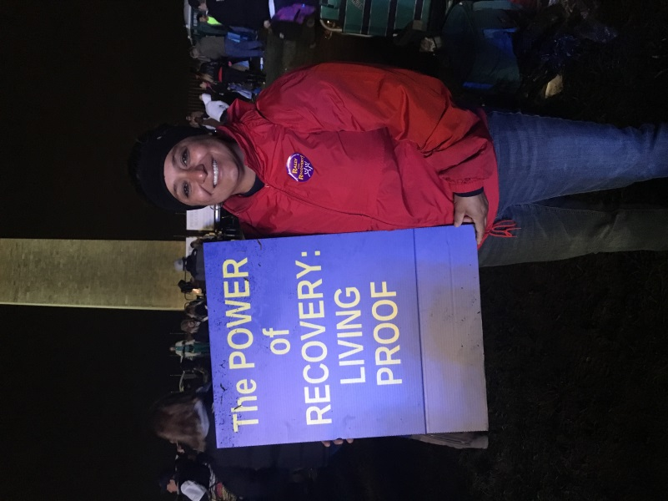
My Story

Slide 5
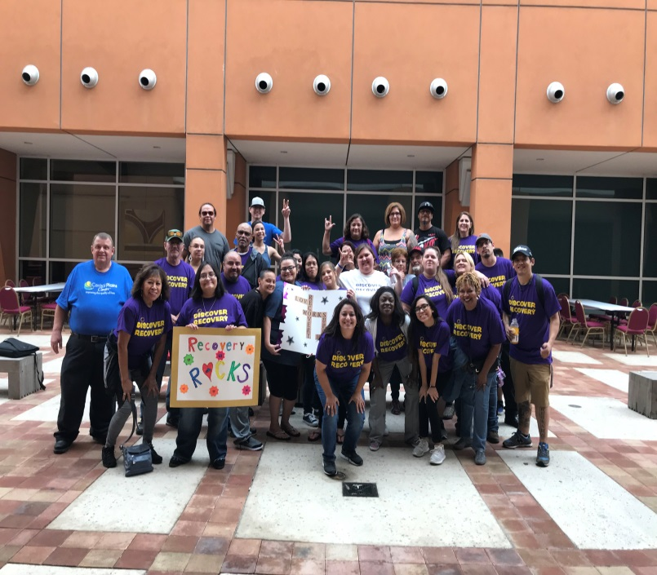
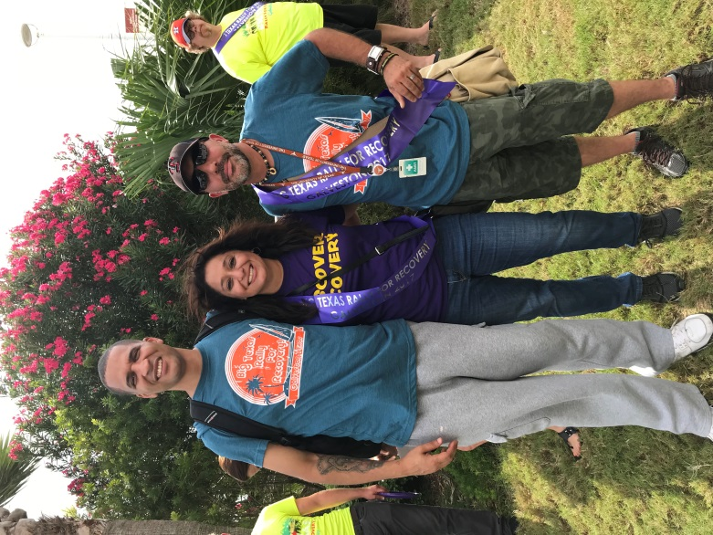
Rally for Recovery
“We must accept finite disappointment, but never lose infinite HOPE.”
- Martin Luther King Jr.

