Slide 1
HCV Current and
Curriculum Authors
HCV Current is a national initiative developed by the ATTC Regional Centers, funded by Substance Abuse and Mental Health Services Administration (SAMHSA) as a comprehensive response to the hepatitis C virus (HCV) epidemic in the United States.
HCV Current is designed to help increase HCV knowledge among medical and behavioral health professionals, especially staff at federally qualified health centers (FQHC) and Opioid Treatment Programs (OTP). The project offers an array of resources and downloadable tools for health professionals, including online and in-person curriculum and trainings throughout all regions in the United States.
Brian R. Edlin, MD, FACP, FIDSA
Senior Principal Investigator, NDRI
Institute for Infectious Disease Research
Diana Padilla
Program Manager, NDRI-USA
Hepatitis C Specialist,
Northeast & Caribbean ATTC
Beth A. Rutkowski, MPH
Associate Director of Training and Epidemiologist
Pacific Southwest ATTC
UCLA Integrated Substance Abuse Programs

Slide 2
Update 2019 Authors
This curriculum was updated in 2019 to include the correlation between the current high rates of injection opioid use and the increased rates of viral hepatitis infections.
    Lynn E. Taylor, MD, FACP, FAASLD
    Research Professor, University of Rhode Island
    Director of HIV and Viral Hepatitis Services, CODAC Behavioral Health Director,
    RI Defeats Hep C
    Diana Padilla
    Program Manager, NDRI-USA
    Hepatitis C Specialist
    Northeast & Caribbean Addiction Technology Transfer Center

Slide 3
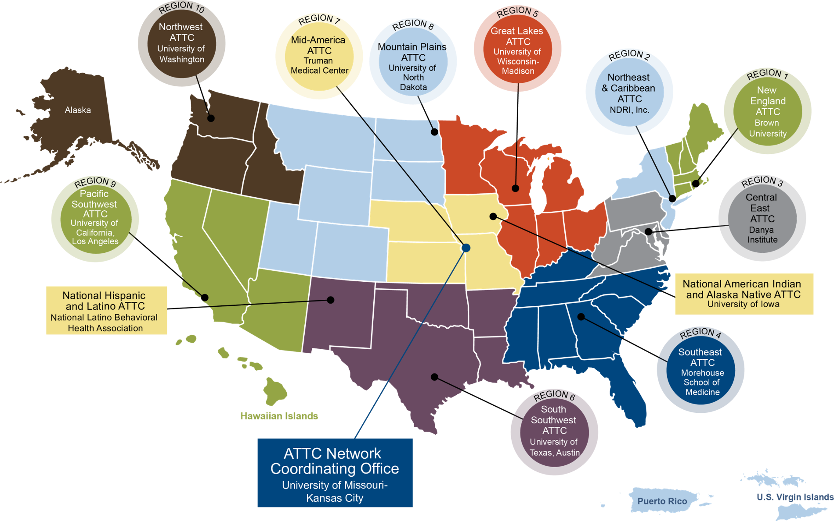

U.S. Based ATTC Network

Slide 4
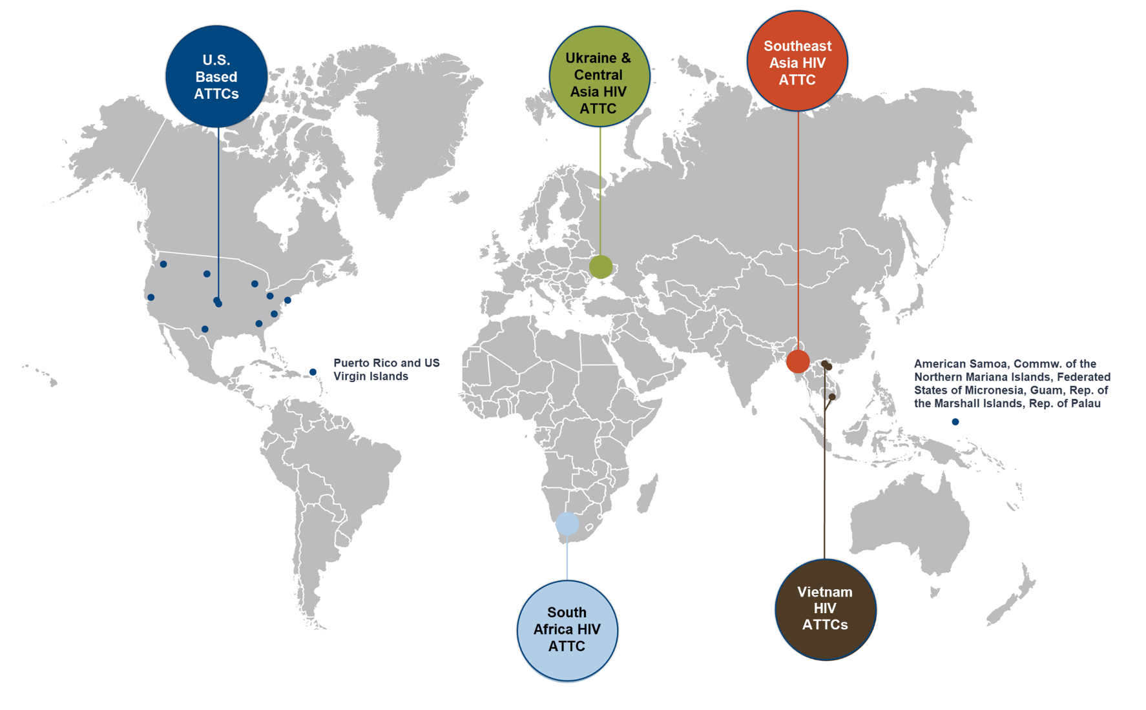
International ATTC Network
South African HIV ATTC
Brown University
University of Cape Town
Southeast Asia HIV ATTC
University of California Los Angeles
Chiang Mai University
Ukraine and Central Asia HIV ATTC
University of California San Diego
Ukranian Res. Inst.Social and Forensic Psychiatry and Drug Abuse
U.S. Based ATTCs
Vietnam HIV ATTCs
University California Los Angeles
Hanoi Medical University
Ho Chi Minh School of Medicine and Pharmacy
Vietnam University of Labor and Social Affairs

Slide 5
Logistics
Days 1 and 2: 9 a.m. – 4 p.m.
Day 3: 9 a.m. – 12 p.m.
Training module and tailoring options
Breaks and lunch
GPRAs
Accreditation

Slide 6
Training Goals
Instruct behavioral health and medical providers in FQHCs, OTPs, and other primary care and prevention settings on hepatitis C and its impact on communities served.
Help providers to identify tools and develop skills to integrate hepatitis C prevention, education, counseling, screening, diagnosis and evaluation, to treat on-site or link to care.

Slide 7
Learning Objectives
List at least three populations impacted by the opioid crisis, 2019.
List at least three infections that result from injection drug use.
Discuss at least two reasons why it is important to promote Hepatitis C screening and confirmatory diagnostic testing.
Describe at least three prevention messages that can be used to promote hepatitis C screening and testing.
List at least three treatment factors to consider and describe at least two new treatment options available for patients with HCV.
Provide examples of at least three strategies to link persons infected with HCV-focused health care.

Slide 8
Training Agenda
Module 1: Opioid Injection Drug Use and Incidence of Viral Infections
Module 2: Focus on Hepatitis C Virus and Populations at Risk
Module 3: Promoting Screening and Confirmatory Diagnostic Testing for Hepatitis C Infection
Module 4: Hepatitis C Evaluation, Treatment and post-Treatment Monitoring, and Therapies
Module 5: Linking Patients Infected with Hepatitis C to Healthcare Services
Resources: Links to key resources for Patients and Providers of Hepatitis C

Slide 9

Introductions
Name
Organization
Position

Slide 10

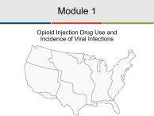

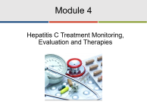
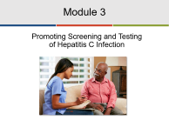
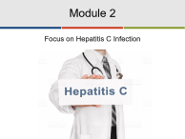

Presentation Menu
Select a cover page to jump to that section of the presentation.

Slide 11

Module 1
Opioid Injection Drug Use and
Incidence of Viral Infections

Slide 12
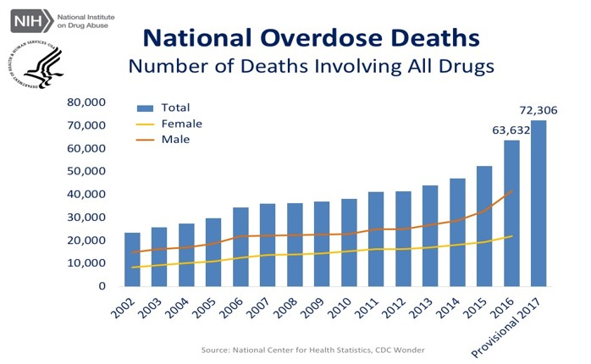
Drug-Overdose Death Rates 2017
Source: NIH Overdose Death Rates, Revised August 2018

Slide 13





Vulnerable Counties and Jurisdictions Experiencing or At-Risk of Outbreaks
Legend:
Top 220 vulnerable counties in 26 states
Jurisdictions determined to be experiencing or at-risk of outbreaks
(States/Territories: 34, Select Counties: 7, Select Cities: 2
Source: CDC, Persons Who Inject Drugs, Vulnerable Counties and Jurisdictions Experiencing or At-Risk of Outbreaks, July 19, 2019

Slide 14
Injection Drug Use and
Related Harms
Persons who inject drugs are at-risk of developing a substance use disorder as well as an array of other medical conditions (infective endocarditis; bone, joint, skin infections; skin problems; etc.).
Sharing of injection drug equipment also carries high risks of transmission and acquisition of various blood-borne pathogens:
  Hepatitis C (HCV), hepatitis B (HBV), HIV, and other blood-borne viruses to sexual partners and children.
Source: Infectious Diseases and Opioid Use Disorder (OUD) Policy Issues and Recommendations - Approved March 2018

Slide 15
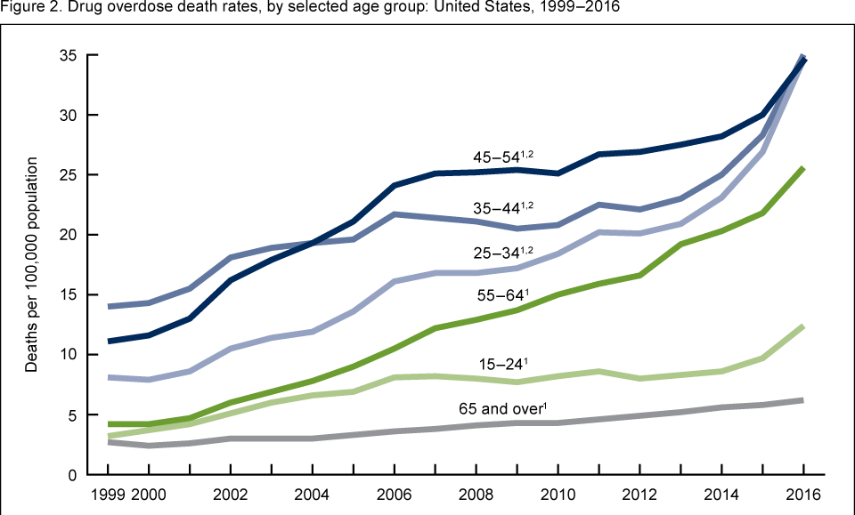
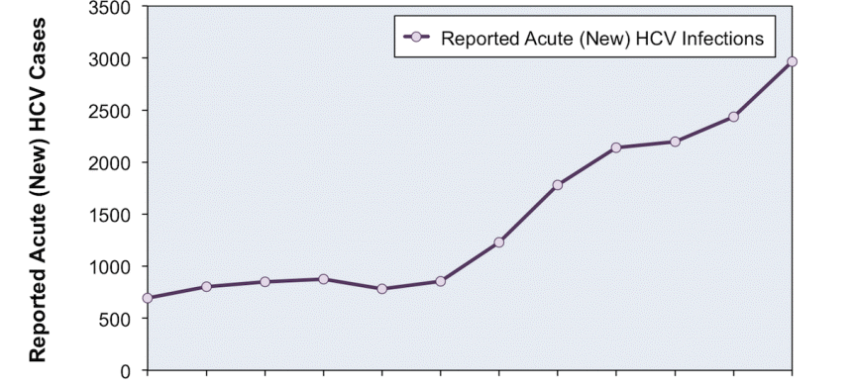
Consequences of At-Risk Behavior
HCV infections nearly tripled within a five-year period.
51% of persons living with HCV are unaware of their infection.
Other viral infections on the rise:
67% of persons living with HBV* are unaware of their infection.
IDU accounts for 9% of new HIV* diagnoses, 2016.
*HBV and HIV can be transmitted through infected blood or bodily fluids.
All three viral infections tend to be asymptomatic in most people, necessitating the need for screening.
Sources: CDC Drug Overdose Deaths in the United States, 1999-2016, and
Press Release, Thursday May 11, 2017 New Hepatitis C Infections Nearly Tripled Over Five Years

Slide 16
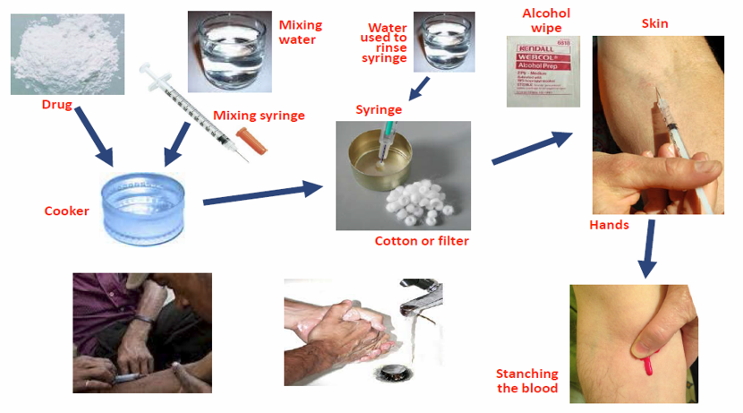
Opportunities for Blood-borne-virus Transmission During Injection Drug Use

Slide 17
Transmission of Viral Infections
HIV
Injection drug use: Contaminated needles, syringes, water, cooker, cotton
Sexually: Blood, semen (pre-seminal fluid), vaginal secretions
Perinatal: Women living with HIV to developing fetus
Other blood-based body fluids: breast milk
HBV
Injection drug use: Contaminated needles, syringes, cooker, cotton
Sexually: Blood, semen, vaginal secretions
Perinatal: Women infected with HBV to developing fetus
Household contact: Sharing razor, toothbrush, nail clipper
Open sores
HCV
Injection drug use: Contaminated needles, syringes, cooker, cotton, sharing straws and bills to snort
Sexually: Traumatic sexual exposure (very low % of transmission)
Perinatal: Women infected with HCV to developing fetus

Slide 18
HIV and Hepatitis – Viral Infections
Category | HIV | HAV | HBV | HCV
Lifelong Infection | 100% | 0% | Adults: 2-5% Perinatal: ~90% | 75-85%
Protective Immunity from Natural Infection | No | Yes | Yes | No
Vaccine | No | Yes | Yes | No
Genetic Material | RNA | RNA | DNA | RNA
Curable | 0% | Self-limited | 1-2% | >95%!

Slide 19
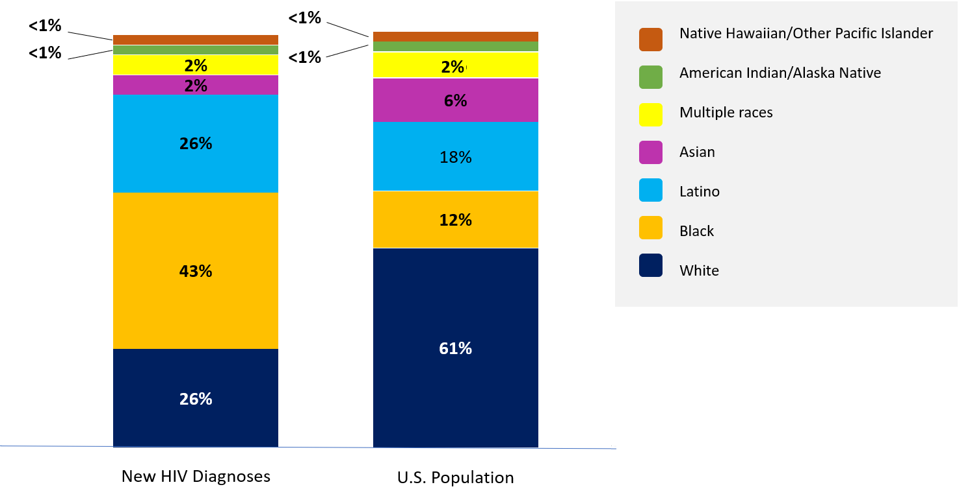
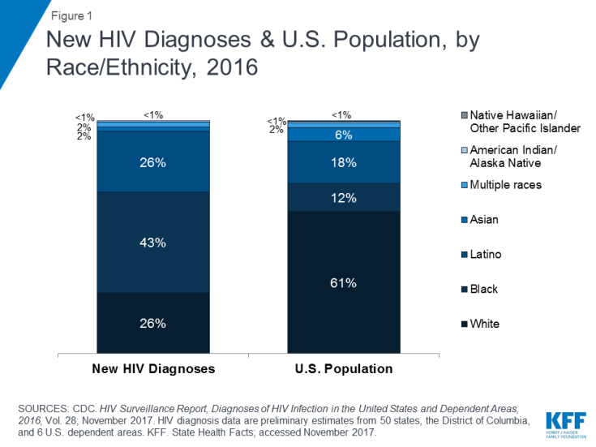
New HIV Diagnoses in U.S. by Race/Ethnicity, 2016
People who inject drugs accounted for 9% (3,425) of the 39,782 diagnoses of HIV in the U.S. in 2016, with Blacks having the highest rate of new HIV diagnoses, followed by Latinos.
Sources: KFF, The HIV/AIDS Epidemic in the U.S: The Basics, April 11, 2018. CDC Fact Sheet, New HIV Infections in the U.S.
Multi-color image was adapted from Figure 1 New HIV Diagnoses & U.S. Population, by Race/Ethnicity, 2017

Slide 20
HBV Infection
An estimated 21,900 acute HBV cases occurred in 2015. Regions hardest hit by opioid crisis are seeing increasing rates of HBV infection associated with IDU.
From 2009 to 2013, the incidence of acute HBV increased by 114% in Kentucky, Tennessee, and West Virginia, while remaining stable in the U.S. overall.
In North Carolina, new cases of HBV increased by 56% between 2014 and 2016.
The Massachusetts Department of Public Health recently issued an advisory about the alarming rise in HBV outbreaks associated with injection drug use in their state, citing a 78% increase in acute HBV cases in 2017.
Sources: HHS The Rise in Acute Hepatitis B Infection in the U.S., and
Hep B United, Hepatitis B and the Opioid Epidemic, July 2017

Slide 21
Potential Complications of Chronic HBV
Without diagnosis or intervention, one in four persons chronically infected with HBV will go on to develop liver failure and/or liver cancer or other complications.
  Hepatitis D infection
  Liver scarring (cirrhosis)
  Liver failure
  Liver cancer
  Death

Slide 22
HBV Vaccination
Despite the fact that routine HBV vaccination was initiated in 1982, an estimated 850,000-2.2 million persons in the U.S. live with chronic HBV infection; many are unaware of their infection status.
Low rates of HBV vaccination coverage among adults older than 30 and increasing rates of injection drug use, especially in rural areas with minimal access to syringe service programs (SSPs), are fueling the recent rise in acute HBV infections in the U.S.
Vaccinate (Twinrix) against HAV and HBV at your health clinic, SSPs, pharmacies, etc.
Sources: HHS The Rise in Acute Hepatitis B Infection in the U.S., and
Hep B United, Hepatitis B and the Opioid Epidemic, July 2017

Slide 23
New HCV Infections and IDU
In 2016, an estimated 41,200 acute HCV (six months from presumed acquisition of infection) cases occurred.
45% of the increases in HCV infections were among persons younger than 30, and IDU is the greatest risk factor and likely responsible for most of these infections.
Among 18- to 29-year-olds:
400% increase in acute hepatitis C
817% increase in admissions for injection of prescription opioids
600% increase in admissions for heroin injection
Among 30- to 39-year-olds:
  325% increase in acute hepatitis C
  169% increase in admissions for injection of prescription opioids
  77% increase in admissions for heroin injection
Source: CDC, Increase in Hepatitis C Infections Linked to Worsening Opioid Crisis, December 21, 2017

Slide 24
HCV Burden
Hepatitis C virus (HCV) infection is the leading cause of cirrhosis, liver failure, liver cancer and liver transplantation in the U.S.
Baby boomers (born from 1945 to 1965) are 6X more likely to be infected with HCV than other age groups and are at much greater risk for death from the virus.
Highest overall number of new infections are among 20- to 29- year-olds, primarily as a result of increasing injection drug use associated with America’s growing opioid epidemic.
Persons with chronic HCV (infected more than six months after acquiring infection) have an estimated mortality rate 12X higher than the general population.
Source: CDC, New Hepatitis C Infections Nearly Tripled Over Five Years.

Slide 25
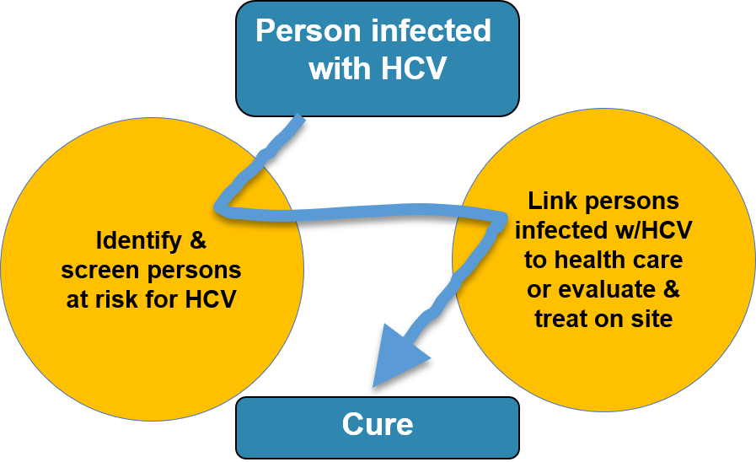
Bridging the Gap to a Cure
HCV can be safely cured with all-oral therapies in the vast majority (>95%) of patients

Slide 26
Expand Viral Hepatitis
Screening and Testing
CDC and USPSTF recommend:
Screening for HCV in persons at elevated risk for infection.
One-time screening for HCV infection to adults born between 1945 and 1965 (Baby boomers).
Screening for HBV infection in persons at risk and/or born in countries where HBV infection is endemic.
SOURCES: Edlin, B.R., & Winkelstein, E.R. (2014). Can hepatitis C be eradicated in the United States? Antiviral Research, 110, 79-93; Coffin, P.O., et al. (2012). Cost-effectiveness and population outcomes of general population screening for hepatitis C. Clin Infect Dis, 54(9), 1259-1271. U.S. Preventive Services Task Force - USPSTF A and B Recommendations

Slide 27

Module 2
Focus on Hepatitis C Infection

Slide 28
History of HCV Discovery
1970s: Virus appears in enough people to be noticed (called non-A, non-B)
1980s: Blood screened for Alanine transaminase (ALT), reducing HCV transmission (before it was discovered)
1989: Hepatitis C virus identified and named
1990: First antibody test helps identify people exposed to the virus and is used to screen blood
1992: Better tests ensure safety of blood supply and confirmatory test for anti-HCV is approved
Source: AASLD, Hepatology, Ward, J. Hepatitis C Virus: The 25-year Journey from Discovery to Cure

Slide 29
Risk-Based Recommendations for HCV Testing
Persons currently injecting drugs
Anyone who has ever injected drugs, ever shared needles and works or snorted drugs
All persons born between 1945 and 1965
All persons with HIV infection
Persons presenting with symptoms of hepatitis or abnormal liver-function tests
Received transfusion or blood products before 1992
Received clotting factor prior to 1987
Ever on hemodialysis
Healthcare, emergency, public-safety workers after exposures to HCV through infected blood
Children >1 year born to HCV-infected women
Tattoo and/or body piercing done while incarcerated or by an unlicensed artist

Slide 30
Hepatitis C Health Disparities
Health disparities in viral hepatitis:
  More than half of people with HCV have:
    Incomes lower than twice the poverty level
    Less than a high school education
American Indians/Alaska Natives have the highest rate of new HCV infections (from .5 to 1.32 cases per/100,00 in 2014).
African Americans account for 25% of people with chronic HCV (but only 11% of the U.S. population).
Other groups with high rates of HCV: PLWHA, people who inject drugs, people who have been incarcerated, people who are homeless.
Source: Denniston, et al. “Chronic HCV Infection in the U.S., NHANES 2003-2011.” Ann Intern Med. 2014;160:293-300. OMH, Eliminating the Public Health Problem of Hepatitis B and C in the United States

Slide 31

Noted Trends
HCV incidence increased by 294% (2010-2015) with the highest rates among young people who inject drugs
Iatrogenic viral transmission (healthcare exposure)
Sexual transmission of HCV among primarily HIV-infected and rarely HIV-uninfected men who have sex with men (MSM).
SOURCES: Altarum Institute. (2013). Technical Consultation: Hepatitis C Virus Infection in
Young Persons who Inject Drugs, February 26-27, 2013. Washington, DC: Office of HIV/AIDS and
Infectious Disease Policy; Martin, T.C., et al., (2013). Hepatitis C virus reinfection incidence and
treatment outcome among HIV-positive MSM. AIDS, 27(16), 2551-2557.
SOURCES: Altarum Institute. (2013). Technical Consultation: Hepatitis C Virus Infection in
Young Persons who Inject Drugs, February 26-27, 2013. Washington, DC: Office of HIV/AIDS and
Infectious Disease Policy; Martin, T.C., et al., (2013). Hepatitis C virus reinfection incidence and
treatment outcome among HIV-positive MSM. AIDS, 27(16), 2551-2557.

Slide 32

Characteristics of Hepatitis C
Hepatitis C virus is a rapidly replicating blood-borne pathogen that causes inflammation of the liver and scarring (fibrosis).
Clinical presentation during acute HCV infection may or may not include jaundice, abdominal pain, or flu-like symptoms such as fatigue, muscle aches, and nausea.
Can live in blood outside body for
days to weeks – much longer than HIV.
Is not spread via casual contact,
and touching infected blood does
not lead to transmission.
No vaccine…yet!

Slide 33
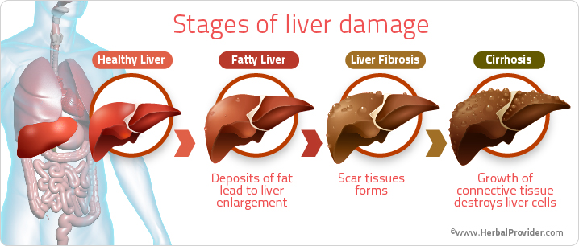
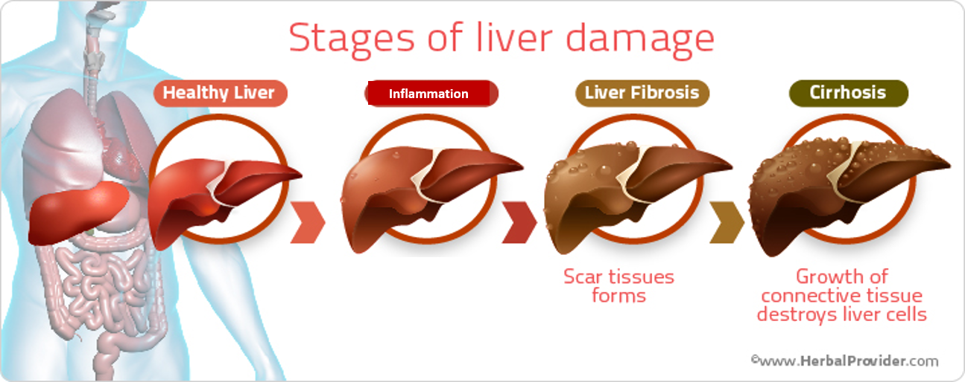
Stages of Liver Damage
Inflammation
HCV infection causes inflammation of the liver.
Over years, inflammation leads to scarring (scarring = fibrosis).
Severe scarring (F4 = stage 4 fibrosis or cirrhosis).
Cirrhosis can lead to end-stage liver disease or decompensated cirrhosis or liver failure, hepatocellular carcinoma (liver cancer), which is fatal without a liver transplant.

Slide 34
Acute* HCV Infection
Average time of development of HCV antibodies when first infected is about six to eight weeks and up to six months in some cases.
15%-25% spontaneously clear HCV without treatment in three to four months, most times without symptoms.
*Acute phase: within the first six months after acquiring infection

Slide 35
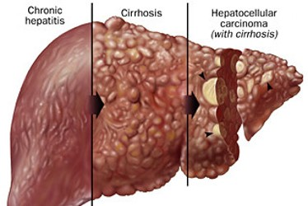
Chronic* HCV Infection
75-85% develop chronic infection and may remain stable for years
20%-30% develop cirrhosis and
serious illness within 20 years if
untreated
20%-37% will die as a result of
liver failure or liver cancer due to
untreated HCV disease
* Chronic phase: infected more than six months after acquiring infection

Slide 36
Chronic HCV Infection
“Extrahepatic” Manifestations
Hematologic mixed cryoglobulinemia
Non-Hodgkin’s lymphoma
Metabolic Insulin resistance, diabetes
mellitus
Renal Membranoproliferative
glomerulonephritis
Membranous nephropathy
Dermatologic Porphyria cutanea tarda
Autoimmune Idiopathic thrombocytopenic purpura
Nonspecific Chronic fatigue
Memory loss
Cognitive impairment (“mental fog”)

Slide 37

Nonspecific Symptoms of
Chronic Hepatitis C
Chronic fatigue, memory loss,
cognitive impairment (“brain fog”)
Not related to severity of liver
disease
(can be early or late)
May be passed off as not due to
hepatitis C
May not be recognized until it goes
away with treatment

Slide 38
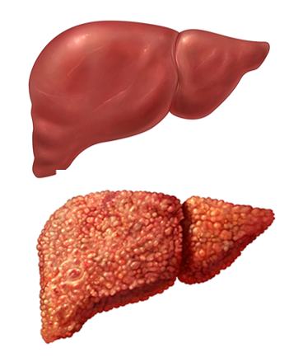
People with Cirrhosis
Compensated cirrhosis
Asymptomatic stage
Decompensated cirrhosis
Clinically evident symptoms
End-stage liver disease
Signs of liver failure
Child Turcotte Pugh Score (CTP) (A, B or C) used to evaluate prognosis of liver cirrhosis

Slide 39
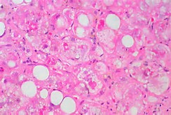
Decompensated Cirrhosis
Symptoms present during end-stage liver disease and can be life-threatening.
Portal hypertension
Ascites (fluid in abdomen)
Jaundice
Variceal bleeding
Hepatic encephalopathy

Slide 40
Monitoring Liver Health and Disease
Liver-enzyme tests (LETs) use measured levels of enzymes as markers of inflammation and injury: ALT, AST (1/3 of people with HCV have normal enzyme levels).
Liver-function tests (LFTs) functional tests that tell us more about liver-disease severity than liver enzymes (platelet count, bilirubin, albumin, prothrombin time).
AFP (for liver cancer).

Slide 41
A Silent Killer
Hepatitis C infection is usually asymptomatic and often goes undiagnosed unless:
Patient enters primary care for unrelated medical issues, and consequent blood panels reflect elevated enzymes
End-stage liver disease has occurred and symptoms present
Promotion of HCV screening and testing based on risk behaviors or birth cohort reveal infection

Slide 42
Hepatitis Risk Assessments
Designed to assess an individual’s risk for viral hepatitis and based on CDC recommendations for testing and vaccination
Center for Disease Control and Prevention, Viral Hepatitis Hepatitis Risk Assessment
Minnesota Dept of Health, HIV/STD/Hepatitis Risk Assessment HIV/STD/Hepatitis Risk Assessment
New York State Dept of Health Hepatitis Risk Assessment

Slide 43

Module 3
Promoting Screening and Testing
of Hepatitis C Infection

Slide 44
Initiating the Conversation
Keep in mind patient factors such as fear, stigma, lack of information and how HCV relates to the patient when initiating a discussion around a patient’s identified risk behavior.
Culturally sensitive and trauma-informed approaches help create safe environments and enable effective communication.
Discuss the entire testing process, the various potential test results and benefits of screening, testing and diagnosis.
Inform patient of provider support and provide tailored risk-reduction counseling and current treatment options.
Source: Trauma Informed Principles through a Culturally Specific Lens

Slide 45
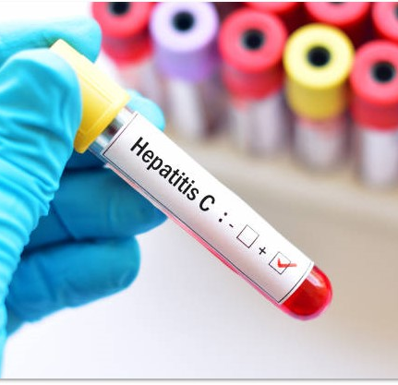
Screening and Testing for HCV
Diagnosing Hepatitis C infection is a two-step process
Screen: Anti-HCV (ab or antibody)
Non-reactive (negative)
Reactive (positive)
Confirmatory testing:
HCV RNA
(PCR, viral load, confirmatory)
Not detected
Detected

Slide 46
Anti-HCV Tests
Anti-HCV tests are used to detect the presence of antibodies to hepatitis C virus.
HCV-screening tests designed to detect antibodies have a “detection period” (antibodies cannot be detected until six to eight weeks).

Slide 47

Anti-HCV Tests
Serological HCV Antibody Assays
EIA (enzyme immunoassay)
CIA (enhanced chemiluminescence immunoassay)
OraQuick® HCV Rapid Antibody Test
Point-of-care antibody test; results in 20 minutes
Fingerstick, venipuncture, serum or plasma (not oral fluid)

Slide 48

Anti-HCV Test Results
A non-reactive (negative) result means HCV antibodies were not found, and patient is likely not infected with HCV.
Patient is not protected
from future HCV infection
May still be in the
“detection period”

Slide 49
Non-reactive Counseling Messages
To stay negative or uninfected, eliminate or reduce risk by (see handout):
Don’t share needles or other injection equipment or snorting items (bills, straws) – anything that may have blood on it.
Get tattoos, piercings, and body art only from a licensed artist who explains what consumer should expect.
Get vaccinated against hepatitis A and B, and test for HIV.
Practice safer sex and get treated for STDs.
* If person engaged in risky behavior within last six months, they should get retested (HCV RNA) in six months.

Slide 50

Anti-HCV Test Results
A reactive (positive) test result means antibodies to HCV were found in a patient’s blood.
HCV infection occurred, and patient
may still be infected
Further testing must be done with an HCV RNA (PCR) test to see if
patient is still infected

Slide 51
Reactive Counseling Messages
HCV RNA test measures amount of HCV in patient’s blood.
If there is no virus, test will come back “not detected.” If “detected,” then patient is infected with hepatitis C.
One in five persons exposed to HCV are infected; getting an HCV RNA test is key.* Counsel on how to protect the liver by avoiding alcohol and practicing other risk-reduction behavior.
Counsel patient to see a doctor and learn about hepatitis C and HCV treatment.
* Encourage reflexive RNA testing/one step diagnostic.

Slide 52

Antibody Tests Cannot Tell the
Difference Between…
Someone who has a chronic infection
Someone who had a past infection
  Someone who has
  “cleared” the virus
  spontaneously
  Someone who has
  been effectively
  treated

Slide 53
Diagnosing HCV Infection
HCV RNA (PCR or Viral Load) or confirmatory testing
Qualitative – test for presence or absence of HCV virus.
Quantitative – test for amount of HCV virus in blood (viral load).
  “Not detected” result means no current infection
  “Detected” result means hepatitis C virus was found, confirming HCV infection

Slide 54
Working with HCV RNA Results
Not Detected
No current infection (some recommend another test in three to six months to be sure).
For individuals in OTP or other substance-use-treatment setting, and with any chance of infection, RNA should be rechecked every six months.
Past cleared HCV infection means patient can still get infected again.

Slide 55
Working with HCV RNA Results
Detected or Viral Load
Diagnosis of active infection
Conduct genotype (GT) testing
    8 known GTs (1a and 1b subtypes, 2-8)
    GTs 1-6 are the most common in the U.S.
    75% of U.S. infections are GT 1

Slide 56
Not Detected/Detected Test Results
“If your HCV RNA test result is ‘not detected,’ then you’re not currently infected. But you can change your risk behavior that first got you infected, so as not to become re-infected.”
“If your HCV RNA test result is, ‘detected,’ (viral load) then understand how you can modify your risk behavior so as not to infect someone else.”
“….allow me (provider) to link you to a specialist who can work to monitor you and perhaps treat your HCV infection.”

Slide 57
Understanding Screening Results ?!
HCV antibody:
Meaning:
Non-reactive
Reactive
Reactive
Not detected
Detected
Not infected¹
Previously infected²
Currently infected³
Additional testing as appropriate:
¹ Unless in window period (recently infected) or immunocompromised
² Repeat HCV RNA test in six months to be sure
³ Needs medical evaluation to assess stage and consider for treatment

Slide 58
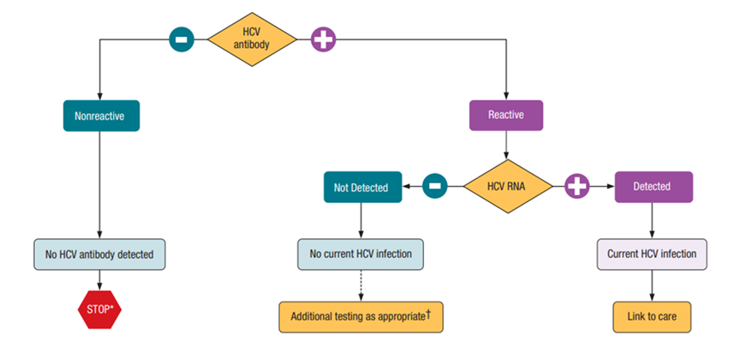
Recommended Testing Sequence for Identifying Current Hepatitis C Virus (HCV) Infection
* For persons who might have been exposed to HCV within the past 6 months, testing for HCV RNA or follow-up testing for HCV antibody is recommended. For persons who are immunocompromised, testing for HCV RNA can be considered. † To differentiate past, resolved HCV infection from biologic false positivity for HCV antibody, testing with another HCV antibody assay can be considered. Repeat HCV RNA testing if the person tested is suspected to have had HCV exposure within the past 6 months or has clinical evidence of HCV disease, or if there is concern regarding the handling or storage of the test specimen.
Source: CDC. Testing for HCV infection: An update of guidance for clinicians and laboratorians. MMWR 2013;62(18).

Slide 59
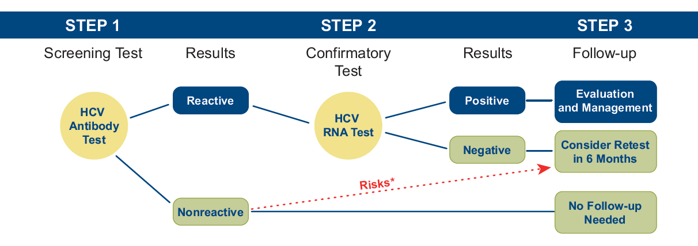
Understanding Your HCV RNA Test Results
IF POSITIVE
Explain results clearly and simply.
Assess patient reactions.
Provide encouragement and respond to patient concerns.
Provide education on liver health.
IF NEGATIVE
Explain results clearly and simply.
Emphasize the need for re-testing.
Discuss precautions to avoid infection.
Provide education on preventative liver health.
*Retest if the person has engaged in risky behavior within 6 months or if risky behavior occurs
Source: Detailed HCV RNA Provider Card

Slide 60





Motivational Interviewing ?!
Select each link to review five different examples of Motivational Interviewing
Using SBIRT to promote testing with Eddie
Using SBIRT to promote HCV testing with Tony
Using SBIRT to promote testing with Eva
Using SBIRT to promote testing with Jorge
Using SBIRT to promote testing with Concetta
Source: IRETA, Institute for Research, Education and Training in Addictions

Slide 61

Module 4
Hepatitis C Treatment Monitoring, Evaluation and Therapies

Slide 62
Monitoring Progression of HCV
Factors that may accelerate the progression of HCV
      Alcohol consumption
      HIV infection
      Older age at the time of infection
      Male sex at birth
      Insulin resistance
      Abnormal accumulation of fat in the liver (steatohepatitis – fatty liver disease)
      Non-alcoholic – diabetes
      HCV genotype 3

Slide 63
Assess Alcohol Consumption
Alcohol consumption accelerates progression of liver fibrosis.
Alcohol-screening questions and brief intervention, if indicated
  “How many times in the past year have you had four to five or more drinks in one setting?” (four for women <65 and five for men)
  CAGE questionnaire
  Center for Integrated Solution, SAMHSA-HRSA, Screening,Brief Intervention, and Referral to Treatment (SBIRT)
SBIRT, (Screening Brief Intervention and Referral to Treatment), (accessible through) ATTC SBIRT Trainer Registry

Slide 64
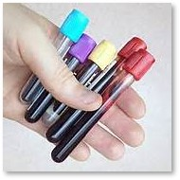
More Aspects of Monitoring
Test all patients for HBV, and provide harm-reduction options:
Use clean syringe and clean paraphernalia (e.g., cooker)
Use barriers when having sex
Get vaccinated for HAB and HBV
Treat HBV in co-infected patients to permit
HCV DAA therapy.
Patients without HCV who have low or
undetectable HBV DNA levels should
be monitored every 6 months.
Educate patients on hepatitis C transmission,
progression and strategies to reduce harm.
Conduct clinical evaluation for treatment.

Slide 65
Clinical Evaluation
Blood tests
  Liver enzymes (ALT, AST)
  Liver-function tests (bilirubin, albumin, prothrombin time)
  HCV genotype
  Platelet count
  Screen for HIV and HBV
Medical history, physical examination, assess degree of hepatic fibrosis, noninvasive markers, or elastography/fibroscan (APRI, FIB4).
Liver-cancer screening for patients with cirrhosis (every six months)
  Serum alpha-fetoprotein
  Hepatic ultrasound
ECHOSENS, http://www.myliverexam.com/en/fibrometer-test.html

Slide 66
Treatment Factors to Consider
Extent and severity of liver disease
Extrahepatic manifestations (e.g., cryoglobulinemia)
Patient preference
Drug-drug interactions
Comorbid HIV or other liver disease
Reinfection
Insurance coverage
Source: Hepatitis C Online - Making a Decision on When to Initiate HCV Therapy

Slide 67



HCV Treatments and Timeline (2016-2015-2014)
Epclusa (sofosbuvir/velpatasvir) first all-oral, single-tablet regimen for adults with genotypes 1-6 (without cirrhosis, compensated or decompensated cirrhosis)
Zepatier (elbasvir and grazoprevir) with or without ribavirin for patients with genotypes 1 and 4 (treatment naïve without cirrhosis, compensated or decompensated cirrhosis)
Daklinza (daclatasvir), for use with sofosbuvir and first 12-week, all-oral treatment for patients with genotype 3
Technivie (ombitasvir, paritaprevir and ritonavir) is used in combination with ribavirin for the treatment of patients with genotype 4 without cirrhosis or with compensated cirrhosis
Harvoni (ledipasvir/sofosbuvir) first once-daily pill that doesn’t require interferon or ribavirin, treatment option for patients with genotype 1, (now approved for gt 1,4, 5, 6).
Viekira Pak (ombitasvir/paritaprevir/ritonavir and dasabuvir) oral combination therapy for the treatment of patients with genotype 1(with compensated cirrhosis)
Source: Hepatitis Central - Medications to Treat Hepatitis C - A Timeline

Slide 68



HCV Treatments and Timeline (2013-2011-2002)
Olysio (simeprevir) capsules in combination with peginterferon alfa and ribavirin or with sofosbuvir, in treatment- naïve patients with genotype 1.
Sovaldi (sofosbuvir) tablets to be used in combination with ribavirin or with pegylated interferon and ribavirin. for patients with genotypes 1, 2, 3 or 4.
Victrelis (boceprevir) in combination with peginterferon alfa and ribavirin, for the treatment of genotype 1 (treatment naïve, experienced, with compensated or decompensated cirrhosis).
Incivek (telaprevir) in combination with peginterferon alfa and ribavirin for the treatment of genotype 1 (treatment naïve, experienced, with compensated or decompensated cirrhosis)
Pegasys (peginterferon alfa-2a) for the treatment of chronic HCV as part of a combination therapy
Copegasus. (ribavirin) in combination with Pegasys in patients five years of age and older (with compensated liver disease that was not previously treated with interferon alpha as well as in adults coinfected with HIV)
Source: Hepatitis Central - Medications to Treat Hepatitis C - A Timeline

Slide 69


HCV Treatments and Timeline (2001-1998)
Pegintron (peginterferon alfa-2b) injections for treatment of chronic HCV patients with compensated liver disease
Rebetol (ribavirin) to be used in combination with interferon alfa-2b (both pegylated and non-pegylated) injections for the treatment of chronic hepatitis C in patients three years of age and older with compensated liver disease.
AASLD, IDSA,
HCV Guidance: Recommendations for Testing, Managing, and Treating Hepatitis C
HCV Guidelines.org
http://www.hcvguidelines.org/full-report/initial-treatment-hcv-infection
Source: Hepatitis Central - Medications to Treat Hepatitis C - A Timeline

Slide 70
Current Recommended Treatment
Mavyret (glevaprevir/pibrentasvir), a regimen of 8,12 or 16 weeks, is now preferred for patients without advanced liver disease.
Genotypes 1 through 6 are curable with Mavyret, with or without cirrhosis.
Potential for HBV reactivation for persons with past HBV infection.
Source: Mavyret Living with Chronic Hepatitis C?

Slide 71
HCV Treatment Update Sites
AASLD IDSa HCV Guidance: Recommendations for Testing, Managing and Treating Hepatitis C HCV Guidelines
Hepatitis C New Drug Research and Liver Health Approved Treatments For Hepatitis C Hepatitis C New Drug Research
Hepatitis C Treatment AND Management Medscape - Hepatitis C Treatment & Management
FDA, Hepatitis B and C Treatments List of approved FDA Therapies

Slide 72
HBV and HCV Coinfection
New Guidance 2016
All patients initiating HCV DAA therapy should be assessed for HBV coinfection with HBsAg+, anti-HBs, and anti-HBc.
HBV vaccination for all susceptible individuals.
Test for HBV DNA prior to DAA therapy in patients who could be actively replicating, (sAg+). For those indicated, treat active HBV infection before HCV DAA therapy is started.
Monitoring patients with low or undetectable HBV DNA levels at regular intervals as recommended by the AASLD’s HBV treatment guidelines.
Source: AASLD - Monitoring Patients Who Are Starting HCV Treatment, Are on Treatment, or Have Completed Therapy

Slide 73
HIV and HCV Coinfection
Consultation between HCV and HIV practitioners
Any DAAs may be used in coinfection treatment – Epclusa, Mavyret, etc.
Treatment recommendations should follow the recommendations for mono-infection specific to genotype.
AASLD IDSA link to drug interactions: HCV Guidelines - Unique Populations
Sources: HHS AIDS info - Considerations for Antiretroviral Use in Patients with Coinfections and
AASLD Unique Populations > Patients with HIV/HCV Coinfection

Slide 74

Treatment Markers and Benefits
Sustained virologic response (SVR) 12 weeks after treatment completion, (no virus detected) means cure.
Reduction in liver failure, liver cancer, and liver-related deaths; reduction in all-cause mortality.
Oral therapies are easier to tolerate.
HCV therapy is shorter duration (8-24 weeks).
Increased treatment tolerability.

Slide 75
Treatment Recommendations
Treatment is recommended for all patients with chronic HCV infection, except those with short life expectancies.
In some cases, limitations on access to medications and the ability to deliver them to patients still exist; in these settings, clinicians may still need to decide which patients should be treated first. See descriptions of unique populations in: AASLD - When and in Whom to Initiate HCV Therapy
Treatment may prevent transmission among those engaging in risk behavior (PWID, HIV+ MSM).
Persons on Buprenorphine, Methadone, and Naltrexone should be treated for hepatitis C infection.

Slide 76
Payment Assistance Resources
Prices are dropping (discounts); access and affordability may improve
Insurance
Patient-assistance programs
  Gilead patient-assistance program (“Support Path”) http://www.gilead.com/responsibility/us-patient-access/support%20path%20for%20sovaldi%20and%20harvoni
  AbbVie patient-assistance program (“proCeed”) http://www.patientassistanceprograms.net/?gclid=CLnKwdefiNACFQRehgodnyoB8Q
Specialty pharmacies can help doctors and patients obtain medications

Slide 77
Payment-Assistance Resources
Patient Access Network Foundation (PAN)
  Contact Information: 866-316-PANF (866-316-7263) or PAN Foundation
  Program Details: The Patient Access Network Foundation offers help to people with chronic or life-threatening illnesses for whom cost limits access to medical treatments
HealthWell Foundation
  Contact Information: 800-675-8416 or Hepatitis C Assistance
  Program Details: The HealthWell Foundation provides financial assistance to eligible individuals to cover coinsurance, copayments, healthcare premiums and deductibles for certain medications and therapies.
HCV-HIV Coinfection
  To find patient assistance and co-pay programs if you are coinfected with HCV and HIV, check out: HIV Drug Assistance Programs and Viral Hepatitis

Slide 78

Module 5
Linking Patients Infected with Hepatitis C
to Healthcare Services

Slide 79

Linkage to Hepatitis C Care
Promoting and linking persons infected with hepatitis C to appropriate healthcare services can be initiated at various points of patient contact and in a variety of care settings, including:
Primary care
Emergency rooms
HIV testing sites
Syringe exchange programs (SEPs)
Substance use disorder treatment programs
Mental health treatment programs
MAT clinics
STI clinics
Community-based outreach to people who inj
Homeless shelters
Others?

Slide 80
Linkage to Hepatitis C Care
Through promotion of HCV screening and testing
  One-time testing of people in birth cohort or with identified-risk-factor-based screening
Ideally provide on-site RNA confirmatory testing
Entering primary care for non-HCV medical issue
Already within the continuum of HCV care

Slide 81
Provider-Focused Initiatives
Develop a hepatitis C “champion”
  Act as a resource for information
  Monitor screening
  Monitor follow-up and cascade of care
Designate a lead clinician who will take on the primary responsibility of HCV treatment and monitoring, or establish and organize a system for evaluation, treatment and monitoring.
Source: US Dept of Health & Human Services, Health Resources and Services Administration,
HIV/AIDS Bureau. (2011). Integrating Hepatitis C Treatment into Ryan White Clinics, Models &
Steps. Available at: http://hab.hrsa.gov/files/hepatitiscmodelstools.pdf.

Slide 82
Community-Focused Forums
Increase public awareness through educational seminars with parent-teacher groups, faith-based communities, presentations on hepatitis C provided by clinics, etc.
Collaborate with community-based providers through a memorandum of understanding (MOU).

Slide 83
Update Standards
Routine screening and testing for HCV, HBV, and HIV with everyone is key to identifying persons potentially infected with HCV.
Include on forms:
  “May we test you for hepatitis C today?”
  “Would you like a hepatitis C test? Yes No”

Slide 84
Medical Model ?
Referral/ Walk in
Reception
(updated forms)
Recommendation for HCV test
Physical exam and reason for visit
Review patient forms, promote HCV screening
Lab tests ordered, interim treatment recommendations
Counsel on HCV test result, reiterate risk reduction, refer for HCV RNA if appropriate, link to HCV healthcare
Primary follow-up appointments
(SVR)
Cure
Medical model
HCV healthcare, HCV RNA detected, evaluation for treatment eligibility,
initiate treatment
Promote HCV screening and testing as standard of care

Slide 85
SA Treatment Model ?
Referral Walk in
Include offer of HCV Test
Medical and
Psychiatric evaluations
Review patient forms, promote HCV screening
Counsel on HCV test result, reiterate risk reduction, refer for HCV RNA if appropriate, link to HCV healthcare
Counselor conducts assessment
Counselor develops treatment plan
SA treatment model
Client adheres to treatment plan
HCV healthcare, HCV RNA detected, evaluate for treatment eligibility,
initiate treatment
(SVR)
Cure
Promote HCV screening and testing as standard of care

Slide 86
Integration Activity
Discuss these two questions and list at least two strategies by practice setting:
How can screening be incorporated at your practice setting and at various patient-contact points, with those entering or already in care?
Does anyone at your practice treat hepatitis C and have a place to refer out to? Do those referred patients go?
(Handout: HCV cascade of care)

Slide 87

Resources
Helpful links for patients and providers

Slide 88
HCV Resources for Patients
Caring Ambassadors Caring Ambassadors Hepatitis C News and Resources
National Viral Hepatitis Roundtable NVHR Newsletters, Resources, Programs and more
Hepatitis C Careline,1-800-532-5274 Managed by the Patient Advocate Foundation to provide Hepatitis C patients with hands-on case-management support
Help-4-Hep Who can you talk to about Hepatitis C?
HCV Advocate: Hepatitis C – Living with Hepatitis C http://www.hcvadvocate.org
American Liver Foundation Support Services Liver Disease Resources

Slide 89
HCV Resources for Providers
AASLD & IDSA, Updated HCV Treatment Guidelines for 2018 Published by AASLD-IDSA AASLD - Welcome to HCV Guidelines
CDC, Centers for Disease Control and Prevention, Viral Hepatitis, CDC - What is Viral Hepatitis?
US Department of Veterans Affairs, Viral Hepatitis and Liver Disease
Stakeholders’ Workbook: Exploring Vital Roles and Opportunities to Break the Silence, HIV.gov Ending the HIV Epidemic: A Plan for America
Project ECHO, Project ECHO - How it Works

