Slide 1
Opioid Overdose 2017 Statistics for Region 8
Notes:
This slide deck provides a brief overview of the use of videoconferencing to deliver assessment and treatment services to individuals with substance use disorders (SUDs) and mental health conditions. It is designed to be used by behavioral health academic faculty, trainers, and state agency staff members for a variety of audiences. Each slide has notes for the presenter to provide guidance if necessary. References are included on the slides and in the notes. If you require further information on this topic, please contact the Mountain Plains Addiction Technology Transfer Center (MPATTC). You are free to use these slides and pictures but please give credit to the MPATTC when using them by keeping the branding and referencing the ATTC at the beginning of your presentation.
MPATTC is part of the SAMHSA-funded ATTC network that offers training/technical assistance (TA) services through a partnership with the University of North Dakota and University of Nevada Reno. The goal of the MPATTC is to improve the capacity of Region 8’s SUD treatment and recovery services workforce by using state-of-the-art training/TA, innovative web-based tools, and proven workforce development activities to expand access to learning, change clinician practice, and advance provider efficiencies, resulting in improved client outcomes. MPATTC training/TA recipients include behavioral health/SUD treatment/recovery administrators, managers, counselors, clinical supervisors, and recovery specialists; health professions academic educators; tribal health professionals; and key stakeholders from related systems of care (e.g., opioid treatment providers); state and local governments; provider associations; and specialized behavioral/primary healthcare providers. You can access additional information at www.mpattc.org.

Slide 2
Disclaimer
This presentation was prepared for the Mountain Plains Addiction Technology Transfer Center (ATTC) under a cooperative agreement from the Substance Abuse and Mental Health Services Administration (SAMHSA). All material appearing in this presentation, except that taken directly from copyrighted sources, is in the public domain and may be reproduced or copied without permission from SAMHSA or the authors. Citation of the source is appreciated. Do not reproduce or distribute this presentation for a fee without specific, written authorization from the Mountain Plains ATTC. For more information on obtaining copies of this presentation, call visit the website (https://attcnetwork.org/centers/mountain-plains-attc/slidedecks4u).
At the time of this presentation, Elinore F. McCance-Katz, serves as SAMHSA Assistant Secretary. The opinions expressed herein are the views of Nancy Roget, MS, MFT, LADC and do not reflect the official position of the Department of Health and Human Services (DHHS), SAMHSA. No official support or endorsement of DHHS, SAMHSA, for the opinions described in this document is intended or should be inferred.

Slide 3
In 2017, 192 people died per day from drug overdoses.
CDC, 2019
Notes:
According to new data released by the Centers for Disease Control and Prevention (CDC), there were 70,237 drug overdose deaths in 2017, or 192 drug overdose deaths per day. This represents a significant increase of 9.6% from 2016 (19.8 per 100,000) to 2017 (21.7 per 100,000).
Source
Scholl L, Seth P, Kariisa M, Wilson N, Baldwin G. Drug and Opioid-Involved Overdose Deaths — United States, 2013–2017. MMWR Morb Mortal Wkly Rep 2019;67:1419–1427. DOI: http://dx.doi.org/10.15585/mmwr.mm675152e1
https://www.cdc.gov/drugoverdose/data/statedeaths.html
https://www.drugabuse.gov/related-topics/trends-statistics/overdose-death-rates

Slide 4

that’s like one commercial plane crash a day x 365 days
Notes:
The point of this slide is to impress upon students/participants the magnitude of the rate of opioid overdose by comparing the number of opioid overdose deaths to plane crash losses (this metaphor has been used on several websites but is not officially attributed to one individual). Ask students/participants how the federal government would respond if the United States suffered one plane crash per day every day for one year? Process students/participants’ responses.
The next slide continues the point about the impact of the opioid overdose epidemic by comparing the annual loss of life due to opioid overdoses to other epidemics, wars, accidents, crimes, or diseases.

Slide 5
Opioid Overdose Deaths (70,237) in 2017 were HIGHER than the number of people:
killed in Vietnam (US Military) | 58,220 ¹
that died from HIV/AIDS at the height of the epidemic (1995) | 48,371 ²
killed in motor vehicle accidents | 37,574 ³
with alcohol-induced deaths | 33,171 ³
murdered | 17,793 ³
1. https://www.archives.gov/research/military/vietnam-war/casualty-statistics.html
2. http://www.factlv.org/timeline.htm
3. http://www.drugwarfacts.org/chapter/causes_of_death

Slide 6
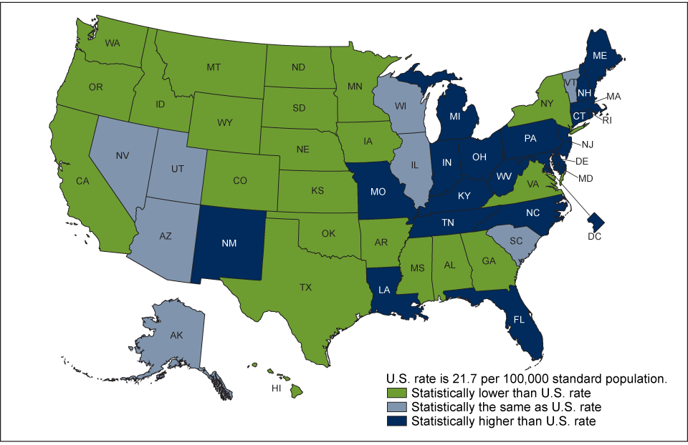
Age-adjusted drug overdose death rates by state:
United States, 2017
Notes:
Five states in Region 8 (Colorado, Montana, North Dakota, South Dakota, and Wyoming) are below the US rate. This is an improvement from the 2016 data, with Wyoming’s rate moving from being the same as the US rate (2016) to lower than the US rate (2017). Utah’s rate is the same as than the national rate.
NOTES: Deaths are classified using the International Classification of Diseases, 10th Revision. Drug-poisoning (overdose) deaths are identified using underlying cause-of-death codes X40-X44, X60-X64, X85, and Y10-Y14.
Sources
Hedegaard H, Miniño AM, Warner M. Drug overdose deaths in the United States, 1999–2017. NCHS Data Brief, no 329. Hyattsville, MD: National Center for Health Statistics. 2018.
NCHS, National Vital Statistics System, Mortality, https://www.cdc.gov/nchs/products/databriefs/db329.htm
Access data table at: https://www.cdc.gov/nchs/data/databriefs/db294_table.pdf#3

Slide 7
Overdose Rates by State in 2017
(National rate 21.7 per 100,000)
20 states and the District of Columbia had drug overdose death rates higher than the national rate of 21.7 per 100,000: UT - 22.3
8 states had rates comparable to the national rate: WY - 12.2
22 states had lower rates: CO - 17.6; MT - 11.7
WV (57.8), OH (46.3), PA (44.3), and the DC (44.0) had the highest observed age-adjusted drug overdose death rates
IA (11.5), TX (10.5), ND (9.2), SD (8.5), and NE (8.1) had the lowest observed age-adjusted drug overdose death rates
Hedegaard et al., 2018
Notes:
This slide provides more specific data on overdose rates in 2017 by state. West Virginia’s rate is significantly higher than other states.
Ask students/participants their reactions/thoughts about this data.
These data also appear in the document by the National Center for Health Statistics.
Source
Hedegaard H, Miniño AM, Warner M. Drug overdose deaths in the United States, 1999–2017. NCHS Data Brief, no 329. Hyattsville, MD: National Center for Health Statistics. 2018.
https://www.cdc.gov/nchs/products/databriefs/db329.htm#
https://www.cdc.gov/nchs/data/databriefs/db329_tables-508.pdf#page=3

Slide 8
For more information, contact

