Slide 1
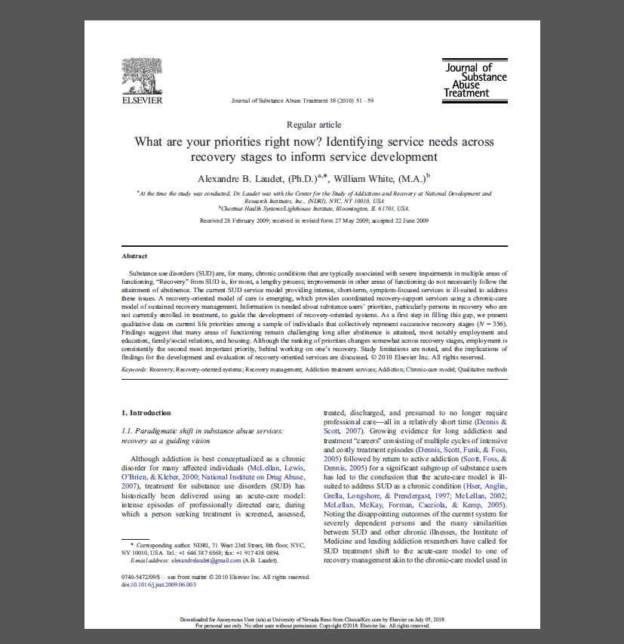
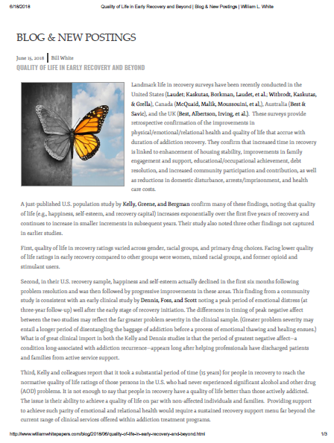
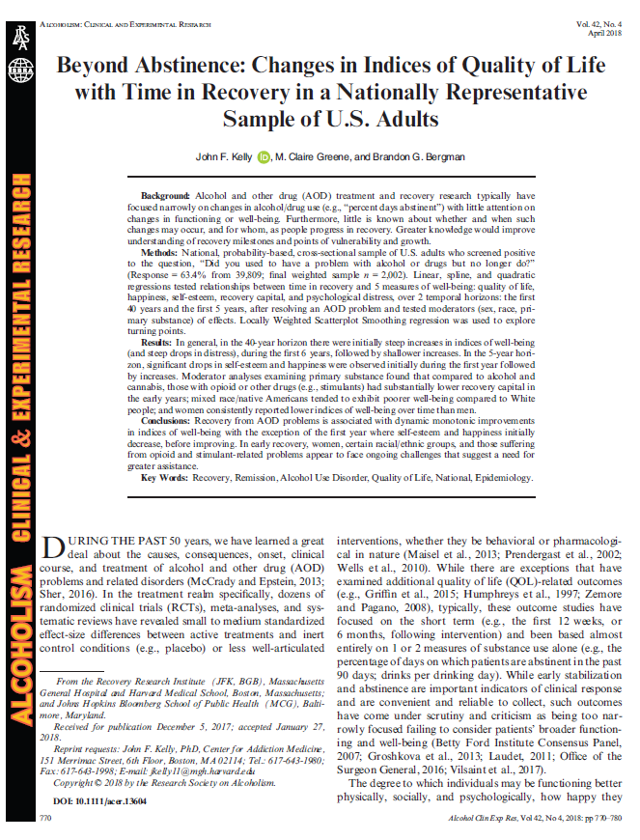
Supporting Recovery by Understanding Benchmarks
Laudet & White, 2010
William White Blog, 2018
Kelly, 2018
Notes:
This slide deck highlights two articles and a blog about recovery benchmarks and differences in recovery regarding quality of life issues for individuals depending on drug of choice; gender; and race/ethnicity. Understanding the benchmarks of recovery and the differences in individuals’ recovery experiences can help both peer support specialists and behavioral health professionals’ normalize recovery experiences.
The slide deck is designed to be used by behavioral health academic faculty, trainers, and state agency staff members for a variety of audiences. Each slide has notes for the presenter to provide guidance if necessary. References are included on the slides and in the notes. If you require further information on this topic, please contact the Mountain Plains Addiction Technology Transfer Center (MPATTC). You are free to use these slides and pictures but please give credit to the MPATTC when using them by keeping the branding and referencing the ATTC at the beginning of your presentation.
MPATTC is part of the SAMHSA-funded ATTC network that offers training/technical assistance (TA) services through a partnership with the University of North Dakota and University of Nevada Reno. The goal of the MPATTC is to improve the capacity of Region 8’s SUD treatment and recovery services workforce by using state-of-the-art training/TA, innovative web-based tools, and proven workforce development activities to expand access to learning, change clinician practice, and advance provider efficiencies, resulting in improved client outcomes. MPATTC training/TA recipients include behavioral health/SUD treatment/recovery administrators, managers, counselors, clinical supervisors, and recovery specialists; health professions academic educators; tribal health professionals; and key stakeholders from related systems of care (e.g., opioid treatment providers); state and local governments; provider associations; and specialized behavioral/primary healthcare providers. You can access additional information at www.mpattc.org.
Sources
Kelly, J. F., Greene, M. C., & Bergman, B. G. (2018). Beyond abstinence: Changes in indices of quality of life with time in recovery in a nationally representative sample of U.S. adults. Alcoholism: Clinical & Experimental Research, 42(4), 770-780.
Laudet, A. B., & White, W. (2010). What are your priorities right now? Identifying service needs across recovery stages to inform service development. Journal of Substance Abuse Treatment, 38(1), 51–59. http://doi.org/10.1016/j.jsat.2009.06.003
White, W.L. (2018, June 18). Quality of Life in Early Recovery and Beyond. (Blog Post). Retrieved from http://www.williamwhitepapers.com/blog/2018/06/quality-of-life-in-early-recovery-and-beyond.html 1/3

Slide 2
Disclaimer
This presentation was prepared for the Mountain Plains Addiction Technology Transfer Center (ATTC) under a cooperative agreement from the Substance Abuse and Mental Health Services Administration (SAMHSA). All material appearing in this presentation, except that taken directly from copyrighted sources, is in the public domain and may be reproduced or copied without permission from SAMHSA or the authors. Citation of the source is appreciated. Do not reproduce or distribute this presentation for a fee without specific, written authorization from the Mountain Plains ATTC. For more information on obtaining copies of this presentation, call visit the website (https://attcnetwork.org/centers/mountain-plains-attc/slidedecks4u).
At the time of this presentation, Elinore F. McCance-Katz, serves as SAMHSA Assistant Secretary. The opinions expressed herein are the views of Nancy Roget, MS, MFT, LADC and do not reflect the official position of the Department of Health and Human Services (DHHS), SAMHSA. No official support or endorsement of DHHS, SAMHSA, for the opinions described in this document is intended or should be inferred.

Slide 3
Recovery Benchmarks
Important to:
differentiate between the needs of peers in early, middle, and late recovery
understand risk factors that can negatively impact recovery
Notes:
Currently, a body of research exists that provides peers and behavioral health professionals with information regarding the different problems/issues that individuals’ experience in recovery. For example, individuals in early recovery focus on different problems than individuals in late recovery. These ‘recovery benchmarks’ can help normalize what individuals’ experience in different stages of recovery, which can provide relief to individuals and guidance to peer support specialists and behavioral health professionals. Previous to these studies, little knowledge existed about these differences in early and late recovery.
Source
Laudet, A. B. & White, W. (2010). What are your priorities right now? Identifying service needs across recovery stages to inform service development. Journal of Substance Abuse Treatment, 38(1), 51–59. http://doi.org/10.1016/j.jsat.2009.06.003
Image credits: Getty Images (purchased image)

Slide 4
4 Time-Linked Recovery Benchmarks
less than 6 months
6 to less than 18 months
18 to 36 months
more than 3 years
Laudet & White, 2010
Notes:
The study conducted by Laudet and White found 4 distinct stages of recovery: less than six month; 6 to 18 months; 18 to 36 months; and 3 years and over. Go over these stages with participants and ask for their reactions to the stages.
Individuals in recovery continue to experience many difficulties even years after establishing sobriety/abstinence. Support in many different life areas was required even after sobriety was reached. This is an important concept for peers and practitioners to understand, especially when planning or delivering peer support services. These four stages could be helpful to peers and practitioners as … ‘milestones or turning points that can highlight periods of vulnerability, resilience, or growth in adaptive change; and in turn, could inform the types of services that may be needed for which individuals and at what junctures, to support long term recovery.’ p.771 Kelly et al., 2018.
Source
Laudet, A. B. & White, W. (2010). What are your priorities right now? Identifying service needs across recovery stages to inform service development. Journal of Substance Abuse Treatment, 38(1), 51–59. http://doi.org/10.1016/j.jsat.2009.06.003
Image credits: Getty Images (purchased image)

Slide 5
Research on the Stages of Recovery and Life Priorities
Laudet & White, 2010
Notes:
In addition to the four distinct stages of recovery, the Laudet and White study found that life priorities changed based on the stage of recovery (e.g., early, middle, and late). For example, it was found that almost half of the individuals in Early Recovery were focused on recovery (staying abstinent) goals during the first six months of recovery, while only a third of the individuals with 3 or more years of recovery were focused on their recovery. This did not mean that after 3 years individuals weren’t worried about remaining abstinent or sober, but they were just more worried about other life issues like employment. This information is important to know so that peers and practitioners can adapt their recovery services depending on individuals’ stage of recovery.
When reviewing this chart, see if anyone remarks on the statistic that concern about sobriety/abstinence returns and increases at the 18 to 36 month stage, which is higher than the early recovery stage.
Source
Laudet, A. B., & White, W. (2010). What are your priorities right now? Identifying service needs across recovery stages to inform service development. Journal of Substance Abuse Treatment, 38(1), 51–59. http://doi.org/10.1016/j.jsat.2009.06.003

Slide 6
Early Recovery
Patients with a pattern of using alcohol to help with sleep have a poor quality of sleep and their sleep continues to remain disrupted even after cessation of alcohol use.
could indicate that patients with a pattern of using alcohol to help with sleep potentially have preexisting sleep disturbances, which some patients may attempt to treat with alcohol
sleep problems appear to persist following 4 weeks of abstinence and could lead to a relapse
study revealed that a large proportion (69.3%) of patients in early alcohol recovery have sleep disturbances and even after their first month of abstinence, rates of sleep disturbances were 49.1%
Kolla et al., 2014
Notes:
This research looked at sleep patterns in early recovery and found that individuals that used alcohol to help them sleep continued to experience disrupted sleep even after stopping alcohol use. It is important that peers and practitioners ask questions about an individual’s sleep patterns, especially in early recovery as it could serve as a relapse trigger.
Recommendations can be made for individuals to try activities that combat sleep disturbances (e.g., meditation, new bedtime routines, soothing sound, or relaxation app, etc.). Referrals to physicians or other health professionals regarding sleep-related problems is essential along with the caveat about avoiding the use of Ambien and other non- benzodiazepines is addressed.
Source
Kolla, B.P., Schneekloth, T., Biernacka, J., Mansukhani, M., Geske,J., Karpyak, V., et al. The course of sleep disturbances in early alcohol recovery: an observational cohort study The American Journal on Addictions, 23 (2014), pp. 21-26
Image credits: Getty Images (purchased image)

Slide 7
Early Recovery
things may get worse before they get better—notably, happiness and self-esteem appear to drop during the first few months followed by a gradual increase beginning 6 to 12 months into recovery.
Kelly et al., 2018; White, 2018
Notes:
This finding is especially important to share with individuals in early recovery. For example, an individual may think… ‘I am in recovery, attending counseling and support groups and not using alcohol and other drugs. Why don’t I feel happier or pleased about the positive steps I am taking?’ According to Kelly and colleagues (2018), two explanations may be helpful: 1) as individuals start to be able to think more clearly, they can reflect on the toll their SUDs have had on their life, which can create feelings of sadness; and 2) as they reflect they may experience guilt and/or remorse, which may lead to decreases in hope that things can change. Explaining these processes as a normal part of recovery and that happiness and self-esteem will increase over time is important.
Sources
Kelly, J. F., Greene, M. C., & Bergman, B. G. (2018). Beyond abstinence: Changes in indices of quality of life with time in recovery in a nationally representative sample of U.S. adults. Alcoholism: Clinical & Experimental Research, 42(4), 770-780.
White, W.L. (2018, June 18). Quality of Life in Early Recovery and Beyond. (Blog Post). Retrieved from http://www.williamwhitepapers.com/blog/2018/06/quality-of-life-in-early-recovery-and-beyond.html 1/3
Image credits: Getty Images (purchased image)

Slide 8
Women in Recovery
Suggests a potentially more persistent challenge facing women in recovery than men, as they appear to struggle more with psychological stress and are less satisfied with physical, psychological, and social aspects of their life in recovery.
Some of these may reflect ongoing different biological (e.g., increased cortisol) and psychosocial challenges (e.g., negative affect; or sociocultural challenges (e.g., gender bias/discrimination) compared to men.
Kelly et al., 2018; White, 2018
Notes:
Review this slide with participants and ask for their reactions. Kelly and colleagues’ study found that women faced greater challenges in recovery than men. It is important that peers and practitioners understand recovery for women may include less satisfaction with all aspects of recovery. As such, these reactions to recovery should be normalized for women and additional support/resources provided.
Sources
Kelly, J. F., Greene, M. C., & Bergman, B. G. (2018). Beyond abstinence: Changes in indices of quality of life with time in recovery in a nationally representative sample of U.S. adults. Alcoholism: Clinical & Experimental Research, 42(4), 770-780.
White, W.L. (2018, June 18). Quality of Life in Early Recovery and Beyond. (Blog Post). Retrieved from http://www.williamwhitepapers.com/blog/2018/06/quality-of-life-in-early-recovery-and-beyond.html 1/3
Image credits: Getty Images (purchased image)

Slide 9
Mixed Race or Native Americans in Recovery
Individuals reporting mixed race or a racial group other than Black, White, or Hispanic (e.g., Native American) showed persistent challenges following AOD problem resolution in these indices of QOL and psychological well-being.
This group includes native/indigenous Americans and other mixed ethnicities who appear to be assiduously disadvantaged and show worsening, rather than improvements, in QOL and psychological distress over time.
Kelly et al., 2018; White, 2018
Notes:
Similarly, individuals reporting being of mixed race or Native American also experienced persistent and greater challenges in recovery than white men. Certainly issues related to historical and current trauma as well as living in areas impacted by poverty and neglect has a negative impact on recovery. Additional studies are needed to increase knowledge regarding how culture and ethnicity for individual with a mixed race or Native American background continue to face disadvantages that have a negative impact on their recovery status.
Sources
Kelly, J. F., Greene, M. C., & Bergman, B. G. (2018). Beyond abstinence: Changes in indices of quality of life with time in recovery in a nationally representative sample of U.S. adults. Alcoholism: Clinical & Experimental Research, 42(4), 770-780.
White, W.L. (2018, June 18). Quality of Life in Early Recovery and Beyond. (Blog Post). Retrieved from http://www.williamwhitepapers.com/blog/2018/06/quality-of-life-in-early-recovery-and-beyond.html 1/3
Image credits: Getty Images (purchased image)

Slide 10
Individuals with OUDs or Stimulant Use Disorders
Appear to begin their recovery journey at a substantial disadvantage- recovery capital compared to those resolving alcohol or cannabis problems
They make take several years to achieve similar sobriety rates compared to other individuals with different drugs of choice
May be among the most marginalized and stigmatized (i.e., those with heroin, methamphetamine, or crack cocaine as their primary substance)
Appear to be at a distinct disadvantage early in the recovery process in terms of access to recovery resources
More likely to have drug-related criminal records that can prevent access to jobs, loans, education and training opportunities, and housing and may need more resource support
Kelly et al., 2018; White, 2018
Notes:
The Kelly and colleagues (2018) study found that individuals in recovery from OUD or stimulant use disorders may start off with a lower amount of resources as their disorder caused them to ‘burn through resources’ leaving few available when entering recovery. For example, in some cases individuals with OUDs were provided housing and monetary support from friends and family members while still in the active phase of their condition. As such, friends and family members may no longer be able or willing to help out even though the individual is in recovery which then requires new support to come from other sources, which may or may not be available within the individuals’ local community. This can put the individual at a distinct hardship, meaning that their recovery capital starts off lower than other individuals with SUDs.
Sources
Kelly, J. F., Greene, M. C., & Bergman, B. G. (2018). Beyond abstinence: Changes in indices of quality of life with time in recovery in a nationally representative sample of U.S. adults. Alcoholism: Clinical & Experimental Research, 42(4), 770-780.
White, W.L. (2018, June 18). Quality of Life in Early Recovery and Beyond. (Blog Post). Retrieved from http://www.williamwhitepapers.com/blog/2018/06/quality-of-life-in-early-recovery-and-beyond.html 1/3

Slide 11
Recovery Benchmarks Implications
The 1st year of recovery is a risky period (happiness/self-esteem; difficulties with sleep); things get worse and then get better. More support services may be necessary around relaxation, stress, sleep, other health issues in the 1st year
Individuals in recovery are still concerned about abstinence, family/friend relationships, and employment even after 3 years.
Women, Native Americans, and individuals of mixed races face more challenges in recovery due to trauma/ discrimination/stigma.
Individuals with OUDs/stimulant abuse may start with lower recovery capital and require more resources. Increase resources over an extended period of time.
Bottom Line… ‘Greater problem severity may entail a longer period of disentangling the baggage of addiction before a process of emotional thawing and healing ensues’
Kelly et al., 2018; White, 2018
Notes:
This final slide focuses on implications of the research reviewed. The first bullet comes from the Laudet & White (2010) research, the next three bullets come from the Kelly et al. (2018) research, and the last bullet is a quote from the White (2018) blog. Overall, the point is… while being in recovery is positive, it does not mean that all problems have been resolved; that early recovery is a risky time for individuals; and that many individuals due to higher levels of problem severity need extended support and resources before the benefits of recovery are experienced. Both peers and practitioners can help ‘normalize’ the ups and downs experienced in recovery.
Sources
Kelly, J. F., Greene, M. C., & Bergman, B. G. (2018). Beyond abstinence: Changes in indices of quality of life with time in recovery in a nationally representative sample of U.S. adults. Alcoholism: Clinical & Experimental Research, 42(4), 770-780.
Laudet, A. B., & White, W. (2010). What are your priorities right now? Identifying service needs across recovery stages to inform service development. Journal of Substance Abuse Treatment, 38(1), 51–59. http://doi.org/10.1016/j.jsat.2009.06.003
White, W.L. (2018, June 18). Quality of Life in Early Recovery and Beyond. (Blog Post). Retrieved from http://www.williamwhitepapers.com/blog/2018/06/quality-of-life-in-early-recovery-and-beyond.html 1/3

Slide 12
For more information, contact

