Slide 1
Motivational Interviewing: Communication Skills to Support Patient-Centered Care
Module developed by Denna Vandersloot, M.Ed.
Co-Director, Northwest ATTC
Notes:
Welcome everyone and thanks for joining us today for this training session.

Slide 2
Learning objectives
After completing this module participants will be able to:
Identify the value of Motivational Interviewing (MI) as a way of communicating with patients to support patient-centered care.
Describe the role of listening and empathy in supporting patient’s change efforts.
Utilize three core MI skills to handle “sticky situations” with patients.
Notes:
Here are the learning objectives for this session.

Slide 3
What is Motivational Interviewing?
“Motivational interviewing is a collaborative conversation for strengthening a person’s own motivation and commitment to change.”
Source: Miller & Rollnick, 2013 pg. 12
Notes:
Ask the group: “What do you already know about motivational interviewing or what have you heard about it?” Share the definition on the slide with the group and then emphasize that:
MI is first and foremost a conversation about change, and while it can be used as a clinical intervention, it can also be used to effectively communicate with people and to strengthen relationships. It is within the second context that this MI training will focus.

Slide 4
Two aspects of Motivational Interviewing
A way of being
MI involves a general way of being with a patient that demonstrates respect and care and allows them to feel safe, cared for, and an active partner in change.
A way to communicate
MI uses key communication skills to demonstrate respect and empathy and facilitate change.
Notes:
During this training, we will review two key aspects of MI:
MI as a way of being with others; and
MI as a way to communicate with others.

Slide 5
Spirit of MI
Partnership
Acceptance
Evocation
Compassion
Notes:
Let’s take just a minute to talk about the “way of being” that MI promotes or what is referred to as the “Spirit” of MI. The Spirit of MI is made up of 4 key components:
Establishing a partnership with the patient – helping the patient have a sense of being supported by all the staff in the clinic. Staff are there to help them get better and promote health.
Providing patients with a sense of acceptance. This is accomplished by being non-judgmental and seeking to understand the patient’s perspective.
Showing compassion by being warm and understanding of the patient’s struggles and challenges. Demonstrating empathy for the patient.
And finally to pull forth (or what we call evoke) their own reasons to make healthy choices (get a flu shot, schedule that next appointment) or, in your case, it might be to ask what is most important to them at the moment or how you can best help them get their needs met, given some of the constraints.
(Source: Miller, W.R. & Rollnick, 2013 Motivational Interviewing 3rd Edition)

Slide 6
Discussion
“What role do you see yourself playing in supporting patient’s change efforts?”
Notes:
Give instructions for this activity by telling the group:
Spend a couple of minutes with someone sitting next to you to answer this question: “What role do you see yourself playing in supporting patient’s change efforts?” Make sure to jot down a few of your answers to share with the larger group.
NOTE: Important to define what we mean by change, not necessarily the “big changes,” like monitoring blood glucose, or losing weight, but smaller changes like showing up for an appointment, following prescription protocols.
Conduct a large group discussion: ask a few people to share how they answered this question in their dyads.

Slide 7
Why should you learn about MI?
A key part of this initiative is increasing the likelihood patients will follow through with appointments. Support staff are important in this area.
Support staff are usually the first point of contact with the patient and the initial interaction can set the tone for the entire visit.
A recent study of 35,000 doctors nationwide found that 96% of complaints are the result of customer service and only 4% are due to patient care. (King & Baum, 2016)
Most importantly, it may make your job easier!
Notes:
Let’s look at how learning MI might help you as support staff with your work and increase customer satisfaction.
Bullet 1: Using MI has been shown to increase the number of individuals who successfully initiate and receive behavioral health services. Support staff are the ones setting up these appointments and so knowing some MI skills for dealing with patient’s reluctance to schedule the session has the potential to increase referral rates to behavioral health providers.
Bullet 2: “First impressions matter” is also true in healthcare settings. You are usually the first point of contact for patients and their interactions with you may influence their perception of the entire visit.
Bullet 3: 96% of online complaints cite poor communications, disorganization and excessive delays in seeing a physician as the primary cause for dissatisfaction and while support staff may have little control over these aspects of customer service how they interact and deal with “frustrated” patients may influence how the patient walks away from the clinic. MI can provide an opportunity for support staff to engage with frustrated patients in a way that not only increases patient satisfaction, but the staff members’ satisfaction as well. [Source: Journal of Medical Practice Management (2016) Authors: Ron Harman King and Neil Baum]
Bullet 4: MI provides a set of communication tools to help clients feel like they are at the center of care (even when the system does not always put them at the center) and it may even make your job easier.

Slide 8
Using the Spirit of MI at first contact
What: Several healthcare organizations involved in a process improvement initiative decided to implement the Spirit of MI into their first contact with patients.
How: Use open-ended questions and empathic conversation to welcome and connect with clients.
Results:
Sinnissippi Centers reduced the first appointment no-show rate from 58% to 14%.
PROTOTYPES reduced first appointment no-shows from 36% to 10%.
Boston Public Health Commission reduced no-show rate by 41%.
(Source: NIATx Promising Practices www.niatx.net)
Notes:
If you are wondering if your role will really make a difference, here is some data from a study looking at how implementing the Spirit of MI at the first point of contact was able to significantly reduce no-shows and increase the likelihood of the person keeping his or her next appointment.
What happens at the front end really can and does influence patient engagement.
Several healthcare agencies involved in a process improvement initiative decided to use what is referred to as the Spirit of MI during the first contact (when patients called for an appointment, or when they were asked to schedule an appointment with another person in the clinic).
These were non-clinical staff answering the phones and serving as the first point of contact. They focused on using open-ended questions and good listening skills to demonstrate empathy and connect with the patients. To help the patients feel seen and cared for.
The results were significant around the number of people who showed up for their first appointment after MI was implemented.
[Source: Use the Spirit of Motivational Interviewing during the First Contact. Available at the NIATx website: https://niatx.net/promisingpractices/Show.aspx?ID=59&SPNID=32]

Slide 9
Listening well
MI starts with good listening.
Notes:
Emphasize during this slide that, while MI is used as a clinical skill, many of the communication skills embedded and described in MI are useful in many areas of a person’s life.
William Miller, the developer of MI recently wrote a book for the general public called Listening Well: The Art of Empathic Understanding.
This presentation will focus on these skills more from this perspective versus using them in a clinical context. If, at the end of this presentation, you are interested in learning more about the value and the “how to” of using the communication skills, we will be focusing on today, this book is a great resource.

Slide 10
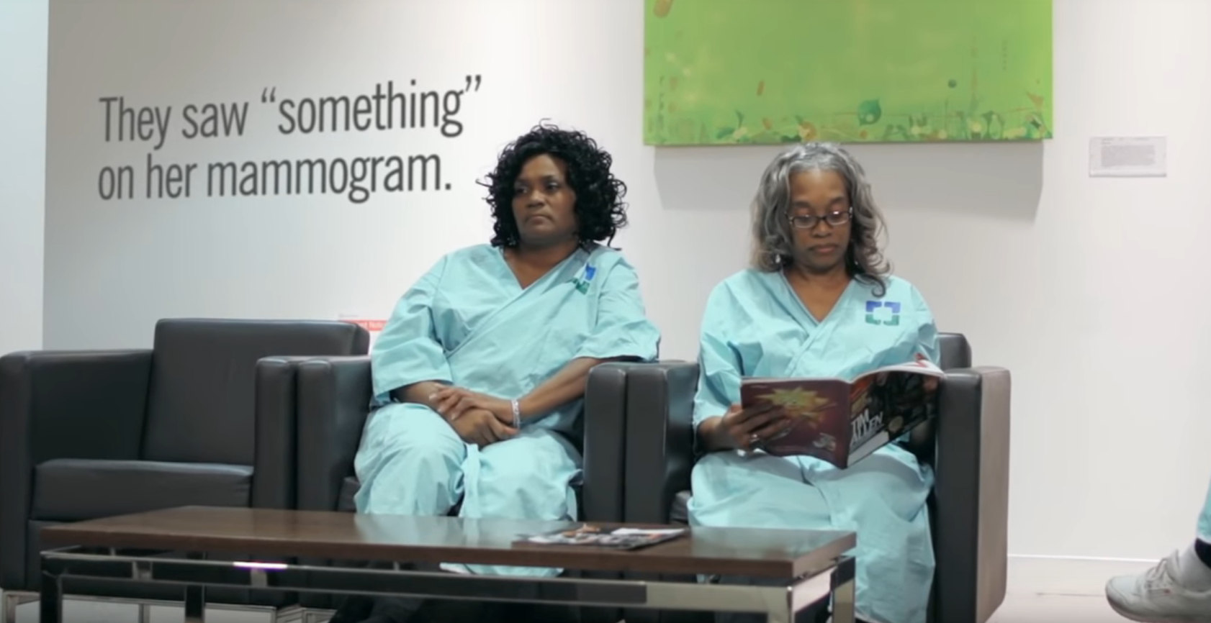
Empathy
Play video from Cleveland Clinic
Notes:
(Optional to show this video)
A good place to start with digging into the Spirit of MI and how it works is by talking about the concept of empathy. Here is a video developed by the Cleveland Clinic about empathy, I would like you to watch it and at the same time pay attention to what you are thinking and feeling as the video plays.
Debrief after the video with a couple of questions:
What were some of your thoughts as you watched this video? Feelings?
Did any of these examples resonate with you, or what you face in your clinics/settings?
Elicit from the group a definition of empathy
Miller (2018) defines empathy as “the ability to perceive and identify with another’s perspective.”

Slide 11
Accurate empathy
Notes:
While empathy is the ability to perceive and identify with another’s perspective, “accurate empathy” goes a step further to check out whether our guesses about what the person is thinking or feeling is accurate.
If time permits, you might ask the group what the value of demonstrating accurate empathy is. Some points to elicit and discuss:
Accurate empathy is “the ability to perceive and communicate, accurately and with sensitivity, the feelings of the person and the meaning of the feelings.” (Miller, W.R., 2018 Listening Well: pgs. 4-5)
Empathy creates a powerful connection; when people feel seen and heard, it creates trust and rapport.
Empathic listening helps people explore and gain a clearer and deeper understanding of their experience.
Talk about the differences between empathy and sympathy.

Slide 12
Communication breakdown
❶ What the
Speaker
means
❹ What the Listener thinks the Speaker
means
❷ What the Speaker says
❸ What the Listener hears
Notes:
Note: this slide is animated so you can discuss each of the 4 communication points one at a time.
Accurate empathy involves understanding what the other person is trying to tell you and this is essential to demonstrating the Spirit of MI.
Thomas Gordon’s communication model provides a way of thinking about communication in a way that outlines the process of what it takes to demonstrate empathic understanding.
Gordon talks about the four places where communication can go wrong.
Speaker chooses words that do not represent what they actually want to say – they may be feeling or thinking something entirely different from what they actually say.
They say the wrong words for various reasons (fear of what others will think, language translation issues). The actual words are only a small part of the actual story.
The listener hears the wrong words or doesn’t fully hear the message (distractions, noise, etc.)
The listener interprets a different meaning than the speaker intended (this is the decoding process and there are lots of opportunities for misunderstanding) - By this time Box 4 may be very different from Box 1; but the listener proceeds as if it the same. Accurate empathy is about closing the loop between Box 1 and Box 4.
Provide an example of what this might look like in day-to-day life to demonstrate how miscommunication happens during this process.
Ask the group: “How can we avoid situations like this with our family, co-workers, or patients?” The response you are looking for is “ask the speaker if you have it correctly” or “reflect it.”
Accurate empathy closes this loop; so we truly understand what the other person is trying to tell us and in the process we help the other person better understand what he/she is thinking and feeling.

Slide 13
Listen with intent to understand
“Most people do not listen with the intent to understand; they listen with the intent to reply.”
Source: Stephen Covey, The Seven Habits of Highly Effective People
Notes:
Next, we will be exploring some key MI skills to demonstrate how to express empathy. We will start with the skill of effective listening. Stephen Covey sums up one of the main barriers to listening in this quote.

Slide 14
Three key MI skills
Reflective Listening
Open-ended Questions
Affirmations
Helpful skills for increasing patient’s readiness to change and dealing with “sticky situations.”
Notes:
We will be reviewing these three MI skills:
Reflective Listening
Open-ended Questions
Affirmations
As a way for you to influence patients and deal with challenging situations.

Slide 15
Reflective listening
Notes:
Photo Credit: David Jefferson
Demonstrating empathy can strengthen your relationship with patients – we use reflective listening and open-ended questions to do that.
Reflective listening is a skill used in MI to demonstrate empathy and make sure you correctly understand what the other person is trying to communicate with you.
Let’s spend a few minutes learning this skill and then explore how you might use it in your interactions with patients to build rapport. You may also use reflective listening to diffuse challenging situations.

Slide 16
What is reflective listening?
Notes:
Reflective listening involves reflecting back to the person what you think he or she said in a way that captures the meaning of what they were trying to tell you. It is a statement that demonstrates understanding.
Reflective listening shows the person that you care about what they are saying, even if you are not exactly on the mark.

Slide 17
Thinking reflectively: Exercise
Split up into triads – 1 speaker and 2 listeners; each person will take a turn being a speaker
Each person shares a personal statement, filling in the blank: One thing I like about myself is _______
Listeners respond with “Do you mean that_____”, filling in the blank with their guesses (up to 5).
The speaker responds with only “yes” or “no” to each guess.
Notes:
See Thinking Reflectively Exercise Instruction Sheet
We are going to start learning this skill by first thinking reflectively…now, I want to emphasize this is not reflective listening.
I would like you to all think about one characteristic you like about yourself, something that is not concrete (like the color of your hair, eyes, etc.) but something that might be interpreted several ways.
Start by demonstrating what you would like them to do. Offer your own statement to the group:
Something I like about myself is that I am “flexible.”
And then ask a few people to complete the statement “Do you mean……?” and you answer with only yes or no.
Set up the exercise and explain that you will have one speaker and two listeners in the group who can take turns asking “Do you mean that….?”
Questions for debriefing:
What was that experience like for you? What did you learn?
Were there any surprises?
What problems were encountered?

Slide 18
Using reflective listening
NO:
“Do you mean. . .?”
YES:
Use a statement, not a question.
Examples: “You. . .”
“So you. . .”
“It’s like. . .”
“You feel. . .”
Notes:
Note: this slide is animated so you can make each point for the difference sections of the slide.
Good reflective listening statements are similar to what we just did; yet different from the “do you mean…?” questions. They do offer a hypothesis about what the speaker means, but this is done in the form of a statement rather than a question.
This requires at least two specific language changes. First you eliminate any front-end words that mark it as a question, such as “do you… can you…, are you… is it…”
Provide an example: “One thing I like about myself is that I am flexible” Drop “do you mean” and state “You can adapt to challenging situations.”
Inflection is important when you are making a reflection. The words may be the same, but the inflection at the end changes a statement into a question. Example “you’re angry about what I said?” vs. “you’re angry about what I said”
A reflective response is a statement and not a question.
Notice the difference: “You’re angry at your parents?” versus “You’re angry at your parents.” Think of reflective listening as hypothesis testing – you are checking your understanding of what the client is saying with a statement, versus asking a question. Clients will correct you if you don’t have it right just yet.
(Source: TNT Manual, 2014 pg. 76-77)

Slide 19
How might this look in your work?
Patient: I thought since my appointment was the first thing in the morning I wouldn’t have to wait so long.
Reflection: One of the reasons you made your appointment for 8:00 a.m. was to avoid the wait and you’re frustrated it is taking so long to get in.
Notes:
Two part slide – next slide continues this patient conversation.
Discuss the value of making a reflective statement in the situation described in the next two slides.
This may just be the start of the conversation, but the reflection helps the person to feel heard and understood.

Slide 20
How might this look in your work?
Patient: I would really like to see my regular doctor, but I guess she won’t be available next month.
Reflection: I get it, It’s hard to see a new doctor.

Slide 21
Your turn to practice
Statement 1:
Patient: I’m so glad I was able to get in today, I really needed to be seen.
Come up with two reflections for this patient statement.
Statement 2:
Patient: I hope I don’t have to wait forever to see the doctor today.
Come up with two reflections for this patient statement.
Notes:
Note: this should take 5 minutes with debrief -- refer participants to the handout so they can jot down their thoughts and ask them to find a partner and develop two possible reflections to respond to each of the patient statements on this slide.
As you work on these, keep in mind that these can be short and to the point; a longer reflection is not a better reflection.
Give them about 2-3 minutes to do this and then bring them back together as a group and ask for a few of the dyads to share what they came up with.

Slide 22
Open ended questions
Gather broad descriptive information
Require more of a response than a simple yes/no or fill in the blank
Often start with words such as:
“How…”
“What…”
“Tell me about…”
Notes:
Another skill that can be useful, when the situation calls for gathering more information, is using an open-ended question. Open-ended questions demonstrate you are interested in the patient’s perspective and you want to make sure they get the care they need.
Provide a few examples contrasting open-ended questions from closed-ended questions and ask how this skill might be helpful for support staff.
Examples: “Are you having a good day?” (closed question) “How is your day going so far?” (open-ended question)

Slide 23
Ambivalence
A normal part of the change process.
Notes:
A key concept in MI is understanding the role of ambivalence in the change process. Elicit from the group their understanding of the word “ambivalence”?
In MI the skills of open-ended questions and reflections are used to help people resolve their ambivalence in the direction of change.
Ambivalence is a normal part of the change process how we treat and respond to ambivalence is key. Most of the time when we think about doing something new or changing a behavior, we feel some ambivalence. We have some reasons to make the change and some reasons not to make the change. Often, we have competing motivations “I want to avoid having the flu, but I don’t like shots and I am afraid the flu shot will make me sick.”
When someone is ambivalent about change it is important that they make the arguments for change, not you, even if it is just around scheduling an appointment.

Slide 24
Caution: Avoid the righting reflex
Notes:
Now consider what happens when a person who is ambivalent meets someone with a righting reflex.
Explain what the righting reflex is: The righting reflex is when we want to help another person make the right choice. This is what kicks in when we start offering someone advice, or ideas for change, or warn them about all the bad things that might happen if they don’t change. It assumes a directive style and tries to convince or persuade someone to make the change.
For example, if someone says, “I really don’t want to get a flu shot” and you say, “You really should get it, you at high risk.” This may just result in the person telling you all the reasons he or she shouldn’t get one. Which makes it less likely that the person will get a flu shot.
You may also talk about the concept of resistance, where if you don’t push back the resistance drops.

Slide 25
MI and ambivalence – example 1
A patient has been asked to by his doctor to make an appointment to see the behavioral health provider and you can tell he doesn’t really want to do it.
Patient: Dr. Mautner wants me to make an appointment with the behavioral health provider to talk about my anxiety. But I don’t know if I really want to.
Support staff: You are not sure you want to make this appointment and at the same time you really want some help with your anxiety.
Patient: Yeah I really do.
Notes:
Share these two scenarios to demonstrate how these two MI skills might be used to help a person resolve his or her ambivalence.

Slide 26
MI and ambivalence – example 2
Support staff: What might be the advantage of at least seeing a behavioral health provider for one session?
Patient: I guess it wouldn’t hurt to check it out.
Support staff: That’s great that you are willing to give it a try, for at least one appointment. Should we go ahead and schedule you?

Slide 27
Affirmations
Affirm the patient’s efforts, strengths, abilities, values, & skills.
A good affirmation is:
Specific
Genuine
Relevant to the conversation
Based on good listening
Notes:
Affirmations recognize and affirm a client’s strength and inherent worth.
Affirmations are also an effective way to help a patient feel seen and heard.
Briefly discuss what a “good affirmation” sounds like.

Slide 28
Affirmations – a few examples
“You are a great advocate for your Mom.”
“Being responsible and timely is important to you.”
“Your time is valuable.”
“You have been really patient with this process. Thank you.”
“Your diligence around making sure your insurance will cover your services is impressive.”
Notes:
Here are some examples of what an affirmation might sound like.

Slide 29
Using MI skills to deal with “sticky situations”
Notes:
Now we will explore how you might use these MI skills to deal with “sticky situations.”

Slide 30
Reflection exercise: gripe session
Find a partner.
Talk about something at work or home that you feel frustrated / angry about.
Listener: provide a reflection capturing the values you hear underneath the “gripe”
Notes:
Note: It can be helpful to demonstrate this exercise first to the group before asking them to do it.
Using reflective listening can be helpful in “sticky situations” with patients who are unhappy. Let’s try it together, and here are your instructions:
One person talks for 1 minute about something they are really frustrated about at home, or at work.
The other person listens closely for the values underlying the gripe session. What is important to the person? What do they value?
When time is called, the listener will provide a reflection of the values underlying the frustration expressed.
Switch roles.
Debrief in the larger group by posing these questions to the participants:
Listeners, what was it like to focus solely on the underlying values?
Speakers, what was your experience of having your values reflected back to you?

Slide 31
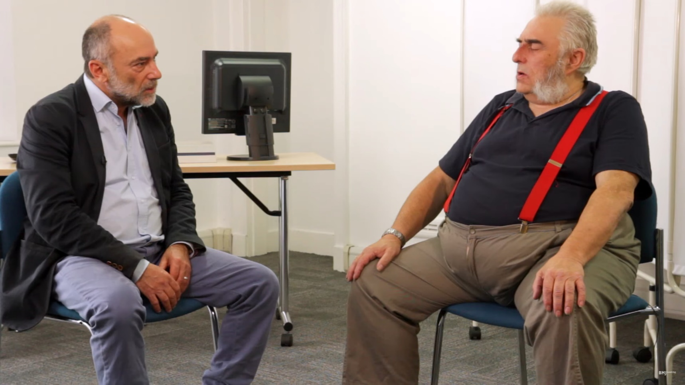
MI skills demonstration video
Play the BMJ Learning video
Notes:
Now let’s watch Stephen Rollnick, one of the developers of MI, use these MI skills with a patient who is upset about the time he has had to wait to be seen for his appointment.
Keep in mind as you watch this, that while it is unlikely you would be dealing with a patient in this exact type of scenario, the skills Dr. Rollnick is using, could be used in very brief interactions with frustrated, angry patients to defuse situations.

Slide 32
Practice session
Form groups of three and you will each be assigned a scenario.
Practice using the MI skills you have just learned about on this worksheet to respond to a sticky situation” with a patient.
Be prepared to share one or two of your favorite responses with the regular group.
Debrief in the larger group.
Notes:
Optional activity if time allows and the group seems interested in this level of practice (this activity could easily take 15 minutes or longer)
If time is short, and you want to do this practice session, one option is to assign each group one of the scenarios on the “sticky situation” worksheet.

Slide 33
Let’s review
Motivational Interviewing supports a lot of work we are all doing in the clinics.
MI is a way of being with people that builds trust and supports change efforts.
Empathy is at the heart of MI and it can be demonstrated by listening well.
Using reflections and open-ended questions can really help you deal with sticky situations.
Notes:
Let’s review now. Ask a participant to read one of these aloud to the group.

Slide 34
Resources for more on MI
Talk with your clinic’s MI champion and/or your behavioral health specialist (if you are in a clinic setting) if you have additional questions.
The book “Listening Well: The Art of Empathic Understanding” by William Miller is a great resource for the non-clinician. Available at Amazon.
If you want to take an introductory MI course, try the 4-hour self-paced course called “Tour of Motivational Interviewing”, available for free at healtheknowledge.org (search for MI from the home page).
Notes:
Here are a few additional ways you can learn more about MI.

Slide 35
Final questions or comments?
Notes:
Before we send you down the road, what final comments or
questions do you have?

Slide 36
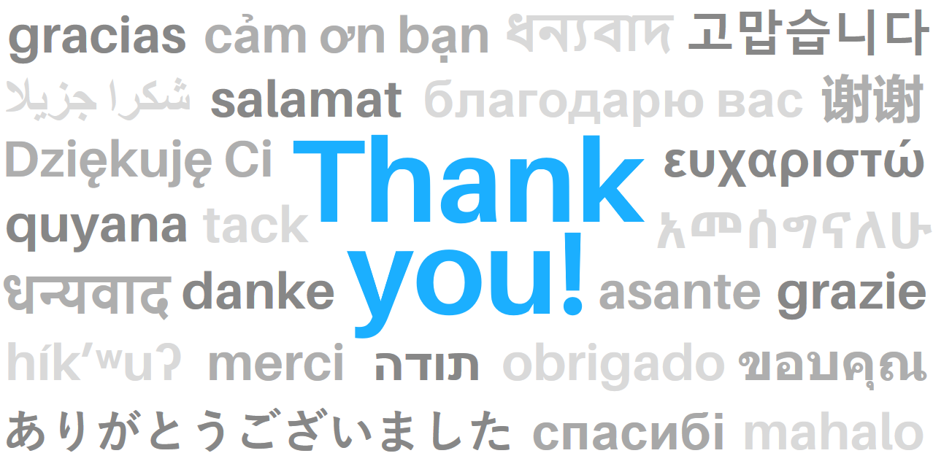
Thank you for your time and attention!
Notes:
Thank you for your time and attention!

