Slide 1
Opioid Overdose 2018-2019 Statistics for Region 8
Notes:
This slide deck provides a brief overview of the use of videoconferencing to deliver assessment and treatment services to individuals with substance use disorders (SUDs) and mental health conditions. It is designed to be used by behavioral health academic faculty, trainers, and state agency staff members for a variety of audiences. Each slide has notes for the presenter to provide guidance if necessary. References are included on the slides and in the notes. If you require further information on this topic, please contact the Mountain Plains Addiction Technology Transfer Center (MPATTC). You are free to use these slides and pictures but please give credit to the MPATTC when using them by keeping the branding and referencing the ATTC at the beginning of your presentation.
MPATTC is part of the SAMHSA-funded ATTC network that offers training/technical assistance (TA) services through a partnership with the University of North Dakota and University of Nevada Reno. The goal of the MPATTC is to improve the capacity of Region 8’s SUD treatment and recovery services workforce by using state-of-the-art training/TA, innovative web-based tools, and proven workforce development activities to expand access to learning, change clinician practice, and advance provider efficiencies, resulting in improved client outcomes. MPATTC training/TA recipients include behavioral health/SUD treatment/recovery administrators, managers, counselors, clinical supervisors, and recovery specialists; health professions academic educators; tribal health professionals; and key stakeholders from related systems of care (e.g., opioid treatment providers); state and local governments; provider associations; and specialized behavioral/primary healthcare providers. You can access additional information at www.mpattc.org.

Slide 2
Disclaimer
This presentation was prepared for the Mountain Plains Addiction Technology Transfer Center (ATTC) under a cooperative agreement from the Substance Abuse and Mental Health Services Administration (SAMHSA). All material appearing in this presentation, except that taken directly from copyrighted sources, is in the public domain and may be reproduced or copied without permission from SAMHSA or the authors. Citation of the source is appreciated. Do not reproduce or distribute this presentation for a fee without specific, written authorization from the Mountain Plains ATTC. For more information on obtaining copies of this presentation, call visit the website (MPATTC).
At the time of this presentation, Elinore F. McCance-Katz, serves as SAMHSA Assistant Secretary. The opinions expressed herein are the views of Nancy Roget, MS, MFT, LADC and do not reflect the official position of the Department of Health and Human Services (DHHS), SAMHSA. No official support or endorsement of DHHS, SAMHSA, for the opinions described in this document is intended or should be inferred.

Slide 3
In 2019, 195 people died per day from drug overdoses.
CDC, 2020
Notes:
According to new data released by the Centers for Disease Control and Prevention (CDC), there were 70,980 reported drug overdose deaths in 2019, or 195 drug overdose deaths per day. This represents an increase of 4.6% from 2018 (20.7 per 100,000) to 2019 (21.7 per 100,000).
Source
American Hospital Association (July 2020). Accessed 07/29/2020 https://www.aha.org/news/headline/2020-07-16-cdc-drug-overdose-deaths-46-2019
CDC (2020). National Vital Statistics Rapid Release: Provisional Drug Overdose Death Counts. Available from: https://www.cdc.gov/nchs/nvss/vsrr/drug-overdose-data.htm
[Updated: 08/01/2020]

Slide 4

that’s like one commercial plane crash a day x 365 days
Notes:
The point of this slide is to impress upon students/participants the magnitude of the rate of opioid overdose by comparing the number of opioid overdose deaths to plane crash losses (this metaphor has been used on several websites but is not officially attributed to one individual). Ask students/participants how the federal government would respond if the United States suffered one plane crash per day every day for one year? Process students/participants’ responses.
The next slide continues the point about the impact of the opioid overdose epidemic by comparing the annual loss of life due to opioid overdoses to other epidemics, wars, accidents, crimes, or diseases.

Slide 5
Opioid Overdose Deaths (70,980) in 2019 were HIGHER than the number of people:
killed in Vietnam (US Military) | 58,220 ¹
that died from HIV/AIDS at the height of the epidemic (1995) | 48,371 ²
killed in motor vehicle accidents | 40,327 ³
with alcohol-induced deaths | 34,865 ³
murdered | 19,362 ³
1. https://www.archives.gov/research/military/vietnam-war/casualty-statistics.html
2. http://www.factlv.org/timeline.htm
3. http://www.drugwarfacts.org/chapter/causes_of_death
Notes:
https://www.drugwarfacts.org/chapter/causes_of_death
[Updated: 08/01/2020]

Slide 6
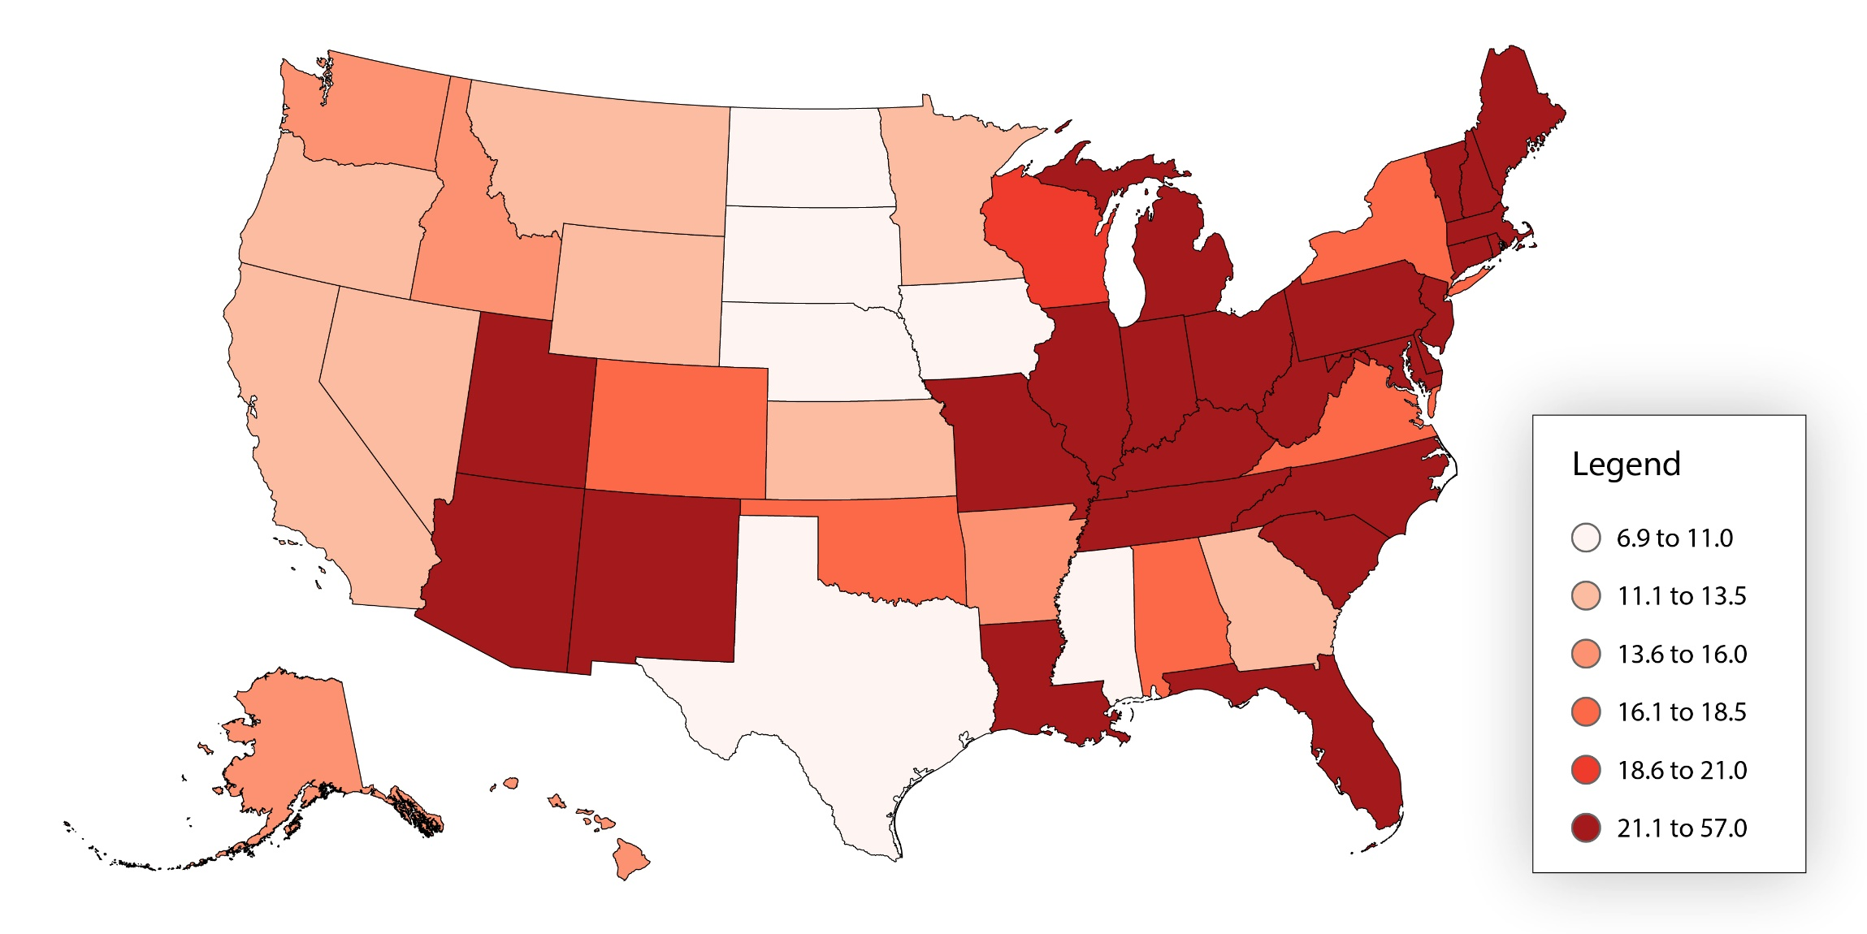
Age-adjusted drug overdose death rates by state: 2018
Hedegaard, Miniño, & Warner, 2020
Notes:
In 2018, the overdose death rates were not significantly different than the 2017 rates for the Region 8 states. Five Region 8 states (Colorado, Montana, North Dakota, South Dakota, and Wyoming) were below the US rate; Utah’s rate was slightly higher than the national rate.
NOTES: Deaths are classified using the International Classification of Diseases, 10th Revision (ICD-10). Drug-poisoning (overdose) deaths are identified using underlying cause-of-death codes X40-X44, X60-X64, X85, and Y10-Y14. Rates are age-adjusted using the direct method and the 2000 U.S. standard population, except for age-specific crude rates. All rates are per 100,000 population.
Sources
CDC/NCHS, National Vital Statistics System, Mortality. CDC WONDER, Atlanta, GA: US Department of Health and Human Services, CDC; 2020. https://wonder.cdc.gov/
Age adjusted https://www.cdc.gov/drugoverdose/data/statedeaths/drug-overdose-death-2018.html
Hedegaard H, Miniño AM, Warner M. Drug overdose deaths in the United States, 1999–2018. NCHS Data Brief, no 356. Hyattsville, MD: National Center for Health Statistics. 2020.
[Updated: 08/01/2020]

Slide 7
Overdose Rates by State in 2018
(National rate 20.7 per 100,000)
26 states and DC had drug overdose death rates comparable to or higher than the national rate of 20.7 per 100,000: UT (21.2)
  WV (51.5), DE (43.8), MD (37.2), PA (36.1), OH (35.9), NH (35.8), and DC (35.4) had the highest observed age-adjusted drug overdose death rates
24 states had rates lower than the national rate: CO (16.8); MT (12.2); WY (11.1); ND (10.2)
IA (9.6), ND (9.2), NE (7.4), and SD (6.9) had the lowest observed age-adjusted drug overdose death rates
Hedegaard, Miniño, & Warner, 2020
Notes:
This slide provides more specific data on overdose rates in 2018 by state. West Virginia’s rate is significantly higher than other states.
Ask students/participants their reactions/thoughts about these data.
Source
Hedegaard H, Miniño AM, Warner M. Drug overdose deaths in the United States, 1999–2018. NCHS Data Brief, no 356. Hyattsville, MD: National Center for Health Statistics. 2020.
https://www.cdc.gov/nchs/products/databriefs/db356.htm
[Updated: 08/01/2020]

Slide 8
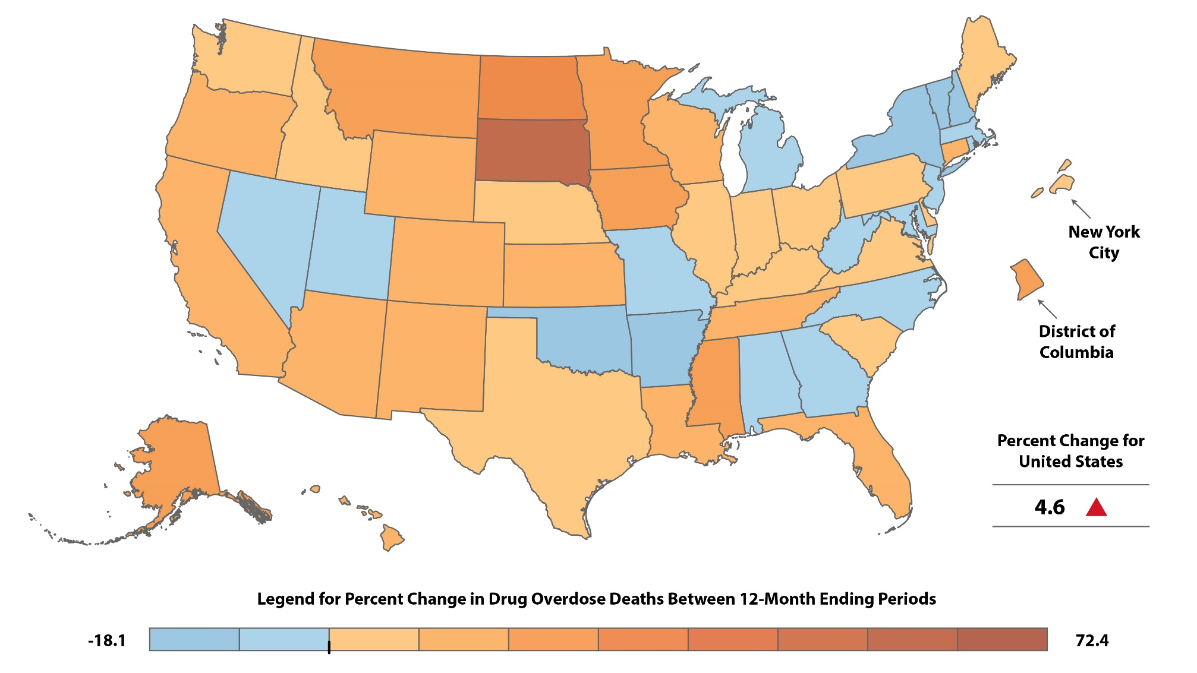
Percent Change in Reported 12-Month-Ending Count of Drug Overdose Deaths: December 2018 to December 2019
Hedegaard, Miniño, & Warner, 2020
Notes:
Recently released data that compare drug overdose death rates between December 2018 – December 2019 indicate a 4.6 percent change increase nationally. Five of the six Region 8 states (CO, MT, ND, SD, WY) experienced increases in overdose death rates; rates in one state (UT) decreased between 2018 and 2019.
State Percent Change 2018 2019
Colorado 9.6 1004 1100
Montana 18.8 117 139
North Dakota 28.6 70 90
South Dakota 54.5 57 88
Wyoming 18.0 61 72
Utah -18.1 630 575
NOTES: Deaths are classified using the International Classification of Diseases, 10th Revision (ICD-10). Drug-poisoning (overdose) deaths are identified using underlying cause-of-death codes X40-X44, X60-X64, X85, and Y10-Y14.
Sources
Hedegaard H, Miniño AM, Warner M. Drug overdose deaths in the United States, 1999–2018. NCHS Data Brief, no 356. Hyattsville, MD: National Center for Health Statistics. 2020.
NCHS, National Vital Statistics System. Estimates for 2019 are based on provisional data. Estimates for 2015-2018 are based on final data (available from: https://www.cdc.gov/nchs/nvss/mortality_public_use_data.htm).
[Updated: 08/01/2020]

Slide 9
For more information, contact

