Slide 1
Substance Use Disorder: A Chronic Brain Disease
Prepared by: Mountain Plains ATTC Staff
Dr. Chris Harsell ANP University of North Dakota Grand Forks, ND 58202 701-777-4520

Slide 2
Disclaimer
This presentation was prepared for the Mountain Plains Addiction Technology Transfer Center (TTC) Network under a cooperative agreement from the Substance Abuse and Mental Health Services Administration (SAMHSA). All material appearing in this presentation, except that taken directly from copyrighted sources, is in the public domain and may be reproduced or copied without permission from SAMHSA or the authors. Citation of the source is appreciated. Do not reproduce or distribute this presentation for a fee without specific, written authorization from the Mountain Plains Mental Health Technology Transfer Center. For more information on obtaining copies of this presentation, call 701-777-6588.
At the time of this presentation, Elinore F. McCance-Katz, served as SAMHSA Assistant Secretary. The opinions expressed herein are the views of Dr. Chris Harsell and do not reflect the official position of the Department of Health and Human Services (DHHS), SAMHSA. No official support or endorsement of DHHS, SAMHSA, for the opinions described in this document is intended or should be inferred.

Slide 3
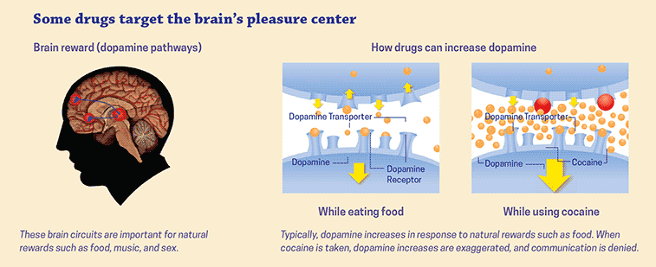
Drugs Impact the Reward Pathway to the Brain
National Institute on Drug Abuse, 2018
Notes:
Source: National Institute on Drug Abuse (2018). Drugs, Brains, and Behavior: The Science of Addiction. https://www.drugabuse.gov/publications/drugs-brains-behavior-science-addiction/drugs-brain

Slide 4
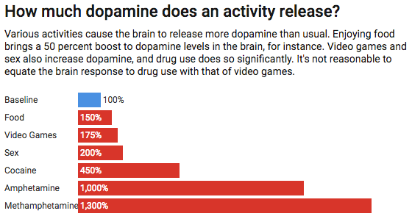
Comparisons of Dopamine Release
Ferguson, 2018
Notes:
Source: Ferguson, C.J. (2018) Debunking the Biggest Myths About Technology Addiction. Discover. http://blogs.discovermagazine.com/crux/2018/05/23/debunking-myths-technology-addiction/#.W9Z7OOJRfb1

Slide 5
Changes in Brain Chemistry
“..persons with addiction often become less motivated by everyday stimuli (e.g. relationships and activities) that they had previously found to be motivating and rewarding.
“…these changes become deeply ingrained and cannot be immediately reversed through the simple termination of drug use”
(Volkow, Koob & McLellan, 2018)
“Every day feels like the second Tuesday in February.”
Volkow, Koob & McLellan, 2018
Notes:
Source: Volkow, N.D., Koob, G.F. & McLellan, T. (2016) Neurobiologic Advances from the Brain Disease Model of Addiction New England Journal of Medicine 374:363-317.

Slide 6
Definitions
Chronic and recurrence disorder characterized by compulsive drug seeking, continued use despite harmful consequences, and long-lasting changes in the brain. A complex brain disorder and a mental illness.
“Addiction is the most severe form of a full spectrum of substance use disorders, and is a medical illness caused by repeated misuse of a substance or substances.”
National Institute on Drug Abuse, 2018
National Institute on Drug Abuse, 2018
Notes:
Source: National Institute on Drug Abuse (2018). Drugs, Brains, and Behavior: The Science of Addiction. https://www.drugabuse.gov/publications/drugs-brains-behavior-science-addiction/drugs-brain

Slide 7
ACES Effects
The Centers for Disease Control and Prevention, 2016
Notes:
Source: Centers for Disease Control and Prevention (2016) About Adverse Childhood Experiences. https://www.cdc.gov/violenceprevention/acestudy/about_ace.html

Slide 8
ACE Indicators
Emotional abuse
Physical abuse
Sexual abuse
Mother treated violently
Household substance abuse
Person struggling with mental health disorder
Parental separation or divorce
Criminal household member
Emotional neglect
Physical neglect
https://attcnetwork.org/centers/mountain-plains-attc/trauma-informed-care

Slide 9
Definition of Disease
A condition characterized by specific signs and symptoms
Caused by a combination of biologic, behavioral, and environmental factors
Results in damage or change in function to body systems
If untreated, can lead to loss of function or death
Control versus cure

Slide 10
Awareness
Use of person-centered language
https://www.communitycatalyst.org/resources/2017-alerts/6-22/Guide-to-non-stigmatizing-languageFINAL.pdf
Avoid “shame and blame”
Screen for substance use and trauma
Talk to people in recovery
Know your referral sources – Warm Hand Offs

Slide 11
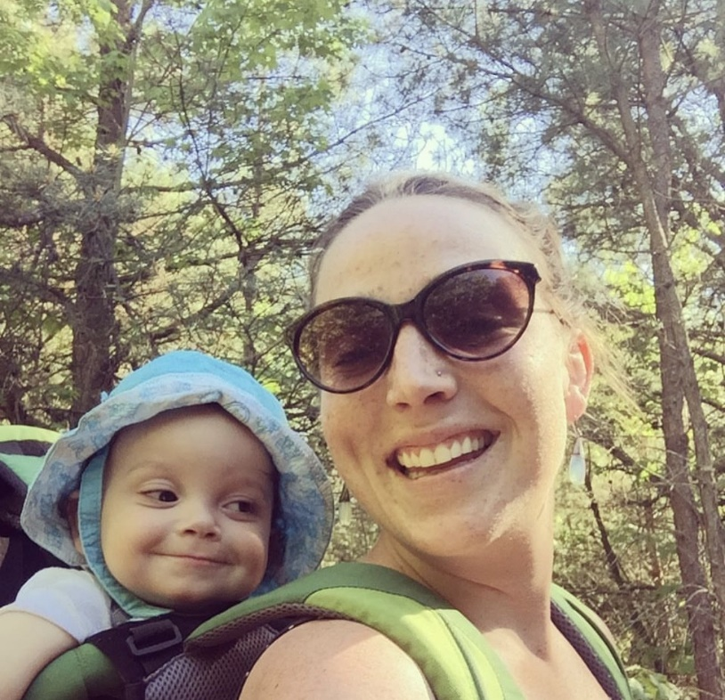
A Powerful Message from Family
Madelyn Linsenmeier
1988 - 2018
https://www.sevendaysvt.com/vermont/madelyn-linsenmeir-1988-2018/Content?oid=21797604&fbclid=IwAR2fjyDwHDuJTyRtruJHqaoeSCAgDLiWkU9HvHdXVeLhVVEe7zch-3V1hgw

Slide 12
For more information, contact
Thomasine Heitkamp, PI/Co-Director
University of North Dakota
thomasine.heitkamp@und.edu
Nancy Roget, Co-Director
University of Nevada, Reno
nroget@casat.org
www.mpattc.org

