Slide 1
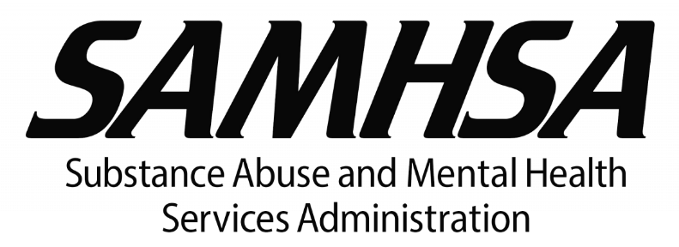
Stigma and Substance Use Disorders (SUDs)
Prepared by:
Mountain Plains ATTC Staff
Dr. Chris Harsell ANP
University of North Dakota
Grand Forks, ND 58202
701-777-4520

Slide 2
Disclaimer
This presentation was prepared for the Mountain Plains Addiction Technology Transfer Center (TTC) Network under a cooperative agreement from the Substance Abuse and Mental Health Services Administration (SAMHSA). All material appearing in this presentation, except that taken directly from copyrighted sources, is in the public domain and may be reproduced or copied without permission from SAMHSA or the authors. Citation of the source is appreciated. Do not reproduce or distribute this presentation for a fee without specific, written authorization from the Mountain Plains Mental Health Technology Transfer Center. For more information on obtaining copies of this presentation, call 701-777-6588.
At the time of this presentation, Elinore F. McCance-Katz, served as SAMHSA Assistant Secretary. The opinions expressed herein are the views of Dr. Chris Harsell and do not reflect the official position of the Department of Health and Human Services (DHHS), SAMHSA. No official support or endorsement of DHHS, SAMHSA, for the opinions described in this document is intended or should be inferred.

Slide 3
What is Stigma?
Stigma is defined as a mark of disgrace or infamy, a stain of reproach, as on one's reputation
Stigma remains the biggest barrier to addiction treatment faced by patients/clients
(naabt.org)
(SAMHSA, 2018)

Slide 4
FACTS
Substance Use Disorder (SUD) is among the most stigmatized conditions in the U.S. and around the world
Healthcare providers might treat patients/clients with substance use disorders differently due to stigma
People with a substance use disorder who expect, or experience stigma have poorer healthcare outcomes
(SAMHSA, 2018)

Slide 5
Burden of Stigma
Upon diagnosis of a disease or substance use disorder, there may be a perceived implication that the patient has control over the condition and is at fault for acquiring it.
Hard to treat Cancers
SUD
(SAMSHA 2018)

Slide 6
Negative Consequences of Stigma
Substance use disorders are viewed more negatively than mental illness.
People who experience stigma are less likely to seek treatment.
Trickle Down Effect:
Less willing to access healthcare
Harm reduction is impaired
Negative effect on self-esteem and mental health
(SAMHSA’s Center For The Application Of Prevention Technologies, 2017)
(Johns Hopkins HUB, October 1, 2014)
Notes:
Source: Johns Hopkins HUB. (October 1, 2014). Drug addiction viewed more negatively than mental illness, Johns Hopkins study shows.

Slide 7
Role of Prevention Providers
Reduce stigma surrounding substance misuse
Challenge providers and communities to be aware of unintentional bias
Use appropriate language in formal and informal conversations when discussing SUDs to decrease stigma by:
Removing labels
Using “person first” language
Review the MPATTC “Language Matters” slideDeck4U presentation at mtplainsattc.org

Slide 8
Changing Language of SUD
Terms that promote stigma:
Addict/Junkie/User/Alcoholic
Addiction/Substance Abuse
Clean/Dirty (in relation to urine test)
Drug Overdoes
Clean (in relation to the person)
Relapse
Terms to decrease stigma:
Person with a substance use disorder
Substance Use Disorder (SUD)
Negative/Positive (in relation to urine test)
Drug Poisoning
Hazardous/Risky/Harmful
Recurrence/Return to Use
Kelly, J.F., Walkerman, S.E. & Saitz, R. (2015, January).
Notes:
Source:
Kelly, J.F., Walkerman, S.E. & Saitz, R. (2015, January). Stop talking 'dirty': clinicians, language, and quality of care for the leading cause of preventable death in the United States. The American Journal of Medicine, 128(1), 8-9.

Slide 9
Reminders
Substance Use Disorder (SUD) is a chronic disease. . . as are diabetes, depression and hypertension
Substance use falls along a continuum
Use ranges from abstinence/low-risk to chronic dependence and encompasses all stages in between
Relapse and lapse are a part of the disease process
As many other chronic diseases can be managed, SUD can also be managed through appropriate treatment -- even during pregnancy
Successful treatment for SUD means the person is in recovery; it does not mean they are “cured”
Adlaf, E.M., Hamilton, H.A., Wu, F., & Noh, S. (2009).
Notes:
Sources:
Adlaf, E.M., Hamilton, H.A., Wu, F., & Noh, S. (2009).

Slide 10
Reminders (cont)
Embrace positive change: Treatment for substance use disorders has historically been viewed as binary, with addiction and abstinence as a person’s only two options
Don’t create a dichotomy of “someone is using or not using.” There are many positive changes a person can make to reduce negative consequences
Don’t convey the impression that abstinence is the only goal
Don’t assume there is only one “right” way to address substance misuse
Brown, S.A. (2011).
Notes:
Source:
Brown, S.A. (2011). Standardized measures for substance use stigma. Drug and Alcohol Dependence, 116, 137-141.

Slide 11
For more information, contact
Thomasine Heitkamp PI/Co-Director
University of North Dakota
thomasine.heitkamp@und.edu
Nancy Roget, Co-Director
University of Nevada, Reno
nroget@casat.org
www.mpattc.org
Notes:
Other useful resources:
Browne, T., Priester, M., Clone, S., & Iachini, A., DeHart, D., & Hock, R. (2015). Barriers and facilitators to substance use treatment in the rural south: A qualitative study. The Journal of Rural Health, 32, 92-101.
Buchman, D.Z., Leece, P., & Orkin, A. (2017, Winter). The epidemic as stigma: the bioethics of opioids. Journal of Law, Medicine, & Ethics, 45(4), 607-611.
Kramlich, D., Kronk, R., Marcellus, L., Colbert, A., & Jakub, K. (2018). Rural Postpartum Women With Substance Use Disorders. Qualitative Health Research, 1-13.

