Slide 1
Introduction to Motivational Interviewing: Part 2
Presented by:
Kevin Tomlin, LPC LMHC CADC-I SUDP
Cheyenne River Tribe via Portland Oregon
Notes:
Welcome to the Native Center for Behavioral Health! I am Elleh Driscoll, and today, Avis Garcia will be presenting Safe at Home: Domestic Violence Awareness Series Part 2!

Slide 2
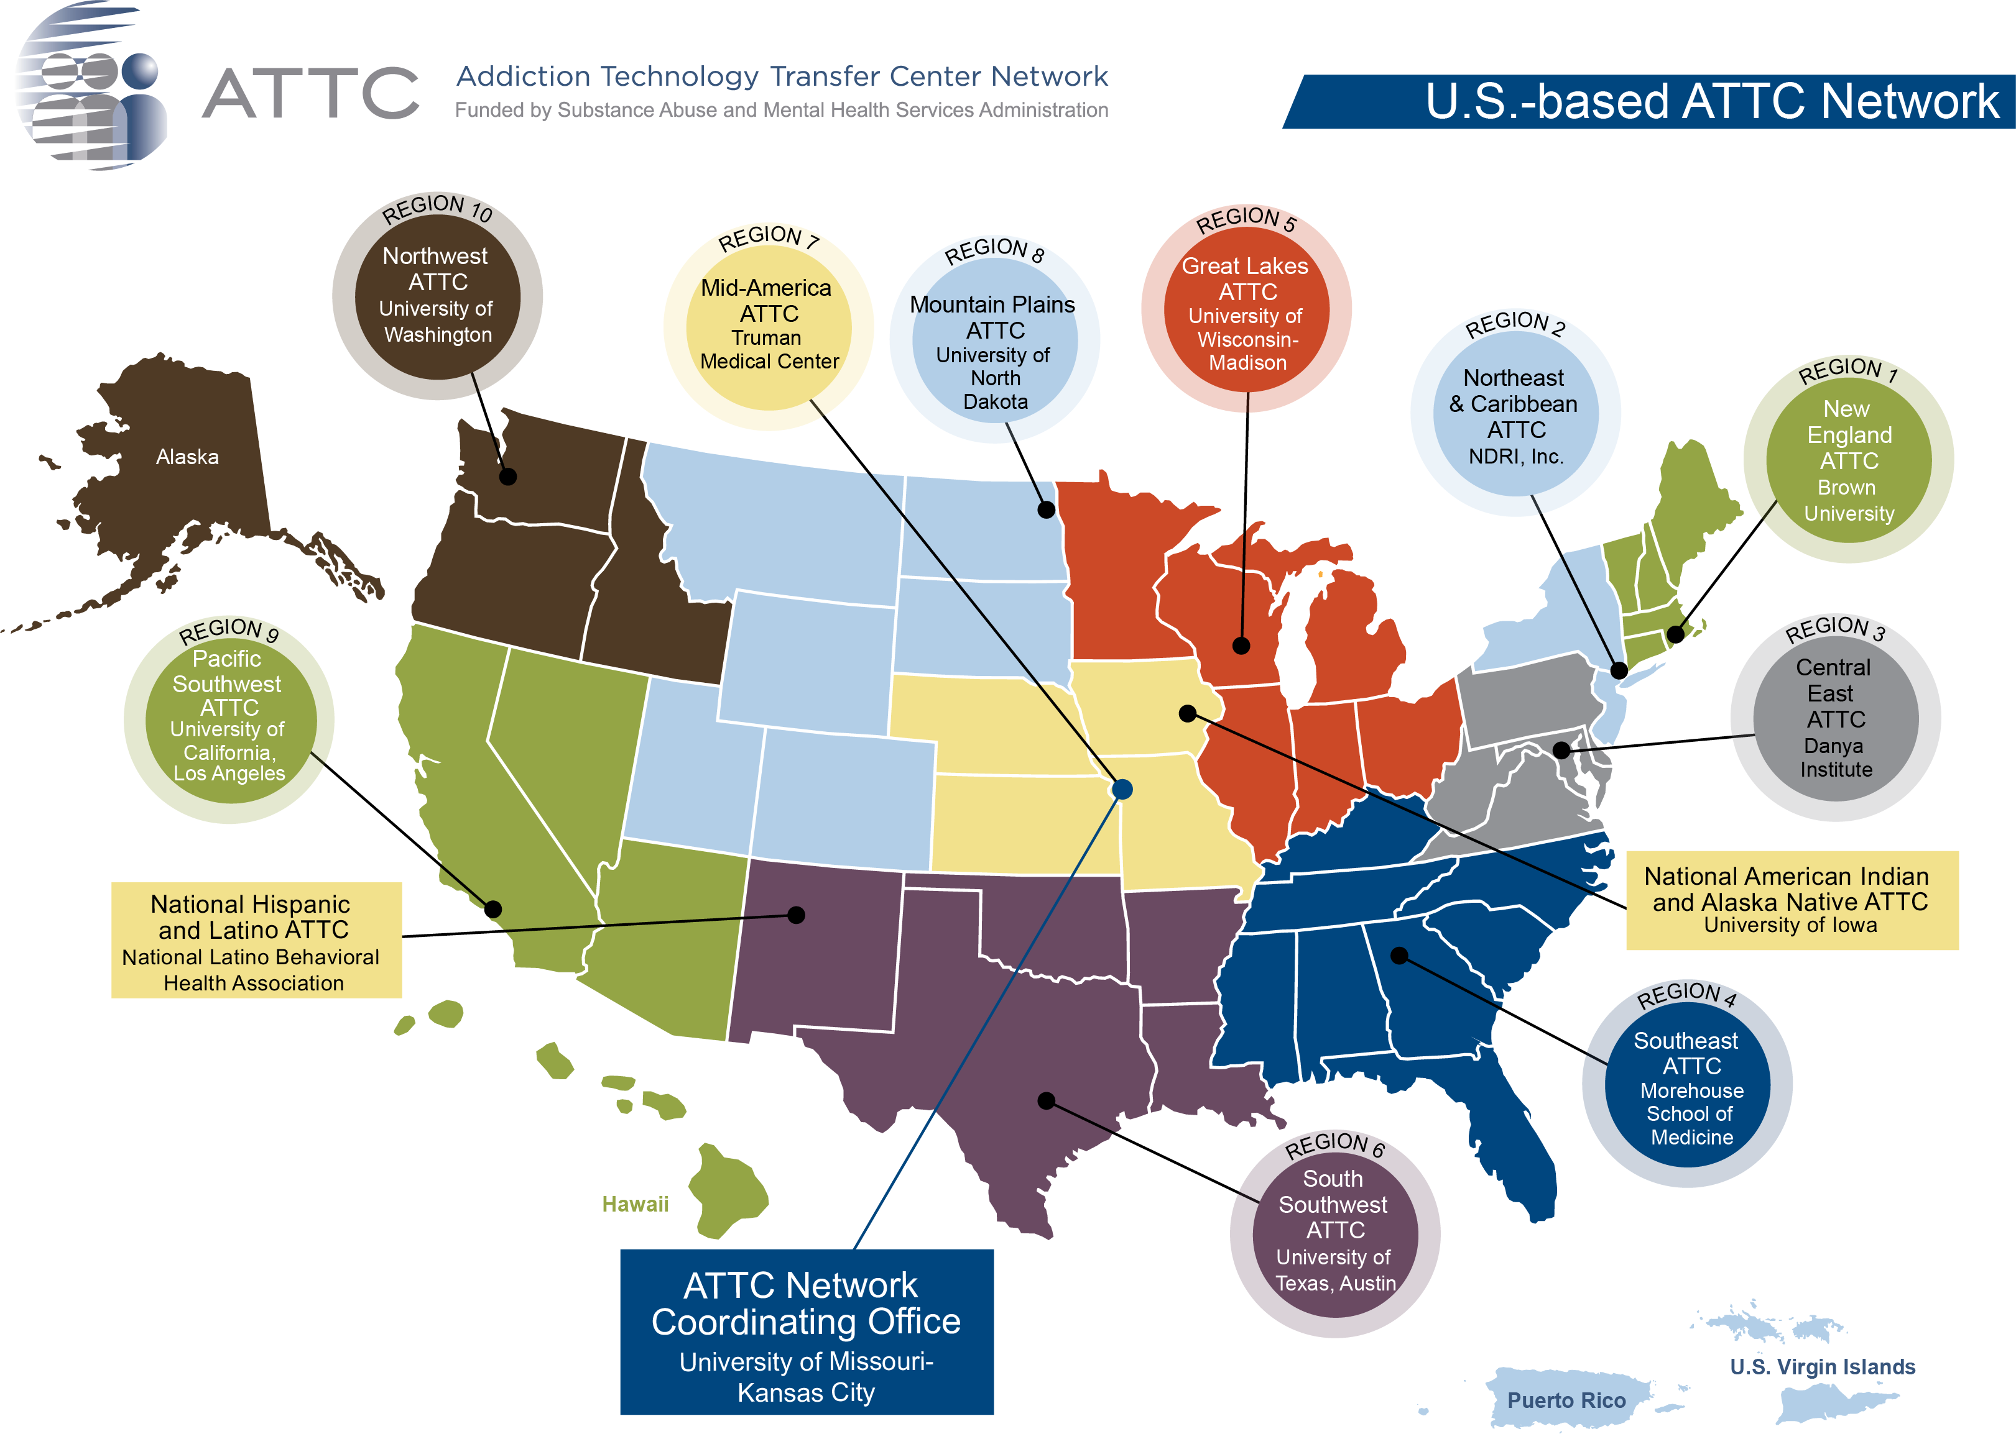
Essential Substance Abuse Skills webinar series
This webinar is provided by the National American Indian & Alaska Native ATTC, a program funded by the Substance Abuse and Mental Health Services Administration (SAMHSA).
Notes:
This training series is brought to you by the National American Indian & Alaska Native Addiction Technology Transfer Center. We are part of the ATTC Network out of Iowa City, Iowa.

Slide 3
Webinar follow-up
Evaluation: SAMHSA’s GPRA
This webinar is provided by the National American Indian & Alaska Native MHTTC, a program funded by the Substance Abuse and Mental Health Services Administration (SAMHSA).
Participation in our evaluation lets SAMHSA know:
How many people attended our webinar
How satisfied you are with our webinar
How useful our webinars are to you
You will find a link to the GPRA survey in the chat box. If you are not able to complete the GPRA directly following the webinar, we will send an email to you with the survey link. Please take a few minutes to give us your feedback on this webinar. You can skip any questions that you do not want to answer, and your participation in this survey is voluntary. Through the use of a coding system, your responses will be kept confidential and it will not be possible to link your responses to you.
We appreciate your response and look forward to hearing from you.
Notes:
We will be sharing a link to our GPRA survey at the end of our session today. This survey takes just a few minutes to complete, and asks about your satisfaction with the event. This feedback is critical to our future work, and we value your opinion and would greatly appreciate your time in sharing your thoughts with us.
In the next couple of days we will send you a follow up email that includes a link to the recording, a handout of the slides, and CEU request instructions. We are a NADAC certified educational provider, and we are currently waiving fees for CEUS throughout the pandemic.
Again, the follow up email will contain instructions for ordering your CEUs.

Slide 4
The National American Indian and Alaska Native Addiction Technology Transfer Center is supported by a grant from CSAT/SAMHSA.
The content of this webinar is the creation of the presenter(s), and the opinions expressed do not necessarily reflect the views or policies of SAMHSA, HHS, or the American Indian & Alaska Native ATTC.
Notes:
This project is supported by the Substance Abuse and Mental Health Services Administration (SAMHSA).
The content is developed by the presenter, and the opinions expressed do not necessarily reflect the views or policies of SAMHSA, HHS, or the American Indian & Alaska Native ATTC.

Slide 5
Zoom Overview
Participant overview:
You will need to click on the “Chat” icon to open up the chat on the right side of the screen.
To ask questions or share comments, please type them into the chat pod and hit “Enter.”
Notes:
You will be muted for the duration of this webinar.
Please use the chat feature to share your questions and comments throughout the presentation, and we will address questions at the end.

Slide 6
Today’s Speaker
Kevin Tomlin, LPC LMHC CADC-I SUDP
Cheyenne River Tribe via Portland Oregon
Kevin is originally from Puget Sound area, and now lives in Portland. He is currently working as an addictions therapist and participating in various ways with members of the MINT community, learning the ropes of becoming a high-quality MI trainer.
Kevin walked with several teachers in shaping his voice as a therapist, retreat leader and speaker, drawing on diverse traditions. Clinical training followed, and Kevin now focuses his energy on integrating this traditional spirit into professional practice. He is currently working closely with members of the Motivational Interviewing Network of Trainers to this end.

