Slide 1
Advanced Medical Interpreting in a Mental Health Setting
March 13th, 2021
9:00 – 12:45
Notes:
Pat – Welcome to the Advanced

Slide 2
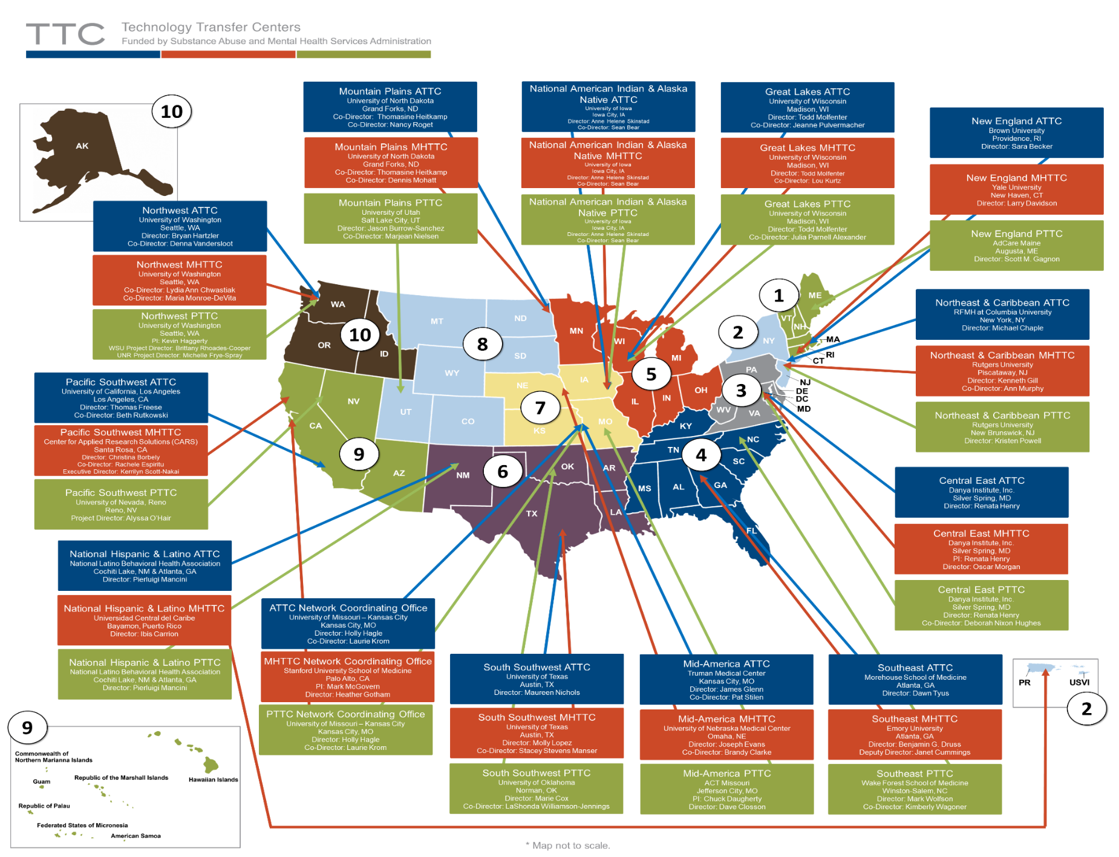
Technology Transfer Center Network
Notes:
PAT: The Technology Transfer Center (TTC) Network is a national network of training and technical assistance centers serving the needs of mental health, substance use and prevention providers.

Slide 3
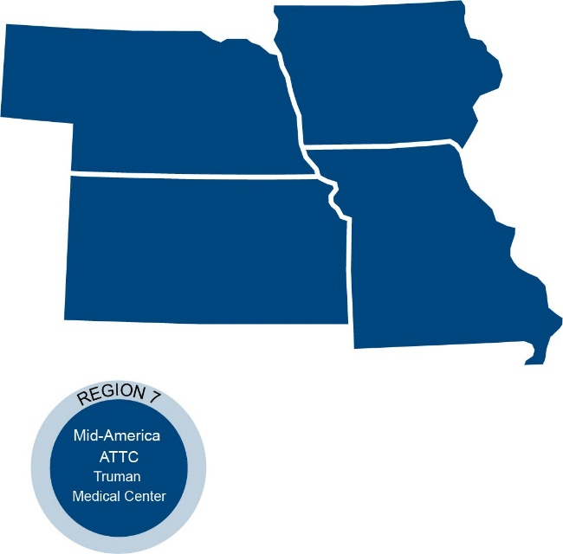
Mid-America ATTC & MHTTC Health and Human Services (HHS) Region 7
Hosting Today’s Webinar
Notes:
PAT: The Mid-America Addiction Technology Transfer Center is one of 12 centers that make up the larger ATTC network. The Mid-America Mental Health Technology Transfer Center is also one of 12 centers that make up the larger MHTTC Network. The TTC Network is funded by the Substance Abuse and Mental Health Services Administration (SAMHSA) to provide training, resources, and technical assistance to individuals serving persons with mental health and substance use disorders. The Mid-America ATTC and MHTTC serves the states of Iowa, Kansas, Missouri, and Nebraska. The Mid-America ATTC is located at Truman Medical Center and the University of Missouri Kansas City in Kansas City, MO. The Mid-America MHTTC located at the University of Nebraska Medical Center in Omaha, NE.

Slide 4
Disclaimer and Funding Statement
This presentation was prepared for the Mid-America Addiction Technology Center and the Mid-America Mental Health Technology Transfer Center under a cooperative agreement from the Substance Abuse and Mental Health Services Administration (SAMHSA). All materials appearing in this presentation, except that taken directly from copyrighted sources, are in the public domain and may be reproduced or copied without permission from SAMHSA or the authors. Citation of the source is appreciated. Do not reproduce or distribute this presentation for a fee without specific, written authorization from Mid-America Addiction Technology Transfer Center.
At the time of this presentation, Tom Coderre served as SAMHSA Acting Assistant Secretary. The opinions expressed herein are the views of Gabriele Flores and do not reflect the official position of the Department of Health and Human Services (DHHS), or SAMHSA. No official support or endorsement of DHHS, SAMHSA, for the opinions described in this presentation is intended or should be inferred.
The work of the Mid-America ATTC is supported by grant 1H79TI080208-01 from the Department of Health and Human Services, Substance Abuse and Mental Health Services Administration.
Notes:
Pat - Today’s presentation is provided free of charge by the Mid-America ATTC and MHTTC. Today’s presentation is available in the public domain and should Not be distributed for a fee without the express written permission of the Mid-America ATTC.
The views and opinions expressed during today’s presentation are those of our presenters and do not reflect the official position of the Department of Health and Human Services or SAMHSA. No official support or endorsement of DHHS or SAMHSA is intended or should be inferred. Please contact us with any questions you may have.

Slide 5
Facilitator Bio
Gaby Flores, MSM
Director, Office of Equity & Diversity​, Kansas City area hospital
Bachelor’s in Cultural Anthropology; Master’s in Science of Management – focus in Healthcare Administration​
25 years of experience in language access, diversity and inclusion ​
Former CCHI Commissioner

Slide 6
Continuing Education
This workshop is nationally accredited by the Continuing Education Program (CEAP) for
3.5 instructional hours
INTERNATIONAL MEDICAL
INTERPRETERS ASSOCIATION
Leading the advancement of professional interpreters
This workshop is nationally accredited by the Continuing Education Program of IMIA for 0.35 IMIA/NBCMI CEUs with the unique education registry ID: 21-1025

Slide 7
Welcome!
Type in the Chat:
What State/Country do you live in now?
What languages do you interpret?

Slide 8
Community Agreements
R: Respect/responsibility, keep it real
O: Open mind, oops/ouch
P: Participating (with the right to pass), personal questions
E: Empathy and education
S: Said here/stays here, safe space

Slide 9
Why Mental Health Interpreting?
In many health care professions, effective communication is crucial for a successful provider- patient interaction
Miscommunication caused by language barriers can lead to mis-diagnosis, errors or no treatment at all
In mental health treatment, clinicians rely on verbal and nonverbal communication as the primary tool for obtaining a detailed psychiatric and psychosocial history and forming a therapeutic relationship with the client
Use of medical interpreters is necessary to bridge the language and cultural gap, even though it may not be the ideal communication
Most interpreters are not properly trained for interpreting in mental health settings
Most clinicians are not skilled in the use of interpreters

Slide 10
Today’s Agenda
9:00 – 9:10 | Welcome
9:10 – 9:25 | Quick overview of Language Access and Interpreter Professional Standards
9:25 – 9:45 | Refugee/Immigrant Context for Mental Health
9:45 – 10:30 | Definitions, Common Mental Health Disorders & Activity
10:30 – 11:00 | Mental Health Interpreting best Practices: Settings, Positioning and Challenges
11:00 – 11:15 | BREAK
11:15 – 11:40 | Treatment overview, Cultural Implications
11:40 – 12:30 | Break Out Rooms and Case Scenarios, Debrief and Discuss
12:30 – 12:45 | Closing Summary and Professional Development Resources

Slide 11
Objectives
Review
Review the professional guidelines and ethical framework of Healthcare Interpreters
Identify
Identify challenges of interpreting in the mental health arena, both ambulatory and inpatient settings
Describe
Describe stressors for refugees and immigrants that may lead to mental health disorders
Identify
Identify common mental health disorders and appropriate terminology
Discuss
Discuss a refugee mental health model
Differentiate
Differentiate your role as an interpreter in a mental health setting, versus a non-mental health setting
Discuss
Discuss best practices in mental health interpreting techniques
Demonstrate
Demonstrate interpreting techniques using mock scenarios related to mental health sessions

Slide 12
Definitions
Limited English Proficient (LEP): An individual who may have a limited proficiency in written or oral English language or who is an English Language Learner
Interpretation: The process of understanding and analyzing a spoken or signed message and re-expressing that message faithfully, accurately and objectively in another language, taking the social and cultural context into account
Translation: The conversion of a written text into a corresponding written text in a different language
Bilingual Person: A person who has some degree of proficiency in two languages
Certified Healthcare Interpreter: An interpreter who has completed language competency assessment in two languages through a nationally validated testing process
National Council on Interpreting in Health Care

Slide 13
Language Access: Regulatory and Compliance Drivers
1964 Civil Rights Act – Title Vi
CLAS Standards
Joint Commission
Affordable Care Act

Slide 14
Healthcare Interpreters Code of Ethics and Professional Standards
Confidentiality
Render the message accurately, convey the content and spirit of the original message
Impartiality
Maintain boundaries of the professional role
Develop awareness of his/her own culture and others
Treats all parties with respect
Advocate – only if patients’ well-being/dignity at risk
Professional Development and Skills
Act in a professional and ethical manner
National Council on Interpreting in Health Care

Slide 15
The Context
What’s the story of the people we interpret for?
The only thing stronger than fear is HOPE

Slide 17
Refugee Facts
79.5 million people have been forced to flee their homes (by the end of 2019)
Increased by 8.7 million over previous year
26.0 million refugees in the world; 45.7 million internally displaced; 4.2 million asylum - seekers
31,250 refugees resettled to the US in 2019
3 million refugees resettled in the US since 1975, in all 50 states
UNHCR, www.unrefugees.org

Slide 18
Stressors for Refugee/Immigrant Populations (Before Migration)
Civil War, Conflict, Violence
Watching family members being killed in war, conflict
Rape and Sexual Assault
Danger of fleeing home to the unknown
The actual journey!
Refugee camp along with 100,000 other people with similar trauma
Adverse Childhood Events

Slide 19
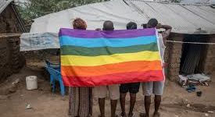
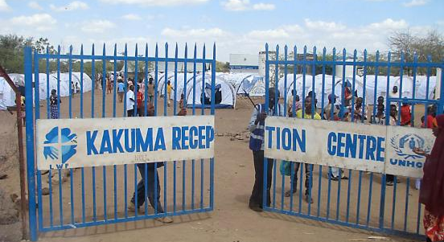
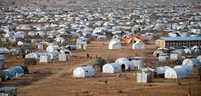

Slide 20
Stressors for Refugee/Immigrant Populations (During Migration)
Separation from family and all things familiar
Language and communication barriers
Health concerns
Housing and living conditions
Food/water insecurity
Adverse Childhood Events
Toxic Stress

Slide 22
Stressors for Refugee/Immigrant Populations (After Migration)
Housing and living conditions
Safety and crime
Employment – goals and deadlines
Self-sufficiency
Language and communication barriers
Health concerns and Adverse Childhood Events
Onset of PTSD
Self-soothing and coping with substances

Slide 23
Refugees have an elevated risk of mental ill health in the resettlement stage as a consequence of the significant personal disruption and experiences of torture, trauma, and loss that many have experienced. Overall, refugees show greater levels of psychological disturbance than the general population, including higher rates of major depressive disorder and post‐traumatic stress disorder (PTSD).
(Fazel, Wheeler, & Danesh, 2005; Porter & Haslam, 2005)

Slide 24
Adverse Childhood Experiences (ACE’s)
ACEs are potentially traumatic events that occur in childhood (0-17 years):
experiencing violence, abuse, or neglect
witnessing violence in the home or community
having a family member attempt or die by suicide
Also included are aspects of the child’s environment that can undermine their sense of safety, stability, and bonding such as growing up in a household with:
substance misuse
mental health problems
instability due to parental separation or household members being in jail or prison
ACEs are linked to chronic health problems, mental illness, and substance misuse in adulthood
ACEs can also negatively impact education and job opportunities
www.cdc.gov/violenceprevention/aces

Slide 25
Video

Slide 26
Psychologists define resilience as the process of adapting well in the face of adversity, trauma, tragedy, threats, or significant sources of stress—such as family and relationship problems, serious health problems, or workplace and financial stressors. As much as resilience involves “bouncing back” from these difficult experiences, it can also involve profound personal growth.
https://www.apa.org/topics/resilience

Slide 27
Common Mental Health Disorders

Slide 28
Quick Poll
Have you interpreted for outpatient mental health therapy?
If so how did it go?
<Awesome, Decent, It was challenging, Epic Fail>
Have you interpreted for a mental health crisis or inpatient psychiatric?
If so, how did it go?
<Awesome, Decent, It was challenging, Epic Fail>

Slide 29
Definition of Mental Health
Mental health is the successful performance of mental functions in terms of thought, mood and behavior. A person with a mental illness has impaired mental functions to the point that it interferes with functioning on a social and developmental level
A person with a mental illness may have difficulty holding a job, making decisions, keeping friends, or enjoying life
Mental health conditions are extremely common, in that about one in four American adults suffer from a diagnosable mental disorder in a given year, and nearly half have more than one disorder
American Psychiatric Association

Slide 30
Most Common Mental Health Disorders
Mood disorders (major, minor or chronic depression, bipolar disorder)
Schizophrenia
Suicide
Anxiety disorders (panic disorder, obsessive-compulsive disorder, post-traumatic stress disorder, generalized anxiety disorder, and phobias)
Eating disorders
ADHD
Autism
Alzheimer’s disease
American Psychiatric Association

Slide 31
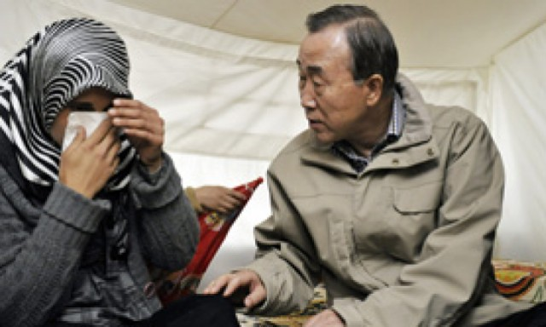
Mental Health Disorders in Resettled Refugees
Estimated 1 out of 3 asylum seekers and refugees experience high rates of depression, anxiety, and PTSD
4-40% for Anxiety
5-44% for Depression
9-36% in PTSD
Mental Health Facts on Refugees, Asylum-seekers and Survivors of Forced Displacement, www.psychiatry.org, pg. 3

Slide 33
Post-Migration Stressors: Adverse Impact on Mental Health
Poverty
Insecure Housing
Unemployment
Multiple moves with changes in neighborhoods
Social, cultural and linguistic isolation
Stressful legal issues
Poor access to services
General disadvantage in host country
Mental Health Facts on Refugees, Asylum-seekers and Survivors of Forced Displacement, www.psychiatry.org, pg. 3

Slide 34
Reluctance to Access Mental Health Care
Refugees and Asylees may be resistant to seeking mental health care due to beliefs that diagnosis will interfere with:
Jobs and housing
That there may be no treatment
Cultural values surrounding silence/disclosure; Stigma
Differing beliefs about manifestation of emotional health
Lack of incorporation of these beliefs into care
Common structural barriers: availability of services, lack of understanding of MH systems, insurance, language proficiency, provider openness
Mental Health Facts on Refugees, Asylum-seekers and Survivors of Forced Displacement, www.psychiatry.org, pg. 3

Slide 35
Refugees and Substance Use Disorders
Because many refugees have suffered intense trauma, they may be especially susceptible to seeking out ways to escape or to self-treat their pain
Stressors described above can create feelings of instability that can encourage substance use
Similarly, refugees reluctance to access MH supports may also lead to socially/culturally more acceptable coping strategy of substance use
Male refugees, young adult refugees, and unmarried refugees are at higher risk of having an alcohol use disorder
Use of culturally-normed substances (ie, traditional alcohol, Khat)
https://www.addictioncenter.com/addiction/refugees-immigrants/

Slide 36
Activity
Please refer to Handout entitled “Common Mental Health Terminology”
Take 5-7minutes to review the term and its definition
Write down the translation (or look it up!)
Take notes on common and medical terms in target language

Slide 37
Debrief
How many terms did you recognize?
Were you able to identify an equivalent in your target language? How would you handle the interpretation if unknown?

Slide 38
Best Practices in Mental Health Interpreting Techniques
Defining Mental Health Interpreting
Positioning and Flow
Challenges

Slide 39
Poll Questions
Have you Interpreted for these kinds of cases?
Spousal or Child Abuse? <yes/no>
Post-Partum Depression? <yes/no>
Mental health therapy? <yes/no>
Inpatient psychiatric? <yes/no>
IEP for school-aged kids <yes/no>

Slide 40
What is Mental Health Interpreting?
A mental health interpreter is an interpreter working in mental health settings. These settings include not only emergency, treatment or rehabilitation settings, but also settings in which the client is identified as a mental health client meeting; a housing and accommodation support meeting with representatives of a relevant support service; a medical setting relating to physical health symptoms that are a consequence of a mental illness or condition.
“Mental Health Interpreting Guidelines” Hlavac, 2017

Slide 41
What is Mental Health Interpreting?
The terms encompass a wide range of clinical sessions or encounters
It is important for the medical interpreter who is being sent to a “mental health” assignment to know exactly what to anticipate
We carry our own cultural interpretation of mental health, so we must watch our biases and preconceptions

Slide 42
Where is the interpreting taking place?
Locked inpatient unit?
Community Mental Health Center?
Inpatient or outpatient setting?
New admission?
Emergency Department for Suicidal Ideation?

Slide 43
What is the purpose of the session?
Case management
Family meeting
Testing/Assessment
Forensic case
Suicide watch
Therapy

Slide 44
Types of Encounters
Taking the medical and psychological history
Explaining evaluations
Diagnoses
Treatment planning and treatment options
Providing individual, group, couples or family therapy
Providing discharge instructions
Follow-up care
Individually designed programs
Family conferences
Psychological and neuropsychological testing
Acute Psychotic Episodes
American Psychiatric Association

Slide 45
How is MH Interpreting Different from Other Interpreting?
In mental health interpreting, how a message is expressed is as important as what is expressed
Register, syntax and tone must be maintained and not altered
Statements that are sexual in nature or profanities must not be censored
Incoherent thought, streams of consciousness or aggitation are all important features of a patient’s communication that must be faithfully rendered from the source into the target language
Cynthia Roat, MPH

Slide 46
Managing the Session
Pre-Session
Hold a pre-session with the provider and find out the goals of the session and special techniques may be used
Try to determine the state of the patient
Positioning
May depend on circumstance of interpreting (outpatient vs inpatient)
Interpreter seated can sometimes help de-escalate
Post-session or De-Brief
Depending on the severity of the case, you might need to unpack with a colleague; Also important to do a hand-off to next interpreter

Slide 47
Role Boundaries/Conflicts
An interpreter should enforce client boundaries at all times by not offering personal opinions, personally expressing a commitment to confidentiality, and explaining what the interpreter can or cannot do.
Sometimes clients want their interpreters to be their advocates or friends.
Interpreters can gently inform clients/patients about their role (pre-session) and advise the clients to speak to a qualified professional such as the clinician.
CMH - Advanced Medical interpreter Course AMI 2012

Slide 48
Role Boundaries/Conflicts
Over identification by patient with the interpreter due to cultural and language bonds.
Overdependence of provider on the interpreter due to unfamiliarity of language and culture.
Rejection of the interpreter by the patient due to fear of breach of confidentiality.
Over exercising the power and authority by the interpreter in relating to patient due to social class difference.
CMH - Advanced Medical interpreter Course AMI 2012

Slide 49
Role Boundaries/Conflicts
Deletion/Omission of information
Paraphrasing
Lack of translatable words or concepts
Side Conversations
Lack of familiarity with terminology
Inability to detect paralinguistic or nonverbal cultural behavior
CMH - Advanced Medical interpreter Course AMI 2012

Slide 50
Reducing Stigma
It is imperative that the MH interpreter be aware of any biases or prejudice he or she may have toward persons with mental illness, and be able to reject the mythology surrounding mental illness.
The MH interpreter must understand the medical concept of mental illness, and that it is like any other medical condition with a biological basis.
The interpreter needs to be able to contrast this with traditional beliefs that mental illness is the result of bad deeds, drugs or alcohol, poor parenting, or bad karma or fate. Further, the interpreter must be aware that such conditions are treatable, and that the patient with a mental health diagnosis can go on to lead a meaningful and rich life.
CMH - Advanced Medical interpreter Course AMI 2012

Slide 51
15-Minute Stretch

Slide 52
Treatment

Slide 53
TITLE/DESCRIPTION |  | FUNCTION
Psychiatrist (MD) | Medical doctor specializing in the medical and chemical treatment of mental health disorders | Makes official diagnosis, prescribes medication, monitors medication. Works closely with case manager or therapist (if part of treatment plan). Signs off on involuntary commitments, admits/releases patients from inpatient facilities.
Psychologist (PhD, PsyD, EdD) | A mental health professional that has completed a Doctorate. | Assist clients in understanding and managing symptoms. May also be researchers or specialize in a specific subgroup, such as neuropsychology. May provide therapy.
Psychiatric Mental Health Nurse Practitioner (PMHNP) | Licensed professional nurse with a master’s degree in nursing. | Assist mental health patients in homes, clinics, may administer or manage medication in cooperation with the psychiatrist.
Licensed Professional Counselor (LPC) | Master’s degree in professional counseling, accompanied with supervised practical experience, licensed by the State. | Provide individual or group cognitive therapy, devise treatment plans to resolve issues.
Licensed Mental Health Counselor (LMHC) | Licensed by State to provide services (requirements vary by State). | Assist clients in setting goals and action plans in order to resolve emotional or mental impairment.
Licensed Independent Clinical Social worker | Licensed by State to make independent clinical decisions in hospital/medical center. | Makes clinical decisions in hospitals/medical centers, assists doctors and psychiatrists in diagnosis and treatment.
Licensed Master Social Workers (LMSW) | Master’s degree in Social Work. | Handles caseloads of families, manage client files and handle referrals, advocate, help client arrange for support systems. May also be referred to as “case manager.”
Licensed Clinical Social Work (LCSW) | Master degree in mental health, with a focus on the clinical aspects, achieved with supervised postgraduate practice. Higher designation than LMSW. | Duties may be similar to that of a Social Worker, but on a larger scale, for example, focusing on the well-being of an entire population
American Psychiatric Association

Slide 54
Harvard’s Approach
1 | Trauma Story | Ask about and listen to their Trauma Story
2 | Psychological States | Exploration of 4 Psychological States: humiliation, anger, revenge/hatred, and hopelessness/despair
3 | Emotional States | Help the patient achieve insight into the causes and consequences of their problems and to reduce negative emotional affect associated with violence
4 | Physical Illness | Torture and other forms of mass violence can (directly and indirectly) manifest in major medical problems; Some result in injury from violence, armed conflict or even HIV/AIDS resulting from sexual assault.
5 | Concrete Social Services | The refugee’s physical and social world has been destroyed, as they have had to give up everything familiar; Help to map out basic needs, but also help coping with change
6 | Therapeutic Activities | Actively involving survivors in their own recovery; Identify resiliency and harness to produce therapeutic outcomes; Care must be contextualized to the survivor’s family and community; ESL, Support Groups, Knitting Clubs
7 | Therapist-Patient Relationship | Closely attend all aspects of therapist-patient relationship; Simplify communication; Engage Medical Interpreters and CHW models; Reminders are important to build trust and demonstrate commitment.
Harvard Program in Refugee Trauma, Clinical Treatment Plan, 2011
*Treatment Plan Checklist is downloadable – reference slide 69

Slide 55
Culture and Mental Health

Slide 56
The Role of Culture in Mental Health
The role of cultural broker is an important aspect of the interpreter’s role.
The interpreter may have to explain traditional beliefs and practices to the provider and specifically articulate what the patient’s view of his or her illness may be.
If the patient comes from a place where there is no comparable mental health system, the interpreter will need to use culturally appropriate substitutions for standard interview questions.
questions related to time, place and orientation, as well as the meaning of proverbs, in the mental status exam.
Joy Connell
MA Dept. of Mental Health
Office of Multicultural Affairs

Slide 57
The Role of Culture in Mental Health
The interpreter may also have to use descriptors as substitutes for words for which there is simply no equivalent in the target language.
The interpreter is key in helping the clinician distinguish between culture and pathology.
Example: Spanish speaking clients from Mexico may attribute their symptoms to “aire” which is loosely translated as “wind”, but can be utilized to describe any strange and sudden unknown ailment associated with the “wind” or “spirit” that becomes knocked or dislodged from the body by a sudden fright, trauma or illness.
CMH - Advanced Medical interpreter Course AMI 2012

Slide 58
The Role of Culture in Mental Health
A common mistake the medical interpreter falls into is to believe that you are the “expert” of the culture in giving context or personal advice to providers and assuming that your view of the culture is the same for the patient.
Rather your interventions on these scenarios will be more effective if your role as the culture broker is more as the clarifier for both provider and patient (transparency).

Slide 59
Case Scenarios
Break Out Rooms
Case Scenario Discussion
Debrief together

Slide 60
Break Out Rooms
You will be placed into a ‘Break Out Room’ with numerous other colleagues
Your group will be assigned a case to review
Please take 1-2 minutes to review the case or read out loud
Please take 5-7 minutes to discuss and respond to the questions
Identify a scribe/ reporter who will share out
VERY brief description of the case
Review of your group’s discussion

Slide 61
Share Out
Discussion of Case #1
Discussion of Case #2

Slide 62
Closing Comments
Comfort: Mental health appointments can be very intense
Preparation: Interpreter should take every step to prepare for the appointment.
Pre & Post-Session: Critical to set rules, boundaries, and build trust and team effort.
Short Term Memory: Concentration is critical to retain large amount of information.
Transparency: Ability to communicate the thoughts/feelings/wants of patient.
Impartiality: Interpreter must check their own thoughts/feelings/wants. Remain impartial!
Cultural Broker/Advocate: Interpret must be comfortable and willing to step into these roles.
Confidentiality: Interpreter need to uphold the clients right to confidentially.
Safety: Interpreter must at all times be aware of her/his own safety.
Self -Care: Interpreters must find ways to release stress/vicarious trauma!

Slide 63
Resources

Slide 64
Resources
“Mental Health Interpreting Guidelines for Interpreters: Guidelines on definitions, protocols, ethics, practices, self-care and content knowledge for interpreters working in mental health settings”
Dr. Jim Hlavac, Translation and Interpreting Studies, Monash University (2017)
https://static1.squarespace.com/static/571683f922482e219db7b3ae/t/5a86f0f64192028861457cda/1518792951958/Mental_Health_Interpreting_Guidelines_fo.pdf

Slide 65
BHMEDS-R3 – A Free App!
EASY ACCESS to Searchable Information on Medications Used in Mental Health and Addiction Treatment:
generic and brand names
purpose
dose and frequency
side effects
emergency conditions
Notes:
Here is an example of content layout. You can put text, images, videos, graphs, etc. in either box. Do not use SmartArt (it is not and cannot be made to be 508 compliant).
Check out the other slide layouts available by selecting “Layout” from the “Home” tab. (If “Layout” is grayed out, you will need to place your cursor in an open area outside the slide to activate it.)

Slide 66
Resources
Refugee Health Technical Assistance
Mental Health Tool Kit
https://refugeehealthta.org/physical-mental-health/mental-health/
Addressing Alcohol and Substance Use Disorders among Refugees: A Desk Review of Intervention Approaches (UNHCR)
https://www.unhcr.org/5c064a8d4.pdf

Slide 67
Resources for Refugee Victims of Torture
https://www.cvt.org/resources/publications

Slide 68
Questions

Slide 70
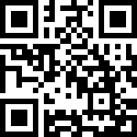
https://ttc-gpra.org/P?s=275531

Slide 71
Continuing Education Credit - Please Note!
This presentation is eligible for the following continuing education:
Certification Commission for Healthcare Interpreters (CCHI)
IMIA/NBCMI
You must miss no more than 30 minutes AND complete the CE Evaluation Survey in order to be eligible for continuing education
You will receive an email at the email address you used to register that will contain a link to a required survey
You will have 72 hours from the date/time you receive the email to complete the survey
You will receive instructions to download your certificate by 3/24/21

Slide 72
For More Info…
Gabriela Flores, BA, MSM
Flores Advisors LLC
816-665-9929
Gabriela.flores.nkc@gmail.com

Slide 73
Please Visit Us!
http://mhttcnetwork.org/midamerica
http://attcnetwork.org/midamerica

