Slide 1
The Brain, Substance Use Disorders and Parenting: A Health Care Professional’s Guide
Presented by
Sharon A. Hesseltine, BSW
Intentional Beginnings/Intentional Development

Slide 2
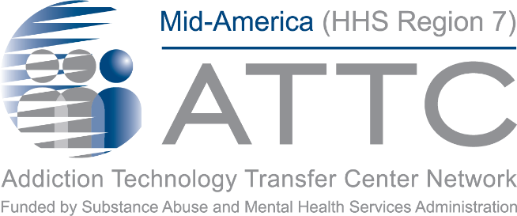
This training is brought to you by:
Notes:
PAT:

Slide 3
Mid-America Addiction Technology Transfer Center
The purpose of the Technology Transfer Centers (TTC) program is to develop and strengthen the specialized behavioral healthcare and primary healthcare workforce that provides substance use disorder (SUD) and mental health prevention, treatment, and recovery support services.
Help people and organizations incorporate effective practices into substance use and mental health disorder prevention, treatment and recovery services.
Notes:
Erika

Slide 4
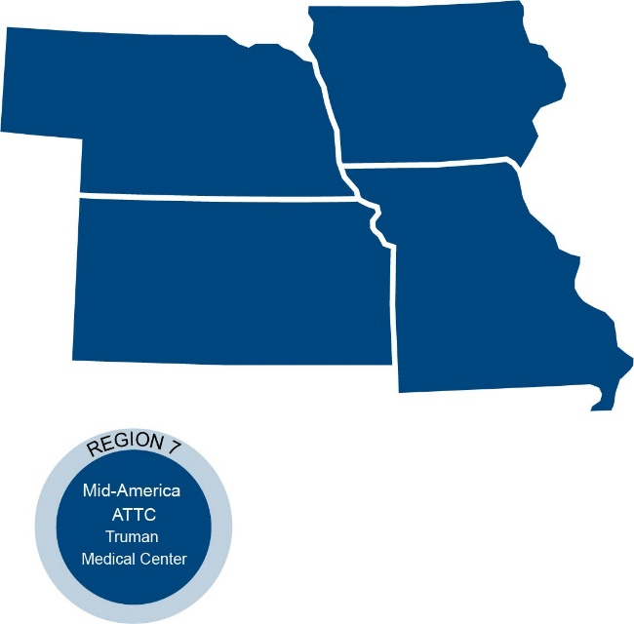
Mid-America ATTC
Notes:
The Mid-America Addiction Technology Transfer Center is one of 12 centers that make up the larger ATTC network.
The TTC Network is funded by the Substance Abuse and Mental Health Services Administration (SAMHSA) to provide training, resources, and technical assistance to individuals serving persons with mental health and substance use disorders.
The Mid-America ATTC serves the states of Iowa, Kansas, Missouri, and Nebraska and is in Kansas City, Missouri co-located at both Truman Medical Center Behavioral Health and the University of Missouri Kansas City’s School of Nursing and Health Studies.

Slide 5
Missouri Hospital Association
Non-profit membership association, MHA represents every acute care hospital in the state, as well as most of the federal and state hospitals and rehabilitation and psychiatric care facilities.
Provide services to member hospital organizations, and partners with various state and community-based organizations to improve healthcare across the state.
MHA advocates for policies that improve health and health care in the state, and provides data, decision-support tools and operational resources to help hospitals and health systems deliver care.

Slide 6
Disclaimer and Funding Statement
This presentation was prepared for the Mid-America Addiction Technology Transfer Center and the under a cooperative agreement from the Substance Abuse and Mental Health Services Administration (SAMHSA). All materials appearing in this presentation, except that taken directly from copyrighted sources, are in the public domain and may be reproduced or copied without permission from SAMHSA or the authors. Citation of the source is appreciated. Do not reproduce or distribute this presentation for a fee without specific, written authorization from Mid-America Addiction Technology Transfer Center.
At the time of this presentation, Tom Coderre served as SAMHSA Acting Assistant Secretary. The opinions expressed herein do not reflect the official position of the Department of Health and Human Services (DHHS), or SAMHSA. No official support or endorsement of DHHS, SAMHSA, for the opinions described in this presentation is intended or should be inferred.
The work of the Mid-America ATTC is supported by grant 1H79TI080208-01. Funded by the Department of Health and Human Services, Substance Abuse and Mental Health Services Administration.
Notes:
Pat –
Today’s presentation is provided free of charge by the Mid-America ATTC and the Missouri Hospital Association. Today’s presentation is available in the public domain and should Not be distributed for a fee without the express written permission of the Mid-America ATTC.
The views and opinions expressed during today’s presentation are those of our presenters and do not reflect the official position of the Department of Health and Human Services or SAMHSA. No official support or endorsement of DHHS or SAMHSA is intended or should be inferred. Please contact us with any questions you may have.

Slide 7
Disclosures
Successful Completion:
This live webinar offers up to 1.5 contact hours. To receive contact hours, participants must attend the activity in full and complete the Evaluation and Request for Credit Form. CNE, CME and CHES Certificates along with Certificates of Attendance will be emailed within 4 – 6 weeks after submitting the Evaluation/request for Credit form.
Commercial Support/Sponsorship:
There is no commercial support for this training.
Non-Endorsement of Products:
The University of Missouri-Kansas City School of Nursing and Health Studies, the American Academy of Family Physicians the American Nurses Credentialing Center do not approve or endorse any commercial products associated with this activity.

Slide 8
Disclosures
Conflict of Interest:
In accordance with continuing education guidelines, the speaker and planning committee members have disclosed commercial interests/financial relationships with companies whose products or services may be discussed during this program.
Speakers: Sharon A. Hesseltine, BSW has nothing to disclose.
Planning Committee:
Pat Stilen, Kelsey Simpson Hussey, Erika Holliday, Bree Sherry, Sharon Colbert, Angela Bolen have nothing to disclose. Jacki Witt serves on the advisory board for Mayne Pharmaceuticals (Resolved). Kristin Metcalf-Wilson serves on the advisory board for Mayne and Afaxys Pharmaceuticals. (Resolved).

Slide 9
Accreditation Statements
Continuing Medical Education
The AAFP has reviewed The Brain, Substance Use Disorders and Parenting: A Health Care Professional's Guide and deemed it acceptable for up to 1.50 Online Only, Live AAFP Elective credit. Term of Approval is from 05/26/2021 to 05/26/2021. Physicians should claim only the credit commensurate with the extent of their participation in the activity.
Continuing Nursing Education
The University of Missouri-Kansas City School of Nursing and Health Studies is accredited as a provider of continuing nursing professional development by the American Nurses Credentialing Center’s Commission on Accreditation.
This program offers up to 1.5 contact hour for nurses.
Certified and Master Certified Heath Education Specialists (CHES & MCHES)
Sponsored by the University of Missouri-Kansas City School of Nursing and Health Studies, a designated provider of continuing education contact hours (CECH) in health education by the National Commission for Health Education Credentialing, Inc. This live webinar is designated for Certified Health Education Specialists (CHES) and/or Master Certified Health Education Specialists (MCHES) to receive up to 1.5 total Category I continuing education contact hours.

Slide 10
Other CEs
Iowa Board of Certification
Missouri Credentialing Board
Kansas Behavioral Sciences Regulatory Board
Nebraska (deemed alcohol and drug specific – accepted for continuing education for licenses alcohol and drug counselors in NE)
Notes:
Certificates of attendance or CEUs –
Instructions for completing required evaluations will be discussed at the end of today’s session.
Need to view the entire live session of the presentation
You are required to complete a follow-up survey
CANNOT receive credit for watching a recording of the session
CE certificates will be emailed in 4-6 weeks

Slide 11
Housekeeping Items
Slides for today’s session are available:
Mid-America ATTC www.attcnetwork.org/midamerica
Missouri Hospital Association Maternal-Child Health - MHA (mhanet.com)
Participant Manual coming soon!
We will provide a FAQ at the end of the series
Please ask questions in the chat
Please keep stay on mute and turn on your cameras

Slide 12
Today’s Learning Objectives
Recognize
Recognize addiction as a chronic brain disease
Understand
Understand the connection between ACE’s and vulnerability for addiction
Discuss
The role of the reward system in driving parenting behavior

Slide 13
Terminology Related to Opioids
Opioid use: Taking an opioid to reduce pain
Broad category includes morphine, codeine, synthetic opioids (e.g., fentanyl or methadone) and semisynthetic opioids (e.g., oxycodone)
Opioid abuse or misuse: Use of prescription drugs without a prescription, or in a manner other than as directed by the prescriber
Opioid dependence: Physiologic adaptation to opioids that produces symptoms of withdrawal when opioids are stopped
Opioid use disorder: Problematic pattern of opioid use leading to clinically significant impairment or distress
Medication Assisted Treatment: Use of specific medication in the treatment of opioid use disorders
Includes methadone, buprenorphine (Subutex, Suboxone) or naltrexone (Vivitrol)

Slide 14
Substance Use Disorder Disease Progression

Slide 15
Substance Use Status Substance Use Care Continuum

Slide 16
Continuum of Care
Early Intervention, for addressing substance misuse problems or mild disorders and helping to prevent more severe substance use disorders
Treatment engagement and harm reduction interventions, for individuals who have a substance use disorder but who may not be ready to enter treatment, help engage individuals in treatment and reduce the risks and harms associated with substance misuse
Substance use disorder treatment, an individualized set of evidence-based clinical services designed to improve health and function, including medications and behavioral therapies.
Emerging treatment technologies are increasingly being used to support the assessment, treatment, and maintenance of continuing contact with individuals with substance use disorders.
SAMHSA Office of the Surgeon General
Facing Addiction in America: The Surgeon General's Report on Alcohol, Drugs, and Health, 2016

Slide 17
Early Intervention
Can be provided in a variety of settings (e.g., school clinics, primary care offices, mental health clinics) to people who have problematic use or mild substance use disorders
Goals are to reduce the harms, reduce risk behaviors and prevent progression
Consists of providing information about substance use risks, safe levels of use, and strategies to quit or cut down on use and use-related risk behaviors
Structured approach includes screening and brief intervention
SAMHSA Office of the Surgeon General
Facing Addiction in America: The Surgeon General's Report on Alcohol, Drugs, and Health, 2016

Slide 18
Use > Misuse > Substance Use Disorder
As individuals continue to misuse alcohol or other substances, progressive changes, called neuroadaptations, occur in the structure and function of the brain
These changes compromise brain function and drive the transition from controlled, occasional substance use to chronic misuse, which can be difficult to control
Brain changes endure long after an individual stops using substances
SAMHSA Office of the Surgeon General
Facing Addiction in America: The Surgeon General's Report on Alcohol, Drugs, and Health, 2016

Slide 19
According to the Surgeon General . . .
“The good news is that a spectrum of effective strategies and services are available to identify, treat, and manage substance use problems and substance use disorders. Research shows that the most effective way to help someone with a substance use problem who may be at risk for developing a substance use disorder is to intervene early, before the condition can progress.”
SAMHSA Office of the Surgeon General
Facing Addiction in America: The Surgeon General's Report on Alcohol, Drugs, and Health

Slide 20
YES, IT’S IN YOUR HEAD! The Neurobiology of Addiction

Slide 21
According To ASAM Addiction Is:
“Addiction is a treatable, chronic medical disease involving complex interactions among brain circuits, genetics, the environment, and an individual’s life experiences. People with addiction use substances or engage in behaviors that become compulsive and often continue despite harmful consequences. Prevention efforts and treatment approaches for addiction are generally as successful as those for other chronic diseases”
Adopted by the ASAM Board of Directors September 15, 2019

Slide 22
ADDICTION IS NOT:
Caused by another mental illness or trauma
A moral or ethical problem
A personality disorder
A choice
Caused by lack of social connection or isolation

Slide 23
ADDICTION IS:
Compulsion to seek and take the drug
Loss of control in limiting intake
Diminished recognition of significant problems
Emergence of negative emotional state
Craving
Chronicity
Periods of remission and recurrence

Slide 24
Like Other Chronic Diseases, Addiction Often Involves Cycles of Recurrence and Remission
NIDA, 2020
NIDA, 2020

Slide 25
What is Addiction? from The Addiction Policy Forum

Slide 26
The Old Brain
Three Main Functions:
Regulate physiological functions
Experience basic emotions (anger, fear, hunger, thirst, lust, pain and pleasure)
Imprint survival memories
Overrides new brain in times of stress
Can be thought of as the “go” or reactive part of the brain
~University of Minnesota

Slide 27
The New Brain: Prefrontal Cortex
Executive Functions
(not fully developed until age 25)
Judgment
Impulse control
Self-monitoring
Coping Functions
Attention span
Organization
Learning from experience
Empathy
Problem Solving
~University of Minnesota

Slide 28
OLD VS. NEW BRAIN
Old brain is senior partner
Craving resides in the old brain and can override the reasoning that happens in the new brain
Old brain acts 4 -5 x more quickly than new brain
~University of Minnesota

Slide 29
DOPAMINE
Neurotransmitter
Signals reward in our brains
Also increased by stimuli that predict a reward
Brain itself will drive the repeating of what it perceives as life-sustaining activity
Over time when the brain is regularly flooded with dopamine (and other neurotransmitters) it will reduce the natural production

Slide 30
Experience Dopamine?

Slide 31
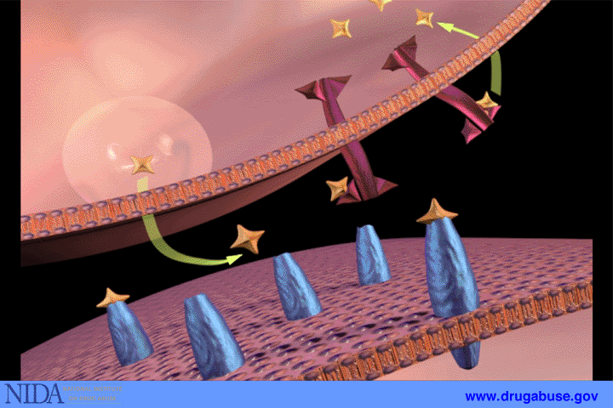
Dopamine from Natural Reward

Slide 32
Dopamine from Cocaine

Slide 33
Three Stages of the Addiction Cycle
Binge/Intoxication, the stage at which an individual consumes an intoxicating substance and experiences its rewarding or pleasurable effects
Withdrawal/Negative Affect, the stage at which an individual experiences a negative emotional state in the absence of the substance
Preoccupation/Anticipation, the stage at which one seeks substances again after a period of abstinence
SAMHSA Office of the Surgeon General
Facing Addiction in America: The Surgeon General's Report on Alcohol, Drugs, and Health, 2016

Slide 34
The Addiction Cycle
The three stages are linked to and feed on each other
A person may go through this three-stage cycle over the course of weeks or months or progress through it several times in a day
May be variation in how people progress through the cycle and the intensity with which they experience each of the stages
The addiction cycle tends to intensify over time, leading to greater physical and psychological harm
SAMHSA Office of the Surgeon General
Facing Addiction in America: The Surgeon General's Report on Alcohol, Drugs, and Health, 2016

Slide 35
Dr. Nora Volkow Explains the Science of Addiction
https://www.youtube.com/watch?v=JH7zq0_VA9U

Slide 36
BRAIN CHANGES INHERENT TO ADDICTION
Less dopamine produced
Fewer dopamine receptors
Ability to experience normal reward – feel joy reduced significantly
Using no longer pleasurable, but about trying to get dopamine function back to a normal level
Brain is driven to seek out and use substances compulsively
Ability to make sound decisions and control impulses is compromised
NIDA – Drugs, Brains and Behavior: The Science of Addiction

Slide 37
How Adverse Childhood Experiences Increase Vulnerability for Substance Use Disorders

Slide 38
Why Do Only Some People Become Addicted?
No single factor
More risk factors = a more vulnerable brain
Protective factors decrease chance of brain becoming addicted
Genetics account for 40% - 60%
Adolescents & people with mental illness are at greater risk
In many ways addiction is a disease that originates in adolescence

Slide 39
ACE Questions
ACE Questions Focus On Occurrences Before The Age Of 18
Personal
Family Members
Physical abuse
Verbal abuse
Sexual abuse
Physical neglect
Emotional neglect
Mother is a victim of domestic violence
Family member in jail
Parent with a substance use disorder
Family member with mental illness
Disappearance of parent through divorce, death or abandonment

Slide 40
ACEs Influence Via Biologic Impact on Neurodevelopment
BRAIN
Hormones, chemicals & cellular systems prepare for a tough life in an evil world
INDIVIDUAL
Edgy
Hot temper
Impulsive
Hyper vigilant
“Brawn over brains”
OUTCOME
Individual & species survive the worst conditions
NEUTRAL START
TRAUMATIC STRESS
Normal Biologic Response to Toxic Stress
INDIVIDUAL
Laid back
Relationship-oriented
Thinks things through
“Process over power”
OUTCOME
Individual & species live peacefully in good times; vulnerable in poor conditions
BRAIN
Hormones, chemicals & cellular systems prepare for life in a benevolent world
Notes:
40

Slide 41
ACE’s Increase Chronic Disease
No ACEs
33%
1 in 16 smokes; 1 in 14 has heart disease
1 in 96 has attempted suicide
1-3 ACEs
51%
With 3 ACES, 1 in 9 smokes, 1 in 7 heart disease
1 in 9 is alcoholic, 1 in 43 uses IV drugs
4-10 ACEs
16%
With 7+ ACEs, 1 in 6 smokes, 1 in 6 has heart disease
1 in 6 is alcoholic, 1 in 30 uses IV drugs
1 in 69 is alcoholic; 1 in 480 uses IV drugs
1 in 10 has attempted suicide
1 in 5 has attempted suicide
Felitti et al, 1998

Slide 42
Relationships
Children’s earliest interactions within the family are crucial to their healthy development and risk for drug misuse

Slide 43
Connectedness Is The Key
YOUR HISTORY OF CONNECTEDNESS IS A BETTER PREDICTOR OF YOUR HEALTH THAN YOUR HISTORY OF ADVERSITY
be with each other I celebrate diversity I listen and learn from others I share time, food, work
The “super-power of human-kind is our capacity to connect; it is regulating and the major ‘route’ by which we can teach, coach, parent, heal and learn”
~Bruce Perry
https://norasblog.wordpress.com/2020/03/21/advice-from-bruce-perry/

Slide 44
The Brain, Addiction & Parenting

Slide 45
The Reward System & Parenting
In chronic active addiction the brain’s reward circuits drive drug-seeking behavior
Key regions of the brain’s reward system do not engage among addicted individuals to the same extent as non addicted persons when it comes to non-drug rewards
Research has shown activation of reward circuits in mothers’ brains when viewing their infant’s smiling face vs. an unfamiliar infant
Studies indicate that these reward processing areas of the brain overlap with the areas of the brain involved in processing infant cues in mothers
The Neurobiology of Addiction and Attachment H. Rutherford, M. Potenza and L. Mayes

Slide 46
The Stress Response System
Considerable research has shown that stress increases craving in addicted individuals
These factors could explain increased incidence of relapse during the postpartum period
Stress may influence the brain to drive drug seeking behaviors that are connected to relief of negative feelings
Stress-induced cravings have been found to significantly predict relapse in abstinent individuals
Source: The Neurobiology of Addiction and Attachment H.Rutherford, M. Potenza and L. Mayes
Notes:
It’s important to take a minute and consider the body’s stress response system in relationship to parents experiencing the dual journey of early recovery and early parenting. We know that craving lives in the old brain and has been found to be activated by stress. There is no doubt that carrying for a very young infant, particularly one that struggles with regulation as babies with NOWS do, could easily be quite stressful. At the same time we know that consistent and reliable relationships; having someone in your life who is available to listen and understand is something that can help to reduce stress. Being this type of reliable source of understanding is something that falls within the role of a Peer Support. Being available, sharing strategies that come from lived experience, normalizing the challenging emotions and being present all go a long way toward helping to reduce stress.

Slide 47
MORE ON STRESS . . . .
Individuals who are more vulnerable to stress may also be impacted more significantly by stressors that are part of parenting
Stress related to lack of resources also contributes
Oxytocin an important facilitator of maternal caregiving behavior (and lactation) and may also help reduce the impact of the stress response
Mothers taking cocaine during pregnancy have lower levels of Oxytocin which were actually decreased by stress – non-using mothers did not show such a decrease
Source: The Neurobiology of Addiction and Attachment H. Rutherford, M. Potenza and L. Mayes

Slide 48
Brain Pathways Overlap
The brain pathways involved in parenting are also the pathways negatively impacted by addiction
Reward and stress pathways are of significant importance in both parenting and addiction
Pathways driving parenting and attachment behaviors seem to be the same pathways negatively impacted or dysregulated by addiction
Source: The Neurobiology of Addiction and Attachment H.Rutherford, M. Potenza and L. Mayes

Slide 49
Early Recovery & Early Parenting
Mama & baby are difficult regulatory partners for each other
Substance-effected baby has hard time regulating sleep/wake cycles, not always a clear signaler, needs more parental help to regulate
Mothers have a difficult time reading baby’s signals –and a reduced tolerance for coping with a distressed baby – very vulnerable combination

Slide 50
Babies Of Mothers With SUDs
Show less positive emotion during interaction
More distress from new situations (novelty)
Slower recovery from interruptions
Have a harder time maintaining alert attentive state
Interaction between moms and babies has less enthusiasm and mutual enjoyment, more conflict and less mutual excitement

Slide 51
Early Recovery & Early Parenting
Women are making several great changes at the same time in multiple areas of their life:
Make room for child in their mind
Take responsibility for child
Give up substances – including smoking
New social network
Life & securing services
Source: M. Pajulo, N. Suchman, M. Kalland and L. Mayes, Enhancing the Effectiveness of Residential Treatment For Substance Abusing Pregnant and Parenting Women: Focus on Maternal Reflective Functioning and Mother-Child Relationship; Infant Mental Health Journal., 2006 Sept 1; 27 (5): 448
Notes:
Having a baby changes everything and particularly when it’s a person’s first baby it’s impossible to be fully prepared for how much life is going to change. And recovery also changes everything – in fact, there’s a saying that goes to be successful in recovery you only have to change one thing ---- everything. When new parenting and new recovery are happening at the same time the degree to which life changes is compounded.

Slide 52
Clinical Finding:
The most problematic areas found in parenting among mothers with SUD’S includes inability to keep the baby in mind and stay emotionally connected and present to baby. Moms have difficulty differentiating the child’s needs from their own.
Source: M. Pajulo, N. Suchman, M. Kalland and L. Mayes, Enhancing the Effectiveness of Residential Treatment For Substance Abusing Pregnant and Parenting Women: Focus on Maternal Reflective Functioning and Mother-Child Relationship; Infant Mental Health Journal., 2006 Sept 1; 27 (5): 448

Slide 53
Post Acute Withdrawal Syndrome
POST ACUTE WITHDRAWAL SYNDROME (PAWS)
Six Major Types of Symptoms
Sleep disturbances
Memory problems
Inability to think clearly/problem solve
Emotional overreactions or numbness
Physical coordination difficulties
Stress sensitivity
Recovery from PAWS usually takes somewhere
between six and 24 months
Hazelden Betty Ford Foundation, 2019

Slide 54
Let’s Unpack All This Just a Bit
When we talk about “keeping the baby in mind” how does that look to you?
How do the brain changes involved with SUD impact the capacity to keep the baby in mind from a neurobiological perspective?
If the capacity to keep the baby in mind is challenging from a neurobiological perspective what are your thoughts around how we support the growth of that capacity?

Slide 55
References
NIDA. 2020, June 3. How long does drug addiction treatment usually last?. Retrieved from https://www.drugabuse.gov/publications/principles-drug-addiction-treatment-research-based-guide-third-edition/frequently-asked-questions/how-long-does-drug-addiction-treatment-usually-last on 2021, April 3
https://www.nimh.nih.gov/health/topics/substance-use-and-mental-health/index.shtml
From the University of Minnesota open library. This is part of an Introduction to Psychology Course. It is from Chapter 3 Brains, Bodies and Behavior and provides an excellent description of the brain and functions of the various parts in an easily understandable manner. Complete with numerous links and illustrations. http://open.lib.umn.edu/intropsyc/chapter/3-2-our-brains-control-our-thoughts-feelings-and-behavior/
Rutherford, Helena & Potenza, Marc & Mayes, Linda. (2013). The neurobiology of addiction and attachment. 10.1093/med:psych/9780199743100.003.0001.
M. Pajulo, N. Suchman, M. Kalland and L. Mayes, Enhancing the Effectiveness of Residential Treatment For Substance Abusing Pregnant and Parenting Women: Focus on Maternal Reflective Functioning and Mother-Child Relationship; Infant Mental Health Journal., 2006 Sept 1; 27 (5): 448
Substance Abuse and Mental Health Services Administration (US); Office of the Surgeon General (US). Facing Addiction in America: The Surgeon General's Report on Alcohol, Drugs, and Health [Internet]. Washington (DC): US Department of Health and Human Services; 2016 Nov. CHAPTER 4, EARLY INTERVENTION, TREATMENT, AND MANAGEMENT OF SUBSTANCE USE DISORDERS. Available from: https://www.ncbi.nlm.nih.gov/books/NBK424859/

Slide 56
References, cont.
What is Addiction? From The Addiction Policy Forum. Retrieved April 28, 2021 from: https://www.youtube.com/results?search_query=what+is+addiction
NIDA. 2020, June 17. The Brain & the Actions of Cocaine, Opioids, and Marijuana. Retrieved from https://www.drugabuse.gov/publications/teaching-addiction-science/brain-actions-cocaine-opioids-marijuana on 2021, April 28
Substance Abuse and Mental Health Services Administration (US); Office of the Surgeon General (US). Facing Addiction in America: The Surgeon General's Report on Alcohol, Drugs, and Health [Internet]. Washington (DC): US Department of Health and Human Services; 2016 Nov. CHAPTER 4, EARLY INTERVENTION, TREATMENT, AND MANAGEMENT OF SUBSTANCE USE DISORDERS. Available from: https://www.ncbi.nlm.nih.gov/books/NBK424859/
Hazelden Betty Ford Foundation Post Acute Withdrawal Syndrome, October 31, 2019. Retrieved April 28, 2021 from https://www.hazeldenbettyford.org/articles/post-acute-withdrawal-syndrome
Felitti VJ, Anda RF, Nordenberg D, Williamson DF, Spitz AM, Edwards V, Koss MP, Marks JS. Relationship of childhood abuse and household dysfunction to many of the leading causes of death in adults. The Adverse Childhood Experiences (ACE) Study. Am J Prev Med. 1998 May;14(4):245-58. doi: 10.1016/s0749-3797(98)00017-8. PMID: 9635069.

Slide 57
Continuing Education Credit – Please Note!
This presentation is eligible for the following continuing education
Certified and Master Certified Heath Education Specialists
Continuing Medical Education
Continuing Nursing Education
You must attend the entire session AND complete the CE Evaluation Survey in order to be eligible for continuing education
You will receive an email at the email address you used to register that will contain a link to a required survey
You will have 72 hours from the date/time you receive the email to complete the survey
You will receive your CE certificate in approximately 6-8 weeks

Slide 58
GPRA Evaluation
https://ttc-gpra.org/P?s=522391

