Slide 1
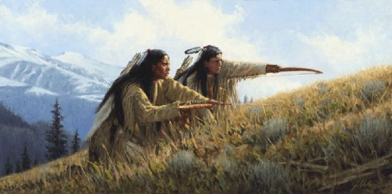
Taking Ourselves Back Our Battle is at Home (Trauma Responses & Victim Programming)
When Our True Hunters, Warriors & Healers Rise
Presented by: Theresa Sault-Brill
Ogiicheduekwe, Nahniibahwiikwe, Jihnahkahzhood
Aniishinabek & Menominee
(McCollum, 2021)

Slide 2
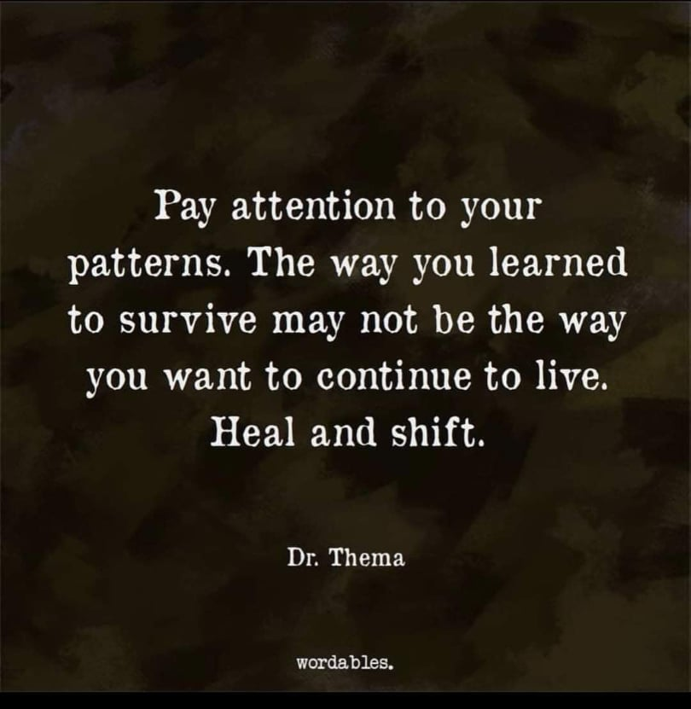
What is “being too human” & how that is not traditional ways of being.
Traditional ways of what feeds spirit, body & mind.
We are of a spiritual ways. To connect with spirit & feed spirit – or – the loss of connection to that which is good, true & pure.
Our warriors, hunters & healers always learned & lived to be true to self & the best for the whole of the people.
Trauma responses, victim mentality or programming & catching the cycles like our old ways: As who & what does it serve.

Slide 3
What is “being too human” & how that is not traditional ways of being. 1
As Indigenous, We Are A Spiritual People: To Walk In Spirit, To Walk With Spirit, To See Spirit,
To Think of Spirit In All We Do – As We Connect With Spirit and Interact With Spirit
What spirit are you connecting with or open to, on the level of, in the realm of when with or in these ways:
Ego, Hurt, Fear, Anger, Grudges, Greed, Selfishness, Dishonesty to Self or Others, Lacking Respect for Self or Others etc.
:Anything that is unhealthy, unresolved matters, matters not faced, extreme or unfitting emotions, emotions carried not serving healthy momentum or solutions to carry forward in the balanced circle of life.
Emotions are natural as alert systems, yet should not run or control our thoughts, choices, words on matters or next moves. They tell us many things. We listened to those things to take those matters & tend to in order to restore spiritual life or focus.
Attachments (physical, mental, emotional or spiritual), clutter, filth etc.
Attachments hinder the spirit. Traditional ways we have connections – Connections recognized for what they are & honored, cared for & thanks given to where all good connections are gifted from.

Slide 4
What is “being too human” & how that is not traditional ways of being. 2
As Indigenous, We Are A Spiritual People: To Walk In Spirit, To Walk With Spirit, To See Spirit,
To Think of Spirit In All We Do – As We Connect With Spirit and Interact With Spirit
What spirit are you connecting with or open to, on the level of, in the realm of when with or in these ways:
Not caring for, tending to, lacking appreciation or gratitude etc. for your blessings or gifts.
Being a spiritual people, we understand that all of life being sacred, all being gifts to use in an honoring way, in the ways of the circle there is reciprocation acknowledging where our gifts, knowledge, opportunities come from & is always for the greater good or the people in heart, mind & spirit. There are many a story on those that left tools or gifts, abandoned etc. & the rights to the people on if they a good use for, would value or appreciate. Living in a spiritual way, understanding all of life being sacred, that even when alone, one is in the world of spirit knowing – If one does not value or care for the sacred, the bad beings see that as in that world which they operate, they too do not care for any gift that brings goods.
Mind- or Mood-Altering Substances – This includes foods that create imbalances i.e.., dairy, fried foods, junk foods etc.
Traditional ways is never been for self pleasure, for self (expect personal care & responsibilities) & always spoken of the balance. Many saw & see that one’s spirit leaves when mind is altered from its natural state. The peoples always strived to steady the mind, body & spirit using even ceremonies, food as medicine, medicines & prayer. The elders would say what is the opposite of & brings the opposite of that which you seek.

Slide 5
Forgiving Ourselves, Our Families & The Elder Relatives Before Us, Our Teachers & Community Members:
Forgive Our Fathers - Smoke Signals – YouTube
(studiobs, n.d.)

Slide 6
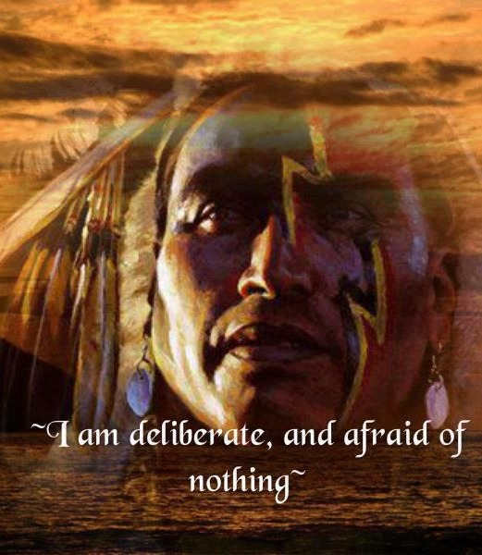
Forgiving Ourselves, Our Families & The Elder Relatives Before Us, Our Teachers & Community Members:
Carrying hurt, fear, anger, shame, remorse etc. serves nothing, yet takes place within self. That place in which is takes, it takes the true intended personalities of us – the us we’d have been if the history or event never occurred. Taking self back is the gain in letting go. Letting go does not mean forgetting the wisdoms gained – those are the healthy boundaries. Healthy boundaries are different than protective walls or barriers.
We are of a spiritual ways. To connect with spirit & feed spirit – or – the loss of connection to that which is good, true & pure.
Ask Self: What does my choice or response serve:
* Is this CHOICE or RESPONSE Victim Stagnant, Survival Mode, Stuck In Past or See’s Only the Now – OR – Is this Learning, Healing, Growth, Moving Forward, Striving to Work for Creating a Better Future or Life.
* Does my CHOICE or RESPONSE SERVE the Immediate (release or dumping) – OR – Future (taking self & life back).
* Does this CHOICE or RESPONSE contribute to the Healing of my Ancestors & Self, does this contribute to Setting Myself & Ancestors Free of Trauma, Learned Dysfunctional Ways etc.
* Does this HABIT or CHOICE Nurture or Take From What I Am Truly About or Capable Of.
(Manor, n.d.)

Slide 7
Always Saw To Look Within – Power Is Within
1st What is my part in this, what can I do, what can I change
If not one's place, whose is it & go from there
If have a part or role in: When sorry one may feel remorse, embarrassment, shame – Again to look within: As a true sorry is not of words, it is of action – flow of life & the waves – Sought counsel, times sat out to recognize & address what led them to cause harm, hurt, dysfunction etc. Then to learn better, heal & release so to move forward in life correctly now – correcting the balance & flow of the circle.
Slippery slope Survivor Mode. Survival Mode becomes a way to survive yet is not a way to live. When it is safe & after one has healed, it is time to step back into the circle of life. To learn from, heal & move forward without carrying the past – leaves open for new to be as if trauma(s) never halted one's life or being.
Taking our DNA back by rewiring self.
Taking our Spirit Direction, Growth & Beauty Back
Stepping Into Self & Not Our Stereotype, Traumas or Ancestors Traumas – Instead, Our Purpose, Beauty & All That’s Good

Slide 8
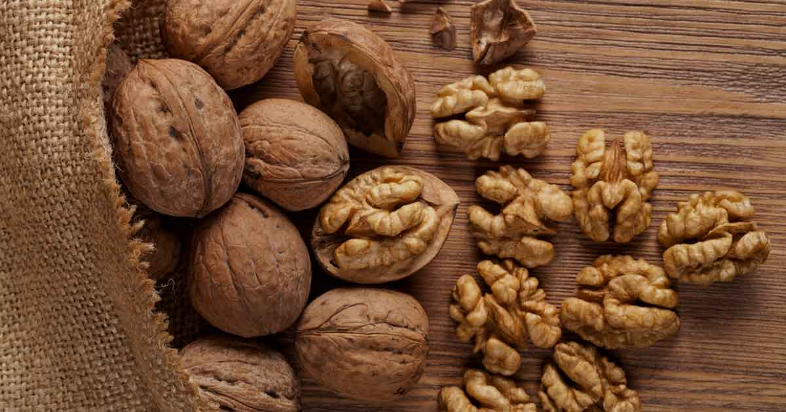
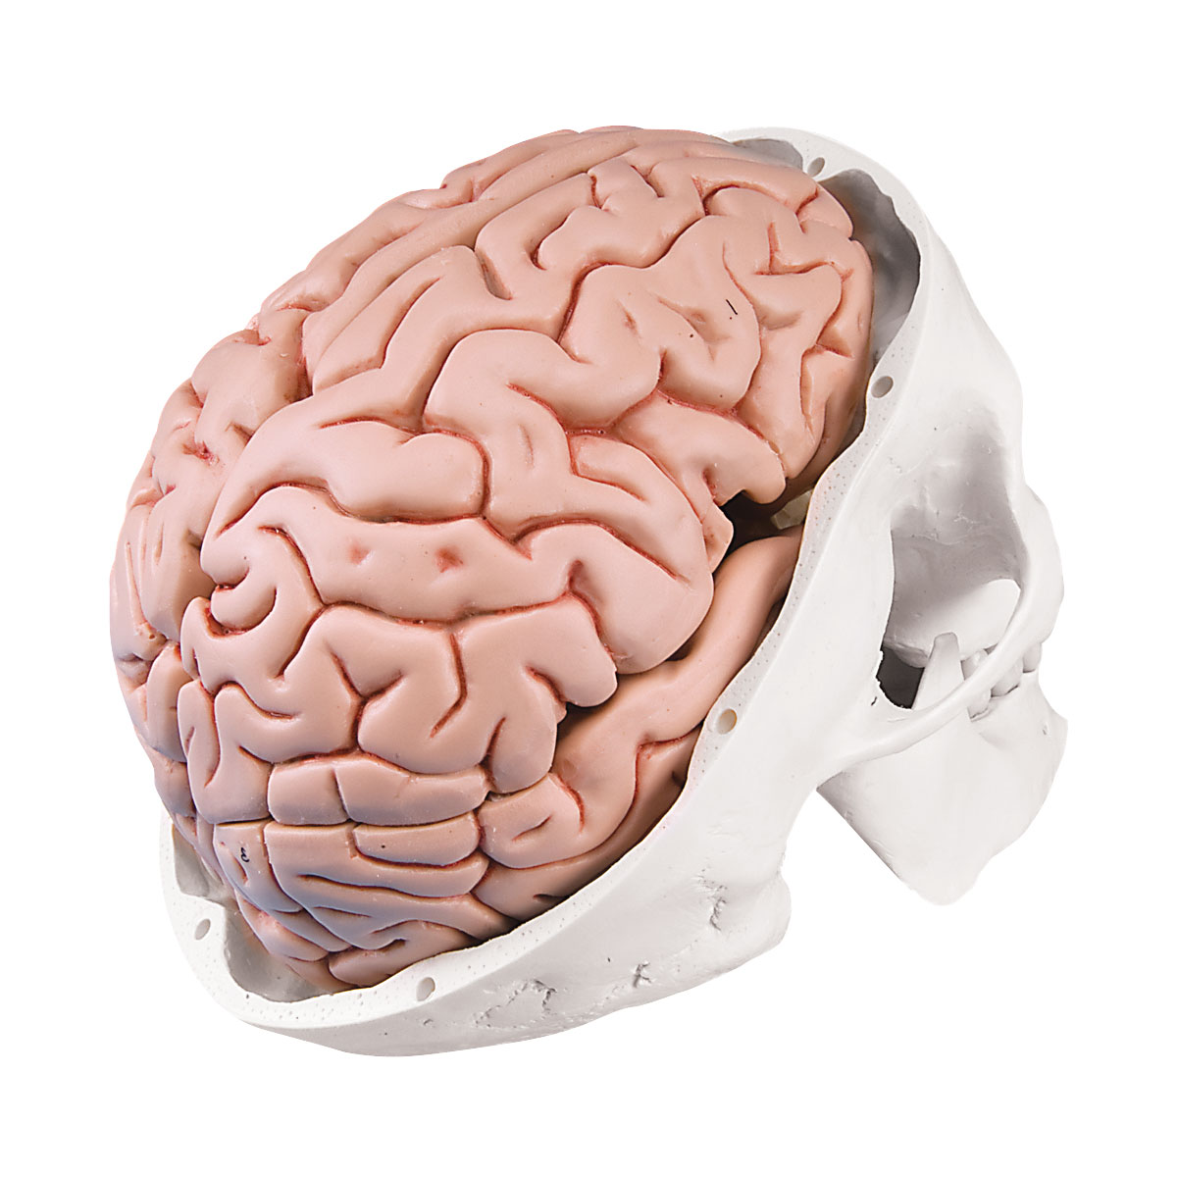
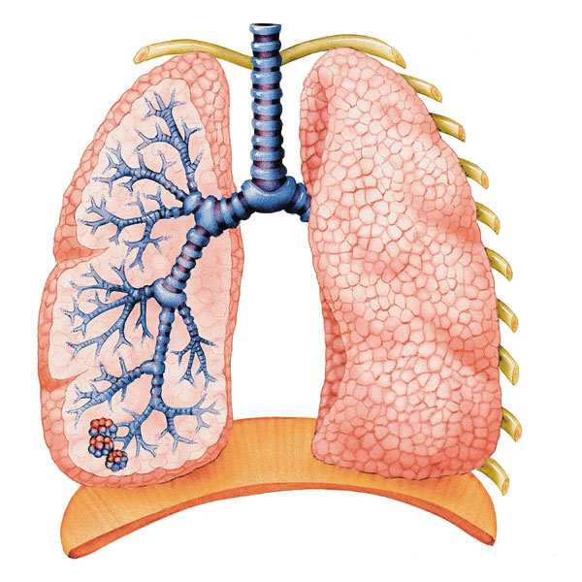
Good * Bad
*Grey Area*
Right * Wrong
Interconnectedness
& Restoration
Day * Night
Air
(walnuts-whole-and-shelled-darkened, n.d.)
Female * Male
(A20/9 CLASSIC HUMAN SKULL MODEL WITH 5 PART BRAIN, n.d.)
Water
(Watron, 2011)

Slide 9
Complex – Compound *to* Simple – What Is
The Reflection of our Choices,
Responses * The Ripples
In The Water
What will your Tree of Life
Flower, Produce & “Leaf” Behind
To Feed the Next Seasons
The ways is always to move forward * Like Life
Holding Onto Being A Survivor Does Not Make Space For Real Restoration & The New

Slide 10
The Grey Area & Fine Line: Finding The Balance
With Truth & Culture
.
“The victim grates on you with a poor-me attitude and is allergic to taking responsibility for their actions. People are always against them, the reason for their unhappiness. They portray themselves as unfortunates who demand to be rescued”
* Many of our people are victims, due to nepotism, gang issues, racism etc. many might be an issue of concern or a barrier & statistically speaking, they may very well be again. Slipping into ‘Victim Mentality’ they may feel entitled to – yet culturally the family or people did come together to help a-& restore the peace. Therefore, innately the peoples did see to pointing the finger on where the issue(s) is-was, yet the peoples also find the lessons to protect & preserve peace so life can move forward.
“you become overwhelmed by their endless tales of woe”
“People must take responsibility for their own lives”
“I can only listen for five minutes unless you’re ready to discuss solutions”
* Solution based is cultural ways of thinking, being & seeing.
“I’m not fighting to survive genocide, poverty, or daily street violence from an insurgency militia”
* For Indigenous, many are fighting to survive & or overcome. Street violence comes from gang problems & even at stands to water protectors etc. (Judith Orloss, 2012)

Slide 11
Characteristics of Survivors of Abuse
Survivors of Abuse often…
¨ Hesitate to identify themselves as victims of abuse.
¨ Feel isolated, depressed, worthless, shameful and helpless to change.
¨ Struggle with negative feelings about God.
¨ Condemn themselves as responsible for the abuse.
¨ Deny that being abused in the past somehow affects present
circumstances.
¨ Lack self-control; feel defeated in areas of compulsive behaviors.
¨ Feel angry and/or bitter.
¨ Have trouble with authority figures.
¨ Have difficulty trusting others or place unwarranted trust in unsafe
individuals.
¨ Lack self-worth.
¨ Are preoccupied with thoughts of what it means to have a “normal”
relationship with others: friends, family, the opposite sex.
¨ Lack a healthy sexual identity.
¨ Act in sexually inappropriate ways.
¨ Question their self-identity—“Who am I?”
¨ Question whether life has a purpose or is worth living.
¨ Feel “at home” in crisis situations.
¨ Struggle with perfectionism or “all or nothing thinking”.
¨ Desire or fantasize about a better life. (TAYLOR, n.d.)

Slide 12
Tracking Reactions, Emotions, Responses, Choices To Unresolved Past Traumas or Old Wounds:
Dysfunctional Ways, Traumas, Prolonged Enduring of Hardships doesn’t always haunt an individual or group by nightmares or memories replaying – Instead, it can often show up by how one or a group perceives people, things, moments, events, how they then react or respond, or even turn within & fail to react or respond in situations where the healthy or unwounded mind or heart would not accept or tolerate.
“Victim mentality is learned behavior.” Victim Mentality: Causes, Symptoms, and More (webmd.com)
What Responses Might Be Telling You:
Extreme Emotional Response = Learned Behavioral Responses
Anger, Outbursts, Ready to Fight = Injustice, Seen This Before, Feeling Of Powerlessness
Fear = Something or Someone That Matters
Often Taking Things To The Offense = “Victim Mentality” or Unhealed Past or Current Instabilities
Accepting or Tolerating Mistreatment = Learned To Accept As Part Of The Way Things or People Are (When Dysfunction Becomes The Norm)

Slide 13
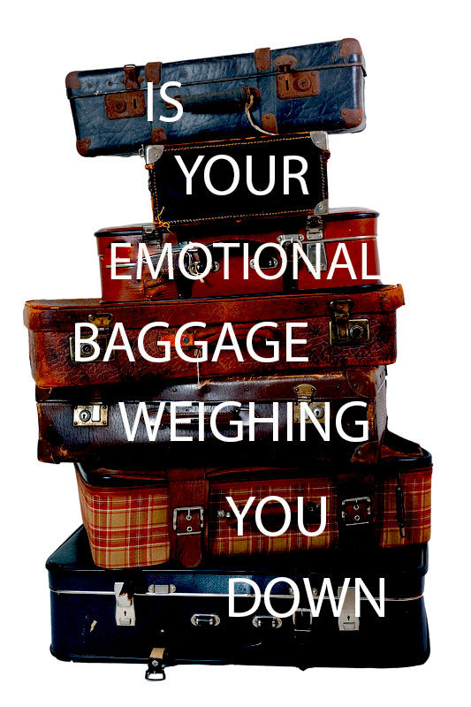
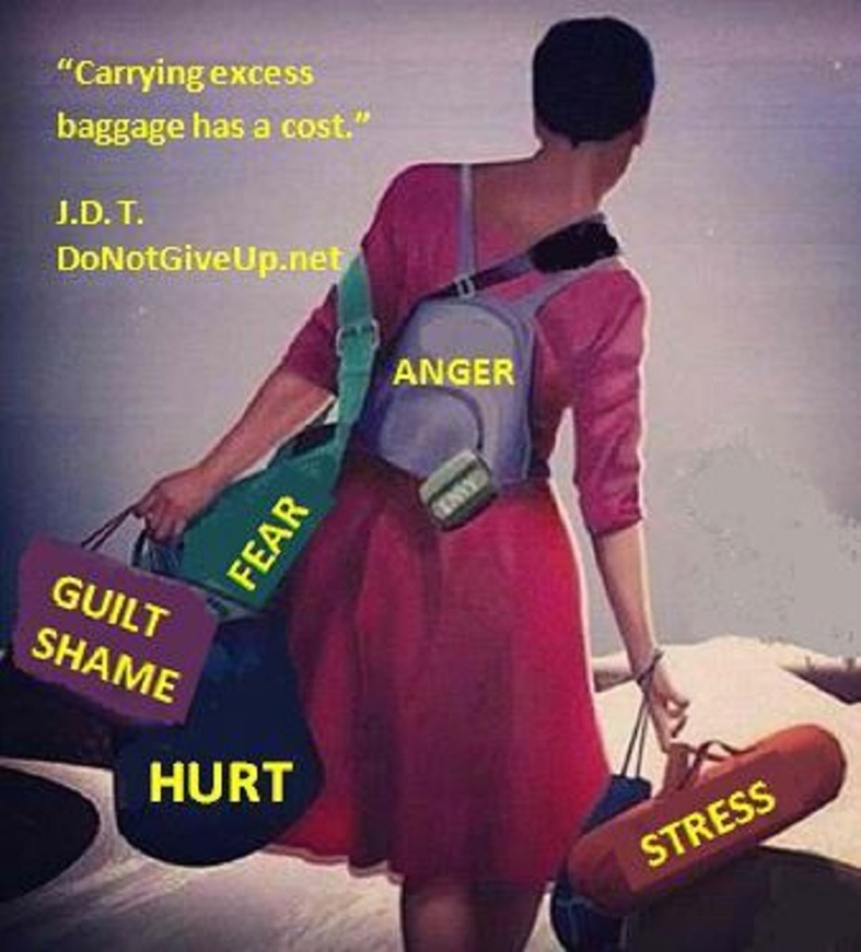
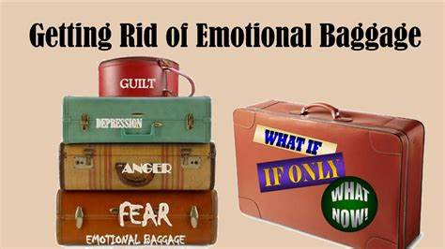
What Are You or Yours Armed With
(How to Get Rid of Emotional Baggage Effectively, 2021)
(How to Get Rid of Emotional Baggage Effectively, 2021)
(Dowell, n.d.)
Fears *or* Truth

Slide 14
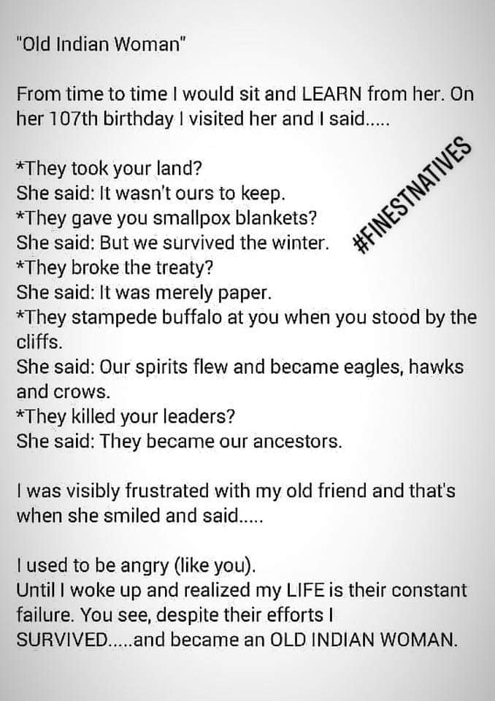
Understandings & Perspective Can Be Liberating
As The Truth They Are
Here Both Are Truth – Which Do You Choose To Carry & Live

Slide 15
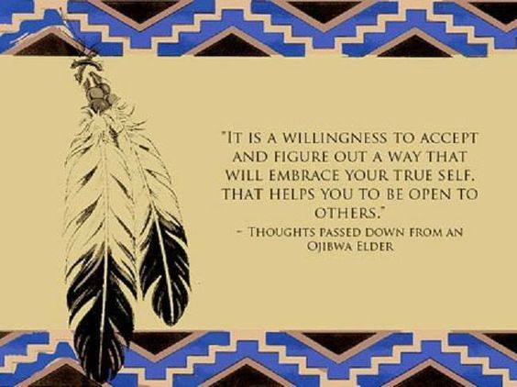
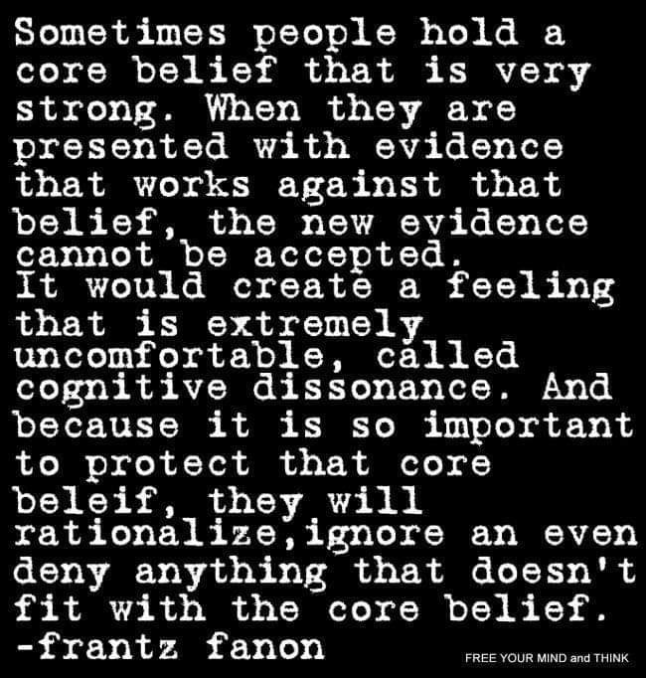
(Botello, n.d.)
Traditional ways teach on being tested – Where do the ‘grey areas’ really lead.
Where the Path Splits * Crossroads
Notes:
Another M.I. tool to engage in finding goods, defining what is not & recognizing where grey areas really lead to.

Slide 16
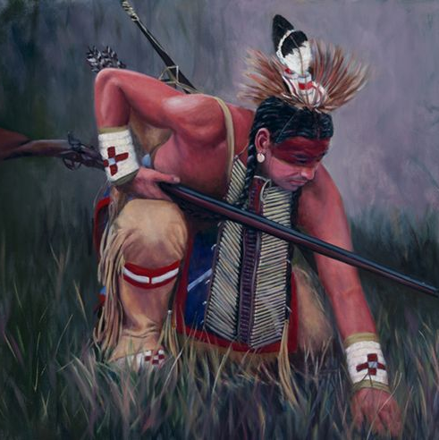
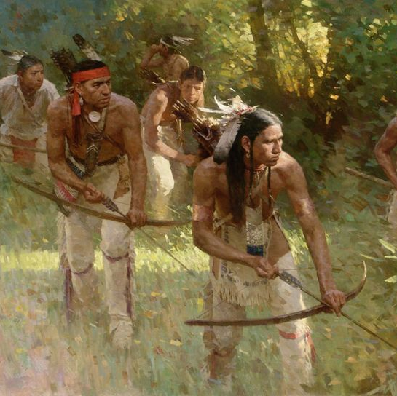
Our Hunters, Warriors, Trappers, Fishers & Medicine People
Noticed & Recognized Patterns, Changes, Tracks etc..
When Support, Help Or Counsel
Needed Went To One Who
Knew Beyond You In That Area
Of Need
There Are Times When
It Takes A Group Or Family
To Take Recognize, Take On,
Face & Deal With To Restore Peace
For Self, Family Or Even The People
(Searching for the Rogue Bear by Z. S. Liang, n.d.)

Slide 17
Tracking the Problem & Finding Focus
5. Who, where or what to tend to, protect or care for. IE Needs
1. Who is the victim or what is suffering
2. What was lost or the cost
3. Who or what is to gain
4. Now you know who, what or where is the “enemy” or problem
Free Will & Our Choices

Slide 18
Bads, Dysfunctional or Toxic
Who or What Got Fed:
Rebirth, Fruition of Choice, Goods or Bads, The You You’d Be Proud of or Regrets etc.
Choice:
Denial, Runaway, Avoidance or Not Deal, Argue, Fight, AODA, Suicide etc.
Effects or Consequences:
Later Outcomes:
More Trouble, Regrets, Can’t Have Another Chance etc.
Wish Would Of:
Notes:
Create Goals, Vision

Slide 19
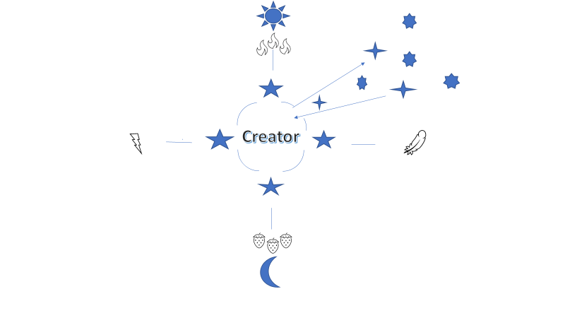
Goods, Functional or Healthy Tracking
Rebirth:
Notes:
Idea of leaving blank to use as M.I. tool to engage

Slide 20
Many of the Peoples are Scared
Something shared with me years ago, I’ve since noted so many all over can relate to due to growing up in, around & even with generational traumas instilled or encoded:
Grew up around or having experienced abuse, sex abuse, addiction, bullying, racism, differential treatment etc.
Gambling parents & the issues that creates due to low income, feelings of not being or having enough, addiction etc.
Addiction issues with family & or friends, the losses, the troubles that come with.
Many communities experience(ed) racism or differential treatment in many parts of the system, including medical, courts, Indian Child Welfare or Children & Family Services etc.
Trouble getting good jobs due to records obtained, due to just some of the above-mentioned repercussions & often stigma alone is enough.
Unstable relationships often from childhood on with so much dysfunction leads to who can one trust.
Their fears can be valid & lead to trauma-based responses, causing compounded issues & needs.

Slide 21
What Do You Choose To Use To Move Forward Or Get Back Up
Tool
Crutch
Healthy Tools To Handle, Deal, Heal, Let Go Of & Move Forward
Gifted, Skilled, Knowledgeable In Ways, Spiritual, Walking In Your Purpose & Evolving With Your Life & Spiritual Growth
Good Traditional Boundaries & Understandings, Grounded In Nature, Always Working & Evolving In Your Purpose(s) & Growth, Quality Connections Within Community
Good Food (Cultural) Balanced Diet, Balanced Rest & Wake Schedules – Utilizing Food As Medicine For Their Life Needs As Needs Change, They Cater To Their Diet
PTSD
ADD
Anxiety, Panic, Social Anxiety
Avoidant Personality
Impulse Control Dysfunction
Depression
Dissociation
Bipolar

Slide 22
Innate Knowledge *or* Generational Traumas
My dad would say, “We are born with Innate Knowledge”
A Cree Paul McLeod said, “Our people need to remember we are good”
We are also born with Generational Traumas & Dysfunctions
We are given choice & only so much ability to tap into:
‘Which Wolf Will You Feed’?

Slide 23
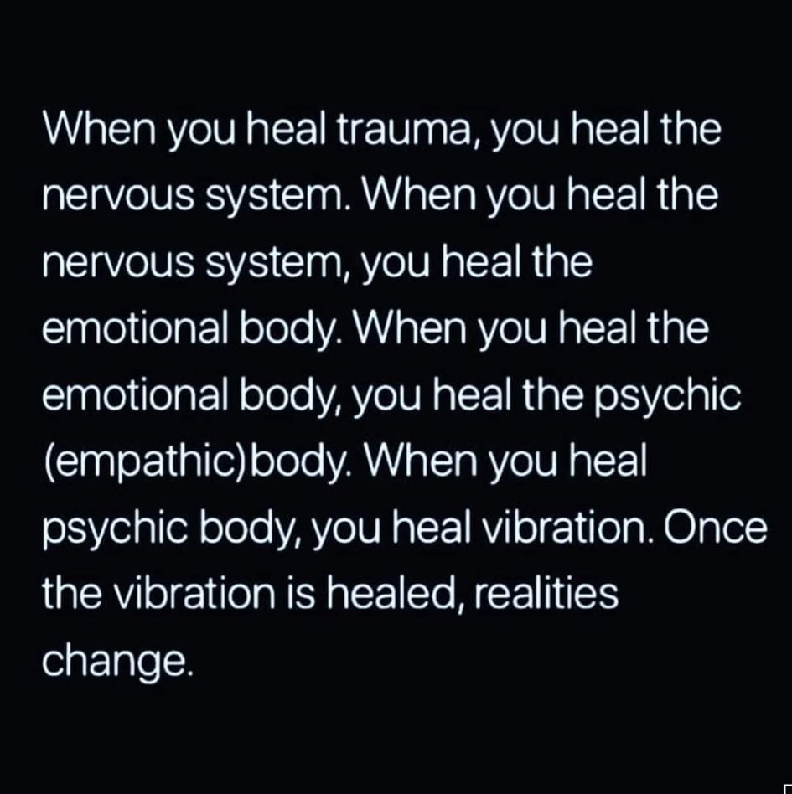
Windigo & Other Such Beings That Feed
(Lamartine, n.d.)
Notes:
Story, Does not mean ppls are one, Old One’s knew be careful feeding bads & openings to, careful not to step in ways or think to feed or open to.

Slide 24
Understood Matter
We walked in truth
We held self & each other accountable. Saw to justice or restoring peace. Stepped up to our parts: good, bad or indifferent.
We lived because of Spirit, understood the Creation of each & all has a story, a time, a part & the boundaries of.
Knowing our life & lives are because of Spirit, supported by Spirit, guided & fed by Spirit – With that we are just a spirit within, if we walk within that circle, live, think, see, understand & keep to those boundaries.
Knowing we are only a part in that moment, yet the ripples go beyond – Knowing without the other parts, beings, the people’s & Spirit we would not be. So, there is no ego to be had, if one does well, all are better off. If one is not going about well or able, others feel the weight. Understood to always seek to learn better at that is our callings or part, doing our wholly honest best – that includes self care & not cutting corners or mixing with or one can’t truly be wholly present & or at their best to learn, share, bring, face – anything.
We always had to face honestly our every thought, feelings upon & what was coming from Spirit, vision, dreams etc. We sought trusted counsel that was knowledgeable in such matters –
Matters = matter, it bares weight & this was-is understood. Weight to weight down thoughts, bring them down – away from a good spirit level, hearts feelings about, conscious etc. can leave one's body even feeling heavy, begin to lag etc.
Matters can weaken body, immune system & ability to become ill, then carrying illness, hinders your work, craft or what you bring to the circle etc.
Matters can take thoughts off, away from what really is true, tunneled or narrow thinking off into the thought & not the whole. If not with the whole, not seeing all truth or aspects. Only path seen is where one is at. Response next. Movement. Dreams. So much can become impacted.
When thoughts are off so can become emotions or heart. The imbalance becomes of body now & the cycle back & forth from body & mind like a bad whirlwind. These whirlwinds can turn to storms that are not natural. Storms can now reach & touch beyond self.
Matter = being of matter or weight or substance, if not a natural pure body, created naturally by Spirit – is not of.

Slide 25
Bad Beings Need Openings To Be Fed
Ego, Hurt, Fear, Anger, Grudges, Greed, Selfishness, Dishonesty to Self or Others, Lacking Respect for Self or Others etc.
:Anything that is unhealthy, unresolved matters, matters not faced, extreme or unfitting emotions, emotions carried not serving healthy momentum or solutions to carry forward in the balanced circle of life.
To not follow your true purpose or heart. To not speak its truth – yet lash out in that which does not serve anything good.
Attachments (physical, mental, emotional or spiritual), clutter, filth etc.
Not caring for, tending to, lacking appreciation or gratitude etc. for your blessings or gifts.
Mind- or Mood-Altering Substances – This includes foods that create imbalances i.e.., dairy, fried foods, junk foods etc.

Slide 26
Defend The Sacred (llocano Welcome Chant)
Defend The Sacred (llocano Welcome Chant) - YouTube
(Defend The Sacred (llocano Welcome Chant), n.d.)

Slide 27
Balance Teachings & The Wolf
Goods
Bads
Healthy Responses:
Recognizes an Issue or need,
No anxiety, fear or panic about,
Does not take personal unless is,
Does not respond from ego,
Seeks communication
to tend to matters,
If matters cannot be resolved may
Engage others to help, takes
Proper steps in restoring
The functionality of life.
Trauma Responses:
Wolf backed up into corner,
Misinterpreted responses leading to,
Reactions, Opening for bad spirits to play upon,
Digs holes or compounds then cycles out.

Slide 28
In the Wolf Pack it is to maintain healthy perseverance of life.
Healthy
* Wolves Would Oust Others If Acting Toxic
* Knows Role Or Place & Part Within
Unhealthy
* Stands By Due To Being Related or From Inner Group
* Becomes Caretaker or Expects Others To Do Everything For Them
Notes:
Another tool for M.I. style to get individual or group engaged to seeing & finding the difference.

Slide 29
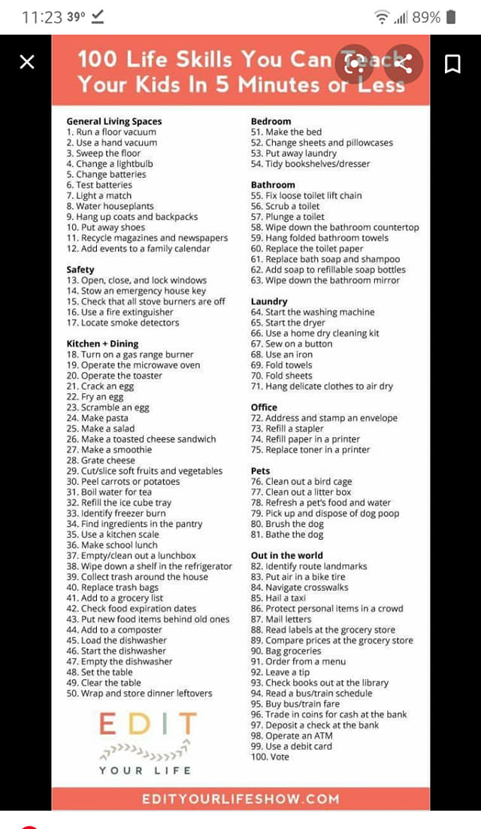
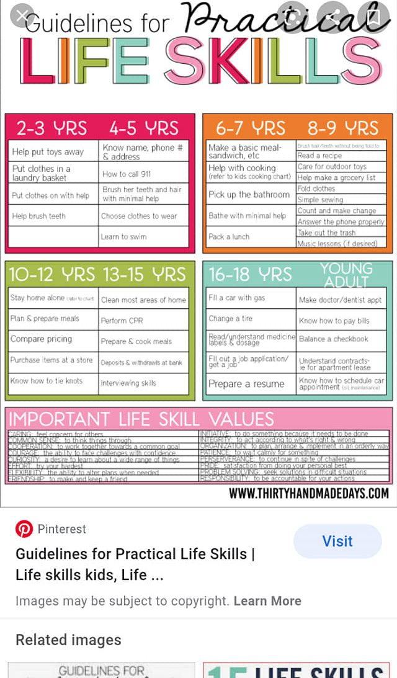
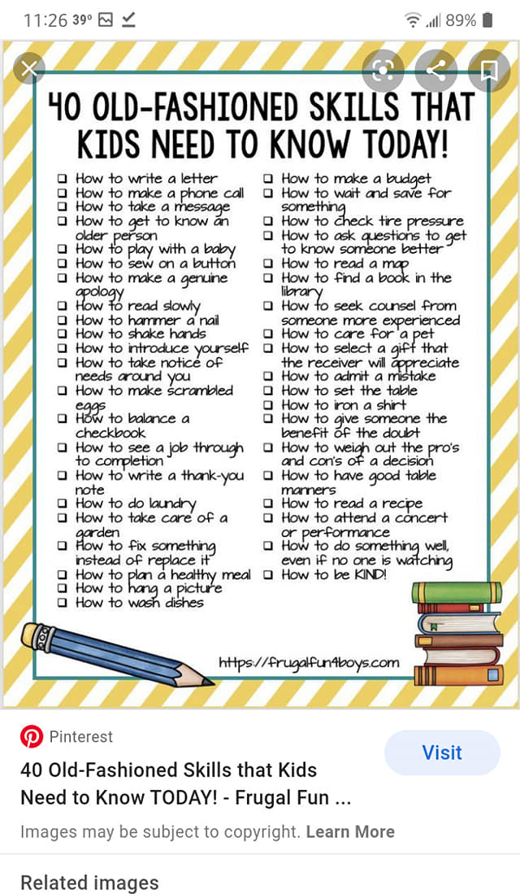

Slide 30
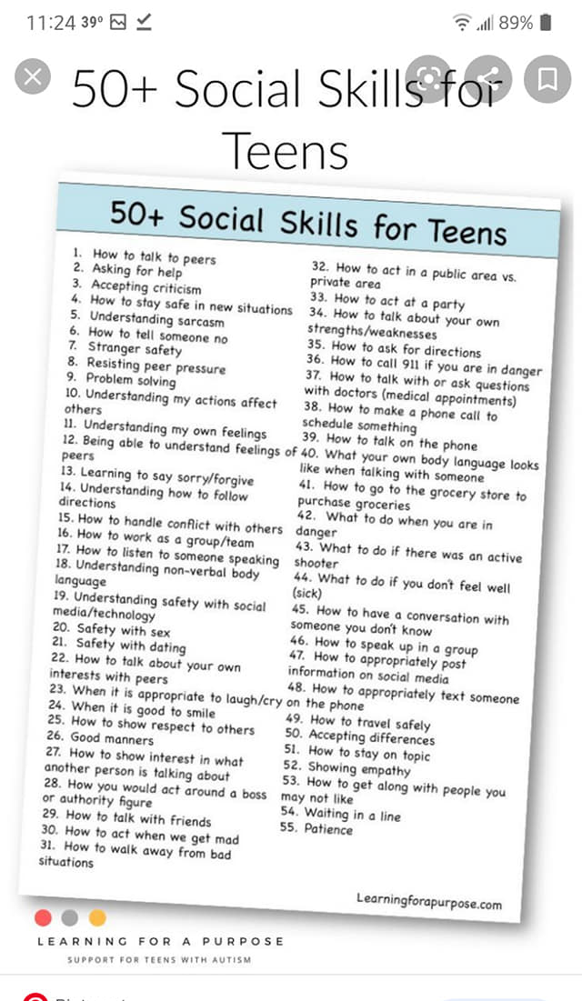
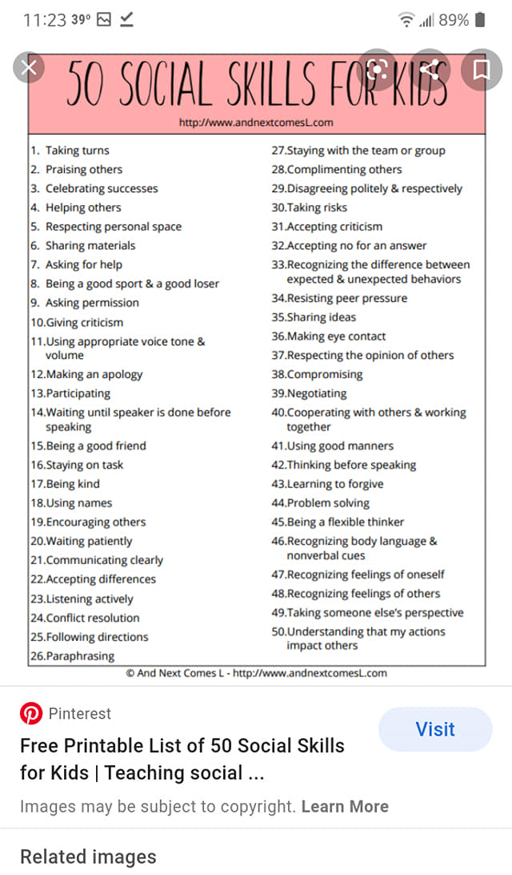
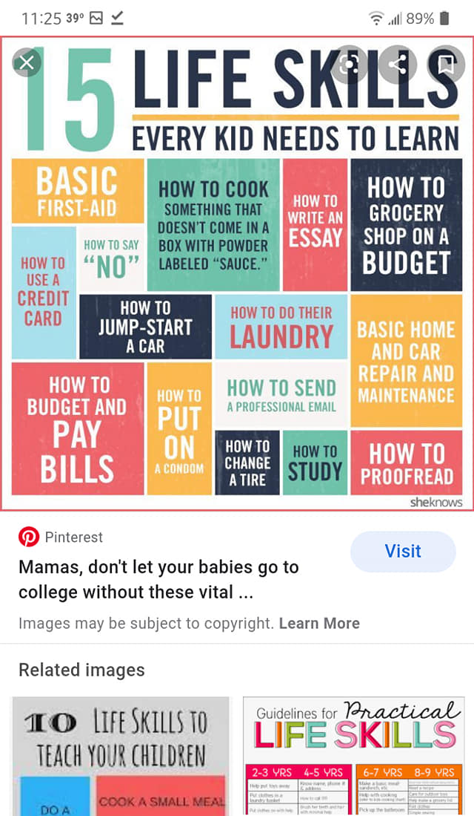

Slide 31
Blue October - Fear
(blueoctoberofficial, n.d.)

Slide 32
Story Resources 1:
Meet The Wendigo, A Cannibalistic Creature From Indigenous Lore (allthatsinteresting.com)
“never satisfied with his cannibalistic urges. Obsessed with hunting for new victims, he is forever hungry until he’s eating another person”
Oral Tradition | Milwaukee Public Museum (mpm.edu)
The similiarities between a Pack of Wolves and a Tribe of Indians
“Many Native Americans credit the wolves for teaching them about the importance of family and how to hunt and forage for food. In other words, they were credited with the livelihood of the tribe.”
Almost Forgotten Native American Survival Skills – 101 Ways to Survive
“lost this ability because of our modern distractions that keep us from really listening and observing things”
Menominee Legends, Myths, and Traditional Indian Stories (native-languages.org)
Important Menominee Mythological Figures
Native American Legends-The Legend of Spirit Rock (uwosh.edu)
Using Native American Legends to Teach Mathematics (uwosh.edu)
Native American Legends-Right in Front of You (uwosh.edu)

Slide 33
Story Resources 2:
Native American Legends (Folklore, Myths, and Traditional Indian Stories) (native-languages.org)
Native American Folklore by Tribe
Native American Indian Trickster Characters (native-languages.org)
Glooskap, culture hero of the Wabanaki Indians (Glooscap, Gluskabe, Gluskap) (native-languages.org)
Native American Indian Culture Heroes (native-languages.org)
White Buffalo Calf Woman (Ptesan-Wi, Ptesanwin, White Buffalo Woman) (native-languages.org)
Esa, the Shoshone-Bannock Wolf God (Issa, Ysa, Pia'isa) (native-languages.org)
Pukwudgies, little people of the Algonquian tribes (Pukwudgie, Puckwudgie, Bagwajinini) (native-languages.org)
Deer Woman – Wikipedia
Deer Woman (Deer Lady), menacing fertility spirit of the Oklahoma tribes (native-languages.org)
Kanaima, evil spirit of the Carib tribes (Canaima, Kenaima) (native-languages.org)
Native American Indian Cannibal Giants (Ice Cannibals) (native-languages.org)

Slide 34
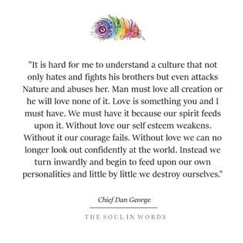
Story Resources 3:
Native American Indian Ghosts of Myth and Legend (native-languages.org)
Native American Legends Organized by Themes and Subjects (native-languages.org)
Great Law of Peace Discussion D1+2 HD 720p – YouTube “To truly be appreciative of what nature provides us. That we have to follow Creation” “They’ve dirtied our minds for an imaginative power” “It is our way”
Navajo Deity, The Speaker of Peace. – YouTube
How The Stars Were Placed, What it Means for You and What is the Way of Integrity? – YouTube What is worse than evil.
Evil is Real Don’t Be fooled a Native American Traditional (Diné) Teaching - YouTube

Slide 35
Additional Online Resources 1
30 things kids should know how to do by 12 - Today's Parent (todaysparent.com)
Periods of Development | Lifespan Development (lumenlearning.com)
Anxiety disorders - Symptoms and causes - Mayo Clinic
Bipolar disorder - Symptoms and causes - Mayo Clinic
Some can relate due to being a “victim, past & present” and due to mistrust of the governments as they have done things to the people such as The Sterilization Programs etc. Operation Monarch (outpost-of-freedom.com)
6 Common Signs of an MK-Ultra Mind Controlled Victim – The Arcane Laboratory
Computer & even Cell Phone Addition now falls with: Computer Addiction - Signs, Symptoms, Support & Treatment (addictions.com)
64 Signs of Mental and Emotional Abuse: How to Identify It, What to Do (healthline.com)
Behavioural consequences of child abuse (nih.gov)

Slide 36
Additional Online Resources 2
Mindfulness 101: How to Learn From the Patterns in Your Life | Observer 1. Set an intention for guidance. 2. Stop sleepwalking your way through your life. 3. Start accepting responsibility for your life.
Warning Signs for Bullying | StopBullying.gov

Slide 37
References 1:
(How to Get Rid of Emotional Baggage Effectively, 2021)A20/9 CLASSIC HUMAN SKULL MODEL WITH 5 PART BRAIN. (n.d.). Retrieved from Klinger Educational Products: https://klingereducational.com/product/a209-classic-human-skull-model-5-part-brain/
blueoctoberofficial. (n.d.). Blue October - Fear. Retrieved from YouTube: https://www.youtube.com/watch?v=Q3b
Botello, M. (n.d.). Retrieved from Pinterest: https://www.pinterest.com/pin/186406872049936649/
Defend The Sacred (llocano Welcome Chant). (n.d.). Retrieved from YouTube: https://www.youtube.com/watch?v=idq-HelWOOU
Dowell, E. (n.d.). Our emotional wellbeing goes hand-in-hand with our physical wellbeing. Retrieved from Grahm Quotes: https://quotesgram.com/img/quotes-about-emotional-baggage/14849005/
How to Get Rid of Emotional Baggage Effectively. (2021, Feb 10). Retrieved from Hub Pages: https://discover.hubpages.com/health/How-to-Clear-Emotional-Baggage-Face-Your-Fears-Daily
Judith Orloss, M. (2012, Oct 1). Strategies to Deal with Victim Mentality Are you in a relationship with someone who is a victim? Retrieved from Psychology Today: https://www.psychologytoday.com/us/blog/emotional-freedom/201210/strategies-deal-victim-mentality
Lamartine, A. (n.d.). When You Heal Trauma, You Heal The Nervous System. Retrieved from The Minds Journal: https://themindsjournal.com/when-you-heal-trauma-you-heal-the-nervous-system/?fbclid=IwAR1EntKTMe2SsW83ZTrMEUsRl7QZyIqVdJBWdMpT6dHFyJAfamXsYXKLsTk
Manor, C. (n.d.). Retrieved from pinterest: https://www.pinterest.com/pin/287456388687552001/

Slide 38
References 2:
McCollum, A. o. (2021). Almost Forgotten Native American Survival Skills. Retrieved from 101 Ways To Survive : http://101waystosurvive.com/survail_tips/almost-forgotten-native-american-survival-skills/
Searching for the Rogue Bear by Z. S. Liang, A. o. (n.d.). Almost Forgotten Native American Survival Skills. Retrieved from 101 Ways to Survive: http://101waystosurvive.com/survail_tips/almost-forgotten-native-american-survival-skills/
studiobs. (n.d.). Forgive Our Fathers - Smoke Signals. Retrieved from YouTube: https://www.youtube.com/watch?v=OB0RgMcB8zc
TAYLOR, R. (n.d.). Breaking Free: Characteristics of Survivors of Abuse. Retrieved from WORDPRESS.COM: https://oneandonlyhigherpower.wordpress.com/recovery-issues/physical-sexual-emotional-abuse/characteristics-of-survivors-of-abuse/
walnuts-whole-and-shelled-darkened. (n.d.). Retrieved from Australian Walnut Industry Association: https://www.walnut.net.au/home/walnuts-whole-and-shelled-darkened/
Watron, R. (2011, Sept 4). Four things about... (a simple approach to anatomy and physiology). Retrieved from Four Things About: https://fourthingsabout.blogspot.com/2011/09/respiratory-system.html

