Slide 1
Harm Reduction in Native Communities
by Joel Chisholm, MD

Slide 2
Harm Reduction Priniciples
SAMSHA definition: Harm reduction is a proactive and evidence-based approach to reduce the negative personal and public health impacts of behavior associated with alcohol and other substance use at both the individual and community levels.
Harm reduction services save lives by being available and accessible to people, and emphasizing the need for humility and compassion toward people who use drugs.
A comprehensive prevention strategy, harm reduction is part of the continuum of care. Harm reduction approaches have proven to prevent death, injury, disease, overdose, and prevent substance misuse or disorder.

Slide 3
Why is Harm Reduction needed?
Per the CDC in the US, drug related reported # of deaths in 2015 = 47,523 and in 2021 = 98,022 (29% increase compared to the same window of time last year).
Use of synthetic opioids primarily Fentanyl based has caused the significant increase in drug related overdoses.
Overdose deaths can be difficult to accurately track due to Provisional counts are being incomplete and causes of death may be pending investigation resulting in an underestimate relative to final counts.
Tribal overdose death rates have an additional barrier of county, state, and tribal (federal) jurisdictions involved.
Psychostimulants such as methamphetamine also increased in the 12-month period ending in April 2021. Cocaine deaths also increased, as did deaths from natural and semi-synthetic opioids (such as prescription pain medication).

Slide 4
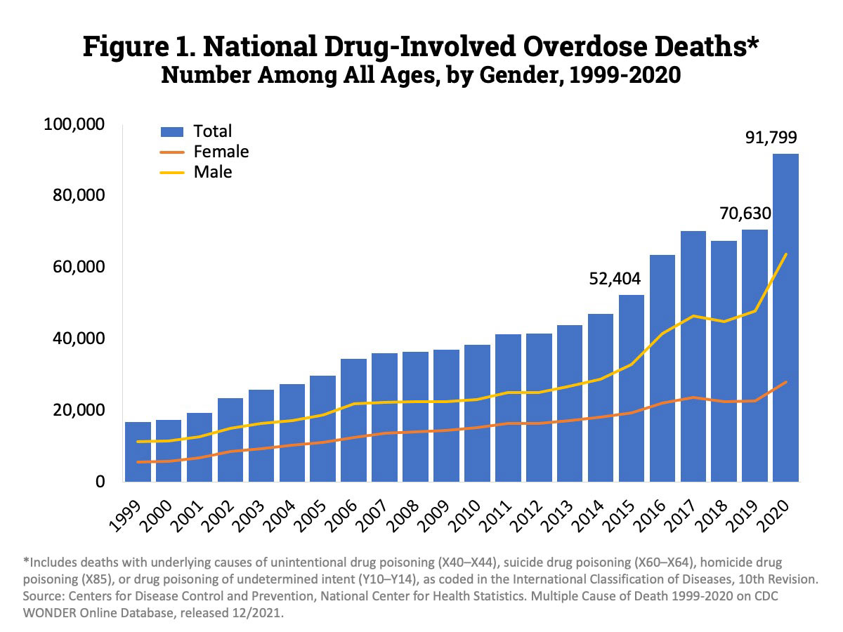

Slide 5
Harm Reduction Strategies
Policy changes within tribal government, tribal courts, police, jail, and health care system.
Education offered individuals throughout the community to “meet the person where they’re at”.
Staff assessment tools and trainings for all employees working within addiction continuum.
Open up access to harm reduction and recovery opportunities for the community.
Destigmatize addiction through policies, education, and trainings while improving through community support.
Empower people who uses to drugs to have a real voice in the creation of programs and policies designed to serve them.

Slide 6
Harm Reduction Drug Use
Accepts, for better or worse, that licit and illicit drug use is part of our world and chooses to work to minimize its harmful effects rather than simply ignore or condemn them
Understands drug use as a complex, multi-faceted phenomenon that encompasses a continuum of behaviors from severe use to total abstinence, and acknowledges that some ways of using drugs are clearly safer than others
Establishes quality of individual and community life and well-being — not necessarily cessation of all drug use — as the criteria for successful interventions and policies
Calls for the non-judgmental, non-coercive provision of services and resources to people who use drugs and the communities in which they live in order to assist them in reducing attendant harm

Slide 7
Overdose Prevention
Syringe Services Program (SSP) or “Needle Exchange”
Fentanyl Testing Strips (FTS)
Widening access to opioid overdose reversal treatments (Narcan kits)
Access to treatment for opiate detoxification and MAT/OTP induction
Find a designated support person (DSP) to educate about available resources

Slide 8
Where is Harm Reduction needed?
Tribal/Community
Police
Courts
Jail
Health Care System
Federal policies as it relates to Tribal influence

Slide 9
Tribal/Community
Define general philosophy of tribe towards addiction (Criminal vs. Therapeutic approach)
Educate and advocate to Tribal Council for evidence-based addiction treatment
Promote the development of tribal policies supporting harm reduction throughout the community
Look for advocates within the community to create support for changes in the current system
Reduce stigma towards addiction by creating events promoting addiction recovery (EBCI- Annual Recovery Rally)
Increase access to overdose prevention strategies (needle exchange, Narcan kits, FTS)

Slide 10
Tribal Court
Educate legal system on the advantages of harm reduction using evidence based approach
Develop tribal laws to support harm reduction model to help decriminalize addiction
Meet with judges, DAs, public defenders, and defense lawyers to collaborate on harm reduction approach within the legal system
Implementation of a drug court to offer addiction treatment approach vs. criminalization approach

Slide 11
Tribal Police/Detention Center
Educate the tribal police in their approach to dealing with people in active addiction
Support police officers by developing resources for mental and emotional health needs to prevent burnout related to bad outcomes
Develop clinical services (individual/group therapy, case management, peer support, and MAT/OTP) in the Detention Center to promote and offer addiction treatment
Direct line of communication with Police department and Detention Center to discuss current status, challenges, and ways for improvement

Slide 12
Inpatient Care
Ana-le-nis-gi Inpatient: Detox/Medical/Psychiatric
Transitional Housing
Supportive Environment
Required participation in Outpatient Care
Outpatient Care
Treatment plan includes employment and/or school
Medication Assisted Treatment (Suboxone and Methadone)
Community Resources
Recovery Center programs
Substance Abuse Treatment groups
Kanvwotiyi: Inpatient Residential ASAM 3.5
Short term (less than 90 days)
Long term (8-12 months)
Cherokee Detention Center
Addiction Continuum of Care
Comprehensive Clinical Assessment/SBIRT

Slide 13
Ana-le-nis-gi Outpatient
Offers a wide variety of services including walk-in clinic, individual/group therapy, psychiatry, case management, peer support, MAT, OTP, and recovery center
Open access to care by offering same day opportunities to tribal members seeking addiction assessments (CCA) and/or treatment options
Utilize the recovery center as a place where people in active addiction can find resources in a non-invasive environment
If indicated, setup direct access to other levels of care (psychiatry, therapy, medical, dental, ED, inpatient services)
Community based approach by utilizing peer support specialists to perform home visits and assist in helping find resources

Slide 14
Medicated Assisted Treatment (MAT)
Open access through outpatient clinic, psychiatric inpatient unit, inpatient residential program, and detention center
Individualize meetings to offer more variety availability and styles of recovery
Direct referrals to other levels of care
Weekly meetings to discuss various issues creating barriers in individuals opportunities for success in recovery
Offer different dosing schedules based the needs of the individuals in the program
Use a treatment team intervention with individuals who are struggling within the program

Slide 15
Opioid Treatment Program (OTP)
Developed in Cherokee in fall of 2020 due to high levels of drug overdoses within EBCI community
Highly federally/state regulated and governed by SAMSHA
Allows for greater withdrawal symptoms and cravings control for individuals using high dose or potent IV opiates
Medication is used as “gateway to recovery”
Opiates and other drugs can be used while on Methadone due to medication being a pure agonist
Utilize community resources to help with transportation (transit, Cherokee boys club)

Slide 16
Ana-Le-Nis-Gi Inpatient
Offer acute medical detoxification from opiates, methamphetamines, benzodiazepines, or alcohol
Case management to determine with individuals which direction for their recovery “meet the person where there at”
Direct transfer to outpatient services or inpatient residential treatment
MAT or OTP inductions
Assist with initiation of available community resources (housing, employment, financial assistance)
Assessment and treatment of psychiatric and/or medical needs of the individuals

Slide 17
Kanvwotiyi
20 bed Inpatient Residential Treatment Program with completion February 2018 (10 men/ 10 women)
Located in Snowbird community (1 hour drive from main boundary)
16 beds designed for short term treatment and 4 beds designed for long term treatment
Available to all EBCI tribal members and open to other IHS eligible tribes who live within the boundary
Modified therapeutic community focusing on rehabilitation and habilitation
Utilizes Living In Balance curriculum, Welbriety, NA and other components. 4 phases during 90 day short term treatment and 5th phase for long term treatment subdivided into 3 phases
Cultural influence lead by Culture Keeper with traditional teachings, talking circles, drumming circles, traditional beadwork/basket weaving, and ceremonies
MAT/OTP, psychiatry, and medical/dental offered
Strong work program

Slide 18
Cherokee Women's Home
Transitional housing designed for women coming from inpatient residential program in need of additional support prior to returning to independent living
Opened in 01/12/2021
Allows children in the home with additional support provided (parenting education, childcare)
Located near hospital with required participation in behavioral health treatment, MAT/OTP, medical/dental, work or school
Assistance with transportation, employment, and financial education
Peer driven with support promoted within the program to provide mentoring
Rules within the home used to create boundaries for healthy living

Slide 19
New Ideas for Harm Reduction
Offering non-beneficiaries who are family members access to direct services including MAT/OTP, outpatient or inpatient psychiatry, and inpatient residential program.
Increase resources at the Cherokee Detention Center with addiction education, offer Narcan kits and FTS upon release, and direct linkage to services on day of release
Build a Homeless shelter to offer education and availability of resources for addiction management and treatment
Increase access to employment and vocational training
Affordable housing for the community

Slide 21
Please email for references or questions:
joel.chisholm@cherokeehospital.org

