Slide 1
Treatment Knowledge
Avis Garcia, PhD, LAT, LPC, NCC, Northern Arapaho
March 2022
Notes:
Welcome to the Essential Substance Abuse Skills webinar series. I am XX, and today, Avis Garcia will be presenting Treatment Knowledge.

Slide 2
Training Objectives
Gain a better understanding of Evidence-Based practices, best practices and promising practices
Gain a better understanding of the importance of the treatment alliance
Become familiar with commonly used evidence-based and best practice approaches
Better understand Co-occurring Disorders and integrated care
Explore medication-assisted treatment (Buprenorphine)

Slide 3
Evidence-Based & Best Practices

Slide 4
Evidence-Based, Best & Promising Practices
Evidence-based practices are methods or techniques that have documented outcomes, have an ability to replicate key factors, and have been recognized in scientific journals by one or more published articles. Evidence-based practices are often manualized, for instance in SAMHSA’s Technical Assistance Publication Series (TAPs).
A best practice is a method or technique that has consistently shown results superior to those achieved by other means. In addition, a "best" practice will evolve as empirical research advances.
A promising practice is generally described as having a body of evidence (either evaluation studies or expert consensus) to support efficacy, is likely to raise to the next level when scientific studies can be conducted, and/or has been endorsed by one or more groups whose opinions matter producing specific desired outcomes.

Slide 5

Characteristics of Addiction
The American Society of Addiction Medicine (ASAM), 3rd Edition, describes the characteristics of addiction as:
“An inability to consistently abstain, impairment in behavioral control, craving, diminished recognition of significant problems with one’s behaviors and interpersonal relationships, and a dysfunctional emotional response.”

Slide 6
Our Goals for Treating Substance Use and Co-Occurring Disorders
To properly assess the patient using multi-dimensional tools
To provide Integrated, coordinated longitudinal care using evidence-based approaches
To provide an optimum opportunity for healthy behavior change through the therapeutic alliance
To improve the patient s overall health and wellness
To measure outcomes
To provide informed consent
Individual, family, and community Recovery-Oriented Systems of Care

Slide 7
What Does All This Mean?
We have a responsibility to improve service delivery and monitor patient outcomes
The field of addictions treatment is evolving and will require a broader understanding of the term “treatment”
We have a responsibility to stay informed about evidence-based practices, best practices and promising practices
Those in leadership positions have a responsibility to prepare and mentor the next generation of addiction professionals

Slide 8
Therapeutic Relationship

Slide 9
The more we involve our patient in the decisions about their treatment process, the more meaning and purpose they will likely associate with their treatment experience…
S. Steine
Notes:
What does this statement evoke in your own thoughts about working with MH/SUD patients?
Patients are much more likely to remember how they felt when they worked with you rather than what you said or did with them during a session.
Can you allow yourself to see the patient as the expert on their own lives?

Slide 10

Therapeutic Relationship
The Therapeutic Alliance
  Develop:
    Rapport
    Common or shared goals
    Safety & Trust
  Ethical Responsibilities
  Power distribution
Notes:
Rapport, what does this mean to you?
Ethical responsibilities, do no harm.

Slide 11
Therapeutic Relationship: Function
Positive reinforcement, encouragement, instill hope, build self-efficacy
Provide the patient with support and accurate, genuine empathy
In partnership with the patient , develop goals that are realistic, attainable and adaptable
Model adaptive interpersonal functioning

Slide 12
Therapeutic Relationship:
Patient Development
Patient feels heard, understood, accepted, respected, and empowered
Feels the therapist is concerned
Feels the therapist is working with them
Feels the therapist is realistically optimistic
Feels (and recognizes) that positive change is possible and/or occurring

Slide 13
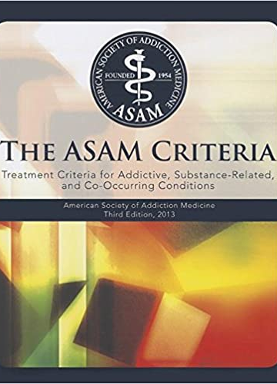
Assessment: ASAM, 3rd Edition
American Society of Addiction Medicine (ASAM) Criteria:
  Clinically driven, not program driven
  Criteria do not involve a prescribed length of stay, but promote a flexible continuum of care
  Involve an interdisciplinary approach to care
  Include informed consent
  Are outcomes driven
  Clarify medical necessity

Slide 14
Continuum of Treatment Care
ASAM (1996,2003) created criteria to allow for a broader continuum of care
Differentiates between adult & adolescent care
Common set of criteria helps determine client’s severity and place the client in appropriate level of care (LOC).
Notes:
The continuum of care suggests that clients are in varying points in the progression of their addiction. Therefore, multiple treatment options are necessary.

Slide 15
ASAM Levels of Care
Level 1: Outpatient treatment
Level 2: Intensive outpatient (IOP) and partial hospitalization program (PHP)
Level 3: Medically monitored inpatient (residential treatment)
Level 4: Medically managed inpatient treatment

Slide 16
Dimensions of ASAM
Acute intoxication and withdrawal potential
Biomedical conditions and complications
Emotional, behavioral or cognitive conditions and complications
Readiness to change
Relapse, continued use, or continued problem potential
Recovery/Living environment
  *Severity in each dimension can be rated as mild, moderate or severe
Notes:
ASAM is also commonly rated in a 0-4 scale 0 being stable or minimal concern/ risk and 4 (a/b) being seen as high risk/ unstable, and needing significant support or response

Slide 17
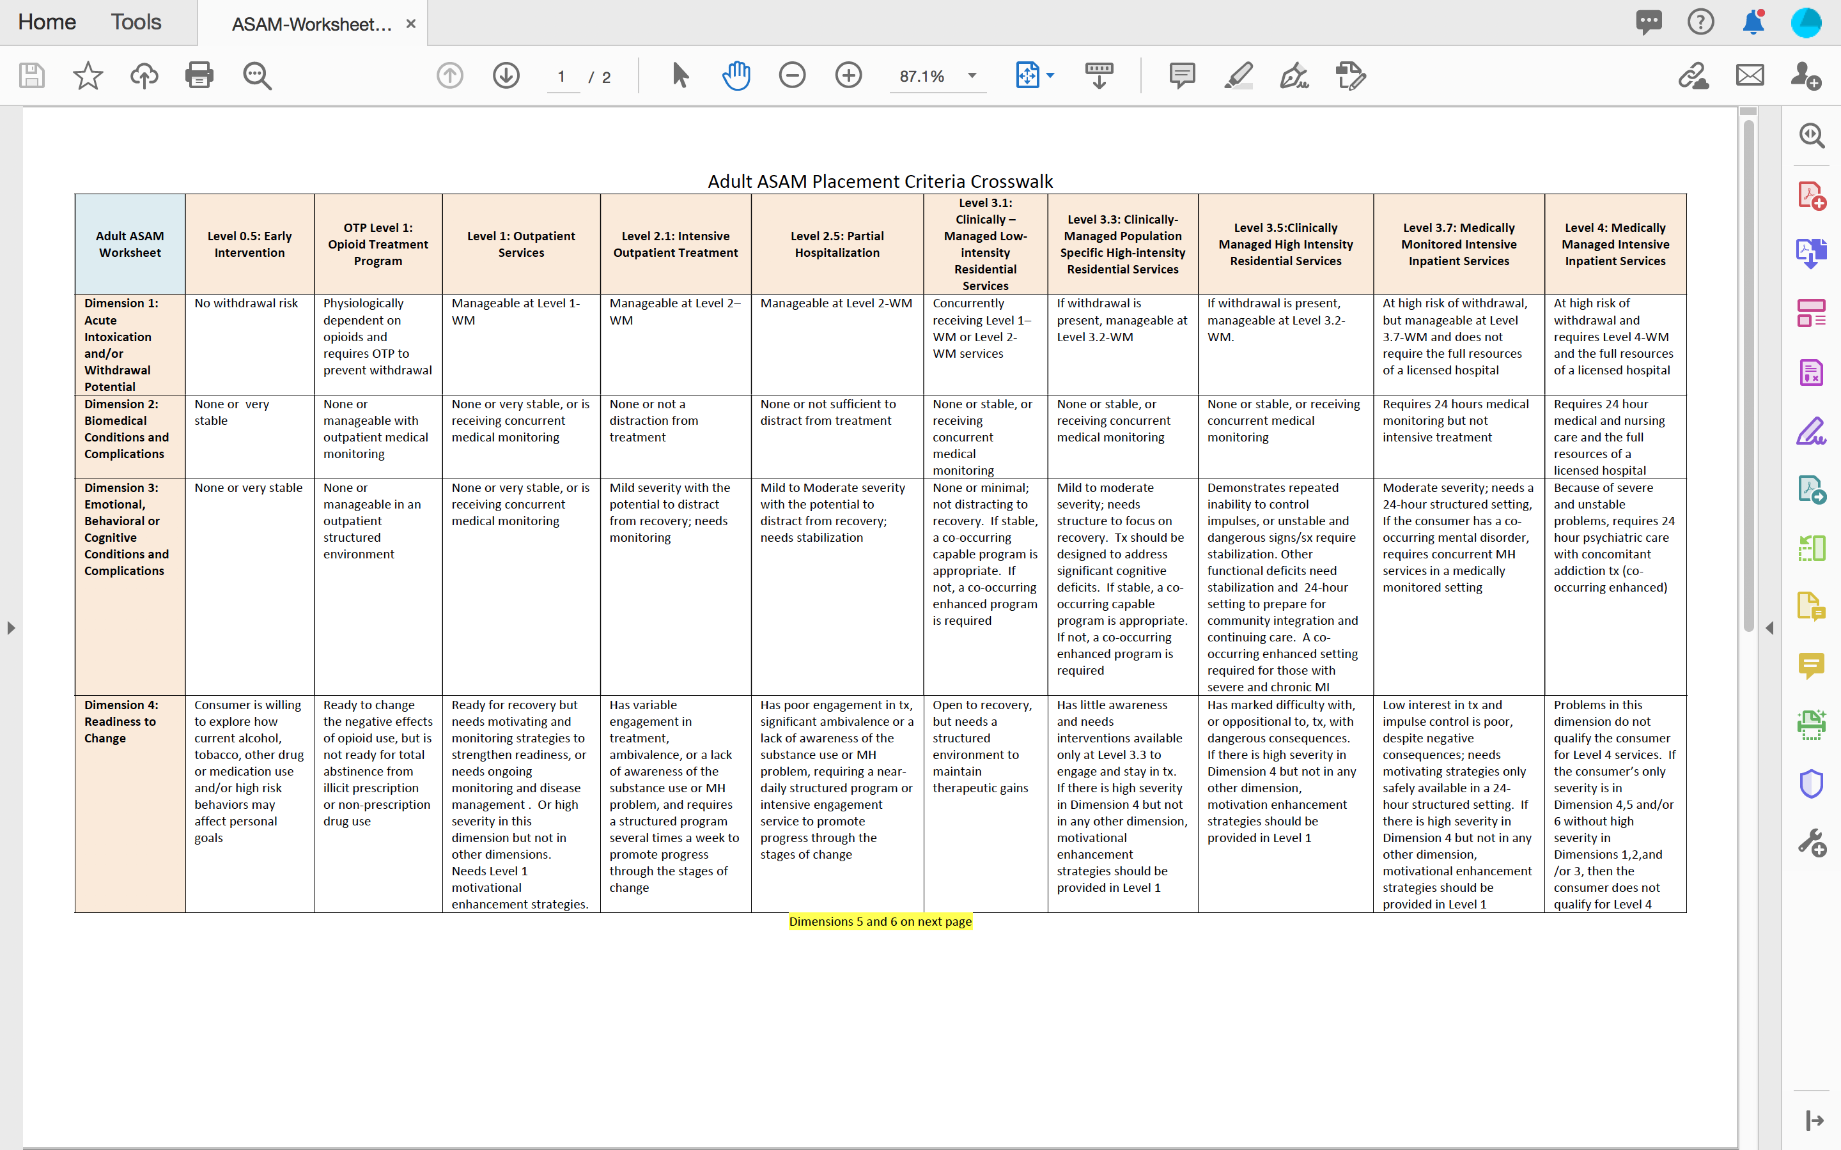

Slide 18
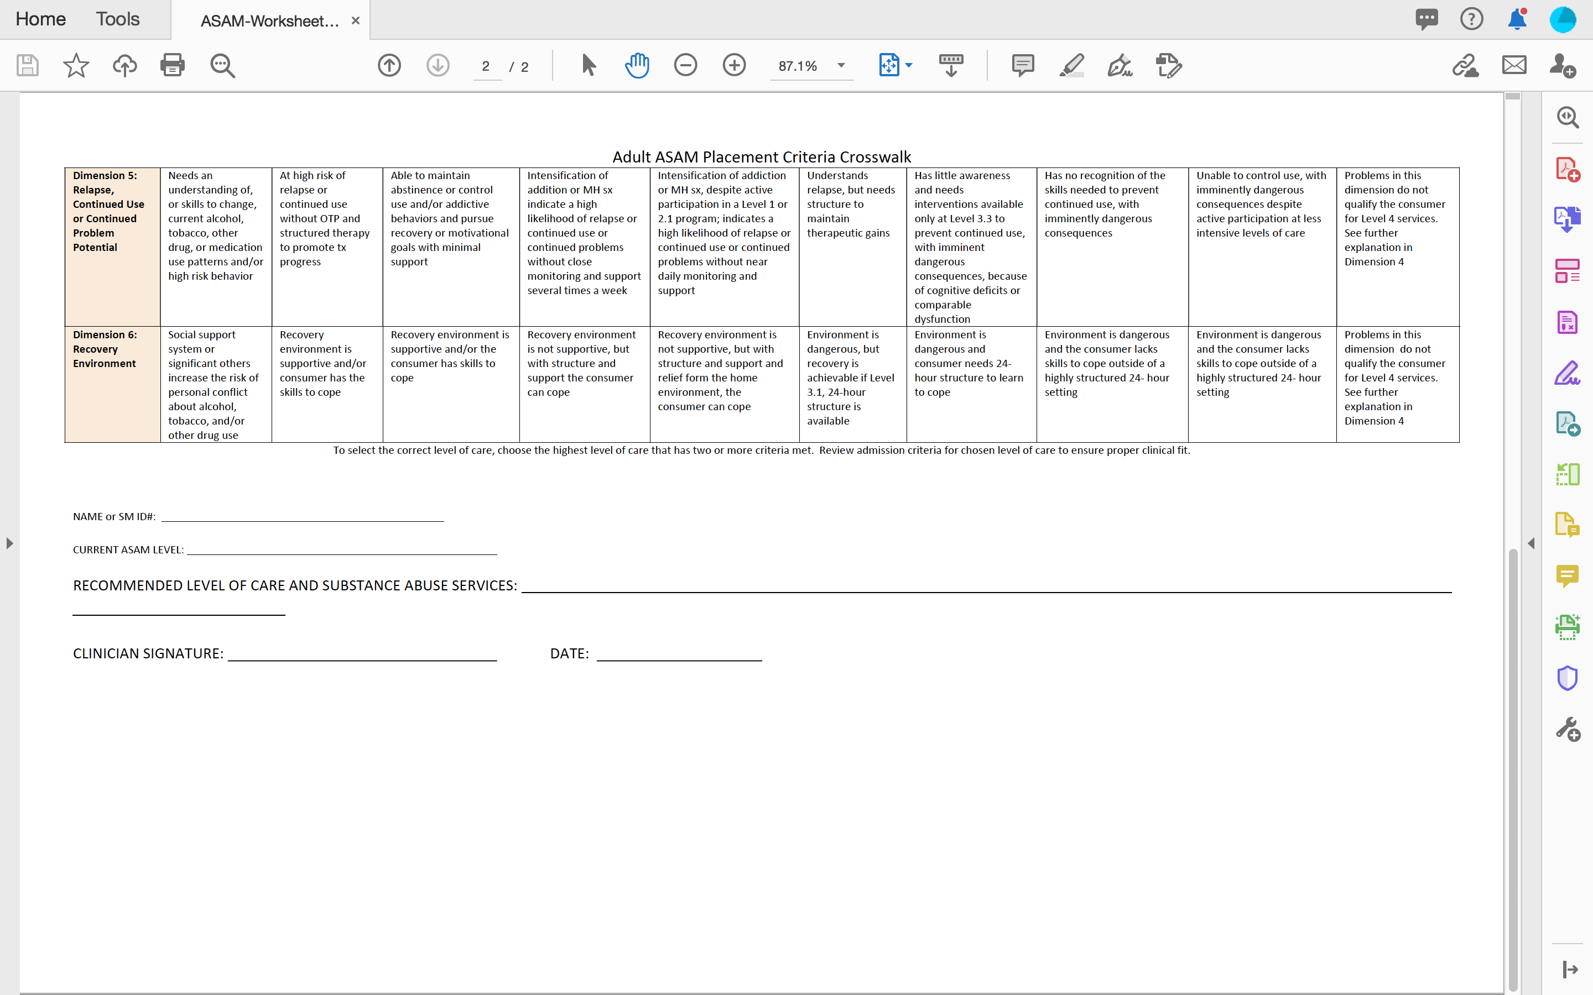

Slide 19

Whole-Person / Patient-Centered Care
Establishing the therapeutic alliance begins with the patient ’s initial contact with the helping professional/organization
Proper treatment requires proper assessment: The American Society of Addiction Medicine (ASAM, 3rd Edition) is a commonly used multi-dimensional assessment tool
Notes:
ROSC: Recovery Oriented System of Care

Slide 20

Whole-Person / Patient-Centered Care
Multi-disciplinary team approach, using community support systems (ROSC)
Selecting a particular theoretical approach that is most likely to result in the patient ’s improved health
Notes:
Person-centered therapy – An approach to counseling where the client, not the counselor, directs the treatment process because he or she is capable of invoking change within him or herself.

Slide 21
Person-centered Therapy
Carl Rogers in the mid-1940’s
Therapy does not have to revolve around therapist’s advice, direction & interpretation
Clients own personal understanding self-realization ad problem-solving techniques.
Counselor or helping professional comprehend how client sees themselves in the world.

Slide 22
Main Principles
Humanism: Innate nature within all humans to achieve our potential and find meaning in life.
Congruence: Counselor is genuine or real.
Unconditional Positive Regard: Counselor shows client constant acceptance and caring.
Accurate Empathic Understanding: Identify with and understand client subjective world.
Notes:
Assumes there is a basic trust to be found in a client’s ability to move in a positive direction if the right elements are provided by the counselor or other helping professional. Primarily the client directs the course of discussion and progression due to the belief that the client is completely capable of initiating change with minimal guidance from the counselor or other helping prodessonal.

Slide 23
Counseling Theories and Practice

Slide 24
Theoretical-Based Approaches
Concrete methods for assessing and conceptualizing individual conditions.
Assist in increasing motivation to effectively follow a path to successful recovery.
No one approach appropriate for for all.
“Theoretical tool bag” select best “tools” for the job at hand.
Notes:
On a final note, it is important to emphasize that very few skilled counselors can be adept at all these theoretic approaches his section covers. However, by developing skills with several of these that best fit the counselor’s philosophy and level of comfort, one can develop an integrative approach to counseling, thus enabling him or her to adjust the approaches (or blending of approaches) that best fit the situation and client.

Slide 25
Evidence-Based Practices
Behavioral Theory (Skinner)
Cognitive/Behavioral Therapy (CBT) (Beck)
Contingency Management/Incentivizing
Screening, Brief Intervention and Referral to Treatment (SBIRT)
Rational Emotive Behavior Theory (Ellis)
Motivational Interviewing (Miller)
Stages of Change/Transtheoretical Model (DiClemente)
Medication-Assisted Therapy (MAT)

Slide 26

Behavioral Theory
Some constructs to consider:
  Behavior is learned, therefore it can be unlearned
  New behaviors can replace old ones
  Focus on the observable: How people act, react, and behave
  Less interested in cognitive/emotional states, believe that behavior represents learned habits
Notes:
Action-oriented form of counseling to promote behavioral change through techniques of conditioning. Originated in the 1950s, applied principles of classic and operant conditioning. The roots of behaviorism Ivan Petrovich Pavlov, John B. Watson, and B.F. Skinner

Slide 27
Behavioral Theory: Conditioning
Classical Conditioning refers to the association between a stimulus and an involuntary or automatic behavior (response)
  Craving can be a conditioned response triggered by stimuli that the patient may or may not be conscious of (Pavlov)
Operant Conditioning refers to an association between a voluntary behavior and a consequence (Skinner)
  The nature of the consequence will impact whether the behavior occurs again (legal, health-related consequences, etc.)
Notes:
Action oriented that is directed at helping people change what they do and think. Behavior therapists believe that most human behavior is learned and can, subsequently, be unlearned if it is not beneficial to the individual.

Slide 28
Behavior Therapy Key Concepts
Ivan Pavlov, B.F. Skinner, Albert Bandura
Classical conditioning
Operant conditioning
Social learning theory

Slide 29
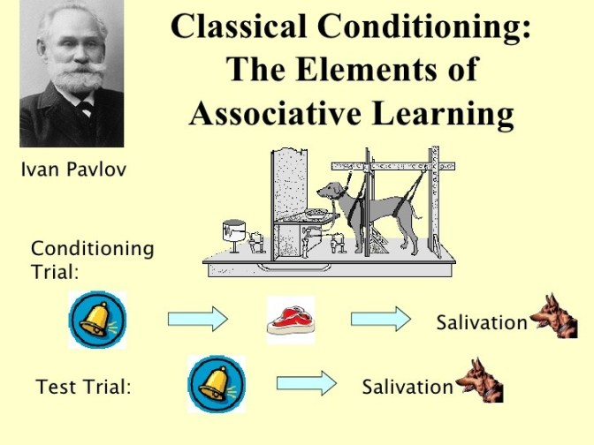
This Photo by Unknown Author is licensed under CC BY-SA-NC
Notes:
Particular response to stimuli can be elicited over time by association with a related stimulus. A method of counseling that focuses on modifying the client’s learned behaviors that are negatively affecting one’s life. Extremely effective for clients in recovery from a psychoactive substance use disorder, since there are specific, learned behaviors or triggers associated with drug use.

Slide 30
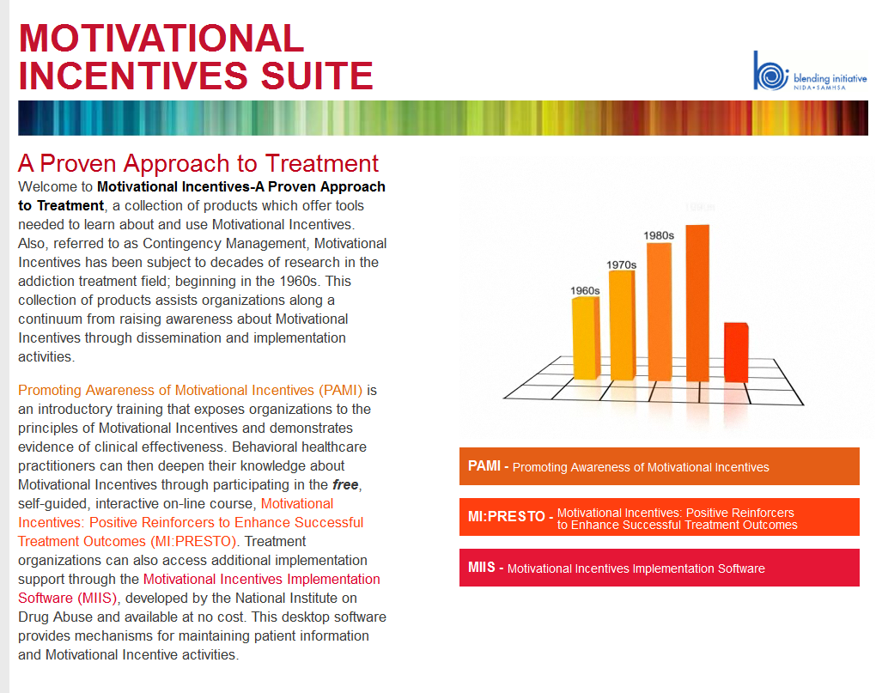
Motivational Incentives = Contingency Management

Slide 31
Motivational Incentives = Contingency Management
Providing reinforcement for healthy behavior
Promoting Awareness of Motivational Incentives (PAMI) is based on the positive research outcomes and lessons learned from the National Institute on Drug Abuse (NIDA) Clinical Trials Network (CTN) study, titled Motivational Incentives for Enhanced Drug Abuse Recovery (MIEDAR).
For more information: http://www.bettertxoutcomes.org/bettertxoutcomes/

Slide 32
Why Use Motivational Incentives?
Help patients stay in treatment and abstain from drug use.
Using low-cost reinforcements (e.g., prizes, vouchers, leave group early, etc.)
Praise and not as bribery but for recognition.
Fishbowls and Candy Bars: tickets for a prize, notebook, pens, small book, small planner.
Notes:
Increased retention and higher rates of abstinence. Perfect attendance, clean urines, socially acceptable behaviors I group. Work with local agencies/businesses to contribute for donations in exchange for media publicizing for contributions. More effective for adolescent treatment: candy, jerky cheese, water, juice, small snacks. Tokens for 30 days, 60 days, and 90 days, and so on.

Slide 33
Cognitive Behavioral Theory
Cognitive behavior therapy (CBT) combines
  Behavior therapy helps to weaken the connections between troublesome situations and your reactions to them
  Cognitive therapy teaches you how certain thinking patterns/feelings impact behavior
Very simply put, CBT attempts to help patients recognize, avoid, and cope
Notes:
Note: I also think of CBT approaches as helping patients connect their thoughts with their behaviors in order to raise awareness and promote positive change if deemed necessary.
CBT a/k/a cognitive therapy was developed in the 1960’s by Aaron Beck. Dr. Beck originally developed CBT as a short-term treatment for depression, since then, numerous researchers have expanded the range of conditions to apply CBT. Today CBT has become the most scientifically proven and most often recommended type of therapy for depression, anxiety, and substance abuse disorders pain disorders and a wide range of other psychological problems.
CBT is a method of counseling that primarily focuses on correcting thoughts, emotions and behaviors that lead to dysfunction by simultaneously restructuring the client’s automatic thought and learning new behaviors.

Slide 34

Relapse Prevention (CBT)
Identify High Risk Situations
Coping Skills Training
Enhance Self-Efficacy
Relapse Reframed as “teachable moment”
Challenge Positive Alcohol Expectancies
Lifestyle Balance

Slide 35
Key CBT concepts
Founder – Aaron Beck
Focus is on the here-and-now.
Client takes on active role.
ABC model

Slide 36
Therapeutic Techniques
Behavioral rehearsal
Homework
Motivational interviewing
Relaxation training
Systematic desensitization
Social skills training
Assertion training

Slide 37
Definition: REBT
Is a cognitive-oriented counseling approach that focuses on changing the attitudes, beliefs and negative self-statements that drive and maintain problematic behavior.
Created by Albert Ellis, in 1955

Slide 38
Rational Emotive Behavioral Theory (REBT)
In a nutshell…
Something happens (to the patient )
patient has an irrational belief about the situation
patient has an emotional reaction to the belief
Therapist helps the patient recognize errors in thinking that led to the irrational belief and find alternative ways of thinking about the event
Example: “I was only arrested for drunk driving because that cop has it out for me”

Slide 39
ABC Model of REBT
A = activating event
Events that occur in life that lead to reaction
B = beliefs
How person feels or thinks about activating
event.
C = emotional and behavioral consequences
How individual behaves based on beliefs
concerning an activating event.
Notes:
Overriding principle of REBT is that events do not disturb people, but rather the view individuals take of the events that lead to dysfunction. The role of cognition is the most important element of human disturbance.

Slide 40
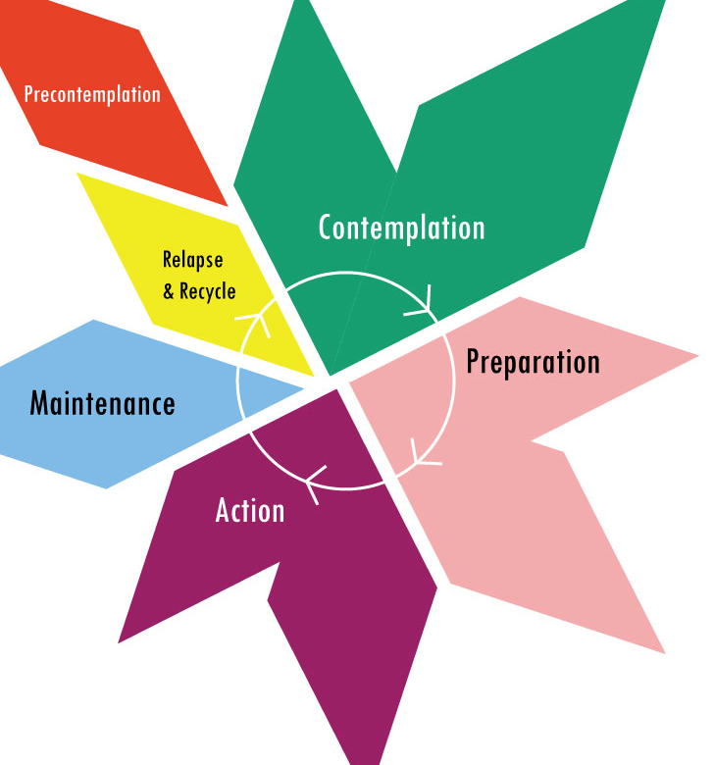
Stages of Change Model
Prochaska & DiClemente
Pre-Contemplation
Contemplation
Preparation
Action
Maintenance
Relapse & Recycle
Notes:
The Stages of Change were developed by psychologists Prochaska and DiClemente in the 1980s in an effort to capture the change process in cigarette smokers in treatment.
It has since been used to characterize changes in other addictive disorders including alcoholism.
Pre-contemplation
Contemplation
Determination/Preparation
Action
Maintenance
Relapse and Recycle
Termination or Graduation
Stage Description
Pre-contemplation -Not considering change -Do not see their behavior as a problem Contemplation -Ambivalent about change -Acknowledge that there may be a problem
Stage Description
Determination/ -Committed to change
Preparation -Have made a decision
to change
Action -Involved in change
-Actively implementing
a plan

Slide 41

Motivational Interviewing (MI)
“If motivational interviewing is a way of being with people, then its underlying spirit lies in understanding and experiencing the human nature that gives rise to that way of being. How one thinks about and understands the interview process is vitally important in shaping the interview”.
  Miller and Rollnick, Motivational Interviewing, pg. 34
Motivational Interviewing was originally developed in an effort to increase the motivation of patients with alcohol problems to change behavior
As part of that process, Miller found that approaching patients with a modified patient -Centered approach increased the impact of the interview
What has evolved is a communication style and focus that increases patients’ motivation to work on their problems

Slide 42

Motivational Interviewing
Fundamental Approach
  Collaboration
  Evocation/suggestion
  Autonomy/self rule
Four Principles
  Express empathy (not sympathy)
  Develop discrepancy
  Roll with resistanc
  Support self-efficacy
Essential Substance Abuse Skills: A Guide for Professionals Clinical Evaluation: Screening

Slide 43
MI Continued
Clinicians commonly think they already practice Motivational Interviewing…though that’s often not the case
What makes Motivational Interviewing a unique communication approach is how its constructs are employed by the clinician
Motivational Interviewing requires attention to timing issues, specific strategies, application methods, and maximizing the effectiveness of these skills
Essential Substance Abuse Skills: A Guide for Professionals Clinical Evaluation: Screening

Slide 44
SBIRT
S- Screening tool is used to assess patient ’s risk of having an SUD.
B,I- Brief intervention consists of a 3-5 minute, motivational discussion with patient concerning the screening results
R- Referral to a specific resource for additional assessment and/or treatment service
T-Treatment provider: process should allow for a “warm hand-off” from referral source to treatment provider.

Slide 45

Other theories worth mentioning…
Social Cognitive Theory: Personal factors, environmental influences and behavior continually interact. People learn from their own experiences and from observing the actions of others
Health Belief Model: Helps to explain why people do or do not use preventive services. Has to do with perception of reward/risk
Social Ecological Model: Considers multiple influences on behavior and states that behaviors both shape and are shaped by the social environment
Notes:
Solution Focused Behavioral Therapy –
The Miracle Question:
https://www.bing.com/videos/search?q=solution+focused+therapy&&view=detail&mid=B56D87DB3A3886A08D9BB56D87DB3A3886A08D9B&&FORM=VDRVRV

Slide 46
Behavioral Health Care Substance Use and Mental Health

Slide 47
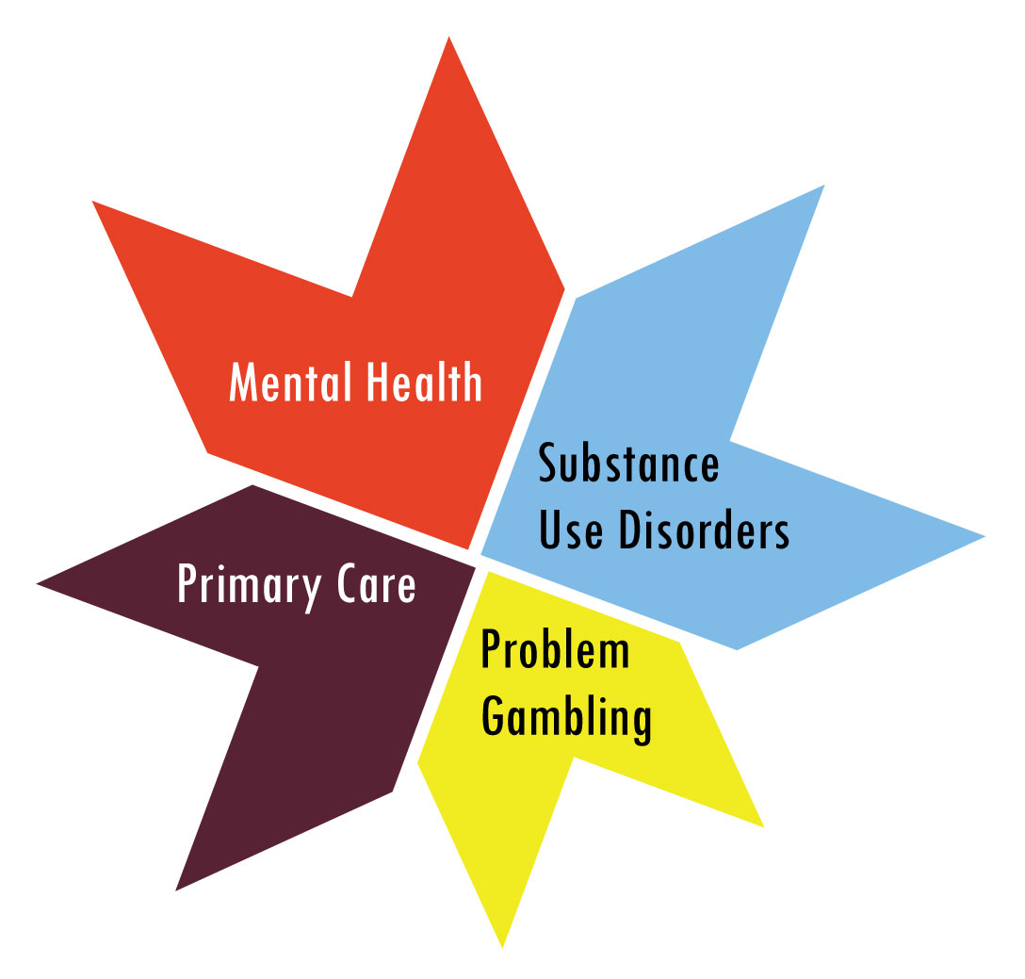
Behavioral Health Integrated Care

Slide 48

A patient’s substance use is not the problem, but rather a sign or symptom of other underlying issues driving the substance use.

Slide 49
Co-Occurring Disorder: What does this mean?
In medicine, comorbidity is either the presence of one or more disorders (or diseases) in addition to a primary disease or disorder, or the effect of such additional disorders or diseases.
The term dual diagnosis is used to describe the co-morbid condition of a person considered to be experiencing difficulties related to a mental illness and a substance abuse problem.
Other ideas?

Slide 50
What are “Co-occurring Disorders”?
The presence of at least two disorders:
One being substance use disorders
The other being a DSM-5 mental health disorder, such as:
  Major Depression
  Bipolar Disorder
  Schizophrenia
  PTSD/Anxiety

Slide 51

Characteristics of
Co-occurring Disorders (General)
Repeatedly cycle through treatment, emergency departments, detox and jail.
  More likely to re-offend or to receive sanctions when: Not taking medication, not in treatment, experiencing mental health symptoms, using substances
  Use of even small amounts of substances may trigger recurrence of mental health symptoms

Slide 52
General Assessment Approach for Co-occurring Disorders
ASAM dimensions can also be used as a multi-dimensional assessment tool for co-occurring disorders
Assess the significance of the substance use disorder
  Obtain longitudinal history of Mental Health and substance use symptom onset
  Analyze whether Mental Health symptoms occur only in the context of Substance use (substance-induced)
  Determine whether sustained abstinence leads to rapid and full remission of Mental Health symptoms
Notes:
ASAM criteria affords the clinician opportunities to identify, treatment plan, and monitor progress for patient’s with co-occurring SUD and MHDs

Slide 53
Characteristics of Co-occurring Disorders
More rapid progression from initial substance use to higher levels of severity
Poor adherence to medication
Decreased likelihood of treatment retention/completion
Greater rates of hospitalization
More frequent suicidal behavior
Difficulties in social functioning
Shorter time in remission of symptoms

Slide 54
Characteristics of Co-occurring Disorders (cont.)
Difficulty comprehending or remembering important information (e.g., verbal memory)
Does not recognize consequences of behavior
Exhibits Poor judgment
Disorganization
Limited attention span
Respond better to patient -centered approaches

Slide 55

Co-Occurring Conditions in Adolescence
Ninety percent with lifetime co-occurring disorder had one MH disorder prior to onset of substance use
Median onset MH disorder at age 11 years
Onset substance use between 16 and 21 years

Slide 56
Evidence-Based Best Practices
(continued)
Pharmacotherapy
Medication Assisted Therapy

Slide 57

Pharmacotherapy
Detoxification/Withdrawal Management
Cravings for Alcohol
Replacement
Aversive
Antagonist
Mixed (Agonist-antagonist)

Slide 58
Medicated Assisted Therapy
Medicated-Assisted Treatment (MAT) is the use of FDA- approved medications, in combination with counseling and behavioral therapies, to provide a “whole-patient” approach to the treatment of substance use disorders.
Notes:
This treatment approach has taken on new meaning considering the recent and increasing sense of urgency surrounding the Opioid crisis that has gripped portions of this Nation from coast to coast. Usually involves a replacement medicated like methadone, buprenorphine, or naltrexone to assist the patient in reduction of cravings, prevent replaces (antagonists) and help stabilize often difficult and/or disruptive withdrawal Sxs associated with OUDs.

Slide 59

Medications for
Alcohol Use Disorders
Naltrexone
Vivitrol (injectable form of Naltrexone), longer lasting)
Disulfiram (Antabuse)
Acamprosate (Campral)
Notes:
B. Several medications are currently being used in alcohol rehabilitation.³
1.Renewed interest led to the FDA approval of naltrexone (Trexan or Revia) in 1994 for the treatment of alcohol dependence.
2.Disulfiram (Antabuse) sensitizing or deterrent agent, was approved for the treatment of alcoholism nearly 50 years earlier.
3.Acamprosate (Campral) has been available by prescription since 1985 in France and more recently in European as well as Latin American Countries. A multi-center trial evaluating the safety and efficiency of acamprosate in alcohol dependent outpatients was recently completed in the United States.
4.Nalmefene (Revex), like naltrexone, is an opiate antagonist currently approved for acute opioid intoxication. It has greater affinity for kappa and delta receptors than naltrexone, and appears to be less hepatotoxic than naltrexone.

Slide 60
Medications for
Opioid Use Disorders
Methadone (oral liquid)
Naltrexone (oral)
Vivitrol (injectable form of Naltrexone), longer lasting)
Sublocade (injectable form of Buprenorphine)
Suboxone/Zubzolv (Buprenorphine/Naloxone)
Probuphine (Buprenorphine/ implant)
Notes:
B. Several medications are currently being used in alcohol rehabilitation.³
1.Renewed interest led to the FDA approval of naltrexone (Trexan or Revia) in 1994 for the treatment of alcohol dependence.
2.Disulfiram (Antabuse) sensitizing or deterrent agent, was approved for the treatment of alcoholism nearly 50 years earlier.
3.Acamprosate (Campral) has been available by prescription since 1985 in France and more recently in European as well as Latin American Countries. A multi-center trial evaluating the safety and efficiency of acamprosate in alcohol dependent outpatients was recently completed in the United States.
4.Nalmefene (Revex), like naltrexone, is an opiate antagonist currently approved for acute opioid intoxication. It has greater affinity for kappa and delta receptors than naltrexone, and appears to be less hepatotoxic than naltrexone.

Slide 61
Opiate/Opioid : What’s the Difference?
Opiate
  A term that refers to drugs or medications that are derived from the opium poppy, such as heroin, morphine, and codeine
Opioid
  A more general term that includes opiates as well as the synthetic drugs or medications, such as Buprenorphine, methadone, Meperidine (Demerol®), Fentanyl—that produce analgesia and other effects like morphine
Notes:
Note to Clinicians: It’s best practice to use the term Opioids when referring to OUDs. It covers all forms of this drug class.

Slide 62
Basic Opioid Facts
Description: Opium-derived, or synthetics which relieve pain, produce euphoria and morphine-like addiction, and relieve withdrawal from opioids
Medical Uses: Pain management, cough suppression
Methods of Use: Intravenously injected, smoked, snorted, or orally administered
Withdrawal: Prolonged and very unpleasant, but not life threatening

Slide 63
A Brief History of Opioid Treatment
The Drug Abuse Treatment Act of 2000 and the approval of Buprenorphine by the U.S. Food and Drug Administration, in 2002, for the treatment of opioid addiction both allow for the expansion of traditional opioid treatment programs beyond the current structure to include treatment in office-based settings. With this expansion, more patients may be willing to access treatment, and the stigma associated with addiction may be reduced by broadening the definition and location of treatment

Slide 64
A Brief History of Opioid Treatment
Opioid addiction continues to be a significant public health problem across the country. In 2007, approximately 12.5 million Americans ages 12 and older used prescription pain medications for non-medical purposes, according to the National Survey on Drug Use and Health administered by SAMHSA
By 2019 full scale efforts to systemically decrease the access to prescribed opioids medications, over the previous decade, have created a continual surge in OD deaths, and the ongoing use of heroin and Fentanyl (acquired illicitly in order to manage the addiction to these opiate based-medications). Thus, creating the epidemic we see cycling through our healthcare/SUD treatment systems of care today.

Slide 65

A Brief History of Opioid Treatment (continued)
1964: Methadone is approved
1974: Narcotic Treatment Act limits methadone treatment to specifically licensed Opioid Treatment Programs (OTPs)
1984: Naltrexone is approved, but has continued to be rarely used (approved in 1994 for alcohol addiction)
Notes:
65

Slide 66
A Brief History of Opioid Treatment (continued)
2000: Drug Addiction Treatment Act of 2000 (DATA 2000) expands the clinical context of medication-assisted opioid treatment
2002: Tablet formulations of Buprenorphine (Subutex®) and Buprenorphine/Naloxone (Suboxone®) were approved by the Food and Drug Administration (FDA)
Notes:
66

Slide 67
Approval of Buprenorphine and Buprenorphine/Naloxone
U.S. FDA approved Buprenorphine (marketed as Subutex®) and Buprenorphine/Naloxone (marketed as Suboxone®) for opioid addiction treatment on October 8, 2002
Product launched in U.S. in March 2003
Interim rule changes to federal regulation (42 CFR Part 8) on May 22, 2003 enabled OTP’s (specialist clinics) to offer Buprenorphine
Notes:
67

Slide 68
A Brief History of Opioid Treatment (continued)
2016 The First-Ever FDA-Approved Buprenorphine Implant For Opioid Dependence (Probuphine)
2017 FDA approves first once-monthly buprenorphine injection, a medication-assisted treatment option for opioid use disorder (Sublocade)
Notes:
68
Sublocade, once-monthly injectable buprenorphine product for the treatment of moderate-to-severe opioid use disorder (OUD) in adult patients who have initiated treatment with a transmucosal (absorbed through mucus membrane) buprenorphine-containing product. It is indicated for patients that have been on a stable dose of buprenorphine treatment for a minimum of seven days.

Slide 69
Buprenorphine Treatment:
The Myths and The Facts

Slide 70

MYTH #1: Patients are still addicted
FACT: SUD is pathologic use of a substance and may or may not include physical dependence
  Physical dependence on a medication for treatment of a medical problem does not mean the person is engaging in pathologic use

Slide 71
MYTH #2: Buprenorphine is simply a substitute for heroin or other opioids
FACT: Buprenorphine is a replacement medication; it is not simply a substitute
  Buprenorphine is a legally prescribed medication, not illegally obtained
  Buprenorphine is a medication taken sublingually (under the tongue), a very safe route of administration
  Buprenorphine allows the person to function normally

Slide 72
MYTH #3: Providing medication alone is sufficient treatment for opioid addiction
FACT:
  Buprenorphine is an important treatment option. However, the complete treatment package should include other elements as well (talk therapy, community support, etc.)
  Combining pharmacotherapy with counseling and other ancillary services may increase the likelihood of success
Notes:
*There is some research indicating that there is no difference in outcome when patients receive counseling in addition to medication

Slide 73
MYTH #4: Patients are still getting high
FACT:
  When taken sublingually, Buprenorphine is slower acting and does not provide the same “rush” as heroin
  Buprenorphine has a ceiling effect resulting in lowered experience of the euphoria felt at higher doses

Slide 74
Advantages of Buprenorphine in the Treatment of Opioid Addiction
Patient can participate fully in treatment activities and other activities of daily living easing their transition into the treatment environment
Limited potential for overdose (Johnson et.al, 2003)
Minimal subjective effects (e.g., sedation) following a dose
Available for use in an office setting
Lower level of physical dependence

Slide 75

Advantages of Buprenorphine/
Naloxone
Discourages IV use
Can prevent overdose deaths (Naloxone)
Notes:
75

Slide 76
Training Summary
Evidence Based – Best Practice
Therapeutic Relationship and Treatment Alliance
Best Practices
Co-occurring Disorders
(some)Pharmacological Treatment options

